Slide 1
ABAC-CC: Attribute-Based Access Control and Communication Control for Internet of Things
Smriti Bhatt¹, Ravi Sandhu²
¹Department of Computing and Cyber Security, Texas A&M University-San Antonio
²Institute for Cyber Security (ICS), CREST-Center for Security and Privacy Enhanced Cloud Computing (C-SPECC) Department of Computer Science, University of Texas at San Antonio
The 10th ACM Symposium on Access Control Models and Technologies (SACMAT)
June 10-12, 2020

Slide 2
Outline
Introduction
Background
Cloud-Enabled IoT (CE-IoT) Architectures
Access Control and Communication Control Requirements in CE-IoT
Use Case Scenarios
ABAC vs. ABCC
Attribute-Based Communication Control (ABCC) – Conceptual model
Attribute-Based Access Control (ABAC)
Attribute-Based Access Control and Communication Control (ABAC-CC) Framework
Future Research Directions
Conclusion and Future Work

Slide 3
Introduction
Internet of Things (IoT) - billions of connected smart things enabled by technologies like Cloud Computing, Artificial Intelligence (AI) and Machine Learning (ML)
IoT devices have some unique characteristics unlike other Internet-connected user devices –
Distributed and deployed in remote locations
Diverse in nature (e.g., size, capability, functionality)
Autonomous operation enabled by AI and Machine learning technologies
Dynamic behavior based on the context
Dynamic access control and communication control framework to adequately address security and privacy issues in the IoT space

Slide 4
Access Control and Communication Control
Dynamic
IoT Space
Access Control:
ensures secure access to protected resources from authorized entities only
Communication Control: secures communication and data flow between authorized components
Attribute-Based Approach
Attribute-Based Access Control (ABAC)
Attribute-Based Communication Control (ABCC)

Slide 5
Background
Cloud-Enabled Internet of Things (CE-IoT) –
Cloud computing has become a key enabling technology with virtually unlimited capabilities (e.g., storage, computation, analytics) for IoT devices
Major cloud services provides such as Amazon Web Services (AWS) Microsoft Azure, and Google Cloud, including others, have introduced new IoT services
Emerging security and privacy threats in IoT with new challenges including traditional cloud threats and vulnerabilities

Slide 6
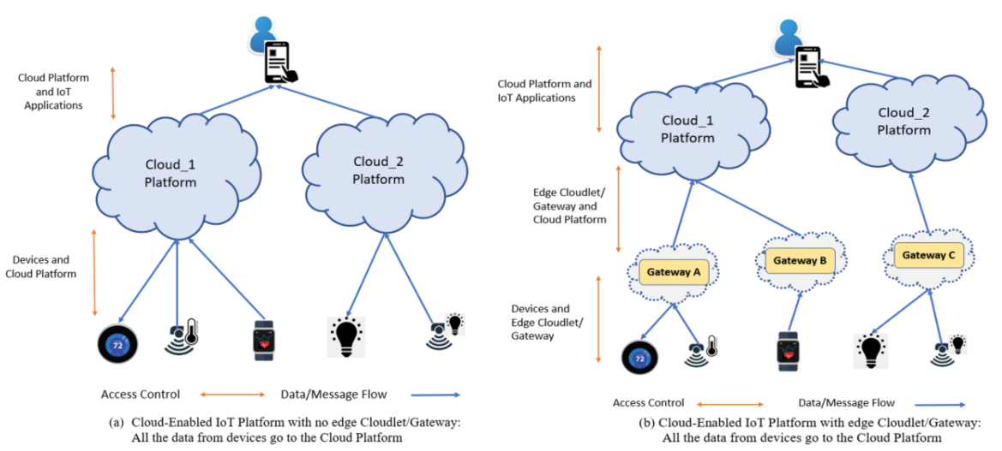
CE-IoT Architectures

Slide 7
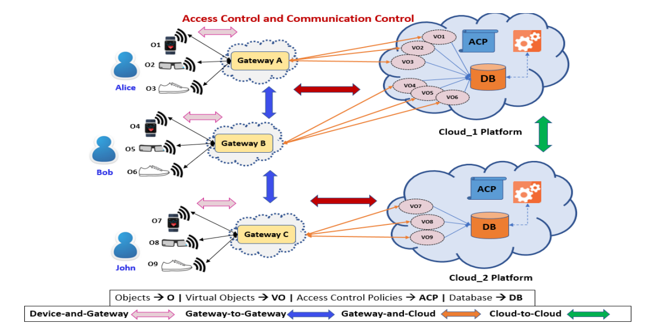
Access Control and Communication Control Requirements

Slide 8
Use Case Scenarios
Scenario 1 (Devices/Gateway to Cloud) -- Users want restrict privacy sensitive data to be shared with the Cloud at all times and rather confine the data at the edge network and only send important updates to cloud based on some predefined conditions.
Scenario 2 (Cloud to Gateway/Devices) -- Users want to restrict messages coming from Cloud to users through IoT applications.

Slide 9
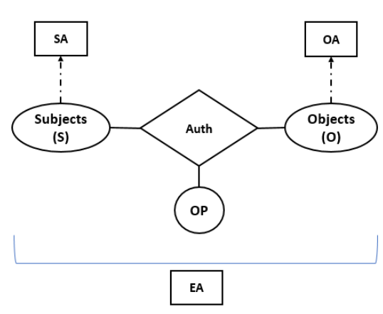
ABAC
Attribute-Based Access Control (ABAC)
Subjects: who request access (e.g., users, processes, devices, etc.)
Objects: protected resources and entities (e.g., devices, files or folders, data)
Subject Attributes (SA): title, age, etc.
Object Attributes (OA): sensitivity, type, etc.
Environmental Attributes (EA): location, time
Operations (or actions): read(r), write(w)
Authorization Function: Auth_func = (s, o, r)

Slide 10
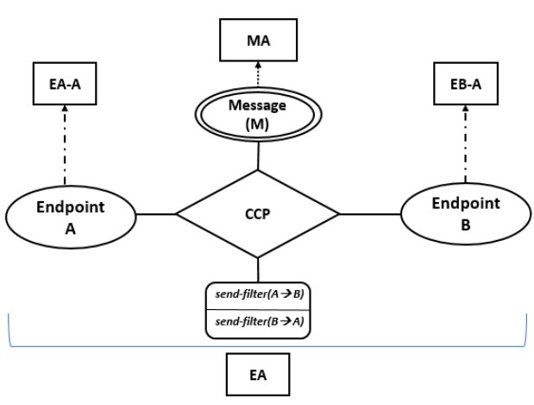
Attribute-Based Communication Control (ABCC)
EndpointA and EndpointB
Endpoint Attributes (EA-A and EB-A)
Message (M): unit of communication
Message Attribute (MA)
Environmental Attributes (EA): location, time
Operations: send-filter
send-filter(A → B)
send-filter(B → A)
Communication Control Policy (CCP) function: Decisions → message can be sent unfiltered (original message), filtered (removing/sanitizing sensitive information), or not sent from a sender to a receiver

Slide 11
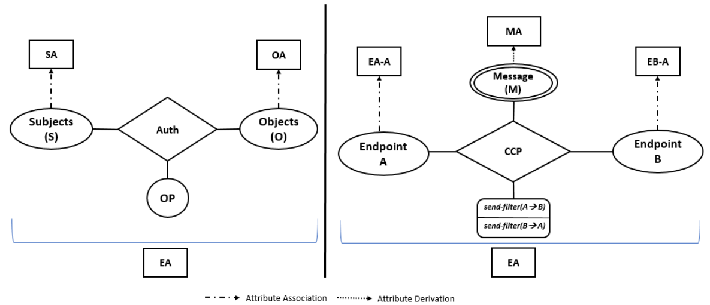
ABAC vs. ABCC

Slide 12
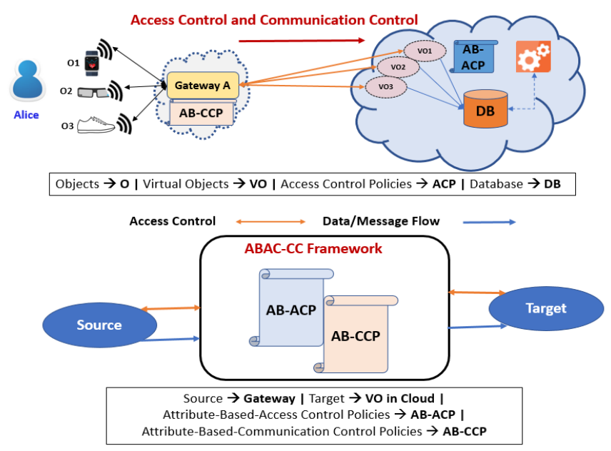
ABAC-CC in a Smart Health Monitoring Use Case Scenario
Access and Communication from Gateway to Cloud (VO)
Gateway (EndpointA)
VOs (EndpointB)
Gateway and Device attribute: owner
Message (m)
Message Attribute: location, temp, heartrate
send-filter(A->B) => m, or m’, or null

Slide 13
Future Research Directions
Artificial Intelligence and Machine Learning
Distributed Computing
Collaborative IoT Models
Insider Threats and Rogue Devices
Dynamic Edge and Fog Computing

Slide 14
Conclusion and Future Work
Introduced the Attribute-based Communication Control (ABCC) model and compared its structure with the basic ABAC
Proposed an Attribute-Based approach for developing the ABAC-CC framework to secure access and communication in CE-IoT architecture
Discussed a smart health monitoring use case and presented future research directions
Goal:
To reevaluate and rethink current access control mechanisms and design new models on top of the attribute-based approach to secure IoT access, communication, and data at rest and in motion
Stimulate research on ABCC models for real-world IoT application domains, such as Smart Home, Smart Health
Future Work: Develop formal ABCC models for securing communication between various components in the context of CE-IoT.

Slide 15
Thank You!
Questions???

