Slide 1
CS 5323
Privacy
Prof. Ravi Sandhu
Executive Director and Endowed Chair
Lecture 15
ravi.utsa@gmail.com
www.profsandhu.com
© Ravi Sandhu
World-Leading Research with Real-World Impact!

Slide 2
Security versus Privacy
Privacy
Security =
Privacy
Security
Privacy
Security
Security
Security
Privacy
Privacy
© Ravi Sandhu
World-Leading Research with Real-World Impact!
2

Slide 3
Security versus Privacy
Privacy
Security =
Privacy
Security
Privacy
Security
Security
Security
Privacy
Privacy
© Ravi Sandhu
World-Leading Research with Real-World Impact!
3

Slide 4
Security and Privacy Objectives
USAGE
purpose
INTEGRITY
modification
AVAILABILITY
access
CONFIDENTIALITY
disclosure
© Ravi Sandhu
World-Leading Research with Real-World Impact!
4

Slide 5
Privacy Goals
Browsing privacy
Interaction privacy
Drive-by privacy
Data disclosure privacy
……
© Ravi Sandhu
World-Leading Research with Real-World Impact!
5

Slide 6
Privacy Legislation in USA
Case by case approach
Fragmented
Reactive
Fair Credit Reporting Act (FCRA), 1970
Privacy Act 1974
Family Educational Rights & Privacy Act (FERPA), 1974
Video Privacy Protection Act (VPAA) 1988
Health Insurance Portability and Accountability Act (HIPAA) 1996
Gramm-Leach-Bliley Act (GLBA) 1999
………
© Ravi Sandhu
World-Leading Research with Real-World Impact!
6

Slide 7
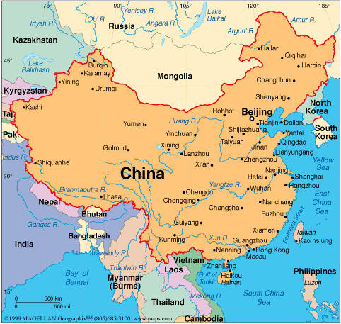
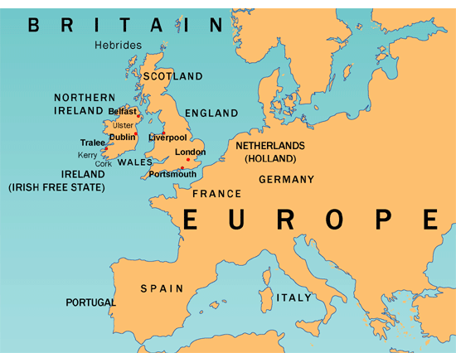
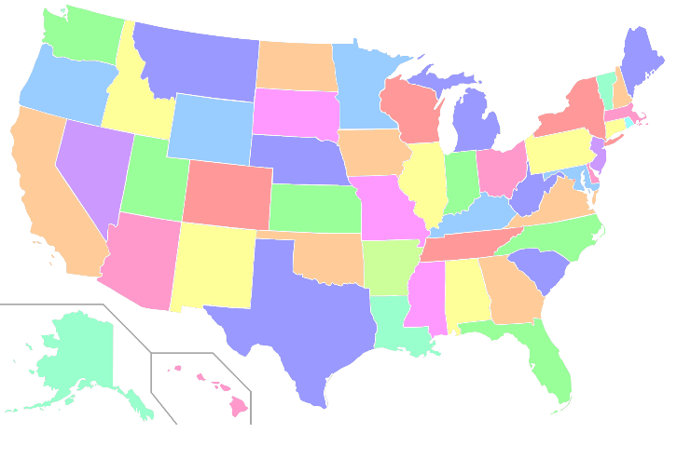
3 Ongoing Experiments
© Ravi Sandhu
World-Leading Research with Real-World Impact!
7

Slide 8
Data Disclosure
Syntactic Anonymity
Differential Privacy
Clifton, Chris, and Tamir Tassa. "On Syntactic Anonymity and Differential Privacy." Transactions on Data Privacy 6, no. 2 (2013): 161-183.
© Ravi Sandhu
World-Leading Research with Real-World Impact!

Slide 9
Data Disclosure
PPDP
Privacy-Preserving
Data Publication
Suppression
Generalization
Rearrange
PPDM
Privacy-Preserving
Data Mining
Respond to
queries on the data
Add random noise
© Ravi Sandhu
World-Leading Research with Real-World Impact!
9

Slide 10
Data Disclosure
PPDP
Privacy-Preserving
Data Publication
Suppression
Generalization
Rearrange
PPDM
Privacy-Preserving
Data Mining
Respond to
queries on the data
Add random noise
??
Syntactic
anonymity
Differential
privacy
© Ravi Sandhu
World-Leading Research with Real-World Impact!
10

Slide 11
Data Disclosure
Syntactic Anonymity
© Ravi Sandhu
World-Leading Research with Real-World Impact!

Slide 12
k-Anonymization
quasi-
Identifiers
QIs
sensitive
attribute
generalization
QI block
QI block
© Ravi Sandhu
World-Leading Research with Real-World Impact!
12

Slide 13
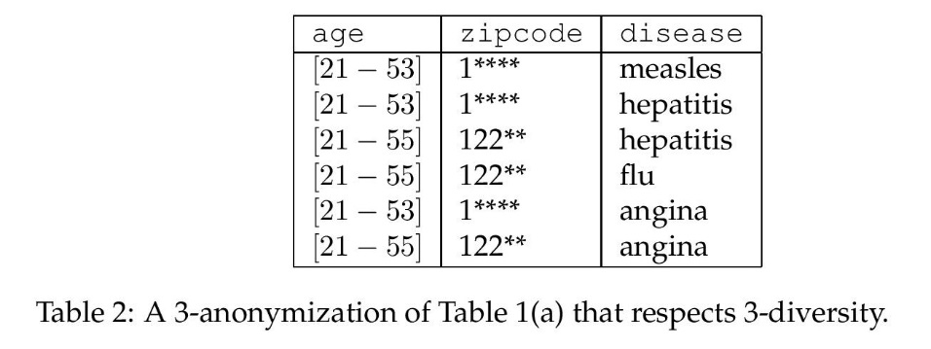
l-Diversity
Frequency of
occurrence of
sensitive attribute
QI block
≤ 1/3
© Ravi Sandhu
World-Leading Research with Real-World Impact!
13

Slide 14
t-Closeness
Frequency of
occurrence of
sensitive attribute
QI block
≤ 1/3
Distribution in each QI block should be t-close to distribution in entire population
stricter than l-diversity
© Ravi Sandhu
World-Leading Research with Real-World Impact!
14

Slide 15
p-Sensitivity
at least p distinct
values in each
QI block
QI block
weaker than l-diversity
© Ravi Sandhu
World-Leading Research with Real-World Impact!
15

Slide 16
Anatomy Anonymization
randomly shuffle
Sensitive attribute
in each QI block
© Ravi Sandhu
World-Leading Research with Real-World Impact!
16

Slide 17
Curse of Dimensionality
Given a large number of Quasi-Identifiers, need to suppress most of the table to achieve k-anonymity
LKC-privacy for high dimensional data:
Attacker knows at most L quasi-identifiers
Every combination of L quasi-identifiers is shared by at least K records
Diversity in each group of K is not more than 1/C
Release different versions of the data with different Quasi-Identifiers for different research purposes
© Ravi Sandhu
World-Leading Research with Real-World Impact!
17

Slide 18
Data Disclosure
Differential Privacy
© Ravi Sandhu
World-Leading Research with Real-World Impact!

Slide 19
Intuition
Database 1
Query
PPDM
Cannot tell which
Database is used
within specified
probability
Differ in only
1 record
Database 2
Response
© Ravi Sandhu
World-Leading Research with Real-World Impact!
19

