Slide 1
Institute for Cyber Security
A Unified Attribute-Based Access Control Model Covering DAC, MAC and RBAC
Prof. Ravi Sandhu
Executive Director and Endowed Chair
DBSEC
July 11, 2012
ravi.sandhu@utsa.edu
www.profsandhu.com
www.ics.utsa.edu
Joint paper with Xin Jin and Ram Krishnan of UTSA
© Ravi Sandhu
World-Leading Research with Real-World Impact!

Slide 2
Attribute-Based Access Control (ABAC)
Attributes are name:value pairs
possibly chained
values can be complex data structures
Associated with
users
subjects
objects
contexts
device, connection, location, environment, system …
Converted by policies into rights just in time
policies specified by security architects
attributes maintained by security administrators
ordinary users morph into architects and administrators
© Ravi Sandhu
World-Leading Research with Real-World Impact!
2

Slide 3
Yet Another Access Control Model!!
Why another model?
Why now?
Why ABAC?
Why ABACα (unifying DAC, MAC and RBAC)?
© Ravi Sandhu
World-Leading Research with Real-World Impact!
3

Slide 4
Access Control Status
Dozens of models proposed and studied. Only three winners (meaningful practical traction)
DAC: Discretionary Access Control, 1970
MAC: Mandatory Access Control, 1970
RBAC: Role-Based Access Control, 1995
RBAC emerged at an inflection point due to dissatisfaction with the then dominant DAC and MAC
We are currently at another inflection point due to dissatisfaction with the now dominant RBAC
ABAC (Attribute-Based Access Control) has emerged as the prime candidate to be the next dominant paradigm
© Ravi Sandhu
World-Leading Research with Real-World Impact!
4

Slide 5
RBAC Overall Assessment
Role granularity is not adequate leading to role explosion
Researchers have suggested several extensions such as parameterized privileges, role templates, parameterized roles (1997-)
Role design and engineering is difficult and expensive
Substantial research on role engineering top down or bottom up (1996-), and on role mining (2003-)
Assignment of users/permissions to roles is cumbersome
Researchers have investigated decentralized administration (1997-), attribute-based implicit user-role assignment (2002-), role-delegation (2000-), role-based trust management (2003-), attribute-based implicit permission-role assignment (2012-)
Adjustment based on local/global situational factors is difficult
Temporal (2001-) and spatial (2005-) extensions to RBAC proposed
RBAC does not offer an extension framework
Every shortcoming seems to need a custom extension
Can ABAC unify these extensions in a common open-ended framework?
© Ravi Sandhu
World-Leading Research with Real-World Impact!
5

Slide 6
ABAC Prior Work Includes
X.509, SPKI Attribute Certificates (1999 onwards)
IETF RFCs and drafts
Tightly coupled with PKI (Public-Key Infrastructure)
XACML (2003 onwards)
OASIS standard
Narrowly focused on particular policy combination issues
Fails to accommodate the ANSI-NIST RBAC standard model
Fails to address user subject mapping
Usage Control or UCON (Park-Sandhu 2004)
Fails to address user subject mapping
Focus is on extended features
Mutable attributes
Continuous enforcement
Obligations
Conditions
Several others ………..
© Ravi Sandhu
World-Leading Research with Real-World Impact!
6

Slide 7
Yet Another Access Control Model!!
Why another model?
Why now?
Why ABAC?
Why ABACα (unifying DAC, MAC and RBAC)?
© Ravi Sandhu
World-Leading Research with Real-World Impact!
7

Slide 8
How the Dominant Access Control Models got Built
DAC: Discretionary Access Control, 1970
Vendors and researchers coping for the first time with multi-user operating systems in different ways
Requirements abstracted from research organizations
MAC: Mandatory Access Control, 1970
Requirements abstracted from established real world pre-computer military and national security policies
RBAC: Role-Based Access Control, 1995
Requirements abstracted from established real world pre-computer policies common to commercial organizations
Vendor implementations of early RBAC-like systems
How do we build ABAC models?
© Ravi Sandhu
World-Leading Research with Real-World Impact!
8

Slide 9
Access Control Models
Policy
Specification
Policy
Enforcement
Policy
Reality
Initial Focus
Policy
Administration
© Ravi Sandhu
World-Leading Research with Real-World Impact!
9

Slide 10
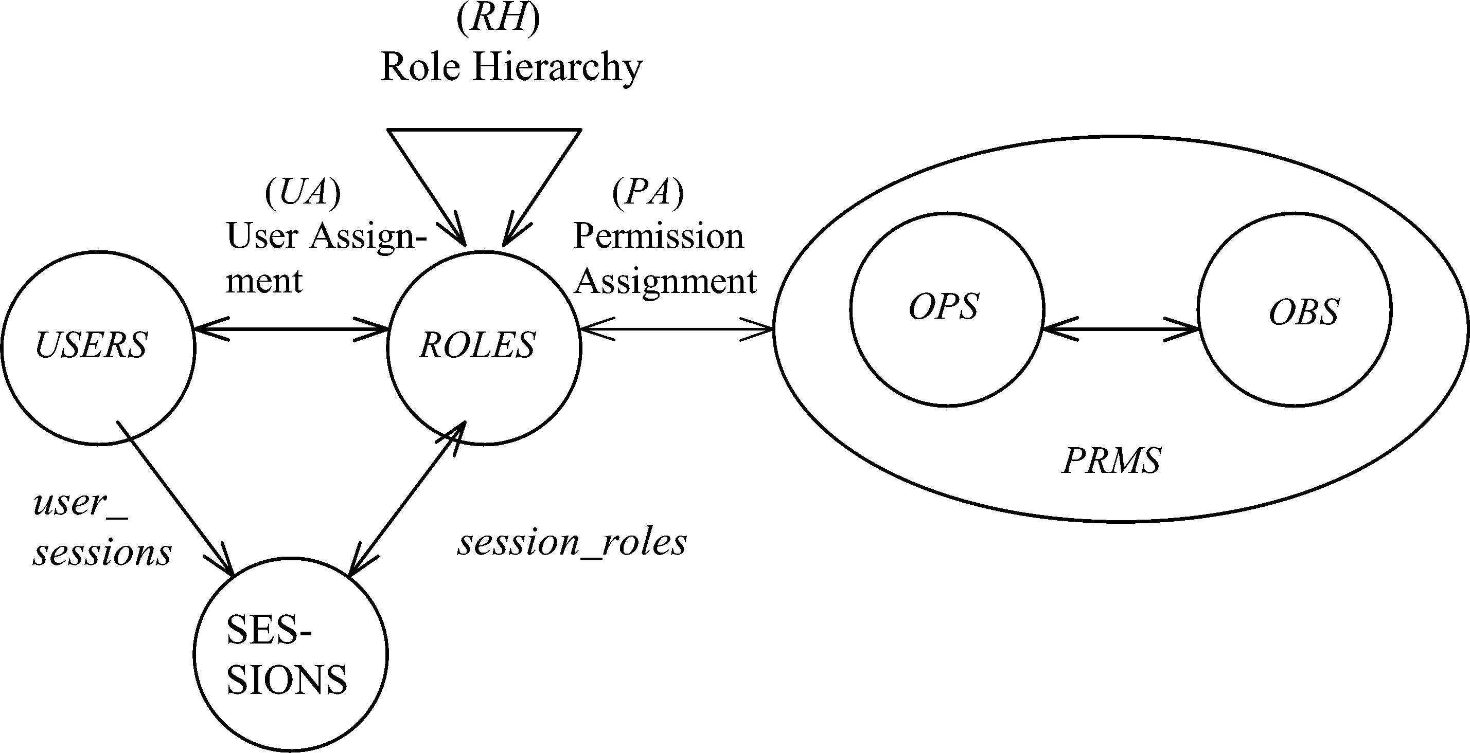
RBAC Policy Configuration Points
Role Hierarchy (RH)
Constraints
© Ravi Sandhu
World-Leading Research with Real-World Impact!
10

Slide 11
RBAC Policy Configuration Points
Security Architect
Role Hierarchy (RH)
Security
Administrator
Security
Administrator
Security
Architect
User
Security Architect
Constraints
Security Architect
© Ravi Sandhu
World-Leading Research with Real-World Impact!
11

Slide 12
ABACα Hypothesis
An ABAC model requires
identification of policy configuration points (PCPs)
languages and formalisms for each PCP
A core set of PCPs can be discovered by building the ABACα model to unify DAC, MAC and RBAC
Additional ABAC models can then be developed by
increasing the sophistication of the ABACα PCPs
discovering additional PCPs driven by requirements beyond DAC, MAC and RBAC
© Ravi Sandhu
World-Leading Research with Real-World Impact!
12

Slide 13
ABACα Requirements
 | Subject attribute value constrained by creating user ? | Object attribute value constrained by creating subject ? | Attribute range ordered? | Attribute function return set value? | Object attribute modification? | Subject attribute modification by creating user?
DAC | YES | YES | NO | YES | YES | NO
MAC | YES | YES | YES | NO | NO | NO
RBAC0 | YES | NA | NO | YES | NA | YES
RBAC1 | YES | NA | YES | YES | NA | YES
ABACα | YES | YES | YES | YES | YES | YES
© Ravi Sandhu
World-Leading Research with Real-World Impact!
13

Slide 14
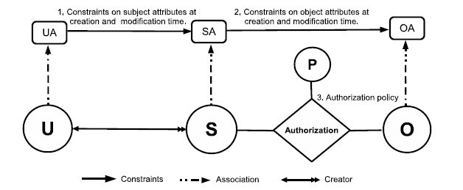
ABACα Model Structure
Policy Configuration Points
© Ravi Sandhu
World-Leading Research with Real-World Impact!
14

Slide 15
Authorization Policy: LAuthorization
DAC
MAC
RBAC0
RBAC1
© Ravi Sandhu
World-Leading Research with Real-World Impact!
15

Slide 16
Subject Attribute Constraints； LConstrSub
MAC
RBAC0
RBAC1
© Ravi Sandhu
World-Leading Research with Real-World Impact!
16

Slide 17
Object Attribute Constraints
Constraints at creation: LConstrObj
DAC
MAC
DAC
Constraints at modification: LConstrObjMod
© Ravi Sandhu
World-Leading Research with Real-World Impact!
17

Slide 18
ABACα Model Structure
Policy Configuration Points
© Ravi Sandhu
World-Leading Research with Real-World Impact!
18

