Slide 1
A User-to-User Relationship-based Access Control Model for Online Social Networks
Institute for Cyber Security
Yuan Cheng, Jaehong Park and Ravi Sandhu
Institute for Cyber Security
University of Texas at San Antonio
World-Leading Research with Real-World Impact!

Slide 2

Relationship-based Access Control
Users in OSNs are connected with social relationships (user-to-user relationships)
Owner of the resource can control its release based on such relationships between the access requester and the owner
World-Leading Research with Real-World Impact!
Notes:
So how does access control in OSNs look like? Previous access control models have been based on roles, security labels, identities, etc., depending on the purpose of different applications. Access control in OSNs presents several unique characteristics different from those traditional ones.
Social relationships form the social graph. AC is based on the topology of the social graph. Mention the approach used by the most dominant OSNs today

Slide 3
Problem
OSNs keep massive resources and support enormous activities for users
Users want to regulate access to their resources and activities related to them (as a requester or target)
Some related users also expect control on how the resource or user can be exposed
World-Leading Research with Real-World Impact!
Notes:
Huge volume of data, Changing dynamically, traditional methods are not scalable
In mandatory ac system, there is a central administrator for policy configuration.

Slide 4
Motivating Example
What current FofF approach cannot do?
  User who is tagged in a photo wants to keep her image private (Related User’s Control)
  Mom doesn’t want her kid to become friend with her colleagues (Parental Control)
  Employee promotes his resume to headhunters without letting his current employer know (Allowing farther users but keeping closer users away)
World-Leading Research with Real-World Impact!
Notes:
Many commercial systems have applied FofF approaches. Not enough. (a little boring and lengthy in this slide)
Purely owner-based control

Slide 5
Characteristics of AC in OSNs
Policy Individualization
  Users define their own privacy and activity preferences
  Related users can configure policies too
  Collectively used by the system for control decision
User and Resource as a Target
  e.g., poke, messaging, friendship invitation, etc.
User Policies for Outgoing and Incoming Actions
  User can be either requester or target of activity
  Allows control on 1) activities w/o knowing a particular resource and 2) activities against the user w/o knowing a particular access requestor
  e.g., block notification of friend’s activities; restrict from viewing violent contents
Relationship-based Access Control
World-Leading Research with Real-World Impact!
Notes:
We summarize four essential characteristics that need to be supported in access control solutions for OSN systems.

Slide 6
Solution Approach
Using regular expression-based path pattern for arbitrary combination of relationship types
Given relationship path pattern and hopcount limit, graph traversal algorithm checks the social graph to determine access
World-Leading Research with Real-World Impact!

Slide 7
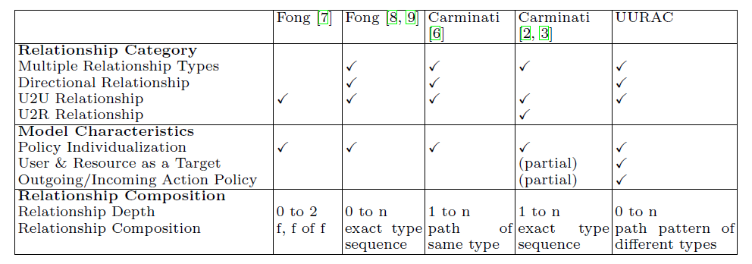
Related Works
The advantages of this approach:
  Passive form of action allows outgoing and incoming action policy
  Path pattern of different relationship types make policy specification more expressive
World-Leading Research with Real-World Impact!
Notes:
Just emphasize our approach

Slide 8
Contributions
Provide an access control policy model and access evaluation algorithm for OSNs based on user-to-user relationships with
  Greater generality and flexibility of policy specification
  Effective evaluation of policy predicate
World-Leading Research with Real-World Impact!
Notes:
Find a balance between generality and flexibility

Slide 9
Outline
Motivation
UURAC Model Foundation
UURAC Policy Specification
Path-checking Algorithm
Conclusions
World-Leading Research with Real-World Impact!

Slide 10
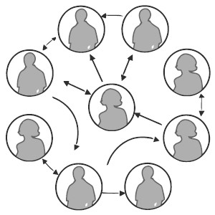
Social Networks
Social graph is modeled as a directed labeled simple graph G=<U, E, Σ>
  Nodes U as users
  Edges E as relationships
  Σ={σ₁, σ₂, …,σ_{n}, σ₁⁻¹, σ₂⁻¹,…, σ_{n}⁻¹}
  as relationship types supported
World-Leading Research with Real-World Impact!
Notes:
Relationship is not mutual any more. We consider incoming relationships, so granting access to users who consider him as a friend is plausible (inverse relationship)

Slide 11
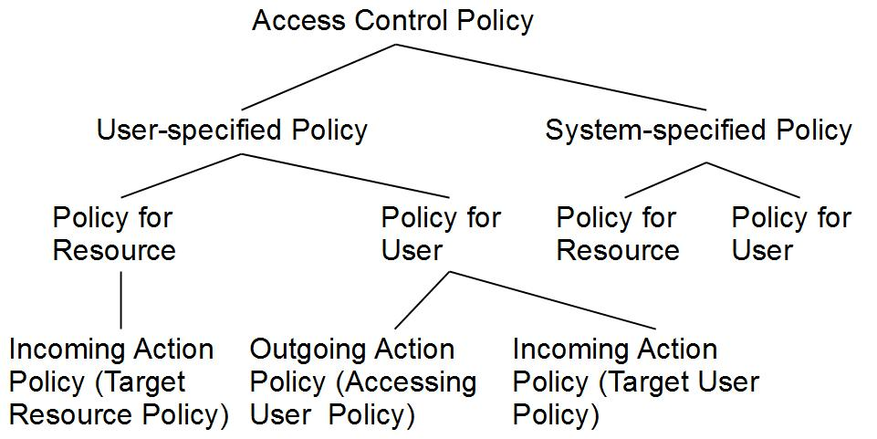
Policy Taxonomy

Slide 12
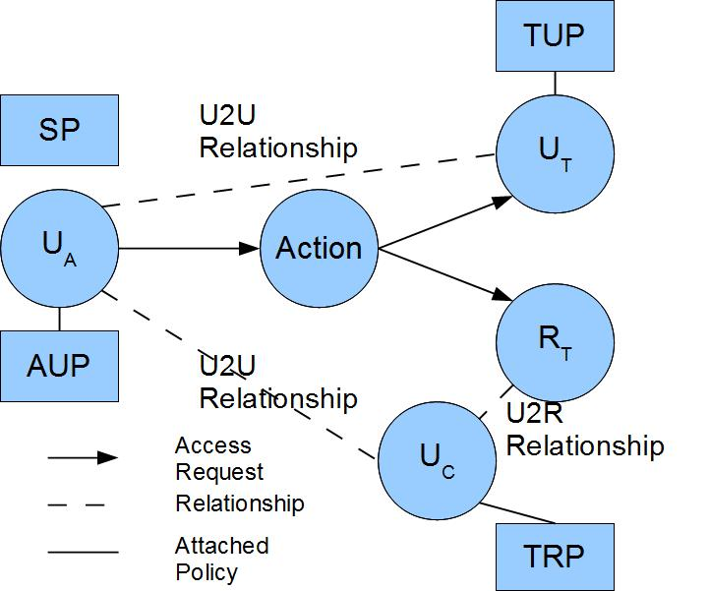
UURAC Model Components
U_{A}: Accessing User
U_{T}: Target User
U_{C}: Controlling User
R_{T}: Target Resource
AUP: Accessing User Policy
TUP: Target User Policy
TRP: Target Resource Policy
SP: System Policy
World-Leading Research with Real-World Impact!

Slide 13
Access Request and Evaluation
Access Request <u_{a}, action, target>
  u_{a} tries to perform action on target
  Target can be either user u_{t} or resource r_{t}
Policies and Relationships used for Access Evaluation
  When u_{a} requests to access a user u_{t}
    u_{a}’s AUP, u_{t}’s TUP, SP
    U2U relationships between u_{a} and u_{t}
  When u_{a} requests to access a resource r_{t}
    u_{a}’s AUP, r_{t}’s TRP (associated with u_{c}), SP
    U2U relationships between u_{a} and u_{c}
World-Leading Research with Real-World Impact!

Slide 14
Outline
Motivation
UURAC Model Foundation
UURAC Policy Specification
Path-checking Algorithm
Conclusions
World-Leading Research with Real-World Impact!

Slide 15
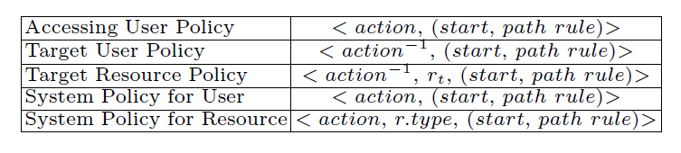
Policy Representations
action⁻¹ in TUP and TRP is the passive form since it applies to the recipient of action
TRP has an extra parameter r_{t} to distinguish the actual target resource it applies to
  owner(r_{t})→ a list of u_{c}→U2U relationships between u_{a} and u_{c}
SP does not differentiate the active and passive forms
SP for resource needs r.type to refine the scope of the resource
World-Leading Research with Real-World Impact!

Slide 16
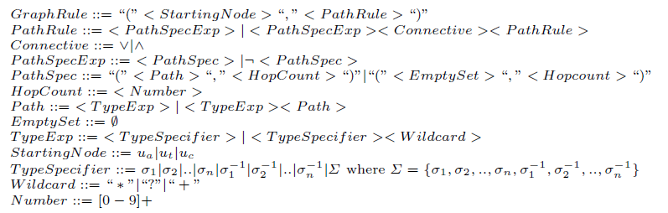
Graph Rule Grammar
World-Leading Research with Real-World Impact!

Slide 17
Example
“Only Me”
  <poke, (ua, (Ø, 0))> says that ua can only poke herself
  <poke⁻¹, (ut, (Ø, 0))> specifies that ut can only be poked by herself
The Use of Negation Notation
  (fffc ˄ ¬fc) allows the coworkers of the user’s distant friends to see, while keeping away the coworkers of the user’s direct friends
World-Leading Research with Real-World Impact!

Slide 18
Policy Collecting
To authorize (u_{a}, action, target) if target = u_{t}
  E.g., (Alice, poke, Harry)
P_{Alice}
<poke, (ua, (f*,3))>
AUP
< poke⁻¹, (ua, (f*,3))>
P_{Harry}
TUP
<poke, (ua, (cf*,5)˅(f*,5))>
<poke⁻¹, (ut, (f*,2))>
SP
P_{Sys}
<poke, (ua, (Σ*,5))>
World-Leading Research with Real-World Impact!

Slide 19
Policy Collecting
To authorize (u_{a}, action, target) if target = r_{t}
  Determine the controlling user for r_{t}:
    u_{c} ← owner(r_{t})
  E.g., (Alice, read, file2)
P_{Alice}
<read, (u_{a}, (Σ*, 5))>
AUP
<read⁻¹, file1, (u_{c}, (cf*, 4))>
P_{Harry}
TRP
<read⁻¹, file2, (u_{c}, ¬(p+, 2))>
P_{Sys}
SP
<read, photo, (ua, (Σ*, 5))>
World-Leading Research with Real-World Impact!

Slide 20
Policy Extraction
It determines the starting node, where the evaluation starts
The other user involved in access becomes the evaluating node
Policy: <action, r.type, graph rule>
Graph Rule: start, path rule
Path Rule: path spec ∧|∨ path spec
Path Spec: path, hopcount
Path-check each path spec using Algorithm 2 (introduced in detail later)
World-Leading Research with Real-World Impact!

Slide 21
Policy Evaluation
Evaluate a combined result based on conjunctive or disjunctive connectives between path specs
Make a collective result for multiple policies in each policy set.
  Policy conflicts may arise. We assume system level conflict resolution strategy is available (e.g., disjunctive, conjunctive, prioritized).
Compose the final result from the result of each policy set (AUP, TUP/TRP, SP)
World-Leading Research with Real-World Impact!

Slide 22
Outline
Motivation
UURAC Model Foundation
UURAC Policy Specification
Path-checking Algorithm
Conclusions
World-Leading Research with Real-World Impact!

Slide 23
Brief Intro
Parameters: G, path, hopcount, s, t
Traversal Order: Depth-First Search
  Why not BFS?
    Activities in OSN typically occur among people with close distance
    DFS needs only one pair of variables to keep the current status and history of exploration
    Hopcount limit prevents DFS from lengthy useless search
World-Leading Research with Real-World Impact!

Slide 24
Initiation
f
Access Request: (Alice, read, r_{t})
п₁
f
Policy: (read⁻¹, r_{t}, (f*cf*, 3))
f
п₃
п₀
Path pattern: f*cf*
Hopcount: 3
c
c
f
п₂
DFA for f*cf*
World-Leading Research with Real-World Impact!

Slide 25
Path pattern: f*cf*
Hopcount: 3
f
Dave
Bob
Dave
Bob
п₁
f
п₁
f
f
f
f
п₃
п₀
п₃
c
п₀
c
Alice
c
c
Harry
c
f
Alice
f
Ed
Harry
п₂
п₂
f
Case 2: found a matching path and DFA reached an accepting state
Case 1: next node is already visited, thus creates a self loop
Case 3: currentPath matches the prefix of the pattern, but DFA not at an accepting state
f
Carol
Fred
George
f
c
f
f
d: 0
currentPath: Ø
stateHistory: 0
d: 1
currentPath: (H,D,f)
stateHistory: 01
d: 3
currentPath: (H,D,f)(D,B,c)(B,A,f)
stateHistory: 0123
d: 2
currentPath: (H,D,f)(D,B,f)
stateHistory: 011
d: 2
currentPath: (H,D,f)(D,B,c)
stateHistory: 012

Slide 26
Complexity
Time complexity is bounded between [O(dmin^{Hopcount}),O(dmax^{Hopcount}) ], where dmax and dmin are maximum and minimum out-degree of node
  Users in OSNs usually connect with a small group of users directly, the social graph is very sparse
  Given the constraints on the relationship types and hopcount limit, the size of the graph to be explored can be dramatically reduced
World-Leading Research with Real-World Impact!

Slide 27
Outline
Motivation
UURAC Model Foundation
UURAC Policy Specification
Path-checking Algorithm
Conclusions
World-Leading Research with Real-World Impact!

Slide 28
Summary
Proposed a U2U relationship-based model and a regular expression-based policy specification language for OSNs
Provided a DFS-based path checking algorithm
World-Leading Research with Real-World Impact!

Slide 29
Future Work
Possible extensions:
  Exploit U2R and R2R relationships
  Incorporate predicate expressions for attribute-based control
  Capture unconventional relationships
World-Leading Research with Real-World Impact!

Slide 30
Questions
World-Leading Research with Real-World Impact!

