Slide 1
On Data Provenance in Group-centric Secure Collaboration
Institute for Cyber Security
Oct. 17, 2011
CollaborateCom
Jaehong Park, Dang Nguyen and Ravi Sandhu
Institute for Cyber Security
University of Texas at San Antonio

Slide 2
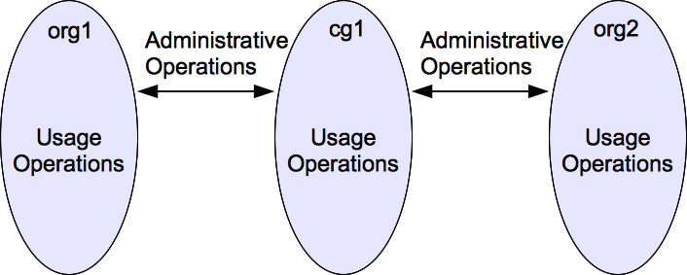
Group-centric Collaboration

Slide 3
Group Collaboration Operations
Administrative operations
  Establish/disband groups, join/leave/substitute users, add/remove object versions to/from a group, import/merge object versions from a group to an org
Usage operations
  Read/update/create object versions

Slide 4
Towards Assured Data Provenance
Data Provenance Security & Trustworthiness
e.g. Provenance Access/Usage Control
Provenance Data
Some Assurance
Data Provenance Model/System
GC Provenance
Operations for Provenance
Some Utilities
Target Domain
Group Collaboration

Slide 5
Data Provenance
Utilities of data provenance
  Pedigree, Usage tracking, Versioning capability
  Trustworthiness, Accountability, Compliance
  Depend on the kinds of provenance data that are captured

Slide 6
Capturing Provenance Data
  Capturing a complete provenance data for all operations is neither feasible nor necessary
    Some can be captured only by user’s manual declaration (i.e., user intention) while user’s memory is limited and cannot identify all the source information (i.e., citations in scientific research article).
    Not all operation information provide additional provenance utilities
  For proper discussion, we need a specific application domain where a set of operations can be specified and expressed

Slide 7
Data Provenance Requirements
Identifying operations for provenance data
Capturing operations as provenance data in a provenance model
Provenance data expression
Provenance data querying
Provenance data analysis
Data Provenance Assurance
  Access/usage Control, trustworthiness, integrity, accountability, etc.
OPM
RDF
SPARQL w/ GLEEN

Slide 8
Data Object Versioning
One object can have multiple versions
Each version can have a multiple identical copies
The versions of an object form a rooted tree structure, relating a parent version to its immediate children versions
Each copy is considered as a separate object.

Slide 9
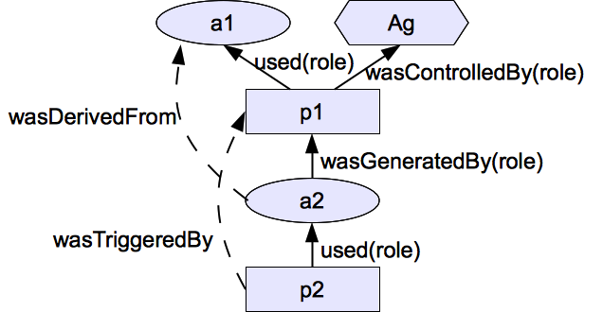
Open Provenance Model (OPM) Notations
3 Nodes
  Artifact (ellipse)
  Process (Rectangle)
  Agent (Octagon)
5 Causality dependency edges (not dataflow)

Slide 10
OPM includes…
A unique identifier for each node
  To distinguish nodes of the same type
Accounts
  Multiple abstracted views of provenance graph by utilizing indirect (dashed) edges
OPM Profile
  Includes domain specific subtypes of edges that are defined for additional semantics
  Includes role-specific (solid) edges

Slide 11
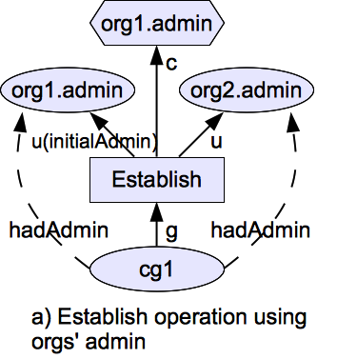
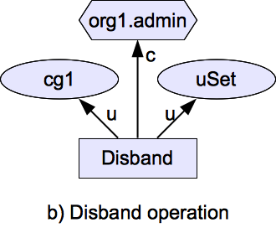
Establish/Disband operations

Slide 12
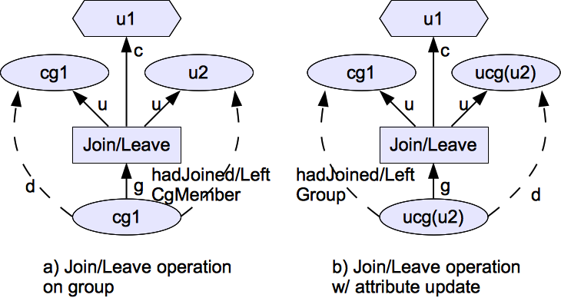
Join/Leave Operations

Slide 13
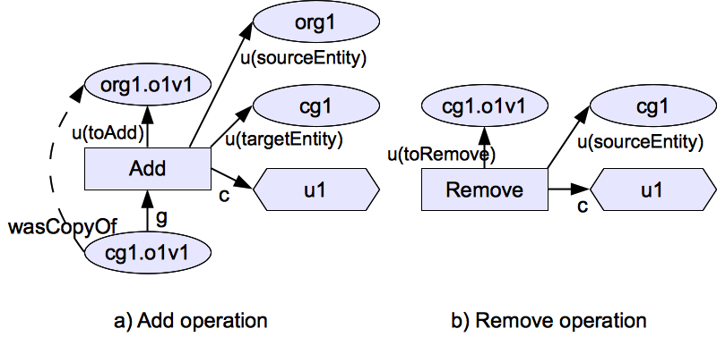
Add/Remove Operations

Slide 14
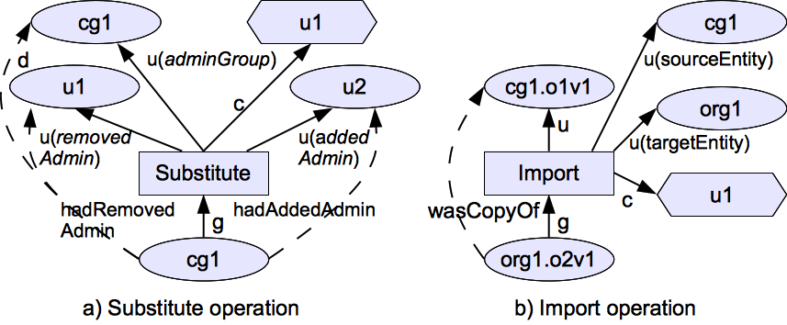
Substitute/Import Operations

Slide 15
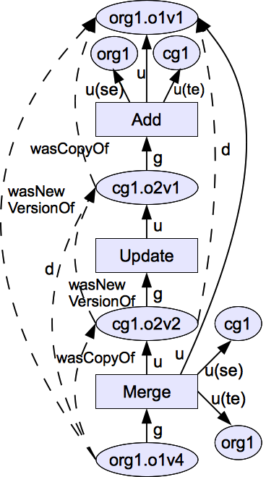
Merge Operation
Similar to “import”
  A version is copied from cg to org
Different from “import”
  The initial version of the merged version in cg was added from the org while the initial version of imported version is newly created in cg
  The merged version becomes a new version of the original version in org

Slide 16
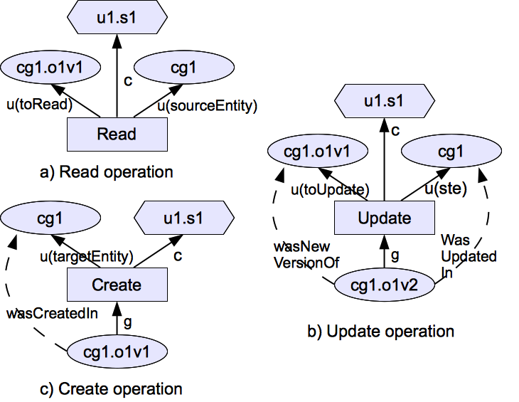
Read/Update/Create Operations

Slide 17
OPM in RDF Expression
Using RDF (Resource Description Framework) data representation to express provenance data
RDF supports a directed graph
<opm:process><opm:used><opm:artifact>
<opm:artifact><opm:wasGeneratedBy><opm:process>
<opm:process><opm:wasControlledBy><opm:agent>
<opm:process><opm:wasTriggeredBy><opm:process>
<opm:artifact><opm:wasDerivedFrom><opm:artifact>

Slide 18
OPM Profile for Group Collaboration Operations (subtypes of “wasDerivedFrom”)
<gcp:artifact><gcp:wasCopyOf><gcp:artifact>
<gcp:artifact><gcp:wasNewVersionOf><gcp:artifact>
<gcp:artifact><gcp:HadAdmin><gcp:artifact>
<gcp:artifact><gcp:HadJoinedCgMember><gcp:artifact>
<gcp:artifact><gcp:HadLeftCgMember><gcp:artifact>
<gcp:artifact><gcp:HadRemovedAdmin><gcp:artifact>
<gcp:artifact><gcp:HadAddedAdmin><gcp:artifact>
<gcp:artifact><gcp:wasCreatedIn><gcp:artifact>
<gcp:artifact><gcp:wasUpdatedIn><gcp:artifact>

Slide 19
Roles for “Used” Edges
<gcp:process><gcp:u(sourceEntity)><gcp:artifact>
<gcp:process><gcp:u(targetEntity)><gcp:artifact>
<gcp:process><gcp:u(adminGroup)><gcp:artifact>
<gcp:process><gcp:u(removedAdmin)><gcp:artifact>
<gcp:process><gcp:u(addedAdmin)><gcp:artifact>
<gcp:process><gcp:u(initialAdmin)><gcp:artifact>
<gcp:process><gcp:u(toJoin)><gcp:artifact>
<gcp:process><gcp:u(toLeave)><gcp:artifact>
<gcp:process><gcp:u(toAdd)><gcp:artifact>
<gcp:process><gcp:u(toRemove)><gcp:artifact>
<gcp:process><gcp:u(toImport)><gcp:artifact>
<gcp:process><gcp:u(toMergeTo)><gcp:artifact>
<gcp:process><gcp:u(toMergeFrom)><gcp:artifact>
<gcp:process><gcp:u(toRead)><gcp:artifact>
<gcp:process><gcp:u(toUpdate)><gcp:artifact>

Slide 20
Roles for “WasGeneratedBy” Edges
<gcp:artifact><gcp:g(toEstablish)><gcp:process>
<gcp:artifact><gcp:g(toJoin)><gcp:process>
<gcp:artifact><gcp:g(toLeave)><gcp:process>
<gcp:artifact><gcp:g(toAdd)><gcp:process>
<gcp:artifact><gcp:g(toSubstitute)><gcp:process>
<gcp:artifact><gcp:g(toImport)><gcp:process>
<gcp:artifact><gcp:g(toMerge)><gcp:process>
<gcp:artifact><gcp:g(toCreate)><gcp:process>
<gcp:artifact><gcp:g(toUpdate)><gcp:process>

Slide 21
SPARQL Query Expression
Standard query language for RDF
Can query by stating a consecutive path of specific triple types of subject, predicate, and object
SELECT ?ver
WHERE{
gcp:cg1.o2v2 gcp:wasCopyOf ?obj.
?obj gcp:wasNewVersionOf ?ver.}

Slide 22
GLEEN-enabled SPARQL
Gleen is a plugin for the ARQ query engine.
ARQ is a query engine for Jena, a semantic web framework for Java which supports the SPARQL RDF query language
Gleen onPath function supports regular expression-based recursive path patterns
subject gleen:OnPath (pathExpression object)

Slide 23
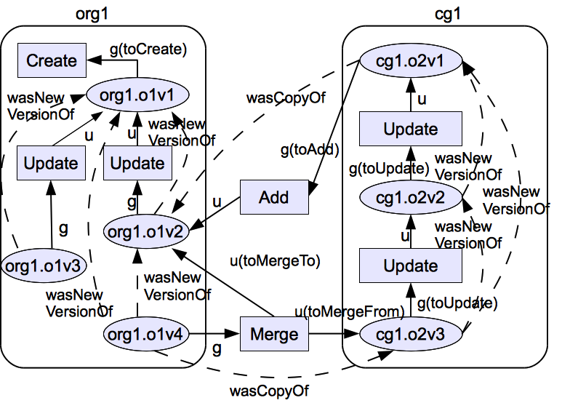
Provenance Data Example

Slide 24
Sample Query 1
Identify the very initial version of cg1.o2v3 and whether it is created in the current group or added from an organization.
The query will return “cg1.o2v1” and “add”
SELECT ?obj ?proc
WHERE{
gcp:cg1.o2v3 gleen:OnPath(
”[gcp:wasNewVersionOf]∗” ?obj ).
?obj gleen:OnPath(
[gcp:g(toCreate)]|[gcp:g(toAdd)] ?proc).}

Slide 25
Sample Query (cont.)
To verify users who may have influenced (update/create) an object content regardless of the fact that whether the influence is done on a version of the same object or a version of a copied object of the object.
SELECT ?agent
WHERE{
gcp:org1.o1v4 gleen:OnPath(
”([ gcp:wasNewVersionOf ]|[gcp:wasCopyOf])∗” ?obj).
?obj gleen:OnPath([gcp:g(toUpdate )]|[gcp:g(toCreate)] ?proc).
?proc gcp:wasControlledBy ?agent.}

Slide 26
Summary
Identified/captured available or necessary operations as provenance data for group collaboration environment
Expressed in RDF triples so it can be queried by utilizing a regular expression based path patterns in SPARQL query language
Showed some utilities of data provenance in a group collaboration environment
Provides an initial foundation for data provenance access control in group collaboration environment

Slide 27
Questions and Comments?

