Slide 1
Dependency Path Patterns as the Foundation of Access Control in Provenance-aware Systems
Institute for Cyber Security
June 14, 2012
TaPP’12
Dang Nguyen, Jaehong Park and Ravi Sandhu
Institute for Cyber Security
University of Texas at San Antonio

Slide 2
Access control in Provenance-aware Systems
Provenance Access Control (PAC)
  Controlling access to provenance data which could be more sensitive than the underlying data
  Needs access control models/mechanisms (e.g, RBAC)
  (Meaningful) control granularity?
Provenance-based Access Control (PBAC)
  Using provenance data to control access to the underlying data
  Provenance-based policy specification
Meaningful granularity of provenance data?

Slide 3
PAC & PBAC in Applications
Common Foundation
  Base provenance data
  Dependency list
    Dependency Name: meaningful, named abstraction
    matching regular expression-based causality dependency path pattern
PAC and PBAC are complementary
  In PAC, control decision can be based on provenance data (PB-PAC)
  In PBAC, PAC can be used for added trustworthiness on provenance data

Slide 4
Provenance Data
Directed Acyclic Graph (DAG)
Causality dependencies between entities (acting users, action processes and data objects)
Dependency graph can be traced for extracting pedigree, usage, versioning information, etc.
    PBAC can support origin/usage-based control, Dynamic Separation of Duty (DSOD), workflow control, etc.

Slide 5
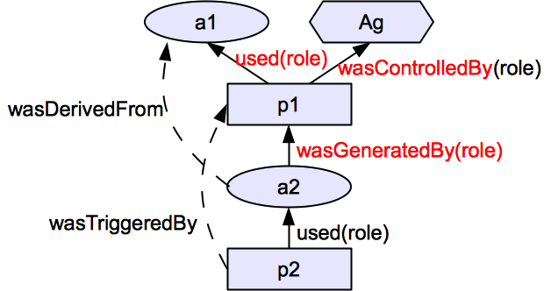
From Open Provenance Model (OPM)
3 Nodes
  Artifact (ellipse)
  Process (Rectangle)
  Agent (Hexagon)
5 Causality dependency edges (not dataflow)
Provenance data: a set of 2 entities & 1 dependency
  E.g., (ag,p1,a1,a2): <p1,ag,c>,<p1,a1,u>,<a2,p1,g>

Slide 6
Direct vs. Indirect Dependencies
Direct dependencies
  Used (u), wasGeneratedBy (g), wasControlledBy (c)
  Captured from transactions as base provenance data
Indirect dependencies
  System-computable dependencies
    using pre-defined dependency names and matching dependency path patterns
  User-declared dependencies
    using pre-defined dependency names

Slide 7
Object Dependency List (DL_{O})
A set of pairs of
  abstracted dependency names (DNAME) and
  regular expression-based object dependency path patterns (DPATH)
Examples
  < wasSubmittedVof, g_{submit}.u_{input} >
  < wasAuthoredBy, wasSubmittedVof?.wasReplacedVof ∗.g_{upload}.c >

Slide 8
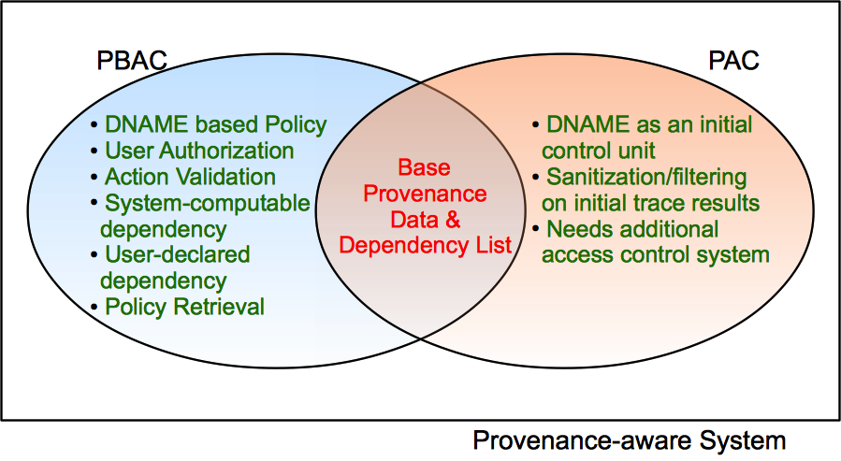
PBAC vs. PAC

Slide 9
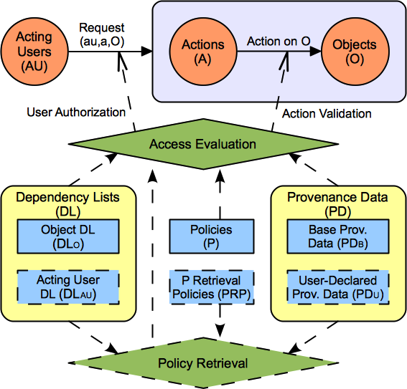

PBAC Models

Slide 10
Example: A Homework Grading System
Anyone can upload a homework.
A user can replace a homework if she uploaded it (origin-based control) and the homework is not submitted yet.
A user can submit a homework if she uploaded it and the homework is not submitted already. (workflow control)
A user can review a homework if she is not the author of the homework (DSOD), the user did not review the homework earlier, and the homework is submitted already but not graded yet.
A user can grade a homework if the homework is reviewed but not graded yet.

Slide 11
Sample Transactions &
Base Provenance Data
(au1, upload1, o_{1v1}): < upload1, au1, c >, <o_{1v1},upload1,g_{upload} >
(au1, replace1, o_{1v1}, o_{1v2}): < replace1, au1, c >,< replace1, o_{1v1}, u_{input}>, < o_{1v2}, replace1, g_{replace}>
(au1, submit1, o_{1v2}, o_{1v3}): < submit1, au1, c >, <submit1,o_{1v2}, u_{input} >,<o_{1v3},submit1,g_{submit} >
(au2, review1, o_{1v3}, o_{2v1}): < review1, au2, c >, <review1,o_{1v3}, u_{input} >,<o_{2v1},review1,g_{review} >
(au3, grade1, o_{1v3}, o_{3v1}): < grade1, au3, c >, < grade1,o_{1v3}, u_{input} >,< o_{3v1},grade1,g_{grade} >

Slide 12
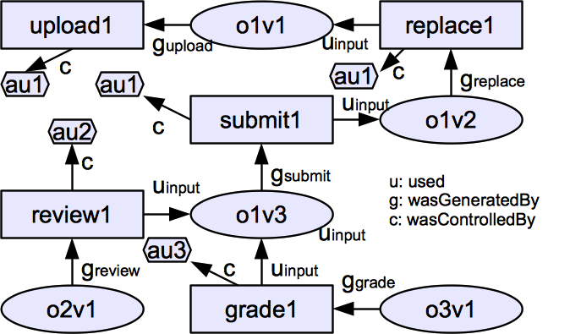
A Sample Base Provenance Data

Slide 13
A Sample Base Provenance Data
wasReviewedOby
wasReplacedVof
DL_{O}: < wasReplacedVof, g_{replace}.u_{input} >
wasSubmittedVof
wasReviewedOof
wasGradedOof

Slide 14
A Sample Base Provenance Data
wasAuthtoredBy
DL_{O}: <wasAuthoredBy, wasSubmittedVof?. wasReplacedVof ∗.g_{upload}.c >

Slide 15
A Sample Base Provenance Data
wasReviewedBy
DL_{O}: < wasReviewedBy, wasReviewedOof⁻¹. wasReviewedOby >

Slide 16
Sample Object Dependency List (DL_{O})
< wasReplacedVof, g_{replace}.u_{input} >
< wasSubmittedVof, g_{submit}.u_{input} >
< wasReviewedOof, g_{review}.u_{input} >
< wasReviewedOby, g_{review}.c >
< wasGradedOof, g_{grade}.u_{input} >
< wasAuthoredBy, wasSubmittedVof?.wasReplacedVof ∗.g_{upload}.c >
< wasReviewedBy, wasReviewedOof⁻¹. wasReviewedOby >

Slide 17
Sample Policies
Anyone can upload a homework.
A user can replace a homework if she uploaded it (origin-based control) and the homework is not submitted yet.
A user can submit a homework if she uploaded it and the homework is not submitted already. (workflow control)
allow(au, upload, o) ⇒ true
allow(au, replace, o) ⇒ au∈(o, wasAuthoredBy) ∧|(o,wasSubmittedVof)| = 0.
allow(au, submit, o) ⇒ au∈(o, wasAuthoredBy) ∧|(o,wasSubmittedVof)|=0.

Slide 18
Sample Policies (cont.)
A user can review a homework if she is not the author of the homework (DSOD), the user did not review the homework earlier, and the homework is submitted already but not graded yet.
A user can grade a homework if the homework is reviewed but not graded yet.
allow(au, review, o) ⇒ au ∉ (o, wasAuthoredBy) ∧au ∉ (o, wasReviewedBy) ∧ |(o, wasSubmittedV of)| ≠ 0 ∧ |(o,wasGradedOof⁻¹)| = 0.
allow(au, grade, o) ⇒ |(o, wasReviewedOof)| ≠ 0 ∧|(o,wasGradedOof⁻¹)| = 0).

Slide 19
Summary
Regular expression-based dependency path pattern
Introduced the notion of named abstractions of causality dependency path patterns as a foundation for PBAC and PAC
Supports Simple and effective policy specification and access control management
Supports DSOD, workflow control, origin-based control, usage-based control, object versioning, etc.

Slide 20
What’s next?
Enhancing/extending PBAC model
Provenance Access Control Models
Provenance data sharing in multiple systems

Slide 21
Thank you
Questions and Comments?

