Slide 1
ParaSDN: An Access Control Model for SDN Applications based on Parameterized Roles and Permissions
Abdullah Al-Alaj¹, Ram Krishnan² and Ravi Sandhu¹
¹Dept. of Computer Science
²Dept. of Electrical and Computer Engineering
^{1,2}Institute for Cyber Security
^{1,2}Center for Security and Privacy Enhanced Cloud Computing (C-SPECC)
University of Texas at San Antonio, TX 78249
The 6th IEEE International Conference on Collaboration and Internet Computing (CIC 2020)
December 1 - 3, 2020

Slide 2
Agenda
Introduction to Software Defined Networking (SDN)
Parameterized Roles and Permissions in SDN
ParaSDN main components
ParaSDN Parameter Engine
ParaSDN Conceptual Model and Definitions
Use-Case Security Configuration in SDN-RBAC
ParaSDN Implementation & Evaluation
Conclusion and Future Work

Slide 3








Introduction
Traditional Networks
Management Layer
CLI
Control plane
Data plane
Infrastructure Layer
Traditional Network
SDN Idea
Control plane
Decoupling
Data plane
.

Slide 4

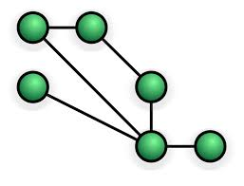











Introduction
Software Defined Networks (SDN)
Applications
Routing
Firewall
Load
Balancing
Intrusion Prevention
Network Visualization
Other
. . .
Network Programming APIs
Network Services
Virtual Network Resources
Topology Service | Entry Pushing
Routing Service | Device Management
Statistics Collection | Link Discovery
Switch Management | Other
Topology
Flow tables
Switches
Ports
Controller
(e.g., Floodlight)
Manage
Control plane
Statistics
Traffic payloads
Config-
urations
VLANs
Hosts
Links
Devices
Other
Decoupling
OpenFlow Protocol
Flow table
Infrastructure
Data plane
.

Slide 5
Motivation
Apps are authorized on object types (e.g., (addFlow, FLOW RULE)) → Fine grained access control is required.
a1
a2
a3
a4
a5
a6
a7
a8
a9
…
Requires restriction
Controller (Floodlight)
CS
CIS
CE
0x1
0x4
0x7
0x8
…
0x2
0x5
0x3
0x6
0x9
Role: Flow Mod₁
Role: Flow Mod₂
Role: Flow Mod₃
…
Assigned Perms:
(addFlow, flow_rule^{sw0x1})
(addFlow, flow_rule^{sw0x2})
(addFlow, flow_rule^{sw0x3})
continue for:
deleteFlow x 3
readFlow x 3
updateFlow x 3
Assigned Perms:
(addFlow, flow_rule^{sw0x4})
(addFlow, flow_rule^{sw0x5})
(addFlow, flow_rule^{sw0x6})
continue for:
deleteFlow x 3
readFlow x 3
updateFlow x 3
Assigned Perms:
(addFlow, flow_rule^{sw0x7})
(addFlow, flow_rule^{sw0x8})
(addFlow, flow_rule^{sw0x9})
continue for:
deleteFlow x 3
readFlow x 3
updateFlow x 3
Multiple very closely related roles are defined to achieve fine-grained access control.
Roles are limited in membership.
Role explosion
Permission explosion

Slide 6
Introducing Parameterized Roles and Permissions in SDN
a1
a2
a3
a4
a5
a6
a7
a8
a9
…
Requires restriction
Controller (Floodlight)
CS
CIS
CE
0x1
0x4
0x7
0x8
…
0x2
0x5
0x3
0x6
0x9
dept = CS
dept = CIS
dept = CE
…
Role: Flow Mod
Assigned Perms:
(addFlow, FLOW RULE)
(deleteFlow, FLOW RULE)
(updateFlow, FLOW RULE)
(readFlow, FLOW RULE)

Slide 7
Proposed work
Formal Access control model for SDN enhanced with role and permission parameters
Authorization Framework extended with parameter engine and enforcement in SDN controller.
Fine-Grained and Scalable Access Control for SDN

Slide 8
Parameterized Permissions and Roles
Parameters
  name:value pairs.
  Add restrictions on access to network resources.
Parameterized Roles:
(r_{i} , {(par₁ , val₁ ), (par₂ , val₂ ), ...})
Example:
(Flow Mod, {(dept, ⊥), (traffic, ⊥)})
Parameterized Permissions:
((op_{i}, ot_{i}), {(par₁ , val₁ ), (par₂ , val₂ ), ...})
Example:
((addFlow, FLOW-RULE), {(dept, ⊥), (traffic, ⊥)})
⊥ = Unknown.

Slide 9
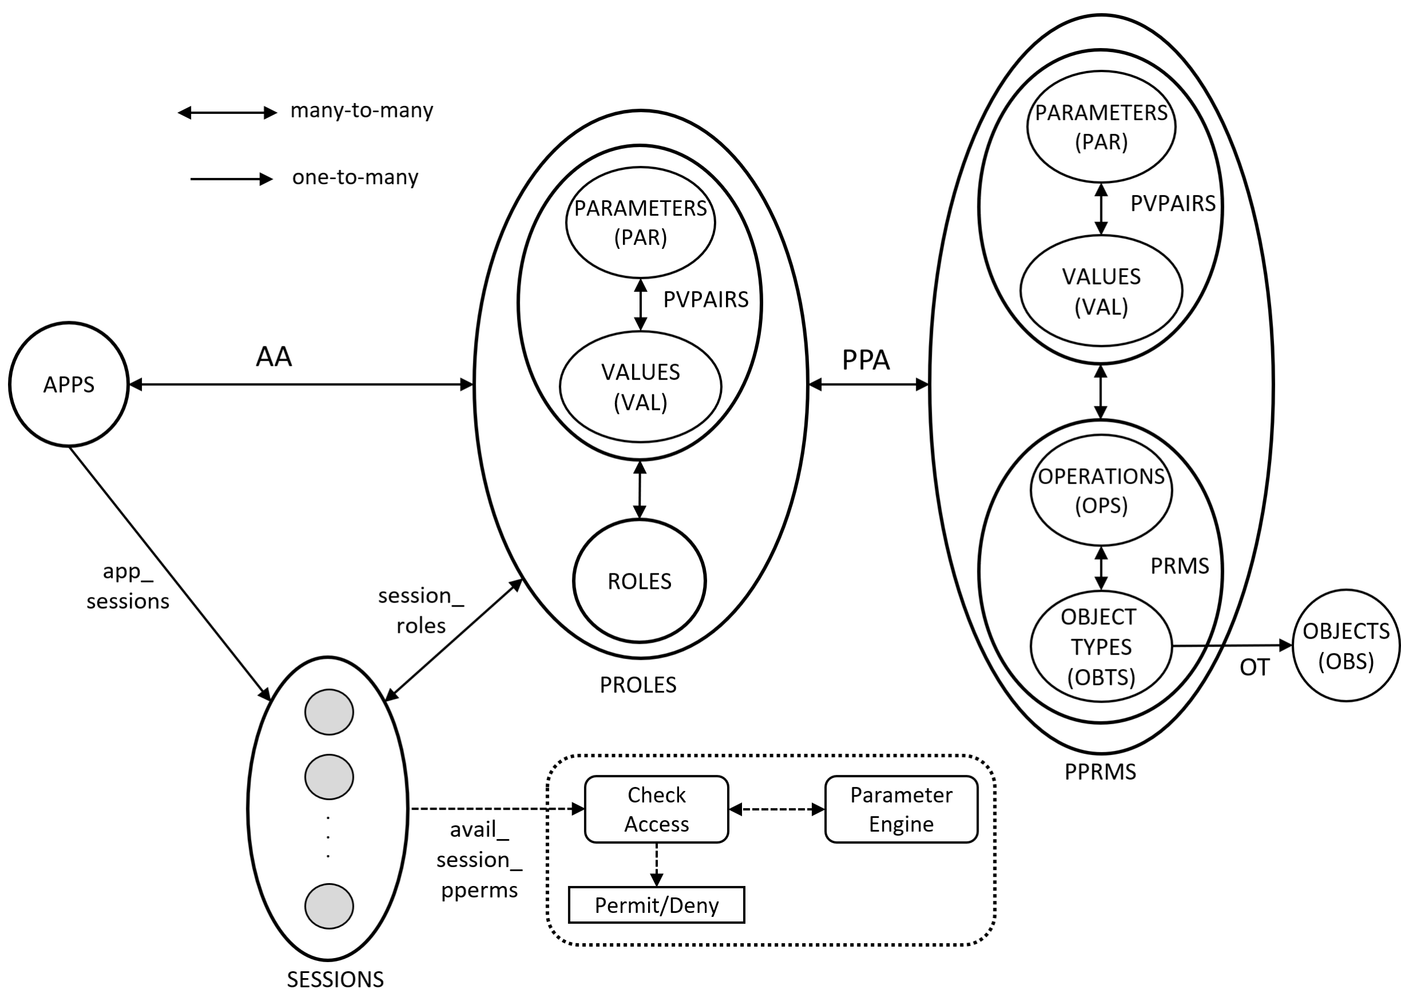
ParaSDN Conceptual Model

Slide 10
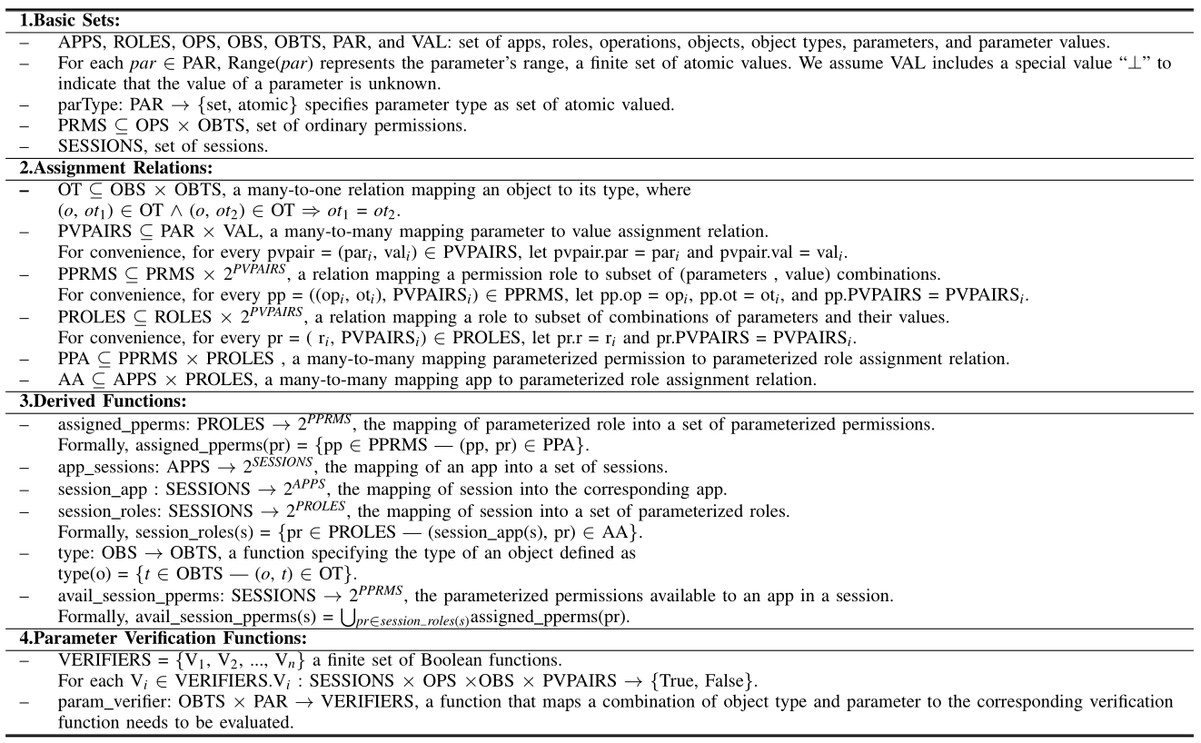
ParaSDN Formal Model Definition

Slide 11
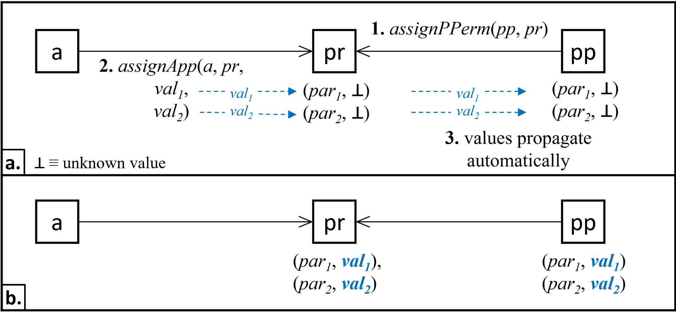
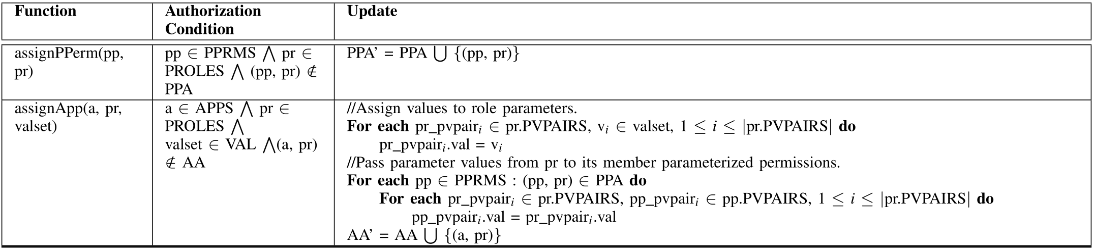
Parameter Value Assignment
Parameter values assigned via assignApp administrative action propagate automatically from role parameters to permission parameters

Slide 12
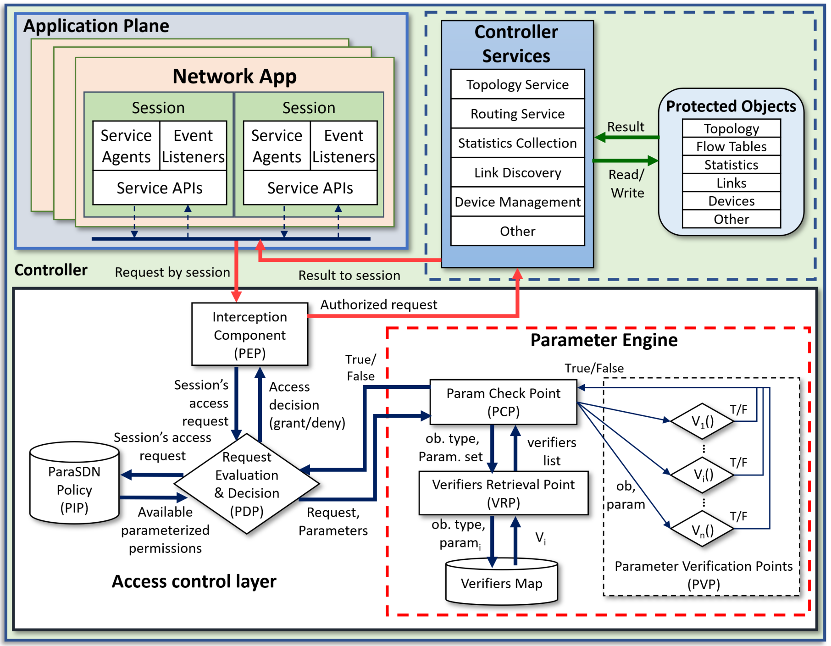
ParaSDN Framework Architucture
.

Slide 13
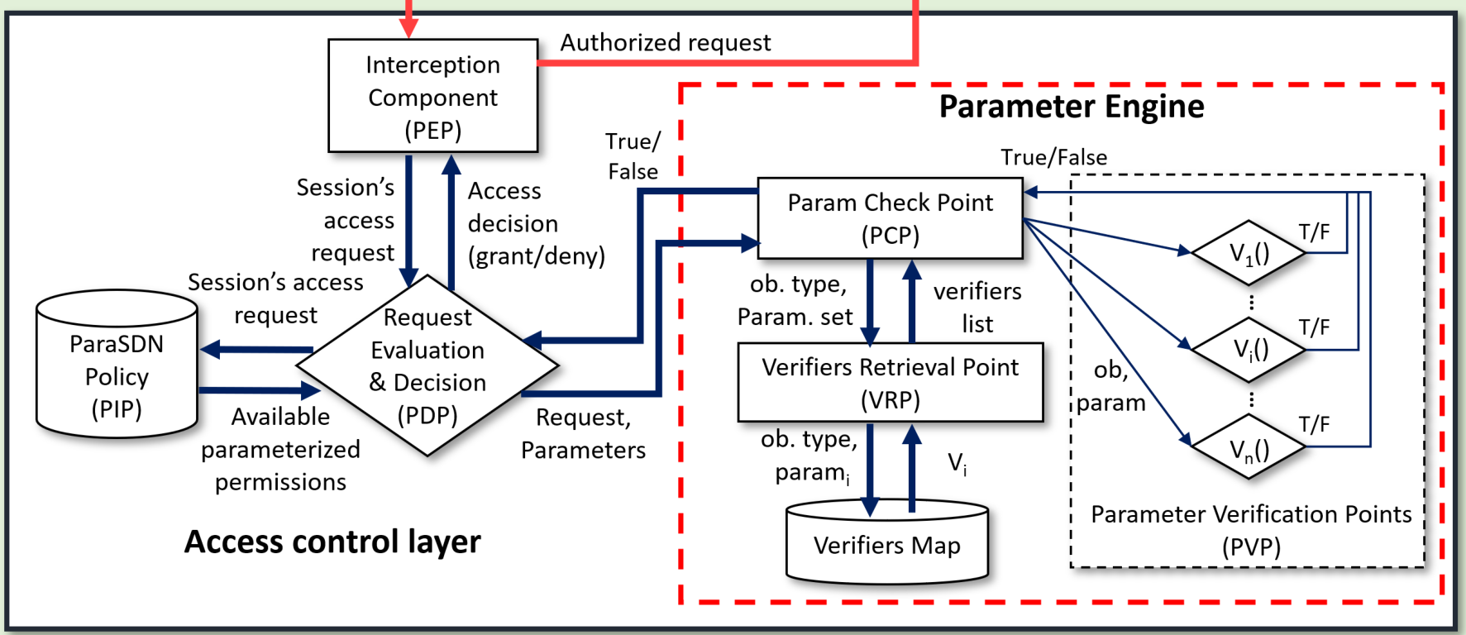
ParaSDN Parameter Engine
The General functionality of the Parameter Engine is distributed among multiple components:
  Parameter Check Point (PCP),
  Verifiers Retrieval Point (VRP), and
  multiple Parameter Verification Points (PVPs).

Slide 14
ParaSDN Implementation
Timer Started
Timer Ended
.

Slide 15
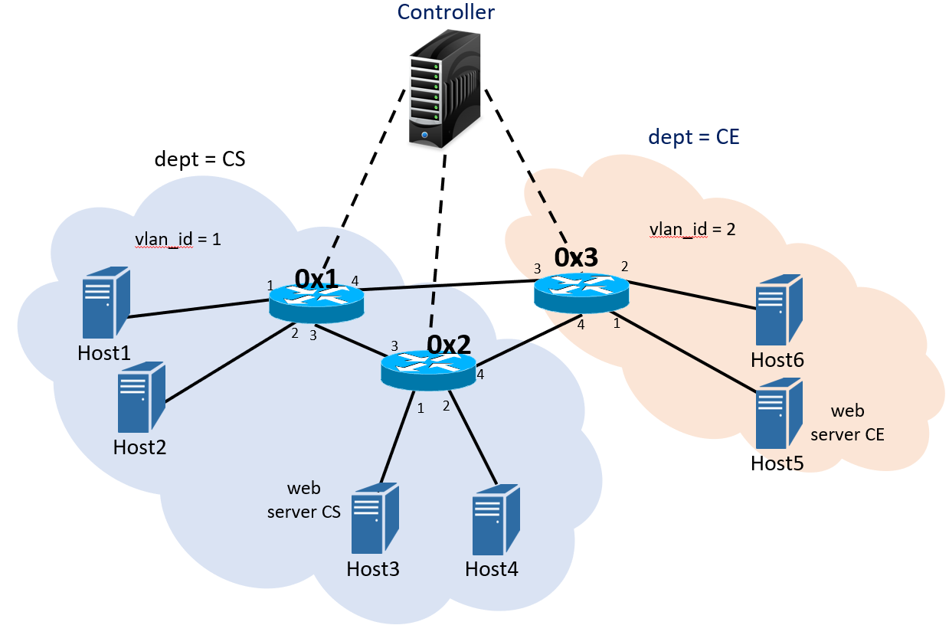
Use-Case & Security Configuration in ParaSDN Model
.
Data Usage Cap Mngr
Intrusion Prevention App

Slide 16
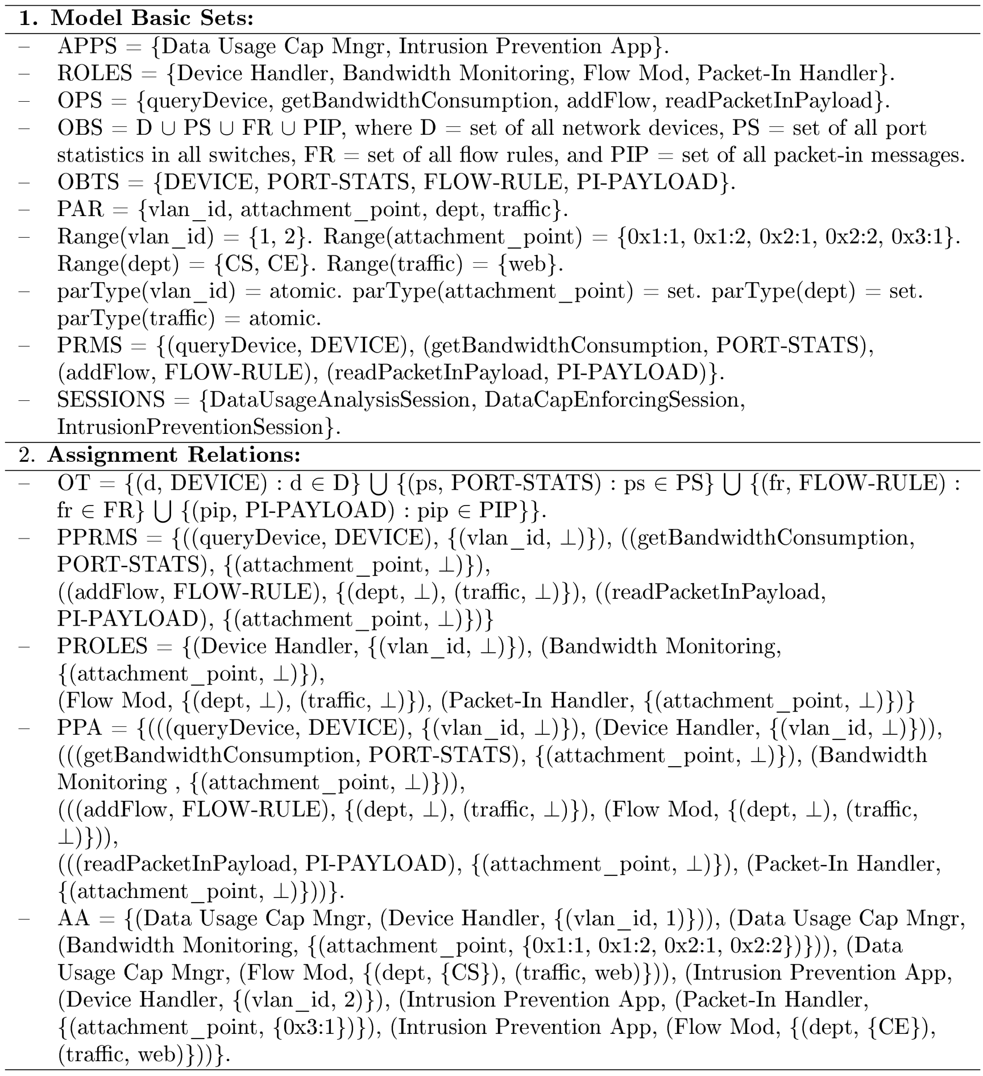
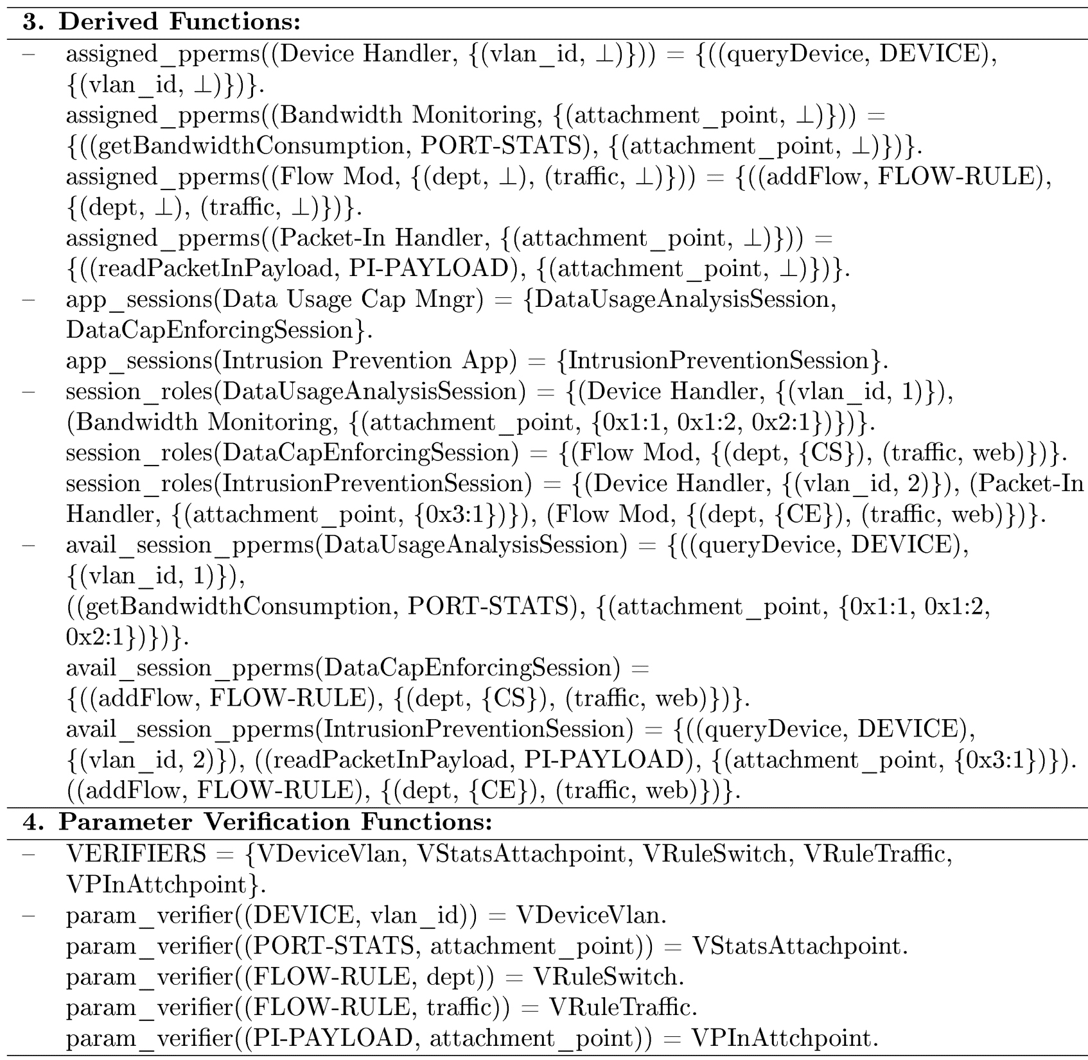
Use-Case Security Configuration in ParaSDN Model

Slide 17
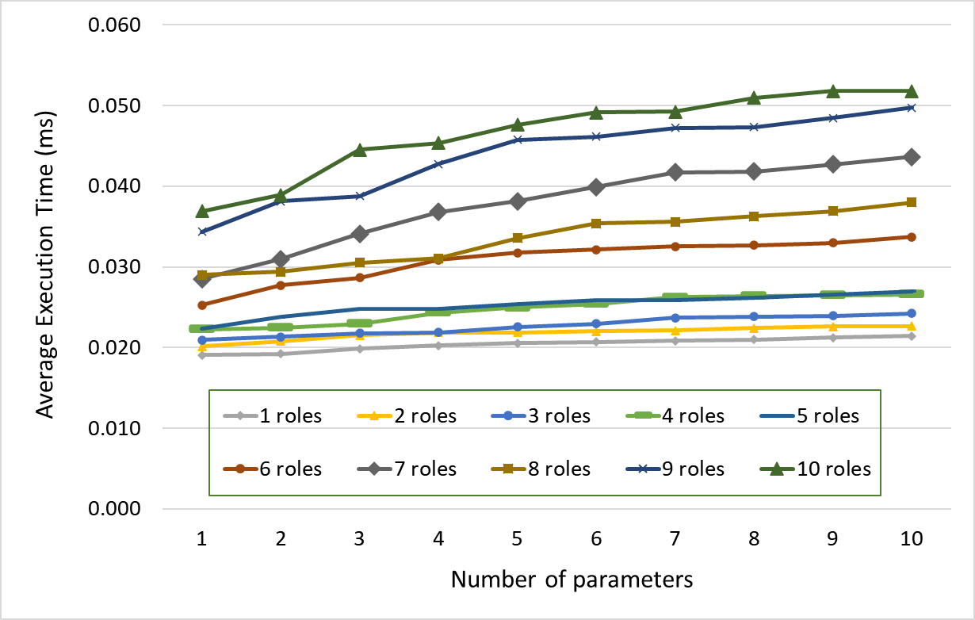
ParaSDN Evaluation
Test app with 50 ops covered by 10 different roles.
Report authorization time for all 50 requests.
Different security policies (parameters and roles).
Test repeated 100 times for each security policy.
Average authorization time is calculated.
Floodlight’s boot-up time is ignored.
.

Slide 18
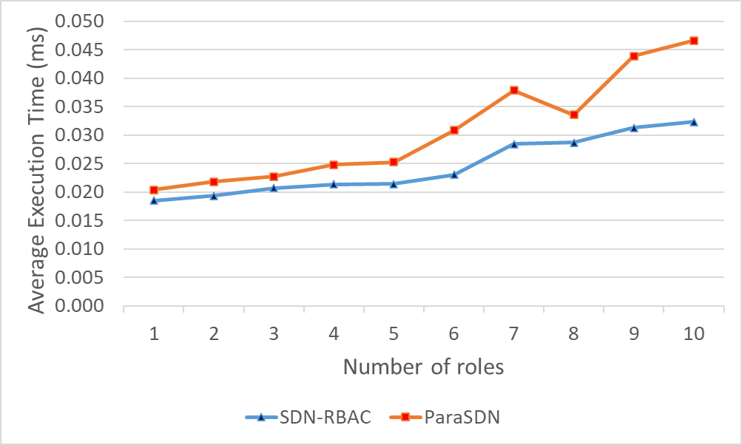
ParaSDN Evaluation
On average: ParaSDN adds 0.031 ms overhead compared to 0.025 for SDN-RBAC.
.

Slide 19
Conclusion and Future Work
In this work:
We proposed ParaSDN, a formal access control model that provides fine grained capabilities for SDN using the concept of parameterized roles and permissions.
We implemented a proof of concept prototype in an SDN controller.
Future research
Extend the model to suit the needs for multi-controller environments in SDN-Enabled technologies like IoT and Cloud infrastructures.

