Slide 1
Evaluating Detection & Treatment Effectiveness of Commercial Anti-Malware Programs
Jose Andre Morales, Ravi Sandhu, Shouhuai Xu
Institute for Cyber Security
University of Texas at San Antonio

Slide 2
Introduction
Evaluate CAmp’s detection and treatment effectiveness against malicious objects
Redefine true positives (TP) to include treatment effectiveness
Evaluate 4 current CAmp’s in three tests reflecting realistic scenarios
Results suggest our approach is a more realistic evaluation of CAmp effectiveness than current trends.

Slide 3
Current Evaluation Trends
In ranking CAmp’s for users to purchase
  Detection accuracy is king
  Treatment not rigorously tested
More realistic approach is to evaluate both detection and treatment
  Treatment just as important as detection and must be equally measured
  Detection alone does not give the full picture of a CAmp’s effectiveness

Slide 4
Desired Characteristics
Camp Should:
  Automatically detect and treat malware
  Correctly inform the user of system status
  Not leave active threats on a system
  Minimize treatment choices left up to the user
From a user perspective, these are desirable characteristics making their life easier!

Slide 5
CAmp Components
CAmp A(S) where S is any input accepted by A for detection and treatment of malicious objects.
A( ) consists of two sub-components
  Detection A_{D}( )
  Treatment A_{T}( )
  Assumption: a malicious objects is always detected first then treated

Slide 6
Detection A_{D}( )
Classic measure of detection accuracy
A_{D}(S)→(TP,TN,FP,FN)
  true positives (TP)
  true negatives (TN)
  false positives (FP)
  false negatives (FN)
  S can be a single object (file, process) or many objects (directory, or system in infected state)

Slide 7
  Treatment A_{T}( )
Measures treatment effectiveness
Input comes from output of A_{D}(S)
A_{T}(TP,FP)→(TP_{A},TP_{O},TP_{N},FP)
  TP_{A} :TP with automatic treatment
  TP_{O} :TP with treatment chosen via user option
  TP_{N} :TP which did not receive treatment
Redefining TP incorporates treatment outcomes in a standardized form

Slide 8
Evaluating A(S)
A(S) → (FN,FP,TN,TP_{A},TP_{O},TP_{N})
Evaluates both detection and treatment effectiveness of a CAmp
Only interested in malicious objects
  We set FP=0, TN=0 thus S = TP + FN
  Tests designed to guarantee as much as possible
Effective detection → high TP & low FN
Effective detection + treatment → high TP_{A} & low FN

Slide 9
Evaluation Tests
4 CAmps (trial versions): Kaspersky, ESET, BitDefender, ZoneAlarm.
Set of 974 malware samples
CWSandbox 27 October 2009 upload
3 tests emulating realistic scenarios a user may face when dealing with malware
VMWare running Windows XP-SP2
Snapshot scanned and assured malware free prior to testing

Slide 10
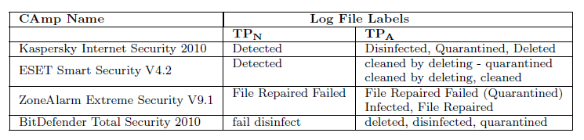
Calculating TP_{A}, TP_{O,}TP_{N}
CAmp log file labels used to calculate results
All labels in TP_{A} verified to do what label suggests
All labels in TP_{N} verified as leaving malware active
Misleading labels leave active malware on system
TP_{O} calculated by counting number of malware samples a user is asked to choose treatmen

Slide 11
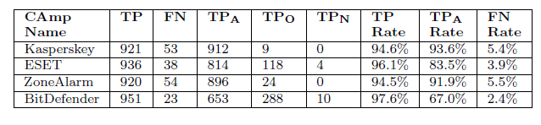
Test 1
A static file scan on a folder of 974 known malware samples, FN = 974 – TP
TP rates higher than TP_{A} meaning detection + treatment less effective then detection alone

Slide 12
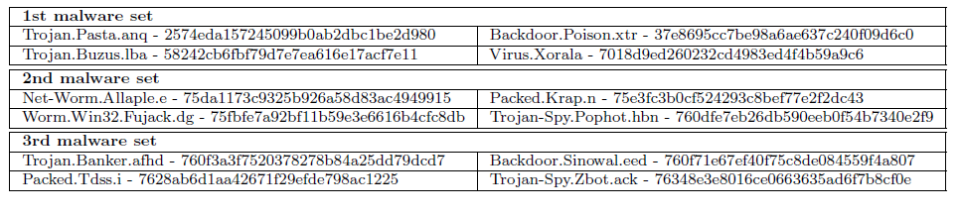
Malware used in Tests 2 & 3
Used 3 sets of 4 malware samples, each set executes together harmoniously
Active at time of testing

Slide 13
Test 2
Install a CAmp in a clean state, infect the system with malware for 3 minutes and perform detection and treatment, FN=TP-4
Almost every case malware detected when attempting to execute, TP=TP_{A}
One case TP=12, a detected malware seems to have executed before treatment, newly infected objects not detected

Slide 14
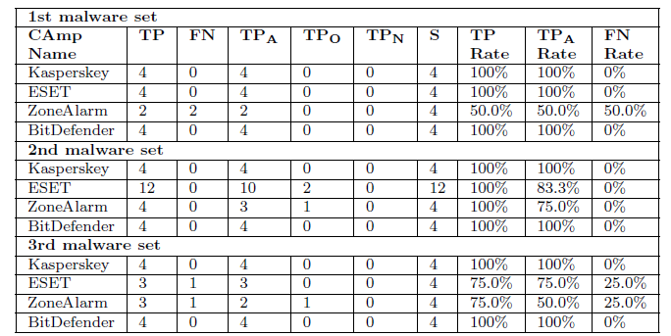
Test 2

Slide 15
Test 3
Execute malware for 3 minutes, then install a CAmp and perform detection and treatment in the infected state
Most difficult for CAmps to handle, broad range of TP, TP_{A} and FN rates
FN calculated using Anubis and CWSandbox
  Compared log files to Analysis reports
  .EXE files in report and not in log file marked FN

Slide 16
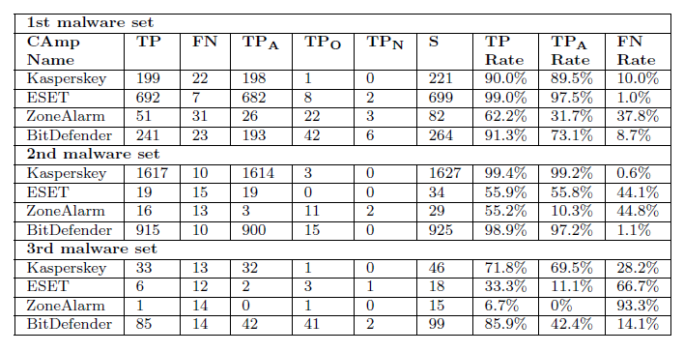
Test 3

Slide 17
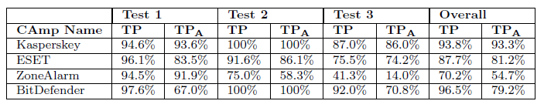
Discussion
Many cases TP_{A} lower than TP, implying detection + treatment not as effective as detection alone
Infected state (Test 3) most difficult case
FN, TP_{O} in all 3 tests, TP_{N} in only 2 tests
Many malware left active on system, either not detected or detected & not treated

Slide 18
One More Thing…
CAmps G-Data, AVG results not included
  AVG did not install, improperly ran, BSOD
  G-Data only produced FN & TP_{O} & no TP_{A}
    Very high detection rate
    Automatic treatment disabled in trial version?

Slide 19
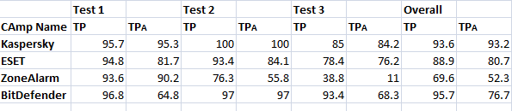
New Results
5000 samples
  CWSandbox: Drew samples from 5 random dates
    2009: Nov 4, Dec 8; 2010: Jan 28, Jun 29, Aug 25

Slide 20
Conclusions - 1
New approach to evaluate detection & treatment effectiveness of a CAmp with standardized output
Redefined TP to include treatment results
Tests show detection & treatment less effective than detection alone
Misleading labels, malware left active
Users unaware of system’s real security status

Slide 21
Conclusions - 2
CAmps need to improve detection & treatment
Should minimize TP_{O} & TP_{N}
Maximize TP_{A}
CAmps need to be tested rigorously and incorporate treatment resulting in a more realistic evaluation than current trends.

Slide 22
Self-Defense Mechanisms
Camp processes can be disabled and terminated with simple commands
Poor self defense
Leaves system vulnerable
Not able to perform static or behavior based malware scans
Gives malware the upper hand.

Slide 23
THANK YOU!
QUESTIONS?

