Slide 1
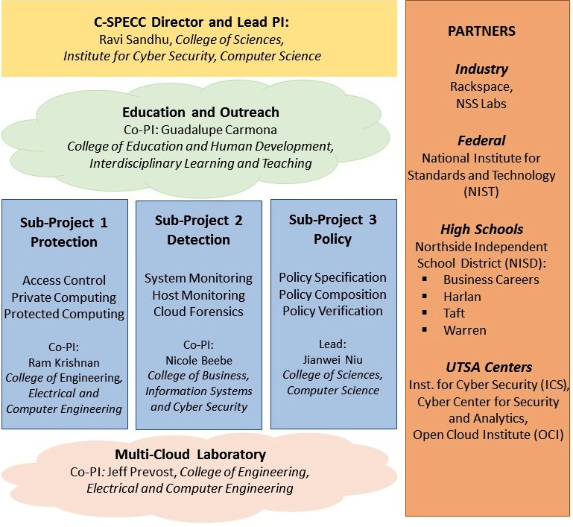
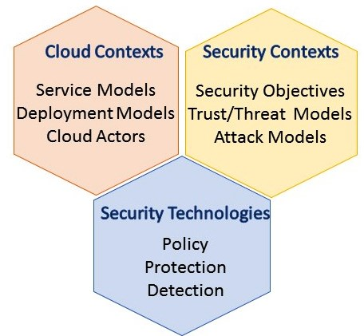
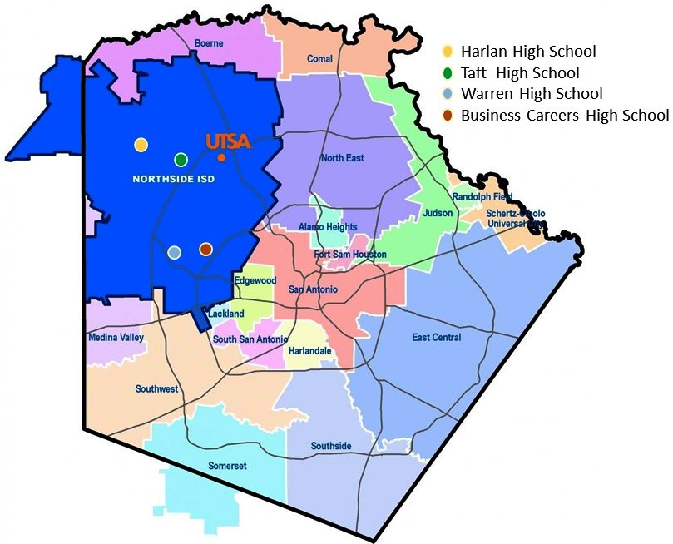
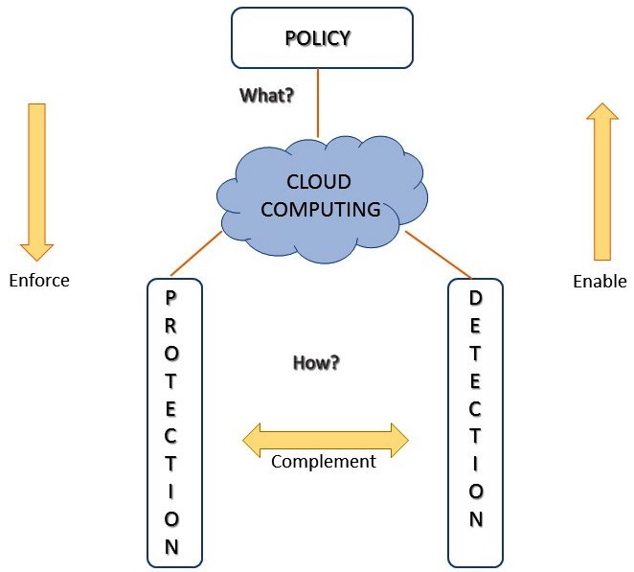
NSF CREST Center for Security and
Privacy Enhanced Cloud Computing (C-SPECC)
NSF Award: 1736209
Founded: September 2017
Director and Lead PI: Ravi Sandhu, University of Texas at San Antonio
PROJECT OVERVIEW
C-SPECC RESEARCH APPROACH
EDUCATION AND OUTREACH
NORTHSIDE INDEPENDENT SCHOOL DISCTRICT (NISD)
SECURITY TECHNOLOGIES HOLISTIC RESEARCH
About NISD
Established in year 1949
4th largest in Texas
Rapid growth: Adding 1500 students each year
Diverse population and communities
Strategic Plan
Partner with 4 high schools
NISD high school teachers receive iSTEM Graduate Education Certificate at UTSA (4 courses)
Collaboratively develop cloud focused cyber security curriculum at high schools
First cohort of 5 teachers for 4 schools start in Spring 2018
Biggest Challenge
Scalable, sustainable engagement within and beyond NISD
C-SPECC RESEARCH THRUSTS
C-SPECC GOALS
Protection: access control, private and protected computing
Detection: system and host monitoring, anomaly detection and digital forensics
Policy : policy specification, composition and verification
Education and Outreach: mechanisms and protocols to increase participation of underrepresented groups
Multi-Cloud Laboratory: operates multiple instances of the open-source, and free OpenStack cloud platform
pursue excellence in research, innovation and education in secure cloud computing,
increase participation of underrepresented groups in high tech computing, and
pursue innovative research-based educational strategies in this arena.
BEYOND NISD
CyberTexas.org
San Antonio based non-profit organization
Mayor’s Cyber Cup
CyberPatriot at local schools
Engaged with multiple school districts
Excellence in Secure Cloud Computing Research and Education!
www.cspecc.ics.utsa.edu

