Slide 1
A Comparison of Logical-Formula and
Enumerated Authorization Policy ABAC Models
Prosunjit Biswas, Ravi Sandhu and Ram Krishnan
The University of Texas at San Antonio
DBSec 2016
July 18, 2016

Slide 2
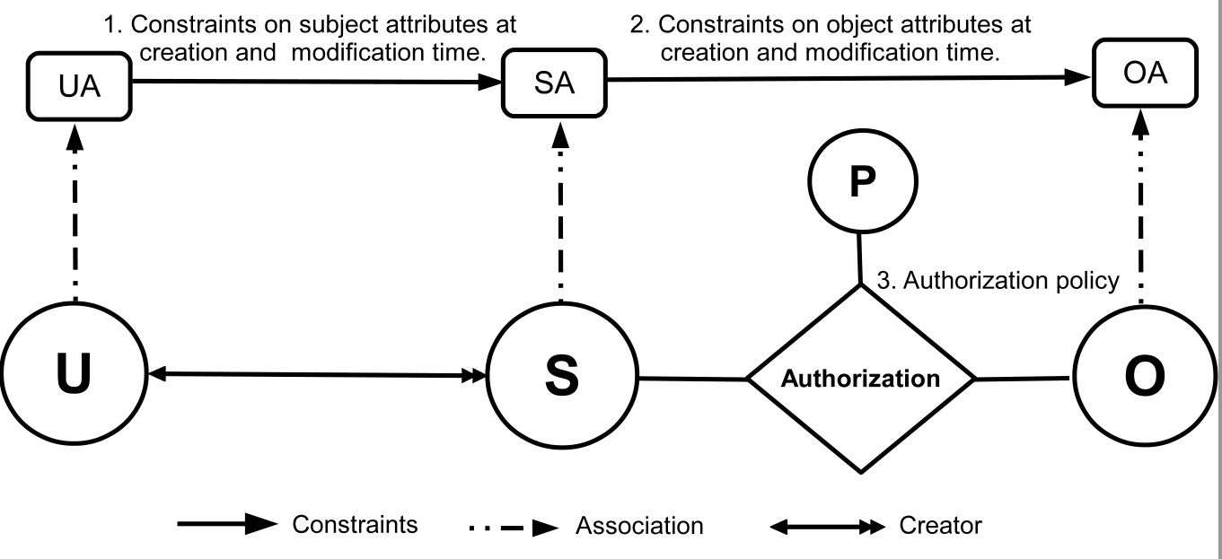
ABAC
ABAC model components
  Users (U), subjects (S), objects (O), their attributes (UA, SA, OA) and access rights (R)
  Authorization policies…
R

Slide 3
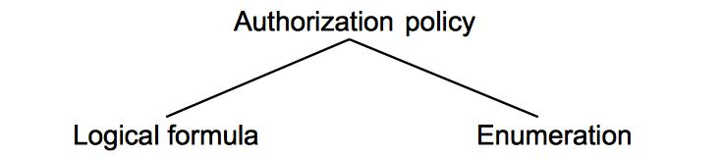
ABAC Auth Policies
Boolean expression
E.g.: auth(u,o,read) ↔ age(u)>18 ∧ age(u) <25
ABAC_{α} (Jin et al, DBSec 2012), HGABAC (Servos et al, FPS 2014)
    Set of authorizing tuples
    E.g.: {(age(u),19), (age(u),20), …(age(u),24)}
    Policy Machine (JSA 2011), 2-sorted-RBAC (Kuijper et al, SACMAT 2014)

Slide 4
Objective
Gain insights into different forms of ABAC auth policy representations
  Logical Authorization Policy ABAC (LAP-ABAC)
  Enumerated Authorization Policy ABAC (EAP-ABAC)
Quantitative and qualitative comparison
  Expressive power, ease of administration, etc.
ABAC Auth Design Scale
LAP-ABAC
EAP-ABAC
??

Slide 5
Attribute Domain
Assume attributes as functions
  UA = {age,clr,friends}
  Range(age) = {1…100}, Range(clr) = {H,L}, and Range(friends) = U
Example finite domain attributes
  Age of user, roles of user, object classification, etc.
Example unbounded domain attributes
  Friends of user, editors of objects, etc.
We assume attribute domains to be finite

Slide 6
Contributions and Results Summary
Candidate LAP-ABAC and EAP-ABAC models for the purpose of this investigation
LAP-ABAC and EAP-ABAC are equally expressive (recall finite domain)
  Single (e.g. UA = {age}) and multi-attribute (e.g. UA = {age,group,clr}) ABACs are equally expressive
However, LAP-ABACs and EAP-ABACs have their pros and cons on qualitative aspects

Slide 7
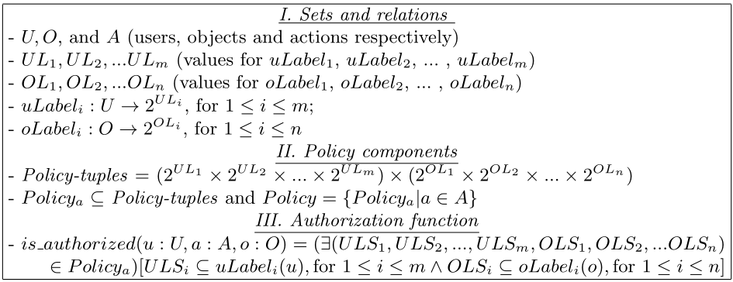
EAP-ABAC_{m,n}

Slide 8
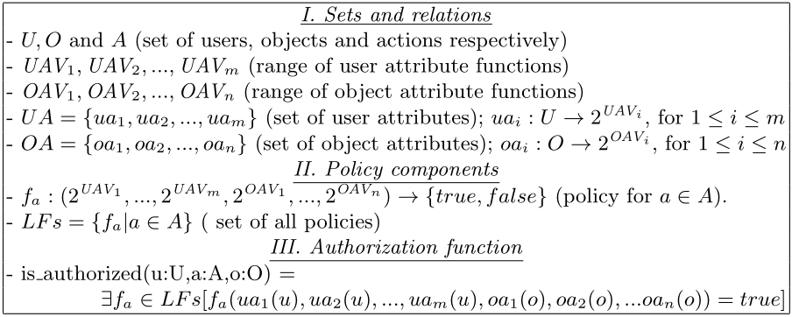
LAP-ABAC_{m,n}

Slide 9
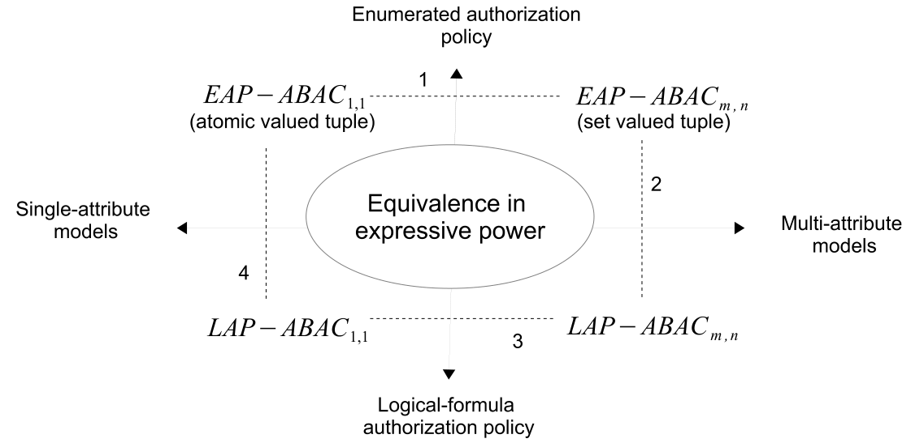
Expressive Power Equivalence
Framework used:
Tripunitara et al, A theory for comparing the expressive power of access control models, JCS 2007.

Slide 10
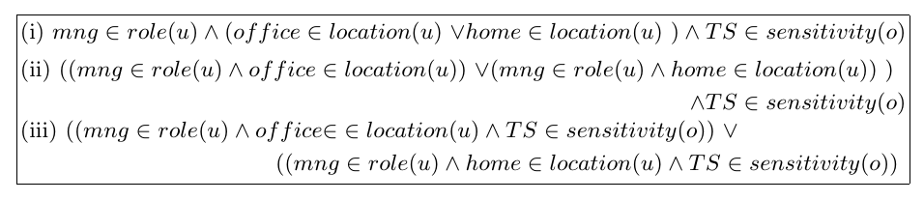
Auth Specification in LAP-ABAC
Multiple ways to set up a policy
(Auth_{read} allows manager to read TS objects from home or office).

Slide 11
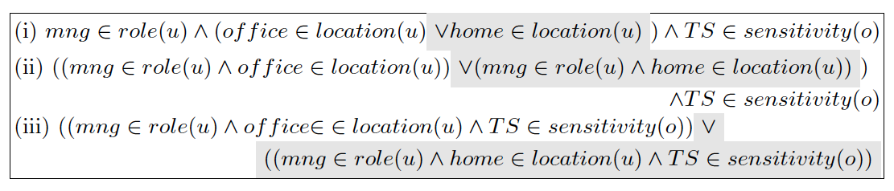
Auth Update in LAP-ABAC
Update Auth_{read} so that
manager can no longer read TS objects from home

Slide 12
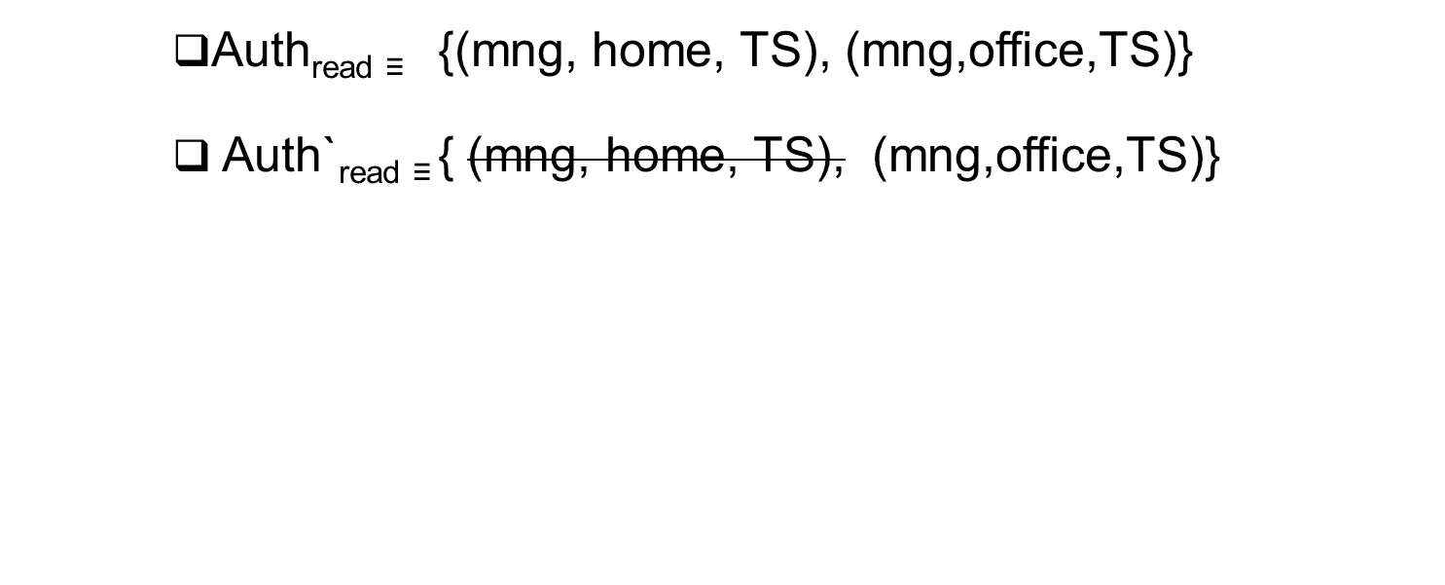
Auth Update in EAP-ABAC

Slide 13
Canonicalization of EAP-ABAC
Suppose Auth_{write} = {({mgr},{TS}), ({mgr,Dir},{TS})}
This can be reduced to Auth_{write} = {({mgr},{TS})}
EAP-ABAC auth policies can be efficiently canonicalized as per policy semantics

Slide 14
Comparison
Easy to setup
Rich & flexible
Concise
Homogeneous
Micro policy
Easy to update
Pros
LAP-ABAC
EAP-ABAC
Difficult to update
Monolithic
Heterogeneous
Large in size
Difficult to setup
Cons

Slide 15

Conclusion
ABAC should be designed with objectives that go beyond expressive power
  E.g.: Administration of authorization policy
    Setting up new policies, update existing policies, etc
ABAC Auth Design Scale
LAP-ABAC
EAP-ABAC
??

Slide 16
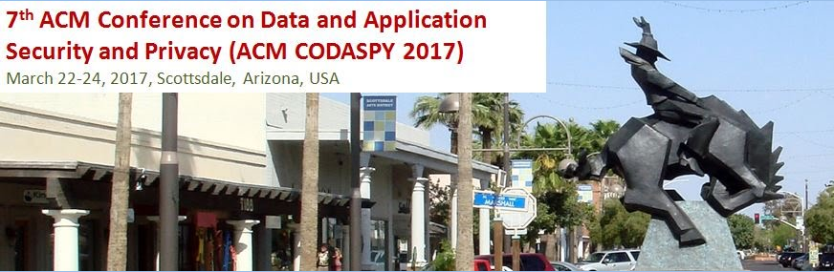
Q&A
Consider submitting your work to ACM CODASPY ’16
Submission deadline: Sept 15, 2016
http://www.codaspy.org/
Thank you!

