Slide 1


Institute for Cyber Security
An Attribute-Based Access Control Extension for OpenStack
and its Enforcement Utilizing the Policy Machine
Prof. Ravi Sandhu
Executive Director and Endowed Chair
2nd IEEE International Conference on Collaboration and Internet Computing (CIC)
November 1-3, 2016
Smriti Bhatt, Farhan Patwa and Ravi Sandhu
Department of Computer Science
ravi.sandhu@utsa.edu
www.profsandhu.com
www.ics.utsa.edu

Slide 2
Outline
  Introduction
  RBAC and ABAC
  Simplified OpenStack Access Control (OSAC) Model
  An ABAC Extension for OpenStack
  Policy Machine (PM) and its Architecture
  ABAC Enforcement Architecture
  Authorization using AE and PM
  Use Cases
  Evaluation
  Discussion and Analysis
  Conclusion and Future Work

Slide 3
Introduction
RBAC:
  Most dominant access control model
  Major cloud computing platforms:
    OpenStack
    AWS
    Microsoft Azure
  Limitations:
    Role explosion
ABAC:
  Access control based on attributes
  Enhanced flexibility and fine grained access control
  Implement ABAC models in real-world applications
A gradual shift from RBAC to ABAC models
Authorization based on RBAC model

Slide 4
RBAC and ABAC
Three different ways of combining RBAC and ABAC by NIST –
  dynamic roles: uses user and context attributes to dynamically assign roles to users
  attribute-centric: roles just another attribute of users with no special semantics
  role-centric: constrains role permissions based on user attributes
Proposed a role-centric ABAC extension for OpenStack
Combining advantages of both RBAC and ABAC

Slide 5
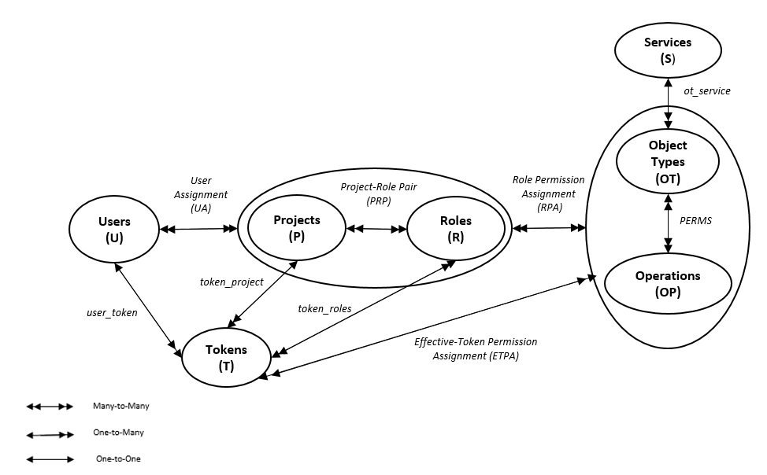
Simplified OpenStack Access Control (OSAC) Model
Union of role permissions
Union of role permissions based on the token of a user
Simplified OSAC Model (Adapted from [*])
Groups and Domains removed
* B. Tang and R. Sandhu, “Extending OpenStack access control with domain trust,” in International Conference on Network and System Security. Springer, 2014, pp. 54–69

Slide 6
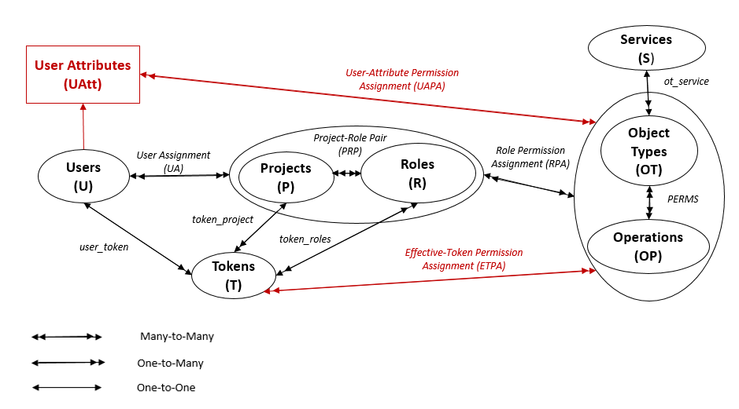

An ABAC Extension for OpenStack
Union of attribute-value permissions
Role-Centric ABAC
User-Attribute Enhanced OSAC in Single Tenant

Slide 7
An ABAC Extension for OpenStack
Extended simplified OSAC with user attributes –
  UAtt – a finite set of user attribute functions
  For each uatt in Uatt, Range(uatt) is a finite set of atomic value
  UAPA – user-attribute value permission assignment
For any user –
  maximum permissions determined based on roles in the token,
  further constrained by permissions associated to its user-attribute values
Currently, model designed for atomic valued attributes only
Object attributes next challenge to explore
Enforced this model in OpenStack utilizing the Policy Machine (PM)

Slide 8
Policy Machine (PM)
General-purpose attribute-based access control framework
Express and enforce arbitrary access control policies
Provide a unified platform supporting:
  Commonly known and implemented access control policies
  Combinations of policies
  New access control policies
PM Core Elements
Users
Objects
User Attributes
Object Attributes
Operations, Access Rights
Processes
Policy Classes
PM Relations
Assignment
Association
Prohibition
Obligation
assignment—for specifying relationships between policies, users, and user attributes, objects and object attributes
association – for defining policies through associations between user attributes and object attributes or objects through some operations

Slide 9
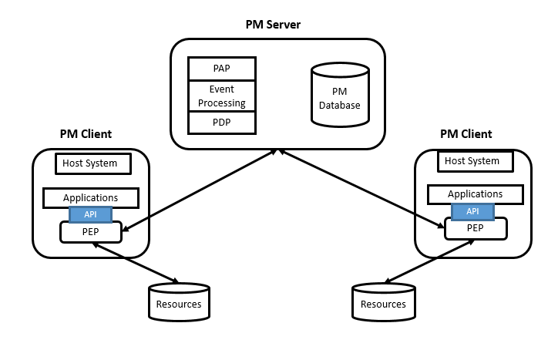
PM Architecture
PAP - Policy Administration Point
PDP - Policy Decision Point
PEP – Policy Enforcement Point
Policy Machine Architecture (Adapted from [*])
* D. Ferraiolo, V. Atluri, and S. Gavrila, “The Policy Machine: A novel architecture and framework for access control policy specification and enforcement,” J. of Sys. Architecture, vol. 57, no. 4, pp. 412–424, 2011

Slide 10
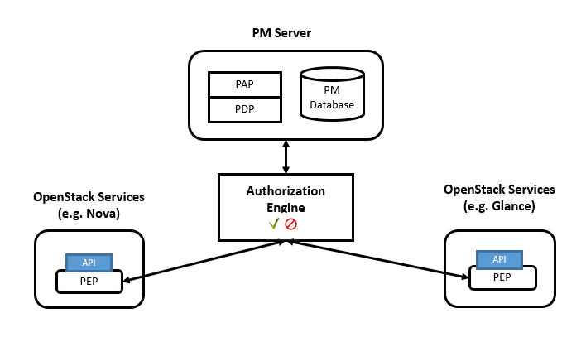
ABAC Enforcement Architecture
Active Directory (AD): stores all the users and their associated user attributes in the system (the same AD also to be Identity backend for OpenStack)
An ABAC Enforcement Architecture for OpenStack using PM

Slide 11
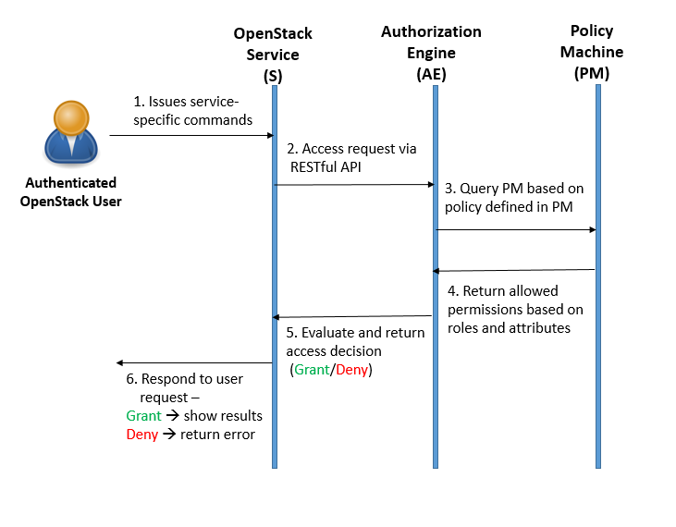
Authorization Sequence Diagram
OpenStack Authorization using AE and PM

Slide 12
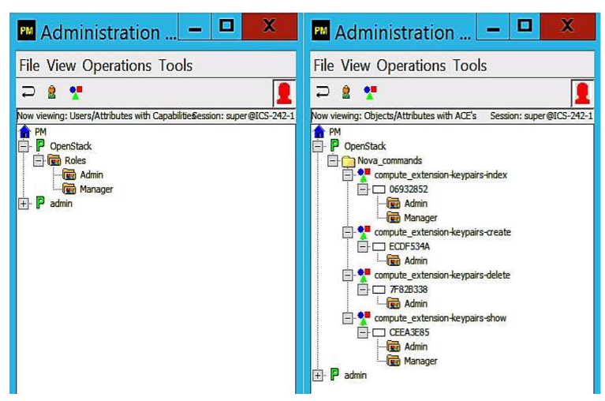
Use Case I
A Simplified OSAC RBAC Policy
  Roles: {Admin, Manager}
  Commands (c):
    compute extension-keypair-index
    compute extension-keypair-create
    compute extension-keypair-delete
    compute extension-keypair-show
  Authorization rules for any user u:
    compute extension-keypair-create → Role(u) = Admin
    compute extension-keypair-delete → Role(u) = Admin
    compute extension-keypair-index → (Role(u) = Admin ˅ Role(u) = Manager)
    compute extension-keypair-show → (Role(u) = Admin ˅ Role(u) = Manager)
A Role-Based Access Control Policy in PM

Slide 13
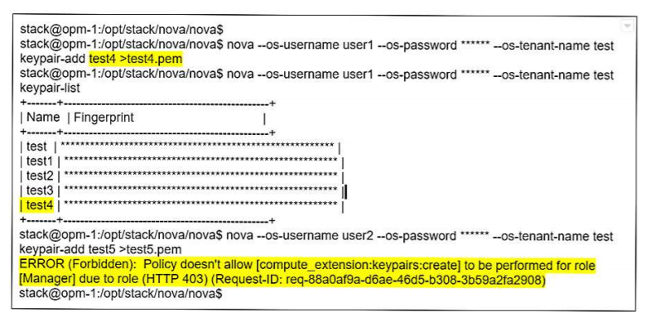
Use Case I
Role = Admin
Role = Manager
OpenStack Enforcement Results

Slide 14
Use Case II
A Role-Centric ABAC Policy
  Roles: {Admin, Manager}
  Department: {IT, OPS}
  Commands (c):
    compute extension-keypair-index
    compute extension-keypair-create
    compute extension-keypair-delete
    compute extension-keypair-show
  Authorization rules for any user u:
    compute extension-keypair-create → (Role(u) = Admin ˄ Dep(u) = IT)
    compute extension-keypair-delete → (Role(u) = Admin ˄ Dep(u) = IT)
    compute extension-keypair-index → ((Role(u) = Admin ˅ Role(u) = Manager) ˄ (Dep(u) = IT ˅ Dep(u) = OPS))
    compute extension-keypair-show → ((Role(u) = Admin ˅ Role(u) = Manager) ˄ (Dep(u) = IT ˅ Dep(u) = OPS))

Slide 15
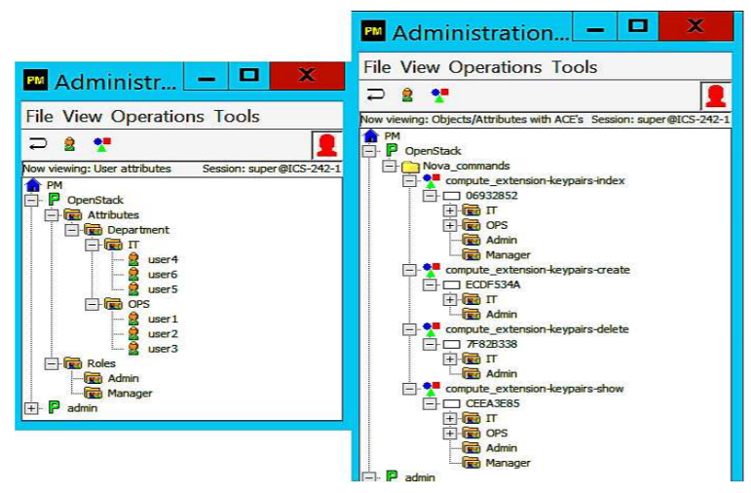
Use Case II
A User-Attribute Enhanced OSAC Policy in PM

Slide 16
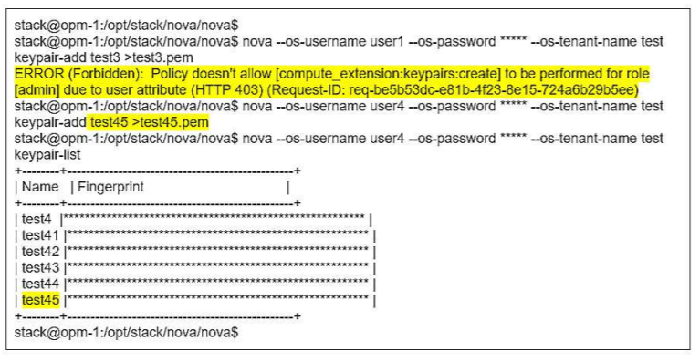
Use Case II
Role = Admin and Department = OPS
Role = Admin and Department = IT
OpenStack Enforcement Results

Slide 17
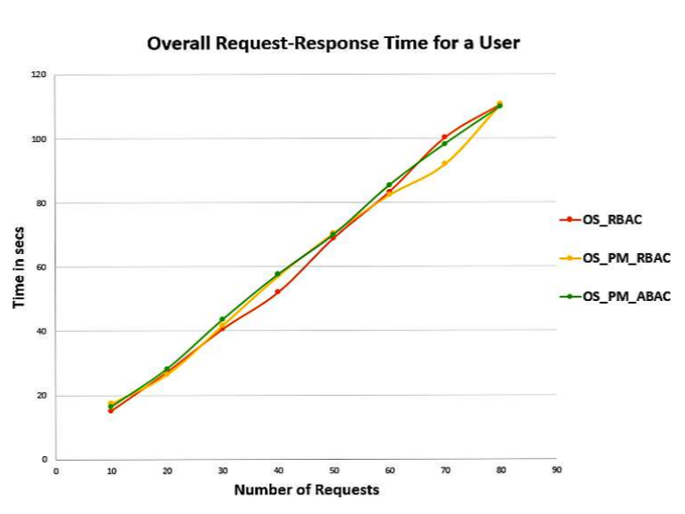
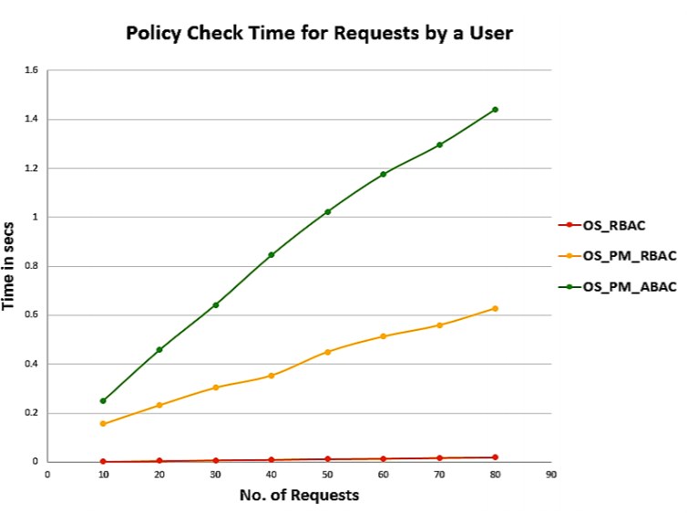
Evaluation
Indications of cost of implementing our ABAC extension in OpenStack using PM
Network latency
Proof-of-concept implementation
Need for Optimization

Slide 18
Discussion and Analysis
Advantages of an ABAC extension with user attributes:
  define more fine-grained access control policies
  significantly reduce number of roles required in a policy
  avoid problems such as role explosion and role-permission explosion
Trade-off between performance and enhanced functionality/capability
Performance improvement techniques:
  high-performance server to host PM and AE to improve policy evaluation time
  cache policy evaluation results locally
  Install PM, AE, and OpenStack services on an isolated subnet

Slide 19
Conclusion and Future Work
Proposed an ABAC extension with user attributes for OpenStack
Enforced our model in OpenStack utilizing the PM and AE
An initial attempt to facilitate transition towards ABAC models in real world applications
Future Work:
  Explore other capabilities of PM – combination of access control polices, attribute and role hierarchy
  Apply performance enhancements to enforcement framework
  Include object attributes

Slide 20
Institute for Cyber Security
Thank you!!
Questions??

