Slide 1
Access Control Model for Virtual Objects (Shadows) Communication for AWS Internet of Things
Asma Alshehri, James Benson, Farhan Patwa, and Ravi Sandhu
Institute for Cyber Security (ICS)
Center for Security and Privacy Enhanced Cloud Computing (C-SPECC)
Department of Computer Science
University of Texas at San Antonio
The 8th ACM Conference on Data and Application Security and Privacy (CODASPY)
March 19 - 21, 2018. Tempe, AZ, USA.

Slide 2
Outline
Introduction and Background.
Access Control Model for VO Communication for AWS IoT.
A Use Case Implementation
Performance
Conclusion and Future Work

Slide 3
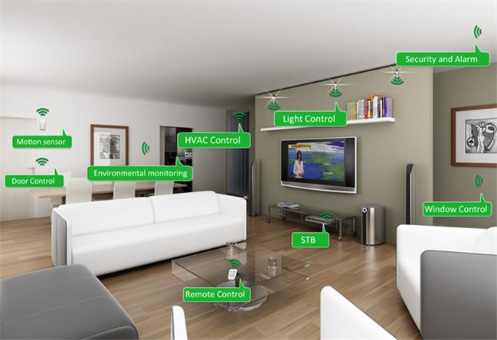

Internet of Things

Slide 4
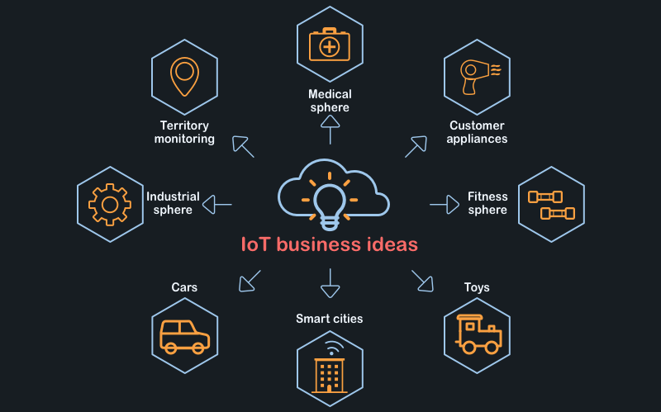
IoT Projects

Slide 5

Access Control Oriented (ACO) Architecture for Cloud-Enabled IoT
Asma Alshehri and Ravi Sandhu. Access control models for cloud-enabled internet of things: A proposed architecture and research agenda. In the 2nd IEEE International Conference on Collaboration and Internet Computing (CIC), pages 530-538. IEEE, 2016.

Slide 6
Access Control Oriented (ACO)
Architecture for IoT
The Object layer:
  Physical objects
  Collect data
  Communication
The Virtual Object Layer:
  Presents status of objects
  Communication
  O-VO Association

Slide 7
Access Control Oriented (ACO)
Architecture for IoT
The Cloud Layer:
  Big data
  Functionality
  Communication
The Application Layer:
  Interface
  Users and Admin
  Generate AC policies

Slide 8
Access Control Issues in ACO Architecture for IoT

Slide 9
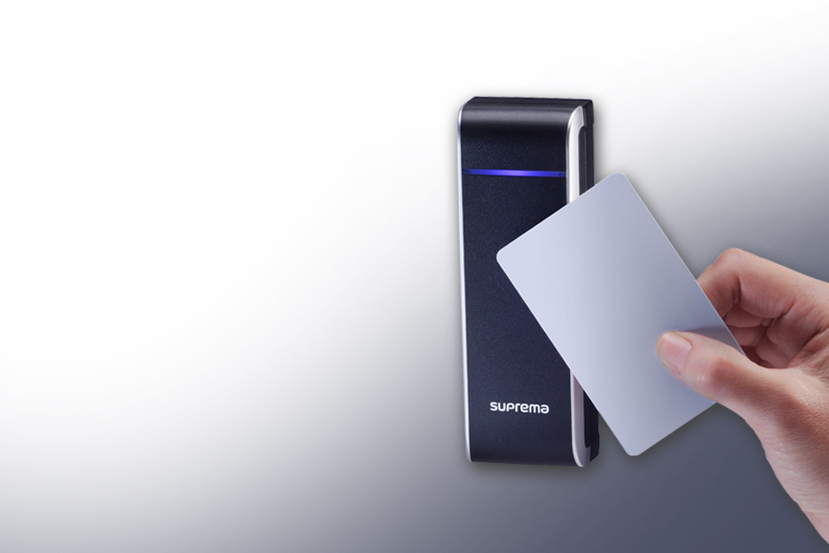
Access Control Models for VO Communications in ACO Architecture
Asma Alshehri and Ravi Sandhu. Access control models for virtual object communication in cloud-enabled iot. In The 18th International Conference on Information Reuse and Integration (IRI). IEEE, 2017.

Slide 10
Access Control Models for VO Communication
Access control models for VO communication in two layers:
    Operational models
      ACL-Cap operational model
      ABAC operational model
    Administrative models
      ACL administrative model
      RBAC administrative model
      ABAC administrative model

Slide 11
A Use Case within ACO Architecture

Slide 12

Access Control Model for VO Communication for AWS IoT

Slide 13
The AWS-IoT-ACMVO Model for AWS IoT
AWS
IOT

Slide 14
The AWS-IoT-ACMVO Model for AWS IoT
Certificates: An identity for devices authentication
AWS IoT policy: A policy for authorization purpose
Virtual objects: A JSON document that stores information about the current and future status of a device.
MQTT topics: AWS IoT service generates reserved MQTT topics for each created virtual object

Slide 15
The AWS-IoT-ACMVO Model for AWS IoT
Rules: Recognize and analyze messages that are sent to MQTT topics and trigger actions.
Actions: There are fixed AWS actions that can be selected, such as inserting a message into a DynamoDB table, invoking a Lambda function, and republishing messages to AWS IoT topics.
AWS identity and access management (IAM) role: Actions authorization

Slide 16
The Publish/Subscribe
Topic-Based Scheme
The communication channel between two VOs is a shared topic

Slide 17
Communication Channel in AWS IoT
The communication channel between two VO Topics is the Rules Engine

Slide 18
The Sensing Speeding
Cars Use Case
n

Slide 19
Sensing the Speed of One Car with two Sensors

Slide 20
Role2 Policy that is Attached to Role2

Slide 21
Sensing the Speed of Multiple Cars with Multiple sensors

Slide 22
Performance

Slide 23

Conclusion and Future Work

Slide 24
Conclusion
Develop access control models for VO communications for AWS IoT
Reconcile the academic access control models within the AWS IoT
Implement the sensing speeding cars use case

Slide 25
Future Work

Slide 26


Questions

