Slide 1


Institute for Cyber Security
Object-Tagged RBAC Model
for the Hadoop Ecosystem
Maanak Gupta, Farhan Patwa, and Ravi Sandhu
Institute for Cyber Security and Department of Computer Science
University of Texas at San Antonio
31st Annual IFIP WG 11.3 Working Conference on Data and Applications Security and Privacy (DBSec 2017), Philadelphia, Pennsylvania, July 19-21, 2017

Slide 2
Outline
Introduction and Motivation
Multi-layer Access Control
Authorization Architecture
Hadoop Ecosystem Access Control Model
OT-RBAC Model
Proposed Implementation
Attribute Based Extensions to OT-RBAC
Conclusion

Slide 3
Big Data and Big Challenges
IDC 2025 :
  global “datasphere” – 163 zettabytes
  10x than 2016
Opportunities: 21st century gold for data miners
Big Data require “Big Systems”
Security:
Secure Storage
Privacy Concerns (eg: HIPPA)
Fine granular access requirements
Notes:
https://www.business.com/articles/privacy-and-security-issues-in-the-age-of-big-data/
https://www.isaca.org/Groups/Professional-English/big-data/GroupDocuments/Big_Data_Top_Ten_v1.pdf
http://www.datasciencecentral.com/profiles/blogs/top-9-big-data-security-issues-you-should-watch-for
https://cloudsecurityalliance.org/media/news/csa-releases-the-expanded-top-ten-big-data-security-privacy-challenges/
Privacy Concerns in Multi-Tenant environment

Slide 4
Hadoop Ecosystem
Hadoop: resilient, cost efficient distributed storage (HDFS) and processing framework (MapReduce) and YARN
Ecosystem = Hadoop core +
Open-Source Projects
Hadoop Data Lake
Security Concerns
Notes:
https://www.cloudera.com/content/dam/www/static/documents/whitepapers/securing-your-enterprise-hadoop-ecosystem.pdf
Hive, hbase, spark, storm, flume..kafka, knox
Some are security related projects, some access data, some are processing frameworks
----
Data lake…variety of user, vared data aformats…make sure users access what they are suppose to ..
---
Security concerns:---Multi-tenant Data Lake offered by Hadoop, stores and processes sensitive information from several critical sources, such as banking and intelligence agencies, which should only be accessed by legitimate users and applications. Threats—including denial of resources, malicious user killing YARN applications, masquerading Hadoop services like NameNode, DataNode etc.—can have serious ramifications on confidentiality and integrity of data and ecosystem resources. The distributed nature and platform scale makes it more difficult to protect the infrastructure assets.

Slide 5
Multi-Layer Access Control
Data and Service Objects
Services
Cluster Resources and Applications
HDFS NameNode,
YARN ResourceManager
Apache Hive
HDFS Files,
Hive Tables
Kafka Topics
YARN Queues,
Cluster Nodes

Slide 6
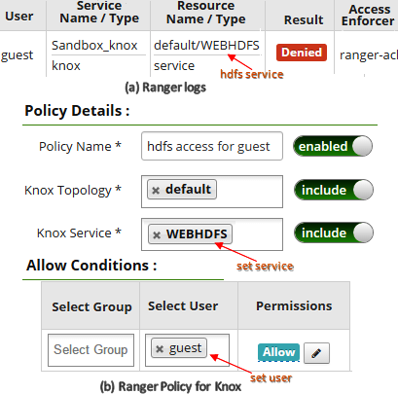
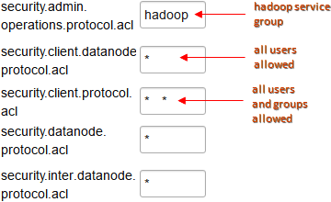
Hadoop and Data Services Access
Hadoop Daemons Access Configuration
WebHDFS Access via Apache Knox
Notes:
Talk about how knox is important…and NameNode and DataNode etc…
Foremost layer of defense: whether a user is allowed to access the services inside the ecosystem.
Fo each slide: talk about where do we require such configurations and how are they important and what change they make.

Slide 7
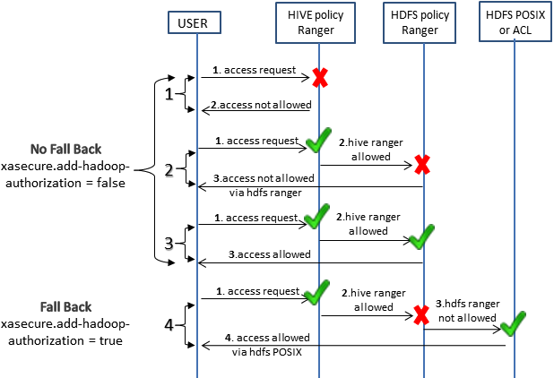
Data Objects Access
Hive and HDFS Access Configurations
Notes:
Configuration options available in Hive and HDFS …fall back…why this scenario is important..some users can access only tables while other might accesss corresponding files in HDFS.

Slide 8
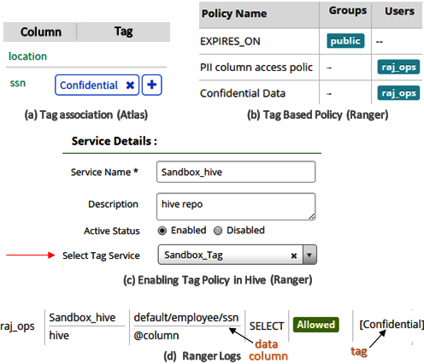
Tag Based Objects Access
Tag Based Policy Configuration
Notes:
Tag based policies…there importance…talk about data masking and several options avalilable fro masking and column filtering..

Slide 9
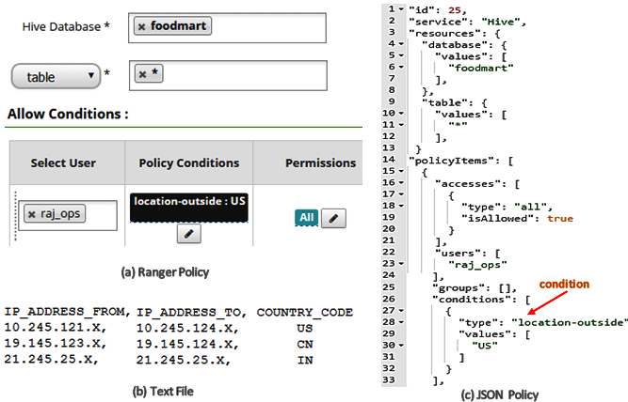
Context Enricher and Policy Conditions
Geo Location Based Policies
Notes:
Context enricher..and their importance.. Geo location based policies…combination of data sets policies.

Slide 10
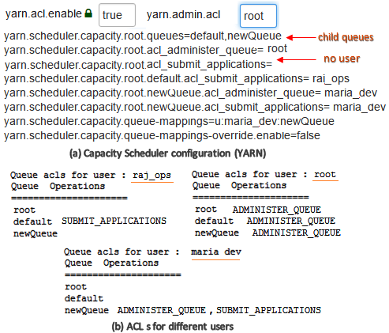
Cluster Resource and Application Access
root
root
access rights
default
newQueue
YARN Queue Access Control Configuration
Notes:
What nodes to run…different queues in how hierarchical nature in access control..
Draw a queue structure

Slide 11
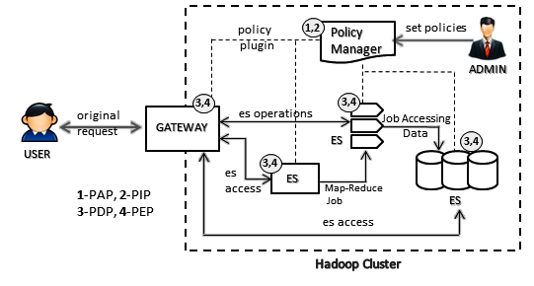
Hadoop Ecosystem
Authorization Architecture
Policy Manager : Apache Ranger, Apache Sentry
Gateway : Apache Knox
Ecosystem Service (ES) : Apache Hive, HDFS, Apache Storm, Apache Kafka, YARN
Notes:
(Apache Open Source Components and how they fit)

Slide 12
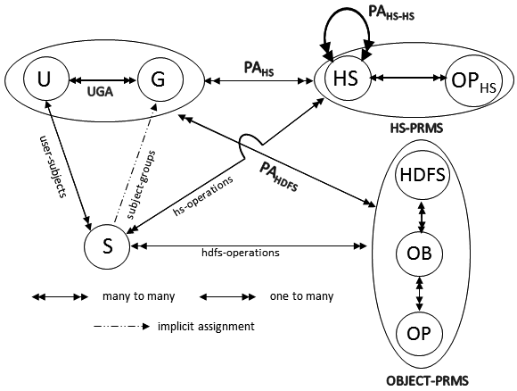
AC Model: Hadoop View
Users (U), Groups (G) , Subjects (S)
Hadoop Services (HS) : NameNode, YARN ResourceManager
Hadoop Service Operations (OP_{HS}) : access / communicate
Objects (OB) : Files and Directories in HDFS
Operations (OP) : read, write, execute
Notes:
Using ACLs
Talk about service layer and all individual components and all three different layers of access control

Slide 13
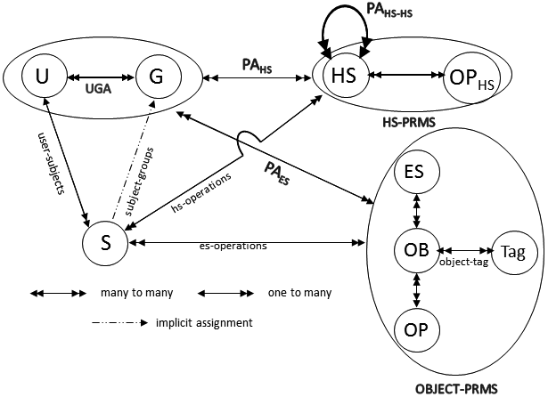
AC Model: Ranger View
Ecosystem Service (ES) : Hive, HDFS, Kafka, HBase
Objects (OB) : Files and Directories in HDFS; Tables, columns in Hive
Operations (OP) : read, write, execute, select, create
Tag : PII, top-secret

Slide 14
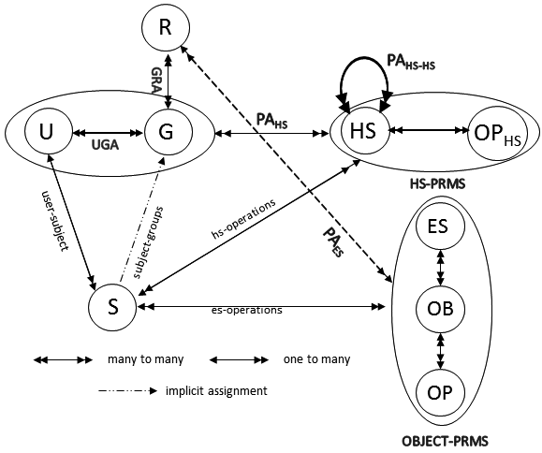
AC Model: Sentry View
Roles (R)

Slide 15
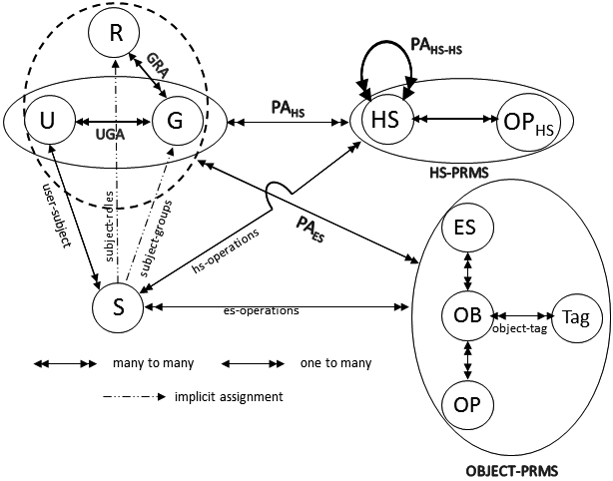
HeAC Model: Consolidated View
Hadoop Ecosystem Access Control Model

Slide 16
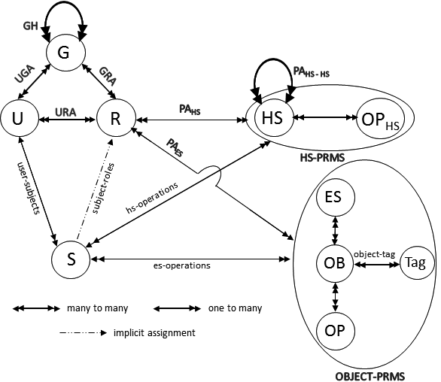
OT-RBAC Model
Object-Tagged RBAC

Slide 17


Group Based Role Inheritance
Roles: {Staff, Grader, TA}
Roles: {student}
Roles: {student, Staff,
Grader, TA}
UGA
Direct & effective membership
URA
Effective Roles
Bob
G₁
Bob
Effective
membership
inheritance
Effective
membership
Roles: {Grader}
Roles: {TA}
G₂
G₃
Group Hierarchy
Major Benefits: Easy Administration where multiple roles can be assigned to user with single administrative operation.

Slide 18
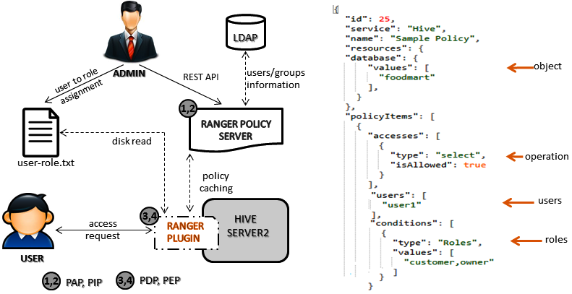
Implementation Approach

Slide 19
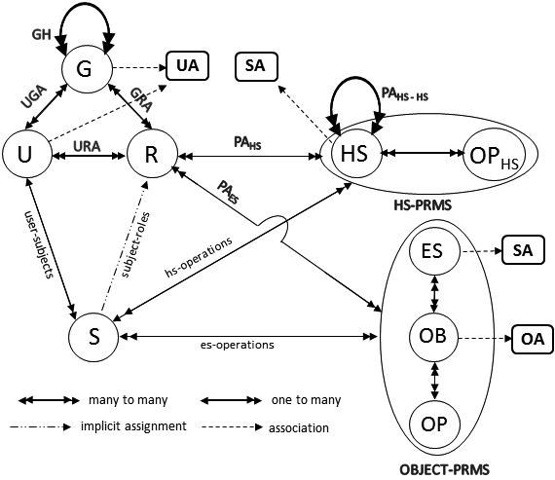
Adding Attributes to OT-RBAC
User Attributes (UA)
Service Attributes (SA)
Object Attributes (OA)

Slide 20
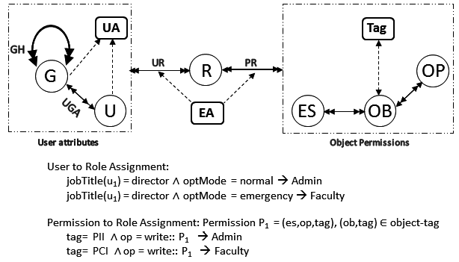
NIST Strategies
Dynamic Roles

Slide 21
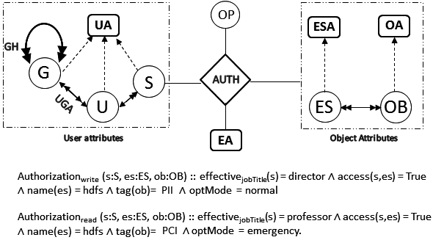
NIST Strategies
Attribute Centric

Slide 22
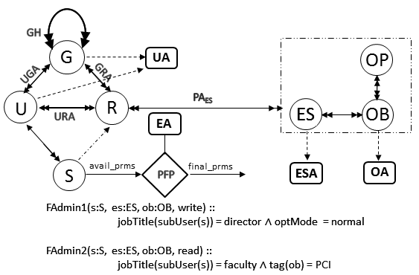
NIST Strategies
Role Centric

Slide 23
Defense in Depth
Secure Hadoop Ecosystem
Data and Service Objects
Hadoop Daemons and Services
Cluster Resource and Application

Slide 24
Conclusion and Future Work
Formalized Conceptual HeAC Model
Object-Tagged-RBAC Model
Attributes based extensions
Some Future Goals:
Introduce Data ingestion security
Privacy concerns and finer grained approaches in Multi-Tenant Hadoop Lake

