Slide 1
Online Malware Detection in Cloud Auto-Scaling Systems Using Shallow Convolutional Neural Networks
Mahmoud Abdelsalam, Ram Krishnan and Ravi Sandhu
Institute for Cyber Security,
Center for Security and Privacy Enhanced Cloud Computing,
Department of Computer Science,
Department of Electrical and Computer Engineering
University of Texas at San Antonio
In Proceedings 31st Annual IFIP WG 11.3 Working Conference on Data and Applications Security and Privacy (DBSec), Charleston, SC, July 15-17, 2019

Slide 2
Introduction and Motivation
© Mahmoud Abdelsalam
World Leading Research with Real World Impact!

Slide 3
Malware Detection Classification
Malware Detection using Machine Learning
Online Malware Detection
File Classification
File classification:
Given a file/executable, classify if it’s a malware or not by running it and observing its behavior.
You have a file as a suspect.
You don’t keep monitoring them once they are clean.
Online malware detection:
Assume that the malware got into the system and is executing.
You keep monitoring the system’s behavior for malware detection.
You don’t just focus on a given file, but the entire system (processes).
© Mahmoud Abdelsalam
World Leading Research with Real World Impact!

Slide 4
Malware Detection using ML
File Classification
Malware and
Benign
Executables
Features Extraction
build/train
ML Model
detect/test
© Mahmoud Abdelsalam
World Leading Research with Real World Impact!

Slide 5
Malware Detection using ML
File Classification
Malware and
Benign
Executables
Features Extraction
build/train
ML Model
detect/test
Running
Systems
System Features
build/train
ML Model
Online Malware
Detection
detect/test
© Mahmoud Abdelsalam
World Leading Research with Real World Impact!

Slide 6
Motivation
Online Malware Detection
Features Extraction
Performance metrics
Memory features
System/API calls
What makes an approach cloud-specific?
Most, if not all, cloud-specific research:
✔️ Restrict the selection of features to those that can only be fetched through the hypervisor.
✘ Leverage cloud characteristics for online malware detection.
© Mahmoud Abdelsalam
World Leading Research with Real World Impact!

Slide 7
Motivation (cont.)
Rapid Elasticity
Resource Pooling
Measure Service
On-Demand
Self-Service
CLOUD
Broad Network Access
Exploited System Vulnerabilities
E.g. Co-resident attacks
Compromised Credentials
Insider Threats
Configuration Vulnerabilities
Can we leverage cloud characteristics for online malware detection? “Auto-Scaling”
Goal: Leverage auto-scaling for online malware detection by:
Using 2d CNN to learn processes behavior of multiple VMs.
Introducing a novel approach of pairing samples to accommodate for correlations between VMs.
© Mahmoud Abdelsalam
World Leading Research with Real World Impact!

Slide 8
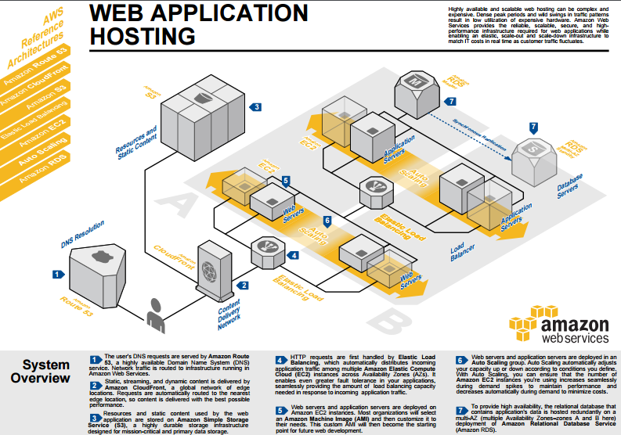
3-tier example
© Mahmoud Abdelsalam
World Leading Research with Real World Impact!

Slide 9
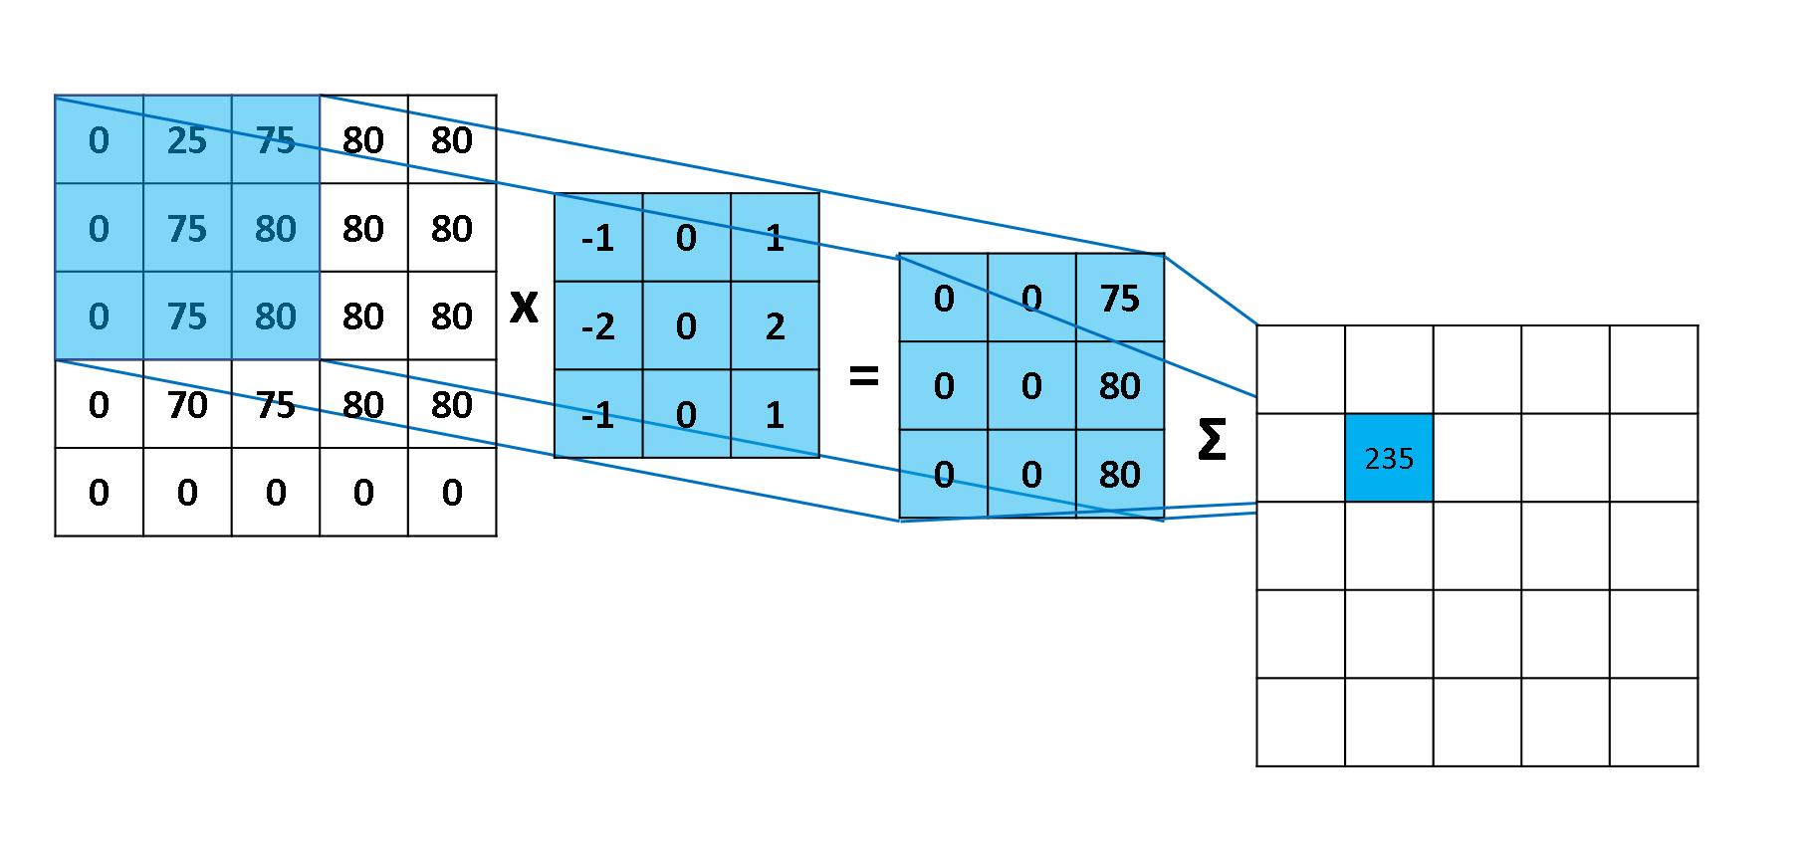
CNN Overview
Convolution
Pooling
Convolution
Pooling
Fully connected
Prediction
Input
Matrix
Normal
Feature Map
Malicious
Feature extraction
Classification
Convolution operation example
Ref: blog.csdn.net
© Mahmoud Abdelsalam
World Leading Research with Real World Impact!

Slide 10
Methodology
© Mahmoud Abdelsalam
World Leading Research with Real World Impact!

Slide 11
Process-level Performance Metrics
We use performance metrics as a way of defining a process behavior.
28 process-level performance metrics.
These metrics can easily be fetched through the hypervisor.

Slide 12
Shallow CNN Model
Standardized Input Matrix
Input layer
Convolution Layer 1 + ReLU activation
Max Pooling Layer 1
Convolution Layer 2 + ReLU activation
Max Pooling Layer 2
Fully Connected Layer 1 + ReLU activation
Dropout Layer
Fully Connected Layer 2
Output Prediction

Slide 13
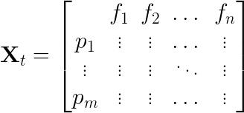
CNN Input
We represent each sample as an image (2d matrix) which will be the input to the CNN.
Consider a sample at a particular time , that records features (performance metrics) per process for processes in a VM:

Slide 14
CNN Input (cont.)
CNN requires the same process to remain in the same row in each sample.
The CNN in computer vision takes fixed-size images as inputs, so the number of features and processes must be predetermined.
Use the max process identification number (PID) which is set by the OS?
The limit (max number of PIDs) is defined in /proc/sys/kernel/pid_max which is usually 32k.
Huge input matrix!
Change the max PID number defined?
Kernel confusion if wrap around happened too often.
there is no guarantee that, for instance, a process with a PID 1000 at a particular time is going to be the same process at a later time.

Slide 15
Unique process
We define a process, referred to as unique process, by a 3-tuple:
process name
command line used to run process
hash of the process binary file (if applicable)
We set the maximum number of unique processes to 120 to accommodate for newly created unique processes.
+-------+----------------+-------------------------------------------------------+------------------------------------+-------------+------------------------------+
| pid | name | cmd | hash | kb_sent | cpu_user | sample_time |
+-------+----------------+-------------------------------------------------------+------------------------------------+----------+----------+---------------------+
| 1241 | php-fpm7.0 | php-fpm: pool www | 7eb8522425... | 33.61710 | 0.03000 | 2018-06-15 11:19:04 |
| 1240 | php-fpm7.0 | php-fpm: pool www | 7eb8522425... | 38.79308 | 0.00000 | 2018-06-15 11:19:04 |
| 1221 | php-fpm7.0 | php-fpm: master process (/etc/php/7.0/... | 7eb8522425... | 0.00000 | 0.02000 | 2018-06-15 11:19:04 |
| 1287 | python | python | 23eeeb4347… | 0.00000 | 0.15000 | 2018-06-15 11:19:04 |
+------+-----------------+-------------------------------------------------------+--------------------+--------------+--------------+-----------------------------+
+-----------------------------------------------------------------------------------------------+
| Unique Process |
+----------------+-------------------------------------------------------+--------------------+----------------------+----------------------+-----------------------------+
| name | cmd | hash | AVG(kb_sent) | AVG(cpu_user) | sample_time |
+----------------+-------------------------------------------------------+--------------------+----------------------+----------------------+-----------------------------+
| php-fpm7.0 | php-fpm: pool www | 7eb8522425... | 36.2051 | 0.0150 | 2018-06-15 11:19:04 |
| php-fpm7.0 | php-fpm: master process (/etc/php/7.0/... | 7eb8522425... | 0.00000 | 0.0200 | 2018-06-15 11:19:04 |
| python | python | 23eeeb4347… | 0.00000 | 0.1500 | 2018-06-15 11:19:04 |
+----------------+-------------------------------------------------------+--------------------+----------------------+----------------------+-----------------------------+

Slide 16
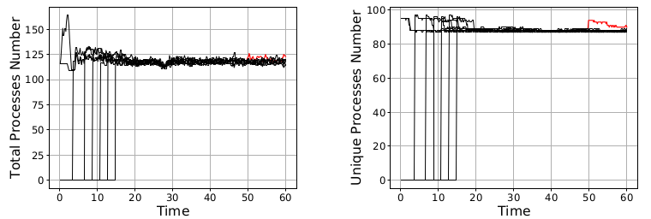
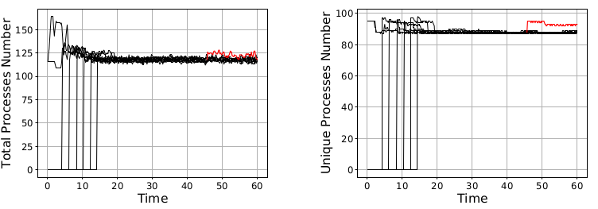
Unique process (cont.)
Two different experiments (each with a different malware) where the number of
total standard processes are compared to the number of unique processes.

Slide 17
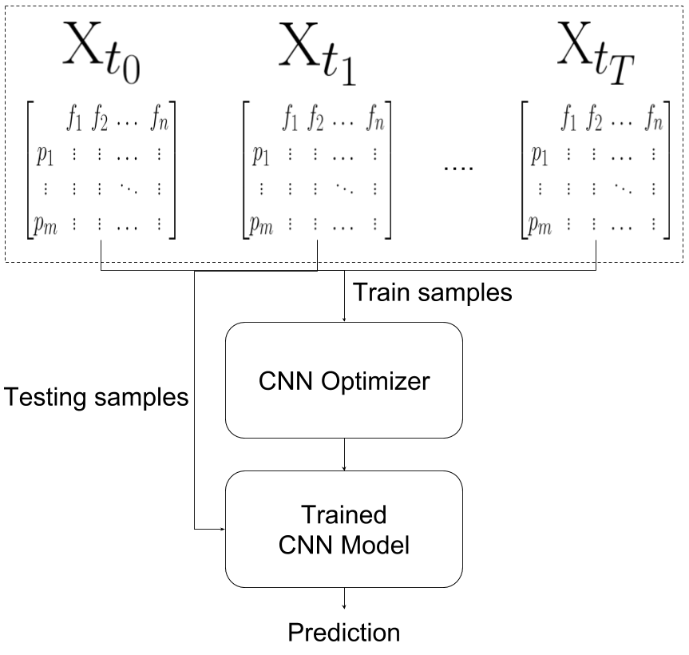
Single VMs Single Samples (SVSS)
© Mahmoud Abdelsalam
World Leading Research with Real World Impact!

Slide 18
Single VMs Single Samples (SVSS)
Disadvantage: Losing information if a VM has some effects on other VMs.
© Mahmoud Abdelsalam
World Leading Research with Real World Impact!

Slide 19
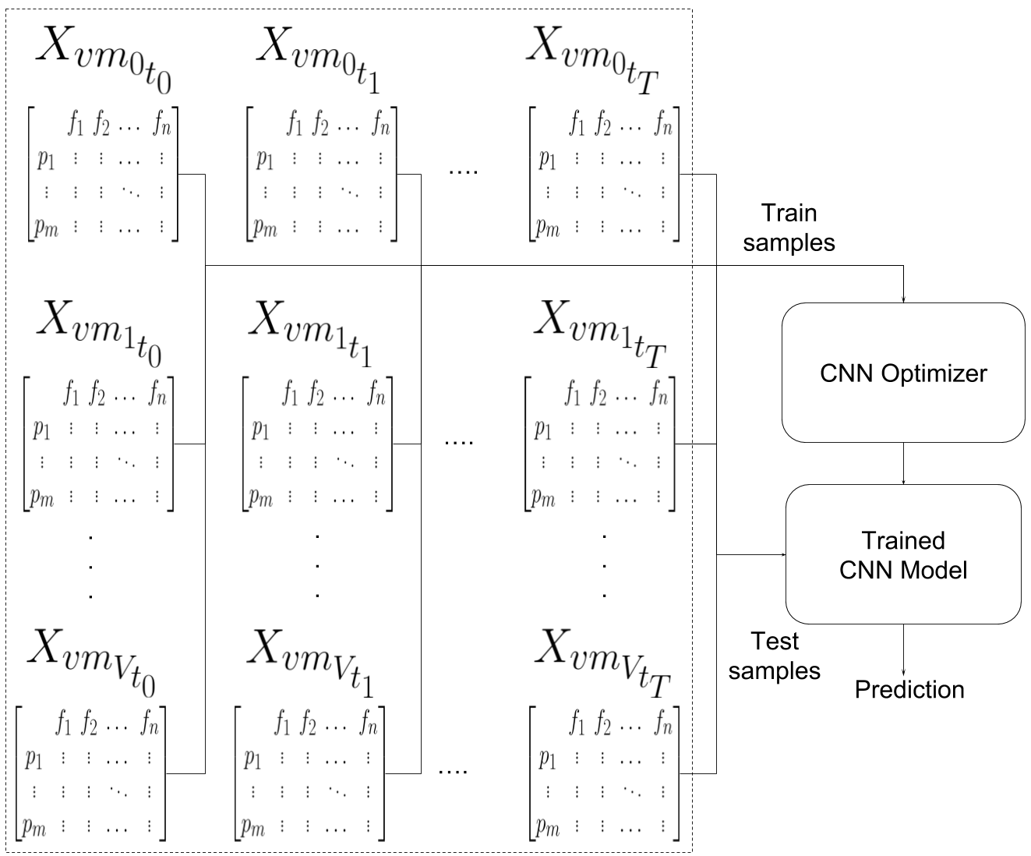
Multiple VMs Single Samples (MVSS)
© Mahmoud Abdelsalam
World Leading Research with Real World Impact!

Slide 20
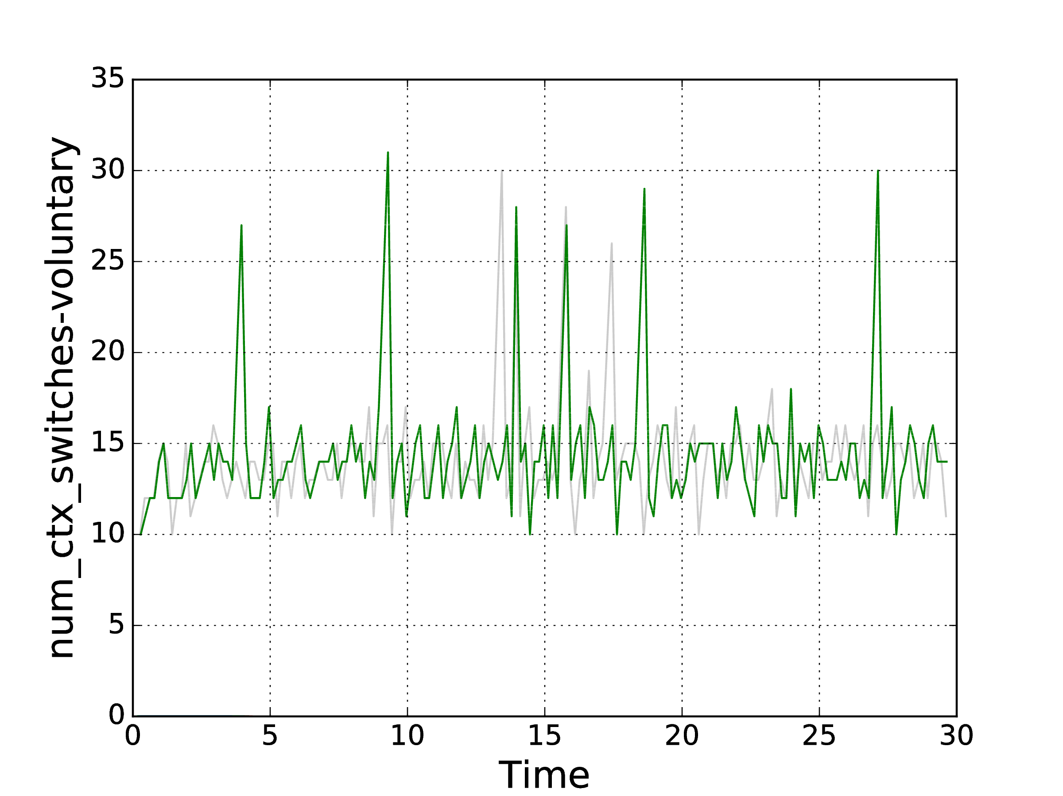
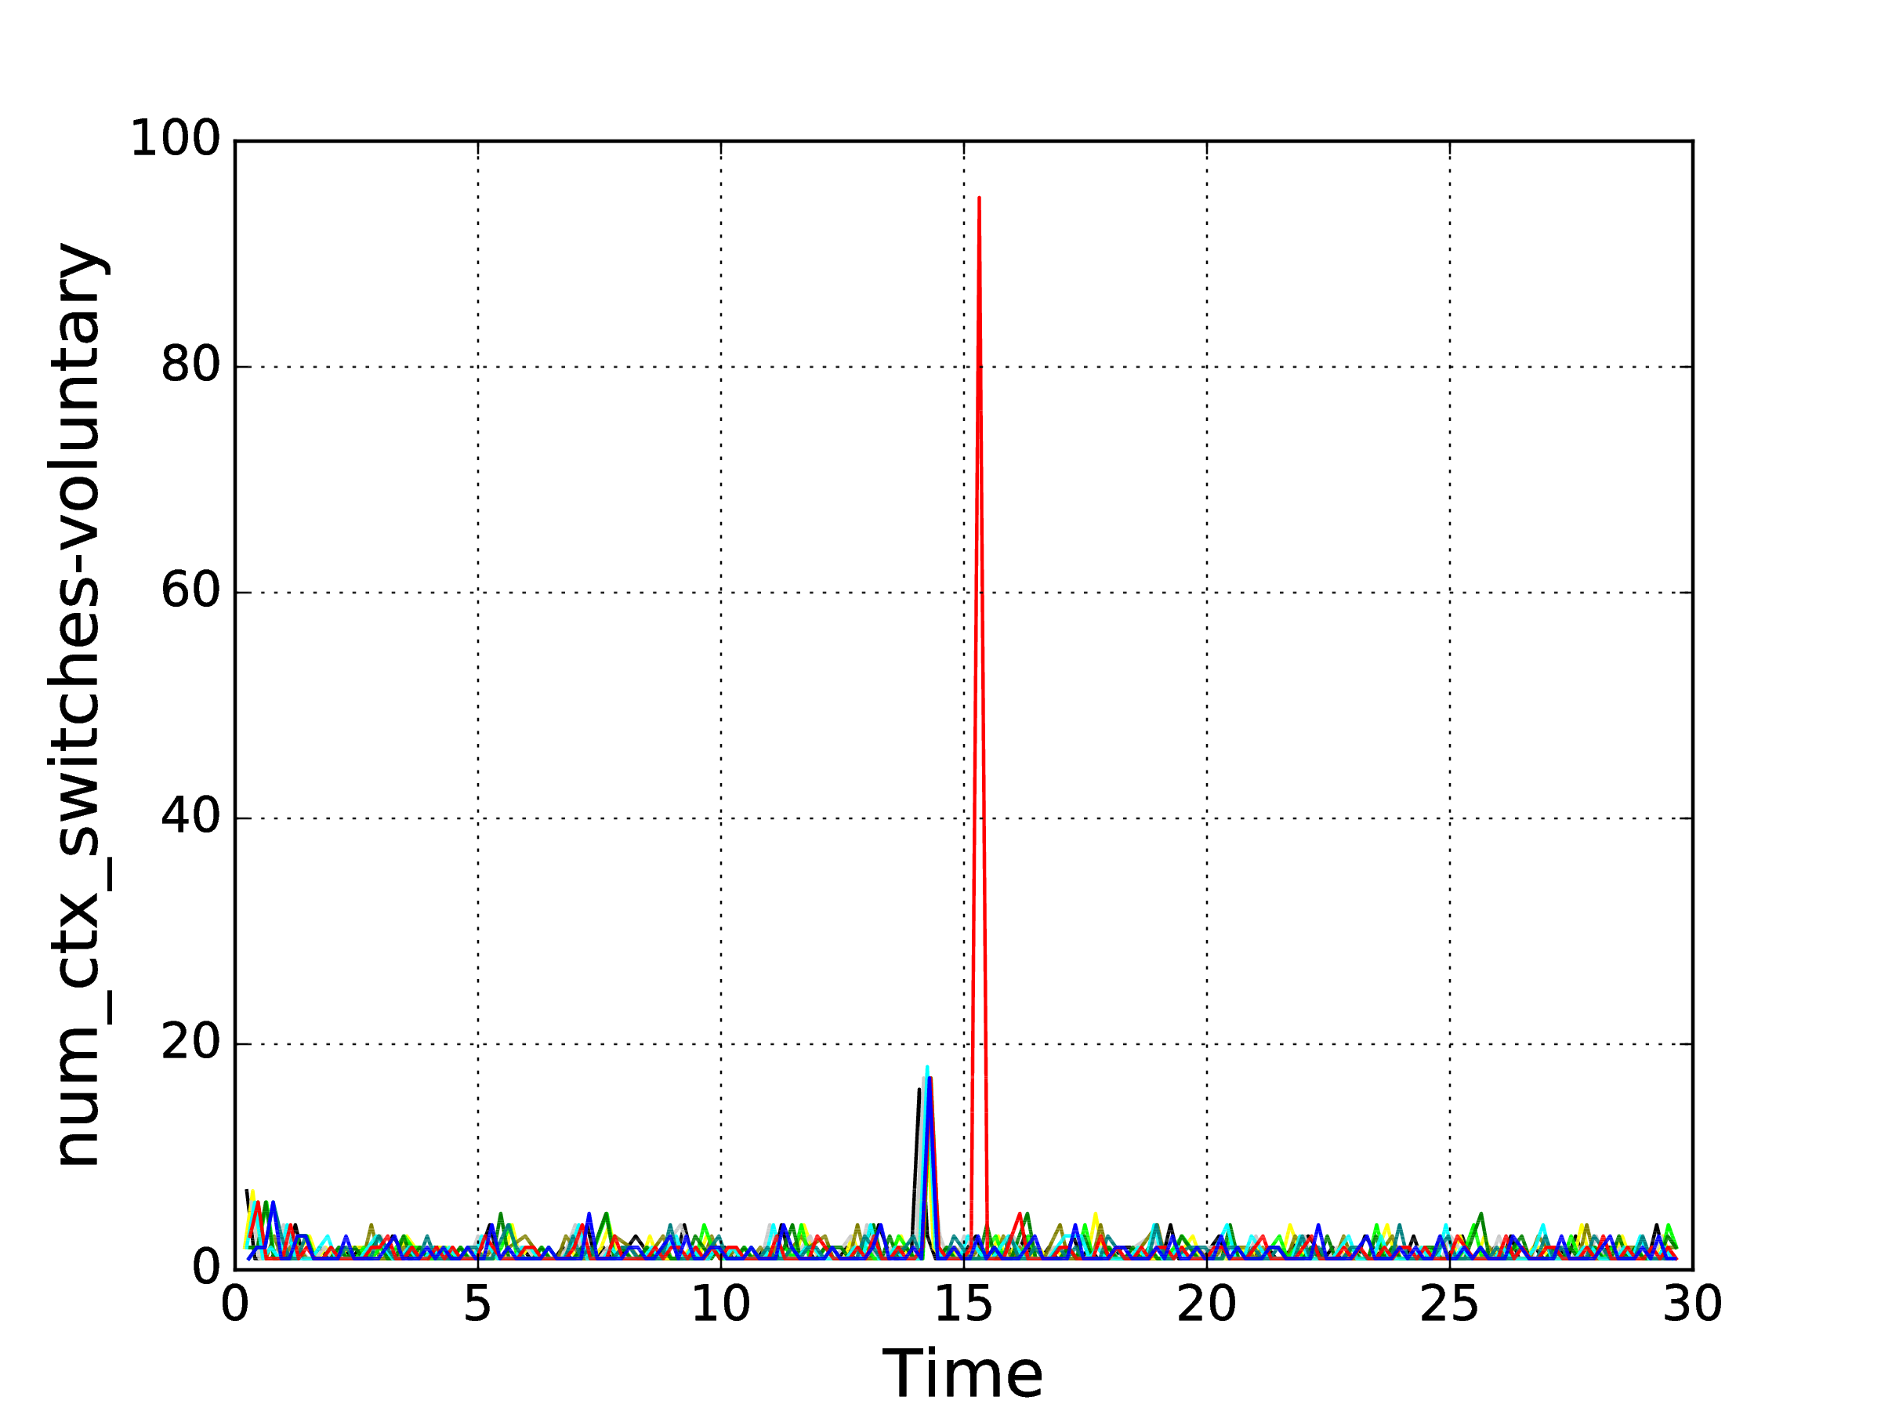
Key Intuition
What do we gain from having multiple VMs in an auto-scaling scenario?
“Correlation between VMs”
Number of used voluntary context switches over 30 minutes for two different runs of the same unique process
Number of used voluntary context switches over 30 minutes for one run of 10 VMs in an auto-scaling scenario.
© Mahmoud Abdelsalam
World Leading Research with Real World Impact!

Slide 21
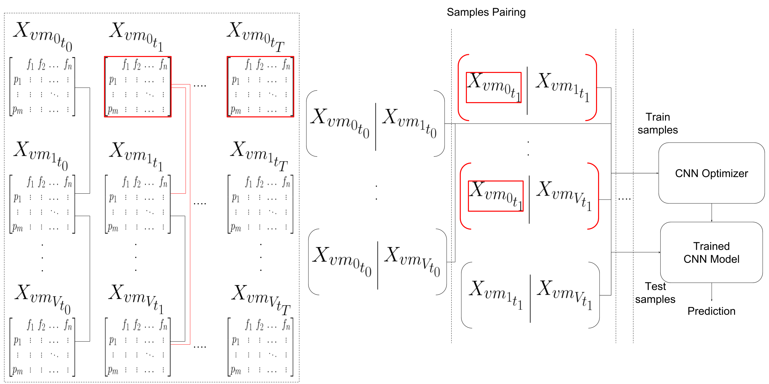
Multiple VMs Paired Samples (MVPS)
© Mahmoud Abdelsalam
World Leading Research with Real World Impact!

Slide 22
Experimental Setup and Results
© Mahmoud Abdelsalam
World Leading Research with Real World Impact!

Slide 23
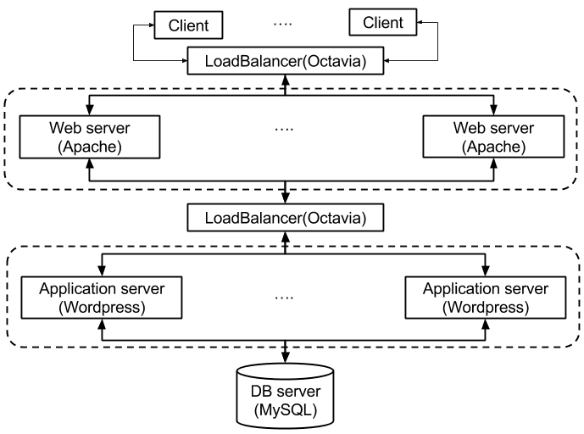
Experimental Setup
Our experiments were conducted
on Openstack.
To simulate a real world scenario,
we used a 3-tier web architecture
and a self-similar traffic gen.
(on/off Pareto) is used.
Data collection:
Collect 28 different process performance metrics (Table I) every 10 seconds for ≃ 100 processes
Time (min)
0 30 60
Clean phase
Malware injection Point.
113 Malware executables are injected (one per experiment).
Period of malware activity

Slide 24
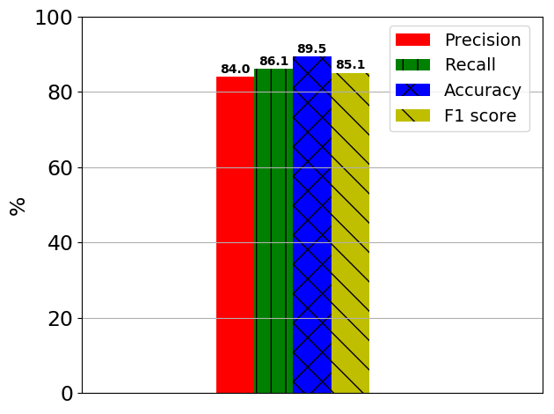
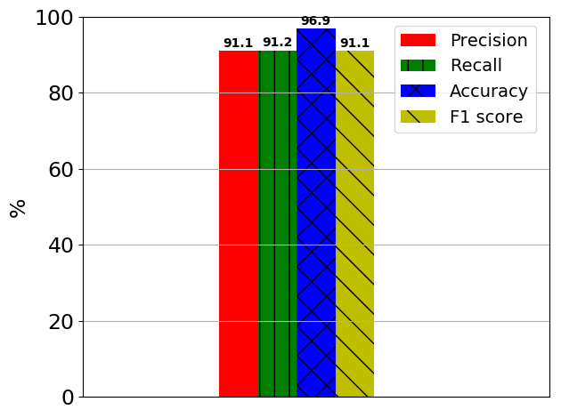
Results
MVSS
MVPS
© Mahmoud Abdelsalam
World Leading Research with Real World Impact!

Slide 25
Conclusion & Future Work
The goal of this paper was to provide a develop cloud-specific online malware detection method by leveraging cloud characteristics (i.e., auto-scaling).
We developed an effective approach for detecting malware using process-level features for low-level malware in an auto-scaling scenario.
We introduced a novel pairing samples approach for capturing correlations between VMs.
Future Work:
Applying and testing multiple architectures (e.g., hadoop systems or containers)
Investigating and leveraging more cloud characteristics for security.
Develop techniques to handle the situation when multiple VMs are infected simultaneously by an attacker.
© Mahmoud Abdelsalam
World Leading Research with Real World Impact!

Slide 26
Questions/Comments
© Mahmoud Abdelsalam
World Leading Research with Real World Impact!

