Slide 1
Authorization Policy Specification and Enforcement for Group-Centric Secure Information Sharing
Ram Krishnan and Ravi Sandhu
University of Texas at San Antonio

Slide 2
Problem
2 phases in access control system design
How do we know 1 and 2 are consistent?
  That is, that they have the same behavior wrt authorization state
Policy Specification
  Concerned about precise conditions for authorization to hold
Policy Enforcement
  Concerned about how to enforce the policy

Slide 3
Goal
Investigate a methodology to show consistency
Approach
  Pick a specific application domain
  Design a “stateless” policy specification
  Develop a “stateful” enforcement specification
  Show authorization equivalence

Slide 4
Stateless Policy Specification
Focus on conditions under which authorization should hold
History of actions that can lead to access
  E.g. Alice can access an object if in the past she had paid membership dues up to current time
Linear Temporal Logic (LTL)
  Excellent fit to specify stateless policies

Slide 5
First-Order Linear Temporal Logic
Extends familiar first-order logic with temporal operators
Consider “Henceforth” and “Since” operators
¬Leave (u,g)
s0
s1
s2
s3
s4
s5
Join (u,g)
¬Leave (u,g) S Join (u,g)
s0
s1
s2
s3
s4
s5
p
p
p
p
p

Slide 6
Application Domain
Group-centric secure information sharing (g-SIS)

Slide 7
Group-centric
Secure Information Sharing (g-SIS)
Users
Strict Leave
Strict Join
Users
Join
Leave
Liberal
Join
GROUP
Authz(U,O,R)?
LiberalLeave
GROUP
Authz(U,O,R)?
Strict
Add
Strict
Remove
Liberal Remove
Liberal Add
Remove
Add
Objects
Objects

Slide 8
Group Operation Semantics
Strict Vs Liberal operations
  User operations (SJ, LJ, SL, LL)
  Object operations (SA, LA, SR, LR)
u not authorized to access objects added prior to join time
Users joining after add time not authorized to access o
SJ (u)
SA (o)
Users authorized to access o at remove time retain access
u retains access to objects authorized at leave time
LL (u)
LR (o)

Slide 9
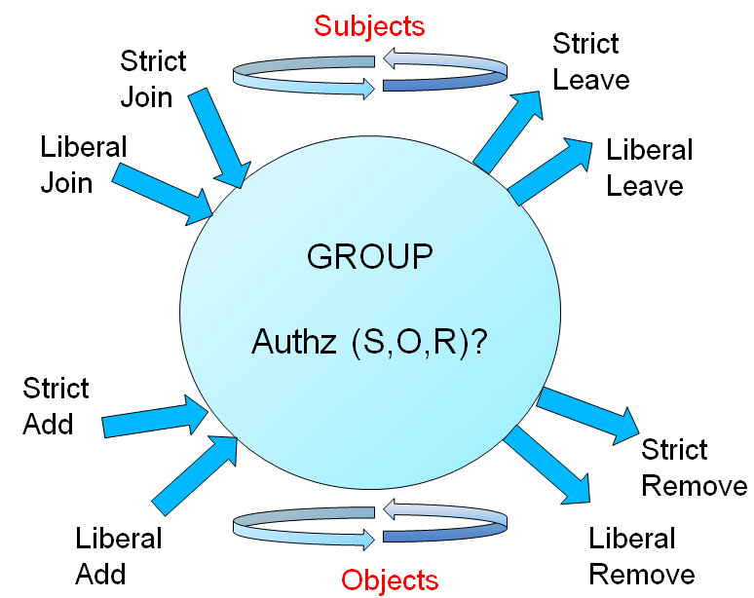
The π-System g-SIS Specification (contd)
Well-formed traces
π-system g-SIS Specification:
Add after Join
Add before Join
Well-formedness constraints rule out invalid traces
Examples: 1. user joining and leaving in the same state
2. leaving before joining
Notes:
9

Slide 10
Stateful Specification
Consists of three modules
state₀
interval₀
state₁
phase₁
phase₂
2.1
2.2
Capture action+authz requests
(Module 1)
Process authz requests
(Module 3)
Process action requests
(Module 2)
Module 2 maintains and manages data structures
  Keeps track of historical joins and leaves and adds and removes for users and objects
Module 3 consults with that data structure

Slide 11
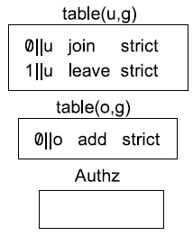
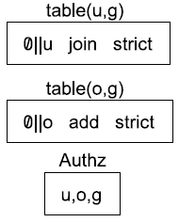
Mapping Stateless and Stateful
state₀
state₁
SJ(u,g)
SA(o,g)
Authz(u,o,g)
SL(u,g)
¬ Authz(u,o,g)
A sample stateless trace
α-mapping
Corresponding stateful trace below
β-mapping
phase₁
phase₂
state₀
phase₁
phase₂
state₁
SJReq(u,g)
SAReq(o,g)
isAuthz(u,o,g)
SLReq(u,g)
isAuthz(u,o,g)
1. Process user & object events & update data structure
2. Check for authz
1. Process user & object events & update data structure
2. Check for authz

Slide 12
Authz_{stateful} ↔ Authz_{stateless}
Lemma 3
  for every trace in stateless, an alpha-mapped action trace exists in stateful
Lemma 4
  for every trace in stateful, a beta-mapped action trace exists in stateless
Lemmas 3 and 4 together prove authorization equivalence

Slide 13
Future Work
We assumed a centralized, ideal situation
Distributed enforcement model (PIPs, PDPs, PEPs, etc.)
  Next step towards real policy enforcement
  Proving equivalence is very difficult
    E.g. staleness of authorization info due to network delay
Stale-safe equivalence with respect to centralized specification feasible
  E.g. in the presence of stale information, a user should be authorized for an action only if it was authorized using accurate information in the recent past
Currently investigating for g-SIS application

