Slide 1
Institute for Cyber Security
RABAC : Role-Centric
Attribute-Based Access Control
MMM-ACNS 2012
Xin Jin, Ravi Sandhu, Ram Krishnan
University of Texas at San Antonio
San Antonio, TX, USA
World-Leading Research with Real-World Impact!

Slide 2
OUTLINE
Motivation
Proposed Model
XACML Profile
Conclusion
World-Leading Research with Real-World Impact!

Slide 3
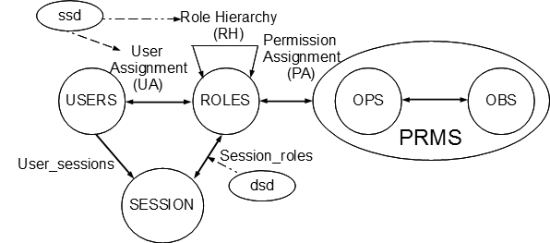
Role Based Access Control
Role Explosion
Role number is supposed to be much than users.
Role Explosion : Different roles have to be defined for slightly different sets of permissions.
World-Leading Research with Real-World Impact!

Slide 4
Example
Doctor
Attending Doctor
Patient
One doctor role for each set of patients.
Patient Document
Revealed for specific project.
prj1
Visit Doctor
Time and devices constraints, etc.
prj2
prj3
One VisitDoctor role for each project.
prjn
World-Leading Research with Real-World Impact!

Slide 5
Related Work
Role Template, Parameterized Role, Attributed role, etc
Two level RBAC (SACMAT 12)
Environment Role, Object Role
Automatic user-role assignment, TrustBAC
Relationship based access control (ReBAC)
Role and organization based access control (ROBAC)
They need modification in user-role and role-permission assignment.
Role engineering is the most costly work in constructing RBAC system.
Why can’t we design a solution which can be enforced with least impact to current deployment?
World-Leading Research with Real-World Impact!

Slide 6
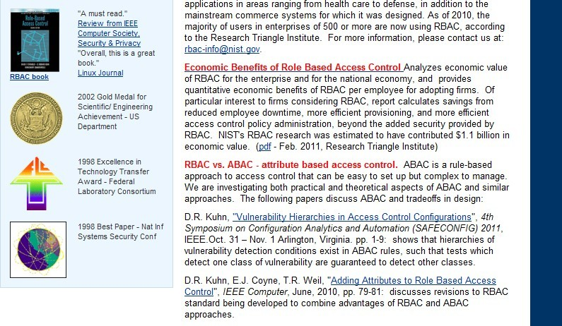
Motivation
World-Leading Research with Real-World Impact!

Slide 7
Motivation
NIST proposed three alternative revisions to RBAC standard
  Attribute Centric
    Totally attribute based, role as a user attribute
    Related work: ABAC–alpha model [Jin, DBSEC12], etc
  Dynamic Roles
    Automatically user-role assignment [Kahtani & Sandhu],etc
  Role Centric RBAC
    Not too much research.
With previous work in ABAC-alpha, We provide a formal model for Role-Centric attribute based access control.
World-Leading Research with Real-World Impact!

Slide 8
OUTLINE
Motivation
Proposed Model
XACML Profile
Conclusion
World-Leading Research with Real-World Impact!

Slide 9
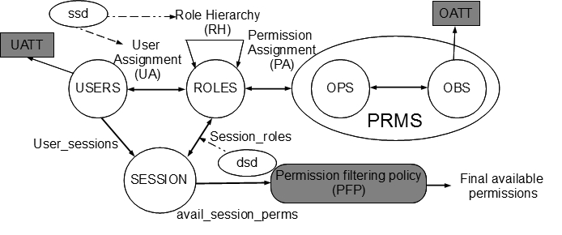
Model Components
World-Leading Research with Real-World Impact!

Slide 10
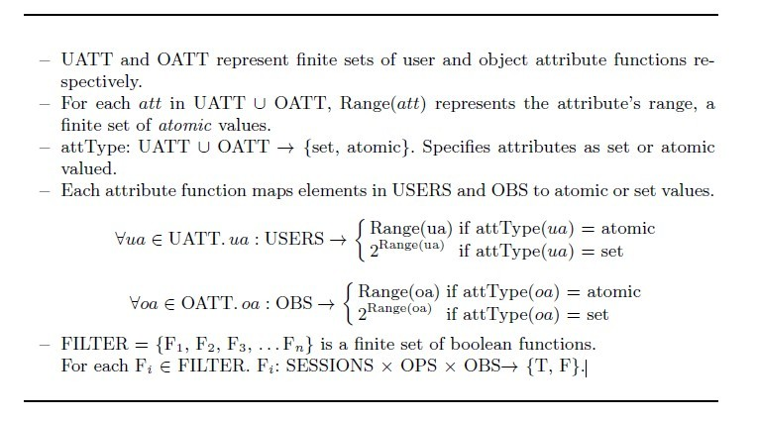
Model Components
World-Leading Research with Real-World Impact!

Slide 11
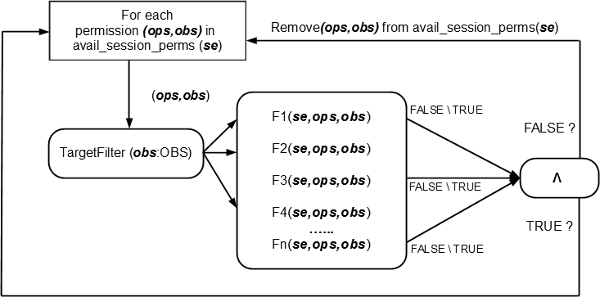
Filtering Policy
World-Leading Research with Real-World Impact!

Slide 12
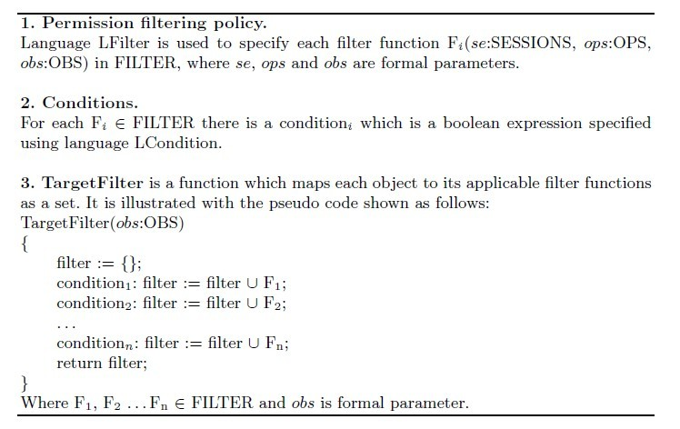
Filtering Policy
How to specify?
World-Leading Research with Real-World Impact!

Slide 13
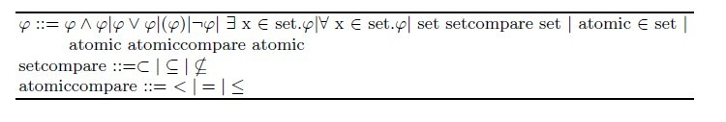

Language for Policy
Common Policy Language (CPL) :
LCondition, used to specify each condition, is an instance of CPL where:
Example:
type(o) = studentrecord ⋀ (owner(o) ∈ GameClub ⋁ (∃ reader ∈ reader(o). reader = user3))
World-Leading Research with Real-World Impact!

Slide 14
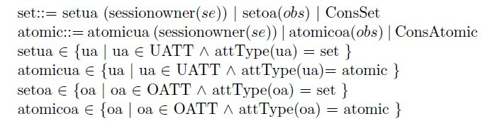
Language for Policy
LFilter, used to specify each filter, is an instance of CPL where:
Example:
major(u) = major(o) ⋀ (location(u)= utsa ⋁ ∃ project∈ involvedprj(u). project=proj(o))
World-Leading Research with Real-World Impact!

Slide 15
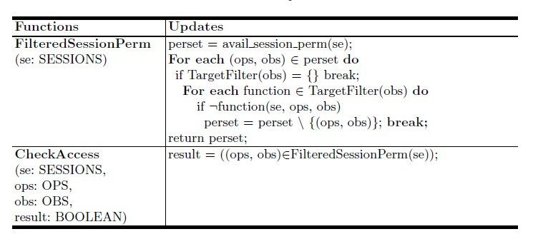
Access Checking
Apply policy and get final available permissions in session
Check against user request
World-Leading Research with Real-World Impact!

Slide 16
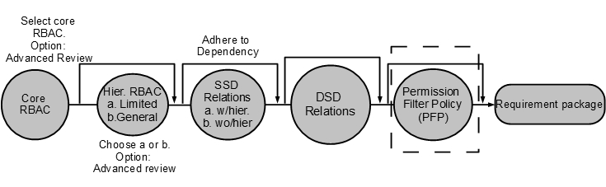
Package Building Path
World-Leading Research with Real-World Impact!

Slide 17
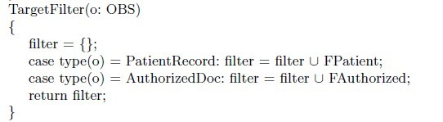
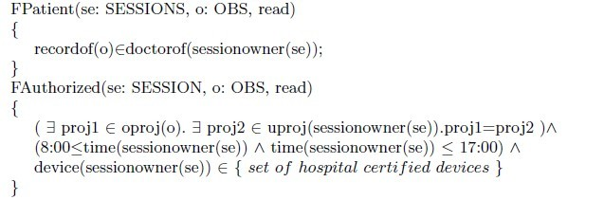
Advantage
Doctor
Patient Document
Visit Doctor
uproj,
device,
time.
doctorof
oproj
Two role definitions are enough.
World-Leading Research with Real-World Impact!

Slide 18
OUTLINE
Motivation
Proposed Model
XACML Profile
Conclusion
World-Leading Research with Real-World Impact!

Slide 19
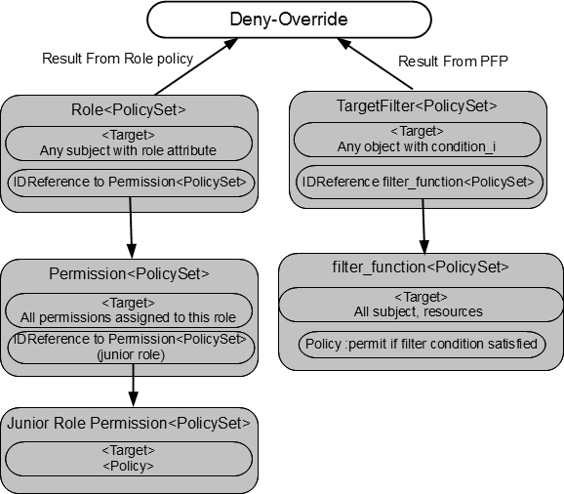
XACML-Profile for RABAC
XACML Profile for RBAC
XACML express permission filtering policy
World-Leading Research with Real-World Impact!

Slide 20
OUTLINE
Motivation
Proposed Model
Use Case
XACML Profile
Conclusion
World-Leading Research with Real-World Impact!

Slide 21
Conclusion
Main contribution
  RABAC model: Extension to RBAC with filtering policy
  Define languages for specifying policy
  Modify functions for access checking
Advantages
  Without modification to original deployment while mitigating role explosion problem.
  Retains the administration convenience of RBAC
  Offer flexibility and administration convenience.
Future work
  Distinguish user attribute and session attribute.
  Enhance policy language.
World-Leading Research with Real-World Impact!

Slide 22
Institute for Cyber Security
Thanks
Any Questions?
World-Leading Research with Real-World Impact!
22

