Slide 1


Institute for Cyber Security
Access Control Model for AWS Internet of Things
Prof. Ravi Sandhu
Executive Director and Endowed Chair
11th International Conference on Network and System Security (NSS)
Helsinki, Finland, 21-23 August, 2017
Smriti Bhatt, Farhan Patwa and Ravi Sandhu
Department of Computer Science
ravi.sandhu@utsa.edu
www.profsandhu.com
www.ics.utsa.edu

Slide 2
Outline
  Introduction
  Contribution
  AWS Access Control (AWSAC) Model
  Access Control Model for AWS IoT
  ACO Architecture for Cloud-Enabled IoT & AWS-IoTAC
  Use Case in AWS IoT
    Use Case – Scenario 1
    Use Case – Scenario 2
  ABAC Enhancements for AWS-IoTAC
  Conclusion and Future Work

Slide 3
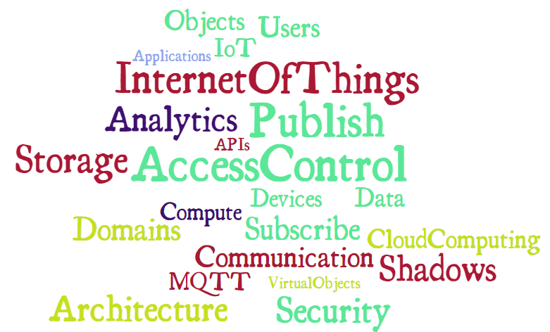
Introduction
Internet of Things (IoT)
  Interconnection of people and things, and things and things
  Rapidly evolving concept with billions of connected devices/things

Slide 4
Introduction (Contd.)
Cloud-Enabled IoT
  Constrained IoT devices (limited resources)
  Cloud Computing capabilities enable IoT
    Seamless communication (devices-to-cloud, cloud-to-devices)
    Unlimited resources → compute, storage, etc.
    Meaningful insights → Analytics and Visualizations
    Facilitate application development → APIs
    Virtual things and management, Access Control policies, …
Security
Cloud
IoT

Slide 5
Access Control in Cloud-Enabled IoT
Current industrial Cloud-Enabled IoT solutions/platforms
  Amazon Web Services (AWS) IoT
  Microsoft Azure IoT Suite
  Google Cloud IoT
  …
Utilize some customized form of Role-Based Access Control (RBAC)
RBAC insufficient to address dynamic IoT requirements
Lack a formal access control model for controlling access and authorization in cloud-enabled IoT

Slide 6
Contributions
Many access control models and architecture for IoT
  Capability-Based Access Control (CAPBAC),
  Role-Based Access Control (RBAC),
  Attribute-Based Access Control (ABAC), …
Our Contributions:
  Develop a formal access control model for AWS IoT, known as AWS-IoTAC
  Present a smart-home IoT use case depicting different access control points and authorizations in a cloud-enabled IoT platform
  Propose some ABAC enhancements for the AWS-IoTAC model for more flexible and fine-grained access control policies

Slide 7
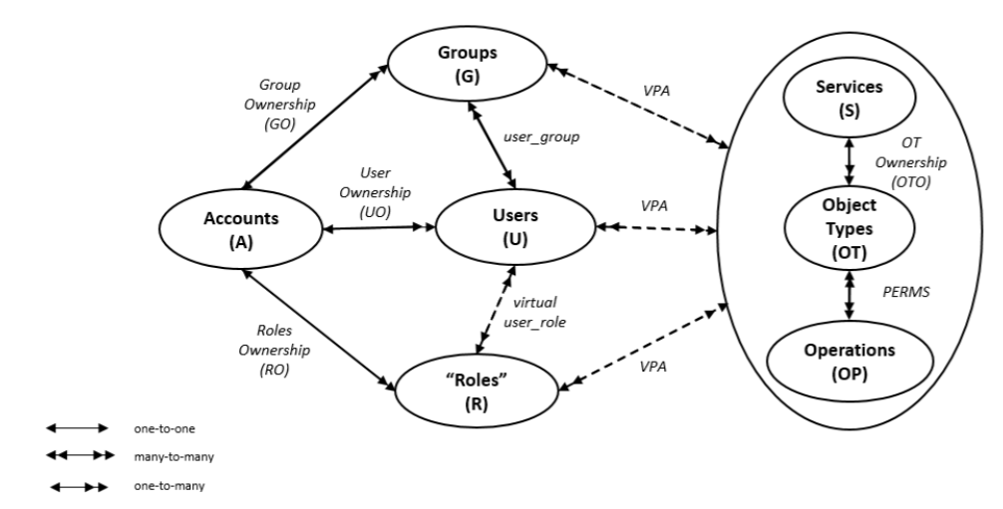
AWS Access Control (AWSAC) Model
Fig 1: AWS Access Control within a Single Account *
* Zhang, Y., Patwa, F., Sandhu, R.: Community-based secure information and resource sharing in AWS public cloud. In: 1st IEEE Conference on Collaboration and Internet Computing (CIC). pp. 46–53. IEEE (2015)

Slide 8
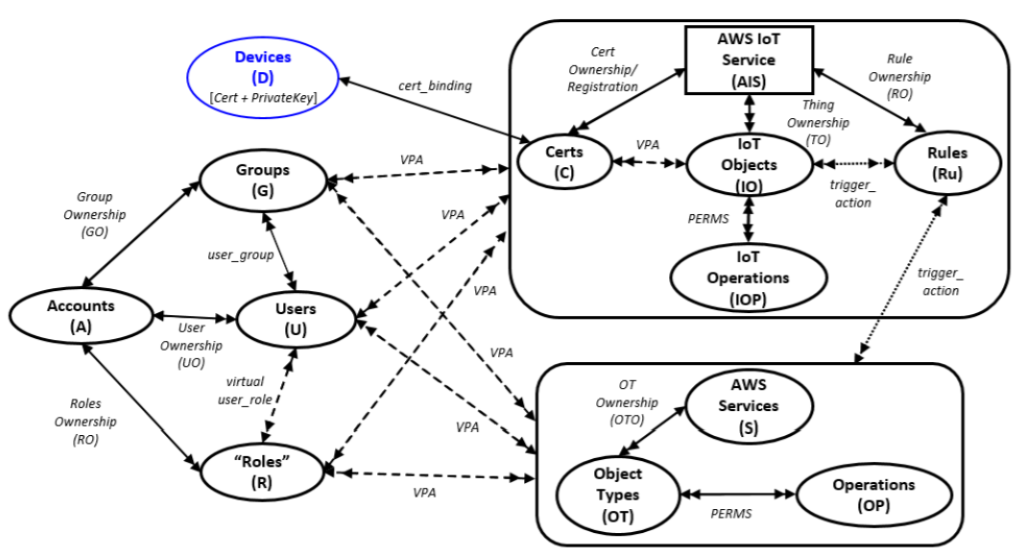
Access Control Model for AWS IoT
Fig 2: AWS IoT Access Control (AWS-IoTAC) Model within a Single Account

Slide 9
Access Control Model for AWS IoT
Fig 2: AWS IoT Access Control (AWS-IoTAC) Model within a Single Account

Slide 10
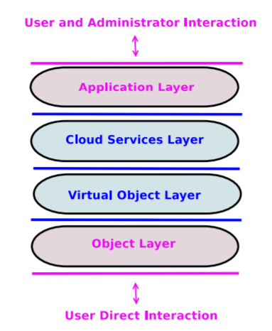
ACO Architecture for Cloud-Enabled IoT
Fig 3: ACO Architecture for the Cloud-Enabled IoT *
* Alshehri, A., Sandhu, R.: Access control models for cloud-enabled internet of things: a proposed architecture and research agenda. In: 2nd IEEE International Conference on Collaboration and Internet Computing (CIC), pp. 530–538. IEEE (2016)

Slide 11
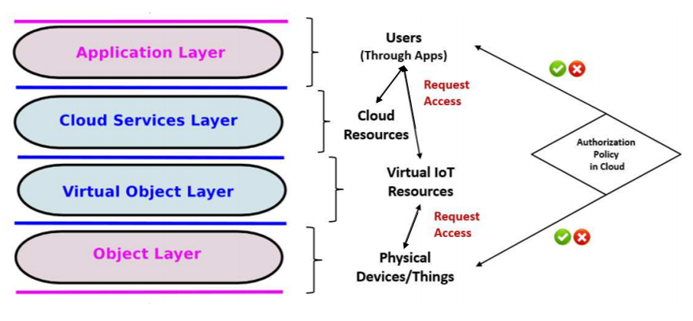
ACO Architecture & AWS-IoTAC
Fig 4: AWS-IoTAC Entities Mapping to ACO Architecture for Cloud-Enabled IoT

Slide 12
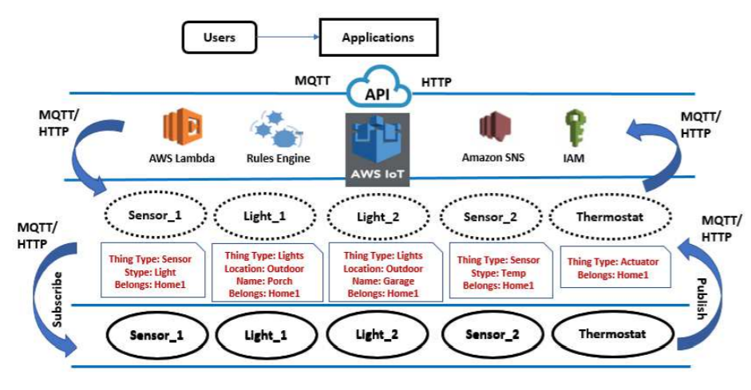
Smart Home Use Case in AWS IoT
Fig 5: Smart-Home Use Case Utilizing AWS IoT and Cloud Services

Slide 13
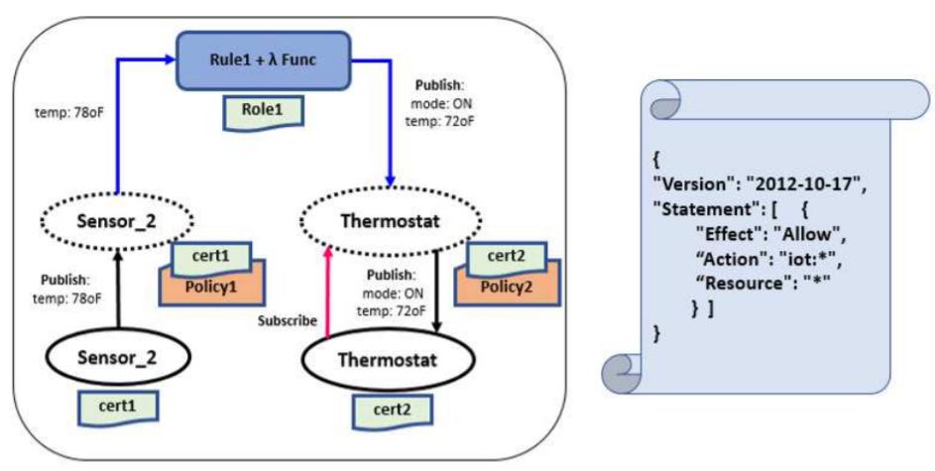
Use Case – Scenario 1
Simple Policy: Allows all the IoT operations on any resource in AWS IoT
A temperature sensor and thermostat use case
Fig 6: Smart-Home Use Case Scenario 1

Slide 14
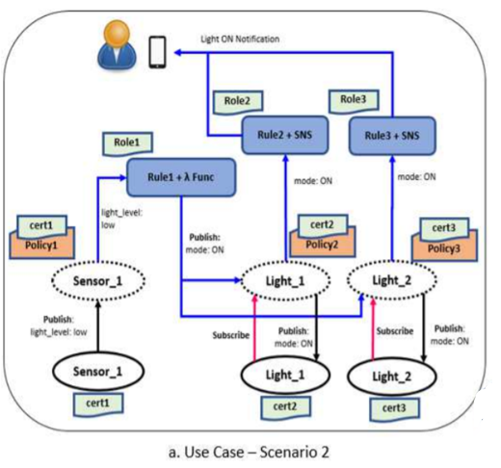
Use Case – Scenario 2
Sensor Attribute:
Belongs = Home1
Light Attributes:
Location = Outdoor
Belongs = Home1

Slide 15
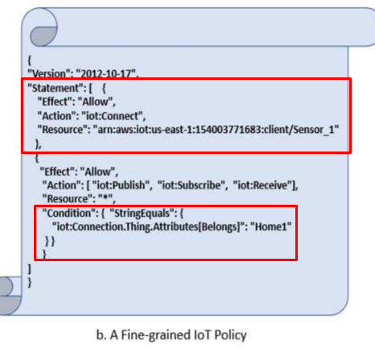
Use Case – Scenario 2
Allows the sensor (client) to connect to AWS IoT only if it is connecting with a client ID as “Sensor_1”
Allows the sensor to Publish, Subscribe, and Receive messages to any iot resource in AWS IoT only if the sensor has attribute “Belongs=Home1”

Slide 16
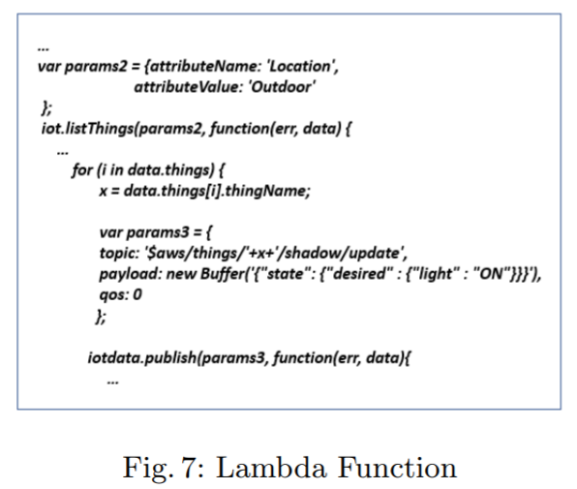
Use Case – Scenario 2
Utilizing target resource (things) attributes through AWS Lambda function
Search and list things with attribute name = Location & attribute value = Outdoor
Publish update on all thing shadows (outdoor lights here) that has attribute “Location = Outdoor” to turn on outdoor lights

Slide 17
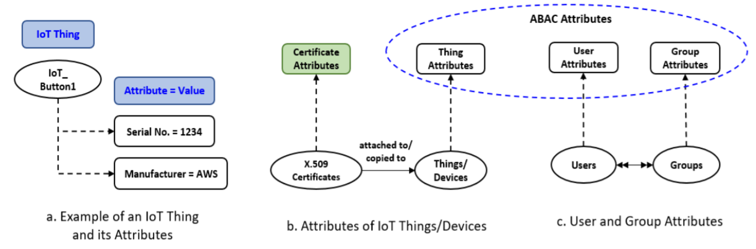
ABAC Enhancements for AWS-IoTAC
AWS IoT Attributes

Slide 18
ABAC Enhancements for AWS-IoTAC (Contd.)
ABAC Including Attributes of Target Resources
  Attributes of things performing IoT operations
  Attributes of things on which the operations are being performed
ABAC Including User and Group Attributes
  Attributes besides things attributes in access control policies
Policy Management Utilizing the Policy Machine
  Policy-Explosion
  Customized policy management for enterprises

Slide 19
Conclusion and Future Work
Presented a formal access control model for AWS IoT, a cloud-enabled IoT platform by the largest cloud services provider – Amazon Web Services (AWS)
AWS-IoTAC, an initial step towards a general access control model for cloud-enabled IoT
Demonstrated a practical use case along various access control configurations
Proposed ABAC enhancements to the AWS-IoTAC model
Future Work:
  Include ABAC enhancements in the AWS-IoTAC model
  Access control and authorization in other real-world cloud-enabled IoT platforms

Slide 20
Institute for Cyber Security
Thank you!!!
Questions???

