Slide 1
Preserving User Privacy from Third-party Applications in Online Social Networks
Institute for Cyber Security
Yuan Cheng, Jaehong Park and Ravi Sandhu
Institute for Cyber Security
University of Texas at San Antonio
Presentation at PSOSM13, Rio de Janeiro, Brazil
May 14, 2013
World-Leading Research with Real-World Impact!

Slide 2
Agenda
Privacy Issues of 3rd-party Apps
Countermeasures
Access Control Framework
Policy Model
Conclusions
World-Leading Research with Real-World Impact!

Slide 3
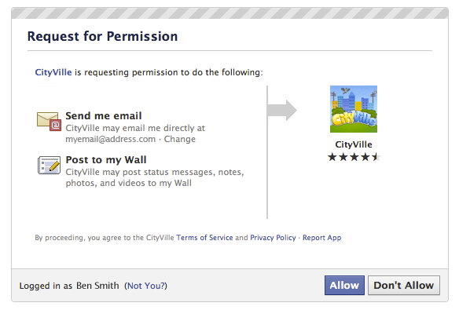
Privacy Issues
An all-or-nothing policy for application-to-user interactions
  User has to grant the app full access, even if the app only needs partial data
Users are not aware of the application’s real needs
World-Leading Research with Real-World Impact!

Slide 4
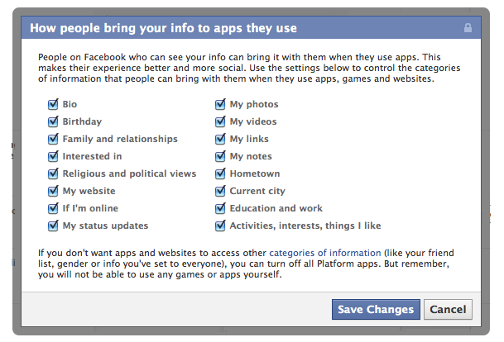
Privacy Issues (cont.)
Coarse-grained opt-in/out privacy control does not let user specify policies for each piece of data
Some permissions are given by user’s friend who installed the app, without user’s knowledge
World-Leading Research with Real-World Impact!

Slide 5
Countermeasures
 | Summary | Pros | Cons
Data Generalization | Convert private data to a privacy-nonsensitive form | Have been widely accepted in recent solutions
User-specified Privacy Preference | Allow user to express their preference more flexibly
Communication Interceptor | Intercept requests, exert user preferences, and return sanitized or dummy data |  | Lose functionality and integrity
Information Flow Control | Confine app execution and mediate information flow | Enable post-authorization | Need substantial modification to current architecture
User-to-application Policy Model | Provide a complete policy model for users to define, use and manage their own policies

Slide 6
Goal
Protect inappropriate exposure of users’ private information to untrusted 3rd party apps
Propose an policy model for controlling application-to-user activities
  More flexible
    further utilize the relationships and the social graph in OSN
  Finer grained
    e.g., per resource vs. per resource type, distinction of different types of access
World-Leading Research with Real-World Impact!

Slide 7
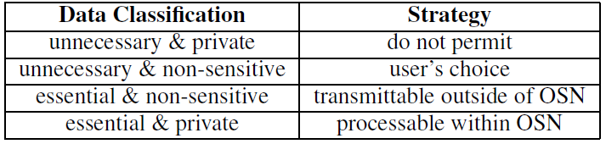
Framework Overview
Prevent applications from learning user’s private information while still maintaining the functionality
Leave private information within OSN system and allow external servers of applications to retrieve non-private data
World-Leading Research with Real-World Impact!

Slide 8
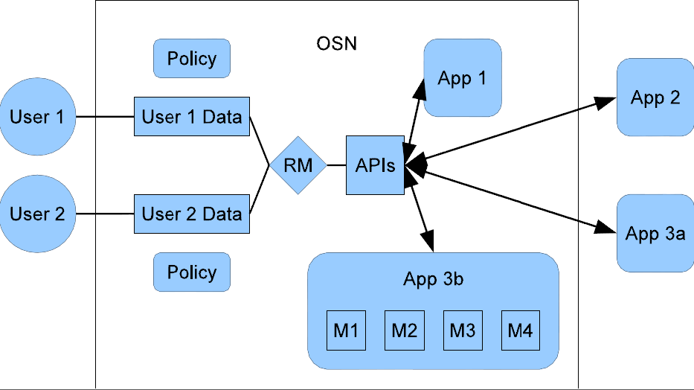
Proposed Architecture
World-Leading Research with Real-World Impact!

Slide 9
Application Components
Internal component
  High trustworthy; can handle private data
  Can be provided by OSN and 3rd-party entities
External component
  Provided by 3rd-party entities
  Low trustworthy; cannot consume private data
World-Leading Research with Real-World Impact!

Slide 10
Communications
 | OSN provided | 3rd-party provided
Communication w/ system calls | M1 | M2
Communication w/ non-private data | M3 | M4
Communication between components only through OSN-specified APIs
  Communication w/ system calls
  Communication w/ non-private data
  Communication w/ private data (not allowed)
World-Leading Research with Real-World Impact!

Slide 11
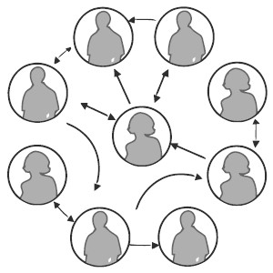

Relationship-based Access Control w/ Apps
He didn’t install the app
follow
friend
install
colleague
World-Leading Research with Real-World Impact!

Slide 12
Policy Specifications
<action, target, (start, path rule), 2^{ModuleType}>
  action specifies the type of access
  target indicates the resource to be accessed
  start is the position where access evaluation begins, which can be either owner or requester
  path rule represents the required pattern of relationship between the involved parties
e.g., “install”, “friend·install”
World-Leading Research with Real-World Impact!

Slide 13
Policy Specifications
<action, target, (start, path rule), 2^{ModuleType}>
  action specifies the type of access
  target indicates the resource to be accessed
  start is the position where access evaluation begins, which can be either owner or requester
  path rule represents the required pattern of relationship between the involved parties
  ModuleType = {M1, M2, M3, M4, external}, 2^{ModuleType} indicates the set of app module types allowed to access
World-Leading Research with Real-World Impact!

Slide 14
Example: App Request Notification
<app request, _, (target user, install), {M1, M2, M3, M4, external}>
  For apps she installed; Protect her data
<app request, _, (requester, install∙friend), {M1, M2}>
  For apps she installed ; Protect her friends’ data
<app request, _, (target user, friend∙install), {M1, M2}>
  For apps her friends installed; Protect her data
World-Leading Research with Real-World Impact!

Slide 15
Example: Accessing User’s Profile
<access, dateofbirth, (owner, install), {M1, M2}>
  DOB is private
<access, keystroke, (owner, install), {external}>
  Keystroke is non-private
  Keystroke information is crucial for fulfilling functionality
<access, emailaddress, (owner, friend∙install), {M1, M2, M3, M4}>
  Protect his friends’ data
World-Leading Research with Real-World Impact!

Slide 16
Conclusions
Presented an access control framework
  Split applications into different components with different privileges
  Keep private data away from external components
Provided a policy model for application-to-user policies
  Specify different policies for different components of the same application
World-Leading Research with Real-World Impact!

Slide 17
Q&A
Questions?
ycheng@cs.utsa.edu
http://my.cs.utsa.edu/~ycheng
Twitter: @nbycheng
World-Leading Research with Real-World Impact!

