Slide 1
Authorization Framework for Secure Cloud Assisted Connected Cars and Vehicular Internet of Things
Maanak Gupta and Ravi Sandhu
Institute for Cyber Security,
Center for Security and Privacy Enhanced Cloud Computing,
Department of Computer Science
University of Texas at San Antonio
23rd ACM Symposium on Access Control Models and Technologies
(SACMAT 2018)
Indianapolis, IN, USA, June 13-15, 2018

Slide 2
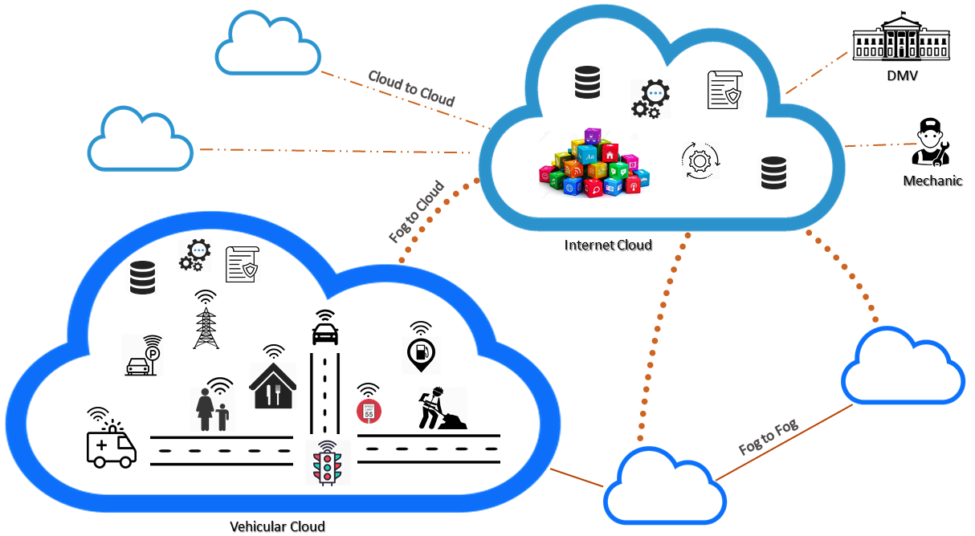
Connected Cars Ecosystem

Slide 3
Security and Privacy Requirements
On-Board Application and Sensors
  Tesla and Jeep X
Over the Air updates
V2X fake messages
In-vehicle ECU communication
Personal Data
Third Party devices
User Privacy Preferences
Spoofing, Ransomware, Injection…
Loss of Information in Cloud
Notes:
Someone disrupts

Slide 4
Security and Privacy Requirements
On-Board Application and Sensors
  Tesla and Jeep X
Over the Air updates
V2X fake messages
In-vehicle ECU communication
Personal Data
Third Party devices
User Privacy Preferences
Spoofing, Ransomware, Injection…
Loss of Information in Cloud
Software Reliance
Broad Attack Surface
Untrusted Entities
Notes:
Someone disrupts

Slide 5
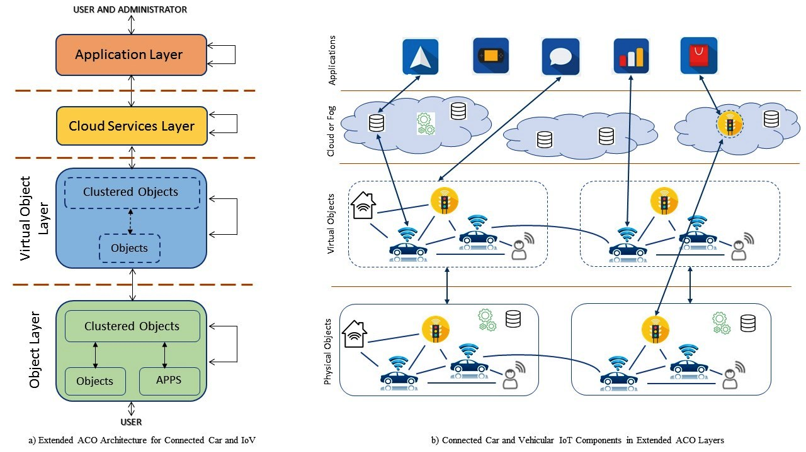
Extended Access Control Oriented Architecture

Slide 6
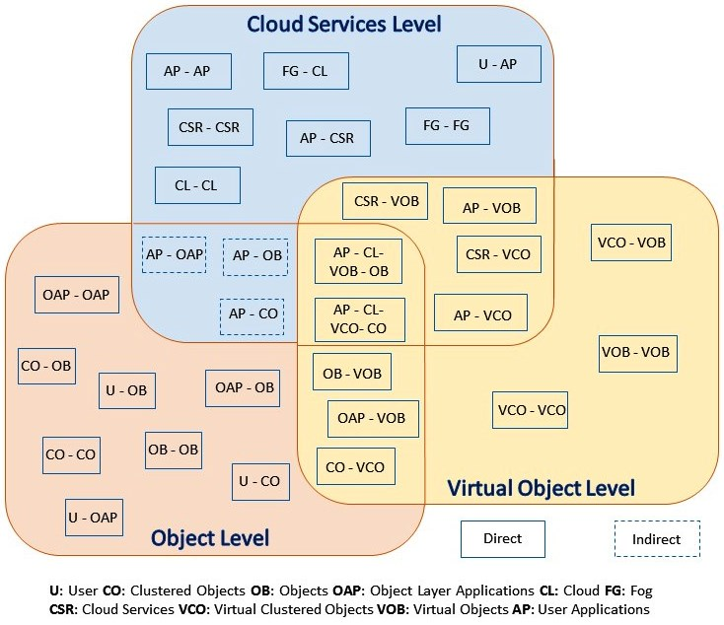
Authorization Framework

Slide 7
Access Control Strategies
Static vs Dynamic
What kind of relationship they have?
  Owner
  Manufacturer
  Friend
  Multi-Layered
  Groups Based
  Trusted Interaction
    How I trust you?
    Previous interaction..?
    ABAC, ReBAC Models
    Who will administer ?
    Data in Cloud, cross cloud sharing, how?

Slide 8
Research Questions
External Interface
In-Vehicle Interaction
Whom to TRUST? How establish TRUST?
Cross Cloud Sharing
Data in Cloud

