Slide 1
Towards Activity-Centric Access Control for Smart Collaborative Ecosystems
ACM Symposium on Access Control Models and Technologies
June 16-18th, 2021
www.maanakgupta.com | mgupta@tntech.edu
Notes:
Unholy alliance?
Is it a needed alliance,
Or a futuristic alliance for smart communities
AI techniques are expected to enhance cybersecurity by assisting human system managers with automated monitoring, analysis, and responses to adversarial attacks. Conversely, it is essential to guard AI technologies from unintended uses and hostile exploitation by leveraging cybersecurity practices. Research results at the intersection of AI and cybersecurity can lead to widespread changes in our understanding of the foundations of cybersecurity, and in turn, give rise to fundamentally new ways to motivate and educate students about cybersecurity in the age of AI.

Slide 2
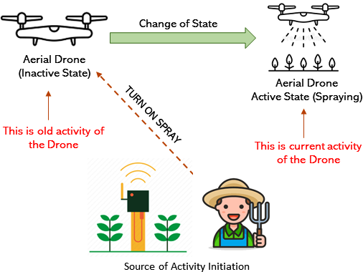
The Notion of Activity.
What is an Activity?
What are the entities
involved in an activity?
How an activity is initiated?
Associated conditions,
obligations and mutability

Slide 3
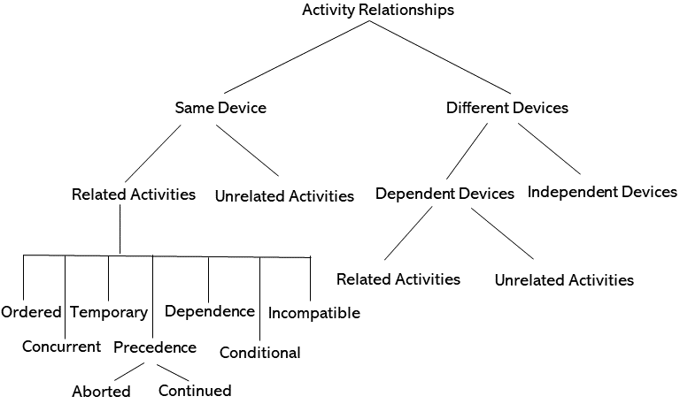
Activity Relation Characterization
Ordered
Concurrent
Temporary
Precedence
Dependence
Conditional
Incompatible

Slide 4
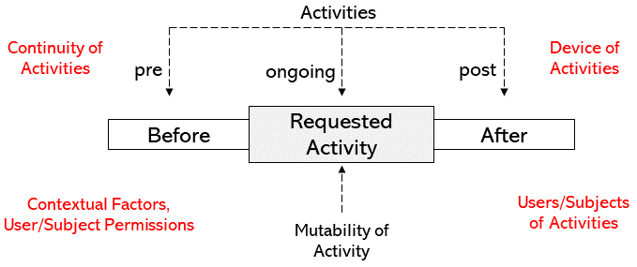
Factors Impacting Activity Decision
Key Questions:
Where is the activity allowed to perform?
Who is allowed to perform the activity?
When is the activity allowed?
How many times an activity can be performed?
Can an activity be performed when other activity is in place?
Several unexplored questions..

Slide 5
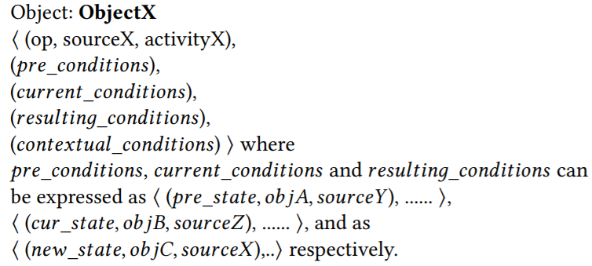
Activity Control Expression
Generalized structure and representation of expression
No attempt to propose a formal language

Slide 6
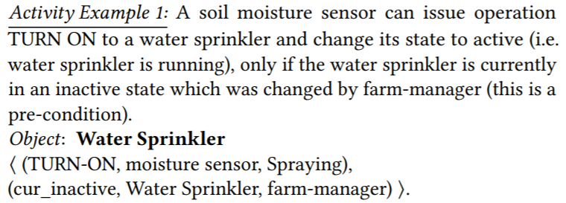
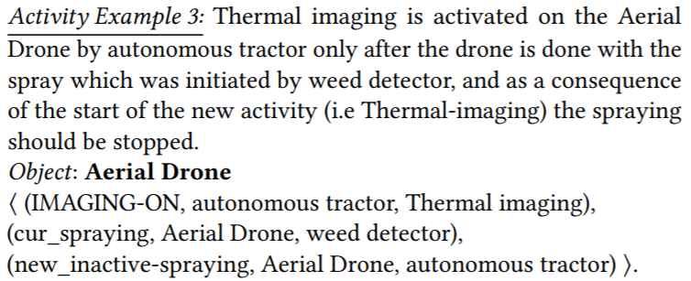
Example Expressions
Activity Control Policies in Smart Farming

Slide 7
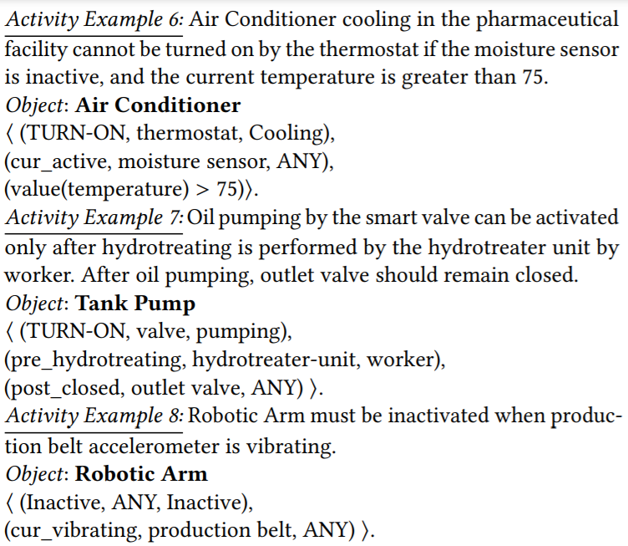
Example Expressions
Activity Control Policies in Smart Manufacturing

Slide 8
Research Questions
Operational Model and Extensions
Enforcement Architectures
Policy Language and Constraints
Administrative Models
Convergence with existing models
AI and data driven deployment
Safety Analysis

Slide 9
Thank You..!!
Questions, Comments or Concerns

