Slide 1
Role-Based Administration of Role-Based Smart Home IoT
Mehrnoosh Shakarami
Ravi Sandhu
Institute for Cyber Security (ICS)
Department of Computer Science
University of Texas at San Antonio (UTSA)

Slide 2
Outline
Introduction and Background
IoT Access Control Requirements
RBAC Administrative Model for Smart Home IoT
Operational Model for Smart Home IoT
Administrative Model for Smart Home IoT
RBAC Administrative Policy Model
Conclusion and Future Work
What could be done?
EGRBAC Model Introduction
Administrative Use Case
Proposed Model’s Properties and Restrictions
Role-Base Access Control (RBAC)

Slide 3
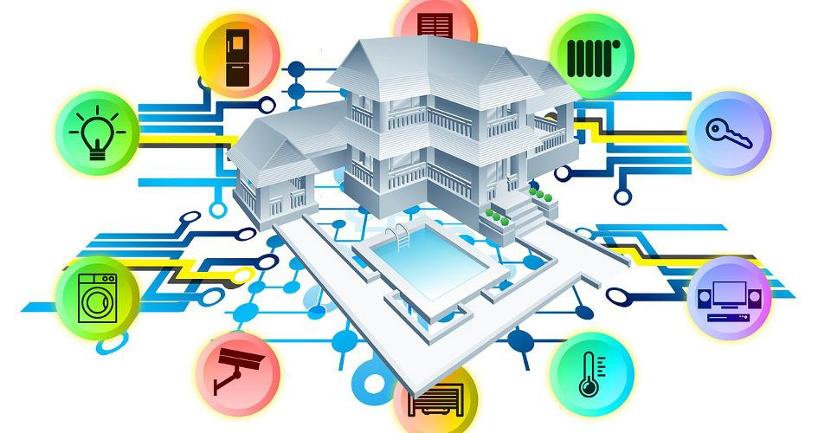
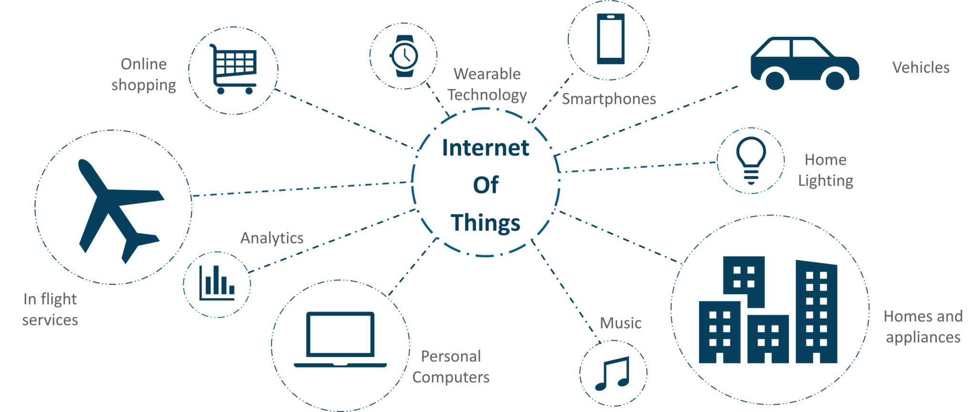
Internet of Things (IoT)
This Photo by Unknown Author is licensed under CC BY-SA

Slide 4








IoT Access Control
Policy Specification
Granularity
Context Awareness
Policy Management
Policy Enforcement
Handling the complexity of Environment
Usability
Minimum user involvement
Light-weight
Reliability and Availability
Multi-domain Administration

Slide 5
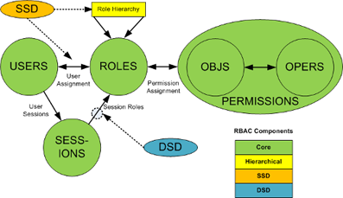
Role-Based Access Control (RBAC)
RBAC mediate permission assignment to users via the concept of a role.
RBAC virtues include its policy neutrality, adherence to least privilege principle, and ease of management.
Administration is facilitated by assigning different users to define roles or making changes to existing role sets of the system.

Slide 6
Outline
Introduction and Background
IoT Access Control Requirements
RBAC Administrative Model for Smart Home IoT
Operational Model for Smart Home IoT
Administrative Model for Smart Home IoT
RBAC Administrative Policy Model
Conclusion and Future Work
What could be done?
EGRBAC Model Introduction
Administrative Use Case
Proposed Model’s Properties and Restrictions
Role-Base Access Control (RBAC)

Slide 7
Operational Model for Smart Home IoT
Many operational models have been proposed for Smart Home IoT.
EGRBAC (Extended Generalized RBAC) is a generalized RBAC model for user-to-device operational access [Ameer et al., 2020]
  Provides granularity by defining Device Roles (DR)
    It is permission-centric, instead of device-centric
  Capture the environmental conditions through Environmental Roles (ER)
  Contextuality has been provided via Role Pair (RP) definition

Slide 8

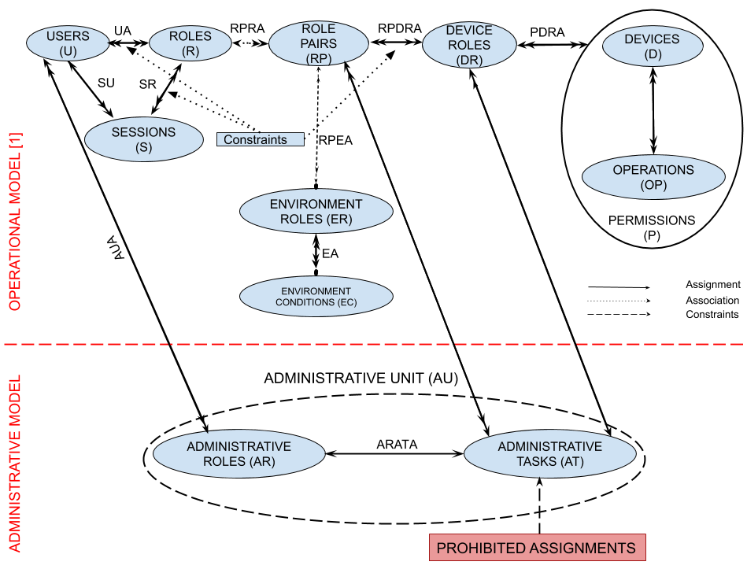











Basic Administrative Model
{(parent,Any_Time),(kid,Entertainment_Time)}
Entertainment_Devices
Bob
Alex
Julia
$P_{1}$={Turn On, Turn Off, PG, R}
Susan
Kids_Friendly_Content
$P_{2}$={Turn On, Turn Off, PG}
Administrative Unit (AU) is the core component of decentralization.
Each AU contains a unique specific Administrative Role (AR) and a set of Administrative Tasks (AT).
Authorization is scoped as a set of administrative tasks defined to manage corresponding assignments in an operational model.

Slide 9

RBAC Administrative Model for Smart Home
Our model addresses the administration of EGRBAC.
Our model is decentralized:
    Avoid single point of failure
    Improve users’ privacy
Potential changes to the dynamic environment of smart home include:
    Add a new user
    Add a new device
    Modification of current assignments in the model

Slide 10
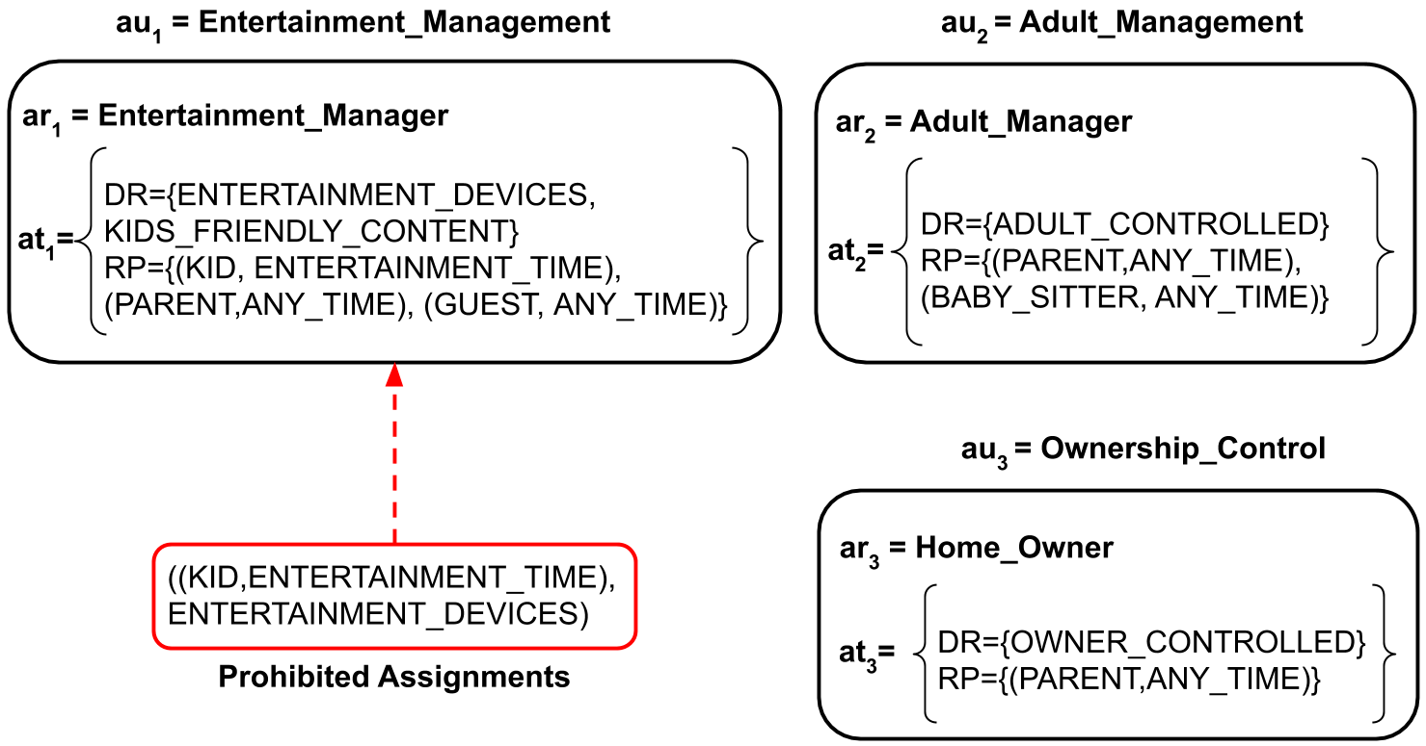
Smart Home Use Case

Slide 11
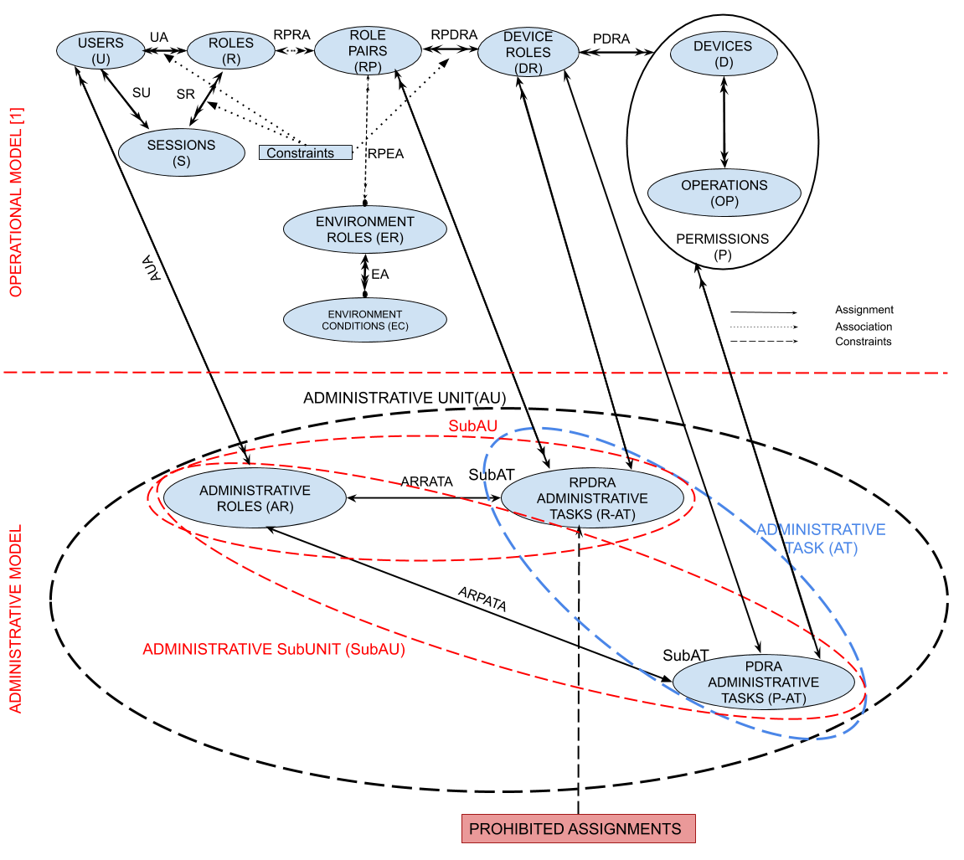
Extended Administrative Model

Slide 12
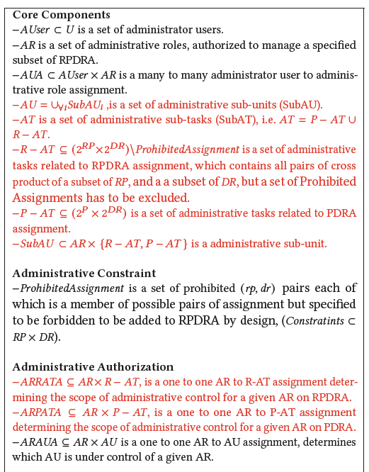
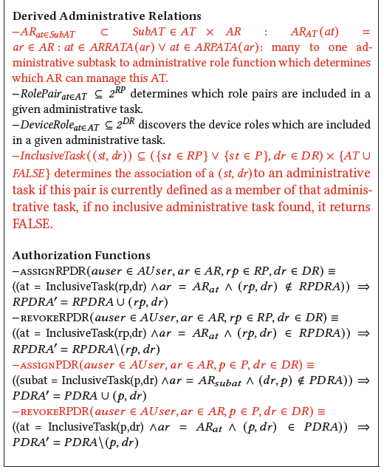
Extended Administrative Model Formalization

Slide 13
Model Properties and Restrictions
Model Properties:
    Decoupled Assignment and Revocation
    Symmetric Assignment and Revocation
    Generalizability
Model Restrictions:
    Continuous Usage Control
    Quota-based Access Enforcement
    Conflict of Interest

Slide 14
Outline
Introduction and Background
IoT Access Control Requirements
RBAC Administrative Model for Smart Home IoT
Operational Model for Smart Home IoT
Administrative Model for Smart Home IoT
RBAC Administrative Policy Model
Conclusion and Future Work
What could be done?
EGRBAC Model Introduction
Administrative Use Case
Proposed Model’s Properties and Restrictions
Role-Base Access Control (RBAC)

Slide 15
Conclusion and Future Directions
In Conclusion:
  We proposed an RBAC administrative model based on EGRBAC operational model in smart home environments.
  We introduced the concept of administrative unit, which consists of a unique administrative role and a set of administrative tasks.
Future Directions:
  Address Model Constraints (continuous usage control, quota-based management
  Device to Device (D2D) communication helps with providing an autonomous intelligence in IoT environments.

Slide 16

Acknowledgement
This work is partially supported by NSF CREST Grant 1736209.

Slide 17

Thank You
Any Questions?

