Slide 1
CS 5323
Attribute-Based Access Control (ABAC)
Prof. Ravi Sandhu
Executive Director and Endowed Chair
Lecture 10
ravi.utsa@gmail.com
www.profsandhu.com
© Ravi Sandhu
World-Leading Research with Real-World Impact!

Slide 2
Access Control
Fixed
policy
Discretionary Access Control (DAC), 1970
Mandatory Access Control (MAC), 1970
Role Based Access Control (RBAC), 1995
Attribute Based Access Control (ABAC), ????
Flexible
policy
© Ravi Sandhu
World-Leading Research with Real-World Impact!
2

Slide 3
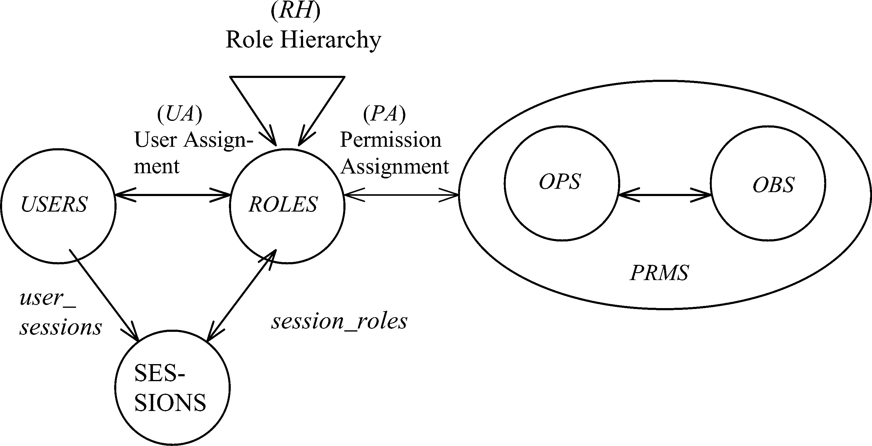
RBAC Shortcomings
Hard Enough
Impossible
Constraints
© Ravi Sandhu
World-Leading Research with Real-World Impact!
3

Slide 4
The RBAC Story
NIST-ANSI
Standard
Adopted
NIST-ANSI
Standard Proposed
RBAC96
model
Ludwig Fuchs, Gunther Pernul and Ravi Sandhu, Roles in Information Security-A Survey and Classification of the Research Area, Computers & Security, Volume 30, Number 8, Nov. 2011, pages 748-76
© Ravi Sandhu
World-Leading Research with Real-World Impact!
4

Slide 5
ABAC Status
Standard
Adopted
Proposed
Standard
RBAC96
paper
1990?
2017
ABAC still in pre/early phase
© Ravi Sandhu
World-Leading Research with Real-World Impact!
5

Slide 6
ABAC is not New
User (Identity)
Attributes
Public-keys +
Secured secrets
© Ravi Sandhu
World-Leading Research with Real-World Impact!

Slide 7
ABAC is not New
User (Identity)
X.500
Directory
X.509
Identity Certificates
Attributes
Public-keys +
Secured secrets
Pre Internet, early 1990s
© Ravi Sandhu
World-Leading Research with Real-World Impact!

Slide 8
ABAC is not New
User (Identity)
X.509
Attribute
Certificates
X.509
Identity Certificates
Attributes
Public-keys +
Secured secrets
Post Internet, late 1990s
© Ravi Sandhu
World-Leading Research with Real-World Impact!

Slide 9
ABAC is not New
User (Identity)
Attributes
SPKI Certificates
Public-keys +
Secured secrets
Post Internet, late 1990s
© Ravi Sandhu
World-Leading Research with Real-World Impact!

Slide 10
ABAC is not New
User (Identity)
Attributes
Anonymous
Credentials
Public-keys +
Secured secrets
Mature Internet, 2000s
© Ravi Sandhu
World-Leading Research with Real-World Impact!

Slide 11
ABAC is not New
Attributes
Action
Authorization Decision
User
Subject
Yes/No
Object
Context
XACML
Policy
Mature Internet, 2000s
© Ravi Sandhu
World-Leading Research with Real-World Impact!

Slide 12
ABACα and ABACβ Models
© Ravi Sandhu
World-Leading Research with Real-World Impact!

Slide 13
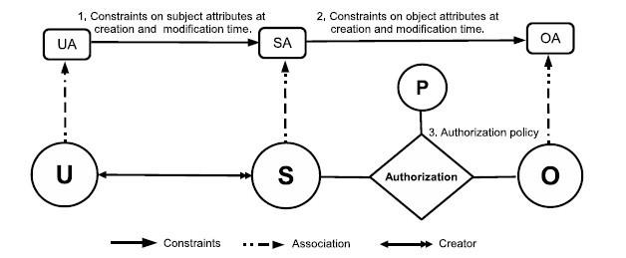
ABACα Model Structure
Policy Configuration Points
Just sufficient mechanism to do
simple forms of DAC, MAC, RBAC
© Ravi Sandhu
World-Leading Research with Real-World Impact!
13

Slide 14
ABACα Authorization Policy
  DAC
  MAC
  RBAC0
  RBAC1
© Ravi Sandhu
World-Leading Research with Real-World Impact!
14

Slide 15
ABACα Subject Attribute Constraints
  MAC creation
  modification FALSE
  RBAC0
  RBAC1

Slide 16
ABACα Object Attribute Constraints
  DAC Creation
  Modification
  MAC Creation
  Modification FALSE

Slide 17
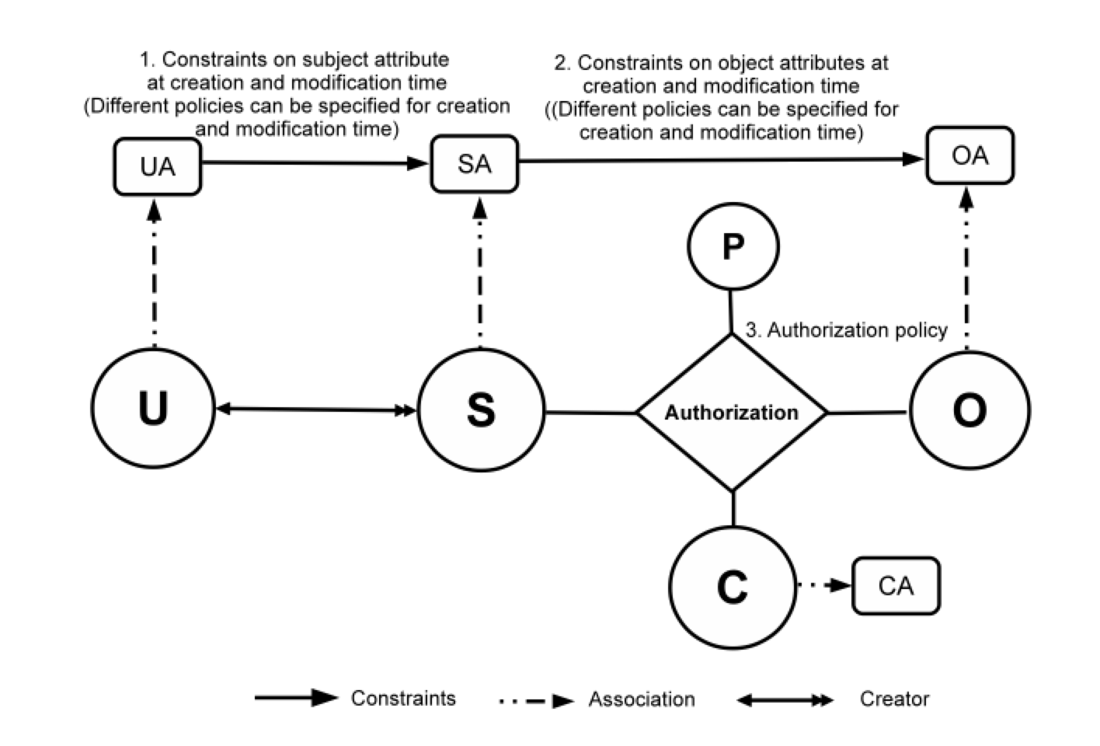
ABAC_{β} Model
Can be configured to do many
but not all RBAC extensions
17
Notes:
Show abac-alpha
Then for each type of extension, highlight the extensions to ABAC
23 and 24 integrated

Slide 18
Roles and Attributes
© Ravi Sandhu
World-Leading Research with Real-World Impact!

Slide 19
Roles and Attributes
Attribute-
Centric
Role is just another attribute. Nothing special about it.
Dynamic
Roles
Compute user roles from user attributes
Role-
Centric
Attributes constrain permissions of roles for each user
© Ravi Sandhu
World-Leading Research with Real-World Impact!
19

Slide 20
User-Role Assignment Problem
Hard Enough
Impossible
Constraints
© Ravi Sandhu
World-Leading Research with Real-World Impact!
20

Slide 21
Beyond Attributes
© Ravi Sandhu
World-Leading Research with Real-World Impact!

Slide 22
Access Control
Fixed
policy
Discretionary Access Control (DAC), 1970
Mandatory Access Control (MAC), 1970
Relationship Based Access Control (ReBAC), 2008
Role Based Access Control (RBAC), 1995
Attribute Based Access Control (ABAC), ????
Flexible
policy
© Ravi Sandhu
World-Leading Research with Real-World Impact!
22

Slide 23
Access Control
Fixed
policy
Discretionary Access Control (DAC), 1970
Mandatory Access Control (MAC), 1970
Relationship Based Access Control (ReBAC), 2008
Role Based Access Control (RBAC), 1995
Attribute Based Access Control (ABAC), ????
Flexible
policy
© Ravi Sandhu
World-Leading Research with Real-World Impact!
23

