Slide 1
CS 5323
Role-Based Access Control (RBAC)
Prof. Ravi Sandhu
Executive Director and Endowed Chair
Lecture 9
ravi.utsa@gmail.com
www.profsandhu.com
© Ravi Sandhu
World-Leading Research with Real-World Impact!

Slide 2
Access Control
Fixed
policy
Ownership gives discretion
One-directional information flow
Discretionary Access Control (DAC), 1970
Mandatory Access Control (MAC), 1970
Policy neutral
Role Based Access Control (RBAC), 1995
Attribute Based Access Control (ABAC), ????
Flexible
policy
© Ravi Sandhu
World-Leading Research with Real-World Impact!
2

Slide 3
The RBAC Story
Standard
Adopted
Proposed
Standard
RBAC96
paper
Ludwig Fuchs, Gunther Pernul and Ravi Sandhu, Roles in Information Security-A Survey and Classification of the Research Area, Computers & Security, Volume 30, Number 8, Nov. 2011, pages 748-76
© Ravi Sandhu
World-Leading Research with Real-World Impact!
3
Notes:
This is a somewhat busy slide
It shows a bird’s eye view of RBAC
There are many details that need to be debated and filled in
Some of these will be discussed in the subsequent panel
For our purpose the bird’s eye view will suffice

Slide 4
RBAC: Role-Based Access Control
  Access is determined by roles
  A user’s roles are assigned by security administrators
  A role’s permissions are assigned by security administrators
First emerged: mid 1970s
First models: mid 1990s
Is RBAC MAC or DAC or neither?
  RBAC can be configured to do MAC
  RBAC can be configured to do DAC
  RBAC is policy neutral
RBAC is neither MAC nor DAC!
© Ravi Sandhu
World-Leading Research with Real-World Impact!
4

Slide 5
RBAC96 Model
© Ravi Sandhu
World-Leading Research with Real-World Impact!

Slide 6
RBAC96 Model Family
ROLE HIERARCHIES
USER-ROLE
ASSIGNMENT
PERMISSIONS-ROLE
ASSIGNMENT
USERS
ROLES
PERMISSIONS
...
SESSIONS
CONSTRAINTS
© Ravi Sandhu
World-Leading Research with Real-World Impact!
6
Notes:
This is a somewhat busy slide
It shows a bird’s eye view of RBAC
There are many details that need to be debated and filled in
Some of these will be discussed in the subsequent panel
For our purpose the bird’s eye view will suffice

Slide 7
RBAC96 Model Family
RBAC3
ROLE HIERARCHIES +
CONSTRAINTS
RBAC1
ROLE
HIERARCHIES
RBAC2
CONSTRAINTS
RBAC0
BASIC RBAC
© Ravi Sandhu
World-Leading Research with Real-World Impact!
7
Notes:
This is a somewhat busy slide
It shows a bird’s eye view of RBAC
There are many details that need to be debated and filled in
Some of these will be discussed in the subsequent panel
For our purpose the bird’s eye view will suffice

Slide 8
Founding Principles of RBAC96
  Abstraction of Privileges
    Credit is different from Debit even though both require read and write
  Separation of Administrative Functions
    Separation of user-role assignment from role-permission assignment
  Least Privilege
    Right-size the roles
    Don’t activate all roles all the time
    Limit roles of a user
    Limit users in a role
  Separation of Duty
    Static separation: purchasing manager versus accounts payable manager
    Dynamic separation: cash-register clerk versus cash-register manager
© Ravi Sandhu
World-Leading Research with Real-World Impact!
8

Slide 9
ROLES AS POLICY
A role brings together
  a collection of users and
  a collection of permissions
These collections will vary over time
  A role has significance and meaning beyond the particular users and permissions brought together at any moment
© Ravi Sandhu
World-Leading Research with Real-World Impact!
9

Slide 10
ROLES VERSUS GROUPS
Groups are often defined as
  a collection of users
A role is
  a collection of users and
  a collection of permissions
Some authors define role as
  a collection of permissions
Most Operating Systems support groups
  BUT do not support selective activation of groups
Selective activation conflicts with negative groups (or roles)
© Ravi Sandhu
World-Leading Research with Real-World Impact!
10

Slide 11
HIERARCHICAL ROLES
Primary-Care
Physician
Specialist
Physician
Physician
Health-Care Provider
© Ravi Sandhu
World-Leading Research with Real-World Impact!
11

Slide 12
HIERARCHICAL ROLES
Supervising
Engineer
Hardware
Engineer
Software
Engineer
Engineer
© Ravi Sandhu
World-Leading Research with Real-World Impact!
12

Slide 13
PRIVATE ROLES
Hardware
Engineer’
Supervising
Engineer
Software
Engineer’
Hardware
Engineer
Software
Engineer
Engineer
© Ravi Sandhu
World-Leading Research with Real-World Impact!
13

Slide 14
EXAMPLE ROLE HIERARCHY
Director (DIR)
Project Lead 1
(PL1)
Project Lead 2
(PL2)
Production 1
(P1)
Quality 1
(Q1)
Production 2
(P2)
Quality 2
(Q2)
Engineer 1
(E1)
Engineer 2
(E2)
PROJECT 1
Engineering Department (ED)
PROJECT 2
Employee (E)
© Ravi Sandhu
World-Leading Research with Real-World Impact!
14

Slide 15
EXAMPLE ROLE HIERARCHY
Project Lead 1
(PL1)
Project Lead 2
(PL2)
Production 1
(P1)
Quality 1
(Q1)
Production 2
(P2)
Quality 2
(Q2)
Engineer 1
(E1)
Engineer 2
(E2)
PROJECT 1
Engineering Department (ED)
PROJECT 2
Employee (E)
© Ravi Sandhu
World-Leading Research with Real-World Impact!
15

Slide 16
EXAMPLE ROLE HIERARCHY
Director (DIR)
Project Lead 1
(PL1)
Project Lead 2
(PL2)
Production 1
(P1)
Quality 1
(Q1)
Production 2
(P2)
Quality 2
(Q2)
Engineer 1
(E1)
Engineer 2
(E2)
PROJECT 1
PROJECT 2
© Ravi Sandhu
World-Leading Research with Real-World Impact!
16

Slide 17
EXAMPLE ROLE HIERARCHY
Project Lead 1
(PL1)
Project Lead 2
(PL2)
Production 1
(P1)
Quality 1
(Q1)
Production 2
(P2)
Quality 2
(Q2)
Engineer 1
(E1)
Engineer 2
(E2)
PROJECT 1
PROJECT 2
© Ravi Sandhu
World-Leading Research with Real-World Impact!
17

Slide 18
CONSTRAINTS
Mutually Exclusive Roles
  Static Exclusion: The same individual can never hold both roles
  Dynamic Exclusion: The same individual can never hold both roles in the same context
Mutually Exclusive Permissions
  Static Exclusion: The same role should never be assigned both permissions
  Dynamic Exclusion: The same role can never hold both permissions in the same context
Cardinality Constraints on User-Role Assignment
  At most k users can belong to the role
  At least k users must belong to the role
  Exactly k users must belong to the role
Cardinality Constraints on Permissions-Role Assignment
  At most k roles can get the permission
  At least k roles must get the permission
  Exactly k roles must get the permission
© Ravi Sandhu
World-Leading Research with Real-World Impact!
18

Slide 19
NIST RBAC Model
© Ravi Sandhu
World-Leading Research with Real-World Impact!

Slide 20
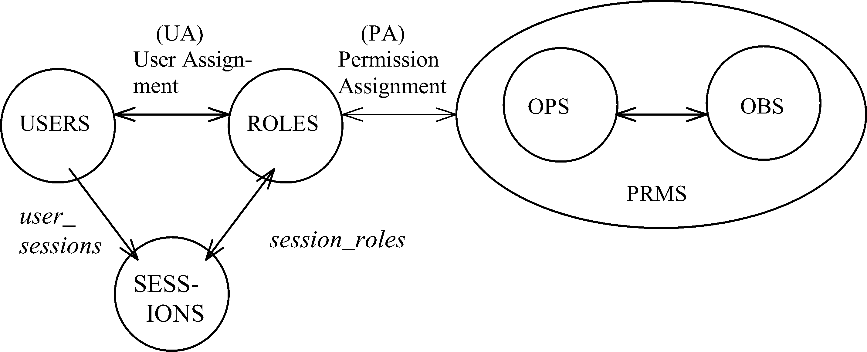
NIST MODEL: CORE RBAC
© Ravi Sandhu
World-Leading Research with Real-World Impact!
20

Slide 21
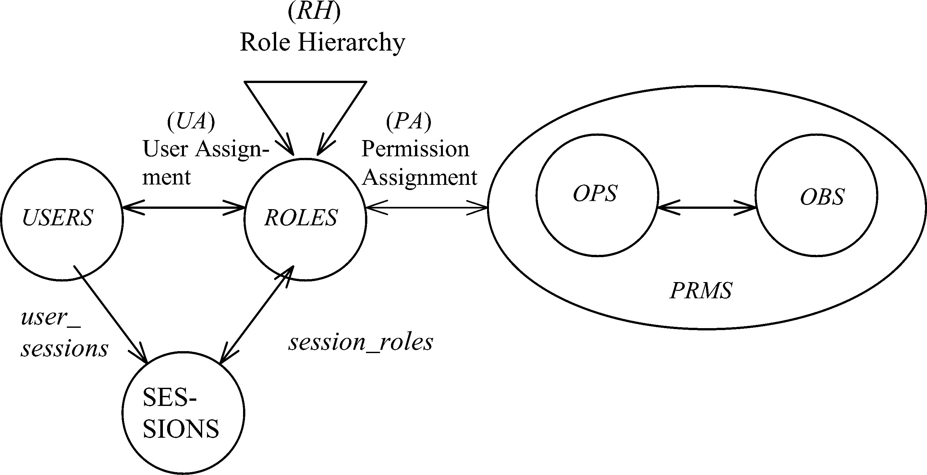
NIST MODEL: HIERARCHICAL RBAC
© Ravi Sandhu
World-Leading Research with Real-World Impact!
21

Slide 22
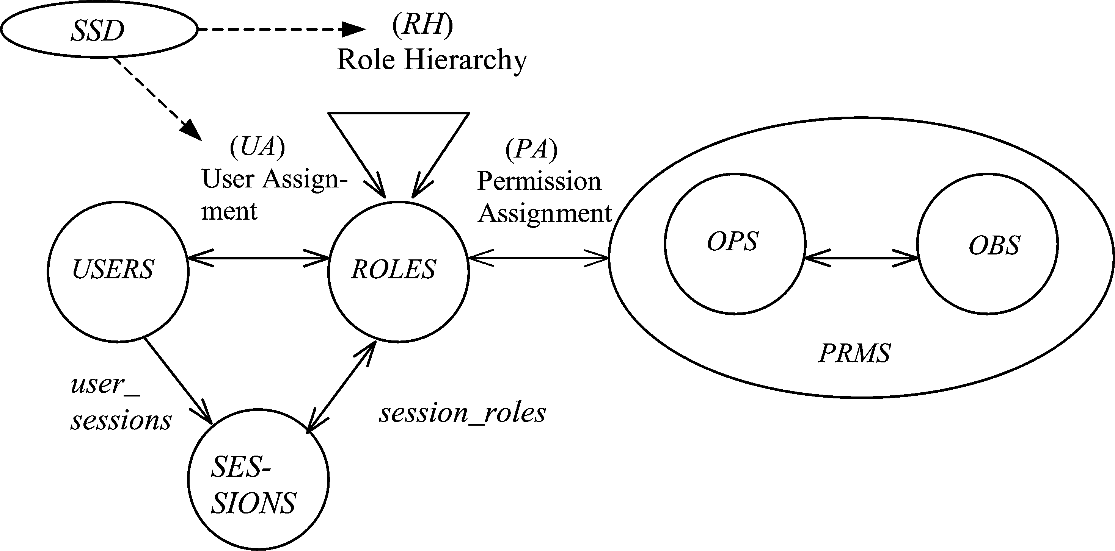
SSD IN HIERARCHICAL RBAC
© Ravi Sandhu
World-Leading Research with Real-World Impact!
22

Slide 23
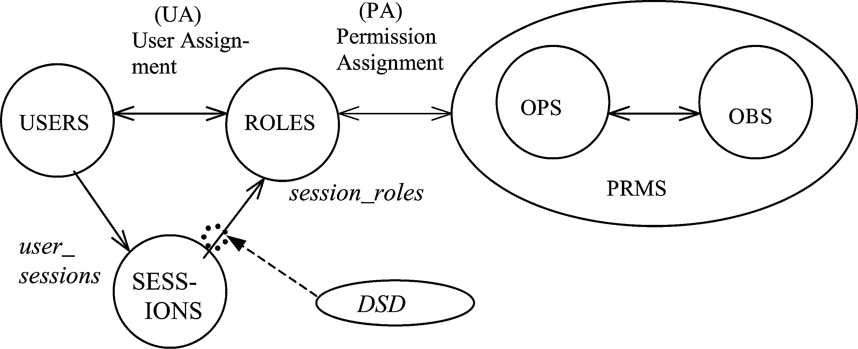
DSD IN HIERARCHICAL RBAC
© Ravi Sandhu
World-Leading Research with Real-World Impact!
23

Slide 24
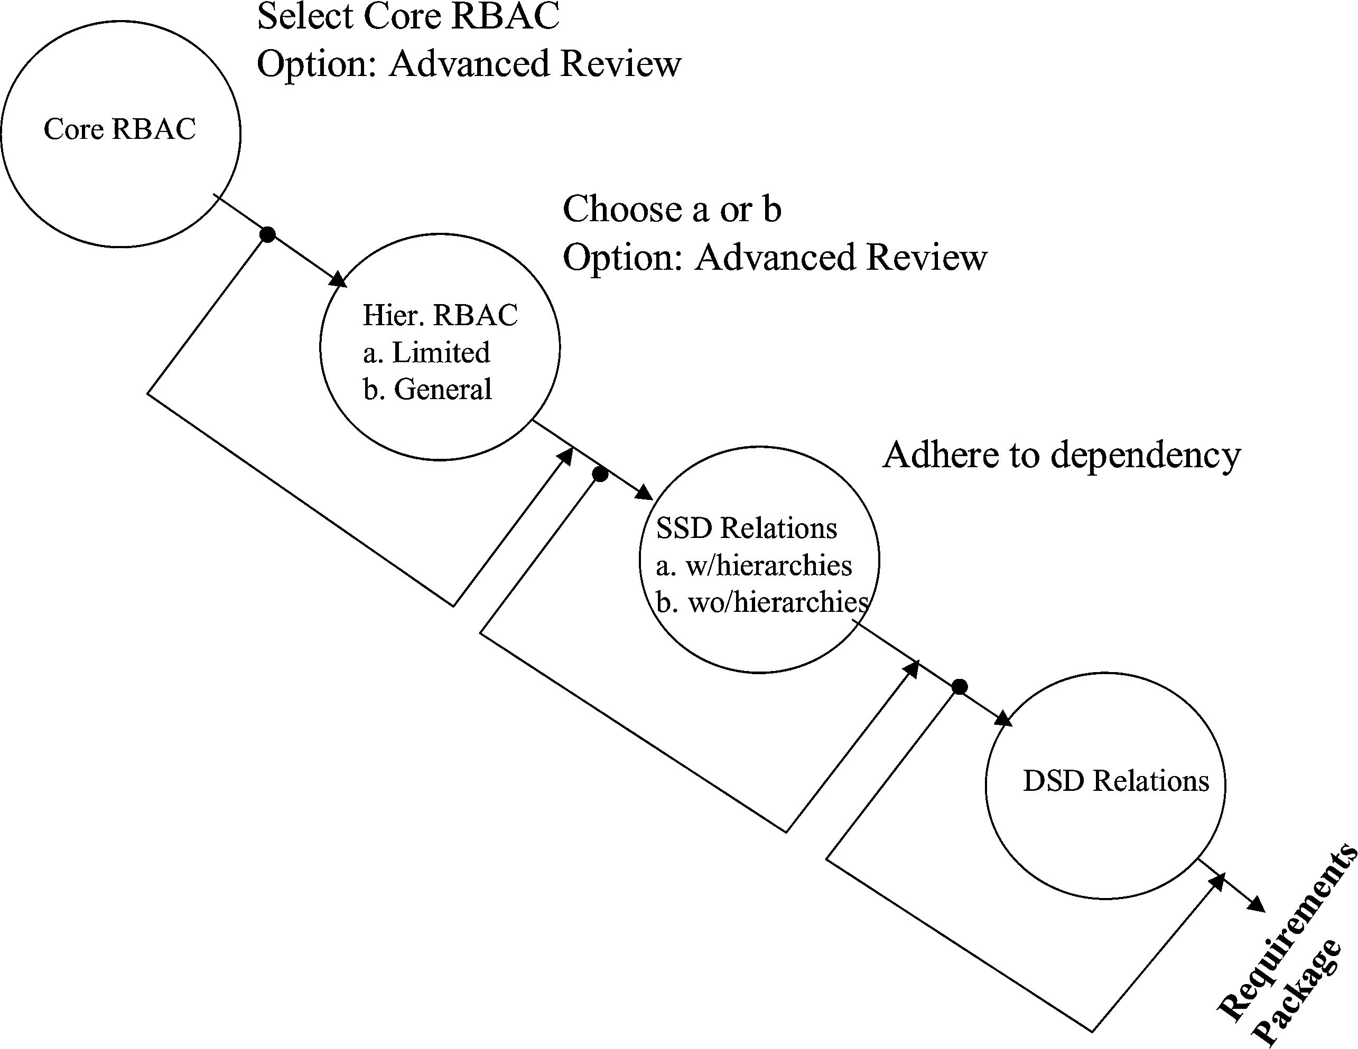
NIST MODEL FAMILY
© Ravi Sandhu
World-Leading Research with Real-World Impact!
24

Slide 25
Compare RBAC96 Model Family
RBAC3
ROLE HIERARCHIES +
CONSTRAINTS
RBAC1
ROLE
HIERARCHIES
RBAC2
CONSTRAINTS
RBAC0
BASIC RBAC
© Ravi Sandhu
World-Leading Research with Real-World Impact!
25
Notes:
This is a somewhat busy slide
It shows a bird’s eye view of RBAC
There are many details that need to be debated and filled in
Some of these will be discussed in the subsequent panel
For our purpose the bird’s eye view will suffice

Slide 26
RBAC Administration
© Ravi Sandhu
World-Leading Research with Real-World Impact!

Slide 27
RBAC96 Model Family
ROLE HIERARCHIES
USER-ROLE
ASSIGNMENT
PERMISSIONS-ROLE
ASSIGNMENT
USERS
ROLES
PERMISSIONS
...
SESSIONS
CONSTRAINTS
© Ravi Sandhu
World-Leading Research with Real-World Impact!
27
Notes:
This is a somewhat busy slide
It shows a bird’s eye view of RBAC
There are many details that need to be debated and filled in
Some of these will be discussed in the subsequent panel
For our purpose the bird’s eye view will suffice

