Slide 1
Access, Usage and Activity Controls
Institute for Cyber Security
Mar. 30, 2012
UTSA CS6393
Jaehong Park
Institute for Cyber Security
University of Texas at San Antonio
jae.park@utsa.edu

Slide 2
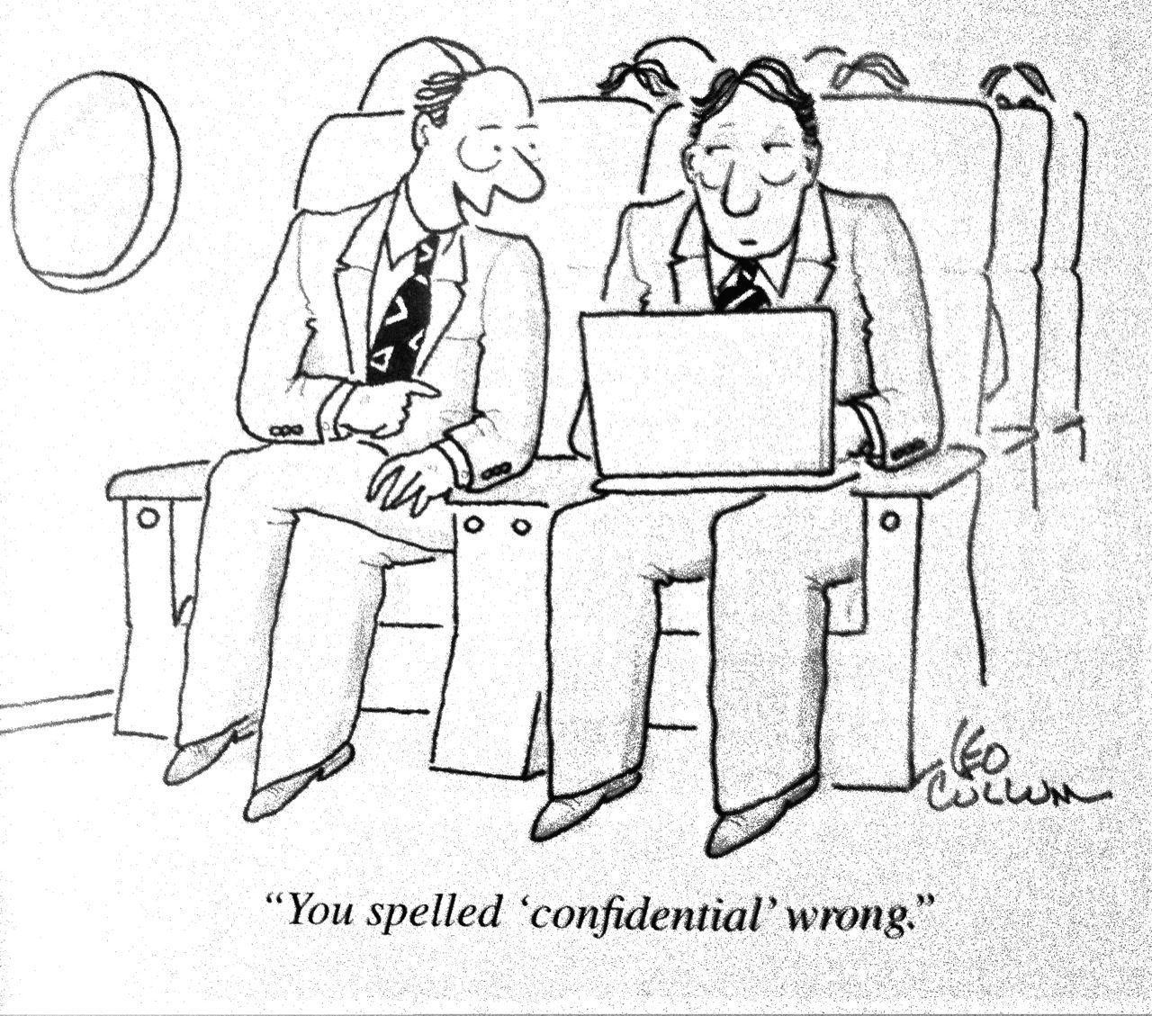
“You spelled ‘confidential’ wrong.”
Who’s the victim?
Problems/Concerns?
Our assumptions?
Necessary access controls?
Notes:
Problem: security, privacy, trustworthiness issues?

Slide 3
Access Control Considerations
Objectives
Security, Privacy, Intellectual Property Rights Protection and trustworthiness
Target domain
System-level, application-level
Access Target
System resource, data, user, policies and attributes
Access Types
Access, usage, activity

Slide 4
OM-AM layered Approach
Model examples: Access Matrix, Lattice-based model, Role-base access control model
ABC core model for UCON

Slide 5
Usage Control (UCON)

Slide 6
Motivation (1)
Traditional access control models are not adequate for today’s distributed, network-connected digital environment.
Authorization only – No obligation or condition based control
Decision is made before access – No ongoing control
No consumable rights - No mutable attributes
Rights are pre-defined and granted to subjects

Slide 7
Motivation (2)
No access control model available to capture Digital Rights Management (DRM)
Control after dissemination
IPR protection
Need for a unified model that can encompass traditional access control models, DRM and other enhanced access control models from recent literature

Slide 8
Usage Control (UCON)
Scope
Encompass traditional access controls, trust management, digital rights management and more
For sensitive information protection, IPR protection, and privacy protection
Model
General purpose, policy neutral models
Policy is assumed to be given to the system
Transaction based control
Existence of right is determined when access is attempted by a subject (no predefined access matrix)
Attribute-based access control

Slide 9
Usage Control (UCON) Coverage
Security
Objectives
Security Architectures

Slide 10
Building UCON_{ABC} Models
Continuity
Decision can be made during usage for continuous enforcement
Mutability
Attributes can be updated as side-effects of subjects’ actions

Slide 11
Examples
Long-distance phone (pre-authorization with post-update)
Pre-paid phone card (ongoing-authorization with ongoing-update)
Pay-per-view (pre-authorization with pre-updates)
Click Ad within every 30 minutes (ongoing-obligation with ongoing-updates)
Business Hour (pre-/ongoing-condition)

Slide 12
UCON_{ABC} Model Space
 | 0(Immutable) | 1(pre) | 2(ongoing) | 3(post)
preA | Y | Y | N | Y
onA | Y | Y | Y | Y
preB | Y | Y | N | Y
onB | Y | Y | Y | Y
preC | Y | N | N | N
onC | Y | N | N | N
N : Not applicable

Slide 13
A Family of UCON_{ABC} Core Models

Slide 14
UCON_{preA}
Online content distribution service
Pay-per-view (pre-update)
Metered payment (post-update)

Slide 15
UCON_{onA}
Pay-per-minutes (pre-paid Phone Card)

Slide 16
UCON_{preA}: pre-Authorizations Model
UCON_{preA0}
S, O, R, ATT(S), ATT(O) and preA (subjects, objects, rights, subject attributes, object attributes, and pre-authorizations respectively);
allowed(s,o,r) ⇒ preA(ATT(s),ATT(o),r)
UCON_{preA1}
preUpdate(ATT(s)),preUpdate(ATT(o))
UCON_{preA3}
postUpdate(ATT(s)),postUpdate(ATT(o))

Slide 17
UCON_{preA0}: MAC Example
L is a lattice of security labels with dominance relation ≥
clearance: S → L
classification: O → L
ATT(S) = {clearance}
ATT(O) = {classification}
allowed(s,o,read) ⇒ clearance(s) ≥ classification(o)
allowed(s,o,write) ⇒ clearance(s) ≤ classification(o)

Slide 18
DAC in UCON:with ACL (UCON_{preA0})
N is a set of identity names
id : S → N, one to one mapping
ACL : O → 2^{N x R}, n is authorized to do r to o
ATT(S)= {id}
ATT(O)= {ACL}
allowed(s,o,r) ⇒ (id(s),r) ∈ ACL(o)

Slide 19
RBAC in UCON: RBAC₁ (UCON_{preA0})
P = {(o,r)}
ROLE is a partially ordered set of roles with dominance relation ≥
actRole: S → 2^{ROLE}
Prole: P → 2^{ROLE}
ATT(S) = {actRole}
ATT(O) = {Prole}
allowed(s,o,r) ⇒ ∃role ∈ actRole(s), ∃role’ ∈ Prole(o,r), role ≥ role’

Slide 20
DRM in UCON: Pay-per-use with a pre-paid credit (UCON_{preA1})
M is a set of money amount
credit: S → M
value: O x R → M
ATT(s): {credit}
ATT(o,r): {value}
allowed(s,o,r) ⇒ credit(s) ≥ value(o,r)
preUpdate(credit(s)): credit(s) = credit(s) - value(o,r)

Slide 21
UCON_{preA3} : DRM Example
Membership-based metered payment
M is a set of money amount
ID is a set of membership identification numbers
TIME is a current usage minute
member: S → ID
expense: S → M
usageT: S → TIME
value: O x R → M (a cost per minute of r on o)
ATT(s): {member, expense, usageT}
ATT(o,r): {valuePerMinute}
allowed(s,o,r) ⇒ member(s) ≠ ∅
postUpdate(expense(s)): expense(s) = expense(s) + (value(o,r) x usageT(s))

Slide 22
UCON_{onA}: ongoing-Authorizations Model
UCON_{onA0}
S, O, R, ATT(S), ATT(O) and onA;
allowed(s,o,r) ⇒ true;
Stopped(s,o,r) ⇐ ¬onA(ATT(s),ATT(o),r)
UCON_{onA1}, UCON_{onA2}, UCON_{onA3}
preUpdate(ATT(s)),preUpdate(ATT(o))
onUpdate(ATT(s)),onUpdate(ATT(o))
postUpdate(ATT(s)),postUpdate(ATT(o))
Examples
Certificate Revocation Lists
revocation based on starting time, longest idle time, and total usage time

Slide 23
UCON_{B}
Free Internet Service Provider
Watch Ad window (no update)
Click ad within every 30 minutes (ongoing update)

Slide 24
UCON_{preB0}: pre-oBligations w/ no update
S, O, R, ATT(S), and ATT(O);
OBS, OBO and OB (obligation subjects, obligation objects, and obligation actions, respectively);
preB and preOBL (pre-obligations predicates and pre-obligation elements, respectively);
preOBL ⊆ OBS x OBO x OB;
preFulfilled: OBS x OBO x OB → {true,false};
getPreOBL: S x O x R → 2^{preOBL}, a function to select pre-obligations for a requested usage;
preB(s,o,r) = Λ(obs_i,obo_i,ob_i) ∈ getPreOBL(s,o,r) preFulfilled(obs_{i},obo_{i},ob_{i});
preB(s,o,r) = true by definition if getPreOBL(s,o,r)=∅;
allowed(s,o,r) ⇒ preB(s,o,r).
Example: License agreement for a whitepaper download

Slide 25
UCON_{onB0}: ongoing-oBligations w/ no update
S, O, R, ATT(S), ATT(O), OBS, OBO and OB;
T, a set of time or event elements;
onB and onOBL (on-obligations predicates and ongoing-obligation elements, respectively);
onOBL ⊆ OBS x OBO x OB x T;
onFulfilled: OBS x OBO x OB x T→ {true,false};
getOnOBL: S x O x R → 2^{onOBL}, a function to select ongoing-obligations for a requested usage;
onB(s,o,r) = Λ(obs_i,obo_i,ob_i, t_i) ∈ getOnOBL(s,o,r) onFulfilled(obs_{i},obo_{i},ob_{i} ,t_{i});
onB(s,o,r) = true by definition if getOnOBL(s,o,r)=∅;
allowed(s,o,r) ⇒ true;
Stopped(s,o,r) ⇐ ¬ onB(s,o,r).
Example: Free ISP with mandatory ad window

Slide 26
UCON_{C}
Location check at the time of access request
Accessible only during business hours

Slide 27
UCON_{preC0}: pre-Condition model
S, O, R, ATT(S), and ATT(O);
preCON (a set of pre-condition elements);
preConChecked: preCON → {true,false};
getPreCON: S x O x R → 2^{preCON};
preC(s,o,r) = Λ_{preCon_i ∈ getPreCON(s,o,r)} preConChecked(preCon_{i});
allowed(s,o,r) ⇒ preC(s,o,r).
Example: location checks at the time of access requests

Slide 28
UCON_{onC0}: ongoing-Condition model
S, O, R, ATT(S), and ATT(O);
onCON (a set of on-condition elements);
onConChecked: onCON → {true,false};
getOnCON: S x O x R → 2^{onCON};
onC(s,o,r) = Λ_{onCon_i ∈ getOnCON(s,o,r)} onConChecked(onCon_{i});
allowed(s,o,r) ⇒ true;
Stopped(s,o,r) ⇐ ¬onC(s,o,r)
Example: accessible during office hour

Slide 29
UCON_{ABC}
Free ISP
Membership is required (pre-authorization)
Have to click Ad periodically while connected (on-obligation, on-update)
Free member: no evening connection (on-condition), no more than 50 connections (pre-update) or 100 hours usage per month (post-updates)

Slide 30
Beyond the UCON_{ABC} Core Models

Slide 31
Summary of UCON
Coined the concept of Usage Control for modern computing system Environment
Developed A family of UCON_{ABC} core models for Usage Control (UCON) to unify traditional access control models, DRM, and other modern enhanced models.
UCON_{ABC} model integrates authorizations, obligations, conditions, as well as continuity and mutability properties.

Slide 32
ACON: Activity-Centric Access Control for Social Computing
Institute for Cyber Security

Slide 33
Social Networking vs. Social Computing
Social Networking Systems
Social computing Systems

Slide 34
Social Networking vs. Social Computing
(Online) Social Computing
(Online)Social Networking
To share ‘social’ interests by utilizing online social network connections
To share ‘social’ interests that may or may not require social network connections

Slide 35
Some Issues in Social Computing
Security
Privacy
Access Control
Trustworthiness
Usability

Slide 36
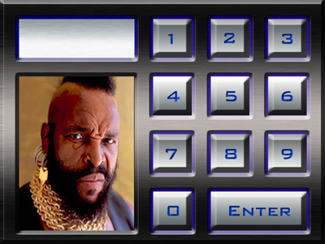
Access Control Considerations
Objectives
Security, Privacy, Intellectual Property Rights Protection, trustworthiness
Target domain
System-level, application-level
Access Target
System resource, data, user
Access Types
Access, usage, activity

Slide 37
Sharing in Social Computing
Users share with others:
knowledge, opinion, interests, information of their (sharing) activities, etc.
Social computing systems (SCS) provide services to promote information sharing by utilizing user activity information and shared contents
Best seller, friends recommendation, friend activity notification, location-based service, etc.
Both users and SCS provide/access information to be shared
Both resource and user as a target of activity
Alice pokes bob, a buyer rates sellers

Slide 38
Controls in Social Computing
A user wants to control other user’s or SCS’s activities against shared information (or users) related to the user
My children cannot be a friend of my co-worker
System should not notify my activity to my friends
User wants to protect their privacy
Only friends can read my comments
Do not notify friends activity to me
Do not recommend a friend
A user’s activity influences access control decisions
Rating-based popularity

Slide 39
Activities in SCS
No traditional access control can provide necessary controls on all kinds of activities found in SCS
Activity as a key concept for access control
Why Activity-centric?
Multiple kinds of activities (in addition to user’s general usage activity against resource) that have to be controlled.
User’s usage/control activity on user/resource, SCS’s service/control activities
A user’s activities influence SCS’s control decisions on own and other users’ activities as well as SCS activities.
Once Alice invites Bob as a friend, Bob is allowed to see Alice’s information
If Alice is a friend of Bob and Bob becomes a friend of Chris, 1) if Chris allows friends of friends to his contents, Alice can access Chris’s contents; 2) SCS may recommend Chris and Alice as a friend
Buyers’ ratings on a seller may collectively used to control the seller’s sales activity.

Slide 40
Activities in SCS
User’s Control Activity (UCA) | System’s Control Activity (SCA)
User’s Service Activity (USA) | System’s Service Activity (SSA)
User’s Usage Activity (UUA) | System’s Usage Activity (SUA)
Control
Service (create)
Usage (consume)
User
System

Slide 41
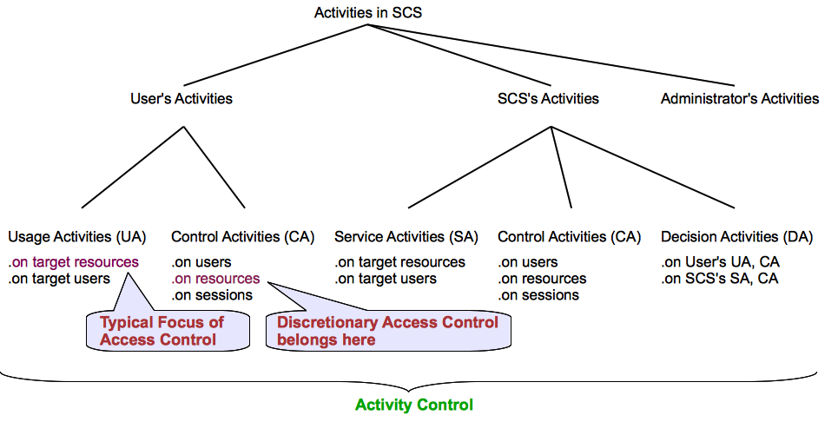
Activity Taxonomy in SCS

Slide 42
User’s Usage Activities
Users’ consuming activity on Target Resources
Read/view shared comments/photos
Typical Focus of Access Control

Slide 43
User’s Service Activities
Users’ activity that shares certain information with other users or SCS
Add comments/review
Rate sellers/products
Tag photos w/ users
Like a comment
Service Activity on Target Users
Poke a friend

Slide 44
User’s Control Activities
Control Activity on Resources
By changing attributes and policies of resources
set a resource as a violent content (attribute), accessible only by direct friends (policy)
Parents can set attributes and policies of children’s resources
Discretionary Access Control belongs here
Control Activity on Users
By changing user attributes and policies
To control activity performed by/against a particular user (self or other related users) without knowing a particular resource
Control Activity on Sessions
By controlling session attributes and policies that are inherited from a user

Slide 45
SCS’s (Automated) Activities
Usage Activities
Typically accessing users’ shared information to use it as an input for service activities
Service Activities
To promote users’ social interactions and information sharing
Friends recommendation, friend activity notification, location-based coupons, most-viewed videos
Control Activities
Through managing policies and attributes of users, resources and sessions
User rating-based seller trustworthiness or product popularity
Decision Activities
SCS evaluates requests for user’s usage and control activities as well as SCS’s service and control activities

Slide 46
Activity(-centric Access) Control Framework
To capture various users and SCS activities and their influences on control decisions
To support controls on various access/usage, service and control activities in SCS
To support personalized user privacy control
To support automated management of SCS services and controls

Slide 47
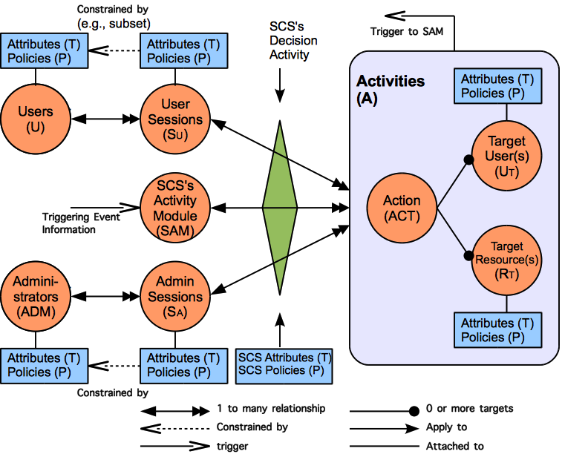
ACON Framework

Slide 48
ACON Framework Components
Users
represent a human being who performs activities in an SCS
Carry attributes and policies
Sessions
Represent an active user who has logged into the SCS
A user can have multiple sessions, but not vise versa
Carry attributes and policies that could be different from user attributes and policies

Slide 49
ACON Framework Components (cont)
Activities
User, SCS, SCS administrator’s activities
Comprise action, target users, target resources
Action
An abstract function available in SCS
E.g., read, rate, poke, friend-invite, activity notification
Target users(’ sessions)
Recipients of an action
Target Resources
Include users’/SCS’s shared contents, user/resource/session policies and attributes

Slide 50
ACON Framework Components (cont)
SCS’s Decision Activity
based on the consolidated individual user/resource policies and attributes together w/ SCS policies and attributes
SCS’s Activity Module (SAM)
A conceptual abstraction of functions that performs SCS’s automated usage, service and control activities
SCS Administrators
Human being w/ a management role

Slide 51
ACON Framework Characteristics
Policy Individualization
A user’s individual policy includes privacy preferences and activity limits
Collectively used by SCS for control decision on activities
Can be configured by related users
User and Resource as a Target
User as a target requires policies for actions against target users.
Poking, friends recommendation
Separation of user policies for incoming and outgoing actions
Incoming action policy: Homer doesn’t want to receive notification of friends’ activities
Outgoing action policy: Homer says Bart cannot be a friend of Homer’s coworkers
User-session distinction
User relationship independent access control
SCS’s automated usage, service and control activities

Slide 52
Examples
Request (Alice, read, video1) is allowed if Alice is a friend of the owner of video1 and if Alice is over 18
Request: AU: Alice, UsageAct: read, TR:video1
Attributes: AU.ATT: friend={bob}; DOB=1980, TR.ATT: owner=Bob, contentType=violent
Policies: TR.P=can be read by owner’s friends, System.P=only >18 can play/read violent contents
Request (Alice, poke, Bob) is allowed if Alice is a friend of Bob

Slide 53
ACON_{user} Model – User Activity Control
U, S, ACT, R, T, P, SCS and D (users, sessions, actions, resources, attributes, policies, social computing system and decision predicate, respectively);
U_{T} ⊆ U and R_{T} ⊆ R (target users and target resources, respectively);
dot notation: we understand e.T and e.P to respectively denote the set of attributes and set of policies associated with entity e;
A, the set of activities is defined as A⊆ACT ×(2^{RT} ×2^{UT} −∅);
Let A = {a₁, a₂, ..., a_{n}}, we denote the components of each individual element as a_{i} = (a_{i}.ACT, a_{i}.R_{T} , a_{i}.U_{T} );

Slide 54
ACON_{user} Model – User Activity Control
AP_R_{T} :A→2^{RT×P}, AP_U_{T} :A→2^{UT×P}, AT_R_{T} :A→2^{RT×T}, AT_U_{T} :A→2^{UT×T}, mappings of activity to a set of target resources and policies, a set of target users and policies, a set of target resources and attributes, and a set of target users and attributes respectively defined as:
AP_R_{T}({a₁,..,a_{n}})=AP_R_{T}({a₁})∪...∪AP_R_{T}({a_{n}}), AP_R_{T}({a_{i}})={(r_{t},p)|r_{t} ∈a_{i}.R_{T},p∈r_{t}.P}
AP_U_{T}({a₁,..,a_{n}})=AP_U_{T}({a₁})∪...∪AP_U_{T}({a_{n}}), AP_U_{T}({a_{i}})={(u_{t},p)|u_{t} ∈a_{i}.U_{T},p∈u_{t}.P}
AT_R_{T}({a₁,..,a_{n}})=AT_R_{T}({a₁})∪...∪AT_R_{T}({a_{n}}), AT_R_{T}({a_{i}})= {(r_{t},t)|r_{t} ∈a_{i}.R_{T},t∈r_{t}.T}
AT_U_{T}({a₁,..,a_{n}})=AT_U_{T}({a₁})∪...∪AT_U_{T}({a_{n}}), AT_U_{T}({a_{i}})={(u_{t},t)|u_{t} ∈a_{i}.U_{T},t∈u_{t}.T};

Slide 55
ACON_{user} Model – User Activity Control
AP(a)=AP_R_{T}(a)∪AP_U_{T}(a),
AT(a)=AT_R_{T}(a)∪AT_U_{T}(a);
allowed(s,a)⇒D(s.P,s.T,a,AP(a), AT(a),scs.P,scs.T), where s ∈ S and a ∈ A.

Slide 56
ACON_{user} Model – Session Management
user_sessions : U → 2^{S}, session_users : S → U;
user_added_sessionT : S → 2^{T} , user_removed_sessionT : S → 2^{T} ;
scs_added_sessionT : S → 2^{T} , scs_removed_sessionT : S → 2^{T} , scs_required_sessionT : S → 2^{T} ;
user_added_sessionP : S → 2^{P} , user_removed_sessionP : S → 2^{P} ;
scs_added_sessionP : S → 2^{P} , scs_removed_sessionP : S → 2^{P} , scs_required_sessionT : S → 2^{T} ;
user_removed_sessionT(s) ⊆ {t ∈ T |t ∈ session users(s).T ∧ t ∉ scs_required_sessionT (s)};
user_removed_sessionP(s) ⊆ {p ∈ P |p ∈ session users(s).P ∧ p ∉ scs required_sessionP(s)};

Slide 57
ACON_{user} Model – Session Management
assignS_T : S → 2^{T} , assignS_P : S → 2^{P} , assignment of attributes and policies to sessions respectively;
assignS_T(s) ⊆ {t∈T|(t ∈ session_users(s).T ) ∨ (t∈ user_added_sessionT(s)) ∨ (t ∈ scs_added_sessionT(s))∧ ¬((t∈ user_removed_sessionT(s)) ∨ (t∈ scs_removed_sessionT(s)))};
assignS_P(s) ⊆ {p∈P|(p ∈ session_users(s).P )∨ (p∈ user_added_sessionP(s))∨ (p∈ scs_added_sessionP(s))∧ ¬((p∈ user_removed_sessionP(s))∨ (p∈ scs_removed_sessionP(s)))}.

Slide 58
Examples
A buyer can rate a seller only if the buyer bought a product from the seller (SCS.P).
N: a list of users, sellerList : S → 2^{N}
allowed(s, rate, u_{t}) ⇒ u_{t} ∈ sellerList(s)
A user can recommend a friendship between two friends if they are not a friend to each other(SCS.P).
N: a list of users, friends : S → 2^{N}
allowed(s, f-recommend, u_{t}1, u_{t}2)⇒
({u_{t}1, u_{t}2}∈ friends(s))∧(u_{t}2 ∉ friends(u_{t}1))∧
(u_{t}1 ∉ friends(u_{t}2))

Slide 59
Summary
Developed activity-centric access control framework for security and privacy in social computing systems.
Developed initial models for user activity controls and session management.

Slide 60
Controlling Access, Usage and Activity
Access
Control
Usage Control
Activity Control

Slide 61
Comments and Questions?
Contact info
jae.park@utsa.edu
www.drjae.com
http://ics.utsa.edu

