Slide 1
Common Criteria
Ravi Sandhu

Slide 2
Common Criteria
International unification
  CC v2.1 is ISO 15408
Flexibility
Separation of
  Functional requirements
  Assurance requirements
Marginally successful so far
  v1 1996, v2 1998, widespread use ???

Slide 3
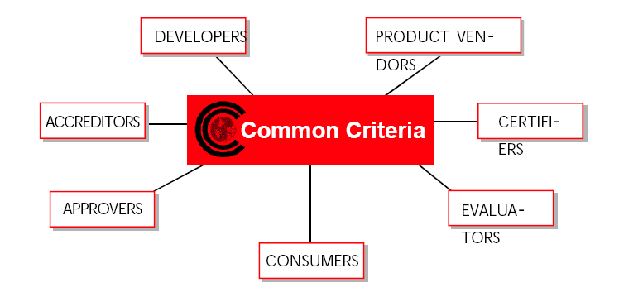
Common Criteria

Slide 4
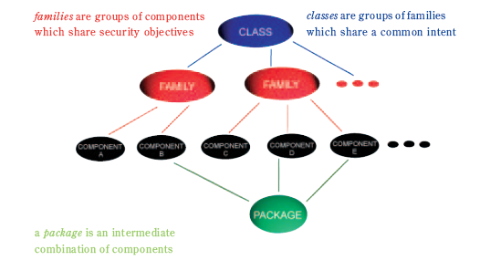
Class, Family, Component, Package

Slide 5
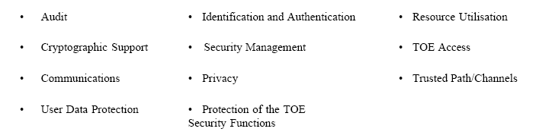
Security Functional Requirements

Slide 6
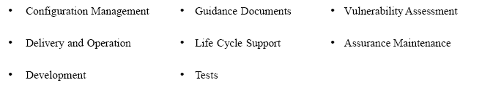
Security Assurance Requirements

Slide 7
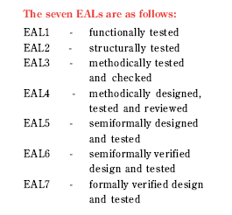
Evaluation Assurance Levels (EALs)
Security can be retrofitted
Security must be designed in
Impractical except for simplest systems

Slide 8
Evaluation Assurance Levels (EALs)
Black box evaluation
Grey box evaluation
White box evaluation

Slide 9
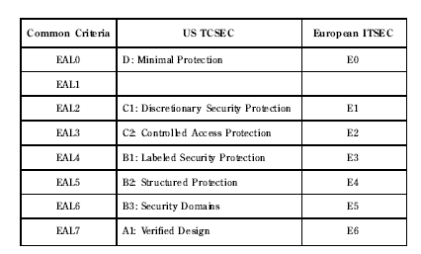
Evaluation Assurance Levels (EALs)

