Slide 1
Provenance-based Access Control in Cloud IaaS
Institute for Cyber Security
August 23, 2013
Dissertation Proposal
Dang Nguyen
Institute for Cyber Security
University of Texas at San Antonio

Slide 2
Data Provenance in Computer Systems
“In computer systems, activities are carried out by processes that take input data, input state, input configuration, and produce output data and output state. Such processes are compositional by nature and can be the result of sophisticated compositions (sequential, parallel, conditional, etc) of simpler processes.” (Luc Moreau, “The Foundation for Provenance on the Web”)
Notes:
Data provenance is utilized in many domains of computer science, including databases and scientific workflows. In databases, allows different types of provenance queries to be made such as why-, where-, and how- provenance queries. In scientific workflows, well documented workflow processes allow smooth reproduction of such workflows at different times.
Data provenance can also be utilized for security purposes in systems. For example, monitoring system events enable mechanism to detect insider threat, identify potential points of intrusion based on behavior of system entities. The use cases grow and go on and on.
Bottom line is: provenance provides significant usefulness and all aspects relating to provenance incorporation into systems should be studied and enhanced.

Slide 3
Characteristics of Provenance Data
Information of operations/transactions performed against data objects and versions
Actions that were performed against data
Acting Users/Subjects who performed actions on data
Data Objects used for actions
Data Objects generated from actions
Additional Contextual Information of the above entities
Directed Acyclic Graph (DAG)
Causality dependencies between entities (acting users / subjects, action processes and data objects)
Dependency graph can be traced/traversed for the discovery of Origin, usage, versioning info, etc.
Notes:
Not a typical regular database data. Forms DAG.
Use of trace and traverse is interchangable.
Data provenance is utilized in many domains of computer science, including databases and scientific workflows. In databases, allows different types of provenance queries to be made such as why-, where-, and how- provenance queries. In scientific workflows, well documented workflow processes allow smooth reproduction of such workflows at different times.
Another contribution can be found in a broader scope: common foundation for access control in prov-aware systems.

Slide 4
Provenance and Access Control
Compared to traditional access control, Provenance-based Access Control (PBAC) provides richer access control mechanisms.
For example: dynamic separation of duties issues.
Notes:
Different aspects of provenance security are mentioned often in the literature.
Essential provenance information can be more sensitive and critical than the attached regular data. Henceforth, provenance data requires access control protection to be secure.
This aspect of access control requires relatively large amount of attention.

Slide 5
Provenance Data Model
Base PBAC Model
Contextual PBAC Model
Provenance data sharing approaches
Notes:
A provenance data model which provides efficient utilities for access control mechanisms is essential. The foundation of access control in systems are enabled with a well defined and rich provenance data model.

Slide 6
Provenance-aware Systems
Capturing provenance data
Storing provenance data
Querying provenance data
Using provenance data
Securing provenance data
Provenance Data Model
Access Control
Notes:
Analyzing provenance data
Pbac is not as extensible as abac. However,
What is pbac’s policy configuration point?
ABAC is application independent.
To put meaning on attribute you need application

Slide 7
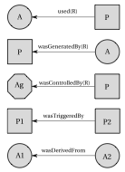
Open Provenance Model (OPM)
3 Node Types
Artifact (ellipse): Object
Process (Rectangle): Action
Agent (Octagon/Hexagon): User/Subject
5 Causality dependency edge Types (not a dataflow)
U: Used(Role)
G: wasGeneratedBy(Role)
C: wasControlledBy(Role)
wasDerivedFrom
wasTriggeredBy
Notes:
As discussed before, provenance has its uses in different application domain. Within each domain, how provenance data is utilized is different. As a consequence, each application domain produces its own provenance data model to specifically cater to its needs. This leads to inconsistency in viewing provenance, and hence the community altogether put in the efforts to generate a grand provenance data model that can be configured to address any application domains where applicable.
The OPM is the result of this effort by the community. Essentially the model identify the core components and the causality dependencies between these in the most abstract level.

Slide 8
OPM Example
100g Sugar
100g
Flour
100g
Butter
Two
Eggs
John
used
wasControlledBy
Bake
wasGeneratedBy
wasDerivedFrom
Cake

Slide 9
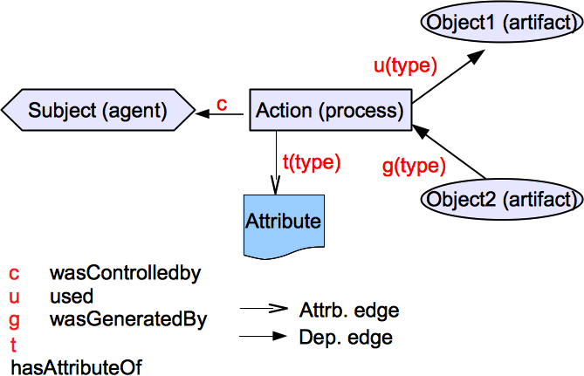
Provenance Data Model
4 Node Types
Object (Artifact)
Action (Process)
Subject (Agent)
Attribute
5 Causality dependency edge Types (not a dataflow) and Attribute Edge
Notes:
This data model effectively captures the core components of provenance entities which we require for access control purpose.
The data model provides us with means of constructing a control units based on dependency path patterns, which serve as the foundation of both the base PBAC model and the extended contextual PBAC model.
The first three node types and three out of 5 causality dependency edge types are utilized in the base PBAC model.
In the extended PBAC C model, we introduce the note type Attribute and the associating Attribute edge to accommodate the model design.

Slide 10
Capturing Provenance Data
(Subject1, Grade1, HW1, GradedHW1, ContextualInfoSet-Grade1)
(Grade1, u, HW1)
(Grade1, c, Subject1)
(GradedHW1, g, Grade1)
(Grade1, t[actingUser], Alice)
(Grade1, t[activeRole], TA)
(Grade1, t[weight], 2)
(Grade1, t[object-size], 10MB)

Slide 11
Provenance Graph
Sub1
c
HW1
u
Grade1
g
HW1_G
t(actUser)
t(…)
t(…)
t(…)
Alice
TA
2
10MB

Slide 12
Storing and Querying Provenance Data
Resource Description Framework (RDF) provides natural representation of triples.
RDF-format triples can be stored in databases.
Utilizes SPARQL Protocol and RDF Query Language for extracting useful provenance information.
Starting Node: any entities (not attribute nodes)
A matching path pattern: combination of dependency edges

Slide 13
Provenance Graph
Sub1
c
HW1
u
Grade1
g
HW1_G
t(actUser)
t(…)
t(…)
t(…)
Alice
TA
2
10MB

Slide 14
Provenance Graph
Sub1
c
SELECT ?agent WHERE { HW1_G [g:c] ?agent}
HW1
u
Grade1
g
HW1_G
t(actUser)
t(…)
t(…)
t(…)
Alice
TA
2
10MB

Slide 15
Provenance Graph
Sub1
c
SELECT ?user WHERE { HW1_G [g:t[actUser]] ?user}
HW1
u
Grade1
g
HW1-G
t(actUser)
t(…)
t(…)
t(…)
Alice
TA
2
10MB

Slide 16
Provenance Graph
Sub1
Sub2
c
c
HW1
u
Grade1
g
HW1_G
u
Grade2
g
HW1_G’
t(actUser)
t(…)
t(…)
t(…)
SELECT ?user
WHERE
{ HW1_G’ [g:u:g:c] ?user}
Alice
TA
2
10MB
{ HW1_G’ [[g:u]*:g:c] ?user}
Notes:
Now that I have presented a detailed discussion of the provenance data model, let us move on to discuss how the provenance data model elevates access control in systems. Essentially, I will describe how dependency path patterns generated from the data model can be used as a foundation for access control approaches, including both PBAC and PAC, before I go into details the specific mechanisms of PBAC.

Slide 17
PBAC Model Components
Notes:
Direct dependency as a result of transaction is captured in base provenance data.
System computable dependency instances are derived based on PDB and object DL.
User declares dependency instances using dependency names found in DL.

Slide 18
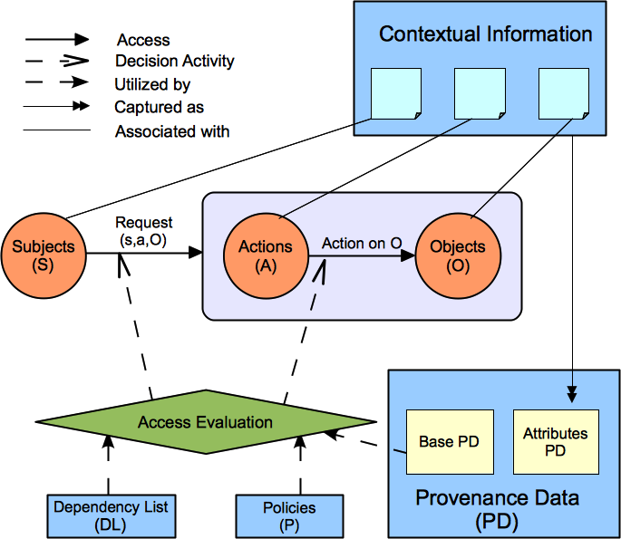
PBAC_{C} : PBAC_{B} + Contextual Info.
Notes:
Explain the differences between the two models.

Slide 19
PBAC_C in Cloud IaaS

Slide 20
Capturing Provenance Data
(Subject1, Create1, VMI1, ContextualInfoSet-Create1)
Create1, c, Subject1)
(VMI1, g, Create1)
Create1, t[tenant], “Development”)

Slide 21
Single- vs Multi-Cloud (IaaS)
Most single-cloud CSP provides centralized service.
Facilitates data sharing (provenance).
Multi-cloud CSPs require collaboration for sharing data.

Slide 22
Multi-cloud PBAC
Cloud 1
Cloud 2
Cloud 3

Slide 23
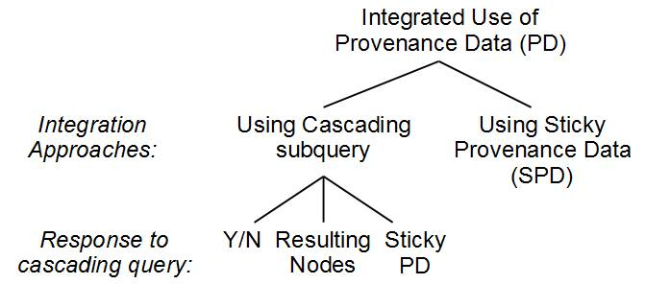
Provenance Data Sharing
Notes:
There are essentially two approaches when two individual systems work together toward sharing provenance data for PBAC purposes.
One organization creates a data object. The object is sent across to another organization. Here, when an access request is received, to make PBAC evaluation, provenance data belonging to the first org need to be shared. We identified two approaches for this case.

Slide 24
Provenance Data Sharing
Centralized Provenance and PBAC Services
Notes:
Centralized Provenance Service is a part of the Centralized PBAC Service.

Slide 25
Single MT-Cloud PBAC Architecture

Slide 26
Provenance Service

Slide 27
PBAC Service

Slide 28
Cross-tenant PBAC

Slide 29
OpenStack Authz

Slide 30
Nova Architecture

Slide 31
Thank you!!!
Questions and Comments?

