Slide 1
CS 6393
Secure Sockets Layer (SSL) and
Man-in-the-Middle Vulnerability
Prof. Ravi Sandhu
Executive Director and Endowed Chair
Lecture 5
ravi.utsa@gmail.com
www.profsandhu.com
© Ravi Sandhu
World-Leading Research with Real-World Impact!

Slide 2
Internet Security Protocols
© Ravi Sandhu
World-Leading Research with Real-World Impact!

Slide 3
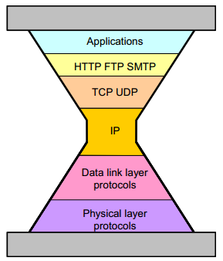
Internet Hourglass Model TCP/IP
TCP RFC 793
Sept. 1981
IPv4 RFC 791
Sept. 1981
© Ravi Sandhu
World-Leading Research with Real-World Impact!

Slide 4
Internet Security Protocols
TCP RFC 793
Sept. 1981
Where to inject security?
IPv4 RFC 791
Sept. 1981
© Ravi Sandhu
World-Leading Research with Real-World Impact!

Slide 5
Internet Security Protocols
SET,1996
TCP RFC 793
Sept. 1981
SSL,1994
IPv4 RFC 791
Sept. 1981
IPsec, 1998
© Ravi Sandhu
World-Leading Research with Real-World Impact!

Slide 6
Internet Security Protocols
Dozens of other security protocols
Half successful
SSL,1994
Some successes
Many failures
IPsec, 1998
Largely failed
© Ravi Sandhu
World-Leading Research with Real-World Impact!

Slide 7

1-way vs 2-way SSL
Client
(Browser)
1-way SSL
Server
Client
(Browser)
2-way SSL
Server
© Ravi Sandhu
World-Leading Research with Real-World Impact!

Slide 8
1-way vs 2-way SSL
Client
(Browser)
1-way SSL
Server
RSA encryption
certificate
Client
(Browser)
2-way SSL
Server
RSA signature
certificate
RSA encryption
certificate
© Ravi Sandhu
World-Leading Research with Real-World Impact!

Slide 9
1-way vs 2-way SSL
Client
(Browser)
1-way SSL
Server
LESS SECURE
Phishing
Man-in-the-middle
Client
(Browser)
2-way SSL
Server
MORE SECURE
Phishing
Man-in-the-middle
© Ravi Sandhu
World-Leading Research with Real-World Impact!

Slide 10
1-way vs 2-way SSL
Client
(Browser)
1-way SSL
Server
LESS SECURE
Phishing
Man-in-the-middle
MASS DEPLOYMENT
Client
(Browser)
2-way SSL
Server
MORE SECURE
Phishing
Man-in-the-middle
MINIMAL DEPLOYMENT
© Ravi Sandhu
World-Leading Research with Real-World Impact!

Slide 11
The SSL Lesson
Client-less trumps client-full
Start-ups (SSL) trump committees (IPSEC)
© Ravi Sandhu
World-Leading Research with Real-World Impact!
11

Slide 12
SSL Details
© Ravi Sandhu
World-Leading Research with Real-World Impact!

Slide 13
SSL
layered on top of TCP
SSL versions 1.0, 2.0, 3.0, 3.1
Netscape protocol
later refitted as IETF standard TLS (Transport Layer Security)
TLS 1.0 very close to SSL 3.1
© Ravi Sandhu
World-Leading Research with Real-World Impact!
13

Slide 14
SSL
application protocol independent
does not specify how application protocols add security with SSL
  how to initiate SSL handshaking
  how to interpret certificates
left to designers of upper layer protocols to figure out
© Ravi Sandhu
World-Leading Research with Real-World Impact!
14

Slide 15
SSL vs TCP Ports
https 443
ssmtp 465
snntp 563
sldap 636
spop3 995
ftp-data 889
ftps 990
imaps 991
telnets 992
ircs 993
© Ravi Sandhu
World-Leading Research with Real-World Impact!
15

Slide 16
SSL Services
peer entity authentication
data confidentiality
data authentication and integrity
compression/decompression
generation/distribution of session keys
  integrated into protocol
security parameter negotiation
© Ravi Sandhu
World-Leading Research with Real-World Impact!
16

Slide 17
SSL Architecture
SSL Record Protocol
TCP
IP
SSL
Handshake
Protocol
SSL Change
Cipher Spec
Protocol
SSL
Alert
Protocol
HTTP
Other
Application
Protocols
© Ravi Sandhu
World-Leading Research with Real-World Impact!
17

Slide 18
SSL Architecture
Handshake protocol: complicated
  embodies key exchange & authentication
  runs in plaintext
  10 message types
Change Cipher Spec protocol: straightforward
  single 1 byte message with value 1
  could be considered part of handshake protocol
  transitions from plaintext to encrypted and mac’ed
Record protocol: straightforward
  fragment, compress, MAC, encrypt
  uses 4 symmetric keys
Alert protocol: straightforward
  2 byte messages
  1 byte alert level- fatal or warning; 1 byte alert code
© Ravi Sandhu
World-Leading Research with Real-World Impact!
18

Slide 19
SSL Record Protocol
4 symmetric keys
Key 1 for MAC
Key 2 for encrypt
Client
(Browser)
Server
Key 3 for MAC
Key 4 for encrypt
© Ravi Sandhu
World-Leading Research with Real-World Impact!
19

Slide 20
SSL Record Protocol
4 steps by sender (reversed by receiver)
  Fragmentation
  Compression
  MAC
  Encryption
© Ravi Sandhu
World-Leading Research with Real-World Impact!
20

Slide 21
SSL Record Protocol
each SSL record contains
  content type: 8 bits, only 4 defined
    change_cipher_spec
    alert
    handshake
    application_data
  protocol version number: 8 bits major, 8 bits minor
  length: max 16K bytes (actually 2¹⁴+2048)
  data payload: optionally compressed and encrypted
  message authentication code (MAC)
© Ravi Sandhu
World-Leading Research with Real-World Impact!
21

Slide 22
SSL Handshake Protocol
initially SSL session has null compression and cipher algorithms
both are set by the handshake protocol at beginning of session
handshake protocol may be repeated during the session
© Ravi Sandhu
World-Leading Research with Real-World Impact!
22

Slide 23
SSL Session
SSL session negotiated by handshake protocol
  session ID
    chosen by server
  X.509 public-key certificate of peer
    possibly null
  compression algorithm
  cipher spec
    encryption algorithm
    message digest algorithm
  master secret
    48 byte shared secret
  is resumable flag
    can be used to initiate new connections
    each session is created with one connection, but additional connections within the session can be further created
© Ravi Sandhu
World-Leading Research with Real-World Impact!
23

Slide 24
SSL Connection State
connection end: client or server
client and server random: 32 bytes each
keys generated from master secret, client/server random
  client_write_MAC_secret server_write_MAC_secret
  client_write_key server_write_key
  client_write_IV server_write_IV
compression state
cipher state: initially IV, subsequently next feedback block
sequence number: starts at 0, max 2⁶⁴-1
© Ravi Sandhu
World-Leading Research with Real-World Impact!
24

Slide 25
SSL Connection State
4 parts to state
  current read state
  current write state
  pending read state
  pending write state
handshake protocol
  initially current state is empty
  either pending state can be made current and reinitialized to empty
© Ravi Sandhu
World-Leading Research with Real-World Impact!
25

Slide 26
SSL Handshake Protocol
Type: 1 byte
  10 message types defined
length: 3 bytes
content
© Ravi Sandhu
World-Leading Research with Real-World Impact!
26

Slide 27
SSL Handshake Protocol
Phase 1
Phase 2
Phase 3
Phase 4
Record
Protocol
© Ravi Sandhu
World-Leading Research with Real-World Impact!
27

Slide 28
SSL Handshake Protocol
Phase 1:
  Establish security capabilities
Phase 2:
  Server authentication and key exchange
Phase 3:
  Client authentication and key exchange
Phase 4:
  Finish
© Ravi Sandhu
World-Leading Research with Real-World Impact!
28

Slide 29
SSL Handshake Protocol
these handshake messages must occur in order
optional messages can be eliminated
10th message
  hello_request
  can be sent anytime from server to client to request client to start handshake protocol to renegotiate session
change_cipher_spec is a separate 1 message protocol
  functionally just like a message in the handshake protocol
© Ravi Sandhu
World-Leading Research with Real-World Impact!
29

Slide 30
SSL 1-Way Handshake with RSA
Phase 1
Phase 2
Phase 3
Phase 4
Record
Protocol
© Ravi Sandhu
World-Leading Research with Real-World Impact!
30

Slide 31
SSL Handshake Phase 1
Establish security capabilities
client hello message
  4 byte timestamp, 28 byte random value
  session ID:
    non-zero for new connection on existing session
    zero for new connection on new session
  client version: highest version
  cipher_suite list: ordered list
    key exchange method, encryption method, MAC method
  compression list: ordered list
server hello message
  32 byte random value
  session ID:
    new or reuse
  version
    lower of client suggested and highest supported
  cipher_suite list: single choice
  compression list: single choice
© Ravi Sandhu
World-Leading Research with Real-World Impact!
31

Slide 32
SSL 1-Way Handshake with RSA
Phase 1
Phase 2
Phase 3
Phase 4
Record
Protocol
© Ravi Sandhu
World-Leading Research with Real-World Impact!
32

Slide 33
SSL RSA 1-way Handshake Phase 2
Server authentication and key exchange
certificate message
  server’s X.509v3 certificate followed by optional chain of certificates
  required for RSA
  server done message
  ends phase 2, always required
© Ravi Sandhu
World-Leading Research with Real-World Impact!
33

Slide 34
SSL 1-Way Handshake with RSA
Phase 1
Phase 2
Phase 3
Phase 4
Record
Protocol
© Ravi Sandhu
World-Leading Research with Real-World Impact!
34

Slide 35
SSL 1-way Handshake Phase 3
Client authentication and key exchange
  client key exchange message
  client generates 48-byte pre-master secret, encrypts with server’s RSA public key
  client and server compute 48 byte master secret
  using 48-byte pre-master secret, ClientHello.random, ServerHello.random
  client and server compute 4 symmetric keys from master secret
Key 1 for MAC
Key 2 for encrypt
Client
(Browser)
Server
Key 3 for MAC
Key 4 for encrypt
© Ravi Sandhu
World-Leading Research with Real-World Impact!
35

Slide 36
SSL 1-Way Handshake with RSA
Phase 1
Phase 2
Phase 3
Phase 4
Record
Protocol
© Ravi Sandhu
World-Leading Research with Real-World Impact!
36

Slide 37
SSL 1-way RSA Handshake Phase 4
Finish and move to record protocol
change cipher spec message
  not considered part of handshake protocol but in some sense is part of it
  1 byte message protected by current state
  copies pending state to current state
Finished message
  sent under new algorithms and keys
  content is MAC of all previous messages with master secret and constant “client finished” or “server finished”
© Ravi Sandhu
World-Leading Research with Real-World Impact!
37

Slide 38
SSL 1-Way Handshake with RSA
Phase 1
Phase 2
Phase 3
Phase 4
Record
Protocol
© Ravi Sandhu
World-Leading Research with Real-World Impact!
38

Slide 39
SSL 2-Way Handshake with RSA
Phase 1
Phase 2
Phase 3
Phase 4
Record
Protocol
© Ravi Sandhu
World-Leading Research with Real-World Impact!
39

Slide 40
SSL RSA 2-way Handshake Phase 2
Server authentication and key exchange
certificate message
  server’s X.509v3 certificate followed by optional chain of certificates
  required for RSA
certificate request message
  request a certificate from client
  specifies Certificate Type and Certificate Authorities
  server done message
  ends phase 2, always required
© Ravi Sandhu
World-Leading Research with Real-World Impact!
40

Slide 41
SSL 2-way Handshake Phase 3
Client authentication and key exchange
  certificate message
  client’s X.509v3 certificate followed by optional chain of certificates
  client key exchange message
  client generates 48-byte pre-master secret, encrypts with server’s RSA public key
  certificate verify message
  signs hash of master secret (established by key exchange) and all handshake messages so far
  client and server compute 48 byte master secret
  using 48-byte pre-master secret, ClientHello.random, ServerHello.random
  client and server compute 4 symmetric keys from master secret
© Ravi Sandhu
World-Leading Research with Real-World Impact!
41

Slide 42
SSL Alert Protocol
2 byte alert messages
  1 byte level
    fatal or warning
  1 byte
    alert code
© Ravi Sandhu
World-Leading Research with Real-World Impact!
42

Slide 43
SSL Alert Messages
© Ravi Sandhu
World-Leading Research with Real-World Impact!
43

Slide 44
SSL Alert Messages
always fatal
  unexpected_message
  bad_record_mac
  decompression_failure
  handshake_failure
  illegal_parameter
© Ravi Sandhu
World-Leading Research with Real-World Impact!
44

Slide 45
SSL Man-in-the-Middle
(MITM) Attack
© Ravi Sandhu
World-Leading Research with Real-World Impact!

Slide 46
1-way SSL MITM
Client
(Browser)
Server
https
RSA encryption
certificate
© Ravi Sandhu
World-Leading Research with Real-World Impact!

Slide 47
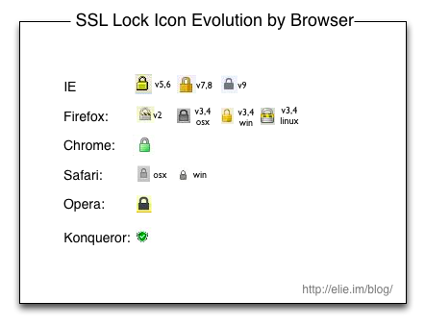
SSL
© Ravi Sandhu
World-Leading Research with Real-World Impact!

Slide 48
1-way SSL MITM
Client
(Browser)
MITM
Server
http
https
RSA encryption
certificate
© Ravi Sandhu
World-Leading Research with Real-World Impact!

Slide 49
1-way SSL MITM
Client
(Browser)
MITM
Server
https
https
RSA encryption
certificate
© Ravi Sandhu
World-Leading Research with Real-World Impact!

Slide 50
1-way SSL MITM
Client
(Browser)
MITM
Server
https
https
fake server
certificate
RSA encryption
certificate
© Ravi Sandhu
World-Leading Research with Real-World Impact!

Slide 51
Server-Side Masquerading
Bob
Web browser
www.host.com
Web server
1 way SSL
Ultratrust
Security
Services
www.host.com
© Ravi Sandhu
World-Leading Research with Real-World Impact!

Slide 52
Server-Side Masquerading
Bob
Web browser
www.host.com
Web server
1-way SSL
1-way SSL
Ultratrust
Security
Services
Mallory’s
Web server
www.host.com
BIMM
Corporation
www.host.com
© Ravi Sandhu
World-Leading Research with Real-World Impact!

Slide 53
Server-Side Masquerading
Bob
Web browser
www.host.com
Web server
1-way SSL
1-way SSL
Ultratrust
Security
Services
BIMM
Corporation
Mallory’s
Web server
www.host.com
Ultratrust
Security
Services
www.host.com
© Ravi Sandhu
World-Leading Research with Real-World Impact!

Slide 54
1-way SSL MITM
Client
(Browser)
MITM
Server
https
https
fake server
certificate
RSA encryption
certificate
RSA signature
certificate
fake client
certificate
© Ravi Sandhu
World-Leading Research with Real-World Impact!

Slide 55
OpenSSL Heartbleed Attack
© Ravi Sandhu
World-Leading Research with Real-World Impact!

Slide 56
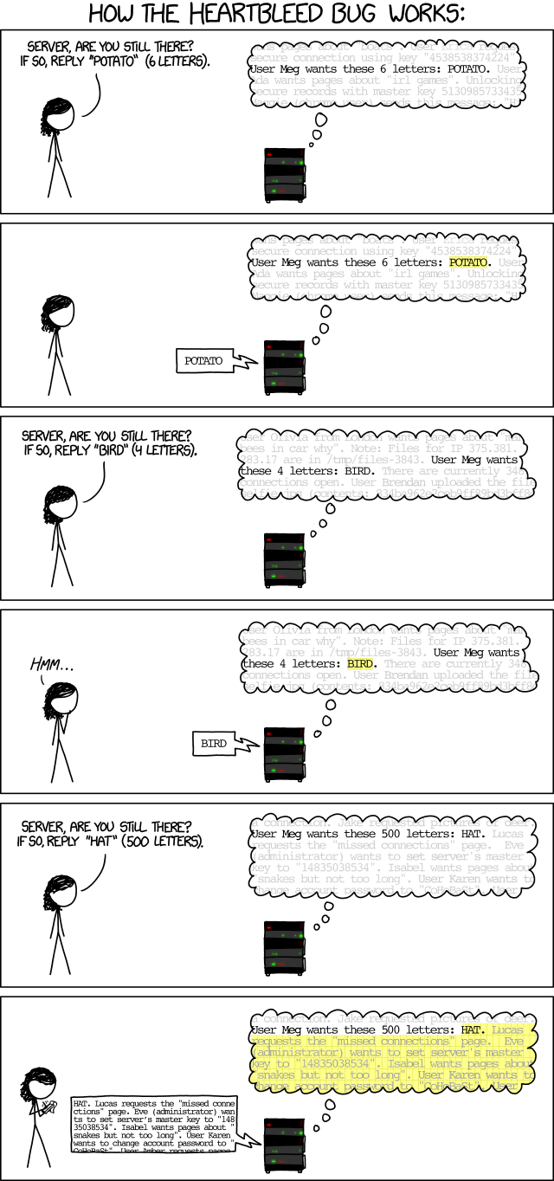
Heartbeat Protocol: RFC 6520, Feb. 2012
© Ravi Sandhu
World-Leading Research with Real-World Impact!

