Slide 1
CS 6393: Cyber Security Models and Systems
AWS and AWS-IoT Access Control Models
Ravi Sandhu
L6-3
© Ravi Sandhu
World-Leading Research with Real-World Impact!

Slide 2
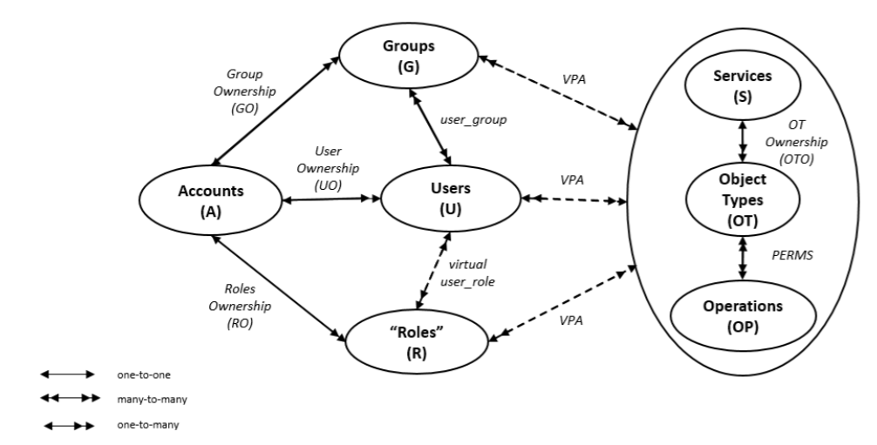
AWS Access Control (AWSAC) Model
* Zhang, Y., Patwa, F., Sandhu, R.: Community-based secure information and resource sharing in AWS public cloud. In: 1st IEEE Conference on Collaboration and Internet Computing (CIC). pp. 46–53. IEEE (2015)
© Ravi Sandhu
World-Leading Research with Real-World Impact!
2

Slide 3
AWS Access Control (AWSAC) Model
* Zhang, Y., Patwa, F., Sandhu, R.: Community-based secure information and resource sharing in AWS public cloud. In: 1st IEEE Conference on Collaboration and Internet Computing (CIC). pp. 46–53. IEEE (2015)
© Ravi Sandhu
World-Leading Research with Real-World Impact!
3

Slide 4
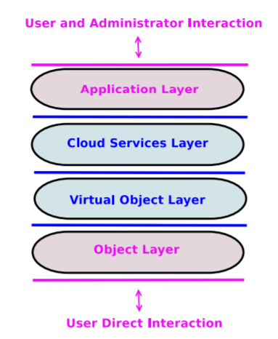
ACO Architecture for Cloud-Enabled IoT
* Alshehri, A., Sandhu, R.: Access control models for cloud-enabled internet of things: a proposed architecture and research agenda. In: 2nd IEEE International Conference on Collaboration and Internet Computing (CIC), pp. 530–538. IEEE (2016)
© Ravi Sandhu
World-Leading Research with Real-World Impact!
4

Slide 5
AWS Access Control (AWSAC) Model
* Zhang, Y., Patwa, F., Sandhu, R.: Community-based secure information and resource sharing in AWS public cloud. In: 1st IEEE Conference on Collaboration and Internet Computing (CIC). pp. 46–53. IEEE (2015)
© Ravi Sandhu
World-Leading Research with Real-World Impact!
5

Slide 6
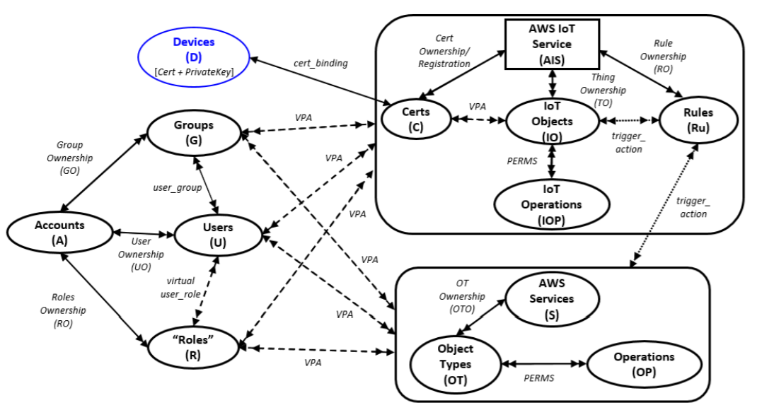
Access Control Model for AWS IoT
* Smriti Bhatt, Farhan Patwa and Ravi Sandhu, Access Control Model for AWS Internet of Things. In Proceedings of the 11th International Conference on Network and System Security (NSS), Helsinki, Finland, August 21-23, 2017, 15 pages.
© Ravi Sandhu
World-Leading Research with Real-World Impact!
6

