Slide 1

Software Defined Networks (SDNs):
Overview
CS6393
Lecture 9-1

Slide 2
Traditional Networks

Slide 3













Overview of Traditional Networks Architecture
Network engineer
Management Layer
Command Line Interface (CLI)
Configuration commands
Control plane
Data plane
Infrastructure Layer
Traditional Network

Slide 4
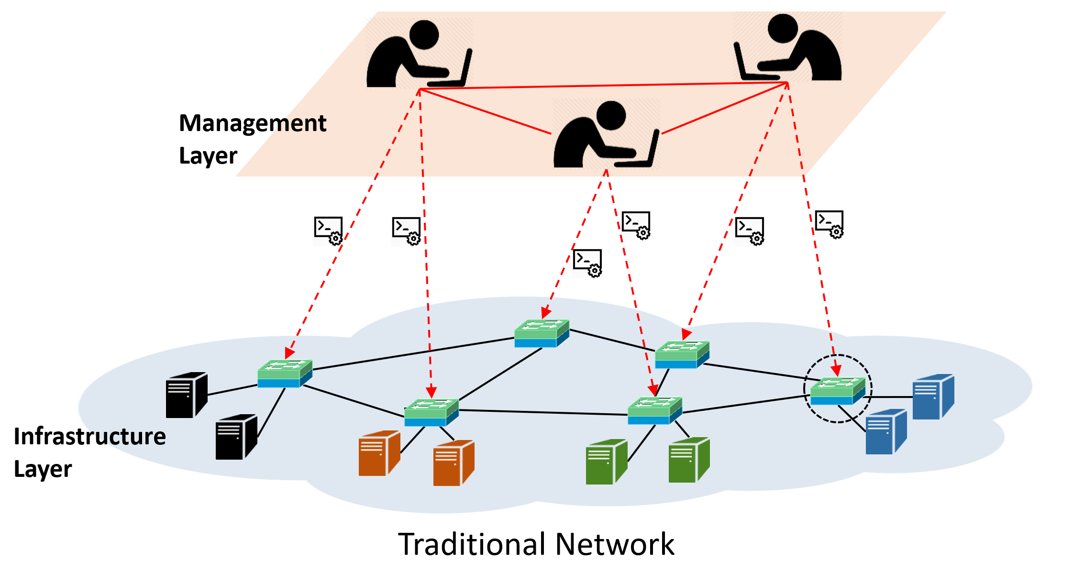

Network Devices in Traditional Networks
  Vendor-specific and heterogeneous.
  Requires manually configuration.
    Costly.
    High-rate of configuration errors.
    Serious security breaches even for well-known security guidelines.
  Hardwired with specific algorithms and protocols to route, control and monitor data flow.

Slide 5
Problems in Traditional Networks
Lack of global visibility of the network state.
Difficulties in deploying and maintaining coherent network-wide policies.
Innovation in networking functionalities and control is difficult.
Unmanageable and high operational cost by network engineers.
Complex and weak integration of decentralized networking devices.
Hard to maintain stable and robust network security.

Slide 6
Security Policies in Traditional Networks
Traditional networks lack security automation and run-time deployment of security policies.
Lack for runtime update of security policies in response to traffic behavior or intrusions.
To implement security policies, network operators need to
  Translate high-level security policies into low-level configuration commands.
  Implement low-level commands manually into large sets of vendor-specific devices.
Updating security policies might require changing the hardware or updating its firmware.

Slide 7
Software Defined Networks

Slide 8

Software Defined Networks (SDN)
SDN decouples the network control from the data forwarding plane in routers and switches.
The result:
  Control plane (logically centralized).
  Forwarding plane takes decisions from the control plane.
  Applications and services are implemented on top of the control Plane.
    Control plan maps the entire network to the application layer.
  Programmability of network functions and control.
Control plane
Control plane
SDN idea
Decoupling
Decoupling
Data plane
Data plane
Legacy switch
Legacy router

Slide 9


Decoupling :
The Idea behind SDNs
OpenFlow
  A Protocol between the control plan and data plane.
  Describes how controller and a network forwarding device should communicate.
OpenFlow Controller
(Centralized)
Control plane
Smart
Decoupling
OpenFlow
Protocol
(Distributed)
Data plane
Dumb, fast
OpenFlow-enabled device
Software Defined Networks
Notes:
Comment conteralized
distributed

Slide 10

Network Programmability
Network
Applications
Application plane
Abstract
view
Northbound APIs
  Network Programming Interface
Control plane
  Traffic mgmt.
Southbound Protocol
(OpenFlow)
Data plane

Slide 11
The three Planes of SDN Architecture
Application Plane: SDN applications for various functionalities, such as
  network management
  traffic automation
  network Monitoring
  security services.
  etc.
Control Plane: Logically centralized control framework that:
  runs the Network Operating System (NOS)
  maintains global view of the network.
  provides hardware abstractions to SDN applications.
Data Plane: Forwarding elements that:
  forward traffic flows based on instructions from the control plane.

Slide 12

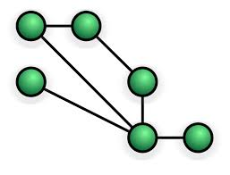












Overview of SDN Architecture
Applications
Routing
Firewall
Load
Balancing
Intrusion Prevention
Network Visualization
Other
. . .
Network APIs
Open Interface: needs control
Network Services
Virtual Network Resources
Topology Service | Entry Pushing
Routing Service | Device Management
Statistics Collection | Link Discovery
Switch Management | Other
Topology
Flow tables
Switches
Ports
Controller
Manage
Control plane
Statistics
Traffic payloads
Config-
urations
VLANs
Hosts
Links
Devices
Other
Decoupling
OpenFlow Protocol
Flow table
Infrastructure
Data plane

Slide 13

Enhanced Network Security in SDN
Network security is enhanced in SDN via:
  Network programmability.
  Centralized control of network behavior.
  Global visibility of the network state.
    Easier to spot network vulnerabilities and intrusions.
    Easier to implement security policies.
    Easier to mitigate the risks of policy collision.
  Run-time implementation of security policies.
  Run-time manipulation of traffic forwarding rules.
  Software based implementation of security policy.
    No hardware change or firmware update needed.

Slide 14

Flow Table Structure
match fields: to match against packets.
actions: to be applied for the matching packet/flow.
priority: precedence of the flow entry.
counters: updated when packets are matched.
timeouts: maximum time/idle time before flow is expired by the switch.
Match Fields | actions | priority | Counters | Timeouts | …
Packet Processing in OpenFlow Switch
Packet
from network
Parse header fields
Match Found?
No
Send to controller
Yes
Update counters
Apply actions

Slide 15






Flow Table Structure example flow rules
SDN Controller
…
OpenFlow Table entry |  | Rule | Priority | Action | Counters
Flow tables
OpenFlow Switch
MAC src | MAC dst | IP src | IP dst | TCP port src | TCP port dst | Priority | Action | Packets
..:00:01 | ..:00:04 | * | * | * | * |  | Port-4
..:00:04 | ..:00:01 |  |  |  |  |  | Port-1
* | * | * | 10.0.0.3 | * | * |  | Drop
Packet Processing in OpenFlow Switch
Packet
from network
Port-1
Port-2
Port-3
Port-4
Parse header fields
Match Found?
No
Send to controller
Host-A
MAC: 00:00:00:00:00:01
IP: 10.0.0.1
Host-B
MAC: 00:00:00:00:00:02
IP: 10.0.0.2
Host-D
MAC: 00:00:00:00:00:04
IP: 10.0.0.4
Host-C
MAC: 00:00:00:00:00:03
IP: 10.0.0.3
Yes
Update counters
Apply actions

Slide 16

Flow Rule Insertion Example -
Routing app
5
6
7
Read topology info.
Find shortest path
Read hosts info.
Routing app
4
8
Flow rule:
Mac-Host-A -> Mac-Host-D : Port-4
Parse packet
Insert flow rule
Forward packet to network apps
3
Controller
Packet Processing in OpenFlow Switch
Packet
from network
If a matching rule found in table, apply actions;
otherwise, forward packet to controller.
Insert flow rule:
Mac-Host-A -> Mac-Host-D: Port-4
9
Parse header fields
Switch receives a network packet
2
Match Found?
No
Send to controller
1
Port-1
Yes
Host-A
Port-2
Port-3
Port-4
Update counters
Host-D
Apply actions
Host-B
Host-C

Slide 17


Flow Rule Insertion Example -
Firewall app
4
5
Security Policy:
Deny connections from Host-A to Host-C.
Allow connections from Host-B to Host-C.
Parse packet
Check security policy
Firewall
app
6
Enforce security policy
Forward packet to network apps
3
7
Decision to controller
SDN
Controller
Insert flow rule: Host-A -> Host-C: Drop
If no matching rule in switch, forward packet to controller
8
Switch receives a network packet
Host-A -> Host-C: Drop
1
2
Host-A
Host-C
Host-B

Slide 18
SDN Security Challenges

Slide 19
Apparent Control Plane Security Challenges
Threats due to Scalability
DoS Attacks
Challenges in Distributed Control Plane
  -SDN response times
  -IP packets with random headers
  -Huge # flow rules
  - Information aggregation from multiple domains.
  - different privacy rules in different domains.
Ahmad, Ijaz, Suneth Namal, Mika Ylianttila, and Andrei Gurtov. "Security in software defined networks: A survey." IEEE Communications Surveys & Tutorials 17, no. 4 (2015): 2317-2346.
© Abdullah Al-Alaj
19

Slide 20
Application Plane Security Challenges
Lack of authentication mechanisms for SDN apps
Lack of access control for SDN apps
Fraudulent and contradicting flow rule insertion
  Requires a permission system to apply least privilege on apps
  Requires a flow rule conflict resolution
  Requires a trust relationship between the
  controller and apps
Ahmad, Ijaz, Suneth Namal, Mika Ylianttila, and Andrei Gurtov. "Security in software defined networks: A survey." IEEE Communications Surveys & Tutorials 17, no. 4 (2015): 2317-2346.
© Abdullah Al-Alaj
20

Slide 21
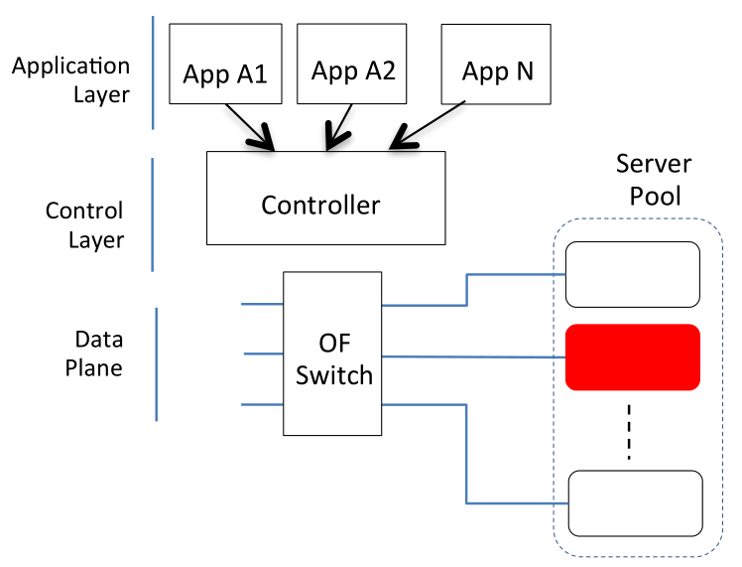


Contradicting flow rule insertion - example
 |  | In port | MAC src | MAC dst | VLAN ID | IP src | IP dst | TCP psrc | TCP pdst | Priority | Action
Rule1 |  | * | * | MAC Server-2 | 10 | * | * | * | * | 150 | drop
Rule2 |  | * | MAC Server-2 | * | 10 | * | * | * | * | 150 | drop
Rule3 |  | 1 | MAC Host-1 | MAC Server-2 | 10 | * | * | * | * | 200 | out port =5
Rule4 |  | 5 | MAC Server-2 | MAC Host-1 | 10 | * | * | * | * | 200 | out port =1
 |  | … | … | … | … | … | … | … | … | … | …
Security App
Load Balancer
…
Other App
Assume this sequence of activities by SDN Apps.
Security App has identified Server-2 as Malicious server.
Security App Inserts rule1 & rule2 to quarantine the flows to/from Server-2.
Server-2 becomes least loaded server in the pool.
Load Balancer App Inserts flow Rules rule3 & rule4 to redirect traffic to Server-2.
Load Balancer App violates the security policy implemented by Security App.
Host-1
1
4
Server-1
Host-2
2
5
Server-2
…
3
6
Host-n
Al-Alaj, Abdullah, Ravi Sandhu, and Ram Krishnan. "A Formal Access Control Model for SE-Floodlight Controller." Proceedings of the ACM International Workshop on Security in Software Defined Networks & Network Function Virtualization. ACM, 2019.
Server-m
21

Slide 22
References
Ahmad, Ijaz, Suneth Namal, Mika Ylianttila, and Andrei Gurtov. "Security in software defined networks: A survey." IEEE Communications Surveys & Tutorials 17, no. 4 (2015): 2317-2346.
Al-Alaj, Abdullah, Ravi Sandhu, and Ram Krishnan. "A Formal Access Control Model for SE-Floodlight Controller." Proceedings of the ACM International Workshop on Security in Software Defined Networks & Network Function Virtualization. ACM, 2019.

