Slide 1
Institute for Cyber Security
Constraints for Attribute Based Access Control with Application in Cloud IaaS
Khalid Zaman Bijon
Department of Computer Science & Institute for Cyber Security
University of Texas at San Antonio
Committee:
Dr. Ravi Sandhu (Advisor)
Dr. Ram Krishnan (Co-Advisor)
Dr. Gregory B. White
Dr. Shouhuai Xu
Dr. Weining Zhang
Dissertation Defense
World-Leading Research with Real-World Impact!
1
Notes:
Hello Everyone, welcome to my dissertation. My name is khalid bijon and my dissertation topic is.

Slide 2

Institute for Cyber Security
Its OK to have your head in the cloud,
if your feet are on the ground
- Adapted from Wilferd Arlan Peterson
World-Leading Research with Real-World Impact!
2
Notes:
I found that this quote is somehow related to dissertation. It says that . My interpretation is that an organization can only enjoy the benefit of cloud computing if its can retain similar control of the on-premise system.

Slide 3
Cloud IaaS
CSP
Tenant
CSP’s Admin-User
Tenant’s Admin-User
Tenant’s IT-User
1. Create and manage tenants
2. Manage infrastructure
1. Create and manage tenant’s IT-User
1. Create and manage virtual resources of the
tenant
Cloud Service Provider (CSP)
  - e.g., AWS, Rackspace.
  - Offers virtualized computing resources
  to enterprises
Enterprises (Tenants)
- e.g., netflix, expedia.
- Consume virtualized computing resources
World-Leading Research with Real-World Impact!
3

Slide 4
Cloud IaaS
Control access of the IT-User to resources
(e.g., who can stop virtual machine vm1,
who can connect virtual network vn1 to virtual machine vm1)
Received interests from academia and industry
1. Jin et. al. ABAC for cloud IaaS
2. Wu et. al. RBAC for AWS cloud
3. AWS IAM, OpenStack Keystone
Constrain the mappings between
resources.
(e.g., if a virtual network vn1 can connect to the virtual machine vm2
No significant research
Mandatory Constraint
Focus of this dissertation
World-Leading Research with Real-World Impact!
4

Slide 5
Problem Space
Compute
Host
Virtual
Machine
VM
Image
(VR-to-VR)
(PR-to-PR)
Rack
Virtual
Storage
Physical
Storage
Virtual
Network
Virtual
Router
Network
Host
(VR-to-PR)
Physical Resources (PR)
Virtual Resources (VR)
Mapping between Resources in Cloud IaaS
Shared Responsibility : CSP and Tenants
Dissertation Scope: VR-to-VR and VR-to-PR Mappings
World-Leading Research with Real-World Impact!
5

Slide 6
Thesis Statement
A suitably devised attribute based constraints specification mechanism can provide effective and expressive capabilities in laying out higher-level security policies for a traditional organization that exercises attribute based access control as well as for the mapping configuration management
of virtual resources in cloud infrastructure-as-a-service.
World-Leading Research with Real-World Impact!
6

Slide 7
Outline
Constraints for VR-to-VR Mapping
2. Constraints for VR-to-PR Mapping
3. Constraints for Attribute Based Access Control
World-Leading Research with Real-World Impact!
7
Notes:
My presentation outline. First I will explain constraints for VR-to-VR mapping. Then, VR-to-PR mapping. And finally for more generalized attribute based access control.

Slide 8
Outline
Constraints for VR-to-VR Mapping
  Constraint Specification and Enforcement
  Automated Constraint Construction
2. Constraints for VR-to-PR Mapping
3. Constraints for Attribute Based Access Control
World-Leading Research with Real-World Impact!
8
Notes:
In VR-to-VR mapping, I will explain the constraint specification and enforcement and automated constraint construction process.

Slide 9
Paper
1. Khalid Bijon, Ram Krishnan, and Ravi Sandhu.
Virtual Resource Orchestration Constraints in Cloud
Infrastructure as a Service. ACM CODASPY’15.
2. Khalid Bijon, Ram Krishnan, and Ravi Sandhu.
Automated Constraints Construction in Cloud Infrastructure as
a Service. Under Preparation (will be submitted to IEEE TDSC).
World-Leading Research with Real-World Impact!
9

Slide 10
VR-to-VR Mapping
Virtual
Machine
VM
Image
(VR-to-VR)
Virtual
Storage
Virtual
Network
Virtual
Router
Virtual Resources (VR)
Complex Management Process
Scope: Intra-Tenant
Goal: Diversity of Tenant
World-Leading Research with Real-World Impact!
10

Slide 11








Constraint Specification and Enforcement
Mapping #1
Mapping #3
Constraint Policy
      For each VR-to-VR mappings
Virtual Storage
Virtual Network
Virtual Machine
Mapping #4
Mapping #2
VM Image
Virtual Router
Constraint Policy
Allow
Mapping
Constraint for
Mapping #1
Satisfied By
      Individual virtual resources
Yes
Virtual Storage
Instance i
No
Virtual Machine
Instance j
Deny
Mapping
Credit: www.iconarchive.com
World-Leading Research with Real-World Impact!
11

Slide 12
An Attribute Based Approach
Workload
Sensitivity
Level
volumeSize
Attribute Specifies Virtual Resource Properties
A name:value Pair
Owner
tenant
Virtual Machine
Virtual Storage
Purpose
ioType
tenant:BOF
volumeSize:
large
tier:
database
ioType:
fast
database
presentation
application
Designed as Functions
tier
Virtual Machine
Domain
Codomain (Scope)
World-Leading Research with Real-World Impact!
12

Slide 13
Constraint Policy
A Constraint
      Logical Formula
      Compares Certain Attribute Values
tier: x
ioType:y
Virtual Storage
Instance i
Request
volumeAttach
Virtual Machine
Instance j
If tier=‘database’
Constraint
Format
Then ioType=‘fast’
True
False
World-Leading Research with Real-World Impact!
13
Notes:
A constraint is a logical formula which compares attributes of respective virtual resources when they are requested for a mapping.

Slide 14
Use Case (3-Tier System)
tier
netType
Mapping #2
route
ioType
Mapping #3
Mapping #1
Virtual Network
Virtual Machine
Virtual Storage
Virtual Router
If tier=‘application’
If route=‘outer’
If tier=‘presentation’
Then netType=‘psNet’
then netType
=‘psNet’
Or netType
=‘webFront’
Constraint 2: Only an application layer VM can connect to a virtual network which is created for passing application layer data.
Then ioTYpe!=‘fast’
Constraint 1: If a VM is for presentation layer, attaching storage’s ioType cannot be fast.
Constraint 3: If a router is for connecting to out-side internet, only presentation layer network or web-fornt network can connect to it.
World-Leading Research with Real-World Impact!
14
Notes:
In this slide, I show 3 examples constriant for 3 tier business application. Here, constraint 1 is for VM-Storage attachment mapping relation. It says, that a

Slide 15
Use Case (Hadoop)
netType
nodeType
Mapping #1
Virtual Network
Virtual Machine
If nodeType=
‘jobTracker’
If nodeType=
‘nameNode’
then netType
=‘nameNet’
Constraint 1: Only jobTracker and nameNode VMs can connect to a network created for passing data to/from name Nodes.
World-Leading Research with Real-World Impact!
15
Notes:
In this slide, I show 3 examples constriant for 3 tier business application. Here, constraint 1 is for VM-Storage attachment mapping relation. It says, that a

Slide 16
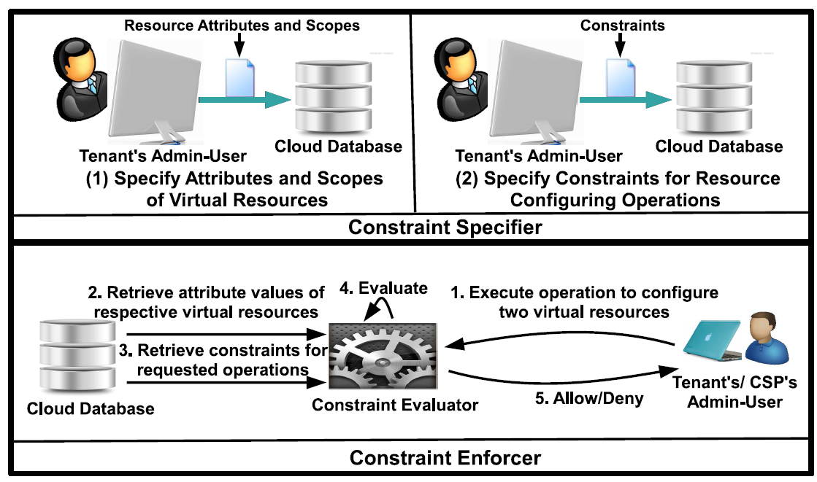

Specify and Enforce
World-Leading Research with Real-World Impact!
16

Slide 17


Specifier
Implemented in OpenStack
Execution of “attribute-creation” operation
Similarly,
    Attribute-value specification
    Constraint Specification
    Attribute-value assignment
Tenant Users
1. Get User Token
2. Create
Attribute Name, Token
6. Allow/Deny
3. Token
Revoked?
4. Verify
Admin Role?
NOVA (Compute)
KEYSTONE (Authentication)
5. Enter
Attribute Name and
Tenant Name
VM Attribute
Table
Credit: www.portalguard.com
World-Leading Research with Real-World Impact!
17

Slide 18
Enforcer Implementation
Implemented in OpenStack
A Constraint Parser
Invoked by Resource Mapping Operations (e.g., volume-attach)
Tenant Users
1. Get User Token
2. Request
volume-attach with VM Id, Storage Id and Token
11. Allow/Deny
6. Verify
Project of VM,
Storage and User
3. Token
Revoked?
10. Evaluate
Constraint
NOVA
KEYSTONE
4
5
9
7
8
Storage
Table
VM
Table
Constraint
Table
VM Attribute
Table
Storage Attribute
Table
World-Leading Research with Real-World Impact!
18

Slide 19

Automated Constraint Construction
Helps the tenants to find policy
From Previous Configurations
Assigned
Attributes
Construct Relation between values of two attributes
tier:
database
Virtual Machine
tier, database
ioType,
fast
Configuration
Log
Virtual Storage
Assigned
Attributes
ioType:
fast
Credit: www.iconarchive.com
World-Leading Research with Real-World Impact!
19

Slide 20


Automated Constraint Construction
Association Rule Mining (Frequent-Itemset Mining)
      relations between variables in large databases
      Apriori Algorithm
      Consider relations between all combination of values
      With customization for cloud IaaS (CVRM-Apriori)
      Only consider relations between every pair of values of two attribute
World-Leading Research with Real-World Impact!
20

Slide 21
CVRM-Apriori
Assigned
Attributes
Virtual Machine
1. Frequent-ItemSet Mining
Attribute
Relations
2. Constraints Construction
Constraints
Configuration
Log
Virtual Storage
Assigned
Attributes
World-Leading Research with Real-World Impact!
21

Slide 22
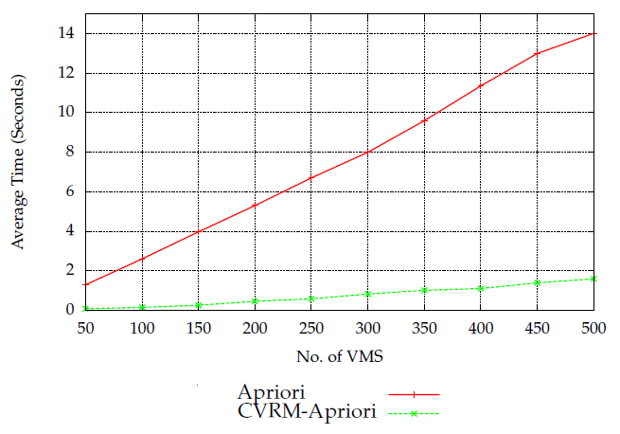
Evaluation
Policy for VM-Network Connectivity Mapping
From VM-Network Table (table virtual_interfaces in Nova, OpenStack)
10 Attributes each with 10 values
10 Virtual Networks
At least three Networks per VM
Mine relations between every
pair of attribute values
World-Leading Research with Real-World Impact!
22

Slide 23
Outline
1. Constraints for VR-to-VR Mapping
2. Constraints for VR-to-PR Mapping
  Conflict-Free Virtual Resource Scheduling
  Physical Resource Optimization
  Experimental Analysis
3. Constraints for Attribute Based Access Control
World-Leading Research with Real-World Impact!
23

Slide 24
Paper
Khalid Bijon, Ram Krishnan and Ravi Sandhu.
Mitigating Multi-Tenancy Risks in IaaS Cloud Through
Constraints-Driven Virtual Resource Scheduling.
ACM SACMAT’15.
World-Leading Research with Real-World Impact!
24

Slide 25
Problem Space
Compute
Host
Virtual
Machine
Virtual
Storage
Physical
Storage
Virtual
Router
Network
Host
Type-2
(VR-to-PR)
Physical Resources (PR)
Virtual Resources (VR)
Shared Responsibility: CSP and Tenant
Tenant: Control Placement of Virtual Resource
CSP: Optimize the Physical Resources
World-Leading Research with Real-World Impact!
25

Slide 26

Goal
Restrict VR-to-PR Mapping
      For security and performance
Security Example (DoD Cloud)
      Should not co-locate conflicting vms to same server
      E.g., VM processing top-secret for Navy might not want to co-locate with top-secret Air Froce
Host Optimization
  Increase host utilization
Scope
  Focus on virtual machine to compute host mapping
  Anti-Affinity (Must-not co-locate)
Credit: www.bartley.hants.sch.uk
www.opsrules.com
World-Leading Research with Real-World Impact!
26

Slide 27

Process
Step 1
VM 4
VM 3
VM 3
VM 1
VM 6
VM 5
VM 6
VM 2
Indentifies
Co-locating VMs
Step 2
VM 1
VM 4
VM 2
VM 5
VM 3
VM 6
Step 3
Host1
Host2
Host3
Host4
Credit: www.iconarchive.com
World-Leading Research with Real-World Impact!
27

Slide 28










An Attribute Based Approach
Attribute Specifies Virtual Resource Properties
Attribute-based conflict-free Virtual Machine Scheduling
  Specify conflicts between values of attributes
sensitivity
tenant
VM 1
VM 2
Credit: www.iconarchive.com
World-Leading Research with Real-World Impact!
28

Slide 29

















Conflict-free VM Scheduling
Step 1: Specify Conflicts among attribute values of each attribute
Step 2: Create Conflict-free partitions of the values of each attribute
Step 3: Create Conflict-free Segments (each segment contains an element of the conflict-free partition of each attribute)
Conflict Set
Sensitivity
Conflict Set
Tenant
Partition Sensitivity
Partition
Tenant
Credit: www.iconarchive.com
World-Leading Research with Real-World Impact!
29

Slide 30






Conflict-free VM Scheduling
Step 4: Create VM partition that can co-reside
VM 3
VM 6
Co-resident 2
Co-resident 3
VM 2
VM 4
VM 5
VM 1
Co-resident 1
Co-Resident 4
Credit: www.iconarchive.com
World-Leading Research with Real-World Impact!
30

Slide 31
Conflict-free VM Scheduling
Step 5: Allocate Separate Hosts for each VM Partition
VM 3
VM 6
VM 2
VM 4
Host2
Host3
VM 5
VM 1
Host4
Host1
Credit: www.iconarchive.com
World-Leading Research with Real-World Impact!
31

Slide 32
Outline
1. Constraints for VR-to-VR Mapping
2. Constraints for VR-to-PR Mapping
  Conflict-Free Virtual Resource Scheduling
  Physical Host Optimization
  Experimental Analysis
3. Constraints for Attribute Based Access Control
World-Leading Research with Real-World Impact!
32

Slide 33

Physical Host Optimization
Step 1: Specify Conflicts among attribute values
Step 2: Create Conflict-free partitions (Crucial)
  Minimum number of conflict-free partitions
  Minimum number of conflict-free segments
  Minimum number of VM partitions
Step 3: Create Conflict-free Segments
Step 4: Create VM partition that can co-reside
Step 5: Allocate Separate Hosts for each VM Partition
Optimization Problem:
  Input-conflicts among values of an attribute
  Output-minimum number of partitions
K-Partition:
  Input-conflicts among values and K
  Output-if there is K number of partitions
K-Partition
World-Leading Research with Real-World Impact!
33

Slide 34


Physical Host Optimization
K-Partition is NP-Complete
  Reduction from k-coloring
Approximation Algorithms for Graph Coloring can Apply
Develop an Exact Algorithm (Backtracking)
  Useful for small number of attribute-values
≤p
K-Partition
K-Coloring
World-Leading Research with Real-World Impact!
34

Slide 35
Outline
1. Constraints for VR-to-VR Mapping
2. Constraints for VR-to-PR Mapping
  Conflict-Free Virtual Resource Scheduling
  Physical Host Optimization
  Experimental Analysis
3. Constraints for Attribute Based Access Control
World-Leading Research with Real-World Impact!
35

Slide 36
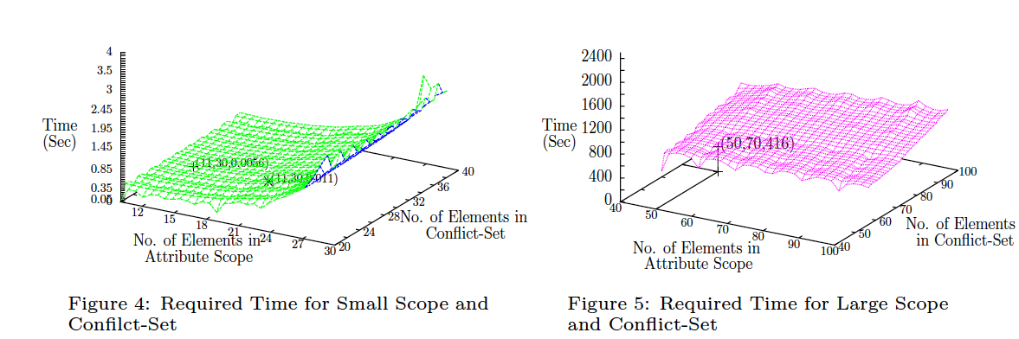
Experimental Analysis
1. Performance of Backtracking algorithm
Required Time for Small Scope and Conflict-Set
Required Time for Large Scope and Conflict-Set
World-Leading Research with Real-World Impact!
36

Slide 37
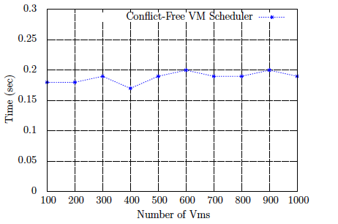
Experimental Analysis
2. Scheduling Latency
Less than 0.2 seconds for scheduling (once the conflict-free partitions are created)
World-Leading Research with Real-World Impact!
37

Slide 38
Outline
1. Constraints for VR-to-VR Mapping
2. Constraints for VR-to-PR Mapping
3. Constraints for Attribute Based Access Control
World-Leading Research with Real-World Impact!
38

Slide 39
Paper
1. Khalid Bijon, Ram Krishnan, and Ravi Sandhu.
Towards An Attribute Based Constraints Specification
Language.
IEEE PASSAT’13.
2. Khalid Bijon, Ram Krishnan, and Ravi Sandhu.
Constraint Specification in Attribute Based Access Controls.
ASE Science Journal’13.
39
World-Leading Research with Real-World Impact!
39
Notes:
39

Slide 40
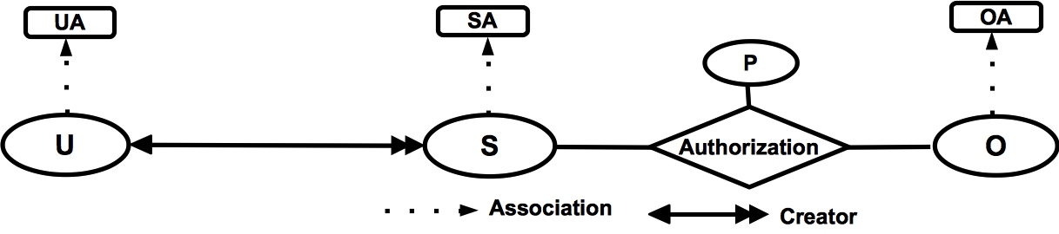
Overview of an ABAC Model
Basic Entities
      User (U), Subject (S) and Object (O)
      Their Attributes (UA, SA, OA)
Attribute can be atomic or set valued (in cloud IaaS it was only atomic value)
  e.g., clearance vs. role
Permission has Authorization policy
  Verify subject and object attributes
World-Leading Research with Real-World Impact!
40

Slide 41
Motivation
ABAC is policy neutral
      Subject with required attribute can access
Proper attribute assignment to the entities
  Need to ensure authorized access
Constraints for the attribute assignment
  Verify subject and object attributes
  configure high level security policy
World-Leading Research with Real-World Impact!
41

Slide 42
Attribute Based Constraints Specification
Develop an attribute based constraints specification language (ABCL)
  Identify relation between values (of same attribute or across attributes)
    (across attribute (VR-to-VR) and same attribute (VR-to-PR))
  A relation restricts an entity to get certain values of an attribute.
      Benefit attribute represents customers’ assigned benefits in a Bank
      A customer cannot get both benefits ‘bf1’ and ‘bf2’ (mutual exclusion)
      Cannot get more than 3 benefits from ‘bf1’, ‘bf3’ and ‘bf6’ (cardinality on mutual exclusion)
bf1
bf2
bf1
bf2
bf1
bf3
bf6
×
×
×
fl1
bf3
×
benefit
benefit
benefit
felony
benefit
User
User
World-Leading Research with Real-World Impact!
42

Slide 43
Attribute Based Constraints Specification
A mechanism to represent different types of such relationships as a set
  1. Mutual-Exclusive relation of the benefit attribute values (single attribute conflict)
Attribute_Set_{U,benefit} UMEBenefit
UMEBenefit={avset1, avset2} where
avset1=({‘bf1’,‘bf2’}, 1) and
avset2=({‘bf1’,‘bf3’,‘bf4’}, 2)
  2. Mutual-Exclusive relation of the benefit and felony (cross attribute conflict)
Cross_Attribute_Set_{U,Aattset,Rattset} UMECFB
Here, Aattset= {felony} and Rattset= {benefit}
UMECFB={attfun1} where
attfun1(felony)=(attval, limit)
where attval={‘fl1’, ‘fl2’} and limit=1
attfun1(benefit)=( attval, limit)
where attval={‘bf1’} and limit=0
World-Leading Research with Real-World Impact!
43
Notes:
We develop a process to represents different types of attribute relationship as a set. First one shows, that mutual exclusive relation values of benefit attribute. UMEBenefit

Slide 44
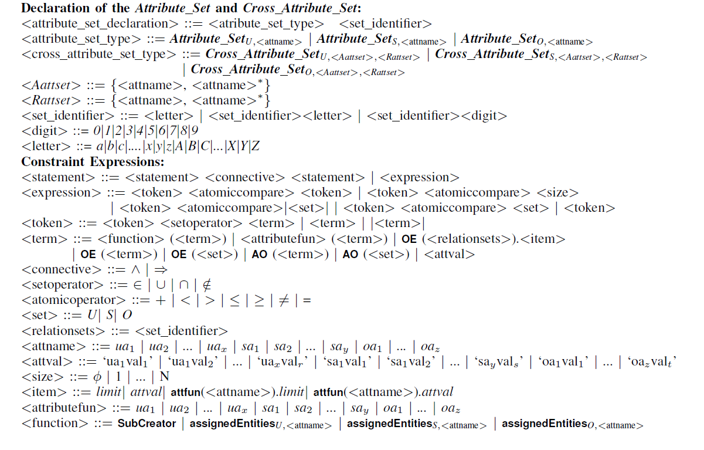
ABCL Syntax
A grammar in Backus Normal Form (BNF)
  Declaration of the Attribute_Set and Cross_Attribute_Set
  Constraint Expression
World-Leading Research with Real-World Impact!
44
Notes:
Difference between syntax and semantics

Slide 45
Example
  1. A customer cannot get both benefits ‘bf1’ and ‘bf2’
Expression: |OE(UMEBenefit).attset ∩ benefit(OE(U))| ≤ OE(UMEBenefit).limit
  2. If a customer committed felony ‘fl1’, She can not get more than one benefit from ‘bf1’, ‘bf2’ and ‘bf3’
Expression: OE(UMECFB)(felony).attset ∩ felony(OE(U))| ≥
OE(UMECFB)(felony).limit⇒|OE(UMECFB)(benefit).attset ∩ benefit(OE(U))|
≤ OE(UMECFB)(benefit).limit
World-Leading Research with Real-World Impact!
45
Notes:
Here is examples of the ABCL expressions. In the first one it says that a customer can not get both benefits bf1 and bf2. In previous slide, I showed that UMEBenefit contains the conflicting values of the benefit attribute and the cardinality

Slide 46
Use Cases
ABCL can configure well-known RBAC constraints
  Role can be considered as a single attribute
  Can express SSOD and DSOD constraints
  Just need to declare conflict-relation sets for conflicting roles
It can configure several security requirements of traditional organization (e.g. banking organization)
  E.g. Constraints on benefit attribute assignment
World-Leading Research with Real-World Impact!
46

Slide 47


Conclusion
A Constraint Specification Framework for ABAC and Cloud IaaS
Easily manageable and generic
Automatic Generation of Constraints
Requirements
Tenants
Future Work
Flag Generator System
Improve mining (incorporate noise)
Analysis for other VR-to-PR
Credit: www.iconarchive.com
World-Leading Research with Real-World Impact!
47

Slide 48




Publications (related to dissertation)
Khalid Bijon, Ram Krishnan and Ravi Sandhu
Automated Constraint Constructions Cloud Infrastructure as a Service.
Under Preparation (target IEEE TDSE)
Khalid Bijon, Ram Krishnan and Ravi Sandhu
Mitigating Multi-Tenancy Risks in IaaS Cloud Through Constraints-Driven Virtual Resource Scheduling.
ACM Symposium on Access Control Models and Technologies, 2015.
Khalid Bijon, Ram Krishnan and Ravi Sandhu
Virtual Resource Orchestration Constraints for Cloud Infrastructure as a Service.
ACM Conference on DATA and Application Security and Privacy, 2015.
Khalid Bijon, Ram Krishnan and Ravi Sandhu
A Formal Model for Isolation Management in Cloud Infrastructure-as-a-Service.
International Conference on Network and System Security , 2014.
Khalid Bijon, Ram Krishnan and Ravi Sandhu
Towards An Attribute Based Constraints Specification Language.
IEEE International Conference on Privacy, Security and Trust, 2013.
Khalid Bijon, Ram Krishnan and Ravi Sandhu
Constraints for Attribute Based Access Control
ASE Science Journal, 2013.
Credit: www.psdgraphics.com
World-Leading Research with Real-World Impact!
48
Notes:
48

Slide 49
Publications (outside dissertation)
Khalid Bijon, MM Haque and Ragib Hasan
A TRUst based Information Sharing Model (TRUISM) in MANET in the Presence of Uncertainty.
International Conference on Privacy, Security and Trust, 2014.
Khalid Bijon, Ram Krishnan and Ravi Sandhu
A Framework for Risk-Aware Role Based Access Control.
IEEE Symposium on Security Analytics and Automation, 2013.
Khalid Bijon, Ram Krishnan and Ravi Sandhu
Risk-Aware RBAC Sessions.
International Conference on Information Systems Security, 2012.
Khalid Bijon, Tahmina Ahmed, Ravi Sandhu and Ram Krishnan
A Lattice Interpretation of Group-Centric Collaboration with Expedient Insiders.
IEEE International Conference on Collaborative Computing: Networking, Applications and Worksharing, 2012.
Yuan Cheng, Dang Nguyen, Khalid Bijon, Ram Krishnan, Jaehong Park and Ravi Sandhu
Towards Provenance and Risk-Awareness in Social Computing.
ACM International Workshop on Secure and Resilient Architectures and Systems, 2012.
Khalid Bijon, Ravi Sandhu and Ram Krishnan
A Group-Centric Model for Collaboration with Expedient Insiders in Multilevel Systems.
IEEE International Symposium on Security in Collaboration Technologies and Systems, 2012.
Tahmina Ahmed, Ravi Sandhu, Khalid Bijon, and Ram Krishnan
Equivalence of Group-Centric Collaboration with Expedient Insiders (GEI) and LBAC with
Collaborative Compartments (LCC).
Technical Report CS-TR-2012-010, Department of Computer Science, 2012
Ravi Sandhu, Khalid Zaman Bijon, Xin Jin and Ram Krishnan
RT-Based Administrative Models for Community Cyber Security Information Sharing.
IEEE International Workshop on Trusted Collaboration, 2011.
Credit: www.psdgraphics.com
World-Leading Research with Real-World Impact!
49
Notes:
49

Slide 50
Thank You!
World-Leading Research with Real-World Impact!
50
Notes:
50

Slide 51
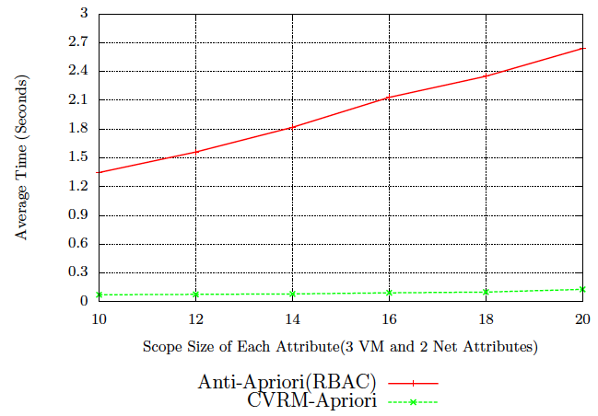
Evaluation
Mining Time with Increasing Scope
World-Leading Research with Real-World Impact!
51

Slide 52
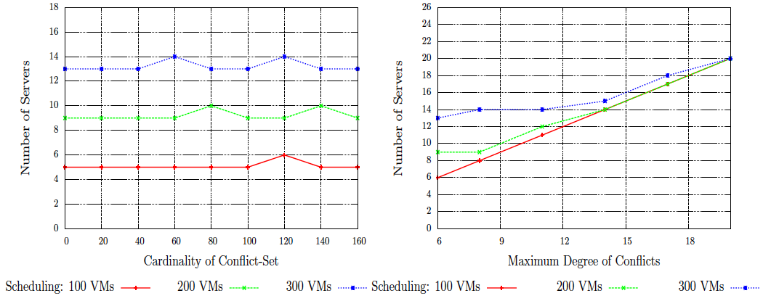
Experimental Analysis
3. Required Number of Hosts
Required Number of hosts for Varying
Number of Conflicts
Required Number of hosts for Max
Degree of Conflicts
World-Leading Research with Real-World Impact!
52

Slide 53


Vision
Resources
Enterprise
Figure 3-A: On Premise
Enterprise
Figure 3-B: In Cloud
Credit: www.erindorpress.com/
World-Leading Research with Real-World Impact!
53

Slide 54
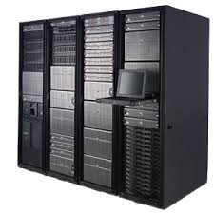

Motivation
Not Scalable
  Manual Groupings of Virtual Resources
Inefficient Scheduler (e.g., filter-scheduler in OpenStack)
  Host Exhaustion problem
Affinity
/Anti-Affinity groups
Compute
Host
Virtual Machine
Tenant Admin
Users
Credit: www.iconarchive.com
www.consulting.ky
World-Leading Research with Real-World Impact!
54

Slide 55
Conclusion
A Constraint Specification for Attribute Based Access Control
Mechanism for High Level Security Policy Specifications for an Organization
Credit: www.iconarchive.com
World-Leading Research with Real-World Impact!
55

Slide 56
Conclusion
Scalable Constraint-Aware Scheduling
Host Optimization
Complete Control
Tenants
Future Work
Affinity Constraints
Combine both of them
Credit: www.iconarchive.com
World-Leading Research with Real-World Impact!
56

