Slide 1
Role Based Access Control For Software Defined Networking
Formal Models and Implementation
Dissertation Defense
Abdullah Al-Alaj
Institute for Cyber Security
Department of Computer Science
The University of Texas at San Antonio
Committee:
Prof. Ravi Sandhu, Ph.D. (Advisor)
Dr. Ram Krishnan, Ph.D. (Co-advisor)
Dr. Palden Lama, Ph.D.
Prof. Gregory White, Ph.D.
Dr. Weining Zhang, Ph.D.
July 20, 2020.

Slide 2
Outline
Introduction
SDN-RBAC Model
Parameterized Permissions and Roles
ParaSDN Model for Fine Grained and Scalable Authorization in SDN
SDN-RBACa Administrative Model
Proxy Operations and Custom Permissions
Conclusion and Future Work

Slide 3








Introduction
Traditional Networks
Management Layer
CLI
Control plane
Data plane
Infrastructure Layer
Traditional Network
SDN Idea
Control plane
Decoupling
Data plane

Slide 4





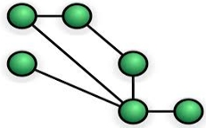







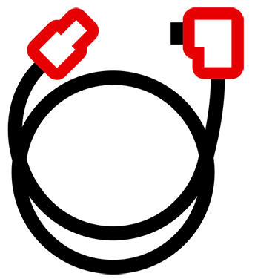




Introduction
Software Defined Networks (SDN)
Applications
Routing
Firewall
Load
Balancing
Intrusion Prevention
Network Visualization
Other
. . .
Network Programming APIs
Network Services
Virtual Network Resources
Topology Service | Entry Pushing
Routing Service | Device Management
Statistics Collection | Link Discovery
Switch Management | Other
Topology
Flow tables
Switches
Ports
Controller
(e.g., Floodlight)
Manage
Control plane
Statistics
Traffic payloads
Config-
urations
VLANs
Hosts
Links
Devices
Other
Decoupling
OpenFlow Protocol
Flow table
Infrastructure
Data plane

Slide 5
Features Provided by SDN Architecture
Logically Centralized Control
Network Programmability
Dynamic Flow Control
SDN
Network-Wide Visibility

Slide 6




Flow Table Structure
SDN Controller
OpenFlow Table Entry |  | Rule | Priority | Action | Counters
Flow tables
OpenFlow Switch
MAC src | MAC dst | IP src | IP dst | TCP port src | TCP port dst | Priority | Action | Packets
..:00:01 | ..:00:04 | * | * | * | * |  | Port-4
..:00:04 | ..:00:01 |  |  |  |  |  | Port-1
* | * | * | 10.0.0.3 | * | * |  | Drop
Packet Processing in OpenFlow Switch
Packet
from network
Port-1
Port-2
Port-3
Port-4
Parse header fields
Match Found?
No
Send to controller
Host-A
MAC: 00:00:00:00:00:01
IP: 10.0.0.1
Host-B
MAC: 00:00:00:00:00:02
IP: 10.0.0.2
Host-D
MAC: 00:00:00:00:00:04
IP: 10.0.0.4
Host-C
MAC: 00:00:00:00:00:03
IP: 10.0.0.3
Yes
Update counters
Apply actions

Slide 7


Flow Rule Insertion Example
5
6
7
Read topology info.
Find shortest path
Read hosts info.
Routing app
4
8
Flow rule:
Mac-Host-A -> Mac-Host-D : Port-4
Parse packet
Insert flow rule
Forward packet to network apps
3
Controller
Packet Processing in OpenFlow Switch
Packet
from network
If a matching rule found in table, apply actions;
otherwise, forward packet to controller.
Insert flow rule:
Mac-Host-A -> Mac-Host-D: Port-4
9
Parse header fields
Switch receives a network packet
2
Match Found?
No
Send to controller
1
Port-1
Yes
Host-A
Port-2
Port-3
Port-4
Update counters
Host-D
Apply actions
Host-B
Host-C

Slide 8
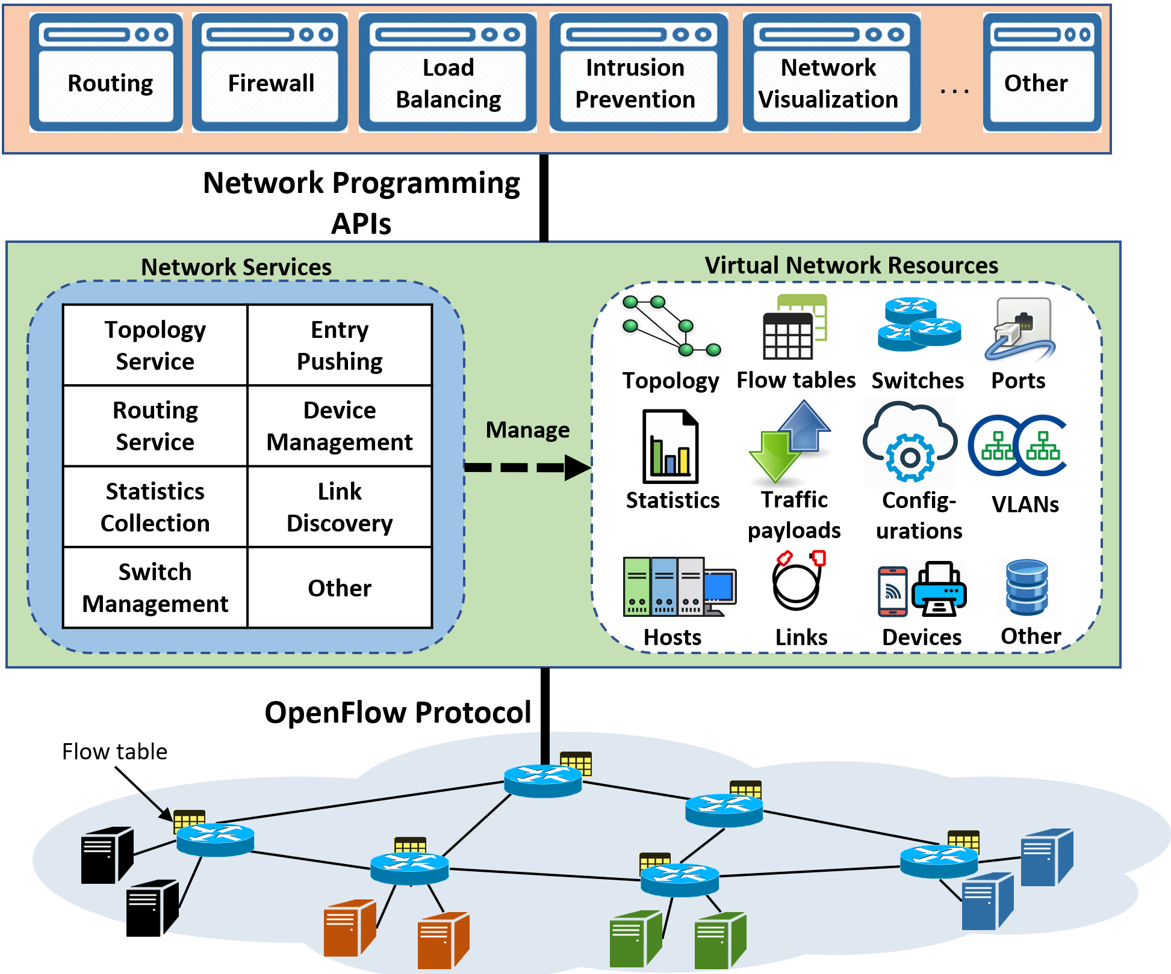
Access Control in SDN
Control which
subjects (network apps) can access which
objects (virtual network resources) for performing which
actions (SDN operations).
Network apps (Untrusted)
Open interface: needs control

Slide 9
Literature of Access Control for SDN
Capability-based approaches
  Direct relation between operations and apps.
  Well studied and known to have administrative complexities.
Capability-based approach
Role-based approach
Permissions
Permissions
Network apps
P1
P1
P2
Network apps
P2
App1
P3
App2
App1
P3
P4
App2
r1
App3
App3
P4
App4
P5
App4
P6
P5
P6
Total associations =3 x 6 = 18
1 new app requires 6 new associations
1 new permission requires 3 new associations
Total associations = 3 + 6 = 9
1 new app requires 1 new associations
1 new permission requires 1 new association

Slide 10
Problem and Thesis Statement
Problem Statement:
Current Software Defined Networking technology is lacking access control models and enforcement for protecting network resources residing in the SDN controller from unauthorized access by OpenFlow applications.
Thesis Statement:
Role-based access control model and its extensions is an effective approach for the specification and administration of dynamic access control for Software Defined Networking.

Slide 11
Summary of Contributions
Enabling Role Based Authorization for SDN.
  SDN-RBAC Model and Authorization Framework with Implementation & Enforcement in SDN Controller.
Fine-Grained and Scalable Access Control for SDN.
  Access Control Enhanced with Role and Permission Parameters with Authorization Framework Extended with Parameter Engine and Enforcement in SDN Controller.
Administration of Access Control in SDN.
  SDN-RBACa Administrative Model for Managing roles, Permissions and Network App Authorizations in SDN.
  Proxy Operations and Custom Permissions for Enhanced Engineering of Administrative Units in SDN.

Slide 12
Summary of Contributions
Enabling Role Based Authorization for SDN.
  SDN-RBAC Model and Authorization Framework with Implementation & Enforcement in SDN Controller.
Fine-Grained and Scalable Access Control for SDN.
  Access Control Enhanced with Role and Permission Parameters with Authorization Framework Extended with Parameter Engine and Enforcement in SDN Controller.
Administration of Access Control in SDN.
  SDN-RBACa Administrative Model for Managing roles, Permissions and Network App Authorizations in SDN.
  Proxy Operations and Custom Permissions for Enhanced Engineering of Administrative Units in SDN.

Slide 13
SDN-RBAC: Conceptual Model
Design goal: conformance with the standard NIST-RBAC Reference Model.
SDN-RBAC adopts standard RBAC model with evolutionary changes, rather than revolutionary.
Sample Operations:
addFlow
getAllDevices
getBandwidthConsumption
etc.
Sample Roles:
Flow Mod
Device Handler
Bandwidth Monitoring
Link Handler
etc.
Sample Apps:
Load Balancer
Firewall
Intrusion Prevention
Routing app
etc.
OPERATIONS
(OPS)
APPS
AR
ROLES
PR
PRMS
OBJECT
TYPES
(OBTS)
OBJECTS
(OBS)
session_
app
SESSIONS
session_
roles
one-to-many
_{OT}
Sample Object Types:
FLOW-RULE
DEVICE
PORT-STATS
PORT
LINK
etc.
Sample Sessions:
deep packet inspection session
transmission rate monitoring session
web-traffic filtering session
shortest path recomputation session
traffic redirection session
etc
many-to-many

Slide 14
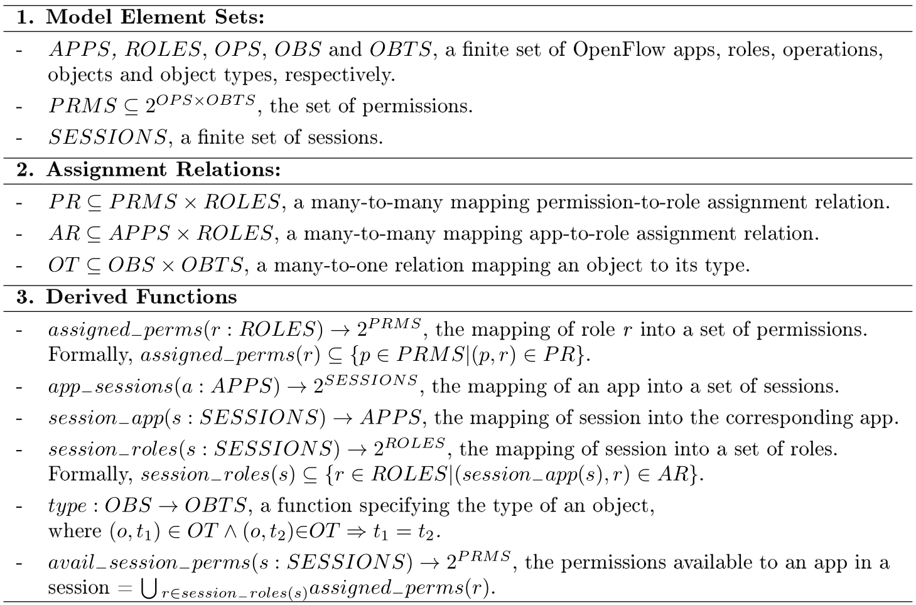
SDN-RBAC Formal Model Definition

Slide 15
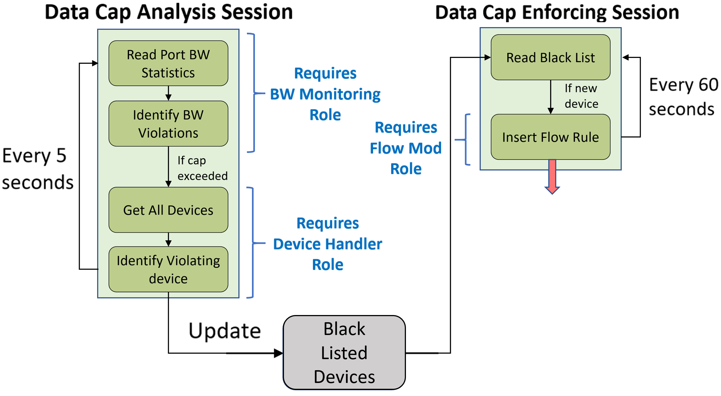
Use-case in SDN-RBAC
Multi session app: Data Usage Cap Manager

Slide 16
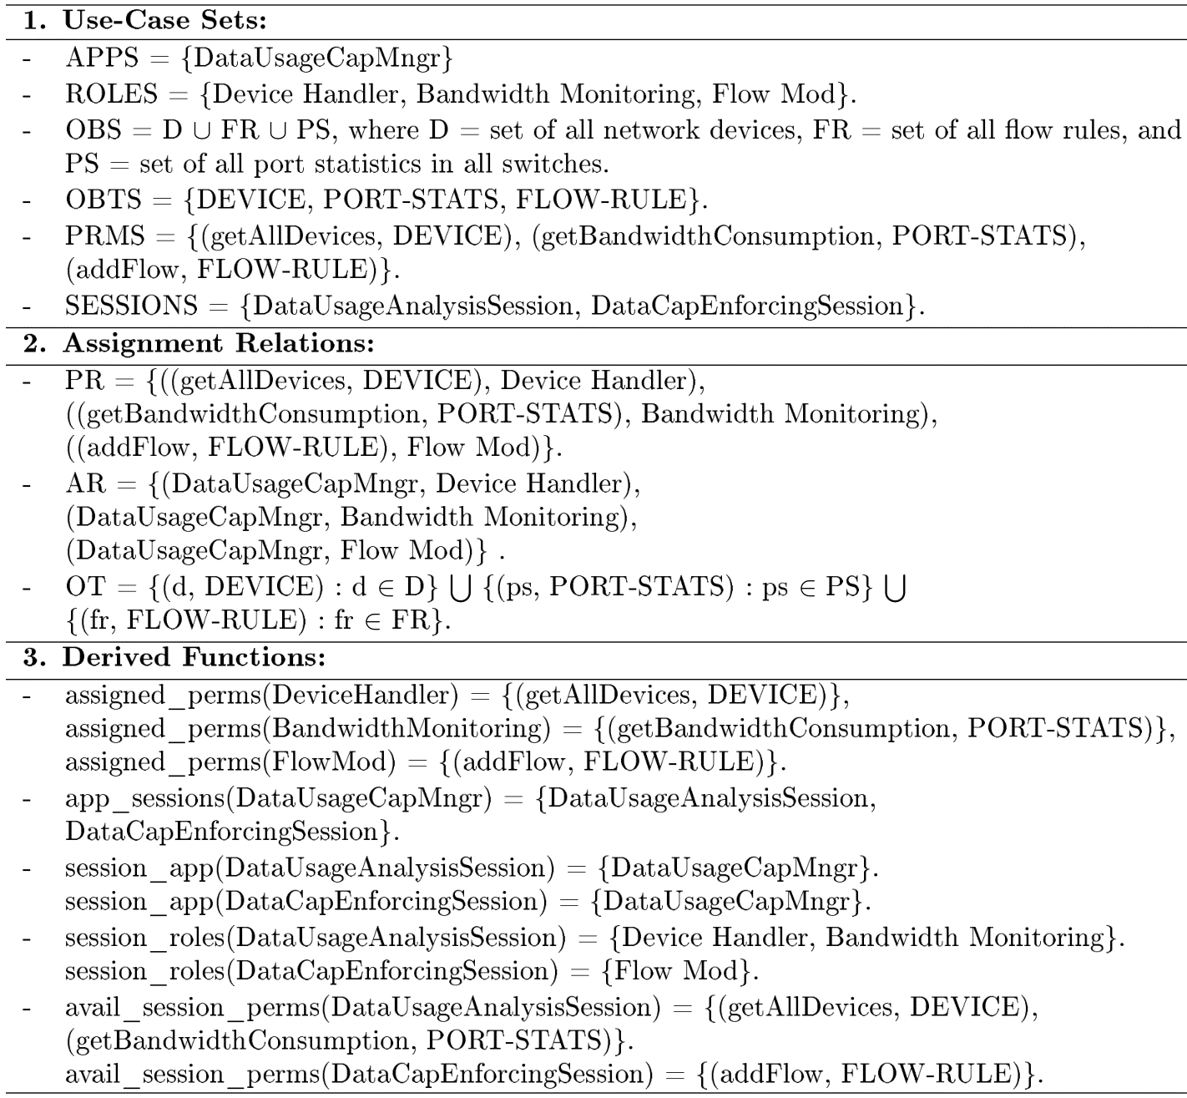
Use-Case Security Configuration in SDN-RBAC
3 roles
2 sessions
permission to insert flow rules
very important role & permission
role assigned to app
role activated in session
permission available to session

Slide 17
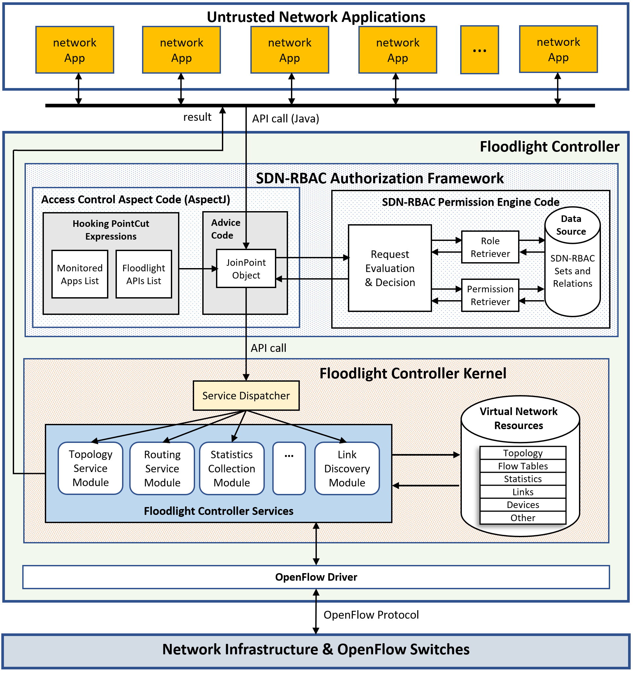
SDN-RBAC Framework Implementation in Floodlight

Slide 18
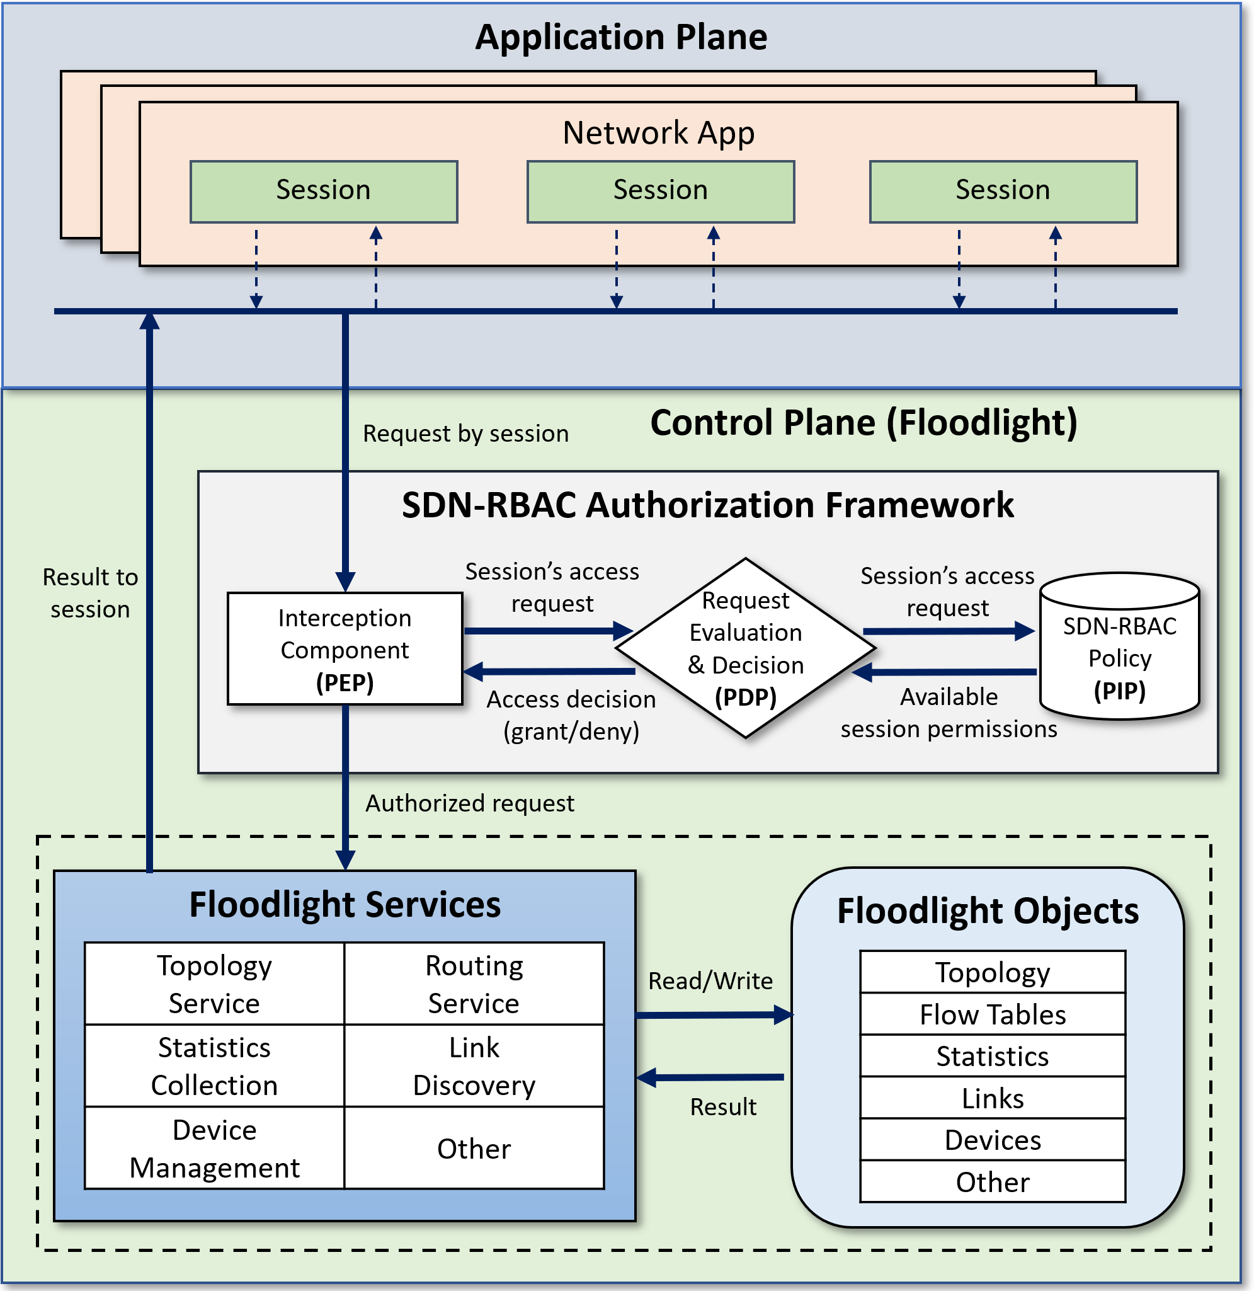
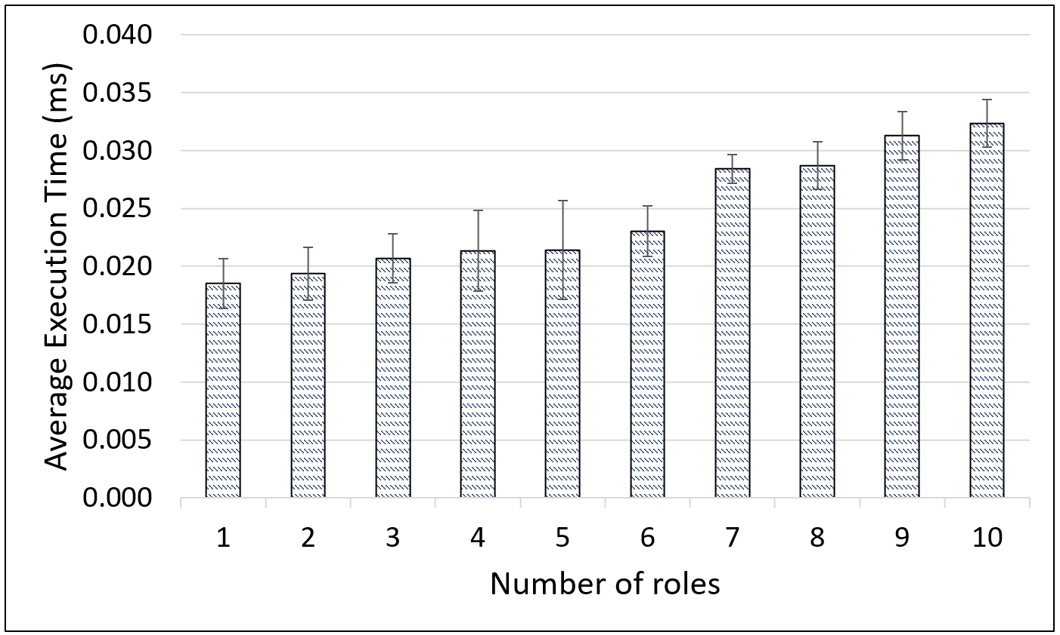
SDN-RBAC Average Authorization Time
Test app with 50 ops covered by 10 different roles.
Report authorization time for all 50 requests.
Different security policies.
Test repeated 100 times for each security policy.
Average authorization time is calculated.
floodlight’s boot-up time is ignored.
Timer Started
Timer Ended
On average: 0.0245 ms overhead for 50 operations.

Slide 19
Summary of Contributions
Enabling Role Based Authorization for SDN.
  SDN-RBAC Model and Authorization Framework with Implementation & Enforcement in SDN Controller.
Fine-Grained and Scalable Access Control for SDN.
  Access Control Enhanced with Role and Permission Parameters with Authorization Framework Extended with Parameter Engine and Enforcement in SDN Controller.
Administration of Access Control in SDN.
  SDN-RBACa Administrative Model for Managing roles, Permissions and Network App Authorizations in SDN.
  Proxy Operations and Custom Permissions for Enhanced Engineering of Administrative Units in SDN.

Slide 20
Limitations of SDN-RBAC
Apps are authorized on object types (e.g., (addFlow, FLOW RULE)) → Fine grained access control is required.
a1
a2
a3
a4
a5
a6
a7
a8
a9
…
Requires restriction
Controller (Floodlight)
CS
CIS
CE
0x1
0x4
0x7
0x8
…
0x2
0x5
0x3
0x6
0x9
Role: Flow Mod₁
Role: Flow Mod₂
Role: Flow Mod₃
…
Assigned Perms:
(addFlow, flow_rule^{sw0x1})
(addFlow, flow_rule^{sw0x2})
(addFlow, flow_rule^{sw0x3})
continue for:
deleteFlow x 3
readFlow x 3
updateFlow x 3
Assigned Perms:
(addFlow, flow_rule^{sw0x4})
(addFlow, flow_rule^{sw0x5})
(addFlow, flow_rule^{sw0x6})
continue for:
deleteFlow x 3
readFlow x 3
updateFlow x 3
Assigned Perms:
(addFlow, flow_rule^{sw0x7})
(addFlow, flow_rule^{sw0x8})
(addFlow, flow_rule^{sw0x9})
continue for:
deleteFlow x 3
readFlow x 3
updateFlow x 3
Multiple very closely related roles are defined to achieve fine-grained access control.
Roles are limited in membership.
Role explosion
Permission explosion

Slide 21
Introducing Parameterized Roles and Permissions in SDN
a1
a2
a3
Requires restriction
a4
a5
a6
a7
a8
a9
Controller (Floodlight)
CS
CIS
CE
0x1
0x4
0x7
0x8
0x2
0x5
0x3
0x6
0x9
dept = CS
dept = CIS
dept = CE
Role: Flow Mod
Assigned Perms:
(addFlow, FLOW RULE)
(deleteFlow, FLOW RULE)
(updateFlow, FLOW RULE)
(readFlow, FLOW RULE)

Slide 22
Parameterized Permissions and Roles
Parameters
  name:value pairs.
  Add restrictions on access to network resources.
Parameterized Roles:
(r_{i} , {(par₁ , val₁ ), (par₂ , val₂ ), ...})
Example:
(Flow Mod, {(dept, ⊥), (traffic, ⊥)})
Parameterized Permissions:
((op_{i}, ot_{i}), {(par₁ , val₁ ), (par₂ , val₂ ), ...})
Example:
((addFlow, FLOW-RULE), {(dept, ⊥), (traffic, ⊥)})
⊥ = Unknown.

Slide 23
ParaSDN Conceptual Model
many-to-many
PARAMETERS
(PAR)
one-to-many
PARAMETERS
(PAR)
PVPAIRS
VALUES
(VAL)
PVPAIRS
APPS
AA
VALUES
(VAL)
PPA
OPERATIONS
(OPS)
ROLES
app_
sessions
PRMS
session_
roles
OBJECT
TYPES
(OBTS)
OBJECTS
(OBS)
_{OT}
PROLES
PPRMS
.
.
.

Slide 24
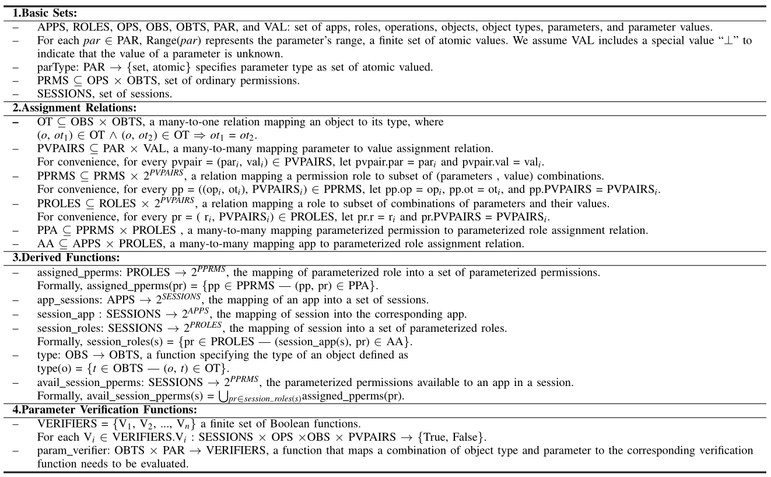
ParaSDN Formal Model Definition

Slide 25
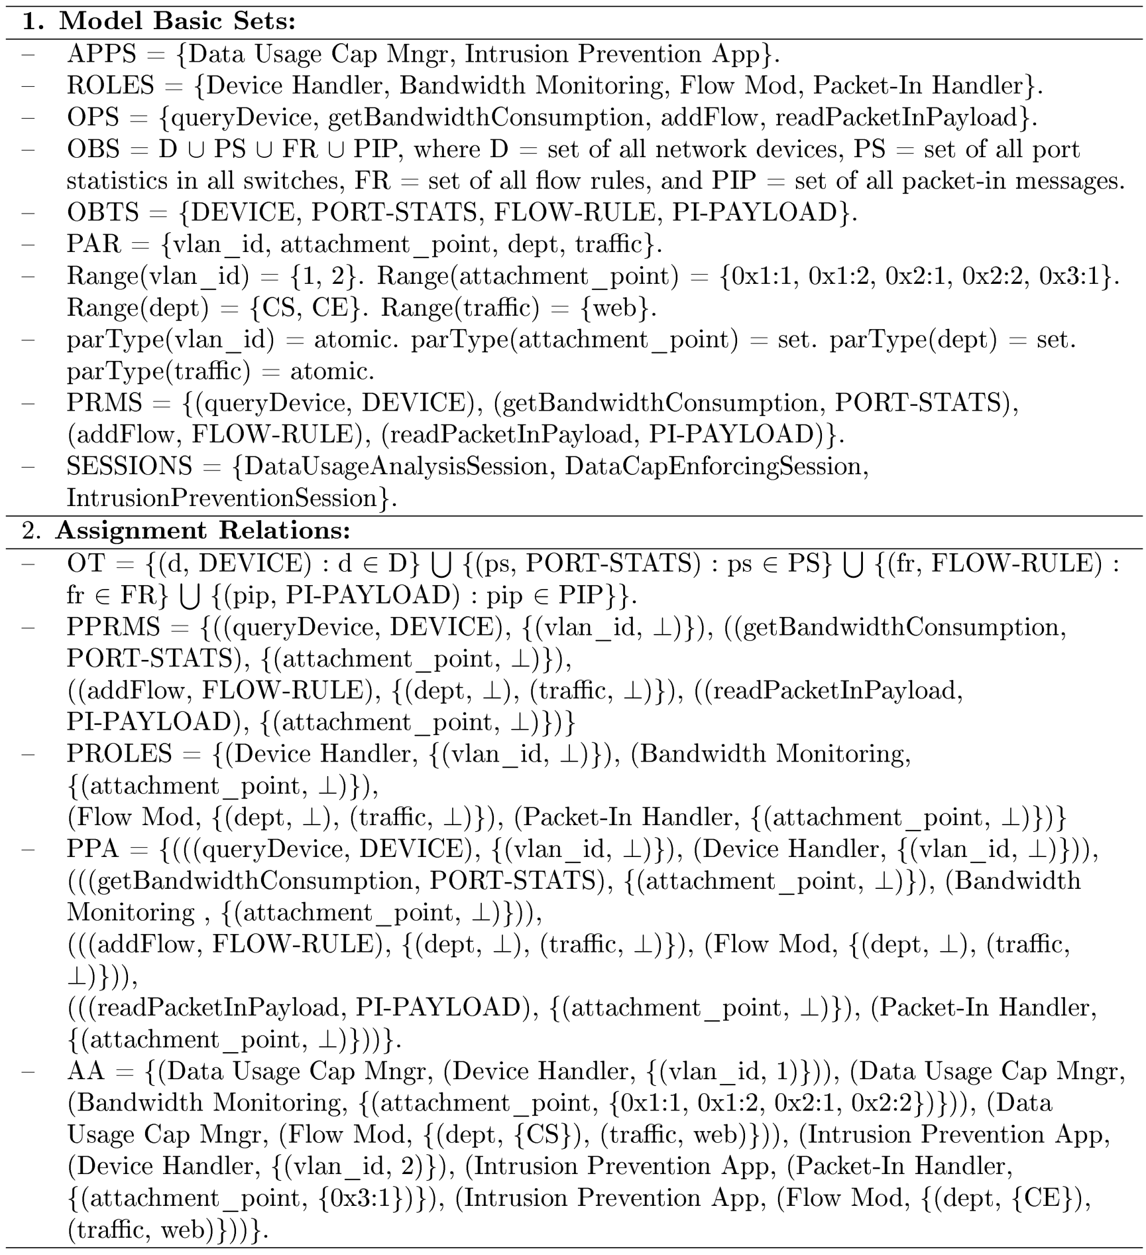
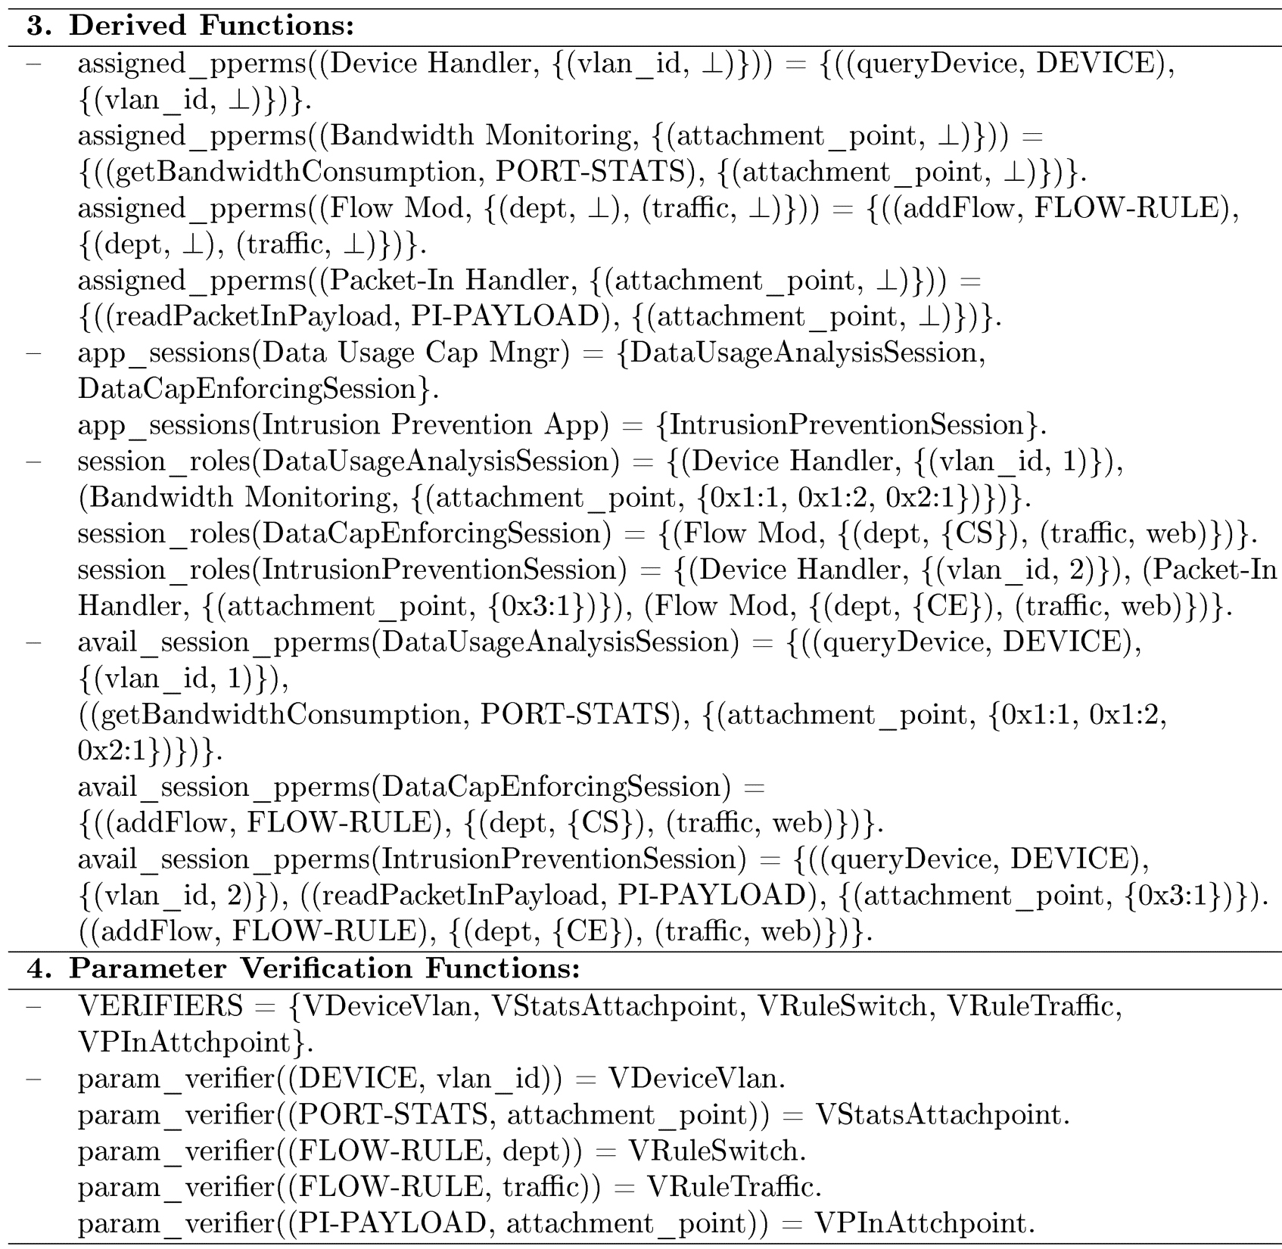
Use-Case Security Configuration in SDN-RBAC

Slide 26
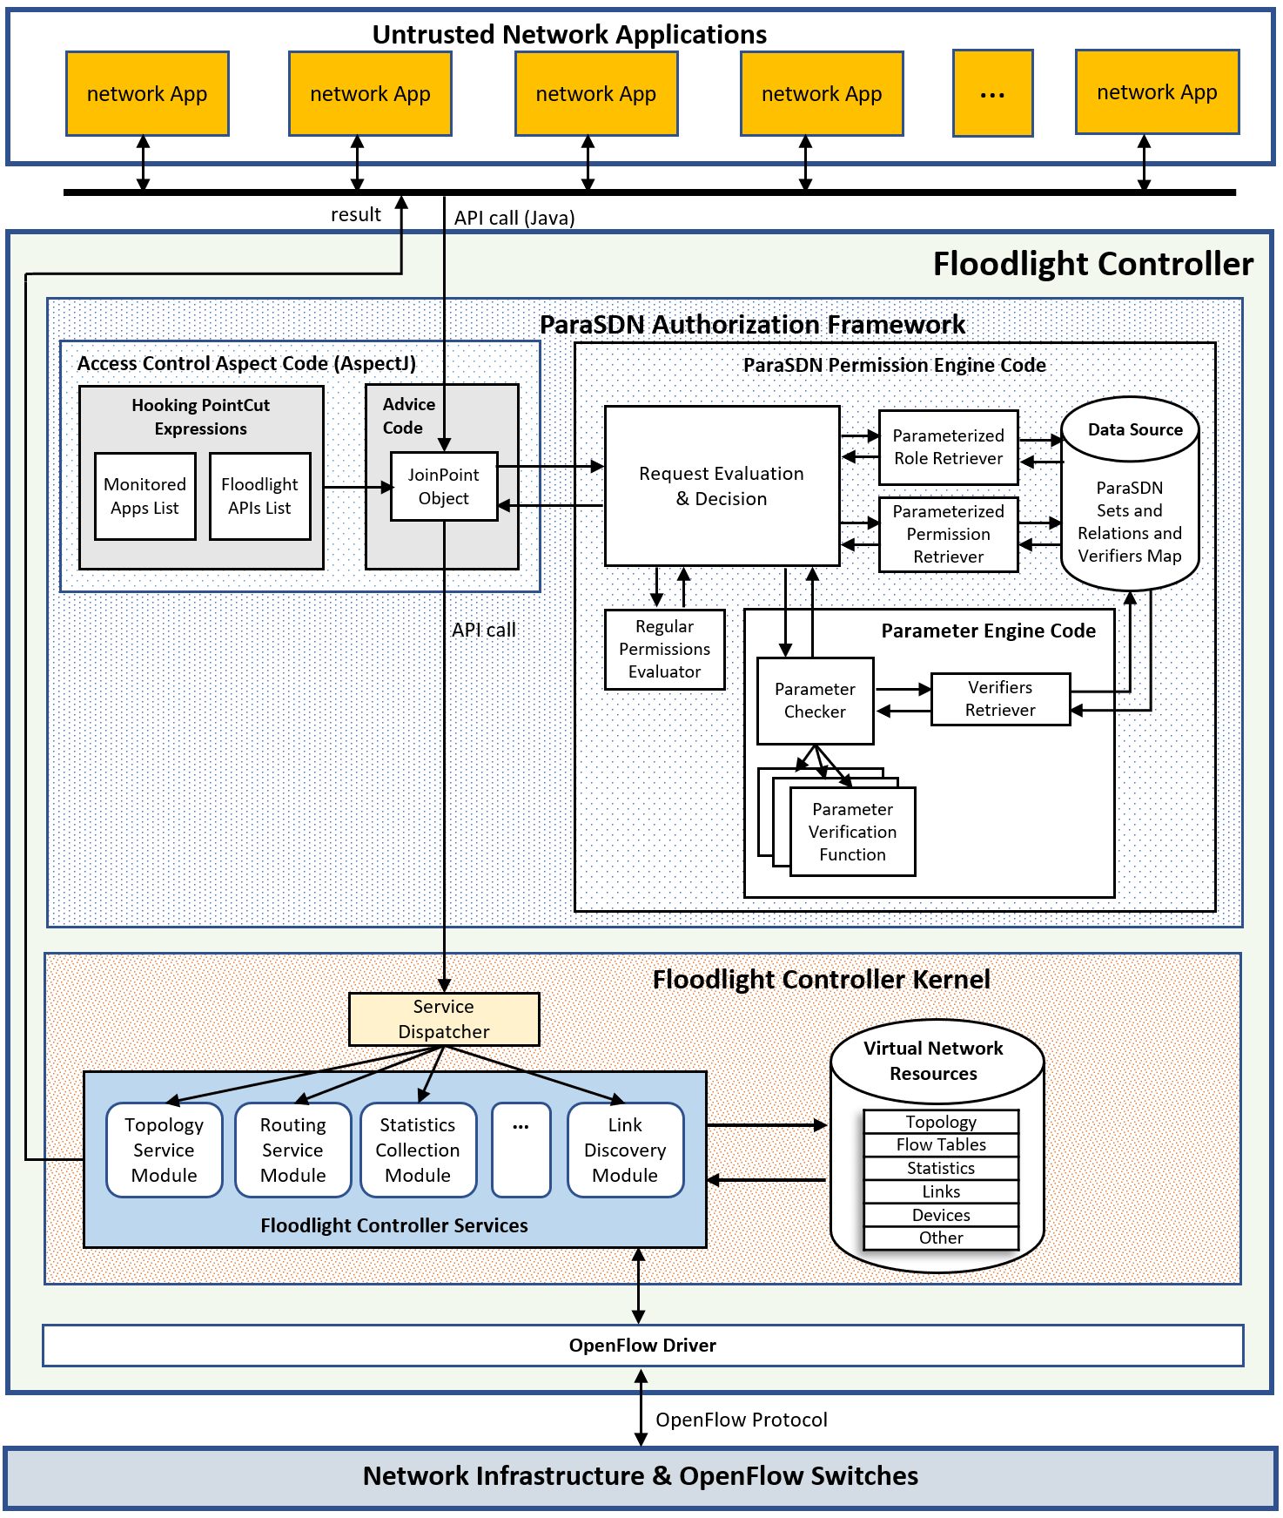
ParaSDN Framework Implementation in Floodlight
.

Slide 27
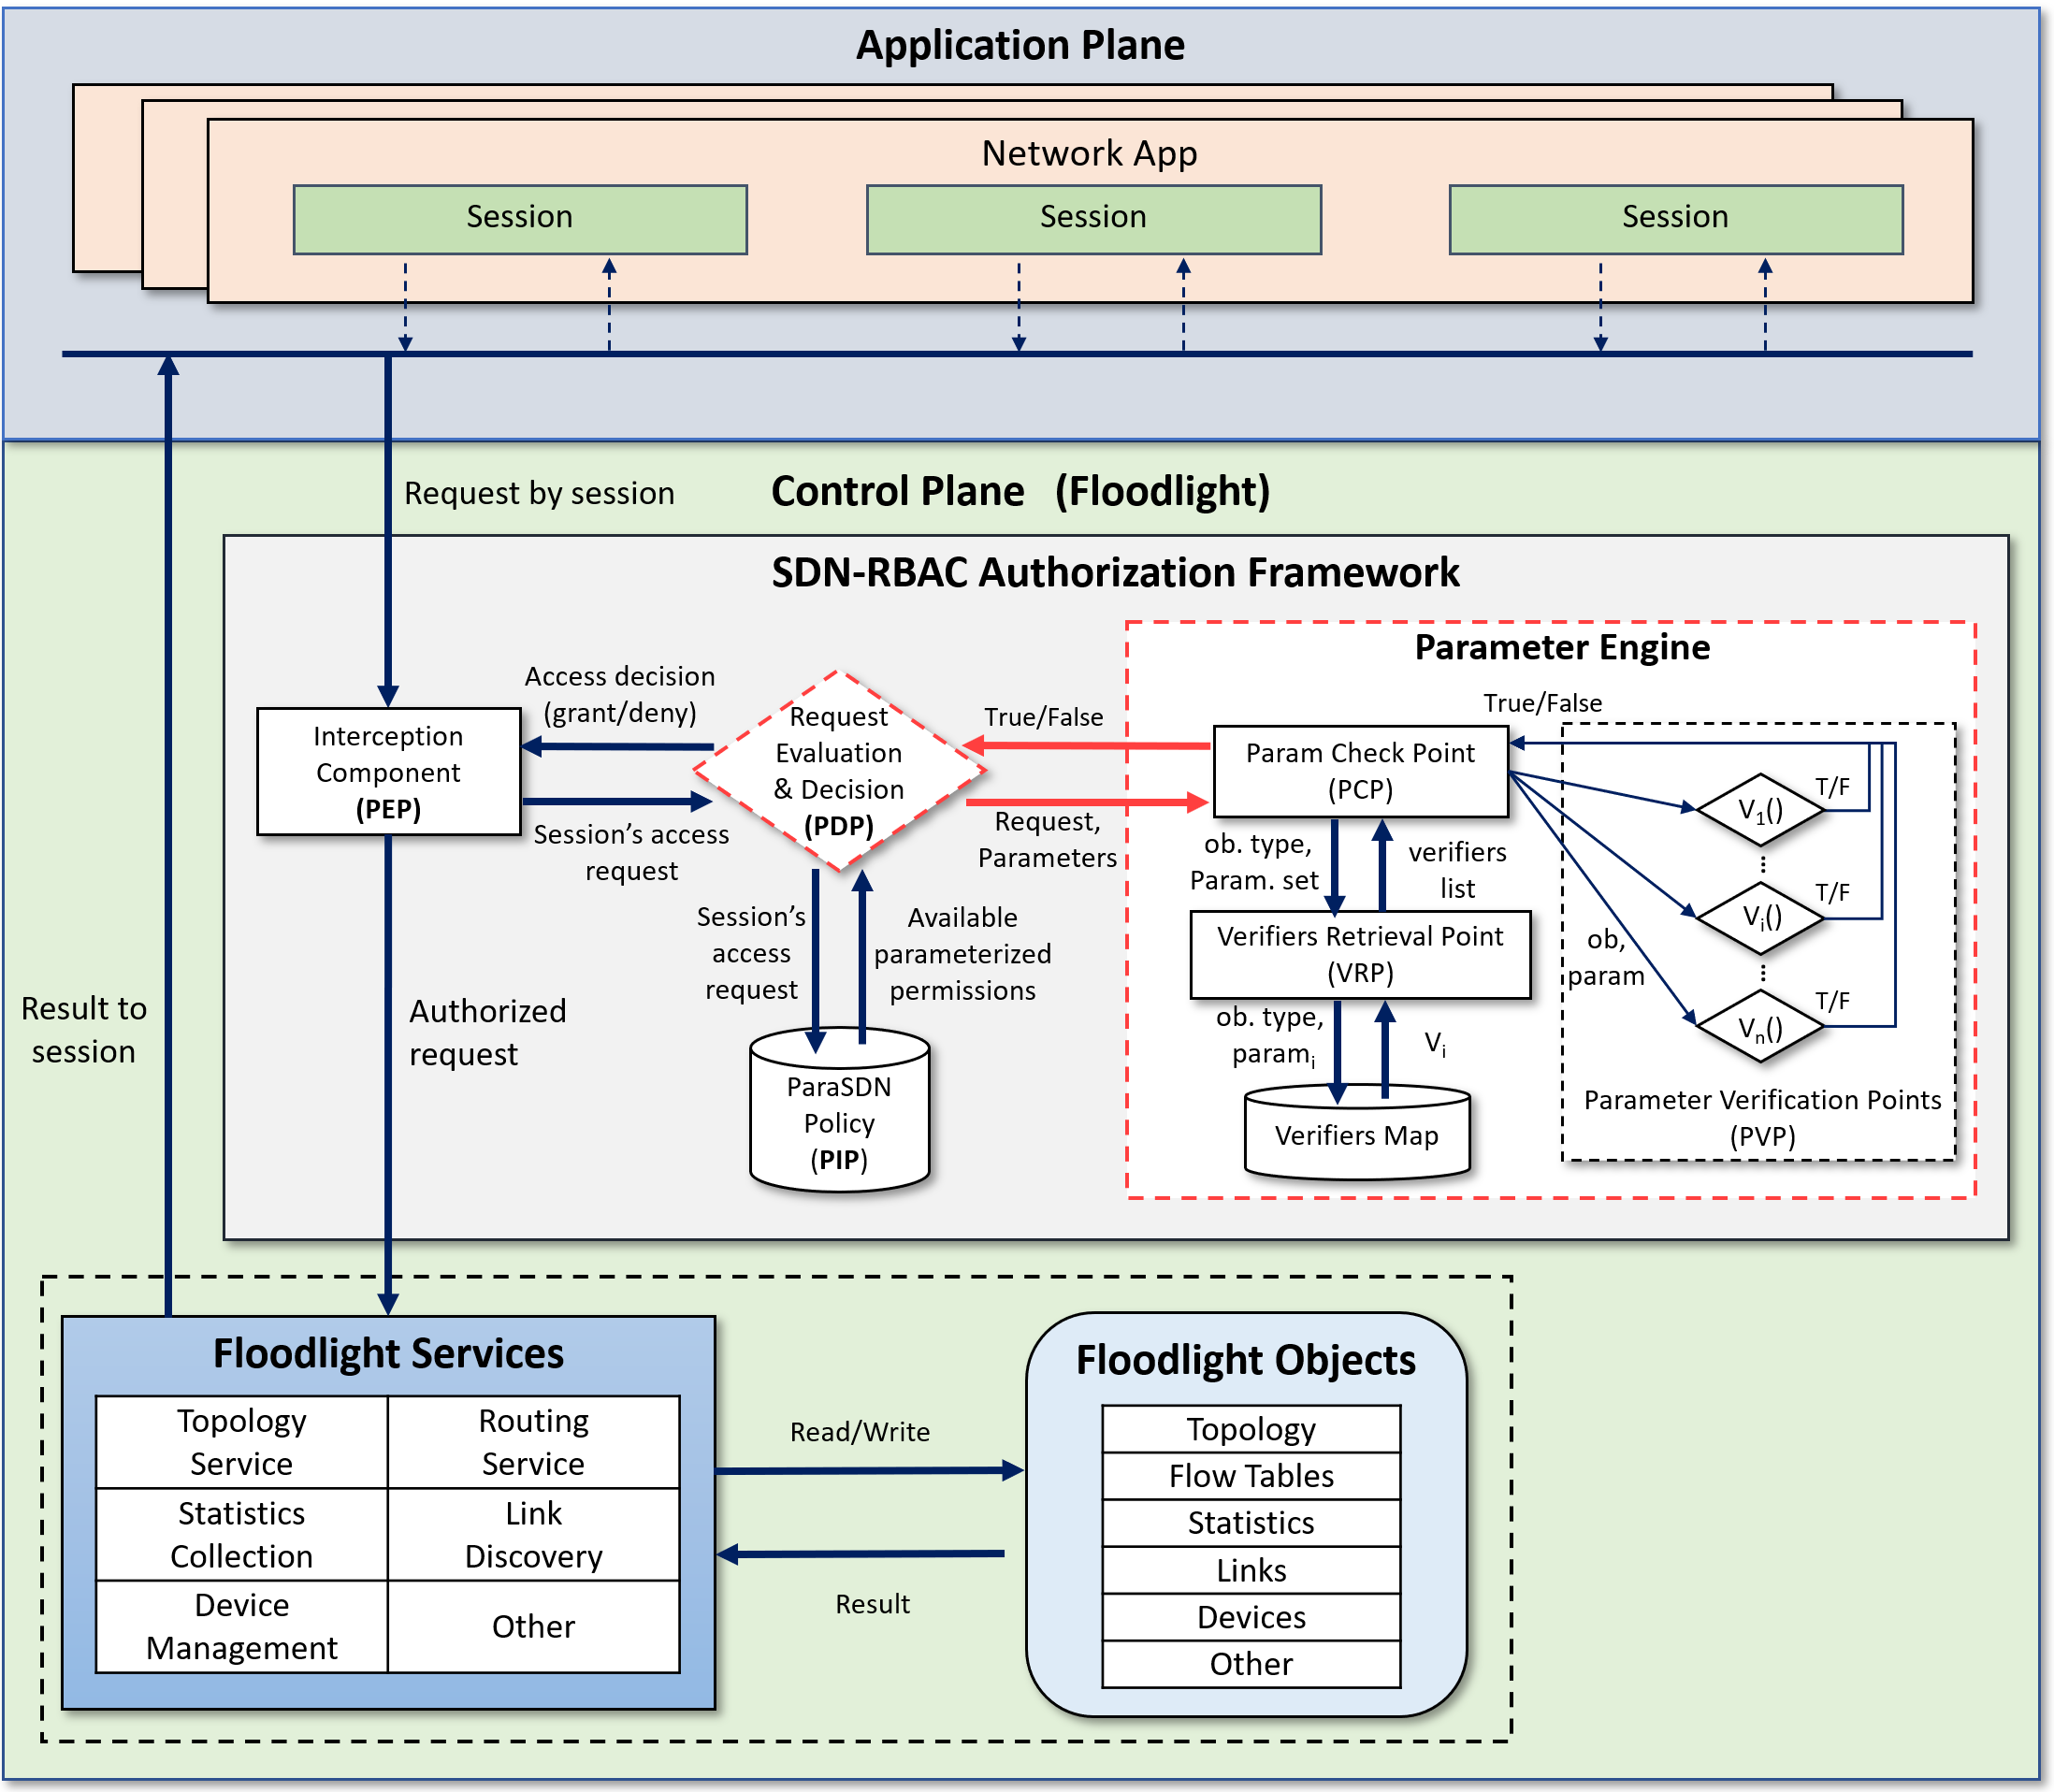
ParaSDN Implementation & Evaluation
Timer Ended
Timer Started

Slide 28
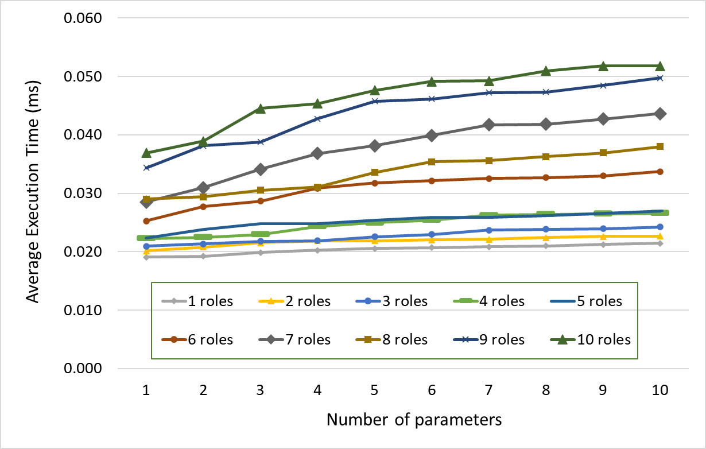
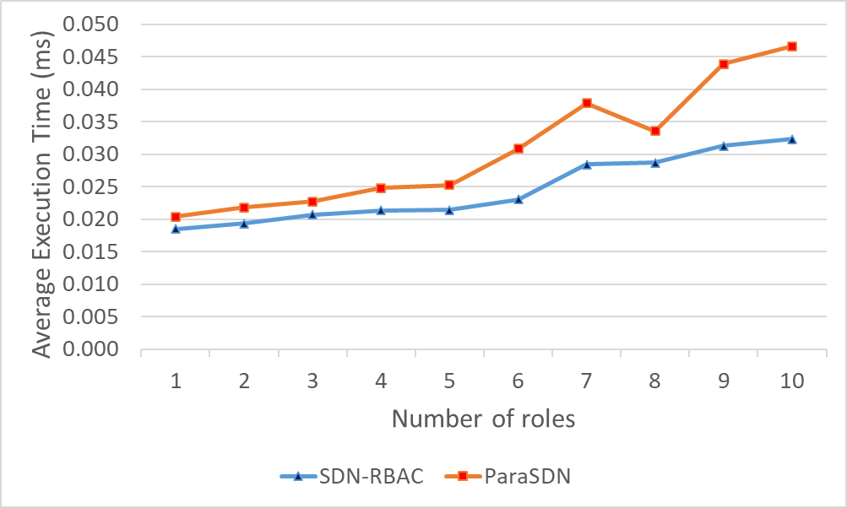
ParaSDN Evaluation - 1
Test app with 50 ops covered by 10 different roles.
Report authorization time for all 50 requests.
Different security policies (parameters and roles).
Test repeated 100 times for each security policy.
Average authorization time is calculated.
Floodlight’s boot-up time is ignored.
On average: ParaSDN adds 0.031 ms overhead compared to 0.025 for SDN-RBAC.
1st parameter in all roles is:
  activePeriod = “08:00-17:00”.
Any request submitted outside active period, will be denied.
Test 8 is conducted outside active period.
.

Slide 29
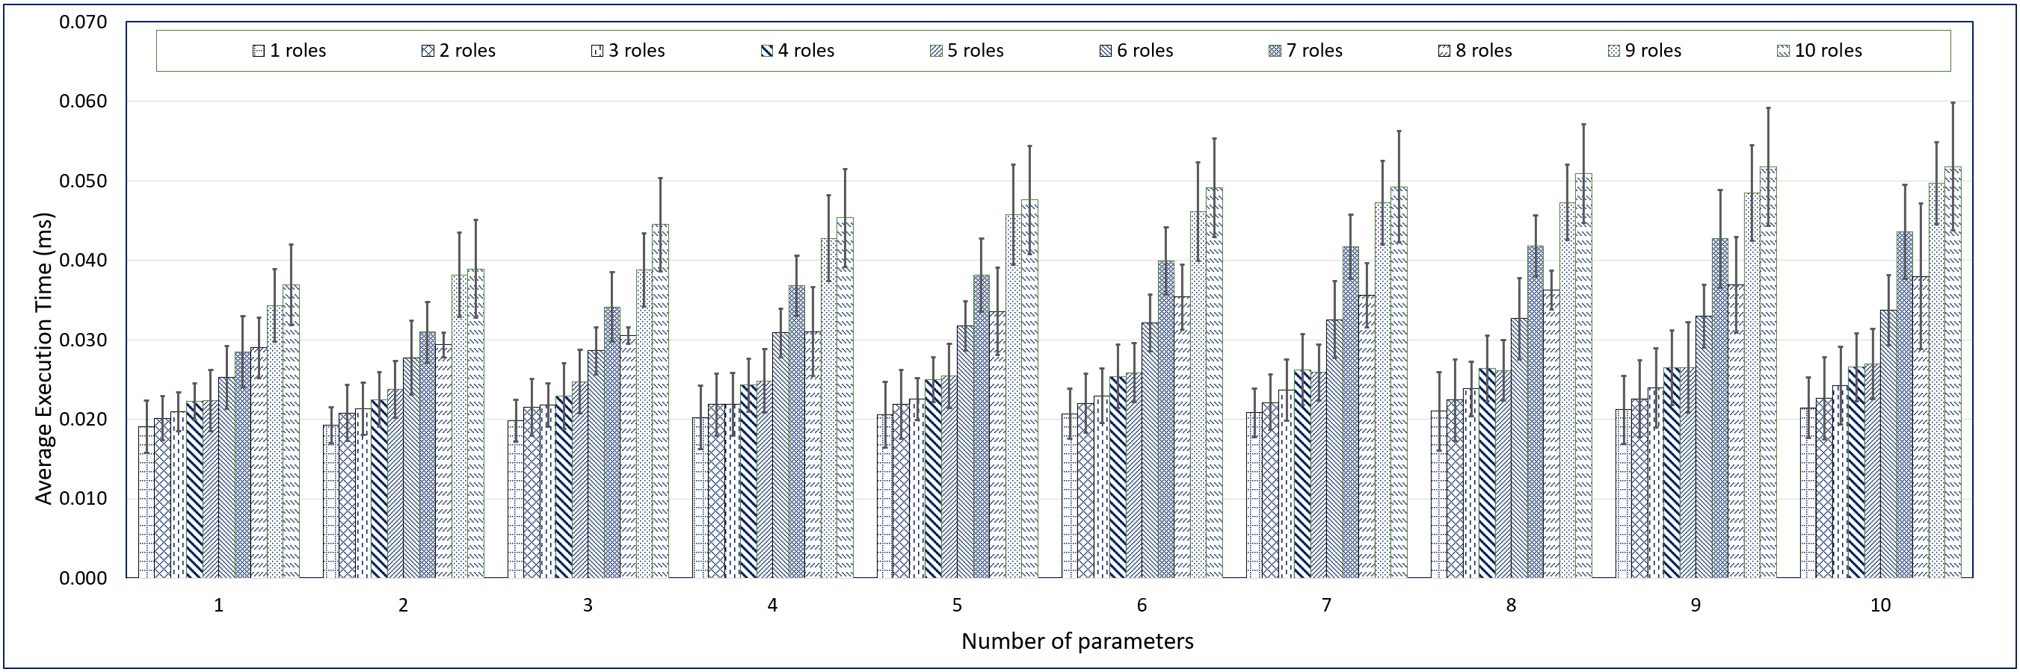
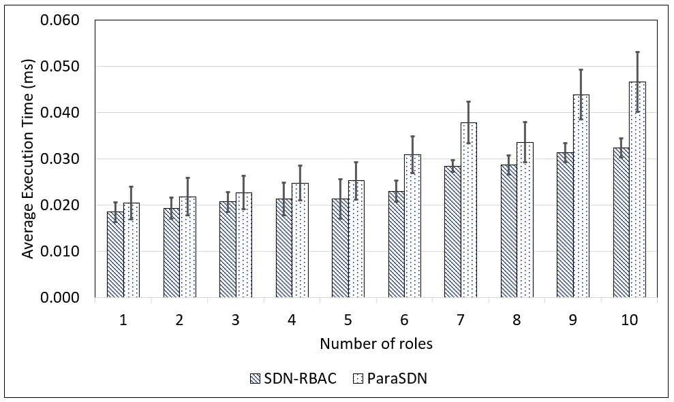
ParaSDN Evaluation - 2

Slide 30
Summary of Contributions
Enabling Role Based Authorization for SDN.
  SDN-RBAC Model and Authorization Framework with Implementation & Enforcement in SDN Controller.
Fine-Grained and Scalable Access Control for SDN.
  Access Control Enhanced with Role and Permission Parameters with Authorization Framework Extended with Parameter Engine and Enforcement in SDN Controller.
Administration of Access Control in SDN.
  SDN-RBACa Administrative Model for Managing roles, Permissions and Network App Authorizations in SDN.
  Proxy Operations and Custom Permissions for Enhanced Engineering of Administrative Units in SDN.

Slide 31



Access Control Administration in SDN
App-role and permission-role relations need management.
In SDN-RBACa administrative model (inspired by Uni-ARBAC):
  Indirect permission-role assignment.
  Permissions are grouped into permission-pools (tasks).
  Tasks: units of network functions.
  Apps are grouped into app-pools.
  Administrative Units for administering app-role and task-role relations.
Assigned to
Admin Unit
Assigned to
Admin User
Admin User
Manages Portion of
Can Manage
Can Manage
Apps
Roles
Tasks
App-role
assignment
Task-role
assignment

Slide 32
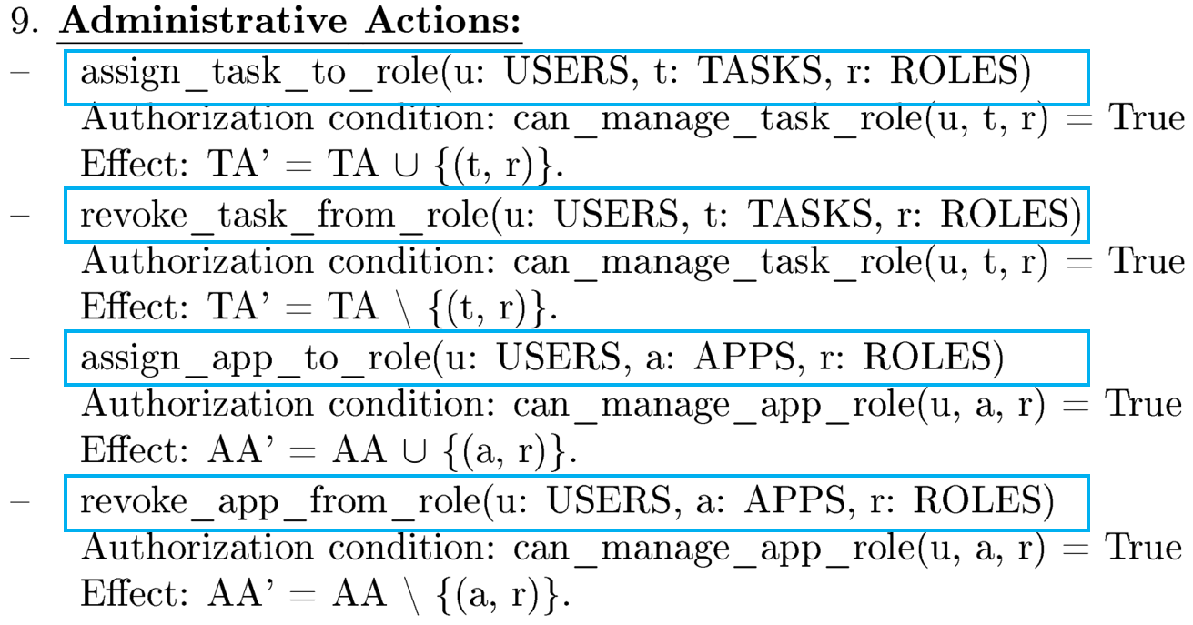
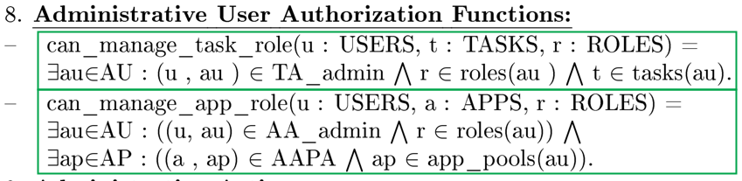
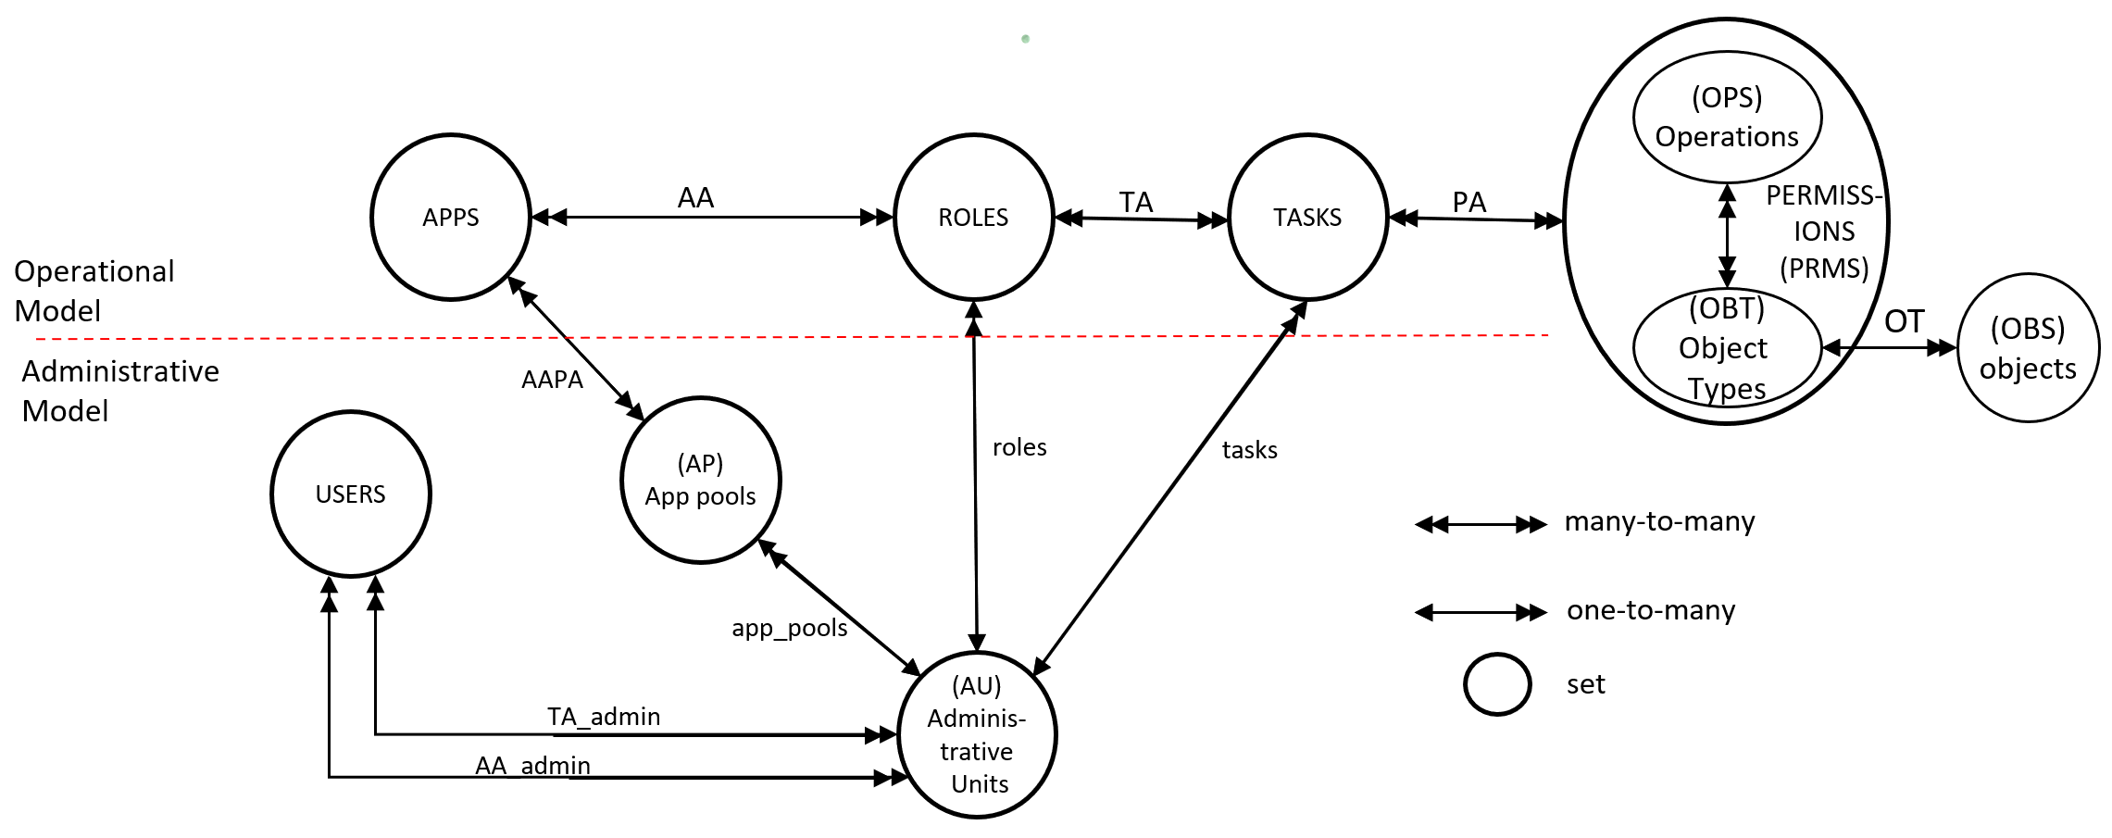
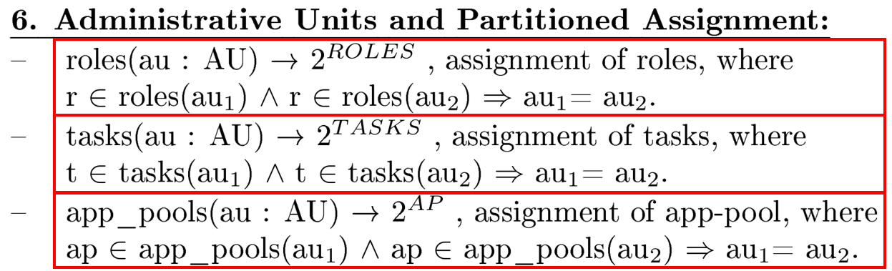
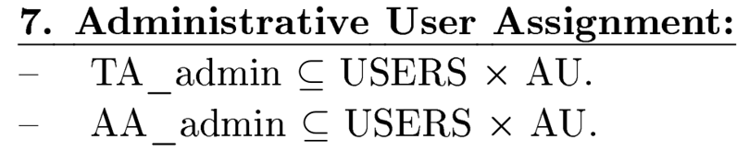
SDN-RBACa Administrative Model
.

Slide 33
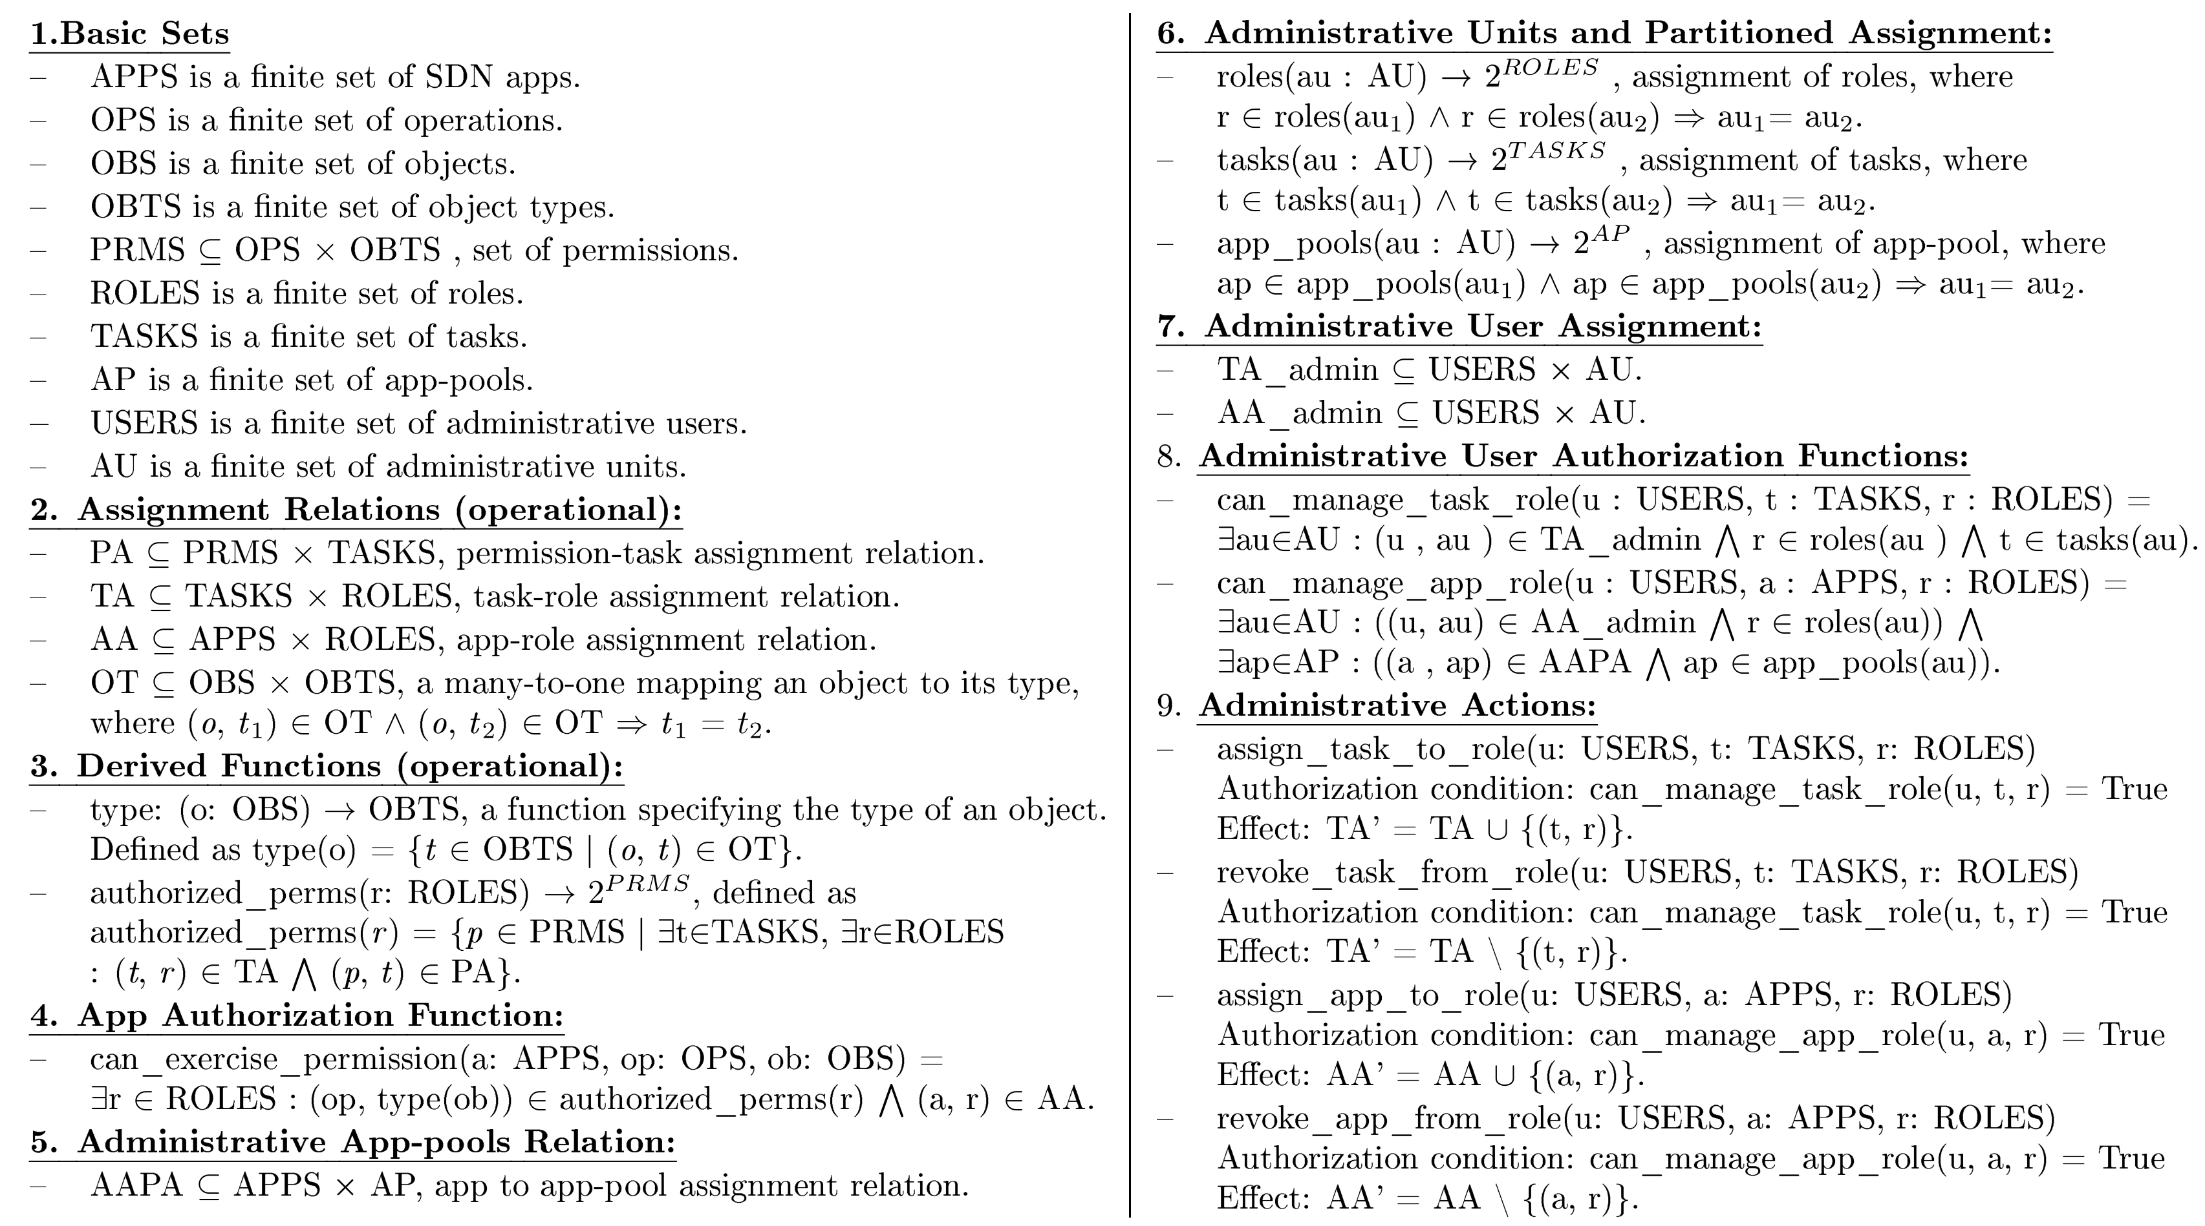
SDN-RBACa Administrative Model Defenition

Slide 34
Use Case using SDN-RBACa -
Introduction
In large SDNs, specialized apps control/analyze and monitor/inspect specific network traffic type.
These apps should be authorized to access only traffic type they handle and not other type (via roles).
Apps
Roles
Web-specific apps:
Web Load Balancers
Web Firewalls
etc.
VoIP-specific apps:
VoIP Load Balancers
VoIP Firewalls
etc.
FTP-specific apps:
FTP Load Balancers
FTP Firewalls
etc.
Email-specific apps:
Email Load Balancers
Email Firewalls
etc.
Web-specific roles:
Web Flow Mod
Web Load Balancing
etc.
VoIP-specific roles:
VoIP Flow Mod
VoIP Load Balancing
etc.
FTP-specific roles:
Ftp Flow Mod
Ftp Load Balancing
etc.
Email-specific roles:
Email Flow Mod
Email Load Balancing
etc.
Authorized via
Authorized via
Authorized via
Authorized via

Slide 35
Use Case using SDN-RBACa -
Introduction
In large SDNs, specialized apps control/analyze and monitor/inspect specific network traffic type.
These apps should be authorized to access only traffic type they handle and not other type (via roles).
Apps
Roles
Web-specific apps:
Web Load Balancers
Web Firewalls
etc.
VoIP-specific apps:
VoIP Load Balancers
VoIP Firewalls
etc.
FTP-specific apps:
FTP Load Balancers
FTP Firewalls
etc.
Email-specific apps:
Email Load Balancers
Email Firewalls
etc.
Roles:
Flow Mod
Load Balancing
etc.
Authorized via
Authorized via
Authorized via
Authorized via

Slide 36
Functional Administrative Units for SDN
Relations between apps and roles should be managed by different administrative units.
Administrative Units
Roles: {Web Flow Mod, Web Load Balancing, etc.}
App-Pools: {Web Security, Web Load Balance, etc.}
Roles: {Email Flow Mod, Email Load Balancing, , etc.}
App-Pools: {Email Security, Email Load Balance}
Roles: {Email Flow Mod, VoIP Load Balancing, etc.}}
App-Pools: {VoIP Security, VoIP Load Balance}
Roles: {FTP Mod Email, FTP Load Balancing, etc.}
App-Pools: {FTP Security, FTP Load Balance}
Web Admin Unit
Email Admin Unit
VoIP Admin Unit
FTP Admin Unit

Slide 37
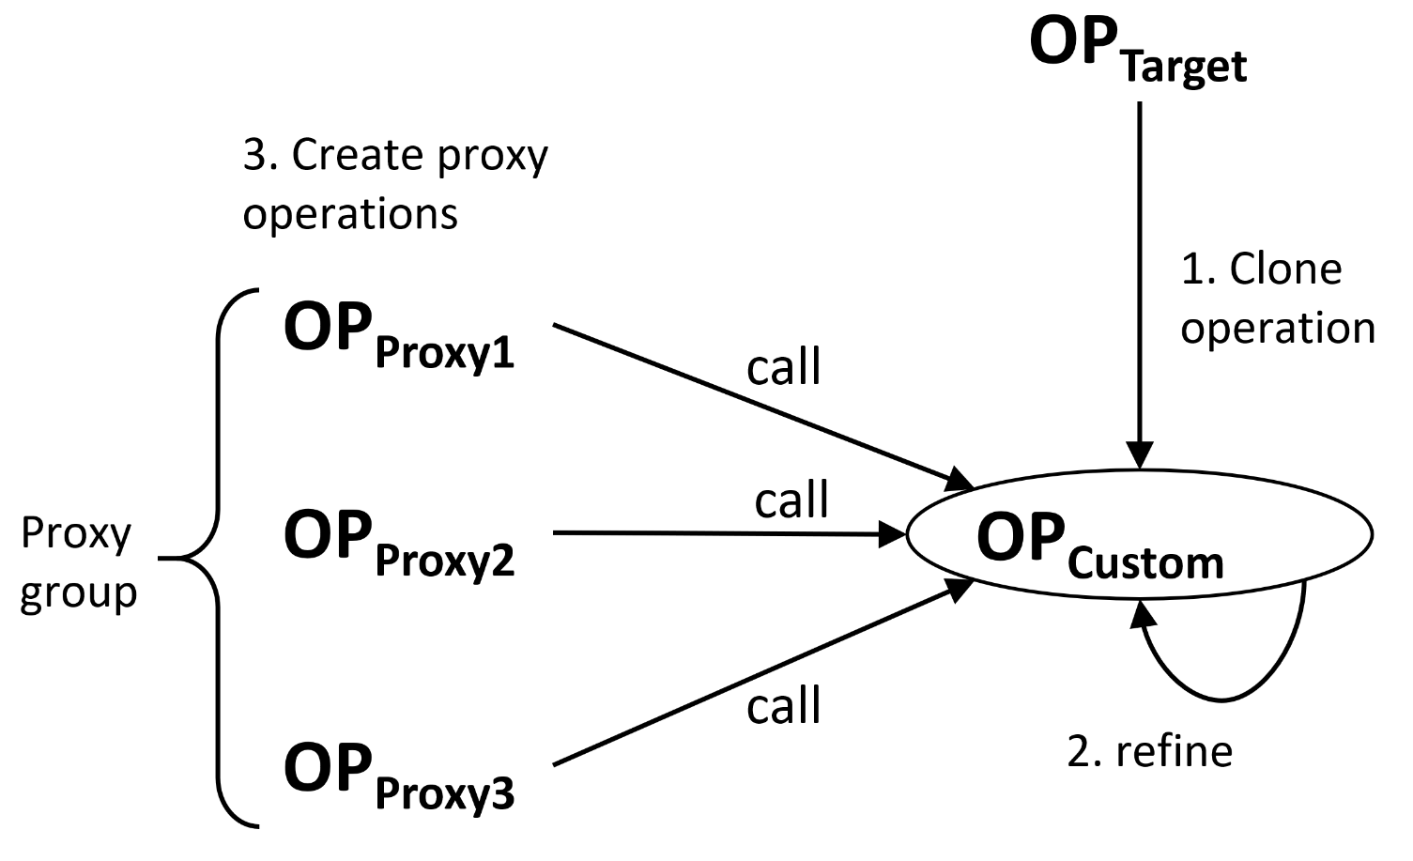
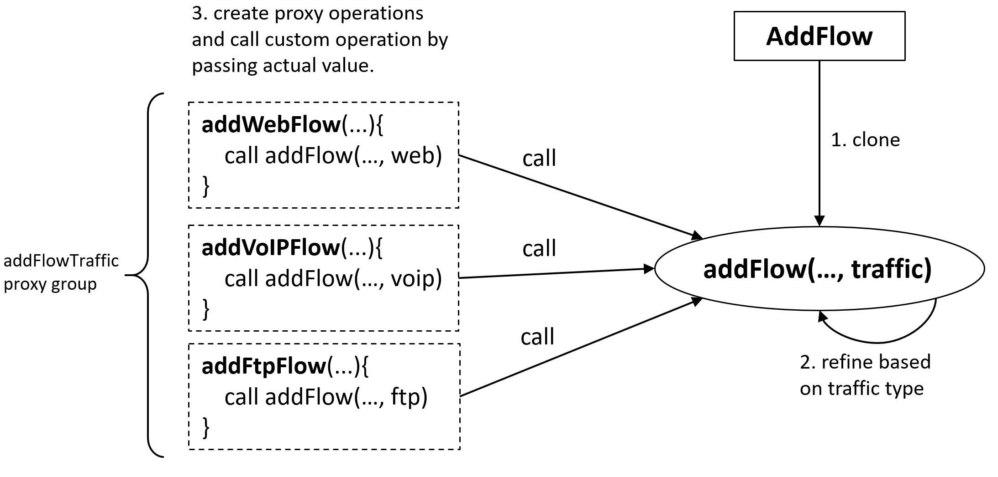
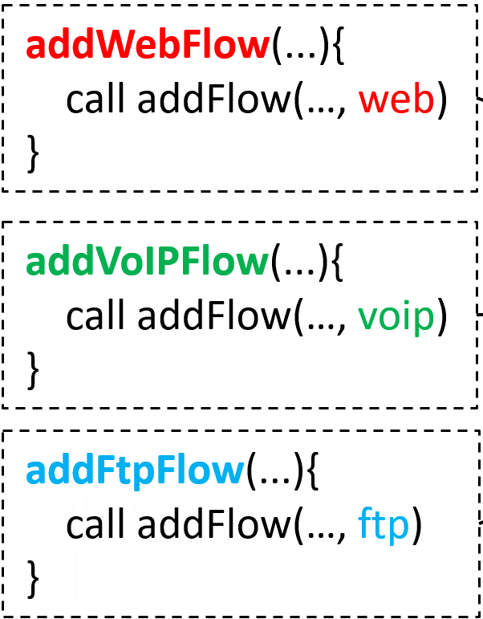
Custom and Proxy Operations
OP_{Proxy1}
OP_{Proxy2}
OP_{Proxy3}
(verify access to appropriate content)
provides restrictive access to specific traffic type.
(ensure that flow rule handles correct traffic type)

Slide 38
Custom Permissions
Custom permissions are those permissions that are created using proxy operations.
(OP_{Proxy_1}, ot)
(OP_{Proxy_2}, ot)
(OP_{Proxy_3}, ot)
…
Examples:
(addWebFlow, FLOW-RULE)
(addVoIPFlow, FLOW-RULE)
(addFtpFlow, FLOW-RULE)
(createWebMember, LB-POOL-MEMBER)
(createVoIPMember, LB-POOL-MEMBER)
(createFtpMember, LB-POOL-MEMBER)
(readWebPacketInPayload, PI-PAYLOAD)
(readVoIPPacketInPayload, PI-PAYLOAD)
…

Slide 39
Task and Role Engineering Custom Permissions
SDN Apps
Roles
Tasks
Custom
Permissions
OP_{Proxy}
OP_{Custom}
OP_{Target}
p1
x11
r1
val1
App1
t1
p2
x12
val2
c1
clone
op1
p3
val3
x13
Actual value
passed to custom operation
p4
x21
r2
val1
App2
t2
p5
x22
val2
c2
clone
op2
p6
val3
x23
p7
x31
r3
val1
App3
t3
p8
x32
val2
c3
clone
op3
p9
val3
x33

Slide 40
Task and Role Engineering using Custom Permissions - Example
SDN Apps
Roles
Tasks
Custom
Permissions
OP_{Proxy}
OP_{Custom}
OP_{Target}
(addWebFlow, FlOW-RULE)
Web Traffic Forwarding Task
(addWebFlow, FlOW-RULE)
Web Traffic Forwarding Task
addWebFlow
addWebFlow
web
Web Intrusion Prevention
web
Web Intrusion Prevention
Web Flow Mod
Web Flow Mod
(addVoipFlow, FlOW-RULE)
voip
clone
addFlow
addVoipFlow
addFlow(traffic)
Web Flow Viewing Task
ftp
Web Flow Viewing Task
(addFtpFlow,
FlOW-RULE)
addFtpFlow
passed to custom operation
(deleteWebFlow, FlOW-RULE)
VoIP Traffic Forwarding Task
(deleteWebFlow, FlOW-RULE)
deleteWebFlow
deleteWebFlow
web
VoIP Load Balancer
web
VoIP Flow Mod
(deleteVoipFlow, FlOW-RULE)
voip
clone
deleteFlow
deleteVoipFlow
deleteFlow(traffic)
Voip Flow Viewing
ftp
(deleteFtpFlow, FlOW-RULE)
deleteFtpFlow
(readWebFlow, FlOW-RULE)
FTP Traffic Forwarding Task
(readWebFlow, FlOW-RULE)
readWebFlow
readWebFlow
web
web
FTP Application Firewall
FTP Flow Mod
(readVoipFlow, FlOW-RULE)
voip
clone
readFlow
readVoipFlow
readFlow(traffic)
FTP Flow Viewing Task
ftp
(readFtpFlow, FlOW-RULE)
readFtpFlow

Slide 41
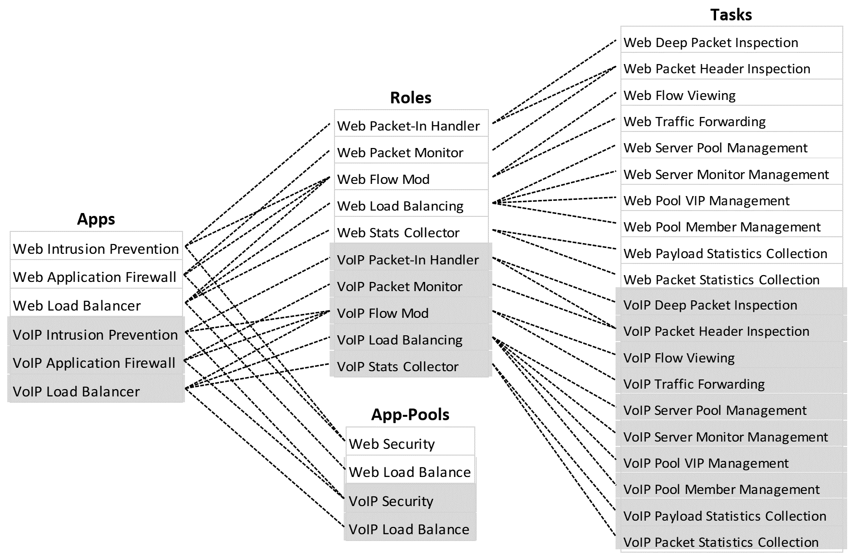
Use-Case and
Administrative Actions
Tasks, roles, and app-pools in white are exclusively managed by:
Tasks, roles, and app-pools in gray are exclusively managed by:
Web Admin Unit
VoIP Admin Unit
Administrative User Assignment:
TA_admin = {
(web_functions_admin_user, Web Admin Unit),
(voip_functions_admin_user, VoIP Admin Unit)}.
Example:
1. Administrative Action to assign task to a role:
assign_task_to_role(web_functions_admin_user, Web Traffic Forwarding Task, Web Flow Mod) is allowed.
→Authorization Function:
can_manage_task_role(web_functions_admin_user, Web Traffic Forwarding Task, Web Flow Mod) = True.
Reason:
∃Web Admin Unit ∈ AU : ((web_functions_admin_user, Web Admin Unit) ∈ TA_admin) ∧
Web Flow Mod ∈ roles(Web Admin Unit) ∧
Web Traffic Forwarding Task ∈ tasks(Web Admin Unit).

Slide 42
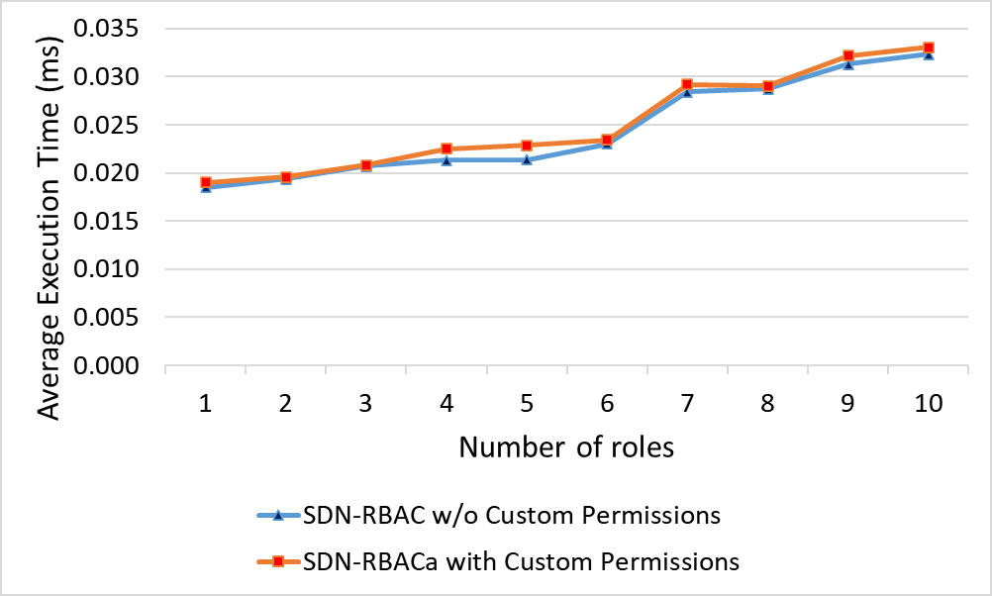
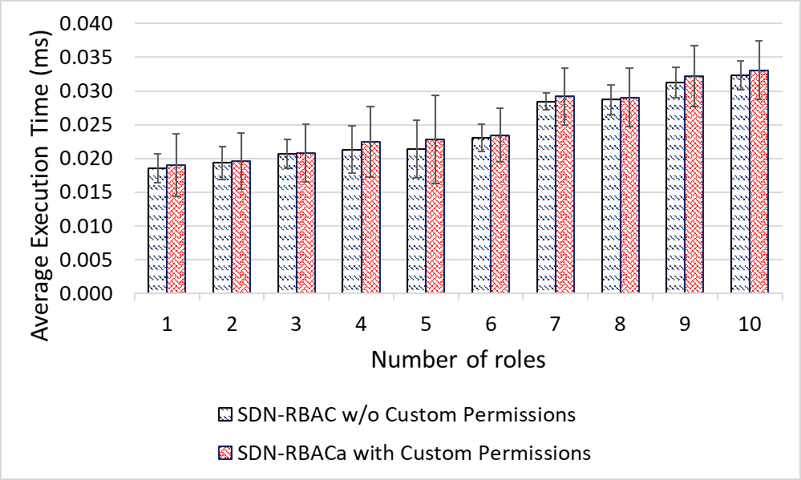
Evaluation and Comparison
Evaluation of SDN-RBACa operational model with tasks and proxy permissions.
Test app with 50 proxy operations ops covered by 10 different roles.
Report authorization time for all 50 requests.
Different security policies.
Test repeated 100 times for each security policy.
Average authorization time is calculated.
Operational model of SDN-RBACa adds an average of 0.0252 ms overhead on the floodlight controller while SDN-RBAC adds 0.0245 ms on average.
Using tasks in SDN-RBACa operational model introduces additional variance in the authorization check time.
The operational model of SDN-RBACa introduces acceptable overhead to the controller for the sake of access control administration.

Slide 43
Conclusion and Future Work
We presented SDN-RBAC, a model for enabling role based authorization for SDN. SDN-RBAC is implemented and enforced in Floodlight controller.
We presented ParaSDN, a fine-Grained and Scalable Access Control for SDN Enhanced with Role and Permission Parameters. The Authorization Framework includes Parameter Engine and Enforcement in SDN Controller.
We presented SDN-RBACa, an administrative model for SND enhanced with Proxy Operations and Custom Permissions.
Future Work:
  Access Control for SDN-Enabled technologies.
  Risk-Aware Access Control for SDN Apps.

Slide 44
Dissertation Publications
Published:
Abdullah Al-Alaj, Ram Krishnan, and Ravi Sandhu. "SDN-RBAC: An Access Control Model for SDN Controller Applications." 2019 4th International Conference on Computing, Communications and Security (ICCCS). IEEE, 2019.
Abdullah Al-Alaj, Ravi Sandhu, and Ram Krishnan. "A Formal Access Control Model for SE-Floodlight Controller." Proceedings of the ACM International Workshop on Security in Software Defined Networks & Network Function Virtualization. ACM, 2019.
Submitted for review:
Abdullah Al-Alaj, Ram Krishnan, and Ravi Sandhu. ParaSDN: An Access Control Model for SDN Applications based on Parameterized Roles and Permissions. In 2020 IEEE 6th International Conference on Collaboration and Internet Computing (CIC ). Atlanta, Georgia, USA, IEEE, 2020.
Abdullah Al-Alaj, Ravi Sandhu, and Ram Krishnan. A Model for the Administration of Access Control in Software Defined Networking using Custom Permissions. In 2020 Second IEEE International Conference on Trust, Privacy and Security in Intelligent Systems and Applications (TPS-ISA). Atlanta, Georgia, USA, IEEE, 2020.

Slide 45
Thank you!
Questions?

Slide 46
Backup Slides

Slide 47
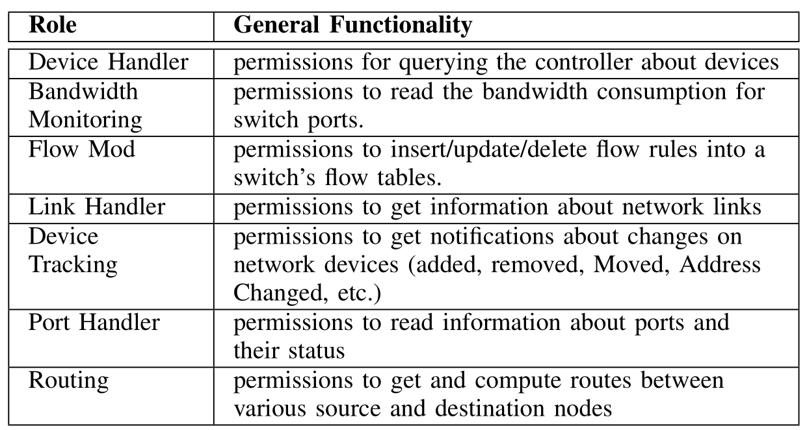
Selected roles in SDN-RBAC

Slide 48
SDN-RBAC - Check Access
SDN-RBAC checkAccess
avail_session_
perms
session_
roles
assigned_
perms
request from session (se)
se
se
session_roles(se)
loop
r_{i} ∈ session_roles(se)
assigned_perms(r_{i})
assigned_perms(r_{i})
loop
p_{i} ∈ assigned_perms(r_{i})
perm p_{i} matches request?
true/false
true/false

Slide 49
SDN-RBAC App Authorization- Example
- dces = DataCapEnforcingSession
SDN-RBAC checkAccess
avail_session_
perms
session_
roles
assigned_
perms
request from session (dces)
addFlow, fr_{i}
dces
dces
{Flow Mod}
loop
Flow Mod
{(addFlow, FLOW-RULE), …}
{(addFlow, FLOW-RULE), …}
loop
(addFlow, FLOW-RULE)
matches request?
true
true

Slide 50
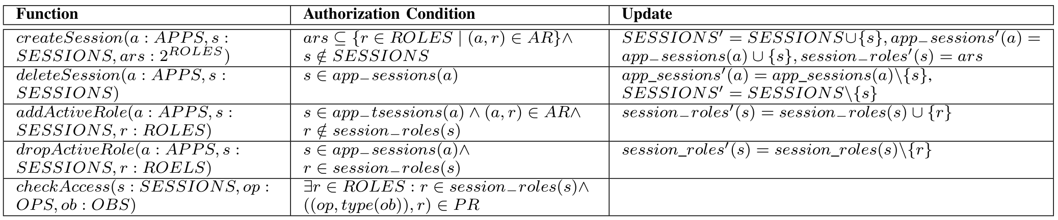
SDN-RBAC: Specifications of System Functions
Session Creation/Deletion
Adding/Dropping Active Role
Access Check
Apps are authorized based on object type.

Slide 51
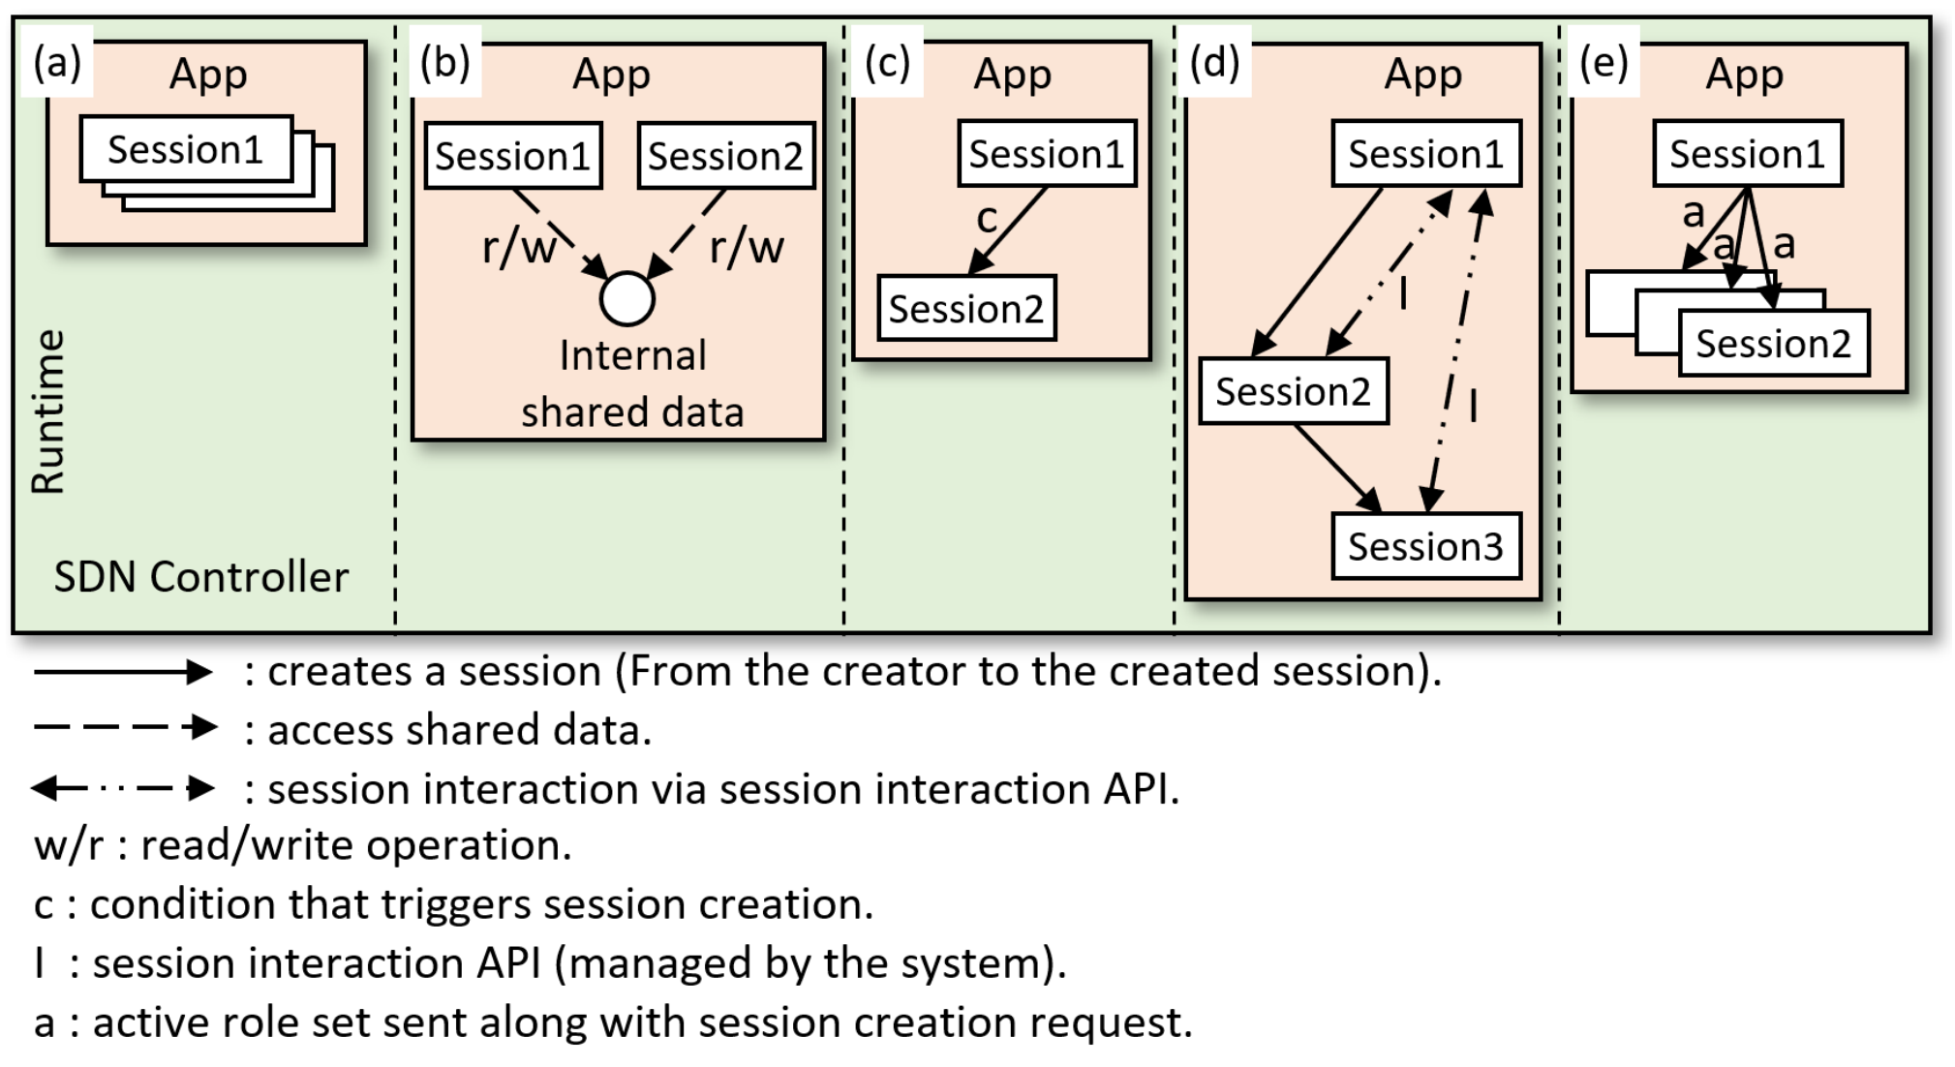
Methods for Inter-session Interaction for SDN-RBAC
Atomic sessions
Two sessions access shared data
Conditional session creation
Interaction via inter-session interaction APIs
Active role set sent from master to slave sessions

Slide 52
Session Handling Approaches
Who is responsible of specifying:
    (T) the tasks and corresponding sessions.
    (C) the condition for session creation/deletion.
    (A) the active role set.
    (R) role to be added/dropped during execution.
Session Handling Approaches
Developer-driven Approach
System-driven Approach
Session-driven Approach
    (T) DD
    (C) DD
    (A) DD
    (R) DD
    (T) CR
    (C) CR
    (A) CR
    (R) CR
    (T) DD
    (C) SR
    (A) SR
    (R) SR
DD = determined by Developer at Design-time.
CR = determined by Controller at Run-time.
SR = determined by Session at Run-time.

Slide 53
Developer-driven Session Handling (1)
Developer has full and prior knowledge of
  all possible sessions
  active role set required for each session to achieve its task.
This information is provided to the controller before app execution.
The controller knows in advance:
  what session instances will be created.
  the tasks that will execute in each session.
  active role set required for each session.
    (T) DD
    (C) DD
    (A) DD
    (R) DD

Slide 54
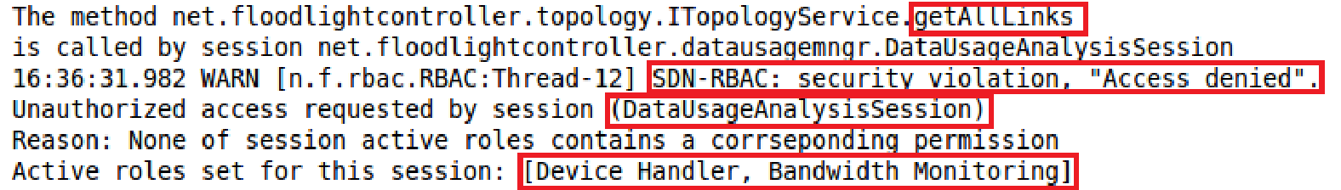
Usability demonstration (1)
Access Denies
To show that SDN-RBAC authorization system can identify and reject any unauthorized operations:
We forced DataUsageAnalysisSession to read link information via operation getAllLinks.
The permission (getAllLinks, LINK) is assigned to the role LinkHandler.
Role LinkHandler is not a member of the active role set of DataUsageAnalysisSession.
A snapshot of the execution result is shown below.
Unauthorized
Snapshot1

Slide 55
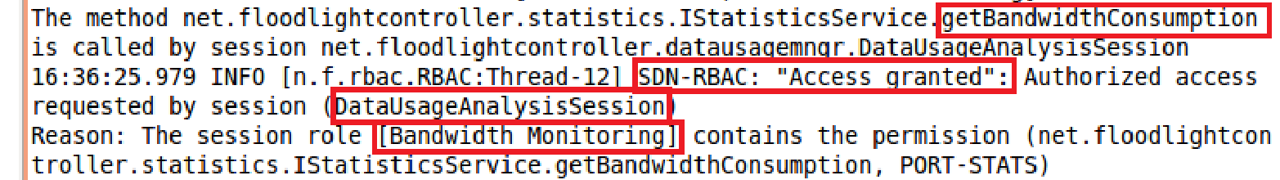
Usability demonstration (2)
Access Allowed
We forced DataUsageAnalysisSession to read device statistics via operation getBandwidthConsumption.
The permission (getBandwidthConsumption, PORT-STATS) is assigned to the role BandwidthMonitoring.
Role BandwidthMonitoring is a member of the active role set of DataUsageAnalysisSession.
A snapshot of the execution result is shown below.
The snapshot below shows how DataUsageAnalysisSession was able to pass the authorization.
Authorized
Snapshot2

Slide 56
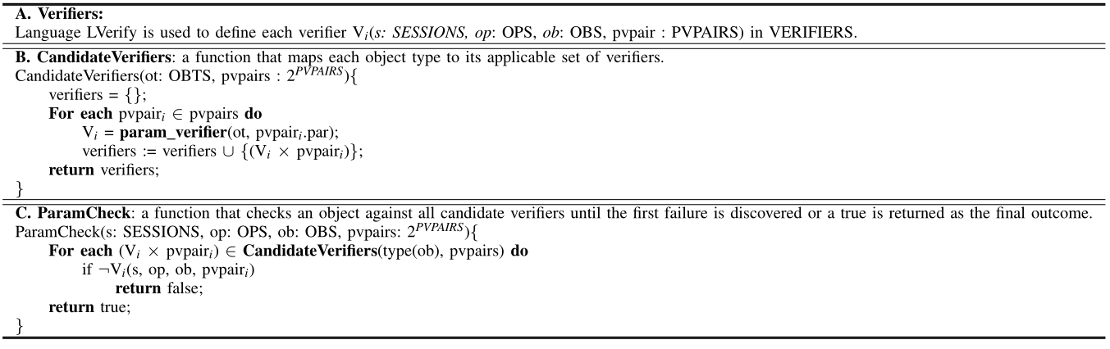
Parameter Checking Functions

Slide 57
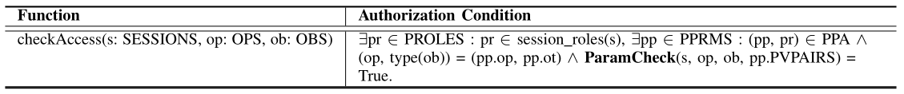
App Authorization Function

Slide 58
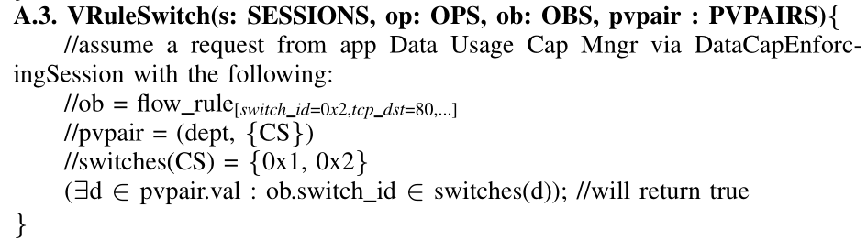
Verifier Example

Slide 59
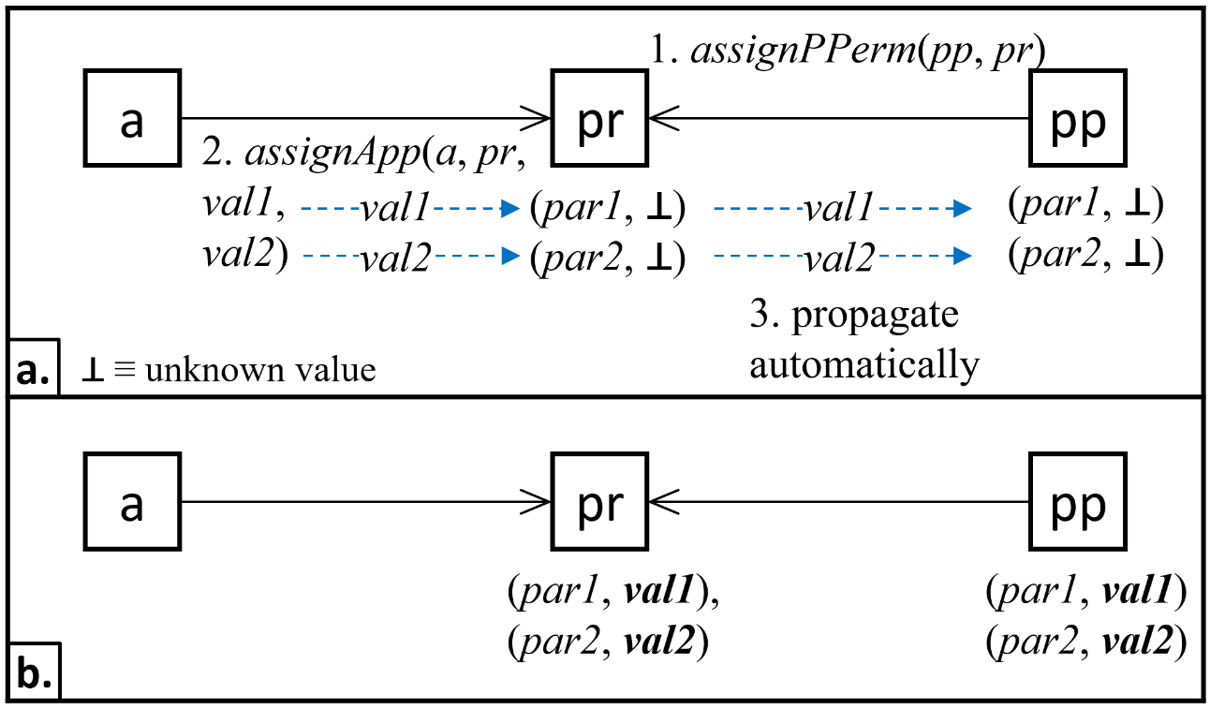
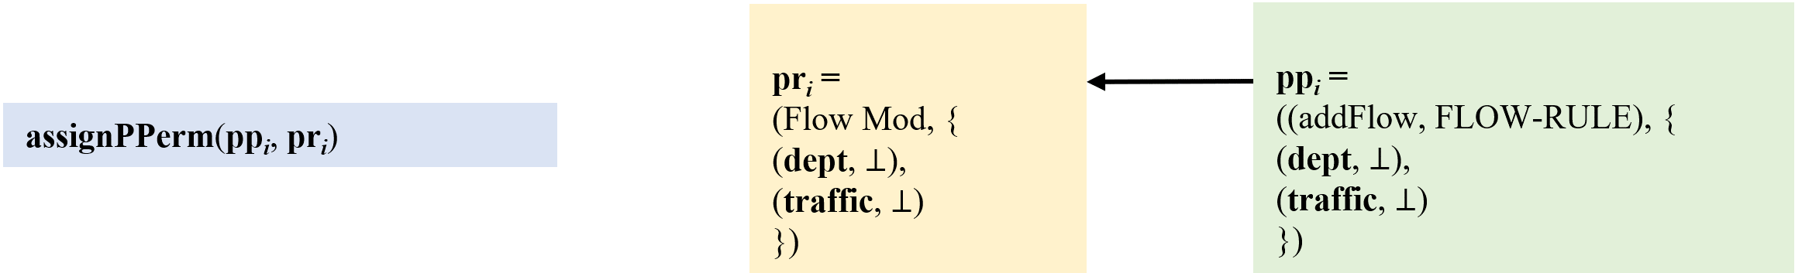
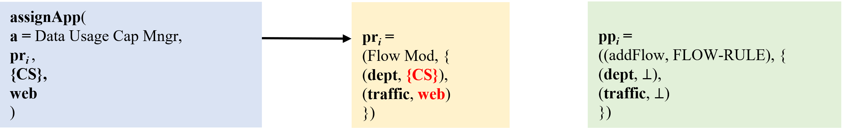
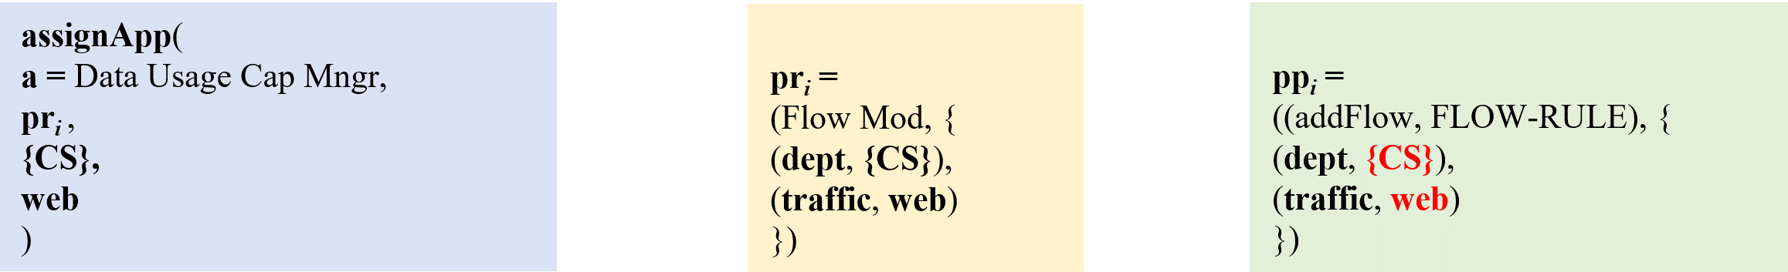
Parameter Value Assignment
Parameter values, assigned via assignApp administrative action, propagate automatically from role parameters to permission parameters.
Example:
(Flow Mod, {(dept, ⊥), (traffic, ⊥)})
((addFlow, FLOW-RULE), {(dept, ⊥), (traffic, ⊥)})
1. Parameterized permission assigned to parameterized role. Parameter values are unknown.
2. Parameter value assigned to parameterized role via assignApp administrative action.
3. Parameter values propagate from parameterized role to parameterized permission.
(Flow Mod, {(dept, {CS}), (traffic, web)})
((addFlow, FLOW-RULE), {(dept, {CS}), (traffic, web)})
.

Slide 60
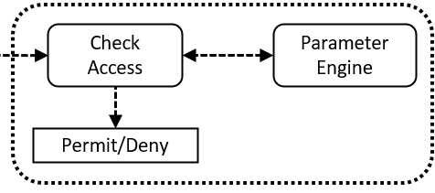
ParaSDN : App Authorization Example
checkAccess(DataCapEnforcingSession, addFlow, fow_rule[switch _ id=0x2,tcp _ dst=80,...] ) ≡
∃(Flow Mod, {(dept, {CS}), (traffc, web)}) ∈ PROLES :
(Flow Mod, {(dept, {CS}), (traffic, web)}) ∈ session_roles(DataCapEnforcingSession),
∃((addFlow, FLOW-RULE), {(dept, {CS}), (traffic, web)}) ∈ PPRMS :
(((addFlow, FLOW-RULE), {(dept, {CS}), (traffic, web)}), (Flow Mod, {(dept, {CS}), (traffic, web)})) ∈ PPA ∧
(addFlow, type(flow_rule[switch _ id=0x2, tcp _ dst=80,...])) = (addFlow, FLOW-RULE) ∧
ParamCheck(DataCapEnforcingSession, addFlow, flow_rule[switch _ id=0x2, tcp _ dst=80,...], {(dept, {CS}), (traffic, web)}) = True.
= true
= true
= true
PPA = {
...,
(((addFlow, FLOW-RULE), {(dept, {CS}), (traffic, web)}),
(Flow Mod, {(dept, {CS}), (traffic, web)})),
...
}.

Slide 61
Parameter Engine - Use Case Example
Request Evaluation & Decision
(PDP)
Param Check Point
(PCP)
Verifiers Retrieval Point
(VRP)
Verifiers Map
DataCapEnforcingSession,
addFlow,
flow_rule[switch _ id=0x2, tcp _ dst=80,...],
{(dept, {CS}), (traffic, web)}
type(addFlow, flow_rule[switch _ id=0x2, tcp _ dst=80,...]),
{(dept, {CS}), (traffic, web)}
(FLOW-RULE, dept)
VRuleSwitch
(FLOW-RULE, traffic)
VRuleTraffic
{VRuleSwitch,VRuleTraffic}
flow_rule[switch _ id=0x2, tcp _ dst=80,...],
(dept, {CS})
…
switches:
CS= [0x1, x02]
CE= [x03]
…
protocol_ports:
web = [80, 443]
voip= [5060,…]
ftp= [20,21]
…
VRuleSwitch
(∃d ∈ pvpair.val :
flow_rule.switch_id ∈
switches(d));
verifier’s result = false
true/false
flow_rule[switch _ id=0x2, tcp _ dst=80,...],
(traffic, web)
VRuleTraffic
(flow_rule.tcp_dst ∈ protocol_ports(pvpair.val))
true/false
CONFIG
verifier’s result = false
true

Slide 62
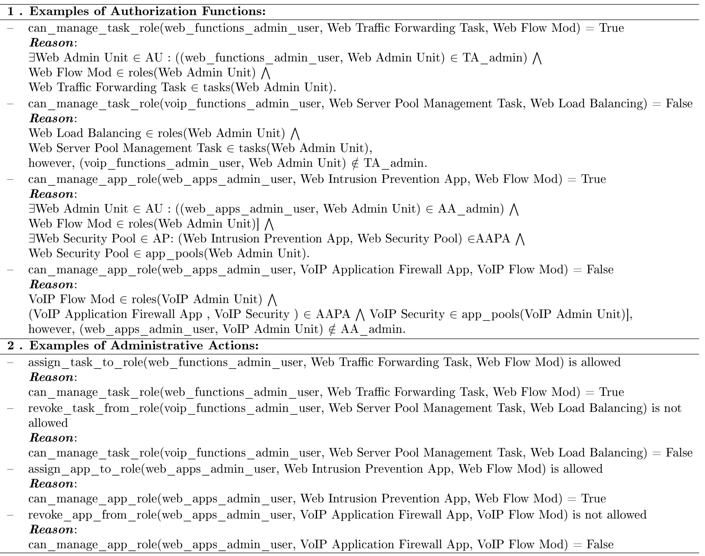
Administrative Actions - Examples

Slide 63
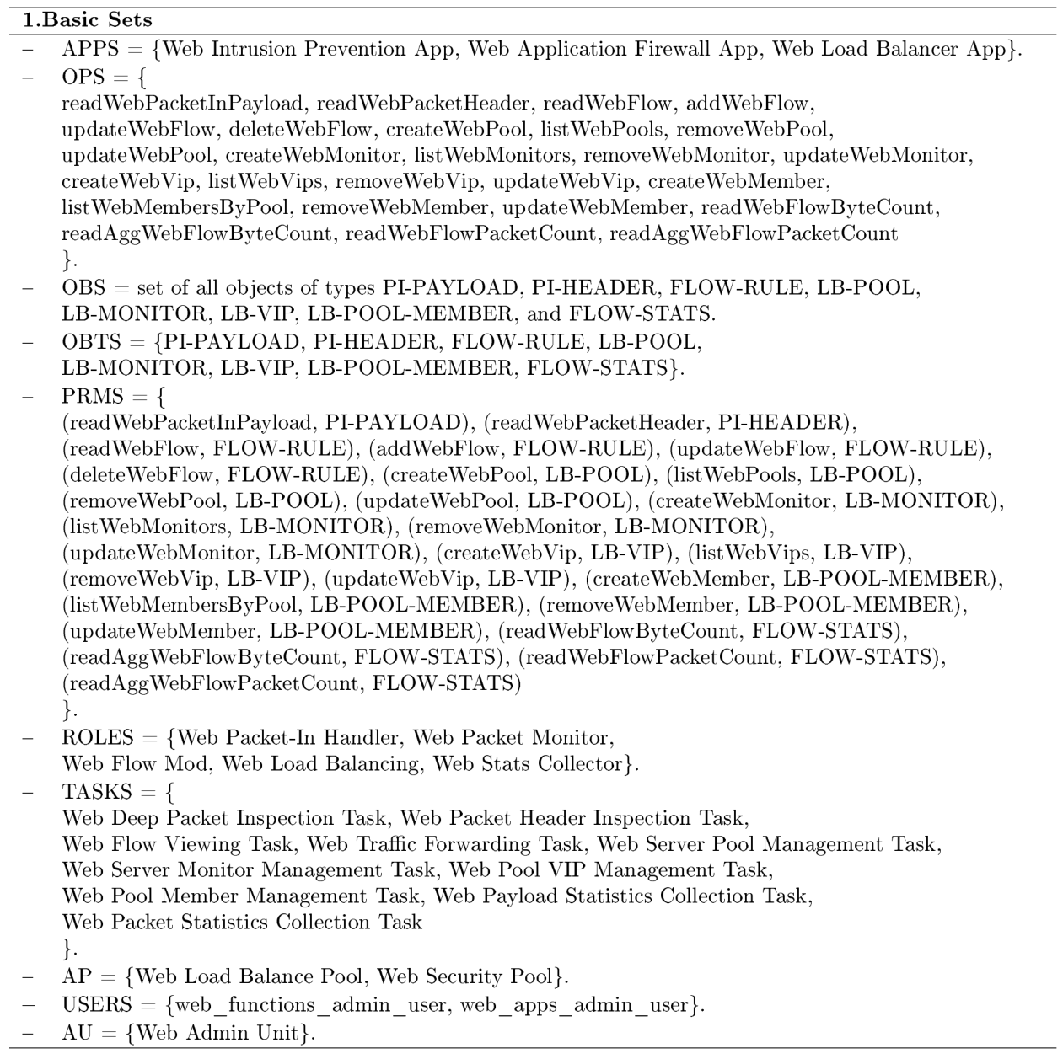
Configuration of the SDN-RBACa in a use case (1)

Slide 64
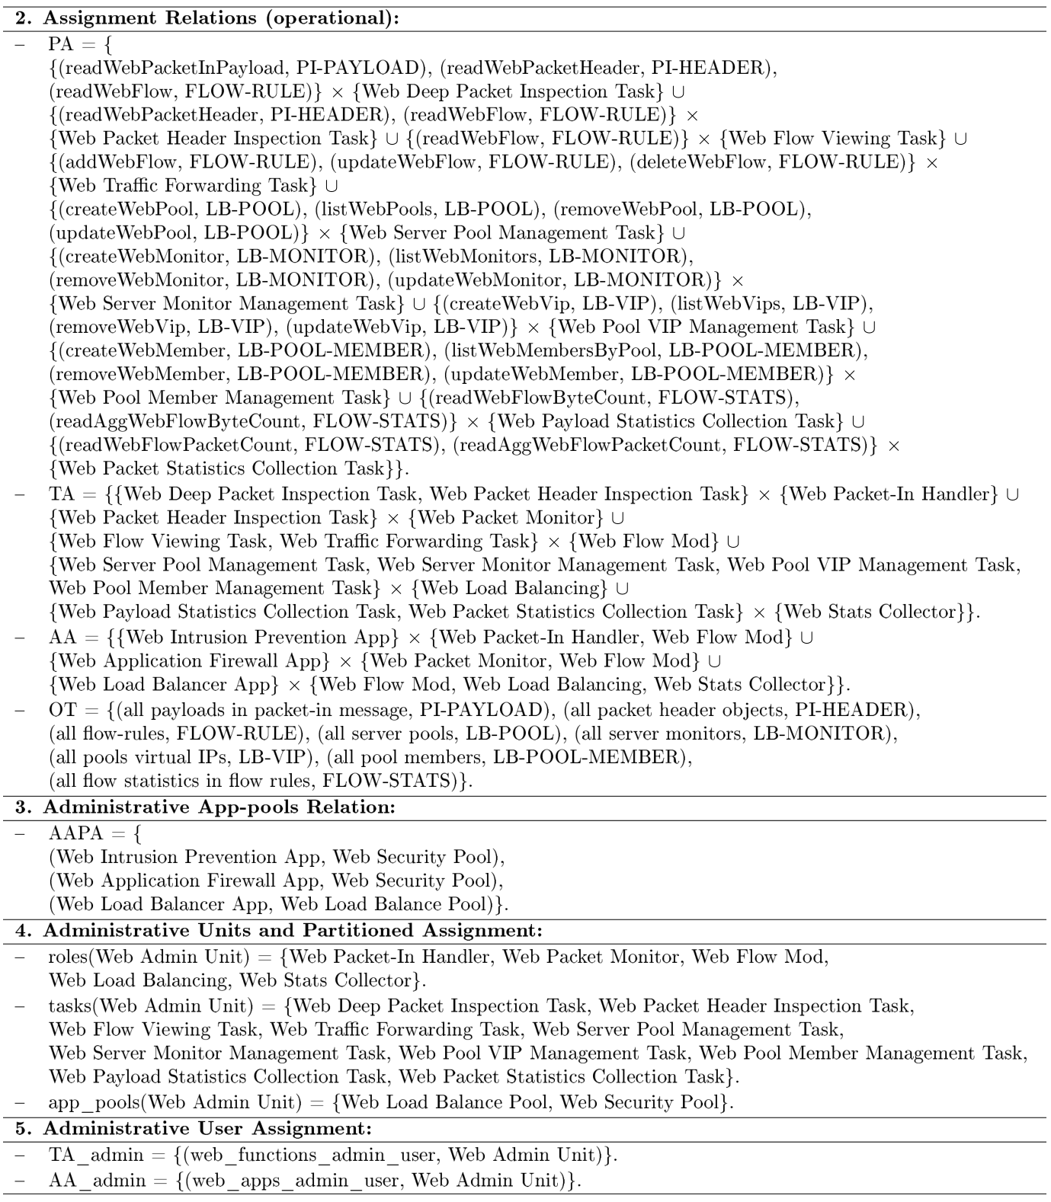
Configuration of the SDN-RBACa in a use case (2)

Slide 65
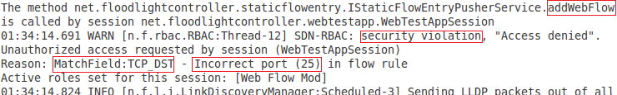
Access Request Authorization Check with Proxy Operation

