Slide 1
Provenance-based Access Control Models
Institute for Cyber Security
July 31, 2014
Dissertation Defense
Dang Nguyen
Institute for Cyber Security
University of Texas at San Antonio

Slide 2
Presentation Outline
Introduction
Provenance Data Model
Provenance-based Access Control Models
PBAC Architecture in Cloud Infrastructure-as-a-Service
Conclusion

Slide 3
Background: what is provenance?
Art definition of provenance
  Essential in judging authenticity and evaluating worth.
Data provenance in computing systems
  Is different from log data.
  Contains linkage of information pieces.
  Is utilized in different computing areas.

Slide 4
Access Control Challenges
Usability of provenance
  Capturing,
  Storing,
  and Querying provenance data.
Utility of provenance
  Policy specification,
  Evaluation,
  and Enforcement.
Provenance in cloud environment
  - Tenant-awareness
Provenance Data Model
Provenance-based Access Control
PBAC in IaaS
Architecture
Security of provenance: provenance access control

Slide 5
Access Control Approaches
Traditional access control
  Based on single units of control: roles, primitive attributes, etc.
Relationship-based access control
  Graph-based.
  Does not make use of history information.
Based on history information
  Utilizes log data to extract useful information
    Mainly looks at users’ history.
  Cannot specify access control based on linkage information.
  Assume history information is readily available.
Provenance-based Access Control

Slide 6
Provenance-based
Access Control (PBAC)
So far, no comprehensive and well-defined model in the literature.
Compared to other access control approaches, PBAC provides richer access control mechanisms
  Finer-grained policy and control.
  Provides effective means of history information usage.
Easily configured to apply in different computing domains and platforms
  Single system (XACML)
  Multi-tenant cloud (OpenStack)

Slide 7
Contributions
Proposed a provenance data model which enables PBAC configurations in multiple application domains.
Proposed provenance-based access control models which provides enhanced and finer-grained access control features.
  Implemented and evaluated an XACML-extended prototype.
Proposed architecture to enable PBAC in cloud IaaS.
  Implemented and evaluated an OpenStack-extended prototype.

Slide 8
Thesis Statement
Provenance data forms a directed-acyclic graph where graph edges exhibit the causality dependency relations between graph nodes that represent provenance entities.
A provenance data model that can enable and facilitate the capture, storage and utilization of such information through regular expression based path patterns can provide a foundation for enhancing access control mechanisms.
In essence, provenance-based access control models can provide effective and expressive capabilities in addressing access control issues, including traditional and previously not discussed dynamic separation of duties, in single systems, distributed systems, and within a single tenant and across multiple tenants cloud environment.

Slide 9
Scope and Assumptions
Assumptions
  Provenance data is uncompromised and protected.
  Provenance data is correct.
  Provenance of provenance is not considered.
Experimental Scope
  Does not include provenance capture.
  Does not include concurrent, dependent access requests.

Slide 10
Presentation Outline
Introduction
Provenance Data Model
Provenance-based Access Control Models
PBAC Architecture in Cloud Infrastructure-as-a-Service
Conclusion

Slide 11
Characteristics of
Provenance Data
Information of operations/transactions performed against data objects and versions
  Actions that were performed against data
  Acting Users/Subjects who performed actions on data
  Data Objects used for actions
  Data Objects generated from actions
  Additional Contextual Information of the above entities
Directed Acyclic Graph (DAG)
Causality dependencies between entities (acting users / subjects, action processes and data objects)
Dependency graph can be traced/traversed for the discovery of Origin, usage, versioning info, etc.

Slide 12
Provenance Data Model
[inspired by OPM]
4 Node Types
  Object (Artifact)
  Action (Process)
  Subject (Agent)
  Attribute
3 Causality dependency edge Types (not a dataflow) and Attribute Edge
Object (artifact)
Subject (agent)
c
Action (process)
u(type)
g(type)
Object (artifact)
t(type)
Attribute
Base PDM
Contextual Extension
c wasControlledBy
u used
g wasGeneratedBy
Inverse edges are enabled for usage in
queries, but cycle-avoidant.
Dep. edge
t hasAttribute
Attrb. edge

Slide 13
Capturing, Storing, and Querying
Provenance Data
Transaction:
(Subject1, Grade1, HW1, GradedHW1, ContextualInfoSet-Grade1)
capturing
(Grade1, u, HW1)
(Grade1, c, Subject1)
(GradedHW1, g, Grade1)
(Grade1, t[actingUser], Alice)
(Grade1, t[activeRole], TA)
(Grade1, t[weight], 2)
(Grade1, t[object-size], 10MB)
RDF Triples:
storing
querying
querying
SELECT ?agent WHERE { HW1_G [g:c] ?agent}
SELECT ?user WHERE { HW1_G [g:t[actUser]] ?user}
SPARQL:

Slide 14
Provenance Graph Example
Sub1
Sub2
c
c
HW1
u
Grade1
g
HW1_G
u
Grade2
g
HW1_G’
t(actUser)
t(…)
t(…)
t(…)
SELECT ?user
WHERE
{ HW1_G’ [g:u:g:c] ?user}
Alice
TA
2
10MB
{ HW1_G’ [[g:u]*:g:c] ?user}

Slide 15
Study Case:
Homework Grading System
Students can upload a homework to the system, after which they can replace it multiple times before they submit the homework. Once it is submitted, the homework can be reviewed by other students or designated graders until it is graded by the teaching assistant (TA).

Slide 16
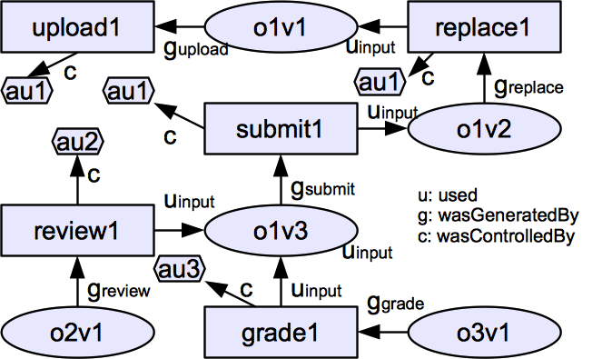
A Base Provenance Data Graph

Slide 17
Dependency List
Dependency List (DL): A set of identified dependencies that consists of pairs of
  Dependency Name: abstracted dependency names (DNAME) and
  regular expression-based dependency path pattern (DPATH)
Examples
  < wasReplacedVof, g_{replace}.u_{input} >
  < wasAuthoredBy, wasSubmittedVof?.wasReplacedVof ∗.g_{upload}.c >

Slide 18
A Base Provenance Data Graph
wasReviewedOby
wasReplacedVof
DL_{O}: < wasReplacedVof, g_{replace}.u_{input} >
wasSubmittedVof
wasReviewedOof
wasGradedOof

Slide 19
Presentation Outline
Introduction
Provenance Data Model
Provenance-based Access Control Models
PBAC Architecture in Cloud Infrastructure-as-a-Service
Conclusion

Slide 20
PBAC Models
PBAC_{B}: utilizes base data model
  Does not capture contextual information
PBAC_{C}: extending the base model
  Incorporate contextual information associated with the main entities (Subjects, etc.)
  Extend base data model with attributes

Slide 21
PBAC_{B} Components
Subjects
Request(s,a,o)
Actions
Action on O
Objects
User authorization
Action validation
Access Evaluation
Policies
Dependency
Lists
Base Provenance Data
access
decision
activities
utilized by

Slide 22
Sample Policies
Anyone can upload a homework.
A user can replace a homework if she uploaded it (usr. authz) and the homework is not submitted yet (act. valid) .
allow(au, upload, o) ⇒ true
allow(au, replace, o) ⇒ au∈(o, wasAuthoredBy) ∧|(o,wasSubmittedVof)| = 0.

Slide 23
PBAC_{C} Components
Contextual Info.
Assoc. with
Assoc. with
Assoc. with
Subjects
Actions
Objects
Captured as
Access Evaluation
Policies
Dependency
Lists
Base Provenance Data
Attribute
Provenance Data

Slide 24
DSOD Examples in HGS
Sample English policies:
  A student cannot review the homework he submitted – Object-based DSOD
  A student cannot grade a homework before it is submitted – History-based DSOD
  A student cannot grade a homework unless reviews’ combined weights exceeds 3 – Transaction Control Expression
An informal policy:
  allow(sub,grade,o) => sum(o,previousReviewProcesses.hasAttributeOf(Weight)) <= 3
Compatible to XACML policy language
  Extending OASIS XACML architecture and implementation.

Slide 25
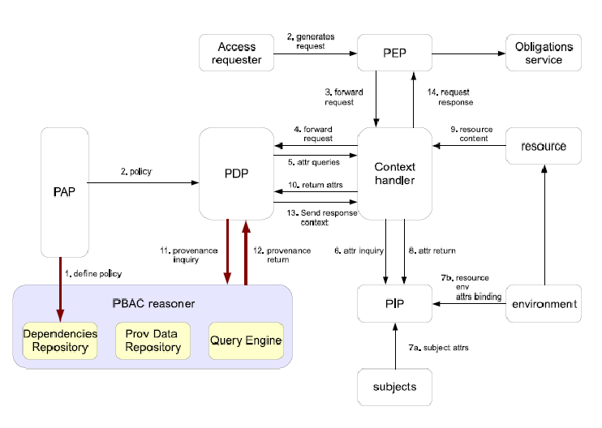
Extended XACML Architecture
PEP: policy enforcement point
PDP: policy decision point
PAP: policy administration point
PIP: policy information point
MySQL
Jena
ARQ

Slide 26
Experiment and Performance
System
  Ubuntu 12.10 image with 4GB Memory and 2.5 GHz quad-core CPU running on a Joyent SmartData center (ICS Private Cloud).
Mock Data simulating HGS scenario
  Extreme depth and width settings for graph traversal queries.
Results for tracing 2k/12k edges
  0.017/0.718 second per deep request
  0.014/0.069 second per wide request

Slide 27
Throughput Evaluation
500 concurrent, nondependent requests
Results for tracing 2k/12k edges
  0.014/0.16 second per deep request
  0.014/0.04 second per wide request

Slide 28
Presentation Outline
Introduction
Provenance Data Model and Access Control
Provenance-based Access Control Models
PBAC Architecture in Cloud Infrastructure-as-a-Service
Conclusion
Notes:
The access control approach as described in this thesis complements traditional access control such as RBAC. At the same time, it can achieve richer access control capabilities in a dynamic environment. I hope this proposal will, in effect, convince the audience in such regard.
Here is the outline of this talk.

Slide 29
Cloud Computing
Cloud computing has been the “next big thing.”
Has 3 primary service models:
  Software-as-a-Service (SaaS)
  Platform-as-a-Service (PaaS)
  Infrastructure-as-a-Service (IaaS)
We focus on PBAC for IaaS
  Specifically, multi-tenant single-cloud systems.

Slide 30
Access Control Aspects
DSOD concerns for virtual resources management and protection
  Ex: Only virtual images up-loaders are allowed to delete.
Multi-tenant concerns
  A virtual image may be created in one tenant, copied to another tenant and modified, and used to launch a virtual machine instance in another.

Slide 31
Tenant-aware PBAC
Tenants as contextual information.

Slide 32
Architecture Overview
(PS)
(PBAS)

Slide 33
Deployment Architecture
Variations:
Integrated Deployment
Stand-alone Deployment
Hybrid Deployment
Design pros & cons:
Ease of integration -
Communication latency -
Provenance data sharing -

Slide 34
Logical Architecture
PROVAUTHZ-SERVICE
Dataflow
PROV-SERVICE Dataflow

Slide 35
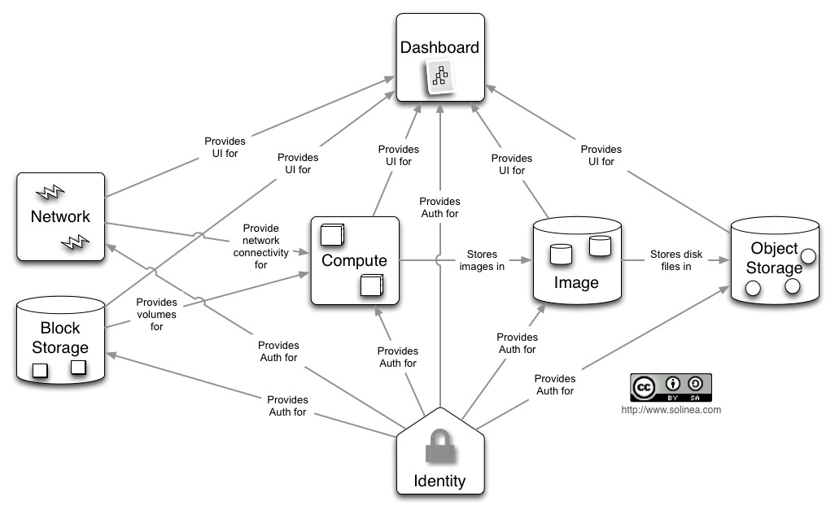
OpenStack Conceptual
Architecture

Slide 36
OpenStack Authorization
?
PBAS

Slide 37
Nova PBAS
Implementation

Slide 38
Experiments
Measure the time an authorization process takes from the time of request until decision is returned.
  nova list
  glance image-list
4 experimental configurations:
  E1: normal Nova and Glance authorization.
  E2: integrated PBAS/PS services with Nova and Glance.
  E3: integrated PBAS/PS service, stand-alone from Nova and Glance.
  E4: separate PBAS and PS services, stand-alone from Nova and Glance.
Deployment Configurations:
  4GB RAM, 2.5 GHz quad-core CPU.
  OpenStack Devstack (Grizzly) on 12.04 Ubuntu.
Mainly test deep-shaped provenance graphs.
  Generate mock data for virtual images and machines scenario.

Slide 39
Results and Evaluation
Traversal Distance | Glance (e1) | Glance (e2) | Glance (e3) | Glance (e4)
No PBAC | 0.55 | - | - | -
20 Edges | - | 0.575 | 0.607 | .642
1000 edges | - | .612 | .788 | .852
Traversal Distance | Nova (e1) | Nova (e2) | Nova (e3) | Nova (e4)
No PBAC | 0.75 | - | - | -
20 Edges | - | 0.84 | 0.902 | 1.062
1000 edges | - | 2.292 | .362 | 4.102

Slide 40
Conclusion
Proposed a framework of provenance data and PBAC models for enhanced access control.
Proposed an architecture that enables PBAC and PS in cloud IaaS.
Proof-of-concept prototypes
  XACML architecture extension and evaluation.
  OpenStack architecture extension and evaluation.
An access control foundation for secure provenance-centric computing!

Slide 41
Future Work and Directions
Expanding provenance data model to include user-declared provenance data.
Collaborated PBAC usage
  Multi-cloud.
  Distributed systems.
Full-cycle implementation and evaluation
  including provenance capturing service.
Provenance Access Control models and mechanisms.
  Utilizing PBAC foundations.

Slide 42
Publications
1. Dang Nguyen, Jaehong Park and Ravi Sandhu, Adopting Provenance-Based Access Control in OpenStack Cloud IaaS. In Proceedings 8th International Conference on Network and System Security (NSS 2014), Xi'an, China, October 15-17, 2014, 15 pages.
2. Dang Nguyen, Jaehong Park and Ravi Sandhu, A Provenance-based Access Control Model for Dynamic Separation of Duties. In Proceedings 11th IEEE Conference on Privacy, Security and Trust (PST), Tarragona, Spain, July 10-12, 2013, 10 pages. (Best Student Paper Award)
3. Dang Nguyen, Jaehong Park and Ravi Sandhu, Integrated Provenance Data for Access Control in Group-Centric Collaboration. In Proceedings 13th IEEE Conference on Information Reuse and Integration (IRI), Las Vegas, Nevada, August 8-10, 2012, 8 pages.
4. Jaehong Park, Dang Nguyen and Ravi Sandhu, A Provenance-Based Access Control Model. In Proceedings 10th IEEE Conference on Privacy, Security and Trust (PST), Paris, France, July 16-18, 2012, 8 pages.
5. Dang Nguyen, Jaehong Park and Ravi Sandhu, Dependency Path Patterns as the Foundation of Access Control in Provenance-Aware Systems. In Proceedings 4th USENIX Workshop on the Theory and Practice of Provenance (TaPP 2012), Boston, MA, June 14-15, 2012, 4 pages.
Jaehong Park, Dang Nguyen and Ravi Sandhu, On Data Provenance in Group-centric Secure Collaboration. In Proceedings 7th IEEE International Conference on Collaborative Computing: Networking, Applications and Worksharing (CollaborateCom), Orlando, Florida, October 15-18, 2011, 10 pages.

Slide 43
Additional Publications
7. Lianshan Sun, Jaehong Park, Dang Nguyen and Ravi Sandhu. A Provenance-aware Access Control Framework with Typed Provenance. Pending revision for Transactions on Dependable and Secure Computing (TDSC), 2014.
8. Elisa Bertino, Gabriel Ghinita, Murat Kantarcioglu, Dang Nguyen, Jae Park, Ravi Sandhu, Salmin Sultana, Bhavani Thuraisingham, Shouhuai Xu. A roadmap for privacy-enhanced secure data provenance. Journal of Intelligent Information Systems, 2014.
9. Yuan Cheng, Dang Nguyen, Khalid Bijon, Ram Krishnan, Jaehong Park and Ravi Sandhu, Towards Provenance and Risk-Awareness in Social Computing. In Proceedings of the First ACM International Workshop on Secure and Resilient Architectures and Systems (SRAS '12), Minneapolis, Minnesota, September 19, 2012, pages 25-30.

Slide 44
Thank you!!!
Questions and Comments?

