Slide 1
Enhancing Security
In Cloud Computing
Through
Virtual Machine Placement
Advisor: Prof. Ravi Sandhu and Prof. Meng Yu
By: Jin Han

Slide 2
Outline
Introduction
Threat Model and Security Assumption
Quantify the Security Risk
Objectives in VM Placement
Secured Multi-Objectives Oriented virtual machine Placement algorithm (SMOOP)
Quantify Co-residency Risk through Machine Learning
Conclusion

Slide 3
Introduction
Virtual machine placement strategies can significantly affect the overall performance, security risks, energy cost of the entire cloud.
We present a Secured Multi-Objective Optimization Virtual Machine Placement algorithm (SMOOP) to seek an overall improved solution.
We present a machine learning based framework to better quantify Co-Residency Risk with Large Scale Dataset

Slide 4
Threat Model and Security Assumption
Co-residency and Network based Attacks were considered.
Attacker are capable of utilizing vulnerabilities in both VMs and virtual machine monitors (VMMs, or hypervisor) of the clouds.
Attacker need to deploy their own VMs into the same physical server to co-locate with Target.

Slide 5
Security Assumptions
The cloud service management, placement related software components, and the migration process are all secure.
For simplicity, each migration of a VM will result in affordable cost in terms of service interruption and consume the same amount of resources.
The cloud service provider has enough CPU, network bandwidth, and other resources to perform arbitrary migration of VMs.
The cloud service provider has sufficient resources as the reward, e.g., extra memory or CPUs, to motivate VM migration.
Above assumptions ensure that change of VM placement is both acceptable and affordable for cloud provider and clients.
Notes:
Reward means the prize to encourage service subscriber will to cooperate with Service provider finishing the mitigation of VMs

Slide 6
Security Assessment in the Cloud
R1: VM Risk
R2: VMM/Hypervisor Risk
R3: Co-Residency Risk
R4: Network Risk
Notes:
VMrisk (R1 in the figure): the risk/vulnerability carried by a VM itself. If a
VM has more vulnerabilities than others, it is more likely to be compromised
first. Vulnerable VMs can be used as stepping stones to attack co-resident
VMs and underlying hypervisor to gain more privileges.
– VMM/hypervisor risk (R2): the risk/vulnerability carried by a VMM/Hypervisor.
An adversary may gain the administrative privileges via the vulnerabilities
in a hypervisor or the control VM. Such vulnerabilities will enable the
adversary to compromise all guest VMs on the hypervisor.
– Co-residency risk (R3): the risk caused by the VMs co-resident on the same
hypervisor. Assume that, in the figure, VM1 (an attacker VM) and VM2 (a
normal user VM) share the same CPU core or are located on the same physical
machine, the attacker will be able to steal the user’s private information, such
as the cryptographic key, via side-channel attacks.
– Network risk (R4): the security risk of a VM caused by the network connections.
For example, VM1, located in host 1, provides web services, and
the VM2, located in host 2, contains a database server. The attacker may
compromise the database server through accessing the web server, e.g., SQL
injection.

Slide 7
Quantify the Security Risk
Quantify the values of each types of security risks, and calculate the overall security risk of the entire cloud.
R1(VM Risk) is not affected by a specific Placement.
R2(VMM/Hypervisor Risk), R3(Co-residency Risk) and R4(Network Risk) are affected by a specific Placement.

Slide 8
R1 – VM Risk
R1, VM risk, is based on CVSS (Common Vulnerability Scoring System).
Assumption : the security level of a VM is determined by the worst vulnerability of that VM.
For a VMi, R1 = f₁ (<S1, S2,…Sj>) = Max(CVSS Scores of VMi) / 10, which is in (0,1).
Notes:
As a result a fundamental assumption is made: VMs that belong to the same group (e.g. webservers group in a 3-tier web architecture) should behave similarly with only small deviations. This assumption is true to a great extent since in practice auto-scaling is done based on the same configuration script, thus VMs (intended for the same purpose) that was spawned from the same configuration scripts should behave similarly
Each VM would have multiple vulnerabilities and each would have one CVSS score. The CVSS score uses an interval scale of (0, 10) to measure the severity of vulnerabilities. If different
tools are used to score vulnerabilities, we can choose CVSS as our baseline to normalize all
vulnerability scores. For example, if a different tool scores 7 for a vulnerability which is scored 8 in
CVSS, then the correlated score relationship is 7:8 between the tool and CVSS. At the same time,
for some vulnerability score tools, such as Nexpose, CVSS is considered as a major factor in the
score calculation model

Slide 9
R2 – Hypervisor Risk
R2, Hypervisor Risk, is determined by two factors: its own vulnerability and the VMs running on it.
Risk_{hypervisor} = Max(CVSS Score) / 10, which is in (0,1).
In our paper, we only considered the VM with the highest risk.
For a Host i, R2 = f₂ (Risk_{hypervisor} , {R1_{i}}) = Risk_{hypervisor} * ( 1 + max(R1 in Host i)) / 2 , which is in (0, 1) too.
Notes:
In this paper, we mainly consider the VM with the highest risk since this may be the most vulnerable
attacking surface to the hypervisor.

Slide 10
R3 – Co-residency Risk
A malicious VM can deploy co-resident attack to its target if they are collocated on the same Host.
In SMOOP work, For a VM i on the Host K, its co-residency risk R3 is calculated with f₃ ({R1_{i}}) as:
R3 = 1- ∏ (1− R1j*Pj),
where Pj = 1 if VM j (other then i) is placed on the Host K.
In our subsequent work, we proposed a machine learning based framework to quantify the Risk R3.
Notes:
The machine learning framework is based on service subscriber

Slide 11
R4 - Network Risk
We assume attacker could find a path to attack the target through Network Connection.
In this paper, we only considered the risk caused by only direct network connections for simplicity.
For a VM i, its network risk R4 is calculated as:
R4 = 1- ∏ (1− R1j),
where VM j is sending packet to VM i directly and they are not at the same Host.
Notes:
Considering
the cascades [13] in the network, giving a VM, a depth first algorithm
can be applied to build all possible attack paths. In our previous work,
we also discussed how to evaluate risks of being attacked based on Markov
Chains [14]. Thus, there are different ways to evaluate the risk levels based on
network connections.

Slide 12
Risk Level of a VM
After R1 to R4 are all quantified, we could have the risk level of a VM i with f（{R<j>}）as:
R_{i} = 1 – (1-R1_{i})(1-R2_{i})(1-R3_{i})(1-R4_{i})
A VM is safer with lower risk level value.
Question: How is the risk level of cloud determined by the set of R value within a specific placement?
Notes:
At the beginning, the cascades was considered for the risk caused by network connection. For example, A->B->C(A sends packets to B, B sends packets to C), then C’s security would depend on B and A. Giving a VM, we could apply depth first algorithm to build all possible attack path.
If there is no packet sending loop existed, such as A->B->C (C only received packets from B without sending packets to A), in practical, we should finish the calculation of overall risk of A, then finish the Risk_network of B and overall_risk of B. After that it is possible to calculate the Risk_network and overall_risk of C.
But if C did send packets to A, then a loop existed and above calculation could never be finished. So we simplified the calculation of Risk_network and Risk_co-residency, which would only be based on Risk_VM. It still could correctly reflect the risk level of a VM. Then a VM with risk rate 70%, it could be claimed safer than a VM with risk rate 80%, but without knowing how much exactly safer.
So we also simplified the network connection by only considering those direct connected parties, one reason is to improve the efficiency of our algorithm, cause it is a time sensitive problem. Another reason is our method was already simplified by above step, so as long as it could represent the correct correlation level, it won’t change the correctness of our result. But it is still possible that there are potential issues existed here.

Slide 13
Secured Multi-Objectives Oriented Virtual Machine Placement
In our experiment, we setup three objectives to optimize: Security Risk(SR), Resource Wastage(RW) and Network Traffic(NT).
Users could add more objectives, based on their preferences.
Notes:
such as energy or migration cost

Slide 14
Security Risk
Within a specific placement, the set of R value of VM is confirmed.
The security level of cloud is determined by the distribution of the set of R value.
We used the median value of the set of R value as the risk level of the cloud within a specific placement.
The security risk of cloud f_{SR} = median(R) in our work so far.
Notes:
Median value is much more robust than media value. It wont be affected by particular high or low value (outliers), but would lost too much detail information by this abstract, the same issue with mean value. Need to consider a better way to calculate the Fsr

Slide 15
Resource Wastage
In this paper, we consider the wastage of multiple resources, including CPU, memory, and disk.
Within a specific placement, the wastage percentage of CPU, memory, and disk in Host K could be calculated as W_{CPU}, W_{MEM}, W_{Disk}.
The resource wastage f_{WS} = ∑ max(W_{CPU}, W_{MEM}, W_{Disk}). Weight could used here per user’s preferences.
Capacity constraints in each host are applied.
Notes:
The wastage percentage could be used as normalized value in different preferences.
while subject to the following capacity constraints in each host J:

Slide 16
Network Traffic
Two VMs with high amount of data exchanging should be placed into same Host, to reduce the network traffic.
The network traffic from VM i to VM j: T_{ij} = Packet_N_{ij} / t
The total network traffic in cloud is
f_{NT} = (T_{ij} * p_{ij}), where p_{ij} = 0 if VM i, j are in the same Host, otherwise it is 1.
Notes:
Tij is the only none-secure network transaction from low assurance level to high assurance level

Slide 17
SMOOP Design
Challenge: It is impractical to directly find the optimal solution minimizing all objectives. At the same time, the security metrics can only be evaluated after the placement is specified.
SMOOP is proposed to search improved solutions on specific target objective or balancing on multiple objectives.
New crossover and mutation operation are designed with security related strategies.
Notes:
Challenges. The VMP can be considered as a bin-packing problem, where
each VM needs to be placed on a physical server once and only once, so it is
an NP hard problem. The challenge is that the security metrics can only be
evaluated after the placement is specified. For example, in a specific placement
Reducing Security Risks of Clouds Through Virtual Machine Placement 283
scheme, a unique attack path exposed by co-residence may disappear in a different
placement. Therefore, there is no generic function mapping a placement
scheme into a security assessment value. As a result, we cannot use any existing
multi-objective programming solutions to solve our problem. Furthermore, we
have complicated security strategies in each placement generation, we have to
design a new crossover and a new mutation procedure in the EMOA algorithm.

Slide 18
Prioritize the Objectives
Our algorithm tries to provide a improved solution which can be as good as possible in Service Provider’s perference.
To enable users to prioritize the objectives according to their business preference, we can add weight factors into the fitness function as:
f = w1* f_{SR} + w2* f_{RW} + w3* f_{NT} , where ∑wi = 1.

Slide 19
Notes:
In an initialization phase, the consideration for migration cost can be avoided.
Our goal is to search for the best possible placement plan based on the multiobjectives
requirement. The crossover operation is used to improve the overall
efficiency. In the re-optimization phase, which is triggered by adding VMs or
removing VMs, the migration cost is considered as an important factor in the
mutation operation to limit the number of migrating VMs (in switch() function
of Algorithm 3). Note that our goal is to improve the survivability of entire cloud,
so we do not optimize our solution for a specific VM. Therefore, our approach

Slide 20
Security related Strategies
Placement strategy I: Put a VM into a physical machine which has network connections with it.
Placement strategy II: high risk VMs should be put into the isolated zones.
Placement strategy III: low risk VM without any connection with VMs in isolated zones should be put into low risk Host.
Placement strategy IV: marked lowest and highest hypervisor risk physical machines should have a higher probability to be kept during crossover operation.
Strategy V: If a VM on one physical machine has connection with a VM on a different physical machine, we should migrate them together.

Slide 21
Strategies Implementation
When VM is deployed, <VM, PM> pair will be generated. Each pair would have a associated “strategy fit set”.
The set will be tested to determine whether it satisfies each strategy.
Higher priority strategy come first.
Multiple strategies should be satisfied as more as possible.
Priority list of strategy will keep evolving in the runtime environment and new strategy will be added too.
Notes:
In our implementation, Strategies I, II, III are applied for VM deployment and Strategies IV and V
are applied for crossover and mutation procedure. When a VM need to be deployed, <VM, PM> pairs
would be generated, in which PM would be all available ones. Each pair has an associated "strategy fit
set"; if a given VM placement fits a particular strategy, then the strategy number will appear in this set.
Each strategy fit set will then be evaluated in order to decide a final deployment choice. To do so, the set
will be tested to determine whether it satisfies each strategy, in order of weight, from highest priority to
lowest priority. This process will progressively eliminate placement choices that do not satisfy a given
strategy, successively shrinking the set of option. For example, given the strategy fit sets 1, 2, 1, and 2,
3, we examine these sets for membership of strategy 1. This eliminates set 2, 3, as it does not satisfy
the highest priority strategy (strategy 1). We continue by testing the remaining sets for membership
of strategy 2, and so on. This discards set 1, 2, as it does not satisfy the next-highest priority strategy
(strategy 2). As a result, only set 1, 2 remains, indicating that its associated VM/PM deployment will
be utilized. The selection rules (i.e., the system of weighting strategies) can be adjusted in real-time.
For instance, after running for a period of time, it might be optimal for strategy 2 to be promoted to the
highest priority; as a result, the weighting factors for strategies 1 and 2 would be swapped. Also, new
strategies should be added, in response to the runtime environment. In this way, the system may evolve
to fit real-world situations.

Slide 22
No guarantee the child generated would be better than parents.
Notes:
In an initialization phase, the consideration for migration cost can be avoided.
Our goal is to search for the best possible placement plan based on the multiobjectives
requirement. The crossover operation is used to improve the overall
efficiency. In the re-optimization phase, which is triggered by adding VMs or
removing VMs, the migration cost is considered as an important factor in the
mutation operation to limit the number of migrating VMs (in switch() function
of Algorithm 3). Note that our goal is to improve the survivability of entire cloud,
so we do not optimize our solution for a specific VM. Therefore, our approach

Slide 23
Incremental Task Handling
When a new VM is deployed or re-activated, the new placement should be generated based on the current one to achieve the multi-objective optimization, while keeping the low migration cost in mind.
We improved our SMOOP algorithm to better handle incremental deployment task by collaborating with latest Virtual Machine Allocation Policies:
1. Co-Location Resistant (CLR)
2. Previous-selected-Server-First (PSSF)
Notes:
The purpose is to improve the efficiency of crossover and mutation operation.

Slide 24
Modified SMOOP
To better handle the incremental task, we improved the SMOOP by removing crossover operation and mutation operation is modified to adapt the latest VM allocation policies.
Notes:
The purpose is to improve the efficiency of crossover and mutation operation.

Slide 25
Evaluation
Computing Complexity
Risk Reduction
Effectiveness of Multi-objective Optimization
Comparison with Random-FFD Algorithm
Notes:
We implemented our solution in Java. All input data are provided through configuration
files. Multiple threads are used to improve the performance. We randomly
generate a large number of VMs with different parameters to evaluate
SMOOP. In our evaluation, for each VM, we randomly assign the requirement of
CPU, memory, and disk. The vulnerability score is assigned based on the uniform
distribution. Following the same method, we configure the physical machine.

Slide 26
Computing Complexity
Timing is key factor here. Our algorithm should provide a solution within acceptable time period.
Notes:
The overall
combined complexity of our algorithm is O(k(MN2 + PMN2 + P log P)), thus O(kPMN2)
Then the complexity of our algorithm will be bounded by O(kPN3)

Slide 27
Risk Conduction
At the beginning of each simulation, we always generate 100 placement with the random-FFD algorithm and use the lowest risk level as the baseline reference.
Notes:
Despite the increased number of the VMs, the
median value of the risk level of VMs is stable within the range of 0.82 to
0.84. If we check placement with the lowest risk level in the first generation,
our algorithm improves with the increased number of the VMs. We repeat our
experiment 20 times with different numbers of VMs and physical machines. The
reduced risk level is from 5% (400 VMs and 20 physical machines) to 15% (6400
VMs and 400 physical machines) just in the first generation.

Slide 28
Risk Conduction
Notes:
Despite the increased number of the VMs, the
median value of the risk level of VMs is stable within the range of 0.82 to
0.84. If we check placement with the lowest risk level in the first generation,
our algorithm improves with the increased number of the VMs. We repeat our
experiment 20 times with different numbers of VMs and physical machines. The
reduced risk level is from 5% (400 VMs and 20 physical machines) to 15% (6400
VMs and 400 physical machines) just in the first generation.

Slide 29
Effectiveness of Multi-objective Optimization
Experimental results with weight setting (0.8, 0.1, 0.1) in an environment of 800 VMs and 60 physical machines.
Notes:
In practice, FFD (First-Fit with the possible fullest node) has been widely
used in VMP. It can quickly provide a placement with consideration on resource
utilization. Thus, we use it to generate a baseline for future comparison in the
algorithm.

Slide 30
Effectiveness of Multi-objective Optimization
Experimental results with weight setting (0.4, 0.3, 0.3) in an environment of 3000 VMs and 200 physical machines.

Slide 31
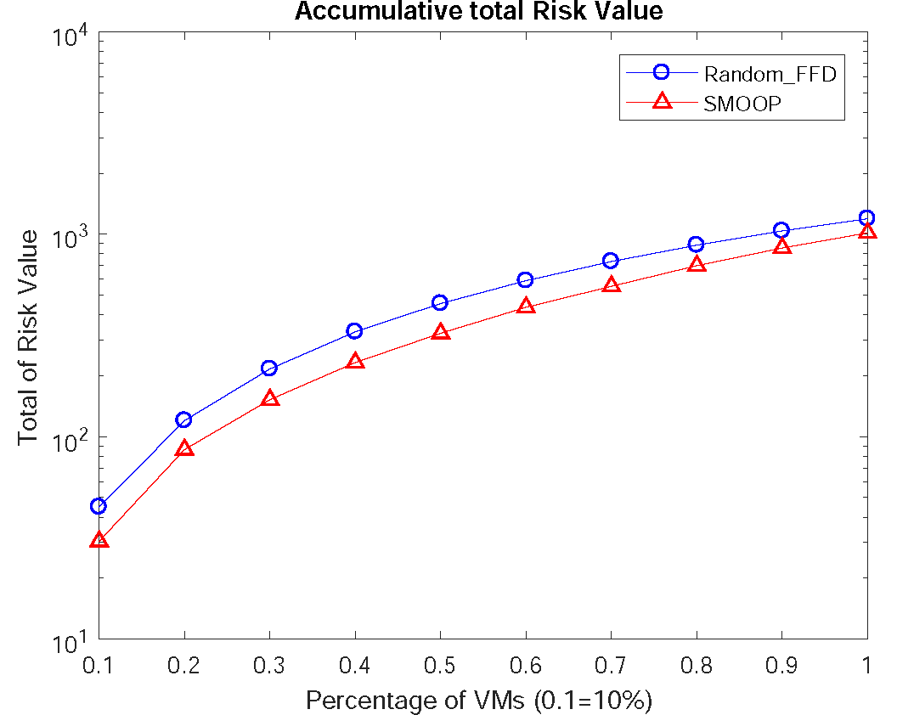
Comparison with Random-FFD Algorithm
By checking accumulative total risk value of whole VM set, SMOOP could more efficiently reduce the risk level of whole cloud.
Notes:
With 1600 VMs, the risk level under 50%
is improved by 15% to 35%. The risk level above 80% dropped from 54% to 33%. The experimental results demonstrate our placement strategies can greatly
improve the security level of the entire cloud.

Slide 32
Quantify Co-Residency Risk through Machine Learning
Profile normal service subscriber’s behavior pattern by large scale Microsoft Azure Dataset.
Co-resident Risk Rate of a VM is mainly determined by the owner
Need a dynamic adapted framework to better quantify Co-Resident Risk Rate for SMOOP
Notes:
such as energy or migration cost

Slide 33
Additional Assumptions
Service Provider has no knowledge about attacker’s appearance
Service Provider has no or limited knowledge about attacker’s behavior pattern
Attacker’s behavior pattern could be evolved and different
Service Provider could verify limited amount of normal service subscriber (mark as legal)
Attacker has no way to compromise the data collected by service provider for profiling purpose
Attacker can’t compromise the detection system implemented by service provider
Above additional assumptions ensure our proposed quantify system act practical in real world.

Slide 34
Co-Resident Attacker’s Potential Behavior Pattern
Attacker must achieve the co-residency with their target first
A number of VMs will be started simultaneously or independently
Check if any these started VMs were deployed into the same PM with Target
Stop failed VMs to save the cost (Optional)
Above steps could be repeated several times until co-residency is achieved.

Slide 35
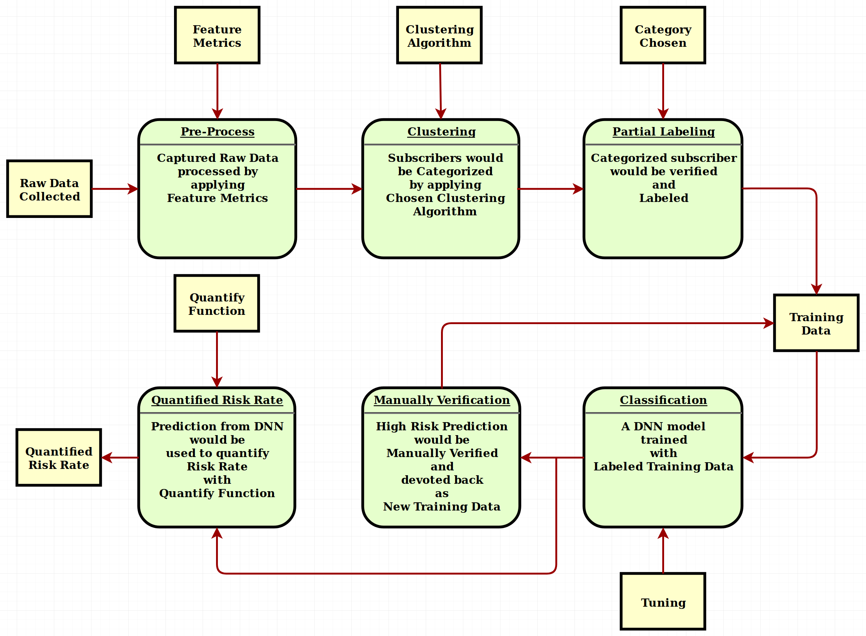
Overview of Framework
Notes:
We implemented our solution in Java. All input data are provided through configuration
files. Multiple threads are used to improve the performance. We randomly
generate a large number of VMs with different parameters to evaluate
SMOOP. In our evaluation, for each VM, we randomly assign the requirement of
CPU, memory, and disk. The vulnerability score is assigned based on the uniform
distribution. Following the same method, we configure the physical machine.

Slide 36
Clustering Subscriber by Feature Metrics
Proposed a six dimension Feature Metrics to profile service subscriber:
N – Total amount of VMs deployed by a subscriber
T – Average interval time between starting two VMs of a subscriber
M – Median memory size of VMs of a subscriber
A – Overall active rate of a subscriber
W – Average amount of active VM in each time stamp of a subscriber
I – Median of average CPU utilization rate among all VMs in each time stamp of a subscriber
Notes:
We implemented our solution in Java. All input data are provided through configuration
files. Multiple threads are used to improve the performance. We randomly
generate a large number of VMs with different parameters to evaluate
SMOOP. In our evaluation, for each VM, we randomly assign the requirement of
CPU, memory, and disk. The vulnerability score is assigned based on the uniform
distribution. Following the same method, we configure the physical machine.

Slide 37
Insight of Azure Dataset
Below diagram is the overall active rate of all VMs. It is clear to see that around 90% VMs is under 15% Average CPU utilization
Notes:
The overall
combined complexity of our algorithm is O(k(MN2 + PMN2 + P log P)), thus O(kPMN2)
Then the complexity of our algorithm will be bounded by O(kPN3)

Slide 38
Median of Active Rate
Over 80% subscriber remained less than 10% active rate in each time stamp.
Notes:
The overall
combined complexity of our algorithm is O(k(MN2 + PMN2 + P log P)), thus O(kPMN2)
Then the complexity of our algorithm will be bounded by O(kPN3)

Slide 39
Average Active VM Amount
Over 95% subscriber only maintained equal or less than one active VM in each Sampling time spot. Combined with Median of Active rate below, we could filter out extreme active subscriber
Notes:
The overall
combined complexity of our algorithm is O(k(MN2 + PMN2 + P log P)), thus O(kPMN2)
Then the complexity of our algorithm will be bounded by O(kPN3)

Slide 40
Median of Avg. CPU Util. Rate
Then we obtained a brief idea about the average CPU util. rate among subscribers in each Sampling Time Spot. We could conclude that over 85% subscriber should be clustered into one category.
Notes:
The overall
combined complexity of our algorithm is O(k(MN2 + PMN2 + P log P)), thus O(kPMN2)
Then the complexity of our algorithm will be bounded by O(kPN3)

Slide 41
Clustering Algorithm
In the end, we used DBSCAN to cluster the service subscriber by comparing with other clustering algorithm, it handle noises better
Using DBSCAN initially cluster out categories of subscribers
Manually check every categories
Partially label them into three major type: Inactive(Normal), Period Active, Extreme Active
Labeled data will be used as the input for the training of classification component

Slide 42
Three type of Active Level
We finished the detail active rate curve for every subscriber
Three typical type of curves are demonstrated on the right diagram.
Over 11000+ subscriber have the similar curve with top category.
Notes:
CNN sub-module will be produced to identify the detail curve diagram for each subscriber

Slide 43
Classification Component
Use collected history to classify new seen data
New classified data could be optional verified and used as new training history data
In our implementation, a Deep Neural Network finished the classification task
Output probability will be used to calculate co-resident risk rate
Notes:
We implemented our solution in Java. All input data are provided through configuration
files. Multiple threads are used to improve the performance. We randomly
generate a large number of VMs with different parameters to evaluate
SMOOP. In our evaluation, for each VM, we randomly assign the requirement of
CPU, memory, and disk. The vulnerability score is assigned based on the uniform
distribution. Following the same method, we configure the physical machine.

Slide 44
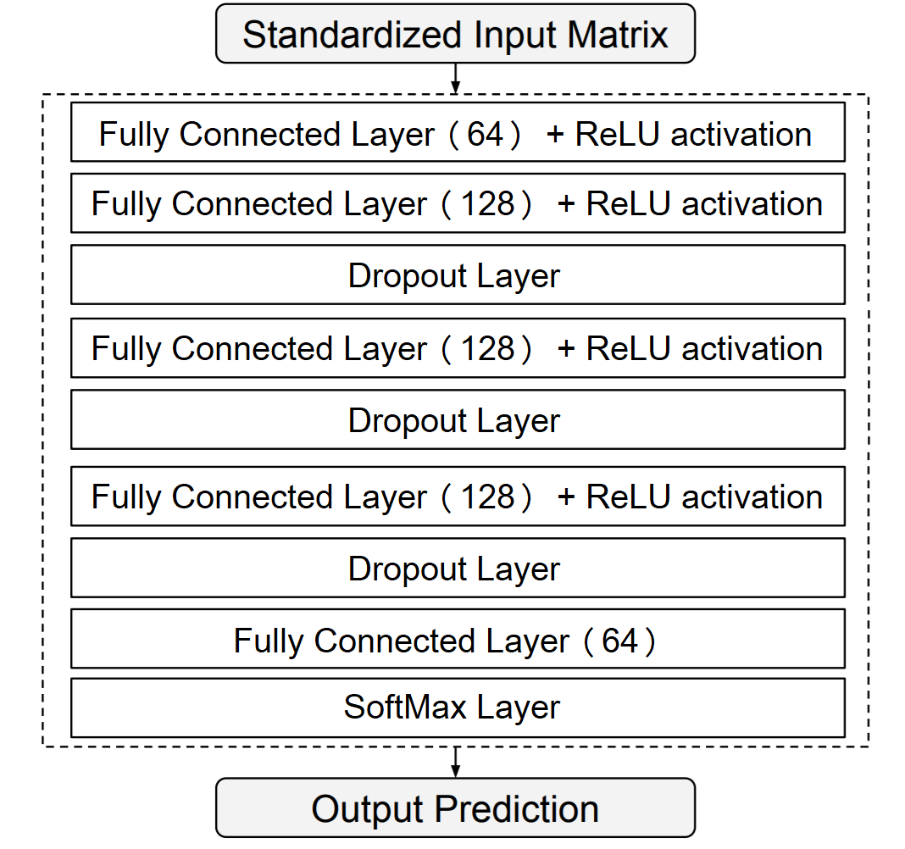
DNN Architecture
Notes:
We used dropout a lots of times here to minimize the overfitting issue

Slide 45
Quantify the Co-resident Risk
Since the we labeled the DBSCAN output into three categories, we setup the output of our DNN in this way:
For inferenced subscriber, three predicted probability number will be output to represent three major category
The number represented the normal category will be used to calculate the co-resident risk. In other word, we believe it represent the derivation rate from normal behavior pattern
In our implementation, R3 = 1 – P(normal subscriber)
Notes:
The overall
combined complexity of our algorithm is O(k(MN2 + PMN2 + P log P)), thus O(kPMN2)
Then the complexity of our algorithm will be bounded by O(kPN3)

Slide 46
Evaluation
Clustering Subscriber
Classification Evaluation

Slide 47
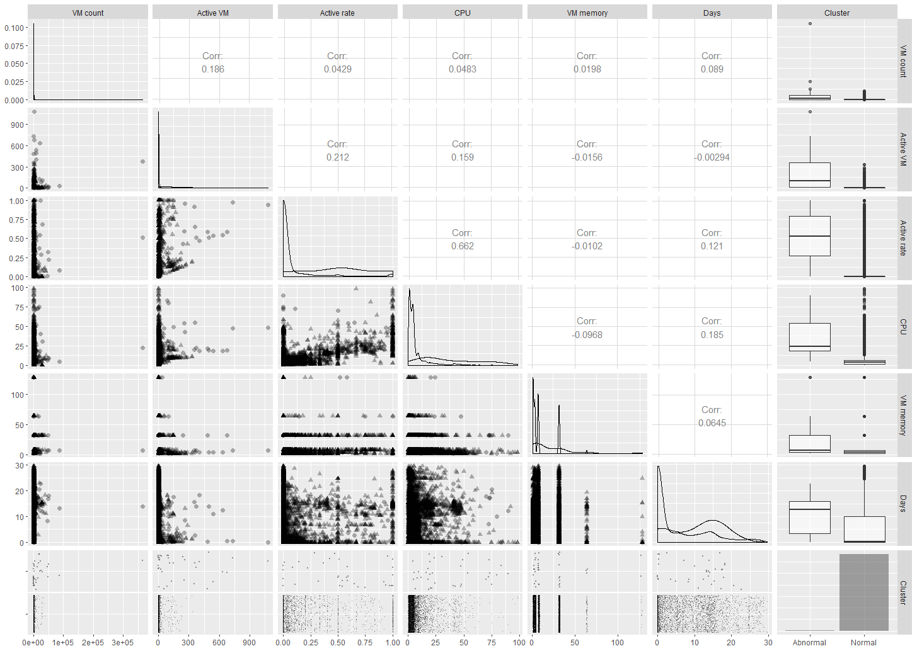
Clustering of Subscribers
Clustering paring diagram among normal subscriber and others.
Clustering finished by DBSCAN algorithm.
Notes:
Eps = 2 minpts = 5 in this pair result, we performed grid search to check all temporary result here

Slide 48
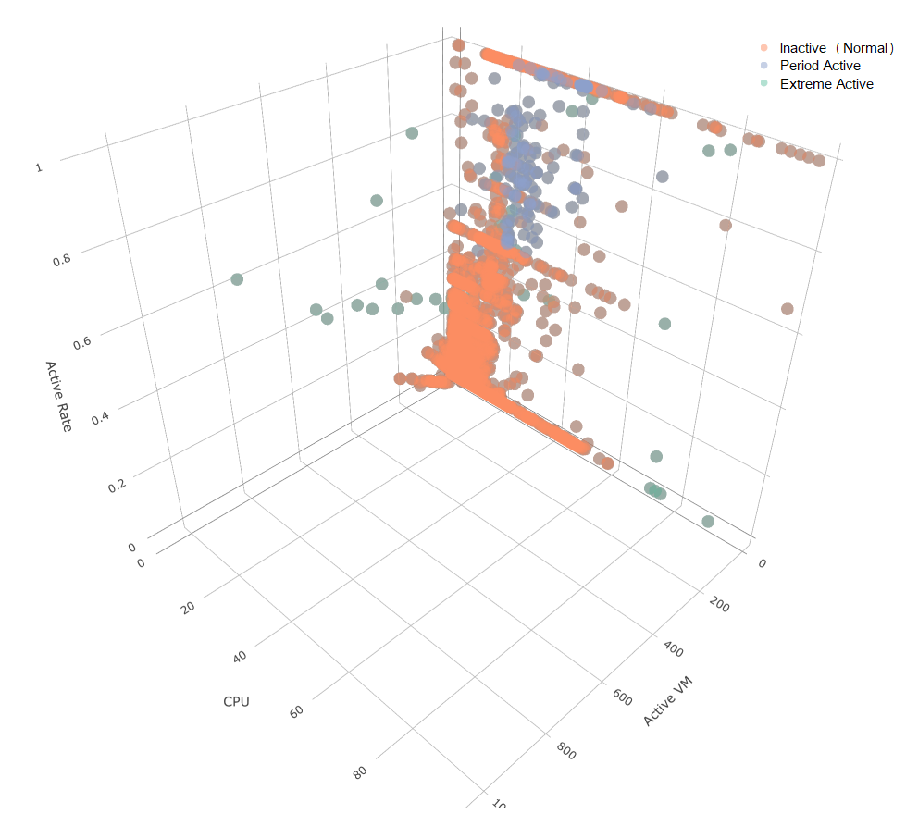
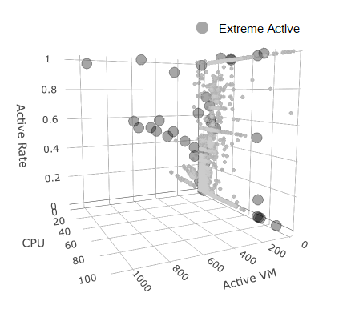
Clustering Result
Based on DBSCAN clustering output, we labeled them into three major category: Inactive(Normal), Period Active, Extreme Active. These labeled data would be used for our training.
Notes:
On the right one, we could see the extreme active subscriber category was marked out as bold ones.

Slide 49
Training of DNN
Decline curve of Loss Function with handling extreme imbalanced training data and conquered the over-fit problem
Notes:
Oversampling Minority Class Considering only total 78 subscribers are located into extreme
active category, and only 379 subscriber are located into period active category. Comparing with
total 11573 normal subscriber, we are facing an extreme imbalanced dataset. First, we divided
whole dataset into two part: Training set (90%) and Test set (10%). For each training session of
our model, we finished 100 batches in each epoch and we finished total 100 epochs. To handle
this imbalance, we have to oversampling these two minor classes. We randomly choose 200 from
normal type, 100 from period active type and 40 from extreme active type and shuffle them to form
a batch of training set, and this batch of training set will be used in one step. Since all training tasks
were finished off-line, the inference procedure for new subscriber data only need few seconds to
generate the final prediction.

Slide 50
Accuracy Rate for Test Set
Accuracy rate for Test set demonstrated our training is quite robust with new seen data.
The test set is 15% reserved and each test is finished by randomly drafted 50% from test set
Notes:
The overall
combined complexity of our algorithm is O(k(MN2 + PMN2 + P log P)), thus O(kPMN2)
Then the complexity of our algorithm will be bounded by O(kPN3)

Slide 51
F Measuring Matrix
F measuring Matrix result demonstrates that there is still a lot improve space for identify the rare event, in our case, the attacker’s appearance.

Slide 52
Conclusion
We conduct security assessment of the cloud and Security Risk of cloud was quantified.
We present a Secured Multi-Objective Optimization Virtual Machine Placement algorithm (SMOOP) to seek an overall improved solution.
Latest VM allocation polices were integrated to better handle incremental deploy situation.
Based on the large scale Microsoft Azure dataset, we finished the task to profile the behavior pattern of normal service subscriber within our proposed feature metrics.
A dynamic adapted framework was proposed to more accurately quantify the co-residency risk rate.
Notes:
such as energy or migration cost

Slide 53
Planned Work
Too much detail information of service subscriber were lost during the data abstract procedure. We need to build a Deep Conventional Neural Network as a sub-module to handle the detail feature diagram directly.
General adaption of our framework should be tested with new large scale dataset.
Abnormal event could be detected by profiling subscriber’s behavior pattern.

Slide 54
Publication
Jin Han, Wanyu Zang, Songqing Chen, and Meng Yu. Reducing security risks of clouds through virtual machine placement. In Giovanni Livraga and Sencun Zhu, editors, Data and Applications Security and Privacy XXXI (Dbsec), pages 275–292, Cham, 2017. Springer International Publishing.
Jin Han, Wanyu Zang, Li Liu, Songqing Chen, and Meng Yu. Risk-aware multi-objectives optimized virtual machine placement in the cloud. Journal of Computer Security, Vol 26, Issue 5, pages 707-730, Published: Aug 7,2018. IOS Press Publishing.

Slide 55
Appendix
Incremental implantation of placement was finished with integrating with latest VM allocation policies.
User constraints were discussed within incremental implantation
Fuzz sorting is discussed to replace single fitness function
AI engine was used to better quantify co-residency risk in our framework (From Proposal)
Possible better equation for Ri values is discussed
The security evaluation is hard to do before the placement was confirmed

Slide 56
Thank You!
Question?

