Slide 1
Online Malware Detection
in Cloud Auto-Scaling Systems
using Performance Metrics
by
Mahmoud Abdelsalam
Committee:
Prof. Ravi Sandhu: (Advisor)
Dr. Ram Krishnan: (Co-advisor)
Dr. Matthew Gibson
Dr. Murtuza Jadliwala
Dr. Gregory White
November 29, 2018
© Mahmoud Abdelsalam
World Leading Research with Real World Impact!

Slide 2
Introduction
Resource Pooling
Rapid Elasticity
Measure Service
On-Demand
Self-Service
CLOUD
Broad Network Access
Exploited System Vulnerabilities
E.g. Co-resident attacks
Compromised Credentials
Insider Threats
Configuration Vulnerabilities
Can we leverage cloud characteristics for online malware detection?
“Auto-Scaling”
© Mahmoud Abdelsalam
World Leading Research with Real World Impact!

Slide 3
Malware Detection Classification
Malware Detection using Machine Learning
Online Malware Detection
File Classification
File classification:
  Given a file/executable, classify if it’s a malware or not by running it and observing its behavior.
  You have a file as a suspect.
  You don’t keep monitoring them once they are clean.
Online malware detection:
  Assume that the malware got into the system and is executing.
  You keep monitoring the system’s behavior for malware detection.
  You don’t just focus on a given file, but the entire system (processes).
© Mahmoud Abdelsalam
World Leading Research with Real World Impact!

Slide 4
Malware Detection Classification
Malware Detection using Machine Learning
Online Malware Detection
File Classification
Dynamic Analysis
Static Analysis
Static Analysis
  No malware execution takes place.
  It is the process of analyzing executables by examining their code without actually executing them.
Dynamic Analysis
  Malware execute, typically, in an isolated environment and information about their behavior is logged/monitored.
© Mahmoud Abdelsalam
World Leading Research with Real World Impact!

Slide 5
Malware Detection Classification
Malware Detection using Machine Learning
Online Malware Detection
File Classification
Dynamic Analysis
Static Analysis
Features Extraction
Performance metrics
Memory features
System/API calls
Binary N-grams
Control Flow Graphs (CFG)
Static API calls
Cloud-specific falls under the “online malware detection” category.
Most, if not all, cloud-specific research:
✔️ Restrict the selection of features to those that can only be fetched through the hypervisor.
✘ Leverage cloud characteristics for online malware detection.
© Mahmoud Abdelsalam
World Leading Research with Real World Impact!

Slide 6
Problem Statement
Problem statement:
  Malware will always find a way-in to infect cloud infrastructures.
  Presence of a gap between malware prevention and malware detection methods.
  Lack of cloud-specific online malware detection methods.
Thesis statement - Cloud unique characteristic “auto-scaling” can effectively be utilized for online malware detection within a single-tenant’s virtual resources, in black-box and white-box granularity using performance metrics.
© Mahmoud Abdelsalam
World Leading Research with Real World Impact!

Slide 7
Contributions - Overview
Detection Ability
Black-box for Multiple VMs
Cloud-specific Online Malware Detection
White-box for Multiple VMs
White-box for
Single VM
Practicality
Data size
Cost
Performance
Vision
© Mahmoud Abdelsalam
World Leading Research with Real World Impact!

Slide 8
Blackbox for Multiple VMs
Detection Ability
Black-box for Multiple VMs
Cloud-specific Online Malware Detection
White-box for Multiple VMs
White-box for
Single VM
Practicality
© Mahmoud Abdelsalam
World Leading Research with Real World Impact!

Slide 9
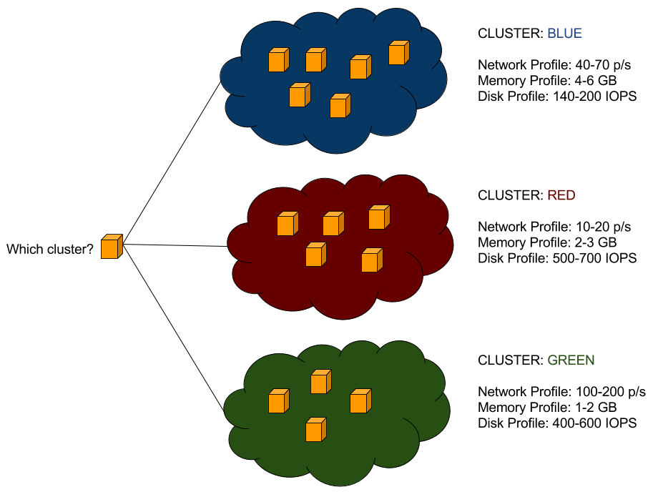
Blackbox Approach
“VMs doing the same function SHOULD behave similarly”
Cluster VMs based on their attributes
When a new VM gets created, “fit” that VM with existing cluster
  If successful: good
  If not: report anomaly
    Admin force fits into an existing category -> consequently cluster profiles are updated, or
    Admin creates a new cluster for this VM
© Mahmoud Abdelsalam
World Leading Research with Real World Impact!

Slide 10
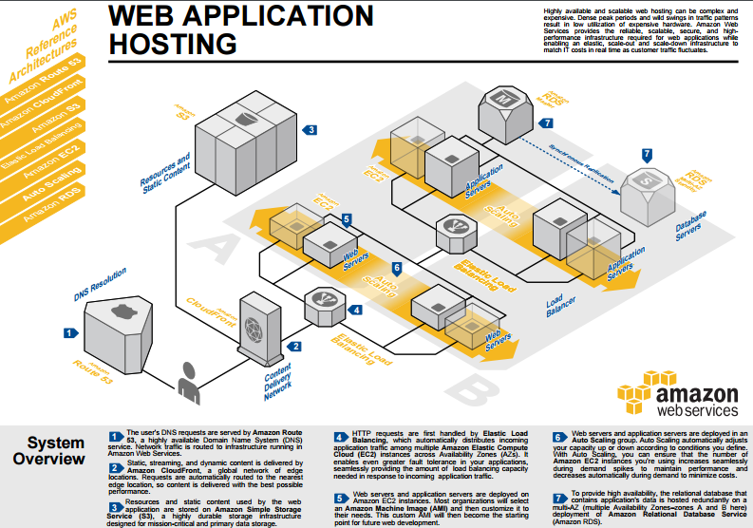
3-tier example
© Mahmoud Abdelsalam
World Leading Research with Real World Impact!

Slide 11
Hypervisor-level VMs Features
Metric | Description | Unit
CPU utilization | Average CPU utilization | %
Memory usage | Volume of RAM used by the VM from the amount of its allocated memory | MB
Memory resident | Volume of RAM used by the VM on the physical machine | MB
Disk read requests | Rate of disk read requests | rate/s
Disk write requests | Rate of disk write requests | rate/s
Disk read bytes | Rate of disk read bytes | rate/s
Disk write bytes | Rate of disk write bytes | rate/s
Network outgoing bytes | Rate of network outgoing bytes | rate/s
Network incoming bytes | Rate of network incoming bytes | rate/s
© Mahmoud Abdelsalam
World Leading Research with Real World Impact!

Slide 12
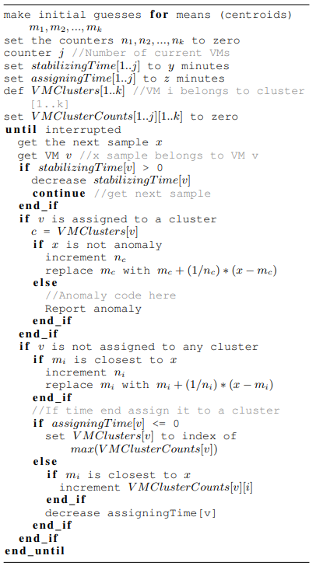
Sequential K-means
© Mahmoud Abdelsalam
World Leading Research with Real World Impact!

Slide 13
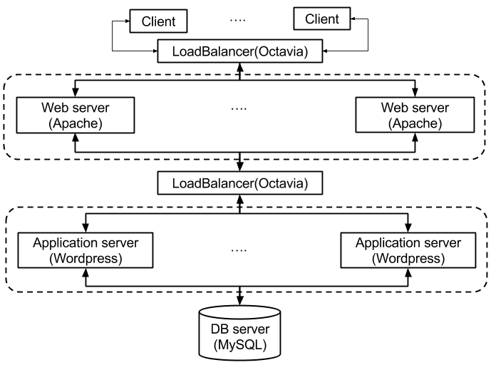
Experimental Setup
Simple & realistic traffic generation
Poisson
  Used in many cases due to its simplicity.
On/Off Pareto
  Internet traffic is proved to be of self-similar nature.
The simulation parameters are as follows:
Generator: On/Off Pareto, Poisson
Number of concurrent clients: 50
Requests arrival rate/hour: 3600
Type of requests: GET and POST (randomly generated)
© Mahmoud Abdelsalam
World Leading Research with Real World Impact!

Slide 14
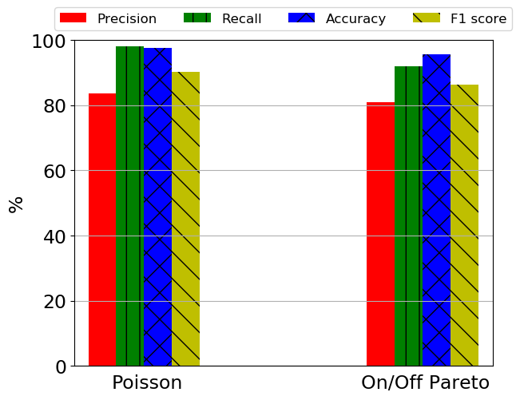
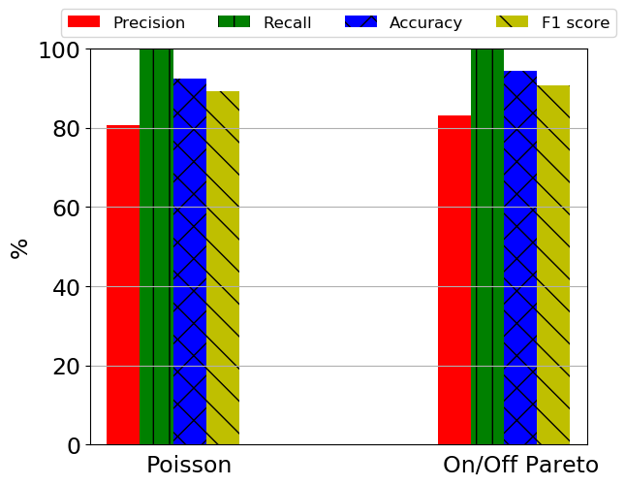
Results
Injected Anomalies:
  cpu, memory and disk intensive
EDoS: One form of EDoS is to create some VMs while remaining dormant and idle
© Mahmoud Abdelsalam
World Leading Research with Real World Impact!

Slide 15
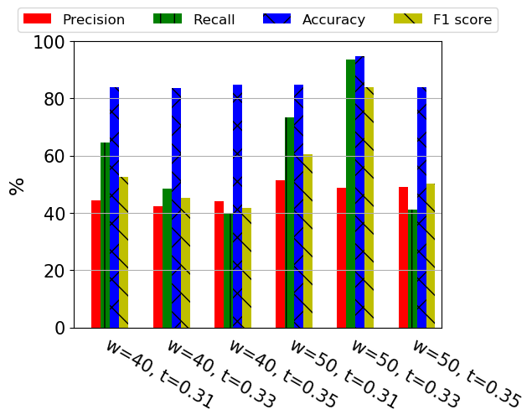
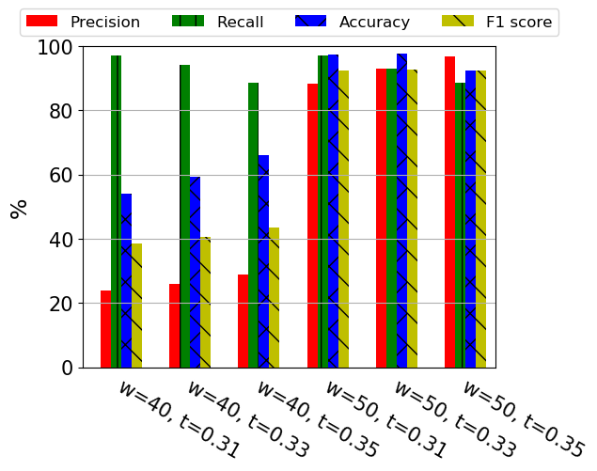
Results
Ransomware is a very critical threat to cloud.
Netskope’s quarterly cloud report states that 43.7% of the cloud malware types detected in cloud apps are common ransomware delivery vehicles.
Ransomware (KillDisk) - Poisson
Ransomware (KillDisk) - On/Off Pareto
© Mahmoud Abdelsalam
World Leading Research with Real World Impact!
15

Slide 16
Whitebox for Single VM
Detection Ability
Black-box for Multiple VMs
Cloud-specific Online Malware Detection
White-box for Multiple VMs
White-box for
Single VM
Practicality
© Mahmoud Abdelsalam
World Leading Research with Real World Impact!

Slide 17
Whitebox Single VMs
Goals:
The feasibility of applying CNN to VMs online malware detection using fine-grained process performance metrics.
Tackling the mislabeling problem by using 3d CNNs.
Benign Phase
Malicious Phase
Inject and execute malware
During the training phase, there is no guarantee that a malware exhibited malicious behavior.
- A malware may never show a malicious activity during the training phase at all.
+ More common scenario is when a malware periodically (e.g., every 1 minute) performs malicious activities such as stealing and sending some information to its Command and Control servers (C&Cs).
© Mahmoud Abdelsalam
World Leading Research with Real World Impact!

Slide 18
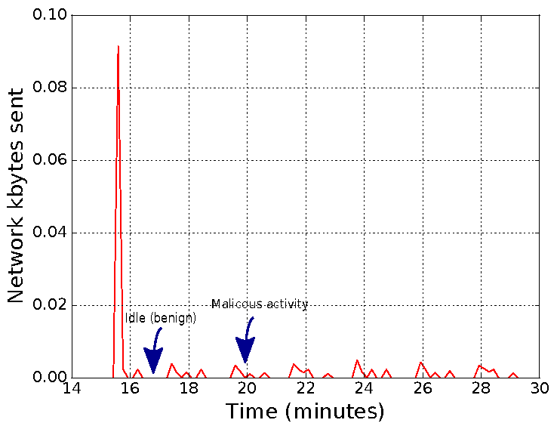
Mislabeling Problem

Slide 19
Mislabeling Problem
0 ➖ Benign
1 ➖ Malicious
0 1 1 1 1 1 1 1 1 1 1 1 1 1 1 1 1

Slide 20
Mislabeling Problem
0 ➖ Benign
1 ➖ Malicious
0 1 1 1 1 1 1 1 1 1 1 1 1 1 1 1 1

Slide 21
Mislabeling Problem
0 ➖ Benign
1 ➖ Malicious
1 1 1 1 1

Slide 22
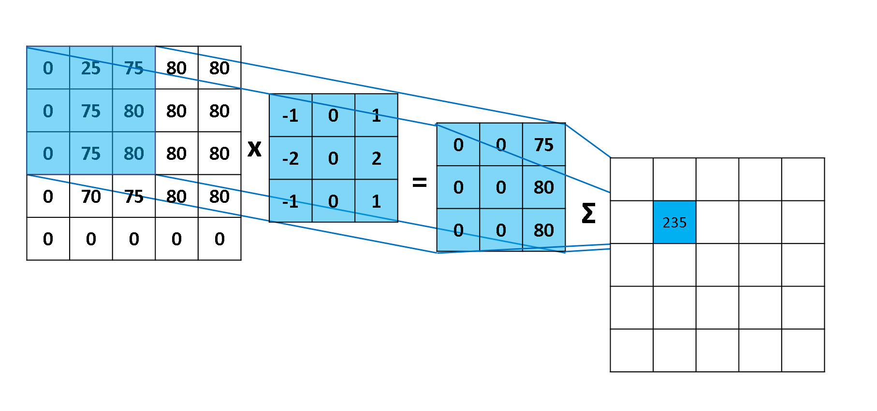
CNN Overview
Convolution
Pooling
Convolution
Pooling
Fully connected
Prediction
Input
Matrix
Normal
Feature Map
Malicious
Feature extraction
Classification
Convolution operation example
Ref: blog.csdn.net
© Mahmoud Abdelsalam
World Leading Research with Real World Impact!

Slide 23
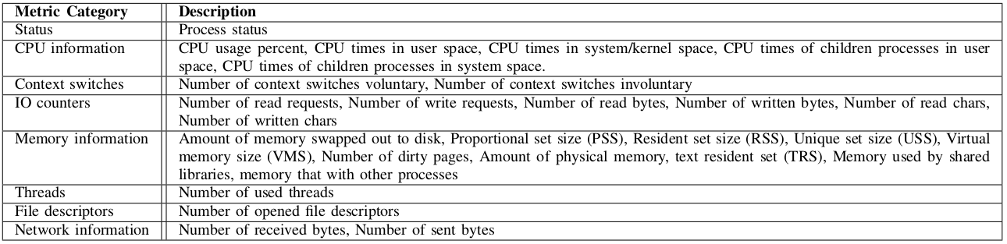
Process-level Performance Metrics
We use performance metrics as a way of defining a process behavior.
28 process-level performance metrics.
These metrics can easily be fetched through the hypervisor.

Slide 24
CNN Model
Standardized Input Matrix
Input layer
Convolution Layer 1 + ReLU activation
Max Pooling Layer 1
Convolution Layer 2 + ReLU activation
Max Pooling Layer 2
Fully Connected Layer 1 + ReLU activation
Dropout Layer
Fully Connected Layer 2
Output Prediction

Slide 25
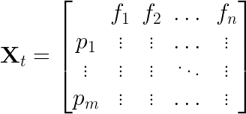
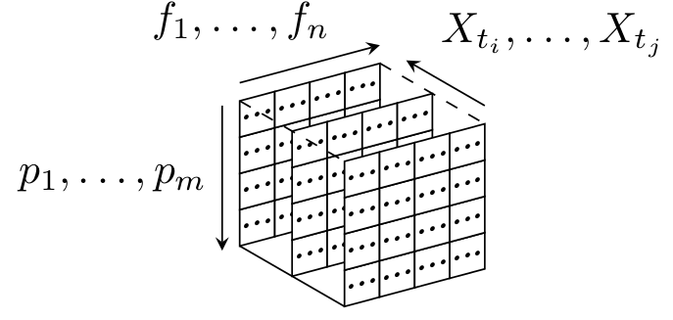
CNN Input
We represent each sample as an image (2d matrix) which will be the input to the CNN.
Consider a sample at a particular time , that records features (performance metrics) per process for processes in a VM:
The 3d CNN model input includes multiple samples over a time window. The input matrix is:

Slide 26
CNN Input Issues
CNN requires the same process to remain in the same row in each sample.
The CNN in computer vision takes fixed-size images as inputs, so the number of features and processes must be predetermined.
Use the max process identification number (PID) which is set by the OS?
  The limit (max number of PIDs) is defined in /proc/sys/kernel/pid_max which is usually 32k.
  Huge input matrix!
  Change the max PID number defined?
    Kernel confusion if wrap around happened too often.
there is no guarantee that, for instance, a process with a PID 1000 at a particular time is going to be the same process at a later time.

Slide 27
CNN Input Issues
We define a process, referred to as unique process, by a 3-tuple:
  process name
  command line used to run process
  hash of the process binary file (if applicable)
We set the maximum number of unique processes to 120 to accommodate for newly created unique processes.
+-------+----------------+-------------------------------------------------------+------------------------------------+-------------+------------------------------+
| pid | name | cmd | hash | kb_sent | cpu_user | sample_time |
+-------+----------------+-------------------------------------------------------+------------------------------------+----------+----------+---------------------+
| 1241 | php-fpm7.0 | php-fpm: pool www | 7eb8522425... | 33.61710 | 0.03000 | 2018-06-15 11:19:04 |
| 1240 | php-fpm7.0 | php-fpm: pool www | 7eb8522425... | 38.79308 | 0.00000 | 2018-06-15 11:19:04 |
| 1221 | php-fpm7.0 | php-fpm: master process (/etc/php/7.0/... | 7eb8522425... | 0.00000 | 0.02000 | 2018-06-15 11:19:04 |
| 1287 | python | python | 23eeeb4347… | 0.00000 | 0.15000 | 2018-06-15 11:19:04 |
+------+-----------------+-------------------------------------------------------+--------------------+--------------+--------------+-----------------------------+
+-----------------------------------------------------------------------------------------------+
| Unique Process |
+----------------+-------------------------------------------------------+--------------------+----------------------+----------------------+-----------------------------+
| name | cmd | hash | AVG(kb_sent) | AVG(cpu_user) | sample_time |
+----------------+-------------------------------------------------------+--------------------+----------------------+----------------------+-----------------------------+
| php-fpm7.0 | php-fpm: pool www | 7eb8522425... | 36.2051 | 0.0150 | 2018-06-15 11:19:04 |
| php-fpm7.0 | php-fpm: master process (/etc/php/7.0/... | 7eb8522425... | 0.00000 | 0.0200 | 2018-06-15 11:19:04 |
| python | python | 23eeeb4347… | 0.00000 | 0.1500 | 2018-06-15 11:19:04 |
+----------------+-------------------------------------------------------+--------------------+----------------------+----------------------+-----------------------------+

Slide 28
Experimental Setup
Our experiments were conducted on Openstack.
To simulate a real world scenario, we used a 3-tier web architecture and a self-similar traffic gen. (on/off Pareto) is used.
Data collection:
Client
.
.
Web server
(Apache)
App server
(Wordpress)
DB server
(MySQL)
Client
Collect 28 different process performance metrics (Table I) every 10 seconds for ≃ 100 processes
Time (min)
0 15 30
Clean phase
Malware injection Point.
25 Malware executables are injected (one per experiment).
Period of potential malware activity prone to mislabeling problem

Slide 29
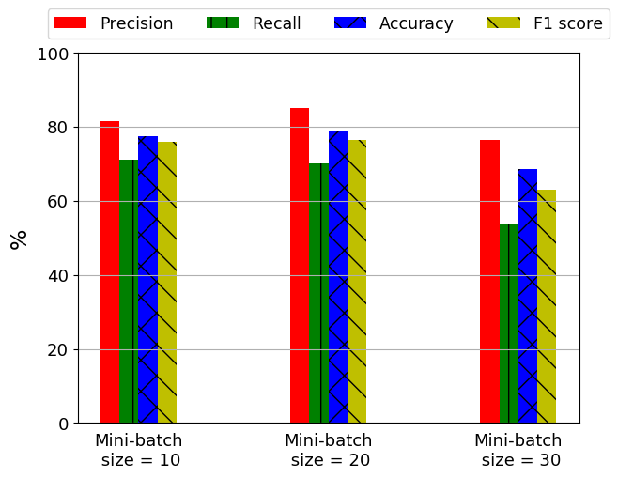
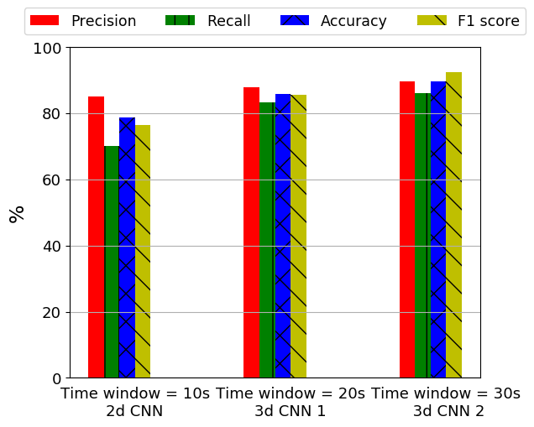
Results
2d CNN
3d CNN

Slide 30
Whitebox for Multiple VMs
Detection Ability
Black-box for Multiple VMs
Cloud-specific Online Malware Detection
White-box for Multiple VMs
White-box for
Single VM
Practicality
© Mahmoud Abdelsalam
World Leading Research with Real World Impact!

Slide 31
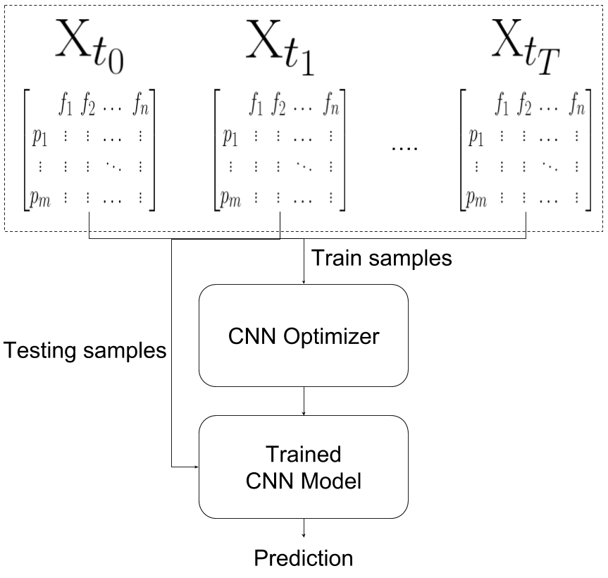
Whitebox Multiple VMs
Goal: Leverage auto-scaling for whitebox online malware detection by
Using 2d CNN for multiple VMs.
Introducing a novel approach of pairing samples to accommodate for correlations between VMs.
Recall “2d CNN”
Single VMs Single Samples (SVSS)

Slide 32
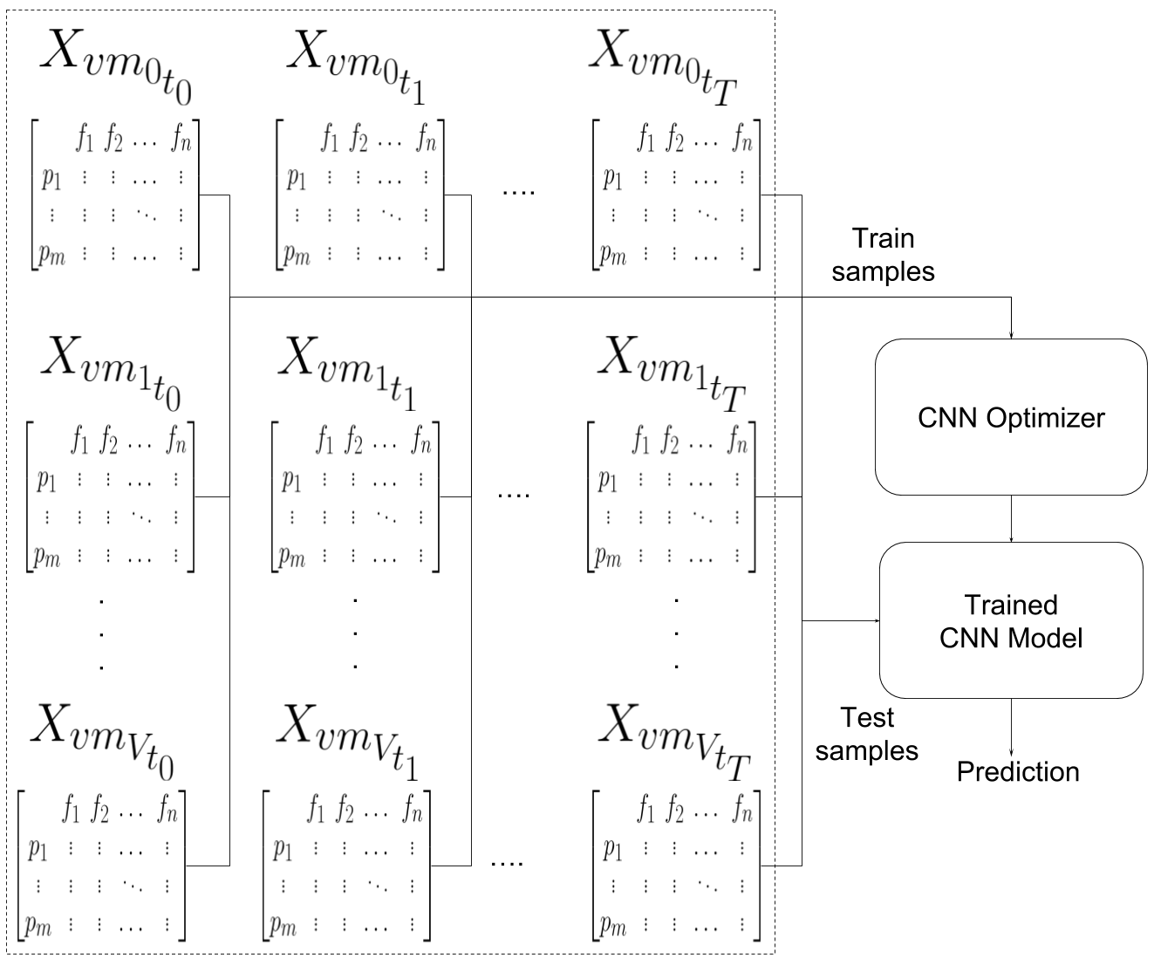
Multiple VMs Single Samples (MVSS)

Slide 33
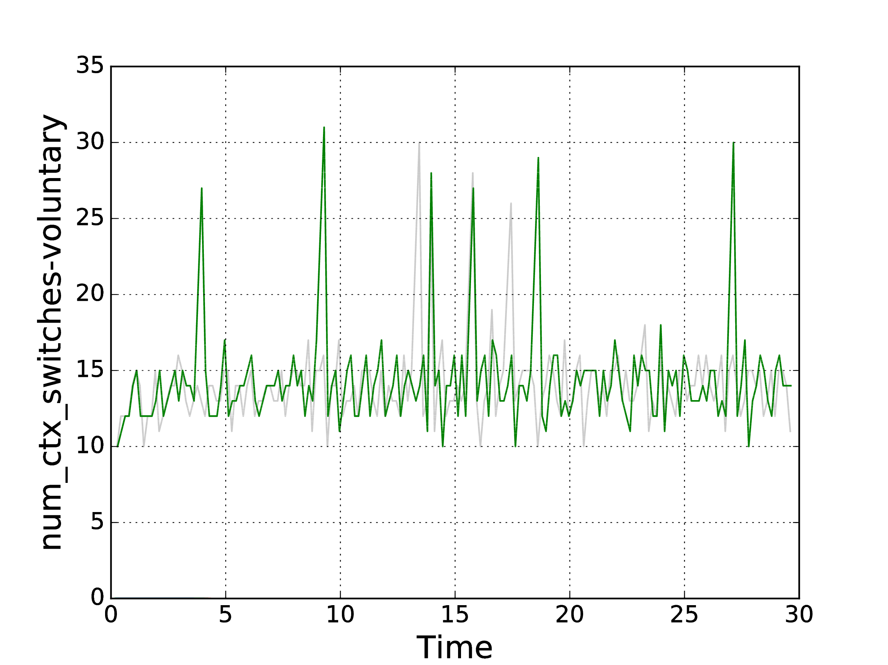
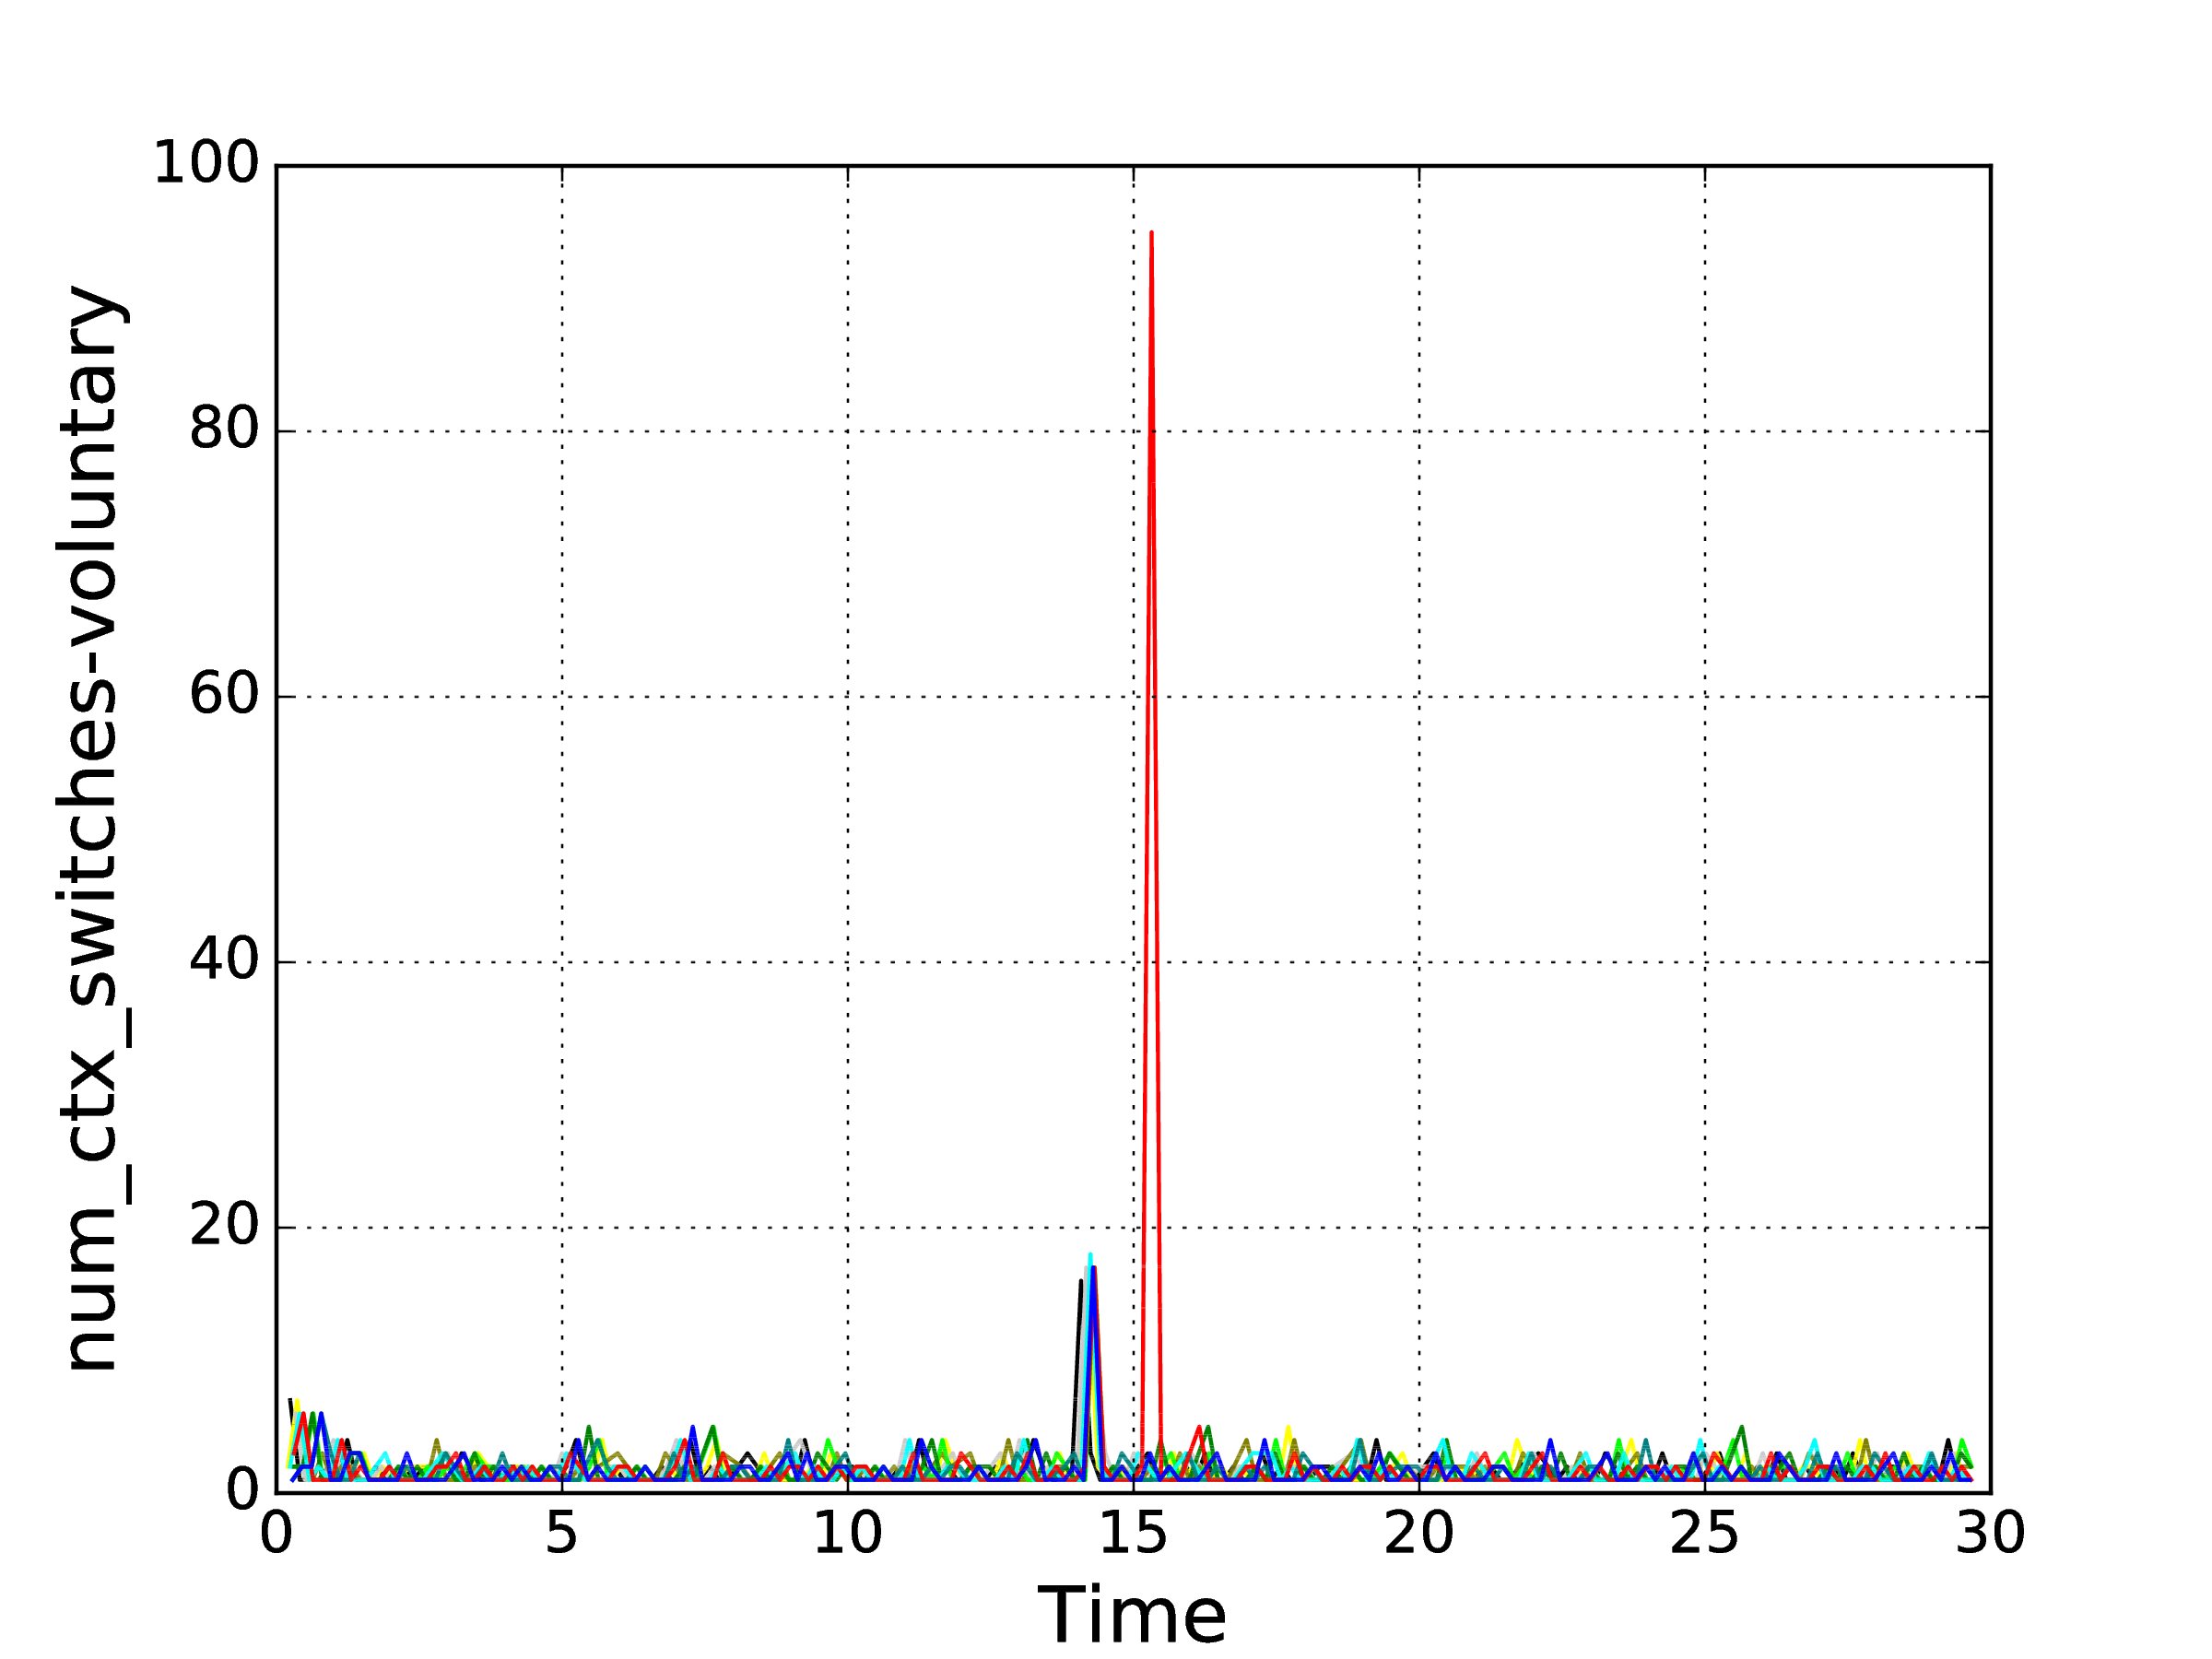
Key Intuition
What do we gain from having multiple VMs in an auto-scaling scenario?
“Correlation between VMs”
Number of used voluntary context switches over 30 minutes for two different runs of the same unique process
Number of used voluntary context switches over 30 minutes for one run of 10 VMs in an auto-scaling scenario.

Slide 34
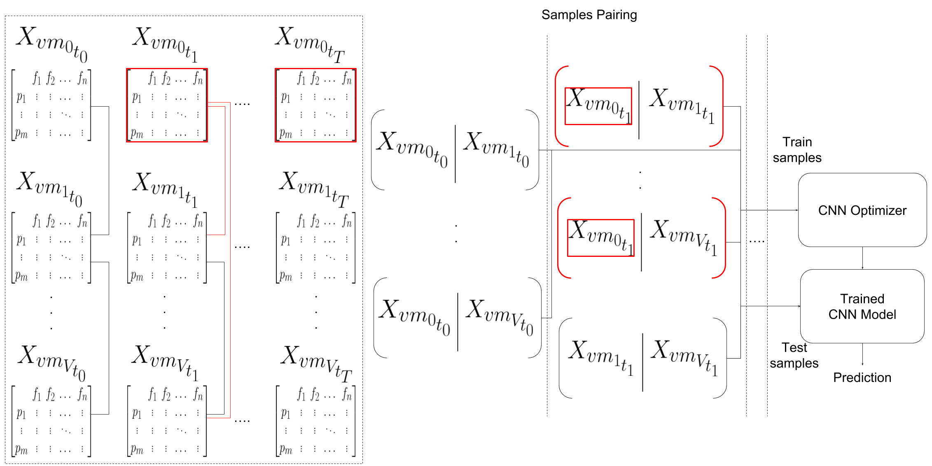
Multiple VMs Paired Samples (MVPS)

Slide 35
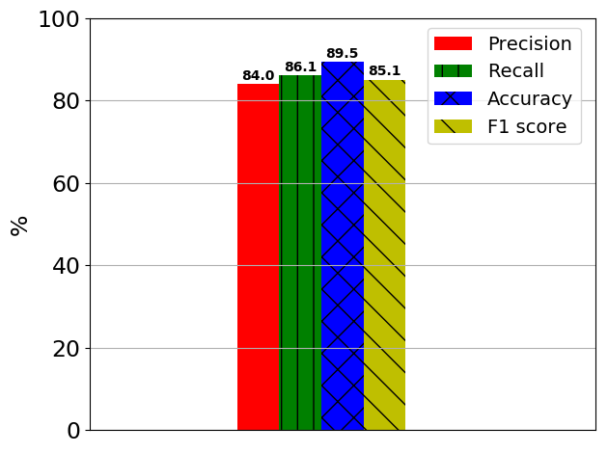
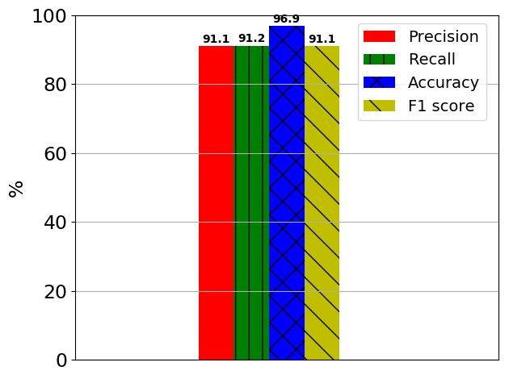
Results
MVSS
MVPS

Slide 36
Conclusion & Future Work
The goal of this thesis was to provide a develop cloud-specific online malware detection methods by leveraging cloud characteristics (i.e., auto-scaling).
In satisfying dissertation objectives:
We developed an online anomaly detection system for cloud IaaS that targeted highly-active malware in an auto-scaling scenario.
We developed an effective approach for detecting malware using process-level features for low-level malware in a single VM scenario.
We developed a pairing samples approach for detecting malware using process-level features that targeted low-level malware in an auto-scaling scenario.
Future Work:
Applying and testing multiple architectures (e.g., hadoop systems or containers)
Investigating and leveraging more cloud characteristics for security.

Slide 37
Publications
Mahmoud Abdelsalam, Ram Krishnan, and Ravi Sandhu “Clustering-Based IaaS Cloud Monitoring”, In Proceedings 10th IEEE International Conference on Cloud Computing (CLOUD), Honolulu, Hawaii, June 25-30, 2017, 8 pages.
Mahmoud Abdelsalam, Ram Krishnan, Yufei Huang and Ravi Sandhu “Malware Detection in Cloud Infrastructures using Convolutional Neural Networks”, In Proceedings 11th IEEE International Conference on Cloud Computing (CLOUD), San Francisco, CA, July 2-7, 2018, 8 pages.
Mahmoud Abdelsalam, Ram Krishnan, and Ravi Sandhu “Online Malware Detection in Cloud Auto-Scaling Systems Using Shallow Convolutional Neural Networks”, submitted for peer review in IEEE ICC CISS 2019.
© Mahmoud Abdelsalam
World Leading Research with Real World Impact!

Slide 38

Questions/Comments
© Mahmoud Abdelsalam
World Leading Research with Real World Impact!

