Slide 1
Towards Machine Learning Based Access Control
Ph.D. Dissertation Defense
Mohammad Nur Nobi
Department of Computer Science
The University of Texas at San Antonio
Committee:
Ravi Sandhu, Ph.D., Co-Chair
Ram Krishnan, Ph.D., Co-Chair
Palden Lama, Ph.D.
Wei Wang, Ph.D.
Xiaoyin Wang, Ph.D.
July 08, 2022

Slide 2


Introduction
Access Control
  The decision to permit or deny a user access to a resource
  User: a human user, a process, an application, etc.
  Resource: network, data, application, service, etc.
There are many mainstream classical approaches for access control
  Access Control Lists (ACLs), Role Based Access Control (RBAC), Attribute Based Access Control (ABAC), Relationship Based Access Control (ReBAC), etc.
These approaches have their benefits and numerous advancements over time
access request
permit/ deny
Access Control System
user
resource

Slide 3
Issues in Classical Approaches
(ABAC)
Attribute Engineering
Policy Engineering (Policy Mining)
To design policy through a manual or automated process
Generalization
Focus on capturing given access control state
Attribute and Policy Update (administration)
Revoke existing access or introduce a new access to existing users
An expert designs attributes based on the metadata
E.g., ‘status’ attribute is engineered from ‘spending’ and ‘credit’ history
E.g., <status = ‘platinum’, type=‘secured’> <access = ‘read, write’>
E.g., Knowing Alice’s access, is it possible to determine Bob’s access?
Depends on human, error-prone

Slide 4

Machine Learning in Access Control
(Deep Learning)
Could it learn from existing access control state of the system?
Could it learn directly from the metadata?
Could it make access control decisions that are accurate and generalize better?
Rules + Attributes
access request
permit
Access Control System
Alice
service1
Obviates the need for related procedures
  Attribute Engineering and Assignments
  Policy Engineering
Ease policy updates (Administration)

Slide 5
Thesis Statement
A deep neural network can precisely learn the access control state of a large-scale, complex, and dynamic system, generalize enough to make accurate decisions for unseen access control requests and ease access control administration by employing processes with minimal human involvement.

Slide 6
Summary of Contributions
Machine Learning Based Access Control (MLBAC)
Comprehensive Literature Review : ML in Access Control
Operational Model of MLBAC
Administration of
MLBAC
Adversarial Attacks in DLBAC
DLBAC
(prototype, interpretation)
Implementation and Evaluation of DLBAC

Slide 7
Section-1
Machine Learning Based Access Control (MLBAC)
Comprehensive Literature Review : ML in Access Control
Operational Model of MLBAC
Administration of
MLBAC
Adversarial Attacks in DLBAC
DLBAC
(prototype, interpretation)
Implementation and Evaluation of DLBAC

Slide 8
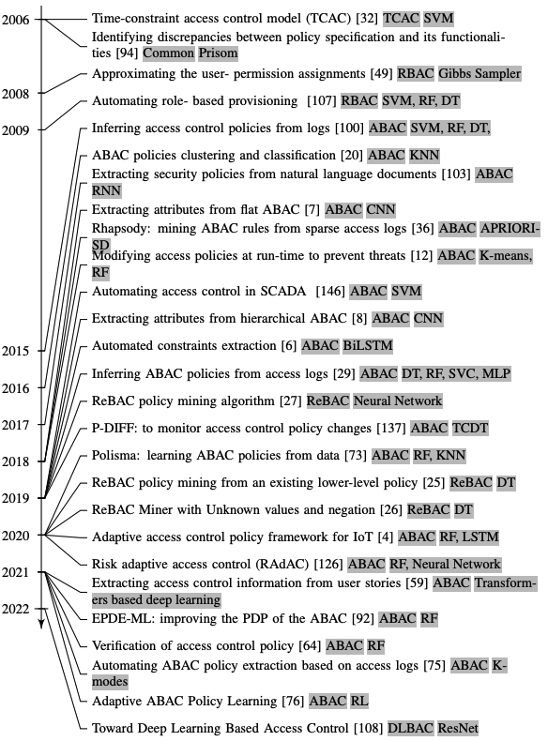
Timeline of
ML in Access Control

Slide 9
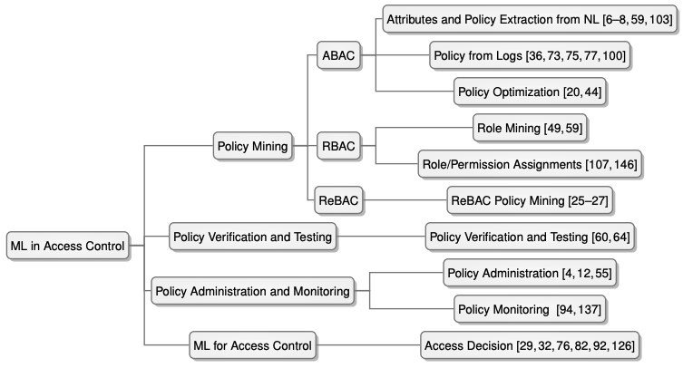
Taxonomy of
ML in Access Control

Slide 10
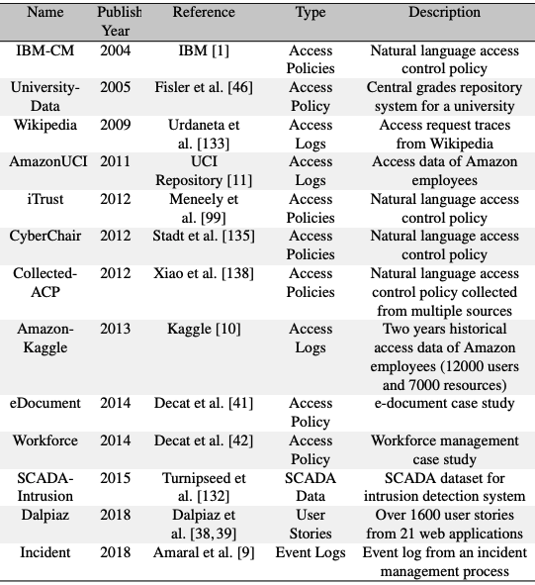
Publicly Available Datasets for Access Control
No attributes
NL Policy Related
Attributes extraction

Slide 11
Section-1 Summary
ML in Access Control is nothing new
  To optimize the underlying process
  Evaluating potential to infer policy
Lack of generalized system
  Target specific application
Lack of good datasets
No discussion about ML model’s vulnerabilities

Slide 12
Section-2
Machine Learning Based Access Control (MLBAC)
Comprehensive Literature Review : ML in Access Control
Operational Model of MLBAC
Administration of
MLBAC
Adversarial Attacks in DLBAC
DLBAC
(prototype, interpretation)
Implementation and Evaluation of DLBAC

Slide 13
Operational Model Of Machine Learning Based Access Control
Authorization Tuple <Alice, projectA, {read, write}>
U-R Metadata
U-R Metadata
U-R Metadata
Authorization Tuple
Authorization Tuple
Authorization Tuple
Input
Feature Engineering
Attribute Engineering
User/ Resource Attribute Assignments
Mining/ Training
ML
or
Non-ML
ML Model Training
RBAC Mining
ABAC Policy Mining
Output
User Assignments
Permission Assignments
Rules
Trained ML Model
RBAC
ABAC
MLBAC

Slide 14

Candidate MLBAC Models
Training data
Random Forest
(RF)
Training data
Authorization Tuple
RF Model
Training data
Training data
SVM
Authorization Tuple
SVM Model
….
Training data
Training data
ResNet Network
Authorization Tuple
ResNet Model
DLBAC
We create a DLBAC instance: DLBAC_{α}

Slide 15
Syntax of
DLBAC_{α} Dataset
User/ Resource metadata
User: Alice
rank | team | project |  | join date
developer | dev | projA | … | Nov 2012
Operations: op1, op2, op3, op4
type | team | project |  | size
source | dev | projA | … | medium
Resource: projectA
Authorization Tuple:
<Alice, projectA, {op1, op3}>
developer | dev | projA | … | Nov 2012
source | dev | projA | … | medium
1 | 0 | 1 | 0
User metadata values
Resource metadata values
Access to operations
A dataset for DLBACα is the collection of such authorization tuples (samples)

Slide 16
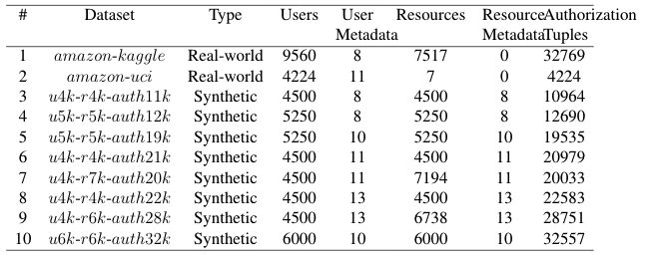
List of Datasets

Slide 17
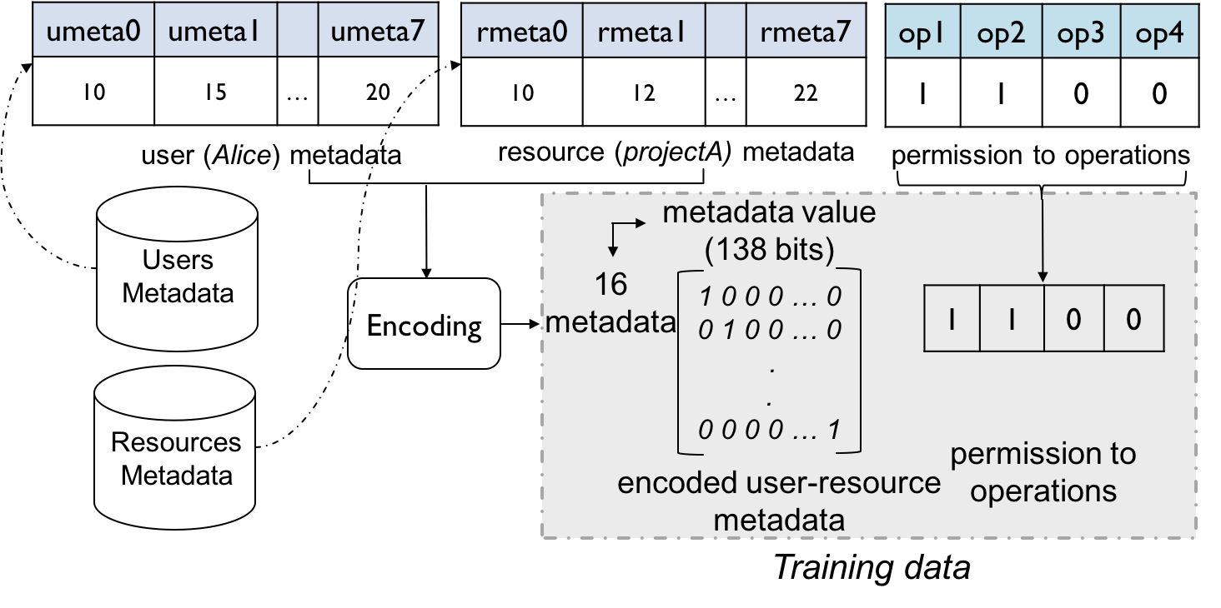
Preparing Training Data for DLBACα
The data type in our datasets are nominal-categorical

Slide 18
Decision Making Process in DLBACα
user
(Alice)
operation (op2)
resource
(projectA)
metadata values
(138 bits)
16
metadata
Encode user-resource metadata
1 0 0 0 … 0
0 1 0 0 … 0
.
.
0 0 0 0 … 1
op1 | op2 | op3 | op4
0.91 | 0.79 | 0.21 | 0.43
encoded user-resource
metadata
Neural Network
permission to operations
Access Control Decision Engine
permit
Permit decision is made comparing the output probability with a threshold

Slide 19
Evaluation Methodology
Classical ML Algorithms
State-of-the-art policy mining techniques
SVM
XuStoller [1]
Random Forest (RF)
Multiple instances of DLBACα
ResNet (DLBAC_{α-R})
DenseNet (DLBAC_{α-D})
Xception (DLBAC_{α-X})
Multilayer Perceptron (MLP)
Rhapsody [2]
EPDE-ML [3]
[1] Xu et al. 2014. "Mining attribute-based access control policies." IEEE TDSC
[2] Cotrini et al. 2018. Mining ABAC rules from sparse logs. In IEEE Euro S&P.
[3] Liu et al. 2021. Efficient Access Control Permission Decision Engine Based on Machine Learning. Security & Communication Networks.

Slide 20
Evaluation Metrics
80% samples for the training, and 20% testing
F1 TPR
FPR
A higher F1 score: better generalization
A higher TPR: accurate and efficient in granting access
A lower FPR: efficient in denying access

Slide 21
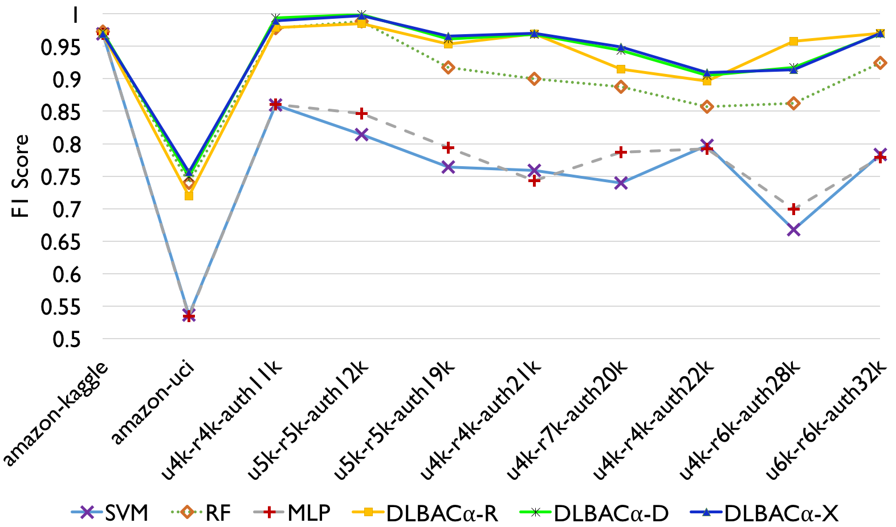
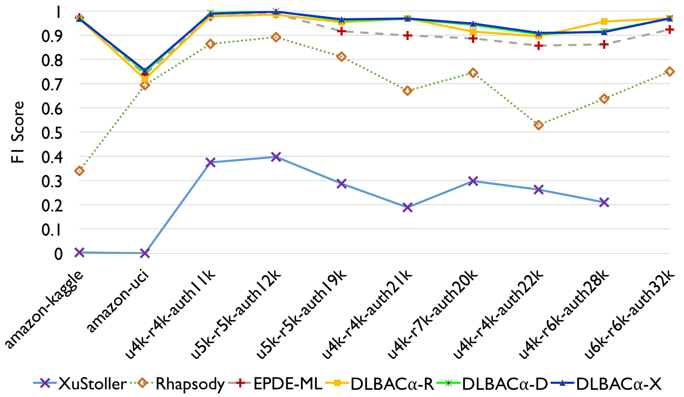
Comparison with ML Algorithms and State-of-the-art Policy Mining
make accurate access decisions and generalize better

Slide 22
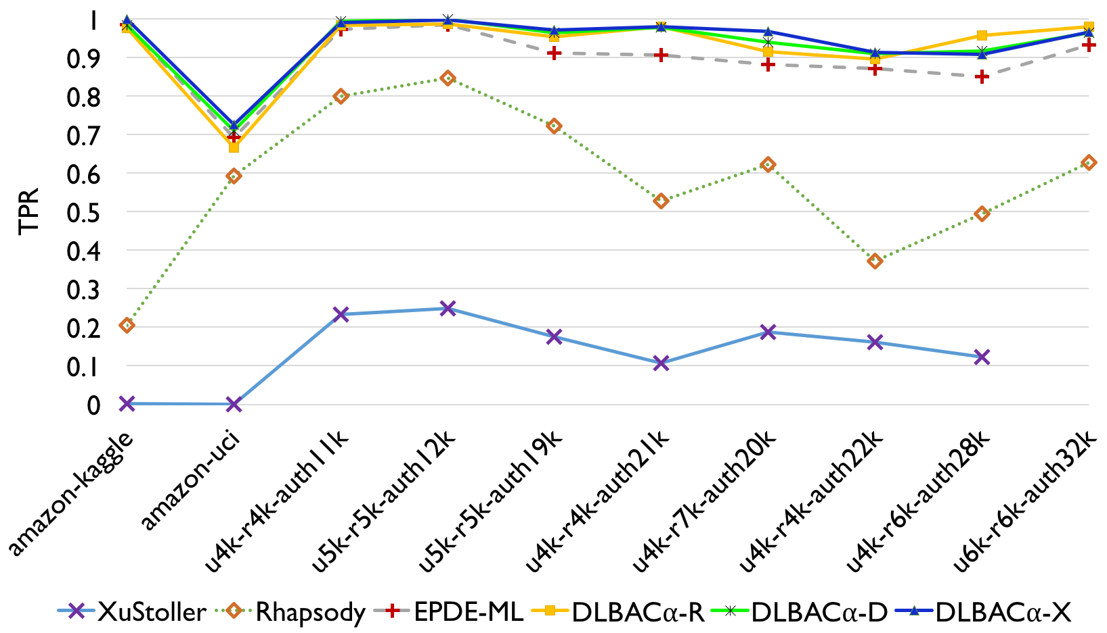
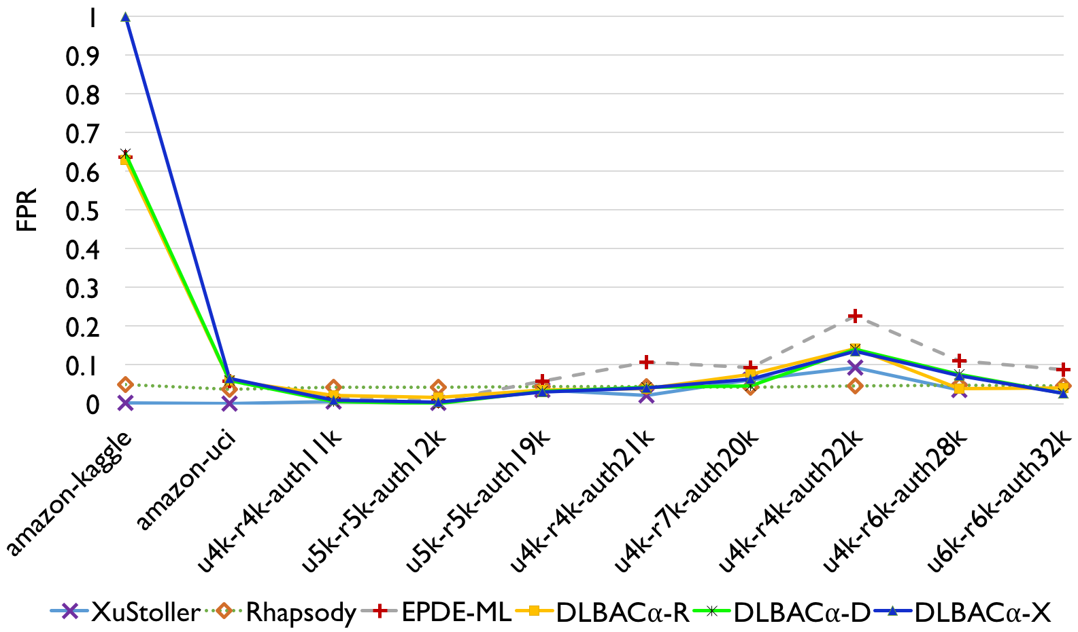
Comparison with Policy Mining Algorithms
handling desirable access
handling unwanted access
Efficient in permitting desired accesses and denying unwanted accesses

Slide 23
Understanding DLBAC Decisions
    Why does Bob’s ‘op2’ access been denied for projectB resource?
Bob
op2
projectB
    Which metadata are important/ influential for this decision?
DLBACα
Propose two approaches
  Integrated Gradients
  Knowledge Transferring
deny
A sample access request

Slide 24
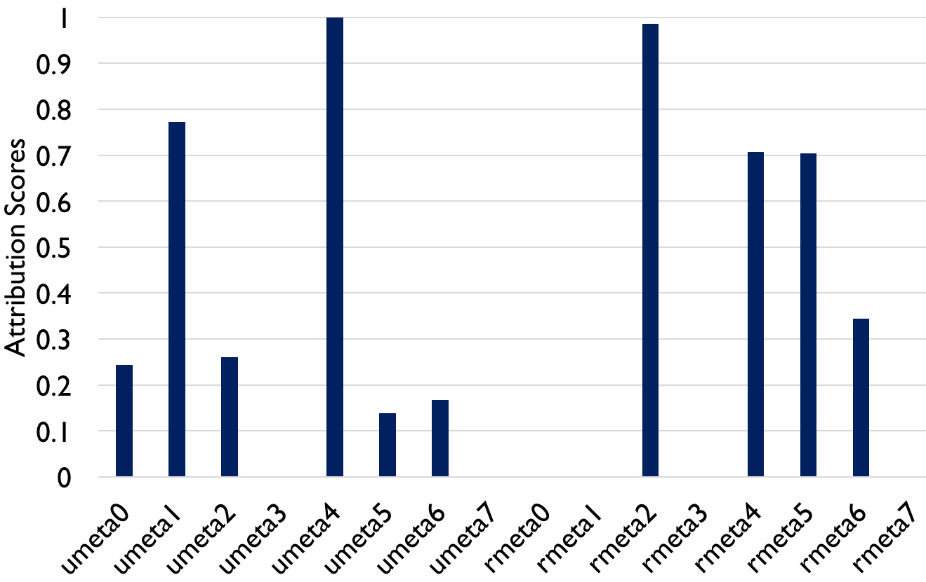
Integrated Gradients
Bob’s metadata
projectB’s metadata
Integrated Gradients
DLBACα
deny for op2
Local Interpretation

Slide 25
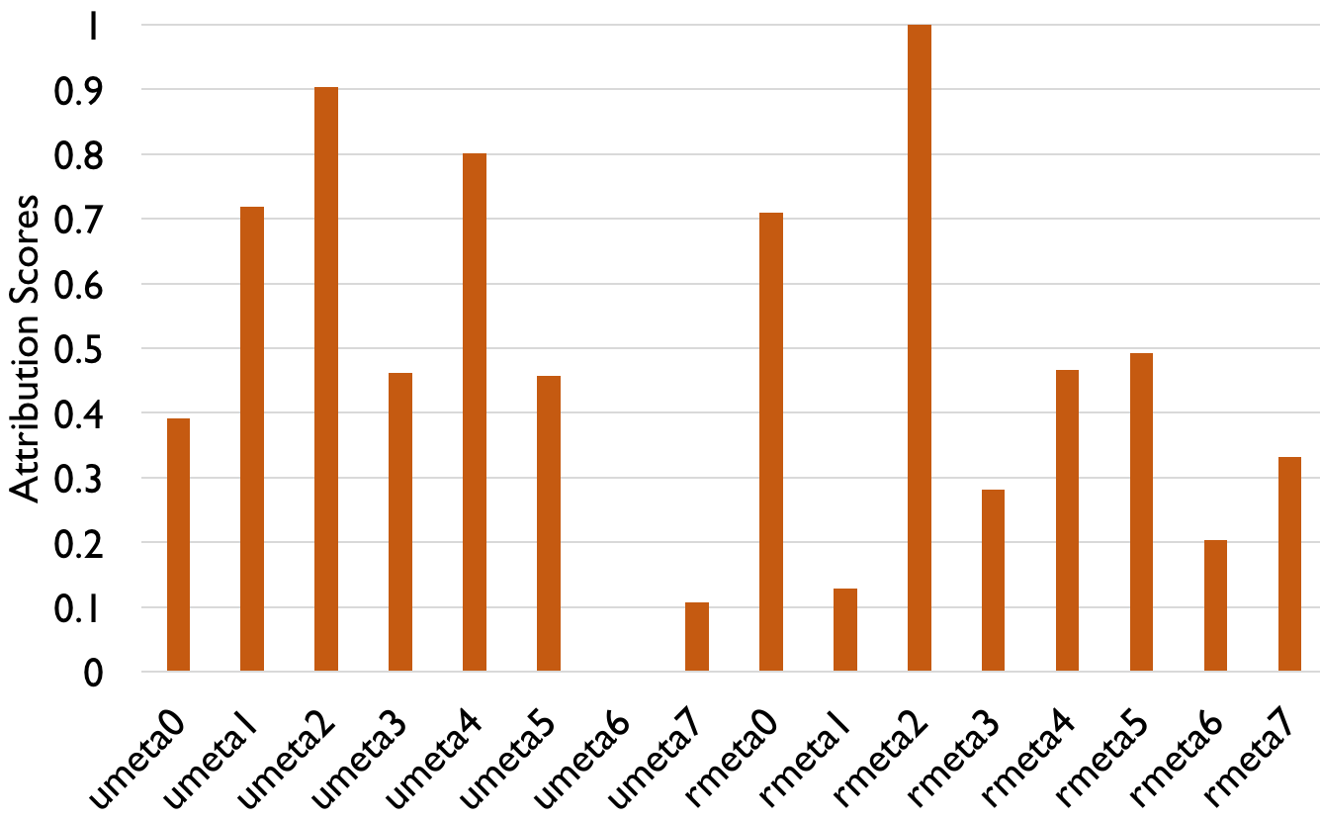
Integrated Gradients
Bob’s metadata
projectB’s metadata
Integrated Gradients
DLBACα
deny for op2
Global Interpretation

Slide 26
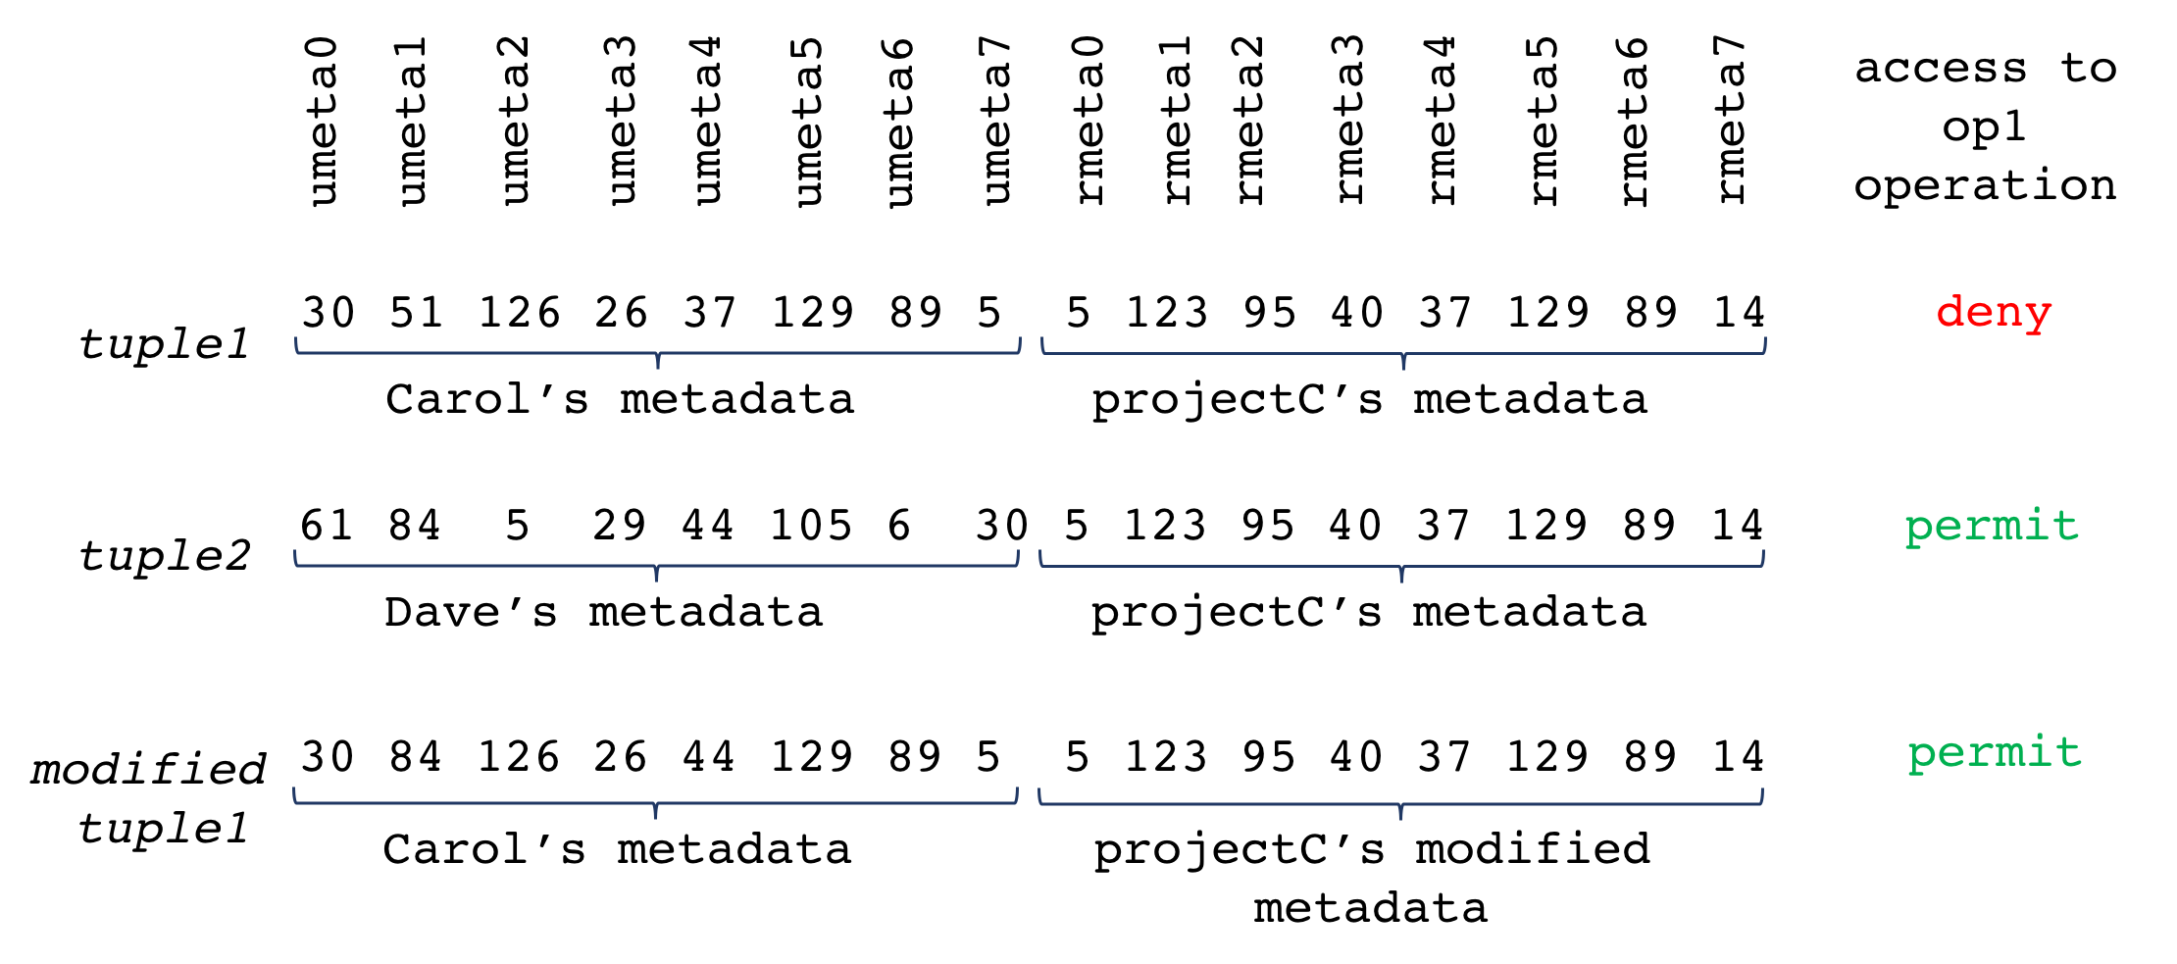
Application of Integrated Gradient-based Understanding
    Strengthen the effect of “influential metadata”
Can be utilized in future access modification
Is there any relations among metadata?

Slide 27
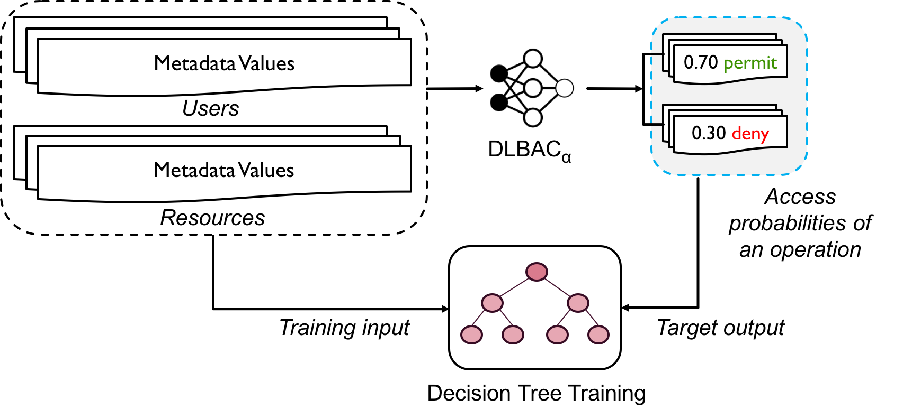
Knowledge Transferring
approximately understand the decision in the form of traditional rules
Rule: local interpretation
DT: global interpretation

Slide 28
Section-2 Summary
DLBAC is an effective operational model for access control
Black-box decisions are understandable in human terms
Issues:
  How to change/ update access control state?

Slide 29
Section-3
Machine Learning Based Access Control (MLBAC)
Comprehensive Literature Review : ML in Access Control
Operational Model of MLBAC
Administration of
MLBAC
Adversarial Attacks in DLBAC
DLBAC
(prototype, interpretation)
Implementation and Evaluation of DLBAC

Slide 30
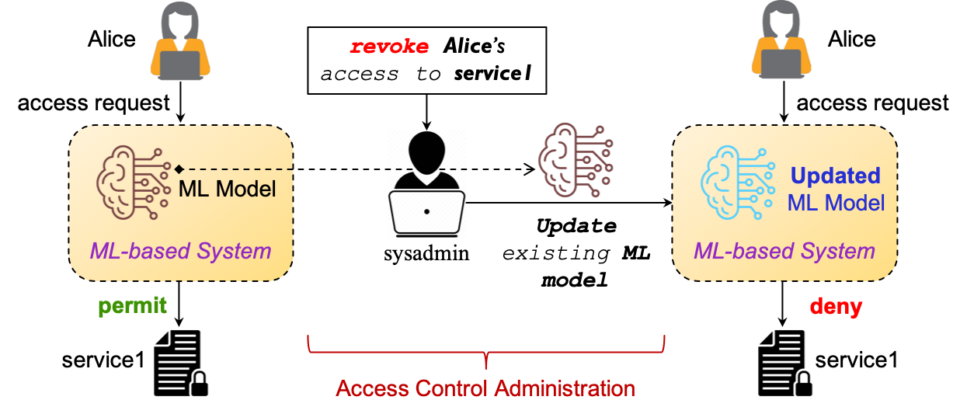
Administration in Machine Learning Based Access Control

Slide 31


MLBAC Administration Overview
Revoke Alice’s read access from projectA
Task
Change Alice’s access because of her department and designation have changed !
Users Metadata
Resources
Metadata
Current
ML Model
Admin Engine
Criteria
Additional AAT
AAT
AATs
Updated ML Network

Slide 32
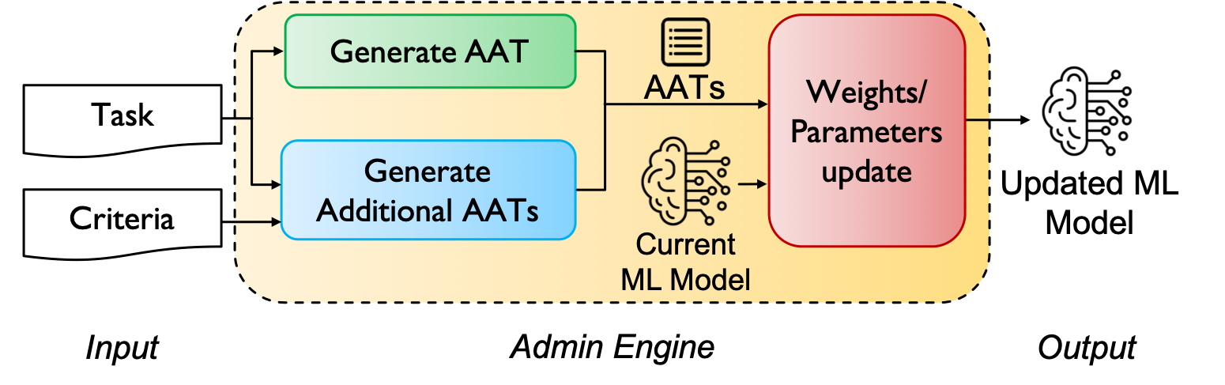
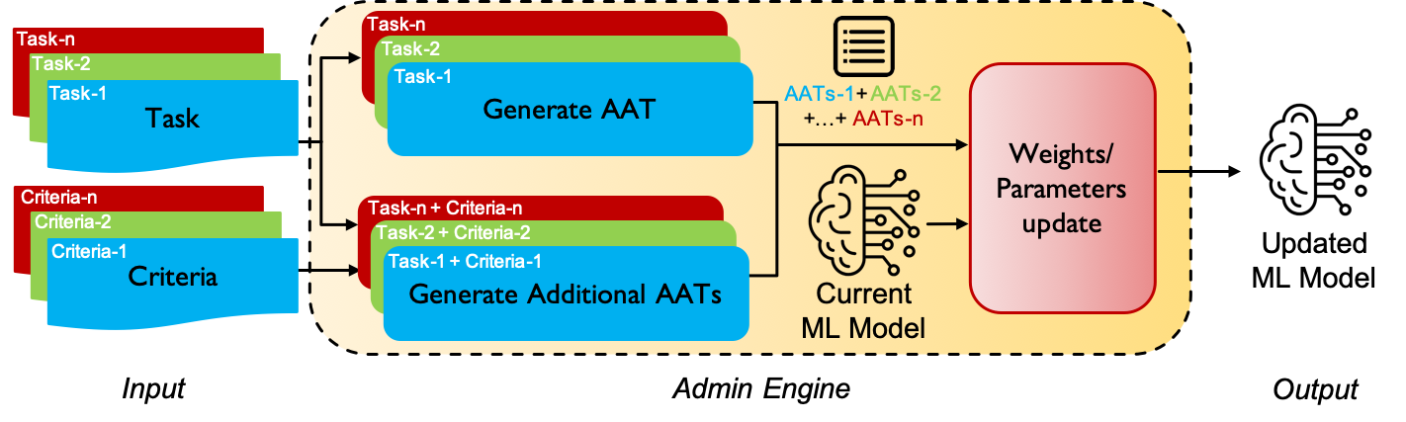
Administration Process Flow
Single Task
Multi Task
Simulate 2-Tasks, 3-Tasks, and 6-Tasks

Slide 33
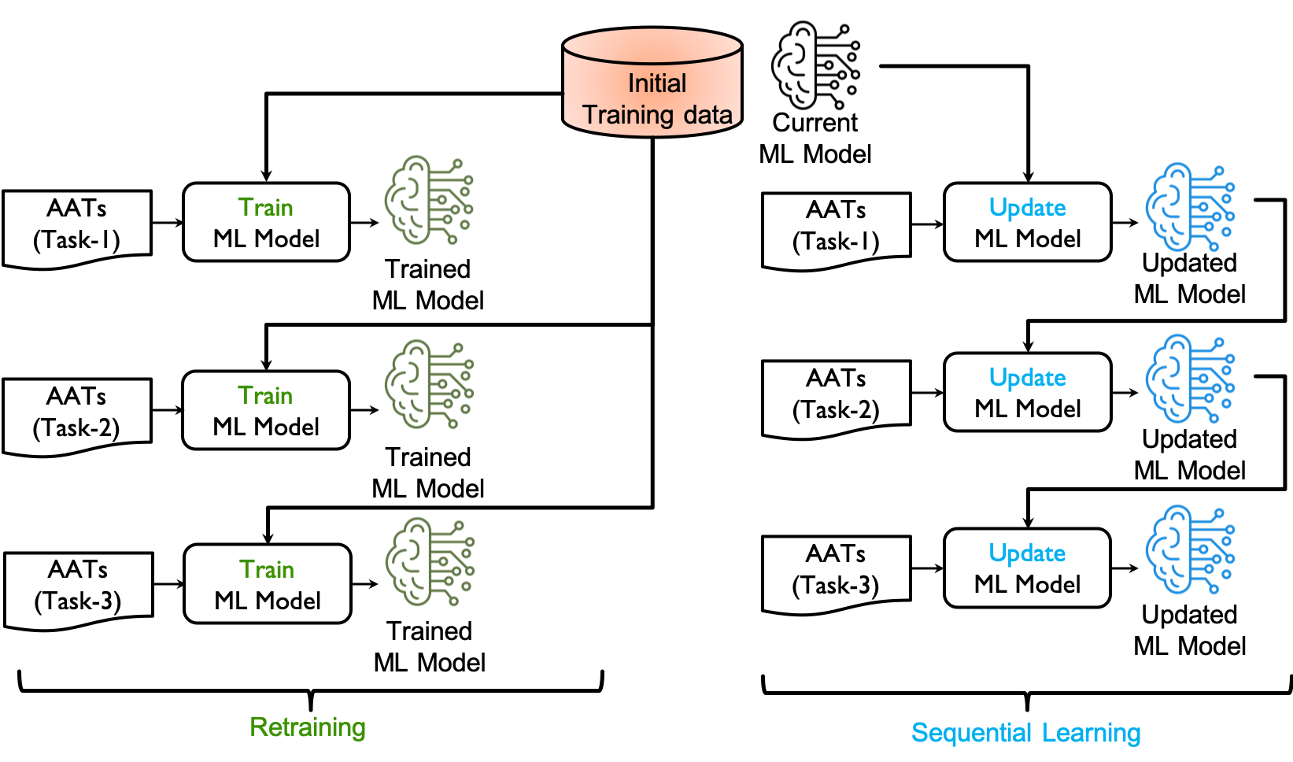
Weights/Parameters Update
18 random Tasks with different Criteria

Slide 34
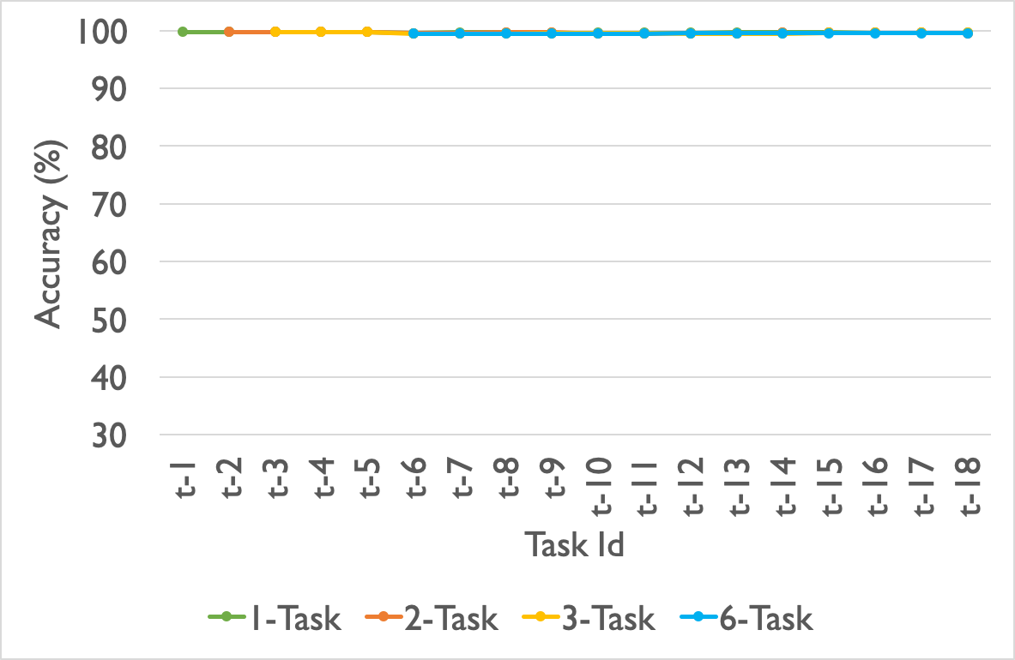
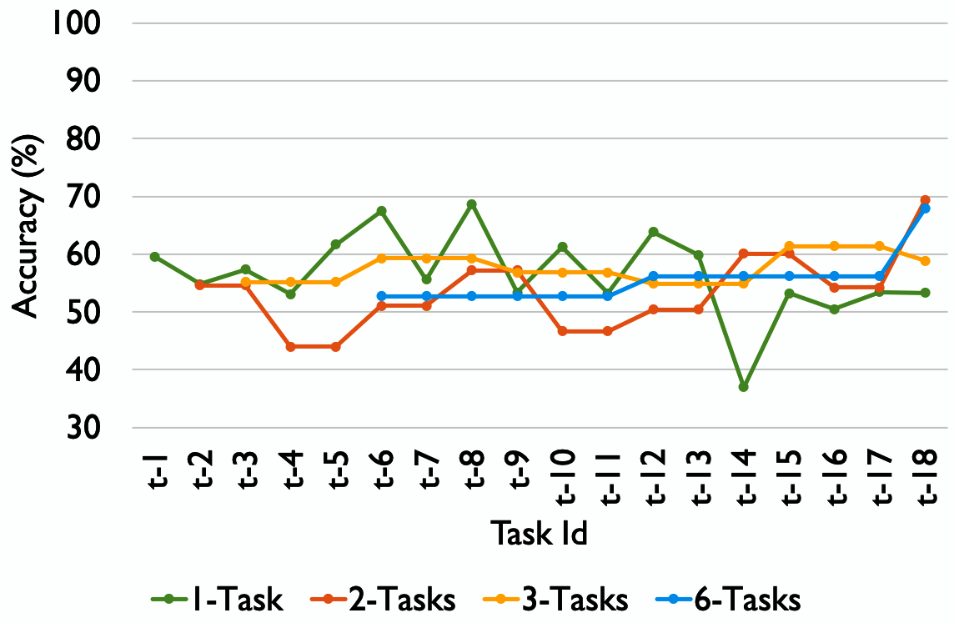
Performance Evaluation
RF-MLBAC: Add additional estimators
ResNet-MLBAC: Fine-tuning
How accurately it can learn new changes (AATs)
How well it can preserve existing access states for all other users/resources (OATs)
OATs
AATs
    Unable to accommodate new changes with good accuracy !

Slide 35
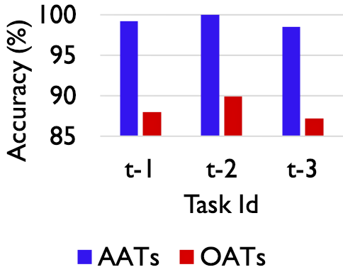
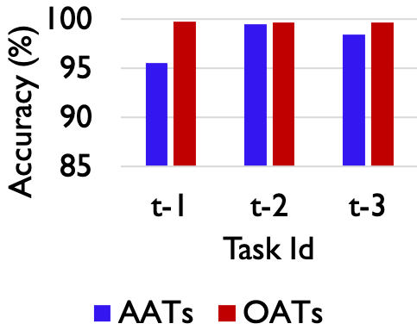
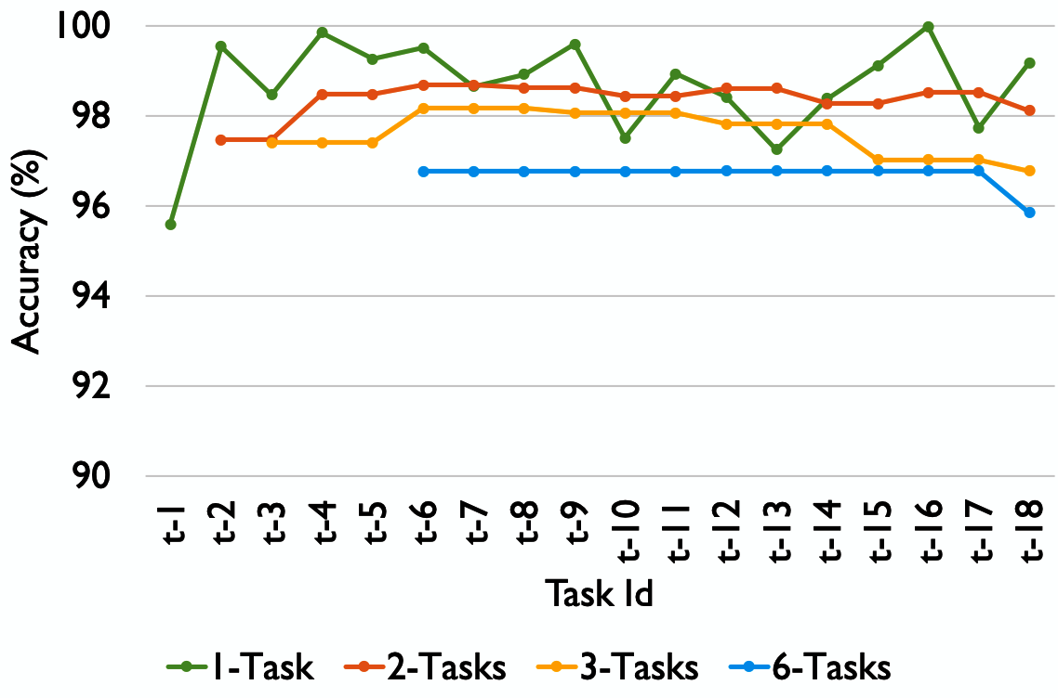
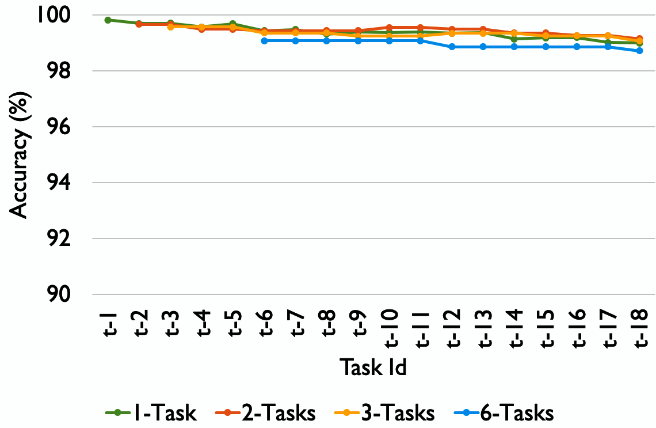
Performance Evaluation (cont’d)
(ResNet-MLBAC)
    Starts to forget other Access Control state- Catastrophic forgetting
Replay Data
AATs
OATs
    Multi-task administration generally provides better performance

Slide 36
Section-3 Summary
Sequential learning is an effective method
Deep neural network systems performed better
Issues:
  Some dependencies on physical data storage (Replay Data)
  Designing better “Criteria” is challenging

Slide 37
Section-4
(Part-A)
Machine Learning Based Access Control (MLBAC)
Comprehensive Literature Review : ML in Access Control
Operational Model of MLBAC
Administration of
MLBAC
Adversarial Attacks in DLBAC
DLBAC
(prototype, interpretation)
Implementation and Evaluation of DLBAC

Slide 38

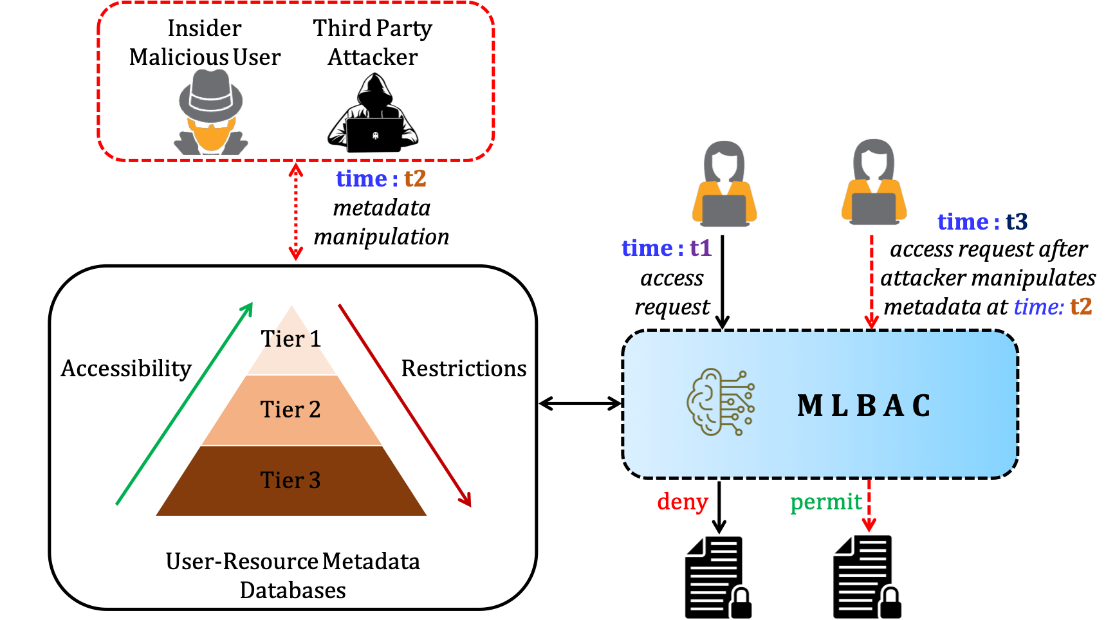
Adversarial Attack in MLBAC
Adversarial Example
Imperceptibility
    Modify part of the input to any degree

Slide 39



Adversarial Attack Problem
Actual decision
Perturbation
Target decision
Perturbation weight
perturbation
Accessibility Constraint
Access
Restriction

Slide 40
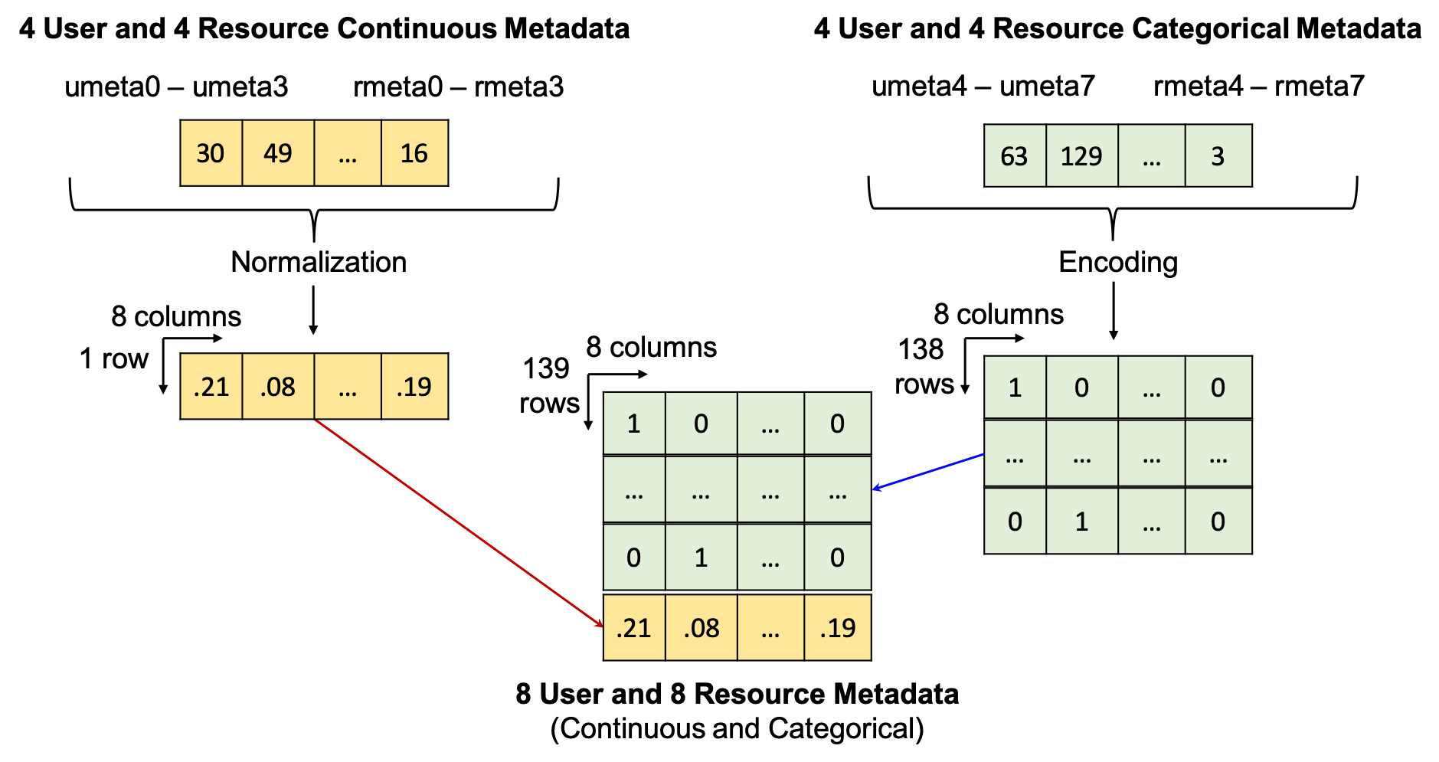
Methodology
Continuous and Categorical
‘age,’ ‘salary’, ‘security_level,’ ‘designation’
Accessibility Constraint
  Pearson’s Correlation
  Value between 0 and 1
  Higher correlation, more restricted
Two DLBAC datasets
  System-1 and System-2

Slide 41
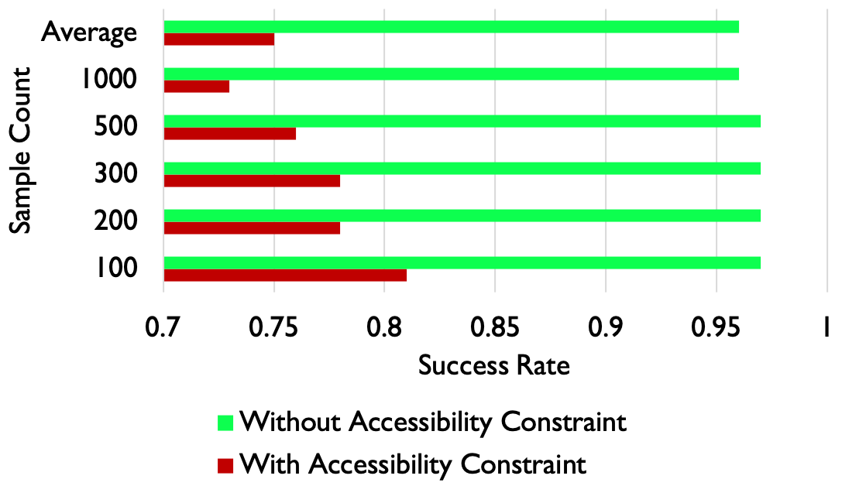
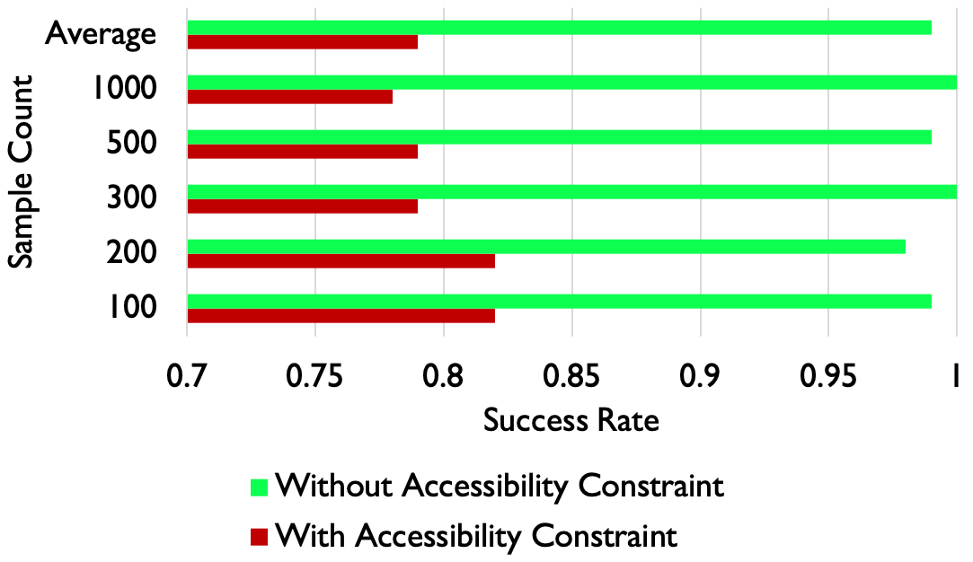
Evaluation
Successfully crafted adversarial examples
Success Rate =
Samples attempted for the adversarial example creation
System-1
System-2

Slide 42
Section-4 (Part-A)
Summary
Accessibility constraint minimized the attacks
Issues
  Need better defense if no accessibility constraint

Slide 43
Section-4
(Part-B)
Machine Learning Based Access Control (MLBAC)
Comprehensive Literature Review : ML in Access Control
Operational Model of MLBAC
Administration of
MLBAC
Adversarial Attacks in DLBAC
DLBAC
(prototype, interpretation)
Implementation and Evaluation of DLBAC

Slide 44
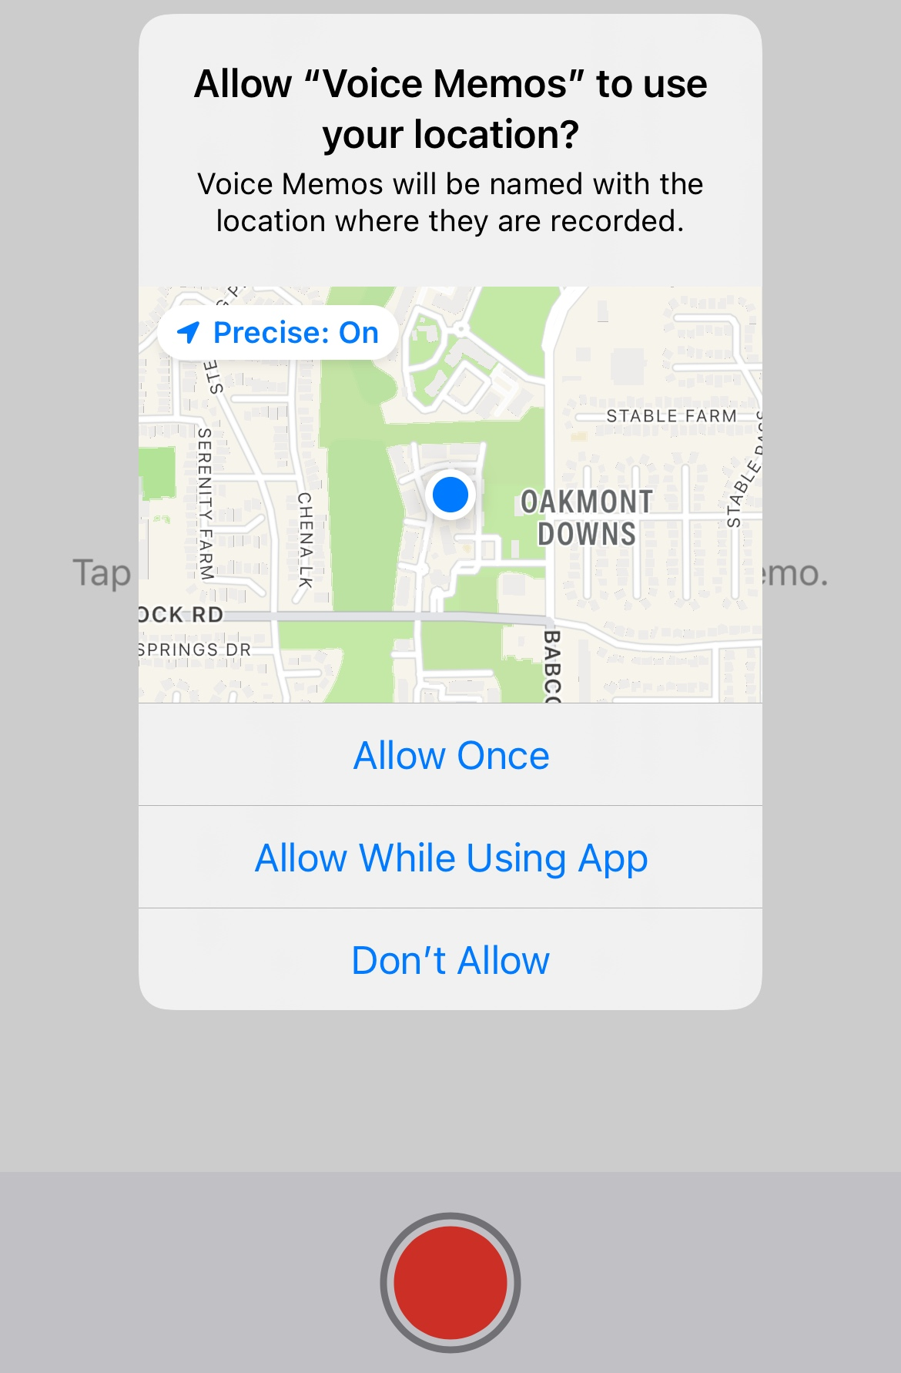
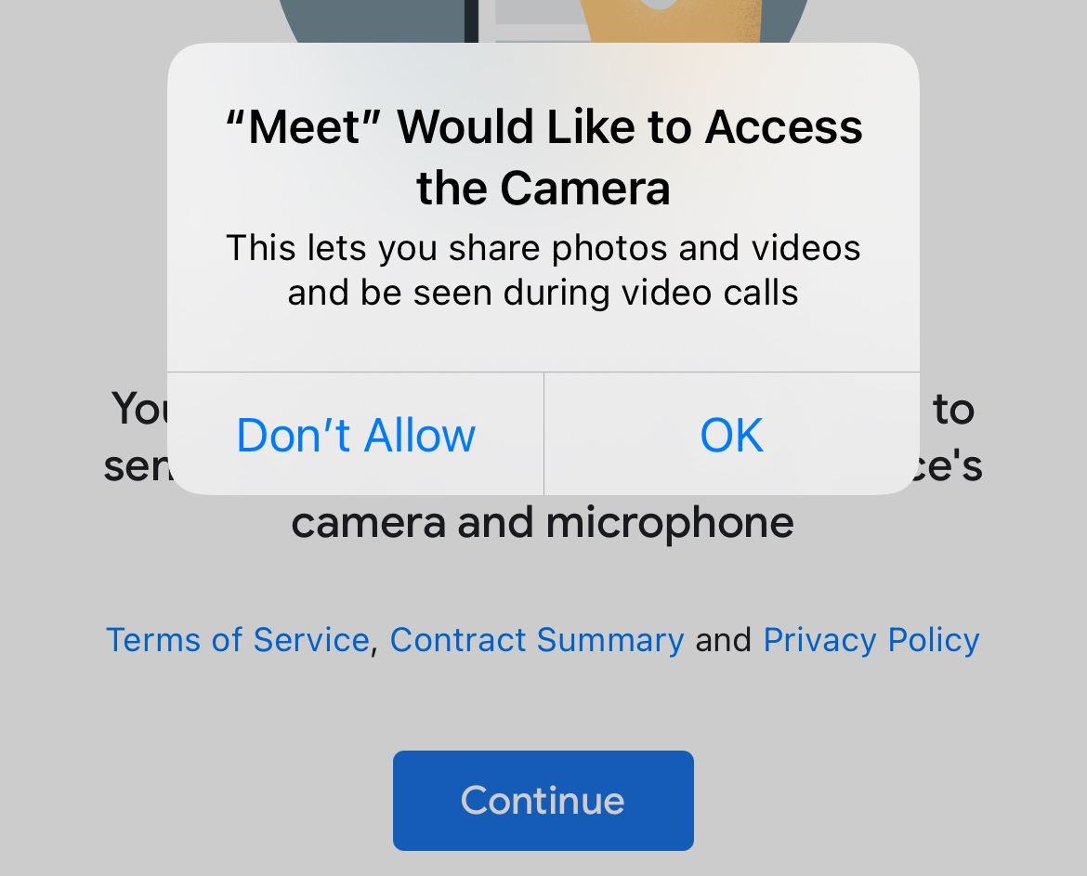
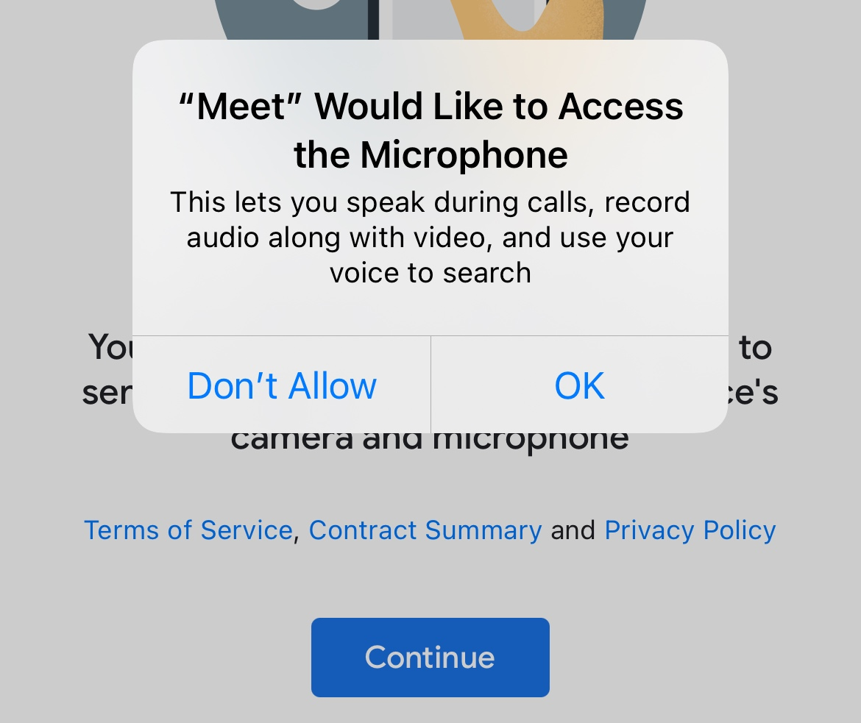
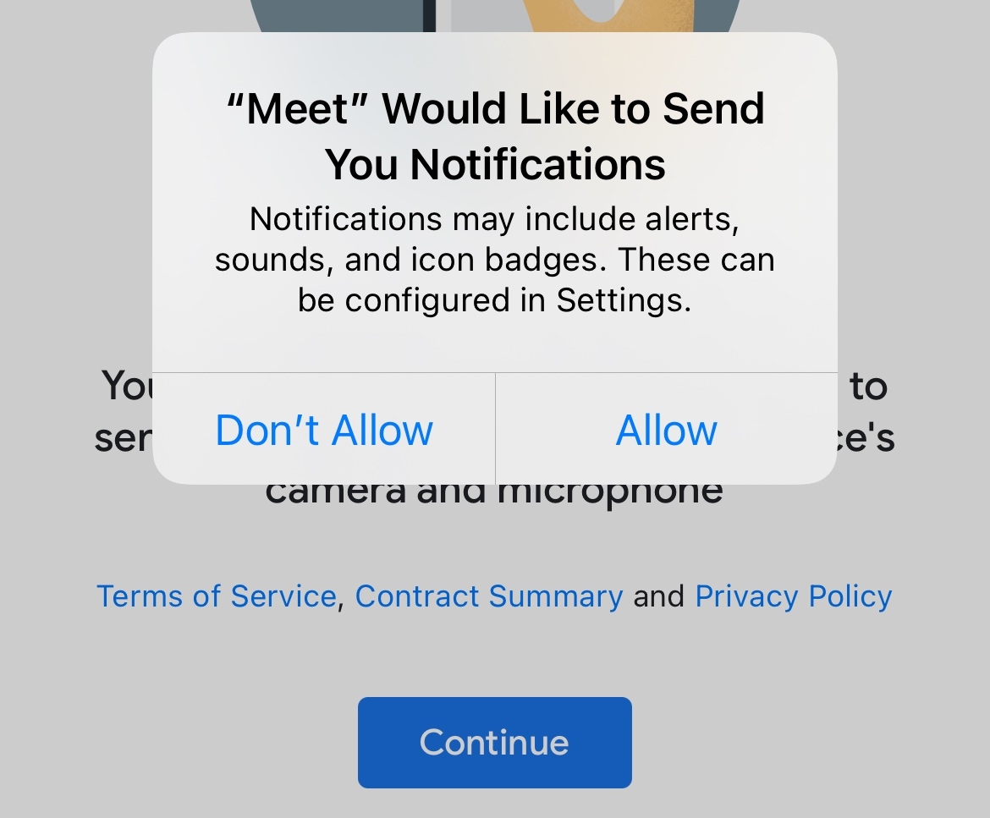
DLBAC Assisted Permission Recommendation for Mobile Devices
Ask-On-Install (AOI)
Ask-On-First-Use (AOFU)
Could DLBAC automate this permission decision?
… abundant permission requests

Slide 45
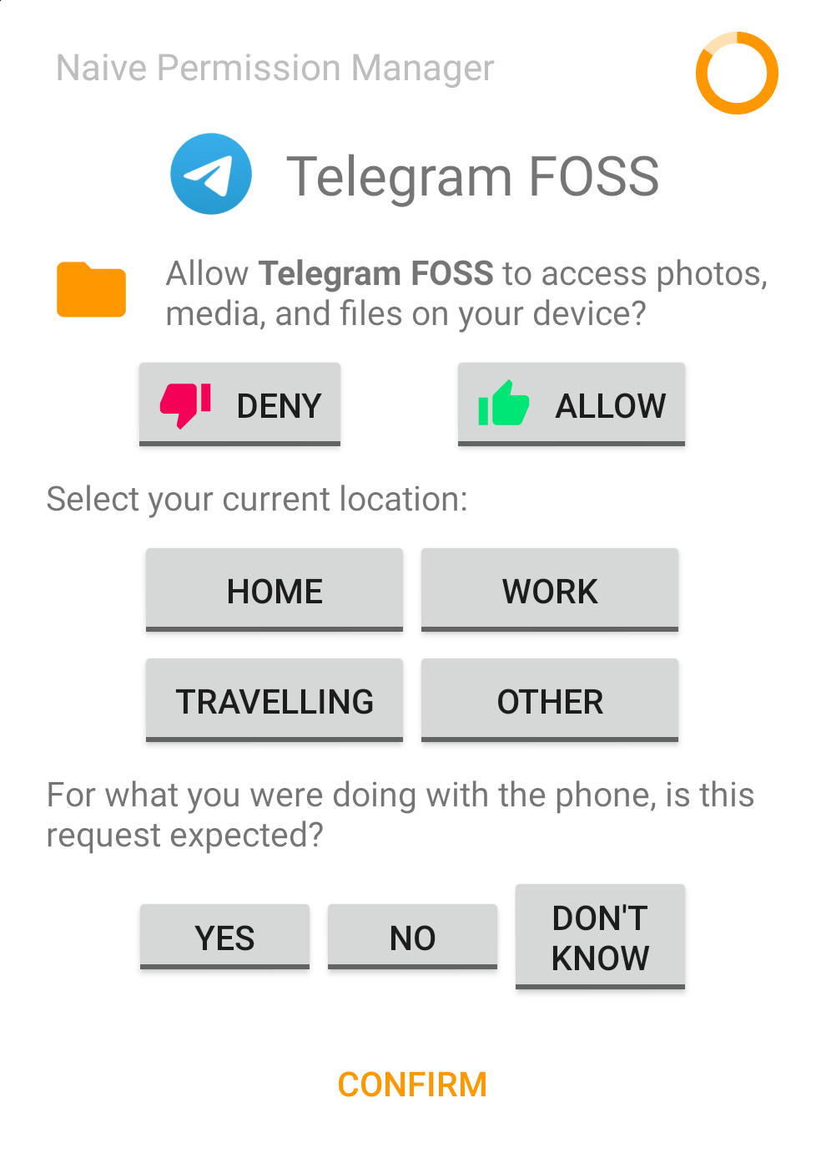
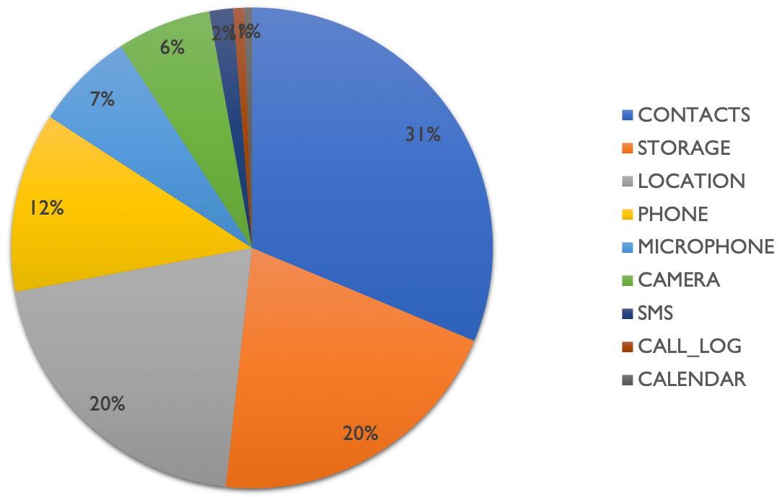
COP-MODE Dataset
Developed by Mendes et al. [4], 65K permission requests
At each permission request:
  Requesting application: name and play store category
  Permission: name (CONTACTS, STORAGE, etc.) and grant result (allow/deny)
  Phone state: geolocation, plug, call state, network connection , etc.
  User context: time, semantic location, in event or not, etc.
[4] . Mendes, R., Brandão, A., Vilela, J. P., and Beresford, A. R.. Effect of User Expectancy on Mobile App Privacy: A Field Study. In 2022 IEEE PerCom.

Slide 46
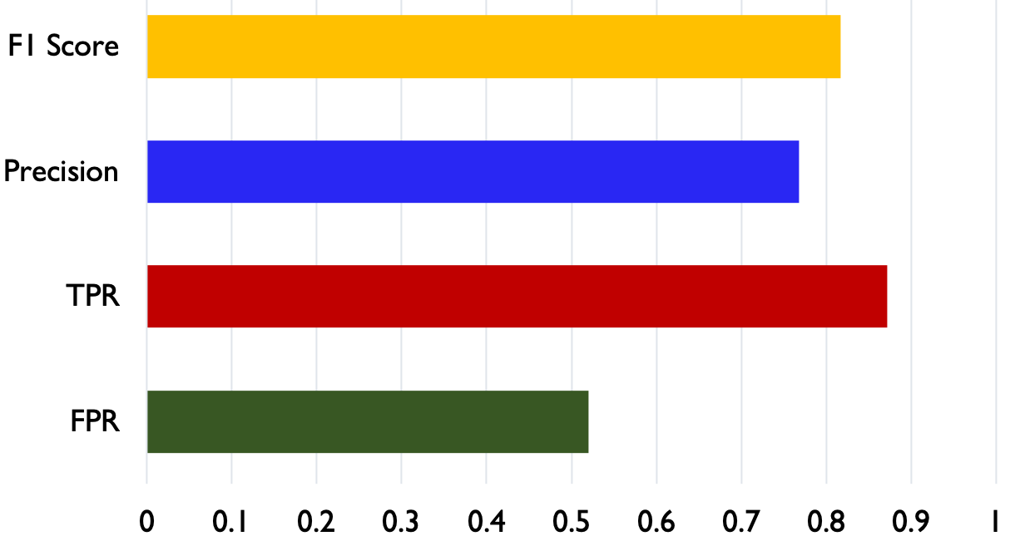
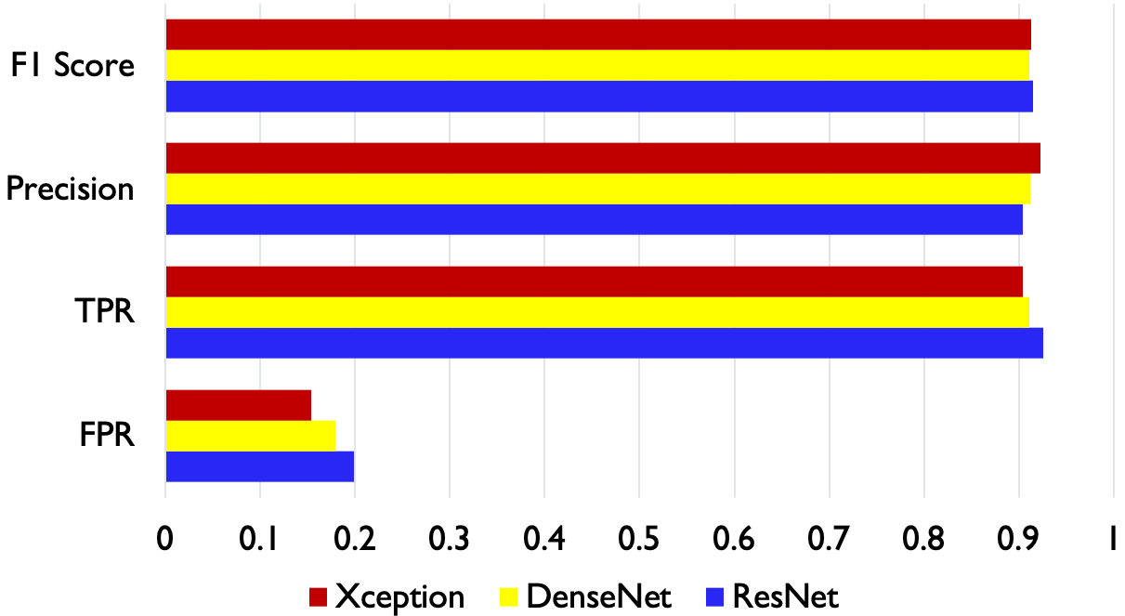
Evaluation
Three DLBAC instances with: ResNet, DenseNet, and Xception
State-of-the-art (Brandão et al. [5]) Accuracy 88% and F1 Score 0.90
Cluster like-minded users, Liu et al. [6]
Accuracy: 74.02%
Accuracy: ~88.5 %
F1 Score: ~0.915
DLBAC Performance (ResNet)
DLBAC Instances Performance
[5]. Brandão, A. et al. Prediction of Mobile App Privacy Preferences with User Profiles via Federated Learning. In 2022 ACM CODASPY.
[6]. Liu et al. Follow My Recommendations: A Personalized Privacy Assistant for Mobile App Permissions. In SOUPS 2016.

Slide 47
Section-4 (Part-B)
Summary
Clustering like-minded users has an advantage
Issues
  Recommendation accuracy needs to be improved

Slide 48
Future Research Directions
MLBAC Verification
Testing Framework
Bias and Fairness
Data could comes from untrusted sources
Imbalance data may bias the decision
DLBAC Issues
Understanding, Administration, etc.
Measuring Correctness
Accuracy is lower in some cases
Adversarial Issues
Adversarial attack for Classical ML based systems
Need more strong defense mechanism
DLBAC in Tandem
Reinforcing access decision
Monitoring and feedback

Slide 49
Dissertation Publications
Nobi, Mohammad Nur, Ram Krishnan, Yufei Huang, Mehrnoosh Shakarami, and Ravi Sandhu. "Toward Deep Learning Based Access Control." In ACM CODASPY. 2022.
Under Review
  (ESORICS 2022) Mohammad Nur Nobi, Ram Krishnan, Yufei Huang, and Ravi Sandhu. “Administration of Machine Learning Based Access Control”.
  (itaDATA 2022) Mohammad Nur Nobi, Ram Krishnan, and Ravi Sandhu. “Adversarial Attacks in Machine Learning Based Access Control”.
  (ACM Computing Survey, arXiv) Mohammad Nur Nobi, Maanak Gupta, Lopamudra Praharaj, Mahmoud Abdelsalam, Ram Krishnan, and Ravi Sandhu. “Machine Learning in Access Control: A Taxonomy and Survey”.
https://github.com/dlbac/DlbacAlpha
https://github.com/mlxac/MLBAC-Admin
https://github.com/mlxac/MLBAC-AdversarialAttack
Source code and datasets URL:

Slide 50

Questions and Comments

Slide 52
Backup

Slide 53
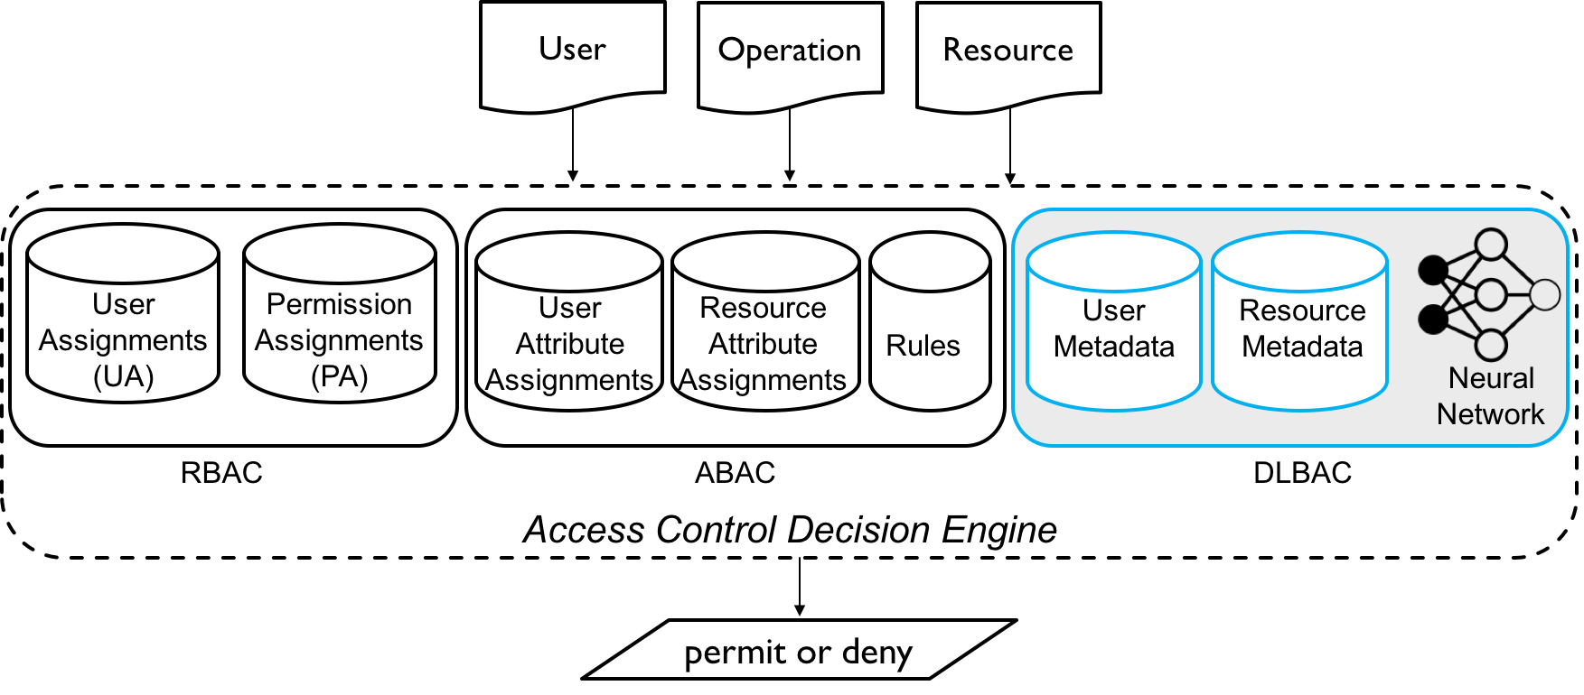
Decision Making in Classical Approaches vs. DLBAC
DLBAC works with any deep neural network

Slide 54
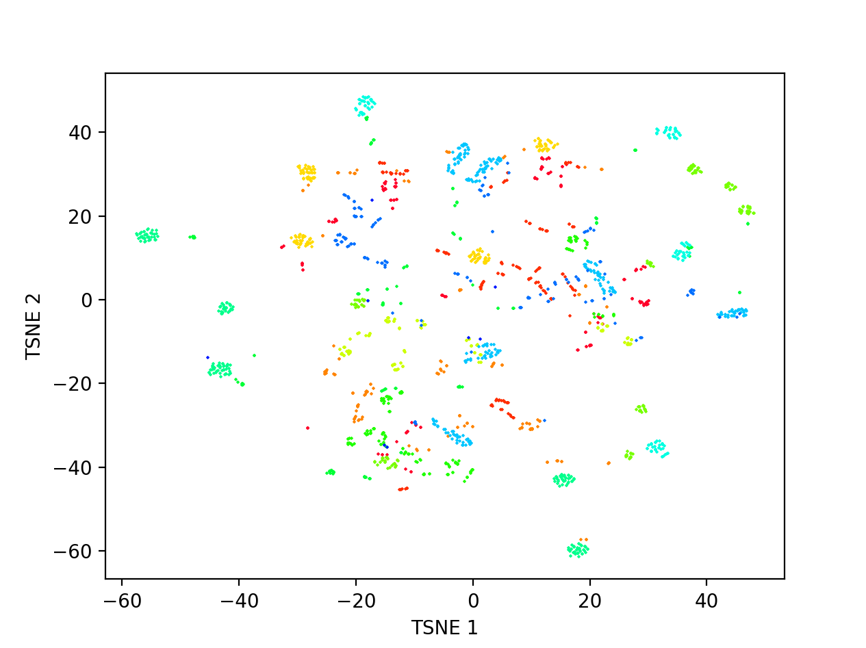
Dataset Generation
Generate a synthetic dataset using Xu et al. [1]
<Alice, projectA, {op1, op3}>
Each dot represents an authorization tuple
Each color indicates a unique combination of access operations
The position of a tuple is based on both user and resource metadata values
Two tuples are closed to each other, which indicates they have similar user-resource metadata values
multiple tuples of the same color indicate they have the same access
t-SNE plot of a synthetic dataset
1. Xu et al. 2014. "Mining attribute-based access control policies." IEEE TDSC.

Slide 55
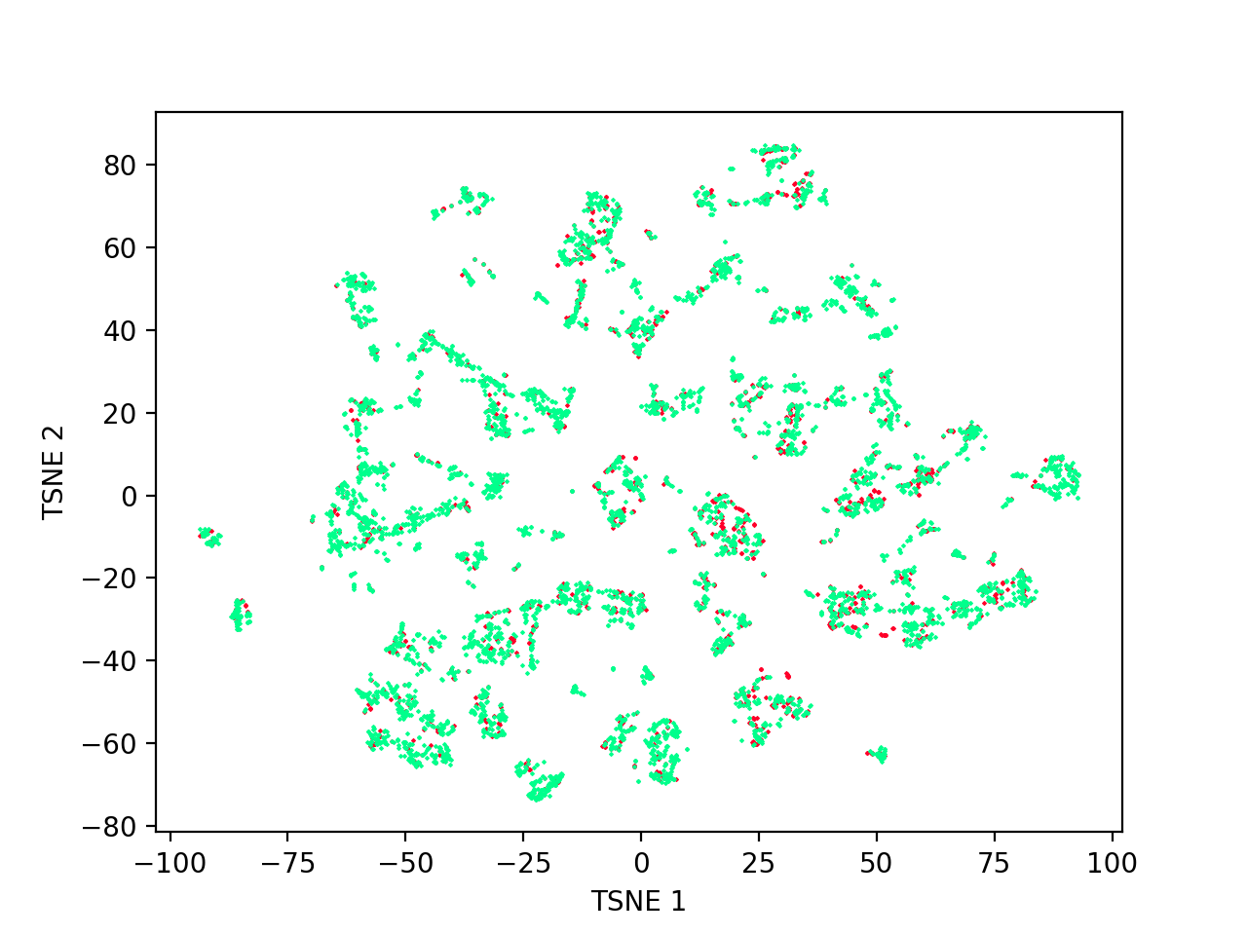
Data Characteristics in Real-world Systems
A dataset representing Amazon* access control system
* https://www.kaggle.com/c/amazon-employee-access-challenge/

Slide 56
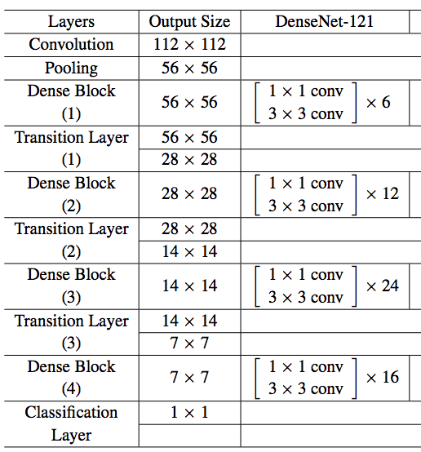
Network Architectures
For dataset 1-4: ResNet8
For dataset 5-10: ResNet50
ResNet, DenseNet

Slide 57
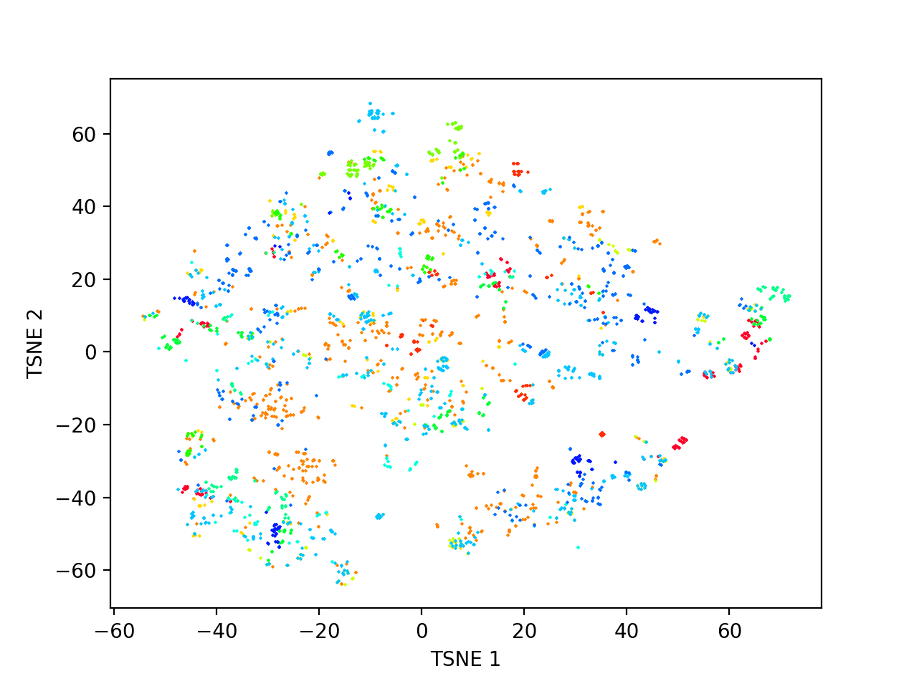
Dataset Generation
A dataset with 800 users and 665 resources, 3 hidden metadata, fixed set of metadata values.
A real-world dataset from Amazon

Slide 58
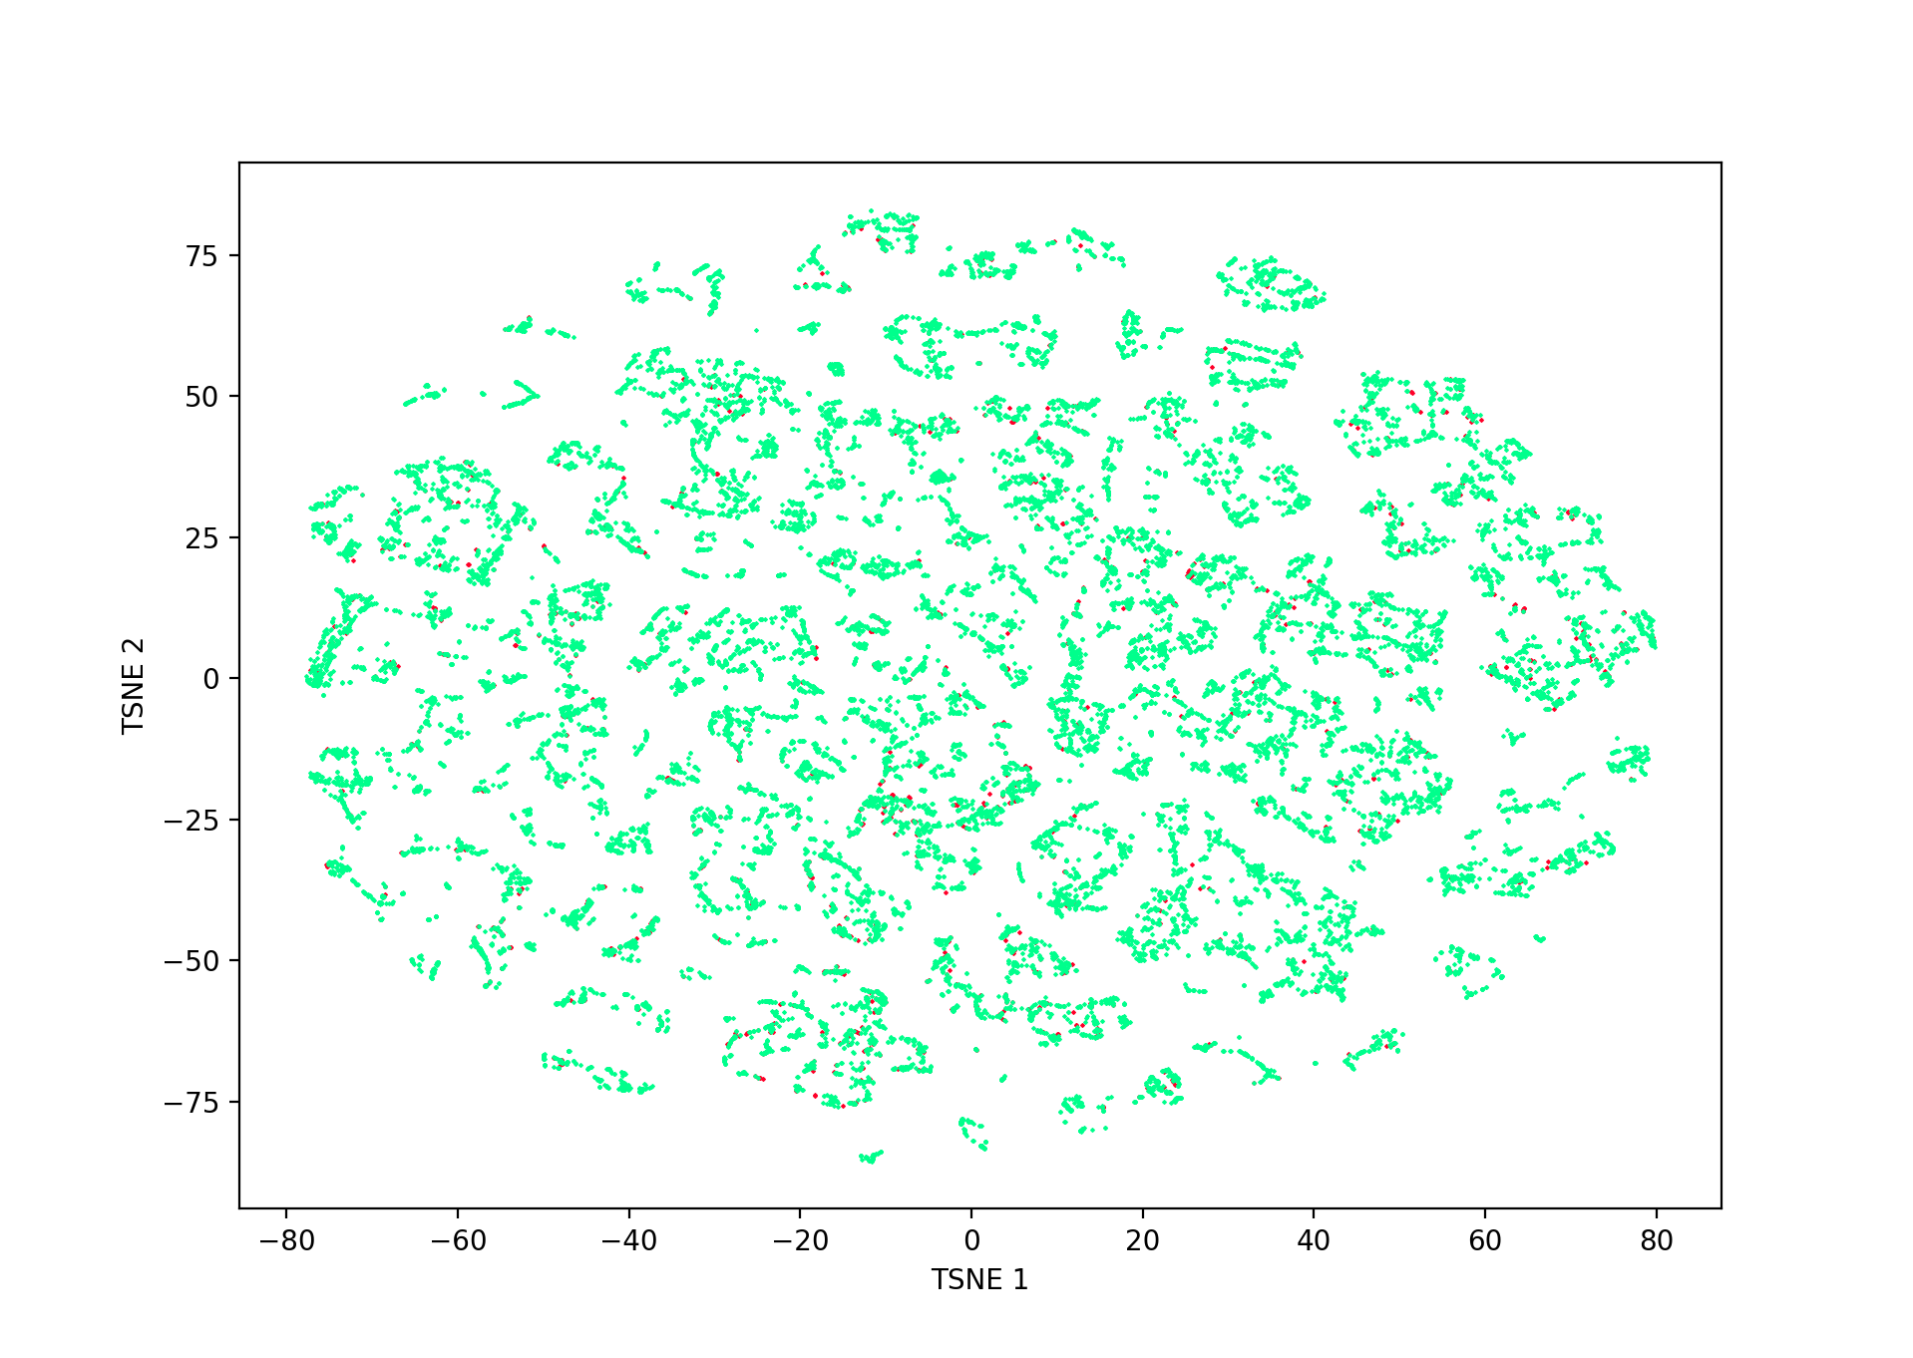
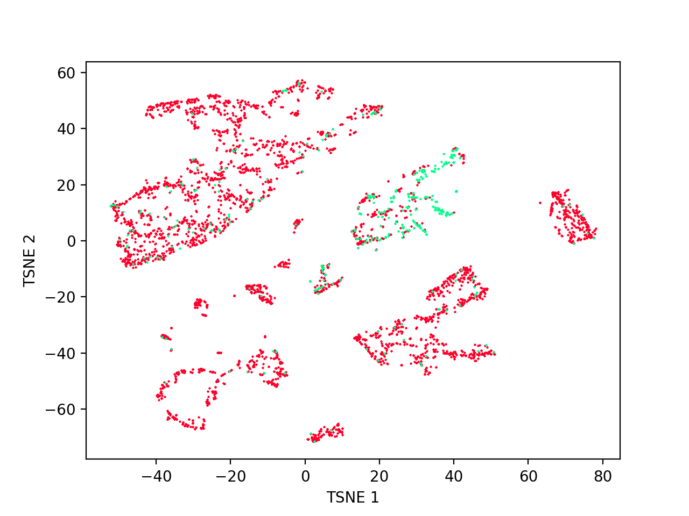
Characteristics of AmazonKaggle and AmazonUCI Datasets
Amazon Kaggle Dataset
Amazon UCI Dataset
Highly imbalanced !

Slide 59
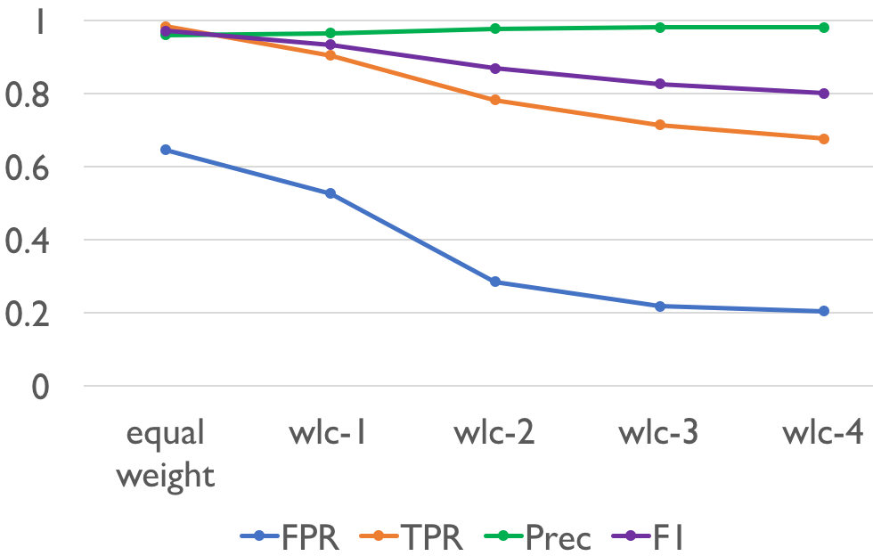
FPR Performance Improvement in DLBACα

Slide 60
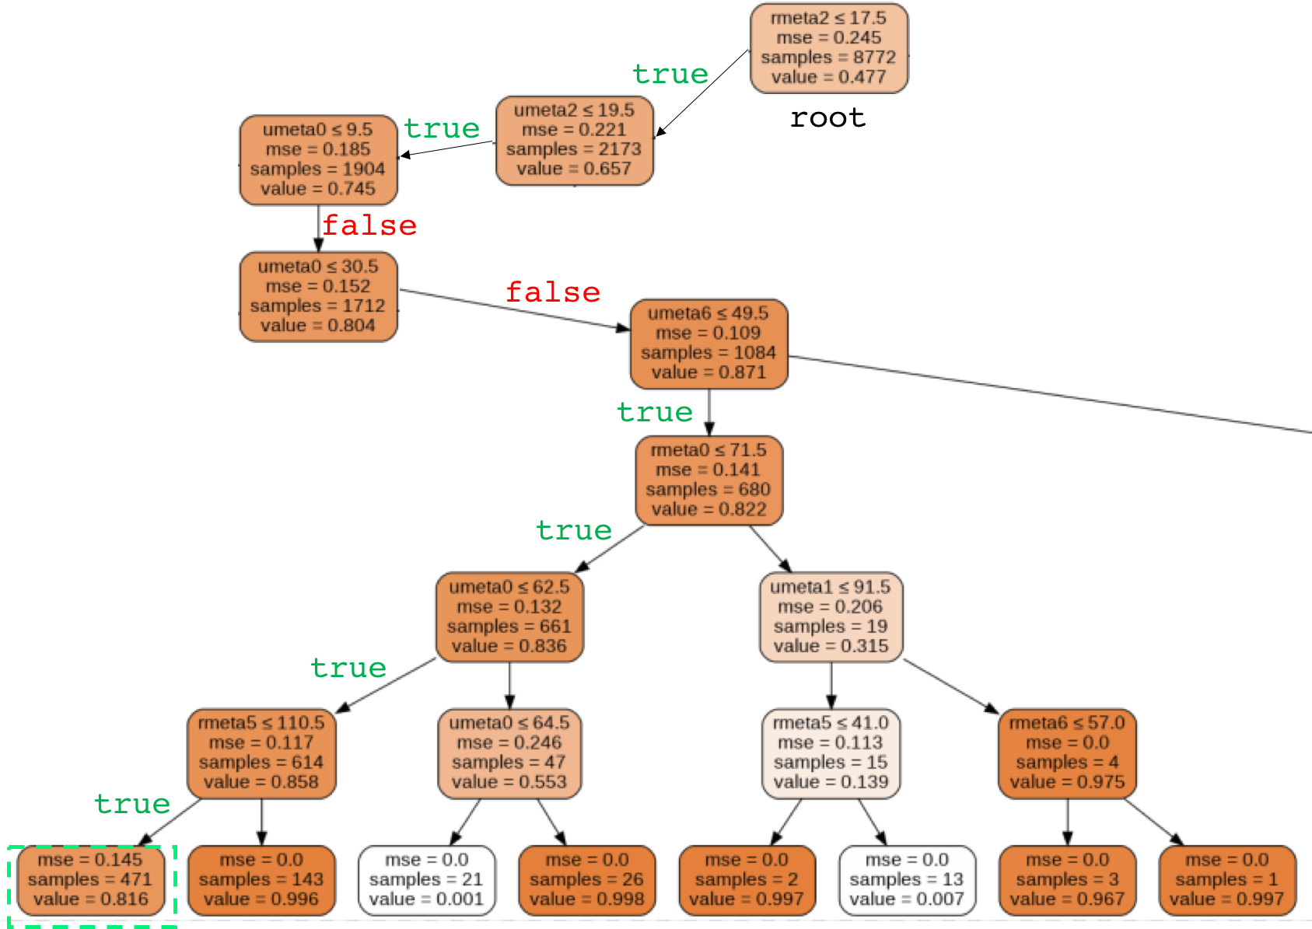
Decision Tree Generated from KT in DLBACα

Slide 61
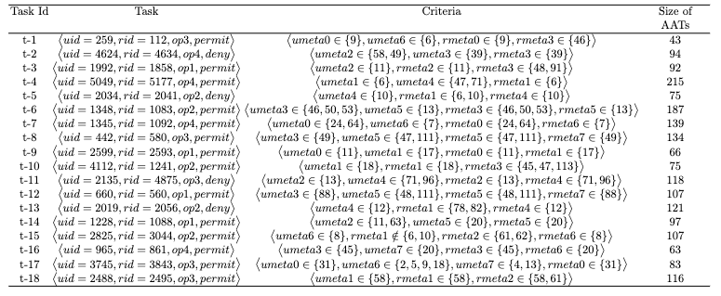
List of Tasks and Criteria for MLBAC Administration

Slide 62
Methodology
Continuous and Categorical data
Objective function optimization
  LowProFool algorithm
  categorical and continuous data
  Custom loss and objective function
  Perturbation control towards gradient
Determining Accessibility Constraint
  Correlation for metadata vs. decision
  Value between 0 and 1
ResNet as candidate ML method
Two DLBAC datasets
  System-1 and System-2

Slide 63
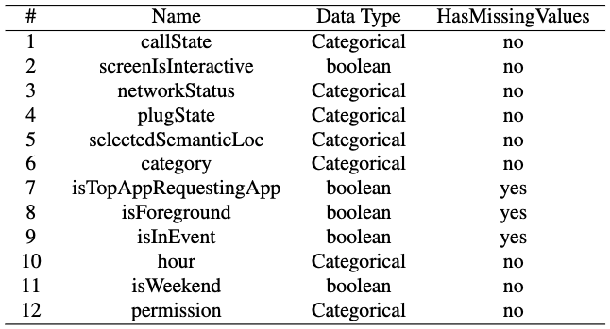
Data Cleaning / Pre-processing
Categorical data : apply One-Hot Encoding
Removed SENSORS permission’s request, only 1 such sample
Conflicts exists (~800 requests): adopt grant-override approach
Introduce a new category name UNKNOWN for missing values
Not all the features are related or usable (device ID, bootTime, answerType, etc.)
Input:
Reqs. Apps info, device’s info, Permission
Output:
Access decision

