Slide 1


Cache-Based Attack and Defense on ARM Platform
Doctoral Dissertation Thesis Defense
Naiwei Liu
10/27/2020

Slide 2
Contents
Introduction
Related Work
Cache-Based Security Threats and Attack
Defense Design and Implementations Based on ARM Platform
Future Work and Plan
Conclusion

Slide 3
Introduction
Abstract
  In Recent years, many research efforts had been made on secure and safe environment on ARM platform.
  ARM structure and chips based on ARM had been taking up a lot of number of products in the market.
  Security problems and potential risks had been discussed.
  Cache and similar design brings in ‘trouble’ for security purposes.
  Uniqueness on ARM-based products made things even tougher to solve.
  What will we do?
    Design defense framework
    Evaluate by experiments
    Optimization

Slide 4
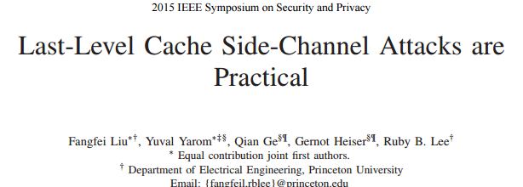
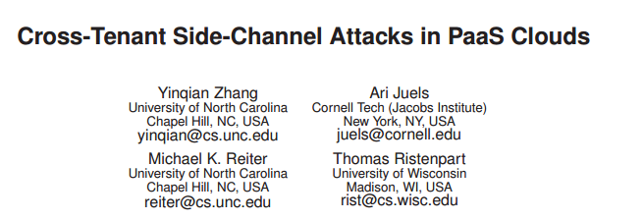
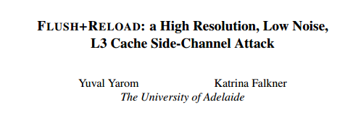
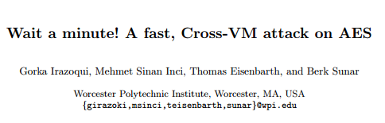
Abstract and Introduction
Introduction
  Last-Level Cache (LLC) is always the target of side-channel attack. On x86 structure, it is always L3 cache that is attacked.
  Last-level cache side-channels are effective enough to extract user’s private information.
  Side-channel: collecting information like performance counters, timing, power consumption, etc. And process the information to derive information about the victim.
  Most frequently used: access time-based side-channels.
Notes:
For cache based side-channel attacks, the memory access
time could be much different depending on if the accessed data
is in the cache memory or not, thus the data being accessed
by the victim can be partially derived based on the data access
time if the attacker and the victim are sharing data in the cache.

Slide 5
Introduction
Introduction (Continued)
  Side-channel attack based via LLC can be dangerous, even without compromising OS.
  Both on single OS machine and Virtual Machines (VMs) can be attacked.
  Most common: FLUSH+RELOAD
    LLC is shared among processes and threads.
    FLUSH+RELOAD can be practical using unprivileged instructions.
    AES key of OpenSSL is recovered by this attack in lab test.
  Threats to different devices
  Modern TrustZone Design on ARM platform

Slide 6
Introduction
Introduction (Continued)
  Contributions
  Research on side-channel and covert-channel attack: bandwidth and effect.
  Investigation on Flush operations on ARM platform and overhead.
  Study of TrustZone technology and previous security design based on TrustZone.
  Investigation on critical instructions related to TrustZone operations.
  Design and test of adaptive control on flush operations.
  Different discussion based on ARMv8-A and ARMv8-M structures.

Slide 7
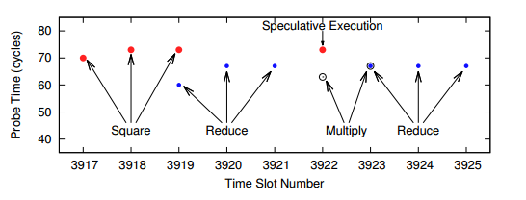
Related Work
Side Channel Attacks
  LLC based side-channel attacks: Flush+Reload, Prime+Probe
  Effectiveness of LLC based side-channels
Notes:
FLUSH+RELOAD is a Side-channel attack is an L3 cache which you place 'probes' on cache lines in the code segment of shared binaries, which get 'triggered' any time any Processes on the system loads that line into cache (i.e. the code was executed) which in effect allows an Observer to see which code other processes are executing.

Slide 8
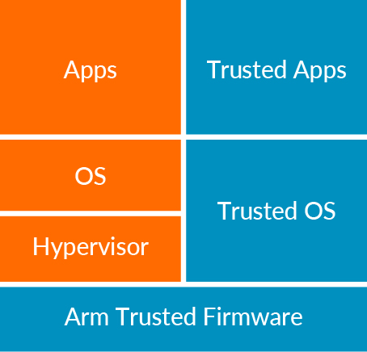
Related Work
Security Design and Protections
  Hardware Solution: Intel SGX, ARM TrustZone
    Hardware isolation for an enclave
    New instructions to establish, protect
    Call gate to enter
  Remote attestation
    Processor manufacturer is the root of the trust
  Prime+Probe Attack: March 2017
    Target to DRAM
Notes:
SGX: Software Guard Extension

Slide 9
Related Work
ARM TrustZone
  Based on ARM Cortex-A and Cortex-M series
    Privileged instructions to call entry/exit
    Light-weighted comparing with other protection
  ARM helps in creating Trusted Execution Environments (TEE)
  Cache Problems
    ARM Cortex-A series
    ARM Cortex-M series (ARMv8-M)

Slide 10
Related Work
Previous Defense Strategy against Side-Channels
  LLC-level Protection (memory access control)
  Cache enclaves (Trusted vs. Untrusted)
  Scheduler-based solutions
  Others
Cache Flush against Side-Channels
  Benefits: easy to implement, ensure safety
  Problems: high overhead, not adaptive to every situation

Slide 11
Related Work
Recent Research on ARM and TrustZone
  TrustZone-based defense;
  Performance measurement without security concerns;
  Keystone Defense Framework;

Slide 12
Overview and Background
Overview
This Dissertation is a re-organization of some published work during years 2018-2020, in which most experimental work had been in 2016-2018.
To summary, we have two major research projects:
  We measure the cost and effectiveness of ARM TrustZone entry/exit and the cost of cache operations, such as Flush operations; (Published on July 2020, WISA conference)
  Based on the measurements and experimental results, we design and implement adaptive defense framework. We also test the defense and have both experimental and theoretical analysis; (Published on March 2018, EAI journal of security and privacy)
  We also have other experimental results and discussions to help and support our analysis. (Book Chapter in 2020, Eliva Press)

Slide 13
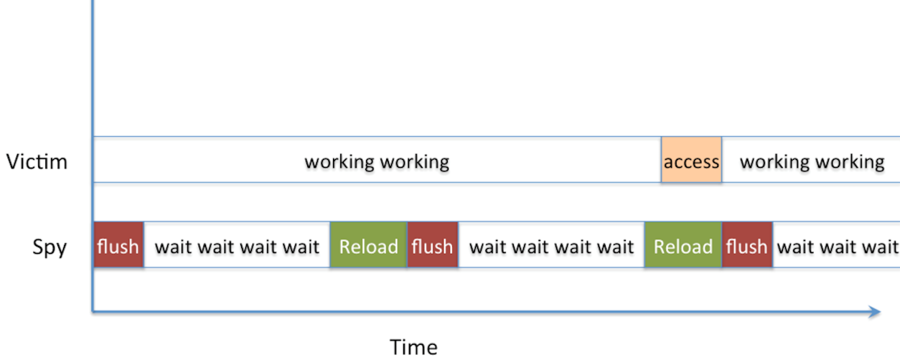
Overview and Background
Cache Threats: Time-Based Attack
Flush+Reload Attack

Slide 14
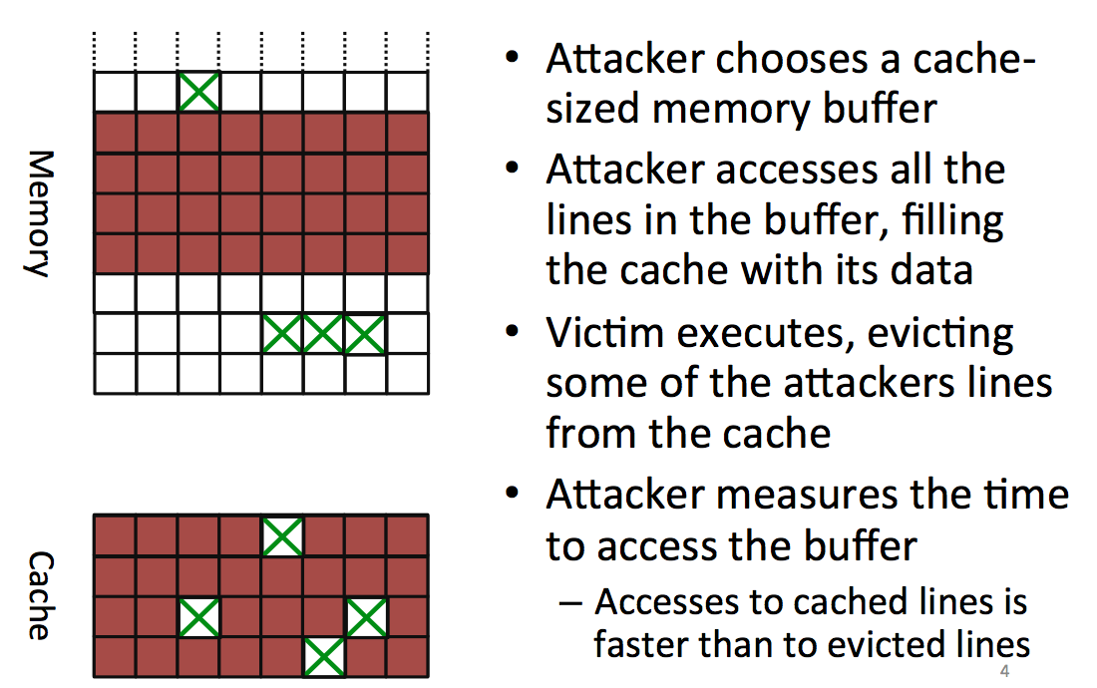
Overview and Background
Prime+Probe Attack

Slide 15
Overview and Background
Threat Model and System Assumptions
  Side-channel attackers and other cache-based attackers are not based on compromised OS.
  We assume that the memory is not shared between victim process and the attacker (Covert Channel)
  On system side, we assume that the operating system components in TrustZone is not compromised.
  we also assume the system is having a control part, i.e. handler to inject interference into possible side-channel.
  We also assume that the attacker has sufficient privilege to access the memory access time. This is not the case in real life, but it shows the worst case for the users to be attacked.

Slide 16
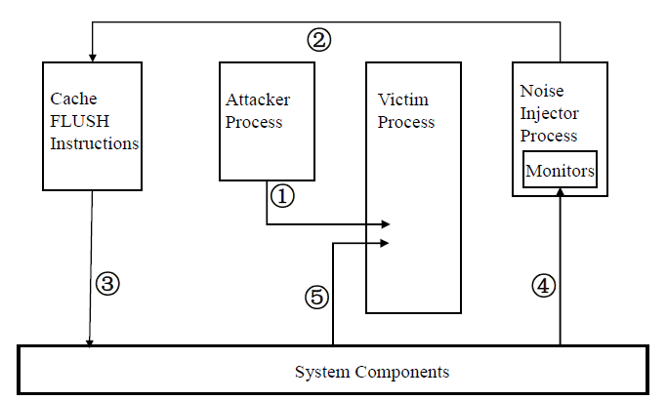
Overview and Background
Step 1:An attacker utilizes the cache to launch side-channel attack, i.e. Flush+Reload attack;
Step 2: the noise injector sends cache FLUSH request, and connect with system components;
Step 3: Cache FLUSH instructions;
Step 4: Monitors collecting performance and other data;
Step 5: Cache FLUSH makes impact on victim’s listening.

Slide 17
Cache-Based Security Threats and Attack
Overview
Users’ memory access are not protected by TrustZone – Covert Channel (Sharing resources)
TrustZone Entry/Exit without Flushing cache – Side-Channel (Malicious collecting access time)
  Flush+Reload Attack
  Prime+Probe Attack
Malicious eavesdropping

Slide 18
Cache-Based Security Threats and Attack
Side-Channel Attack Experiment
Flush+Reload Attack
  step 0: attacker maps shared library → shared memory, shared in cache
  step 1: attacker flushes the shared line
  step 2: victim loads data while performing encryption
  step 3: attacker reloads data → fast access if the victim loaded the line
Prime+Probe Attack
  step 0: attacker fills the cache (prime)
  step 1: victim evicts cache lines while performing encryption
  step 2: attacker probes data to determine if the set was accessed

Slide 19
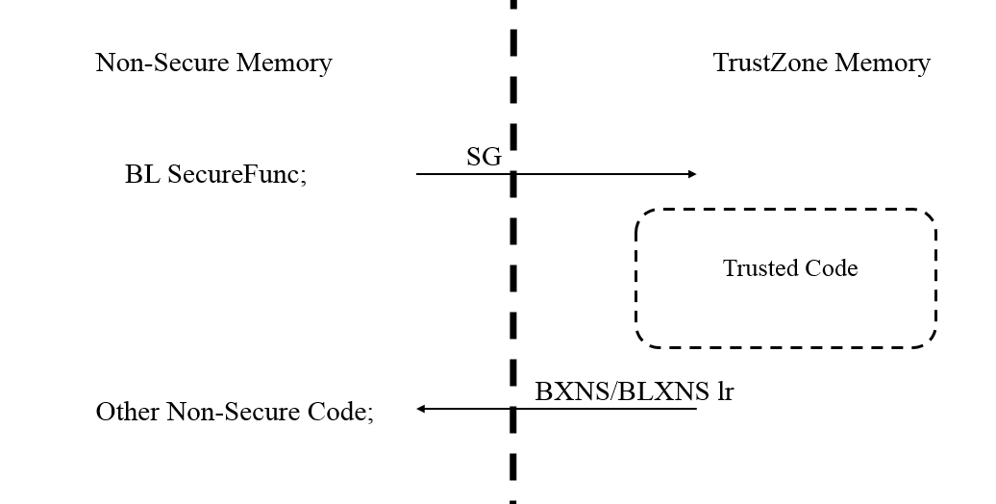
Design and Implementations
TrustZone-Related Instructions
  ARMv8-A
    Test Environment: ARM Juno r1 Board, with A57 and A53 chips; QEMU as testing benchmark.
  ARMv8-M
    Test Environment: ARM Development Kits with Cortex-M4

Slide 20
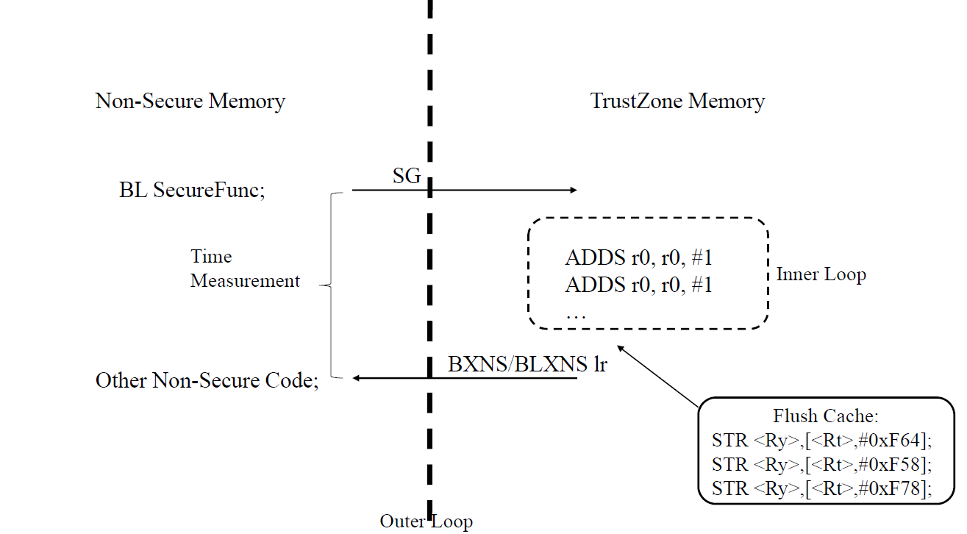
Design and Implementations
Experiments on TrustZone Instructions
ARMv8-M
Our experiments on ARMv8-M are using ARM Versatile V2M-MPS2 Motherboard with an ARM Cortex-M4 chip. It offers 8Mb of single cycle SRAM, and 16Mb of PSRAM. It supports the application of different ARM Cortex-M classes, from Cortex-M0, to M3, M4, and M7.

Slide 21
Experimental Results
Experiments on TrustZone Instructions
ARMv8-A
  We use Ubuntu 16.10 as the normal world OS, with 26 processes running on background, including the workload we use for testing. We count the smc-related instructions that belongs to TrustZone-related operations, and analyze the attributions of them.
Type | Percentage
Non-secure to Secure Test R/W | 2.87%
Secure to Non-secure Test R/W | 2.91%
Others (Access from Background) | 0.01%

Slide 22
Experimental Results
Experiments on TrustZone Instructions
Cortex-A
Using QEMU as shown above.
Operation | Direction | Cost on Average (Clock Cycles)
P0_nonsecure_check_register_access | Non-Secure to Secure | 1950
P0_secure_check_register_access | Secure to Non-Secure | 2200

Slide 23
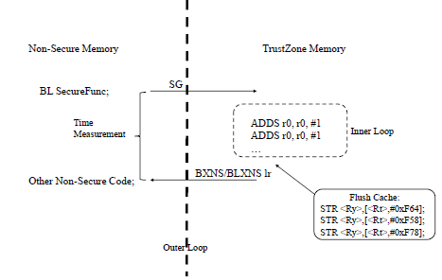
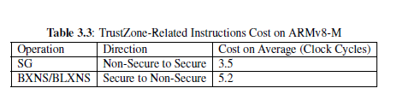
Experimental Results
Experimental results on Cortex-M series chips

Slide 24
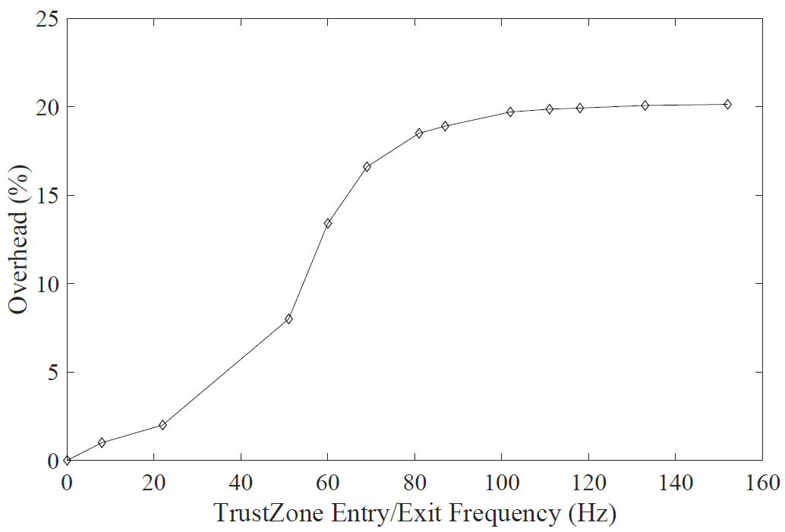
Experimental Results
Experiments on TrustZone Instructions
ARMv8-A
With every smc-related instruction, we operate Flush on cache.

Slide 25
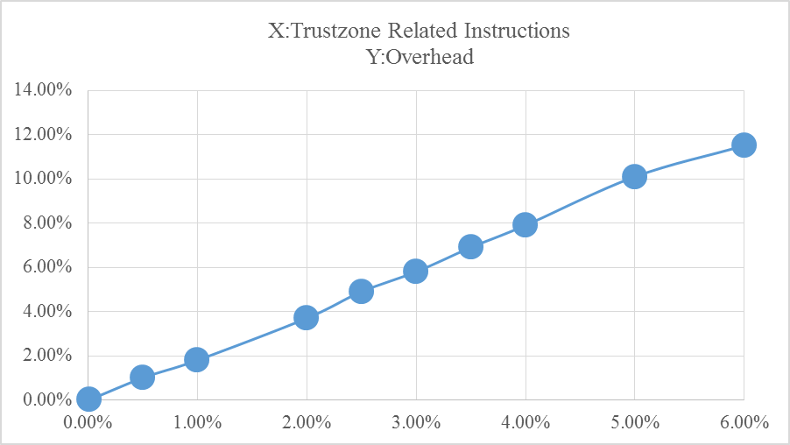
Experimental Results
Experiments on TrustZone Instructions
ARMv8-A
We change the overall percentage of smc instructions and see the overhead difference.

Slide 26
Evaluation
On the cost-effectiveness balance of defending by Flush operations
  Flush operations are necessary, but they cost much;
  We can never wipe out the risk, but can cut down bandwidth;
  Adaptive strategy is used to keep the balance of performance and effectiveness;
  On Cortex-A series chips, usually adaptive strategy can cost less than 10% overhead;
  Even better on ARMv8-M chips.

Slide 27
Evaluation
On TrustZone related instructions
  Most of the apps and users are not ‘making use of’ TrustZone features;
  On IoT devices, TrustZone is not costing much resources;
  It is possible to move some of the hardware/software security design into TrustZone surface;
  Cortex-M series chips perform better than Cortex-A series chips.
  On Cortex-A series chips or x86 chips, cache flush operations are just some instructions with privileges. However, the case are different on ARMv8-M. The allocation of a memory address to a cache address is defined by the designers of the applications.
  Because of the special structure of ARMv8-M, the cache Flush operations are sets of DSB (Data Synchronization Barrier) operations, with address-related instructions.

Slide 28
Defense Design and Implementations Based on ARM Platform
Defense Strategy
  Hardware Defense
  Privilege level designs
    Not everybody can flush the cache or do cache related measurement, e.g., ARM
  When the cache should be flushed?
    Whenever there is a possibility of information leak - what about the performance?
    During process context switching?
    During processor mode switching?
  Experiments – Performance and Bandwidth

Slide 29
Defense Design and Implementations Based on ARM Platform
Defense Strategy
  Software Solution
  Design on ARMv8
    TrustZone entry/exit
  Noise injections to the channels
    Also decrease the performance but under control.
  Experiments – Noise Injection and Bandwidth

Slide 30
Defense Design and Implementations Based on ARM Platform
Defense on ARMv8-M Challenges and limitations
  TrustZone for IoT
  Efficiency in entry/exit
  Defense based on TrustZone
  Experiment – Cost of TrustZone operations

Slide 31
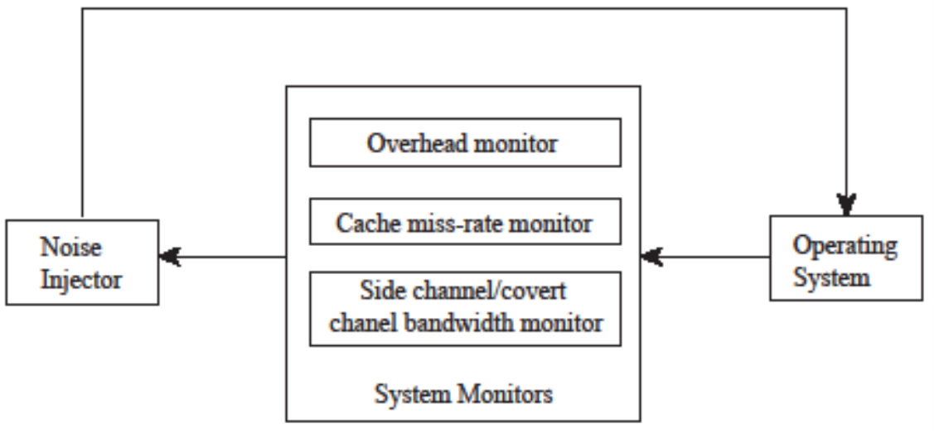
Design and Implementations
Adaptive Flush Operations on ARMv8-A
On ARMv8-A tests, we change cache flush frequency when the system is on high frequency of TZ operations.
Must maintain good performance (low overhead) while keeping lower bandwidth

Slide 32
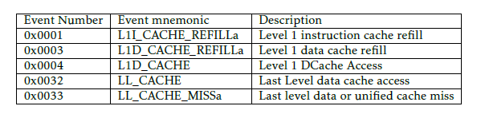
Design and Implementations
Monitors Setup
  Time measurement: special registers and instructions;
  Overhead: TEE and benchmark;
  Cache miss rate: Special Registers.

Slide 33
Design and Implementations
Other Implementations
  Error Correction;
  Flush Operation;
  TrustZone entry/exit.

Slide 34
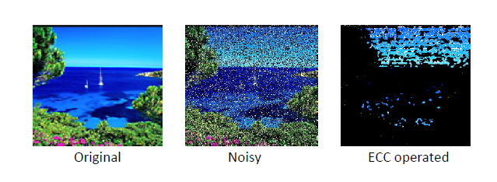
Experimental Results
Experiments on Side-channel
Flush+Reload Attack on libjpg;
Using CRC to try recovering the original file;
Calculating Bandwidth and performance overhead difference by Flushing cache.

Slide 35
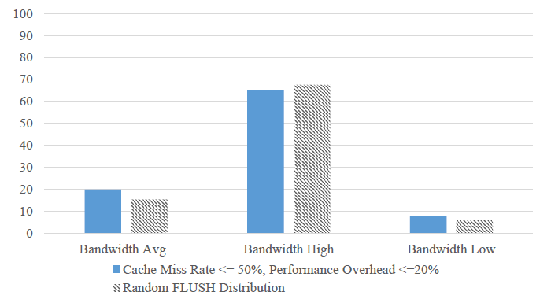
Experimental Results
Test: Cache miss rate and overhead balance.

Slide 36
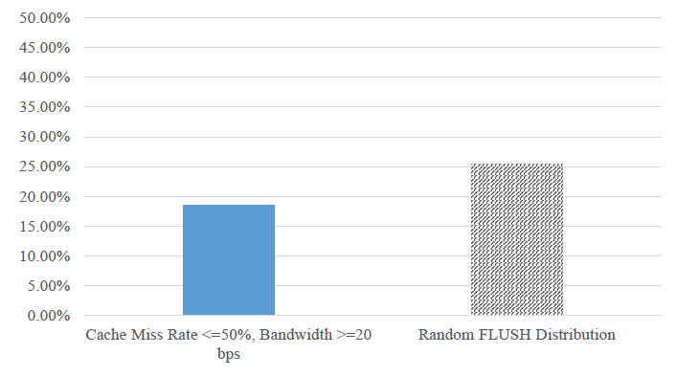
Experimental Results
Test: Cache miss rate and Flush frequency balance.

Slide 37
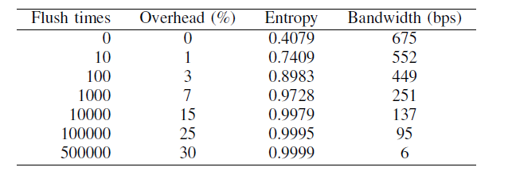
Evaluation
Dealing with covert channel is also a problem of balancing overhead and effectiveness.
From our test results, it is almost impossible for some malicious users to launch covert channels with high entropy and very low bandwidth, which means that they cannot retrieve useful information, or the time consuming is not acceptable.

Slide 38
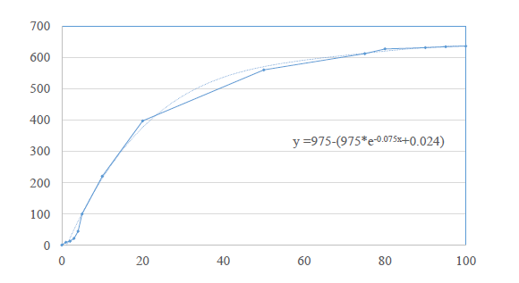
Evaluation
In the experiments where we randomly insert flush operations to interfere with the side-channels, the time of injecting noise is randomly distributed. Also, the interval of each pair of operations is randomly distributed. Exponential distribution is usually used to describe the distribution of intervals of a set of statistically independent events.

Slide 39
Conclusions
Cache-based attack are new focal point on security design, with risks of leaking information through side-channel and covert channels.
Flushing cache is effective to cut down the risk, but with high performance overhead, and sometimes not affordable.
On IoT devices, the performance of connecting with TrustZone can be better, which brings the possibility to making use of TrustZone.
Adaptive strategy is still needed for the balance of the performance and the defense effectiveness.

Slide 40
Future Work and Plan
Implementations and Experiments
  Design and implement a defense framework based on ARMv8-M.
  Test the performance of defense framework using some benchmarks, and optimize the framework to good effectiveness and lower overhead.
  Port defense framework to new ARMv8-M boards: M23 and M33 series chips.

Slide 41
Future Work and Plan
Theory Work
  Study adaptive control method in theory to match the experimental results and predict the optimal solution of best adaptive control in defense.
  Investigate entropy theory based on experimental results, predictions and related theory.
  Discuss performance of implemented defense framework in theory and try to have theoretical conclusion on defense against cache-based attack.

Slide 42
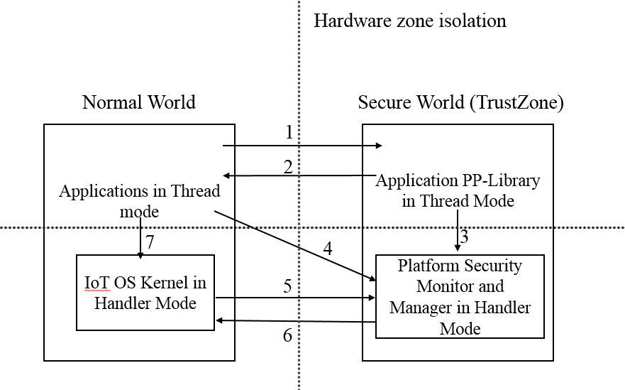
Future Work and Plan

Slide 43
Publications
Liu N, Zang W, Chen S, Yu M, Sandhu R: Adaptive Noise Injection against Side-Channel Attacks on ARM Platform, EAI Endorsed Transactions on Security and Safety, 2019;
Liu N, Zang W, Yu M, Sandhu R: On the Cost-Effectiveness of TrustZone Defense on ARM Platform, The 21st World Conference on Information and Security Applications (WISA), 2020, Maison Glad, Jeju, Korea
Liu N, Yu M, Sandhu R: Cache Security on ARM: Side-channel Attack and Defense: Introduction to Side-channel on ARM Platform, Book Chapter by Eliva Press, ISBN: 978-1952751264, 2020;
Liu N, Zang W, Yu M, Sandhu R: Cost and Performance of TrustZone Defense against Cache Threats on ARM Platform, Journal of Wireless Mobile Networks, Ubiquitous Computing, and Dependable Applications (JoWUA, Invited), 2020.

Slide 44
Q&A Time
Thank you so much for your questions!

