Slide 1
Expressive Power, Safety and Cloud Implementation of Attribute and Relationship Based Access Control Models
Dissertation Defense: Tahmina Ahmed
Dissertation Committee:
Dr. Ravi Sandhu, Supervising Professor
Dr. Jianwei Niu
Dr. Gregory White
Dr. Weining Zhang
Dr. Ram Krishnan

Slide 2
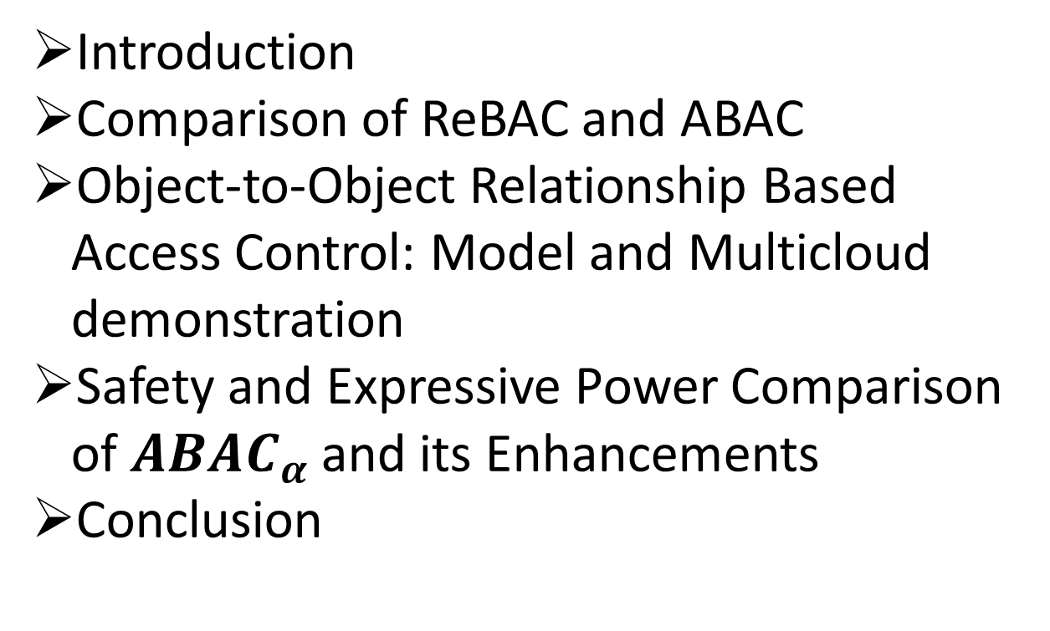
Outline
Introduction
Comparison of ReBAC and ABAC
Object-to-Object Relationship Based Access Control: Model and Multicloud demonstration
Safety and Expressive Power Comparison of $ABAC_{α}$ and its Enhancements
Conclusion

Slide 3
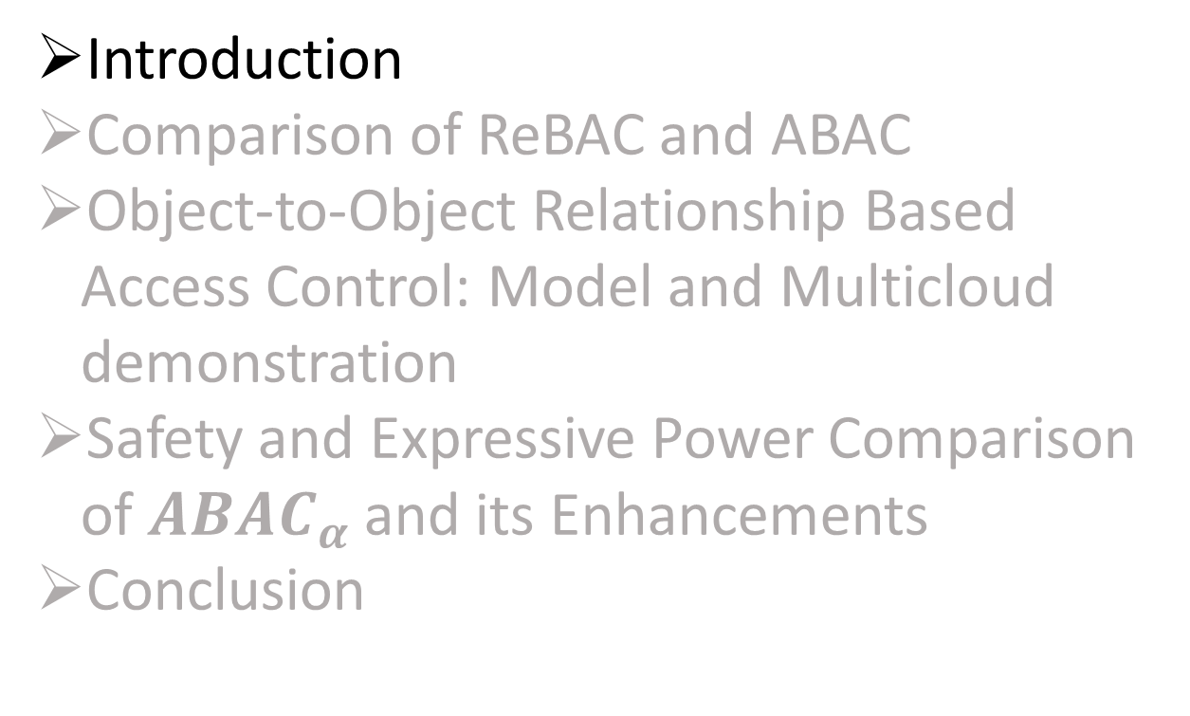
Outline
Introduction
Comparison of ReBAC and ABAC
Object-to-Object Relationship Based Access Control: Model and Multicloud demonstration
Safety and Expressive Power Comparison of $ABAC_{α}$ and its Enhancements
Conclusion

Slide 4
Access Control Evolution
Discretionary Access Control (DAC), 1970
Mandatory Access Control (MAC), 1970
Role Based Access Control (RBAC), 1995
Attribute Based Access Control (ABAC), ????
Relationship Based
Access Control (ReBAC) ????
Born 1990s
Born mid
2000s
Figure 1: Evolution of Access Control

Slide 5
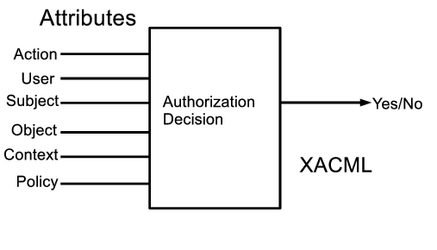
ABAC: Using Attributes for controlling access
Using attributes for controlling usage of digital resources (Park and Sandhu 2004)
X.500 standard(1994): Manages object information through attributes

Slide 6
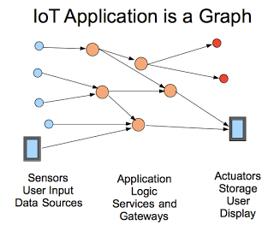
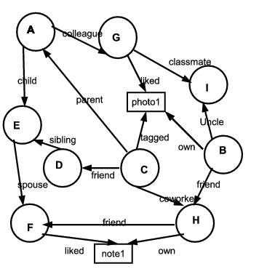
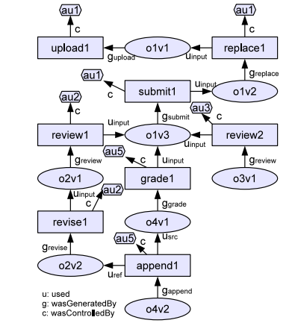
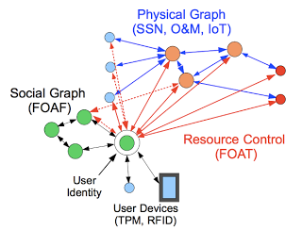
ReBAC:Using Relations for
Controlling Access
A sample social graph
Access control for IOT
A sample Provenance Graph (Park et al. 2012 )

Slide 7
Problem Statement
?
ABAC
ReBAC
Are they Comparable ? Can Attributes Express Relationships?
Can ReBAC Configure ABAC? Vice versa?
Do they have equal expressive power? If not which one is more expressive?
ABAC vs. ReBAC : There is a fundamental lack of understanding regarding the relationship between ABAC and ReBAC.
What are the novel ways other than OSN ReBAC can be seen, extended and applied?
ReBAC Potential: The potential of ReBAC has recently been recognized and there remain many directions in which ReBAC models can be developed.

Slide 8
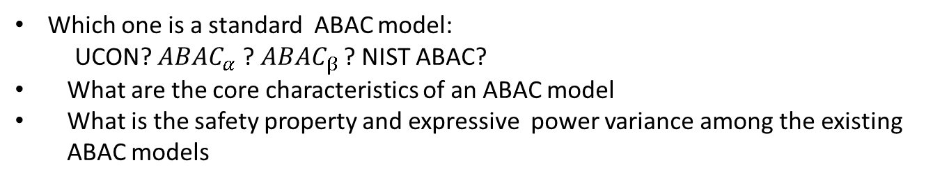
Problem Statement(Cont..)
Which one is a standard ABAC model:
UCON? $ABAC_{α}$ ?$ABAC_{β}$ ? NIST ABAC?
What are the core characteristics of an ABAC model
What is the safety property and expressive power variance among the existing ABAC models
ABAC vs. ABAC: There is a proliferation of ABAC models without a formal understanding of their safety properties and relative expressive power.

Slide 9
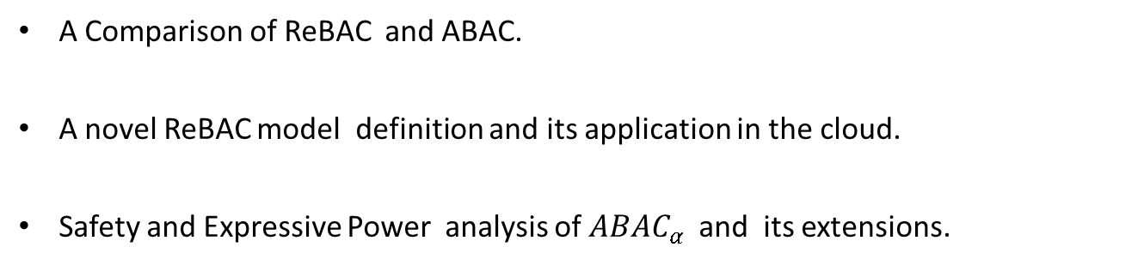
Summary of Contribution
A Comparison of ReBAC and ABAC.
A novel ReBAC model definition and its application in the cloud.
Safety and Expressive Power analysis of $ABAC_{α}$ and its extensions.

Slide 10
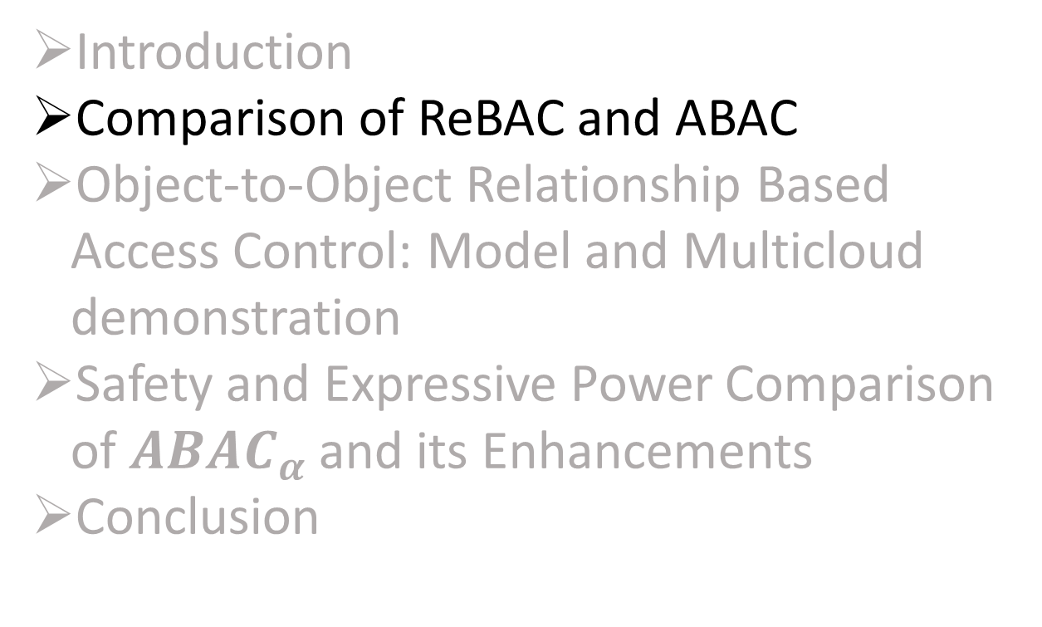
Outline
Introduction
Comparison of ReBAC and ABAC
Object-to-Object Relationship Based Access Control: Model and Multicloud demonstration
Safety and Expressive Power Comparison of $ABAC_{α}$ and its Enhancements
Conclusion

Slide 11
Attribute Types
Attribute Value Structure
    Atomic-valued or Single-valued Attribute (e.g. gender)
    Set-valued or Multi-valued Attribute (e.g. phoneNumber)
    Structured Attribute (e.g person-Info (name, age, phoneNumber ))
Attribute Value Scope
    Entity Attribute (e.g. friend)
    Non-entity Attribute (e.g. age)
Boundedness of attribute range
    Finite Domain Attribute (e.g. gender)
    Infinite Domain Attribute (e.g. time)
Attribute association
    Contextual or Environmental Attribute (e.g. currentTime)
    Meta Attribute (e.g. role(user) = manager , task(manager) = supervise)
Attribute mutability
    Mutable Attribute
    Immutable Attribute

Slide 12
Expressing Multilevel Relationship With Attributes
Alice
Bob
Carol
Attribute Composition
Needs one attribute: friend
Policy Expression uses
Attribute composition
friend(Alice)={Bob}
friend(friend(Alice))={Carol}
Composite Attribute
Needs two attribute
1. friend
2. friendOfFriend
Policy Expression uses
direct attributes
friend(Alice) ={Bob}
friendOfFriend(Alice)={Carol}

Slide 13
ReBAC Classification
Figure 2: ReBAC Classification

Slide 14
ABAC Classification
Figure 3: ABAC Framework

Slide 15
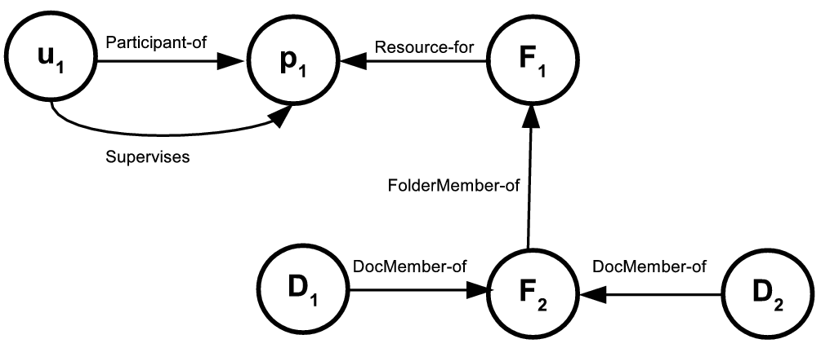
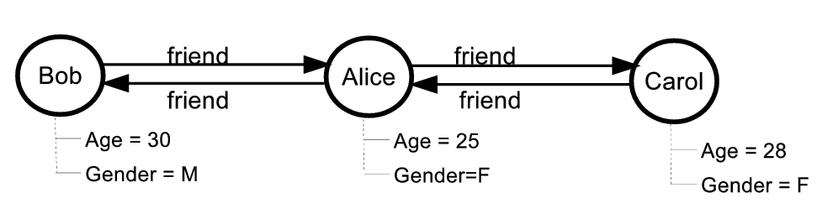
Expressing Relationship Graph
with Attributes
Entity types = {user, project, folder , document}
Attributes:
  User attributes ={Participant-of, Supervises}
  Folder attributes = {Resource-for, FolderMember-of}
  Project attributes = {}
  Document attributes ={DocMember-of}
Figure 4: Relationship Graph [Crampton et al 2014] Expressible with ReBAC_{B} and ABAC_{E}
entityType = {user}
Attribute:
  User’s entity attribute ={friend}
  User’s Non Entity Attribute ={Name, Age, Gender}
Figure 5:Relationship Graph Expressible with ReBAC _{BN} and ABAC_{E}

Slide 16
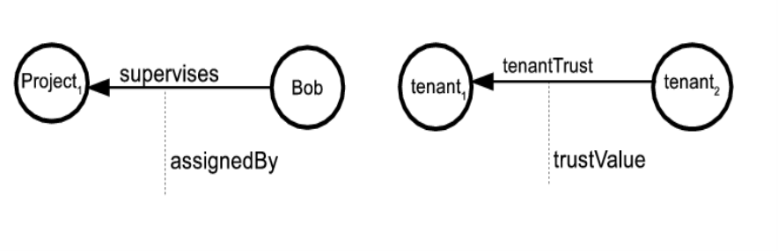
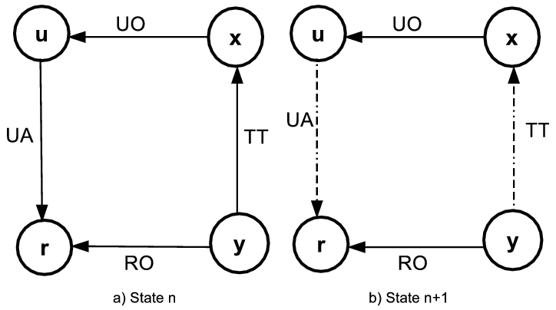
Expressing Relationship Graph with
Attributes (Continued…)
entityType = {user, project, tenant}
Attribute:
  user’s atomic entity attribute ={supervises}
  User’s structured entity Attribute ={assignedBy}
  e.g. assignedBy(Bob) =(“Project1”, “supervises”,“Alice”)
Figure 6:Relationship Graph Expressible with
ReBAC _{BE} and ABAC_{ES}
Entity types: {user, tenant, role}
Attribute:
  User’s atomic entity attribute: {UO,UA}
  Users Structured Entity Attribute: {dependentEdge}
  dependentEdge(u) = (“r”,“UA”,
  {(y,x,TT)} )
Figure 7: Relationship Graph [cheng et al 2016] Expressible with ReBAC_{BNES} and ABAC_{ES}

Slide 17
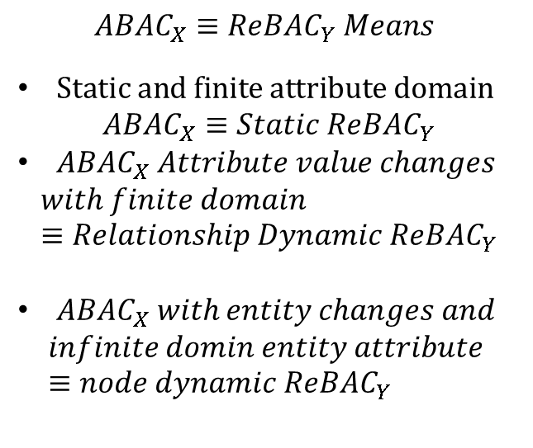
Comparison: On Dynamics
$$ABAC_{X}≡ReBA{C_{Y} Means}_{ }$$
$Static and finite attribute domain$
$$ABAC_{X}≡Static ReBAC_{Y}$$
$ABAC_{X} Attribute value changes$
$$with finite domain≡Relationship Dynamic ReBAC_{Y}$$
$ABAC_{X} with entity changes and$
$$infinite domin entity attribute ≡node dynamic ReBAC_{Y}$$
Figure 8: ReBAC Dynamics, ABAC Dynamics and Attribute Domain wise Comparison between ReBAC and ABAC

Slide 18
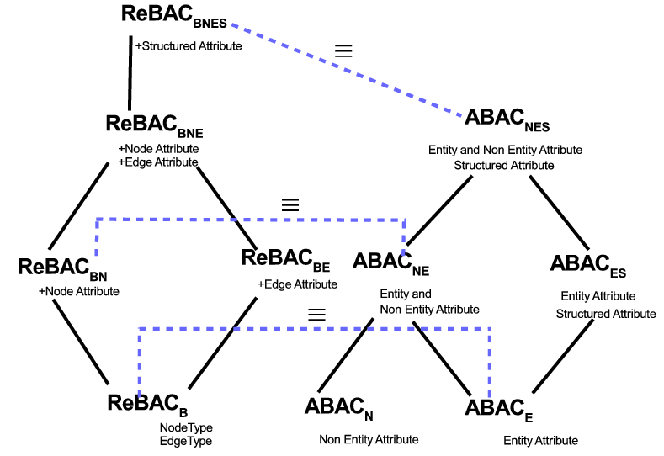
Comparison: Equivalent Structural Models for ReBAC and ABAC
Figure 9: Equivalence of ReBAC and ABAC Structural Classification

Slide 19
Comparison: Non-Equivalent Structural models for ReBAC and ABAC
Figure 10: Non-Equivalence of ReBAC and ABAC Structural Classification

Slide 20
Comparison
Attribute Composition: Polynomial complexity for authorization policy and constant complexity on update
Composite attribute: Constant complexity on authorization policy and polynomial complexity on update to maintain relationship changes.
Performance Depends on :
        Node Dynamics
        Relationship Dynamics
        Density of the Relationship Graph
Choice of Models:
For static system or only non entity attribute change------Composite attribute is the best approach
System with huge node dynamics, relationship dynamics and high relationship density----- Attribute composition is the best option
If the system is in the middle between two extremes ---- A hybrid approach where both composite attribute and attribute composition is used.
Hybrid Approach:
To achieve p level relationship composition it uses m level composite attribute and n level attribute composition where p = n X m.

Slide 21
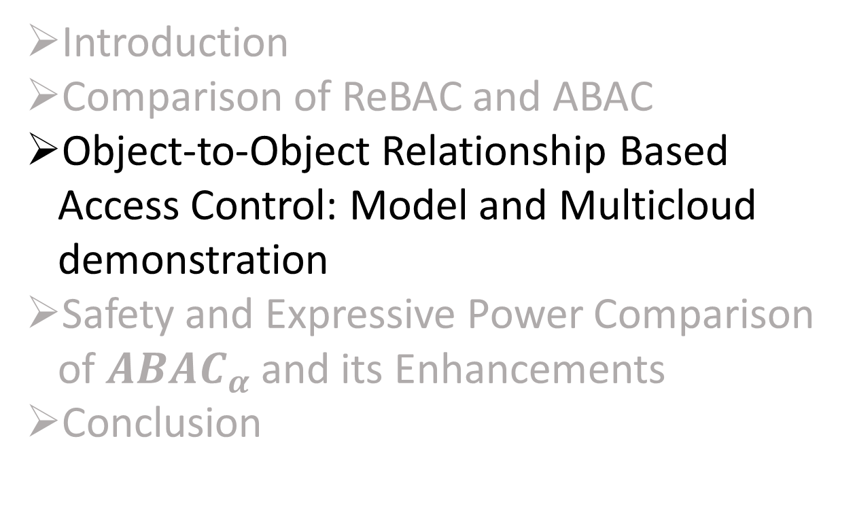
Outline
Introduction
Comparison of ReBAC and ABAC
Object-to-Object Relationship Based Access Control: Model and Multicloud demonstration
Safety and Expressive Power Comparison of $ABAC_{α}$ and its Enhancements
Conclusion

Slide 22
Relationships in OSN
User to user relationships in a sample social graph [UURAC, Cheng et al. 2012]
User to user, user to resource and resource to resource relationships in a sample social graph [URRAC, Cheng et al. 2012]
Limitations:
Cannot configure relationship between objects independent of user.
Cannot express authorization policy solely considering object relationship.

Slide 23
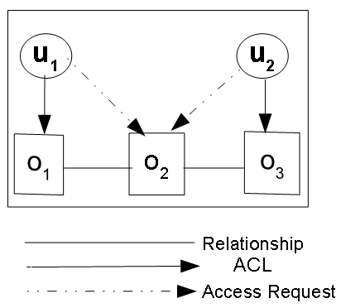
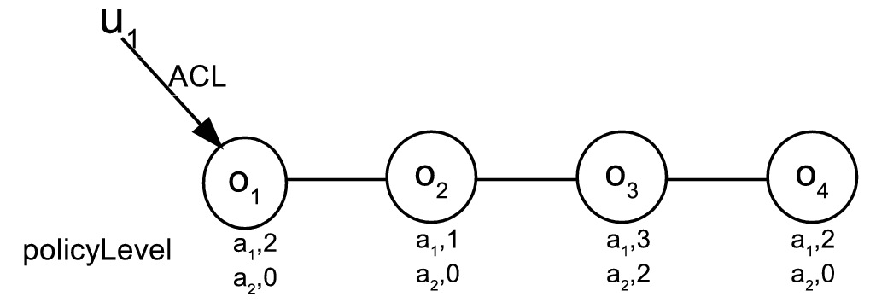
How the model would look like?
An Object to Object Relationship Based Access Control
Policy Level Example
policyLevel(a₁ ,o₁) =2
policyLevel(a₂ ,o₁) =0
policyLevel(a₁,o₂) =1
policyLevel(a₂ ,o₂) =0
policyLevel(a₁ ,o₃) =3
policyLevel(a₂ ,o₃) =2
policyLevel(a₁ ,o₄) =2
policyLevel(a₂ ,o₄) =0
ACL(o₁) = {u₁}
ACL(o₂) = {}
ACL(o₃) = {u₂}

Slide 24
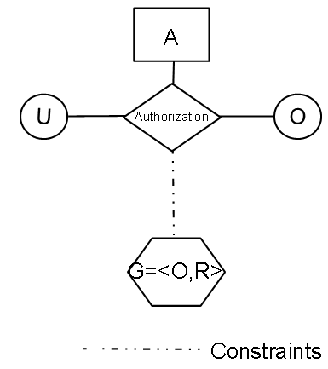
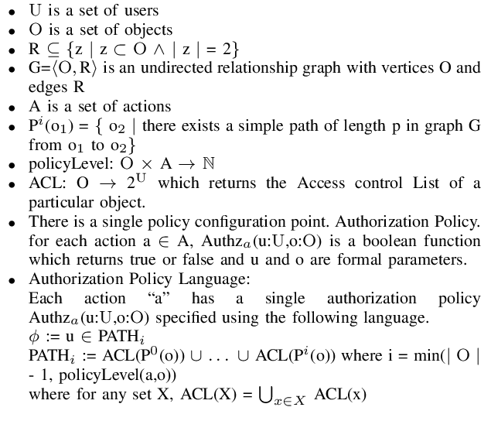
OOReBAC: Model Components and Definition
Figure 10: OOReBAC Model Components

Slide 25
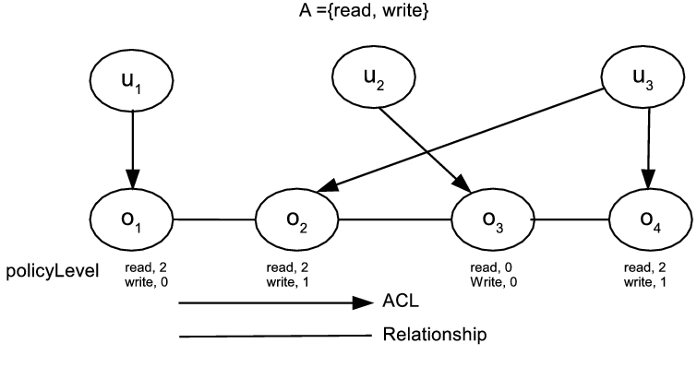
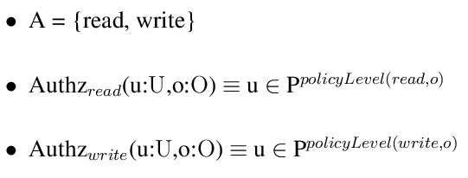
OOReBAC: An Example
Sequence of operations and its outcome:
Configuration:
Sequence of operations and its outcome:

Slide 26
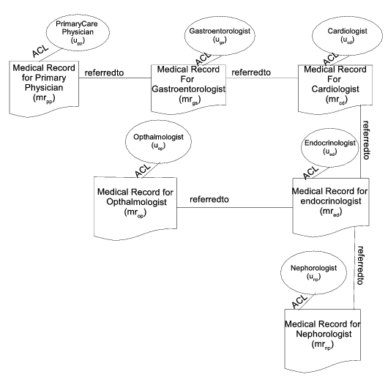
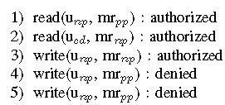
OOReBAC:Application
An OOReBAC Instantiation
Sequence of Operations and Outcomes
Figure 11: An Example of OOReBAC
Application in Medical

Slide 27
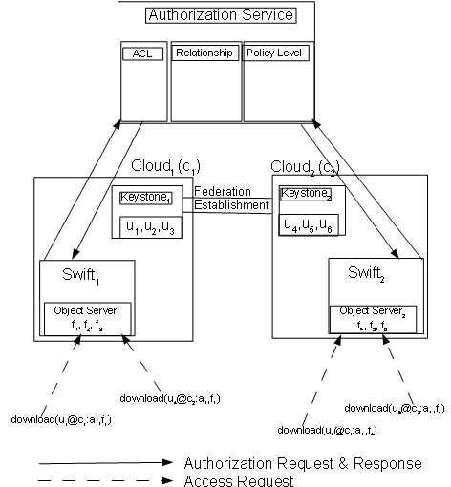
Implementation: Openstack Object Storage (Swift)
Relationship
ACL
PolicyLevel
Figure 12: OOReBAC Implementation

Slide 28
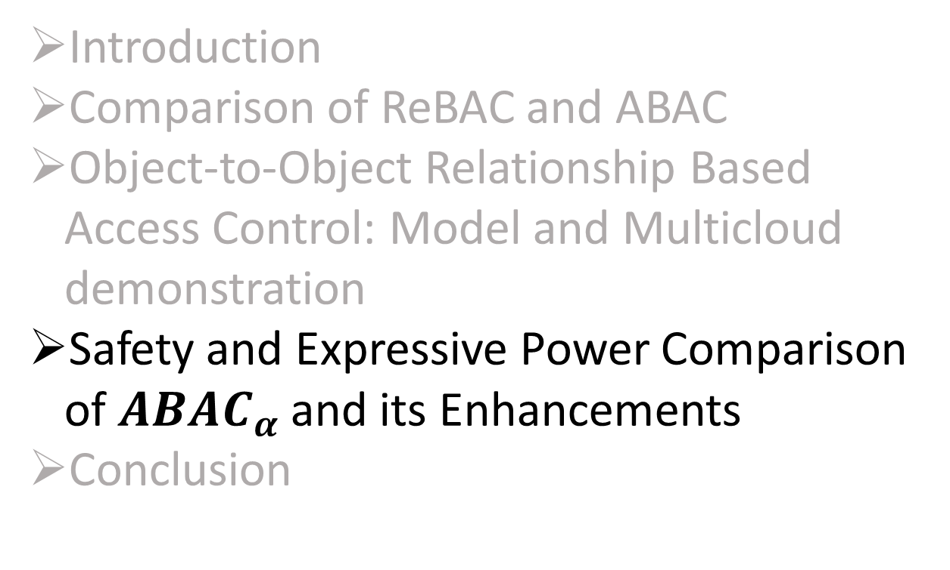
Outline
Introduction
Comparison of ReBAC and ABAC
Object-to-Object Relationship Based Access Control: Model and Multicloud demonstration
Safety and Expressive Power Comparison of $ABAC_{α}$ and its Enhancements
Conclusion

Slide 29
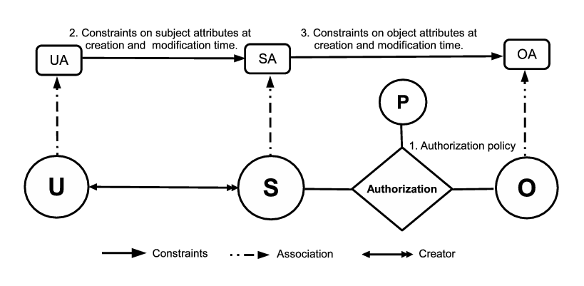
$$ABAC_{α}$$
Figure 13: $ABAC_{α}$ Model [Jin et al. 2012]

Slide 30
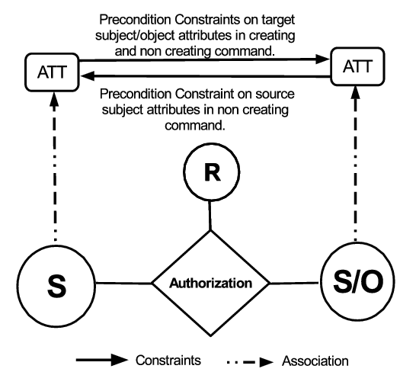

      $UCON_{preA}^{finite }$ Model
$Figure 14$: $UCON_{preA}^{finite}$ Model

Slide 31
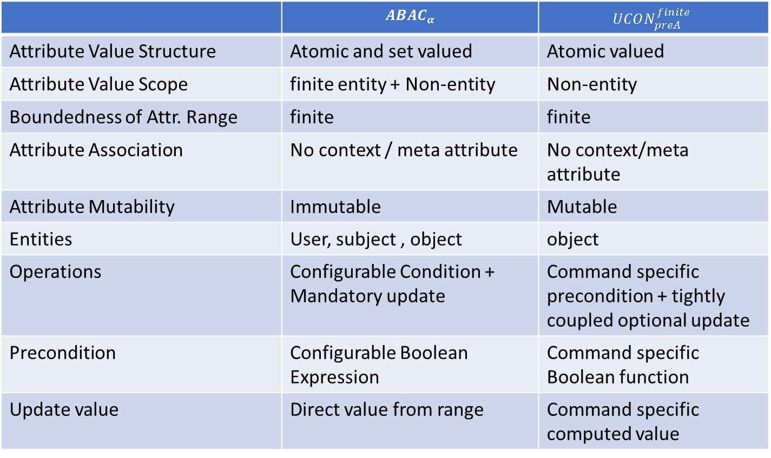

$$ABAC_{α} vs. UCON_{preA}^{finite }$$
 | $$ABAC_{α}$$ | $$UCON_{preA}^{finite }$$
Attribute Value Structure | Atomic and set valued | Atomic valued
Attribute Value Scope | finite entity + Non-entity | Non-entity
Boundedness of Attr. Range | finite | finite
Attribute Association | No context / meta attribute | No context/meta attribute
Attribute Mutability | Immutable | Mutable
Entities | User, subject , object | object
Operations | Configurable Condition + Mandatory update | Command specific precondition + tightly coupled optional update
Precondition | Configurable Boolean Expression | Command specific Boolean function
Update value | Direct value from range | Command specific computed value

Slide 32
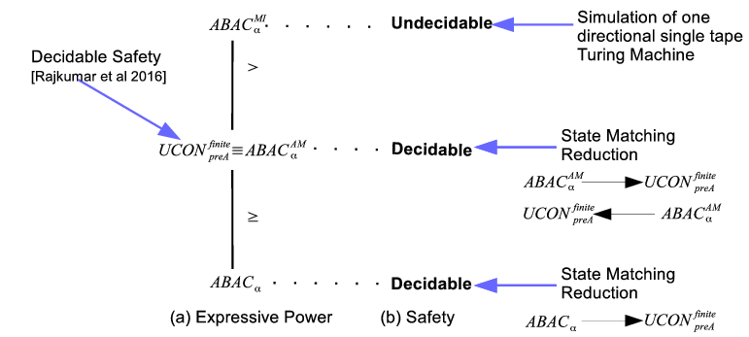
Central Result
Figure 15: Central Result

Slide 33

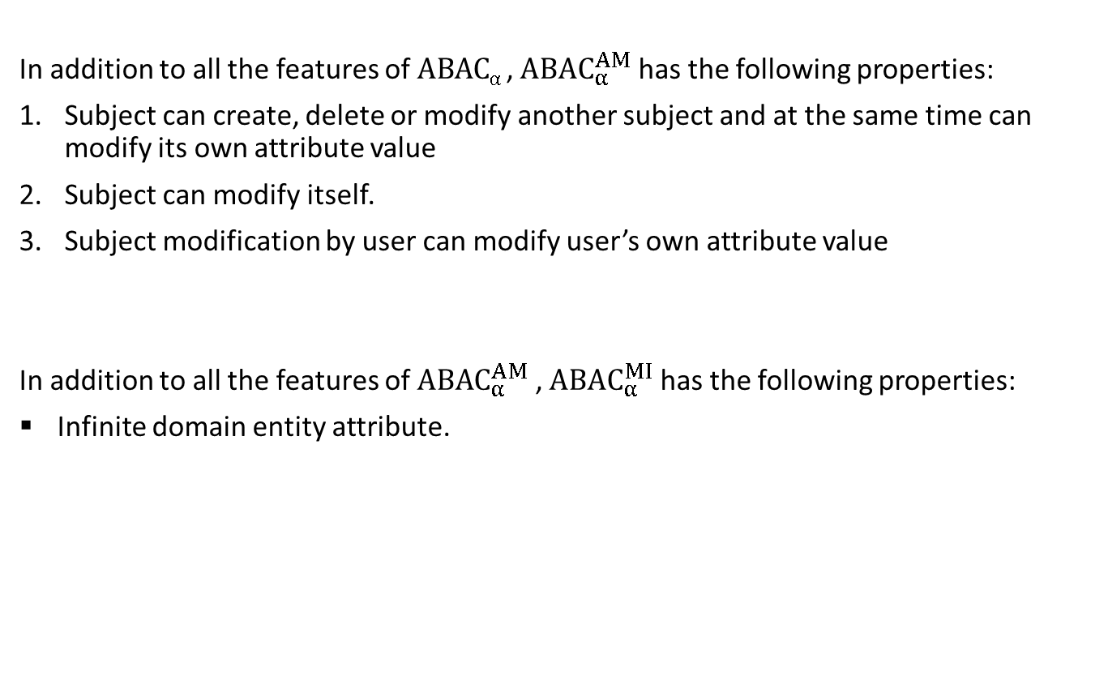
${ABAC}_{α}^{AM}$ and ${ABAC}_{α}^{MI}$
In addition to all the features of $ABACα$ , ${ABAC}_{α}^{AM}$ has the following properties:
Subject can create, delete or modify another subject and at the same time can modify its own attribute value
Subject can modify itself.
Subject modification by user can modify user’s own attribute value
In addition to all the features of ${ABAC}_{α}^{AM}$ , ${ABAC}_{α}^{MI}$ has the following properties:
Infinite domain entity attribute.

Slide 34
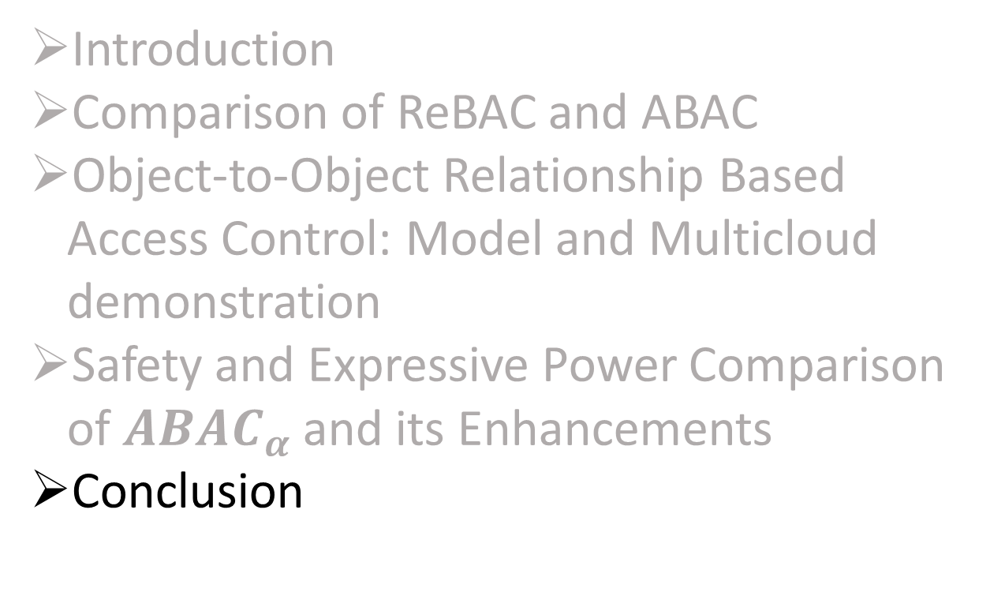
Outline
Introduction
Comparison of ReBAC and ABAC
Object-to-Object Relationship Based Access Control: Model and Multicloud demonstration
Safety and Expressive Power Comparison of $ABAC_{α}$ and its Enhancements
Conclusion

Slide 35
Conclusion: Summary of Contribution
The most general form ABAC and ReBAC are equivalent. The relationship between less general ABAC and ReBAC is subtle and variable depending on the precise flavor of these two access control approaches in any given model.
OOReBAC is the first attempt towards using object relationship independent of user in authorization policy specification. Its application is possible for multicloud resource sharing in Openstack object storage Swift.
Safety and Expressive power of an ABAC model depend onto the detail of that model.

Slide 36
Conclusion: Future Work
This work can be expanded in many directions:
Formal definition of specific ReBAC and its structural equivalent ABAC model would bring more realistic result for theoretical equivalence.
To better understand the relative advantages and disadvantages of ReBAC and ABAC we can consider metrics beyond theoretical equivalence such as performance, maintainability, robustness, and agility.
OOReBAC model can be extended to accommodate multiple type asymmetric relationships to configure version control and object oriented system.
Application of relationship based authorization policy in various fields such as IoT.

Slide 37
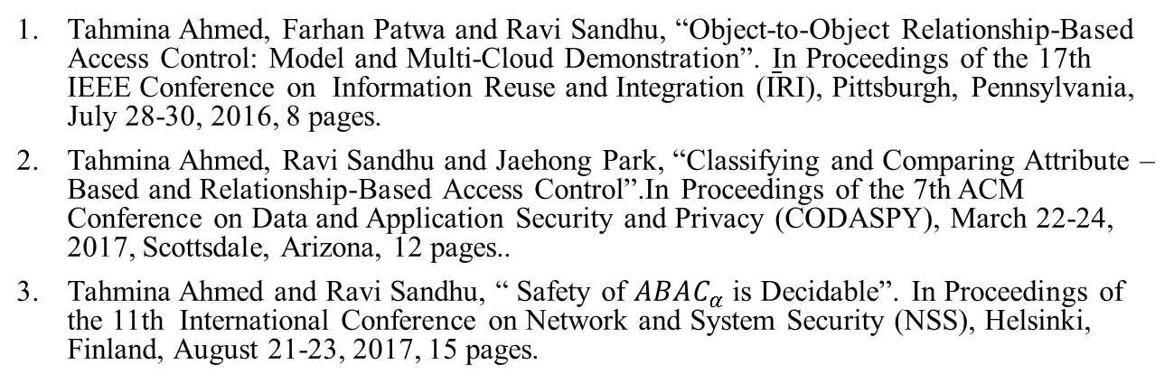
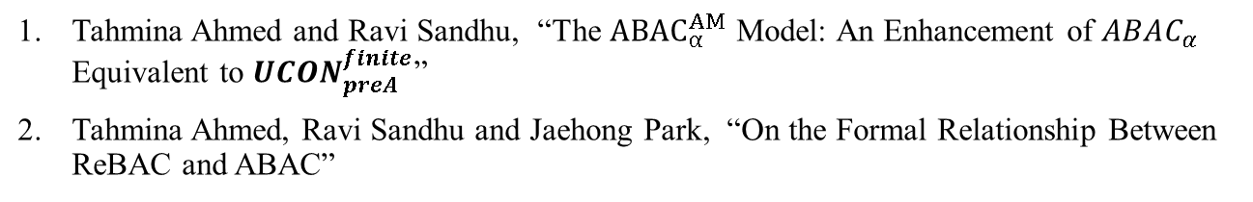
Dissertation Publications
Conference Papers(Published):
Tahmina Ahmed, Farhan Patwa and Ravi Sandhu, “Object-to-Object Relationship-Based Access Control: Model and Multi-Cloud Demonstration”. In Proceedings of the 17th IEEE Conference on Information Reuse and Integration (IRI), Pittsburgh, Pennsylvania, July 28-30, 2016, 8 pages.
Tahmina Ahmed, Ravi Sandhu and Jaehong Park, “Classifying and Comparing Attribute –Based and Relationship-Based Access Control”.In Proceedings of the 7th ACM Conference on Data and Application Security and Privacy (CODASPY), March 22-24, 2017, Scottsdale, Arizona, 12 pages..
Tahmina Ahmed and Ravi Sandhu, “ Safety of $ABAC_{α}$ is Decidable”. In Proceedings of the 11th International Conference on Network and System Security (NSS), Helsinki, Finland, August 21-23, 2017, 15 pages.
Journal Papers (Work in Progress):
Tahmina Ahmed and Ravi Sandhu, “The ${ABAC}_{α}^{AM}$ Model: An Enhancement of $ABAC_{α}$ Equivalent to $UCON_{preA}^{finite}$”
Tahmina Ahmed, Ravi Sandhu and Jaehong Park, “On the Formal Relationship Between ReBAC and ABAC”

Slide 38

Questions/Comments

