Slide 1
Attribute Based Access Control and Implementation in Infrastructure as a Service Cloud
Dissertation Defense
Xin Jin
Advisor: Dr. Ravi Sandhu
Co-Advisor: Dr. Ram Krishnan
Dr. Rajendra V. Boppana
Dr. Hugh Maynard
Dr. Jianwei Niu
World-Leading Research with Real-World Impact!

Slide 2
Presentation Outline
Introduction
ABAC Operational Models
ABAC Administrative Model
ABAC In IaaS Cloud
Conclusion
World-Leading Research with Real-World Impact!

Slide 3
Access Control Scenario
User
Information required for authorization
Subject
Access Control Component
Access Decision
Grant
Deny
Resources
Others (e.g., NotApplicable, Error)
World-Leading Research with Real-World Impact!
Notes:
Should also mention that the access decision could be others rather than grant and deny

Slide 4
Classical Access Control Models
Discretionary Access Control (DAC), 1970
Mandatory Access Control (MAC), 1970
Role Based Access Control (RBAC), 1995
1. Policy Neutral
2. Administrative Convenience
3. Configure both DAC and MAC
Figure from http://profsandhu.com/miscppt/iri_130815.pptx
World-Leading Research with Real-World Impact!
4
Notes:
DAC and MAC fixed policy
RBAC because of requirements in policy flexibility
RBAC has been studied ever since its apperance

Slide 5
User Discretionary DAC
The list of users who can read the file
Create and own
Alice
File 1
Bob, Carol, Dan
Bob
File 2
Carol
Carol
Dan
File 3
Alice, Bob
File 4
Bob, Carol
World-Leading Research with Real-World Impact!
Notes:
Owner
Modify read list
Create and destruct

Slide 6
Mandatory Access Control
(Lattice based Access Control)
Lattice of Security Labels
Top Secret
File 1
Secret
File 2
Subject 1
Alice
Classified
File 3
Subject 2
Unclassified
File 4
Subject 3
World-Leading Research with Real-World Impact!
Notes:
A (non-strict) partial order^{[2]} is a binary relation "≤" over a set P which is reflexive, antisymmetric, and transitive, i.e., which satisfies for all a, b, and c in P:
a ≤ a (reflexivity);
if a ≤ b and b ≤ a then a = b (antisymmetry);
if a ≤ b and b ≤ c then a ≤ c (transitivity).

Slide 7
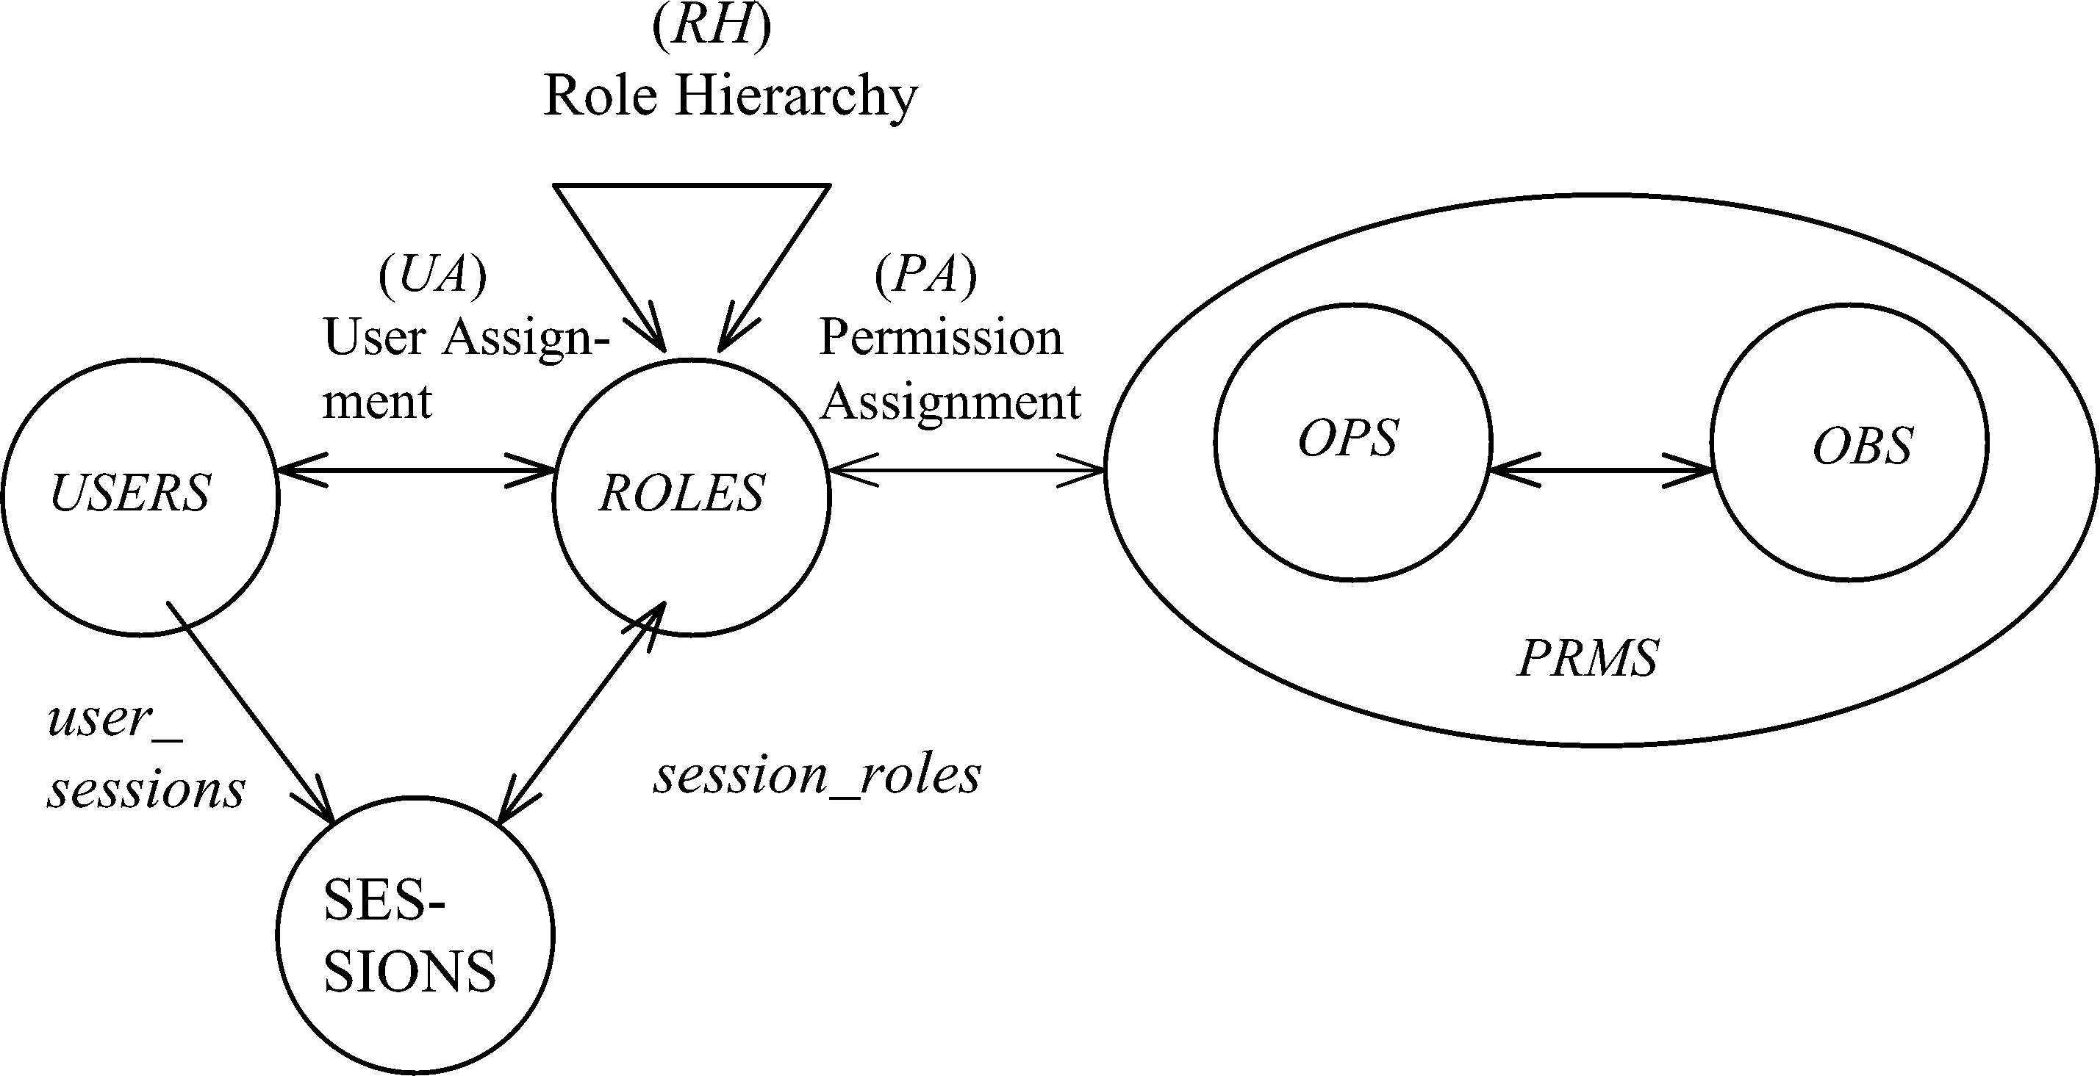
NIST-RBAC
Constraints
World-Leading Research with Real-World Impact!

Slide 8
RBAC Limitations
Role explosion
Parameterized privileges, role templates, parameterized roles (1997-)
Difficult role design and engineering
Role engineering top down or bottom up (1996-), and on role mining (2003-)
Assignment of users/permissions to roles is cumbersome
Decentralized administration (1997-), attribute-based implicit user-role assignment (2002-), role-delegation (2000-), role-based trust management (2003-), attribute-based implicit permission-role assignment (2012-)
Adjustment based on local/global situational factors is difficult
Temporal (2001-) and spatial (2005-) extensions to RBAC proposed
RBAC does not offer an extension framework
Every shortcoming seems to need a custom extension
Slide from http://profsandhu.com/miscppt/iri_130815.pptx
World-Leading Research with Real-World Impact!
8
Notes:
Many different direcitons of RBAC
No proposals to cover them
It is not possible to implement once and achieve all
Required in public cloud

Slide 9
Classical Access Control
Discretionary Access Control (DAC), 1970
Mandatory Access Control (MAC), 1970
Role Based Access Control (RBAC), 1995
Can ABAC unify these extensions in a common framework?
1. Flexibility
2. Automation
………
Attribute Based Access Control (ABAC), ????
World-Leading Research with Real-World Impact!
9
Notes:
The concept of ABAC is there for a while
Many research focus already exists for the purpose of bringing ABAC as a unified standard

Slide 10
General Idea of ABAC
Attributes are name and value pairs
Attributes are associated with different entities
User: role, group, department, project, research_topic
Subject: clearance, role, admin, network
Object: sensitivity, date, owner, size, last_modified
Context: CPU usage, server_location, risk_level, time
Attribute (i.e., meta-attribute): risk_level_of_role, size_of_organization, head_of_department, trust_of_clearance
Converted by policies into rights just in time
Retrieve attributes related with each request: (subject, object, operation)
World-Leading Research with Real-World Impact!
10

Slide 11
Related Work
Formal Model
UCONABC (Park and Sandhu, 01): authorization, mutable attributes, continuous enforcement
Logical framework (Wang et al, 04): set-theory to model attributes
NIST ABAC draft (Hu et al, 13): enterprise enforcement
Policy Specification Language
SecPAL (Becker et al 03, 04), DYNPAL (Becker et al 09), Rule-based policy (Antoniou et al, 07), Binder (DeTreville 02) , EPAL1.2 (IBM, 03) , FAF (Jajodia et al 01)
Enforcement Models
ABAC for web service (Yuan et al 06), PolicyMaker (Blaze et al 96)
Implementations
XACML: authorization
SAML: pass attributes
OAuth: authorization
Attribute Based Encryption
KP-ABE (Goyal et al 06), CP-ABE (Bethencourt et al 07)
No distinguish between user and subject (classical models can not be configured)
No relationship of user, subject and object attributes.
Focus on authorization and
attribute release among organizations
Limited Policy Language
World-Leading Research with Real-World Impact!
11
Notes:
Based on the assumption that users and objects are associated with certain sets of attributes, the
Following works exists:
NIST ABAC: enprisize enforcement such as
SecPAL: SecPAL: Design and semantics of a decentralized authorization language.
^{Policies and credentials} are defined in logical clause
DYNPAL: with updating of system
Rule based policy: include statement of credential and action
Binder: open logic based security language specifies attributes communications among parties.
EPAL: enterprise privacy authorization language
FAF: predicate and support inference
Key-Policy Attribute-Based Encryption: extends the above work to associate policy tree instead of lists of attributes with private keys
Cp-abe: on the other hand enables encryptor to associate policy trees with ciphertext
^{Say limitations at the end}

Slide 12
Thesis Content
Problem Statement
No widely agreed ABAC model that strictly distinguishes user and subject
Thesis Statement
ABAC is suitable for flexible access control specification with reasonable complexity
Policy Specification
ABAC-alpha model to unify DAC, MAC and RBAC
ABAC-beta model to cover operational RBAC models and extensions
Policy Administration
Extend user-role assignment model to manage user-attribute assignment
Reachability analysis on policy
Policy Enforcement
And Implementation
Design ABAC model for access control in Infrastructure as a Service cloud
Implement it in OpenStack and evaluate cost
World-Leading Research with Real-World Impact!
12

Slide 13
Presentation Outline
Introduction
ABAC Operational Models
ABAC Administrative Model
ABAC In IaaS Cloud
Conclusion and Future Work
World-Leading Research with Real-World Impact!

Slide 14
ABAC-alpha Model Features
ABAC-alpha Cover DAC, MAC and RBAC
DAC: user-discretionary access control
MAC: LBAC with tranquility
RBAC: RBAC0 and RBAC1
 | Subject attribute Value constrained by creating user ? | Object attribute value constrained by creating subject ? | Attribute range ordered? | Attribute function returns set value? | Object attribute modification? | Subject attribute modification by creating user?
DAC | YES | YES | NO | YES | YES | NO
MAC | YES | YES | YES | NO | NO | NO
RBAC0 | YES | NA | NO | YES | NA | YES
RBAC1 | YES | NA | YES | YES | NA | YES
ABAC-alpha | YES | YES | YES | YES | YES | YES
World-Leading Research with Real-World Impact!
14
Notes:
Least features for ABAC to naturally configure the three models.
The DAC is xxx, MAC is xxx. RBAC is xxx.
Features include those. And for each feature, not all of them requires.
ABAC-alpha should have all.

Slide 15
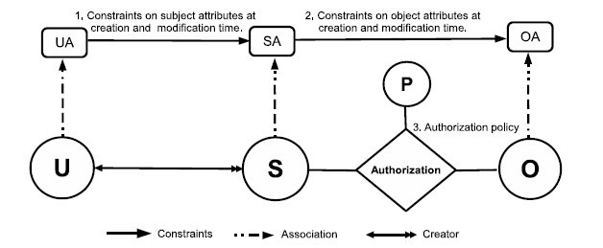
ABAC-alpha Model Structure
Policy Configuration Points
SubCreator as a distinguished subject attribute.
World-Leading Research with Real-World Impact!
15
Notes:
User, subject and object
They are associated with attributes.
User can create subject and own the subject. He is the only one who can destruct the subject.
User suggest attributes for subject attributes. If those satisfy the constraints, they will be assigned. If not, the subject will not be created. Similarly, user can modify subject attributes, the constraints will also need to be satisfied.
Subject create objects on behalf of users. There is no ownership here. Similarly, subject suggest attributes for objects. If they satisfy the constraints, the object will be created. Otherwise, it will not be created.
Object attributes will be modified by subjects and constraints should be satisfied.

Slide 16
Example User Attributes
UA = {Clr, Dept, Proj, Skill}
Attributes assignment for Alice:
Clr(Alice) = classified
Dept(Alice) = finance
Proj(Alice) = {search, game, cloud}
Skill(Alice) = {web, server}
Attribute | Type | Scope
Clr | atomic | unclassified, classified, secret, topsecret
Dept | atomic | software, hardware, finance, market
Proj | set | search, game, mobile, social, cloud
Skill | set | web, system, server, windows, security
World-Leading Research with Real-World Impact!
16
Notes:
UA is like this
And SA, OA is defined for subjects and objects.
UA for users are assigned by administrators discussed in the second part.
SA and OA are assigned and modified by users and subjects respectively.

Slide 17
Policy Configuration Points
Authorization policies for each operation
2. Subject attribute assignment and modification constraints
Exp: Set of Subject Attributes = {location, role, cls}
saset = {(location, CSConference), (role,{faculty, PhD}), (cls, classified)}
3. Object attribute constraints at object creation time
4. Object attribute constraints at object modification
Authorizationop(s, o)
ConstrSub(u, s, saset)
ConstrObj(s, o, oaset)
ConstrObjMod(s, o, oaset)
World-Leading Research with Real-World Impact!
17
Notes:
What is the format of the constraints policy
Why is the difference for objects not subjects? We will illustrate it through configurations from DAC. MAC and RBAC
If they return true, what will be the effect?

Slide 18
Policy Configuration Languages
Authorization policy
Attributes of the involved subject and object
Subject attributes constraints
User attributes and the proposed attributes for subjects
Object attribute constraints at creation time
Attributes of the subject and the proposed value of object
Object attributes constraints at modification time
Attributes of the subject and object and the proposed value of object
World-Leading Research with Real-World Impact!
18
Notes:
Language structure is the same. Because each configuration point allows some comparison between values from subject and objects. This structure is the same. The only difference is that not all attributes are allowed to be referred in the system.
For example, the subject attribute constraints only allows the value . In each language, say simple example.
Detailed example is in next slide

Slide 19
User Discretionary DAC
{}
{}
{reader, owner}
U
S
Authorization
O
OP
ConstrObj(s, o, {(owner, owner_name), (reader, {name1, name2})}):
owner_name = SubCreator(s)
Example:
ConstrObj(Sub-Alice, docA, {(owner, Alice), (reader, {Bob, Carol})}):
Alice = SubCreator(Sub-Alice)
ConstrObj(Sub-Alice, docA, {(owner, Dan), (reader, {Bob, Carol})}):
Dan = SubCreator(Sub-Alice)
ConstrObjMod(s, o, {(owner, owner_name), (reader, {name1, name2})}):
owner(o) = SubCreator(s) and owner_name = SubCreator(s)
World-Leading Research with Real-World Impact!
Notes:
Emphasize the feature
Owner
Modify read list
Create and destruct

Slide 20
Configuration for RBAC
urole
srole
ReadRole, WriteRole
U
S
Authorization
O
A user can only activate roles already assigned to him.
The subject has some role that is in the
ReadRole attribute of the object.
OP
World-Leading Research with Real-World Impact!
20
Notes:
Adding language because we don’t allow the policy to refer to the attributes of other

Slide 21
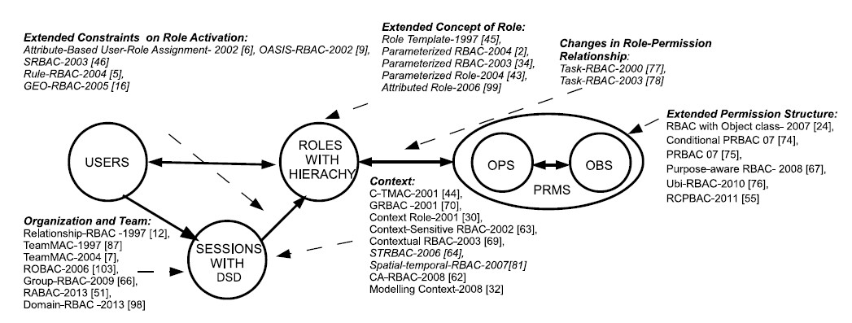
ABAC-beta Scope
1,4
1, 2, 4, 5
1, 4, 5
4, 5
1, 2, 3, 4, 5
4
1, 4, 5
1. Context Attributes
2. Subject attribute constraints policy are different at creation and modification time.
4. Policy Language
5. Meta-Attributes
3. Subject attributes constrained by attributes of subjects created by the same user.
World-Leading Research with Real-World Impact!
21
Notes:
Give examples about what is excluded

Slide 22
Examples
2. Subject attribute constraints policy are different at creation and modification time.
1. Context Attributes
OASIS-RBAC
Prerequisite role
Initial role assignment constraints
Other role assignment constraints
3. Subject attributes constraints by attributes of subjects created by the same user.
Ubi-RBAC
CS Conference Room
Geography
Accounting
Science Building
Business Building
5. Meta-Attributes
UTSA Campus
Task-RBAC
Role
Task
OP
OBJ
task(r1) = {t1, t2}
readtask(o1) = {t1, t2, t3}
urole(u) = {r1, r2}
World-Leading Research with Real-World Impact!
22
Notes:
User can activate their roles in different spaces.
Users is allowed to activate r1 in UTSA space (modeled as subject) and r2 in CS conference room.
If a user does not specify his role in CS Department space, the default roles is depended on his activated roles in UTSA space.

Slide 23
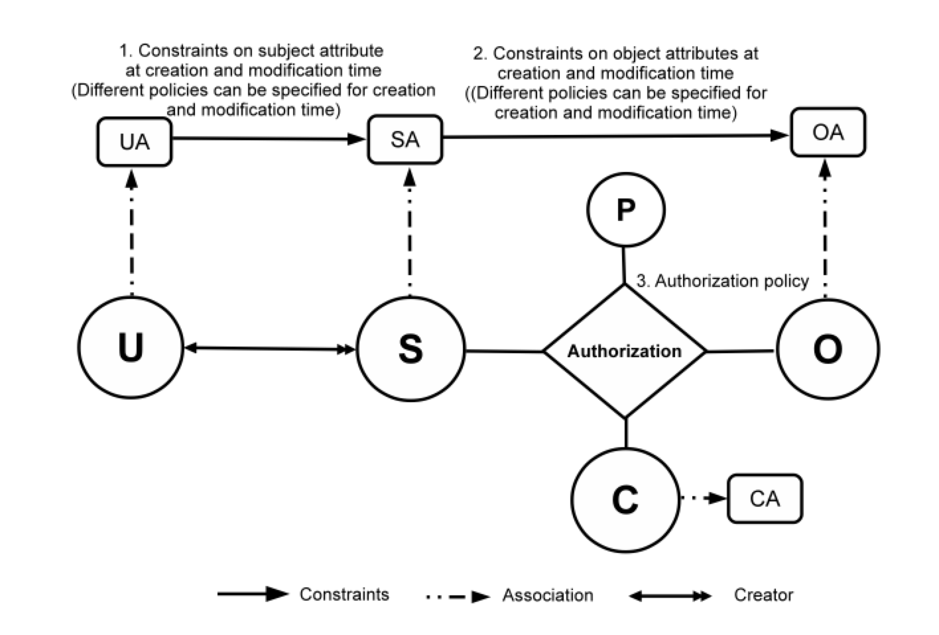
ABAC-beta Model
23
Notes:
Show abac-alpha
Then for each type of extension, highlight the extensions to ABAC
23 and 24 integrated

Slide 24
Summary of ABAC Models
ABAC-alpha: “Least” features to configure DAC, MAC and RBAC
ABAC-beta: extension of ABAC-alpha for the purpose of unifying operational RBAC and its extended models
Future Work
Theoretical analysis of enforcement complexity, RBAC compared with ABAC instance of RBAC
Policy specification language. For example, to be able to detect misconfiguration, compliance with privacy expectation
World-Leading Research with Real-World Impact!
24

Slide 25
Presentation Outline
Introduction
ABAC Operational Models
ABAC Administrative Model
ABAC In IaaS Cloud
Conclusion and Future Work
World-Leading Research with Real-World Impact!

Slide 26
GURA Model
The generalized User-Role Assignment Model (GURA) deals with user-attribute administration.
It is an extension of URA component in ARBAC97
Although subject and object are also associated with attributes, this mode is not suitable
Subject and object attributes are modified by regular users
This model is useful as long as this style of attribute administration is involved
Advantage
Well-documented advantage of RBAC inherited
World-Leading Research with Real-World Impact!
26
Notes:
User attributes assignment is not discussed

Slide 27
GURA Model
Administrators request to modify attributes of users
add, delete, assign
Policy
Administrative users with [administrative roles] can [modify] value [value] to [attribute name] attribute of a user if [condition]
GURA0
can_add project = { (manager, windows in project(u) and linux in project(u), security) }
add(Alice, Bob, project, security) where adrole(Alice) = manager
add(Carol, Bob, project, security) where adrole(Carol) is not manager
GURA1
can_assign approved = { (director, true, {true, false}) }
can_add project = { (manager, windows in project(u) and linux in project(u) and clearance(u) > c and phd in degree(u) and approved(u)= true, security) }
assign(Alice, Bob , approved, true) where adrole(Alice) = director
assign(Carol, Alice, approved, true) where adrole(Carol) is not director
World-Leading Research with Real-World Impact!
27
Notes:
Syntax on the board

Slide 28
Attribute Reachability Problem
att1(u1) = 1
att2(u1) = {2}
att1(u2) = 3
att2(u2) = {4}
+
This state is supposed to be unreachable by the policy.
State
att1(u1) = 1
att2(u1) = {2,3}
att1(u2) = 3
att2(u2) = {4}
att1(u1) = 1
att2(u1) = {2}
att1(u2) = 3
att2(u2) = {4}
……….
This state is supposed to be reachable .
Whether there exists any states which satisfies the query: att1(u1) =3 and att2(u1) contains 4?
World-Leading Research with Real-World Impact!
28

Slide 29
Reachability Query and Types
We define two query types. RP-equal ( ) and RP-super ( )
Query Type: RP-same
Clr(Alice) = classified
Proj(Alice) = {search, cloud}
Clr(Alice) = classified
Dept(Alice) = finance
Proj(Alice) = {search, cloud}
Skill(Alice) = {web, server}
Clr(Alice) = classified
Dept(Alice) = finance
Proj(Alice) = {search, game, cloud}
Skill(Alice) = {web, server}
Query Type: RP-super
Clr(Alice) = classified
Dept(Alice) = market
Proj(Alice) = {search, cloud}
Clr(Alice) = classified
Dept(Alice) = finance
Proj(Alice) = {search, cloud}
Skill(Alice) = {web, server}
Clr(Alice) = classified
Dept(Alice) = market
Proj(Alice) = {search, game, cloud}
Skill(Alice) = {web, server}
rGURA is different from GURA model only in the [condition] specification languages for administrative rules
Only conjunction and negation is allowed
World-Leading Research with Real-World Impact!
29

Slide 30
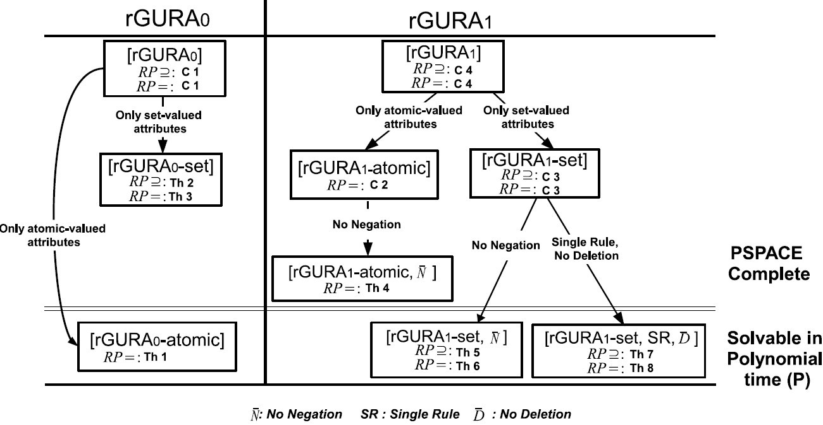
Analysis Results Summary
World-Leading Research with Real-World Impact!
30
Notes:
Understand pspace and turing machine
Polynomial time algorithm to generate path

Slide 31
Presentation Outline
Introduction
ABAC Operational Models
ABAC Administrative Model
ABAC In IaaS Cloud
Conclusion and Future Work
World-Leading Research with Real-World Impact!

Slide 32
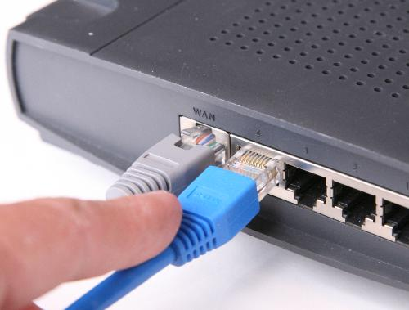
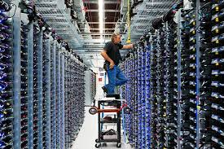
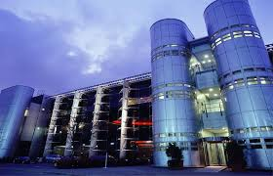
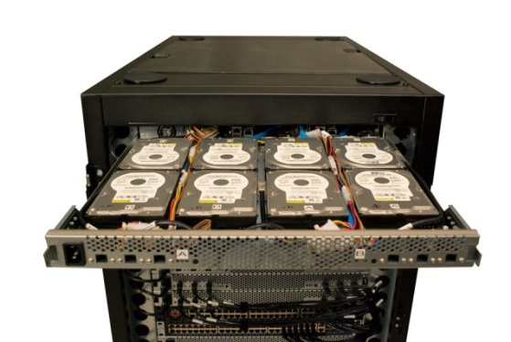
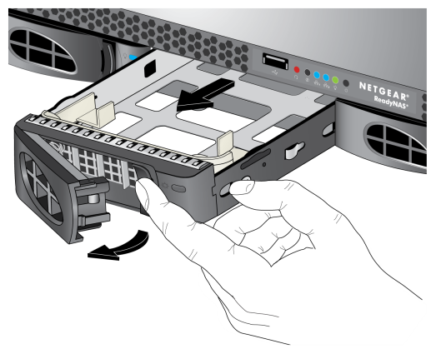
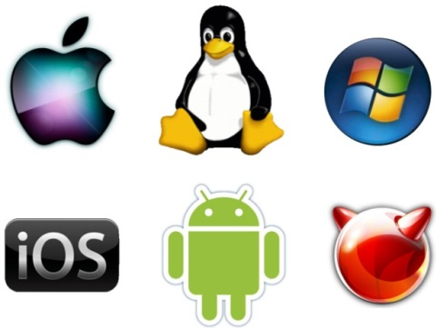
Operations in Local Data Center
World-Leading Research with Real-World Impact!
32

Slide 33
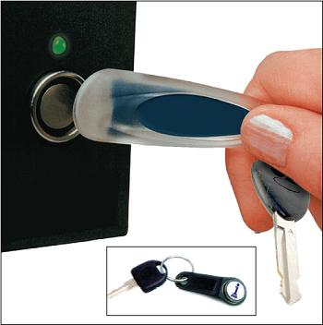
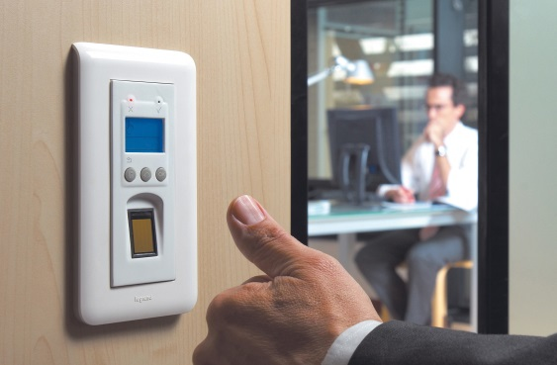
Access Control
World-Leading Research with Real-World Impact!
33

Slide 34
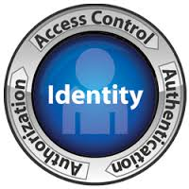
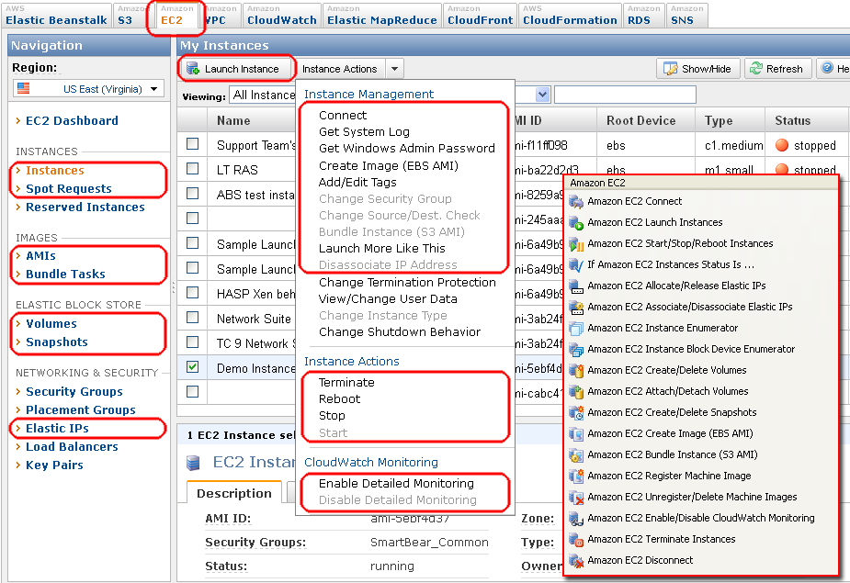
Access Control in IaaS Cloud
Equivalent policy in physical world should be able to be configured using cloud access control service
With virtualization, cloud may provide more fine-grained access control
World-Leading Research with Real-World Impact!
34

Slide 35
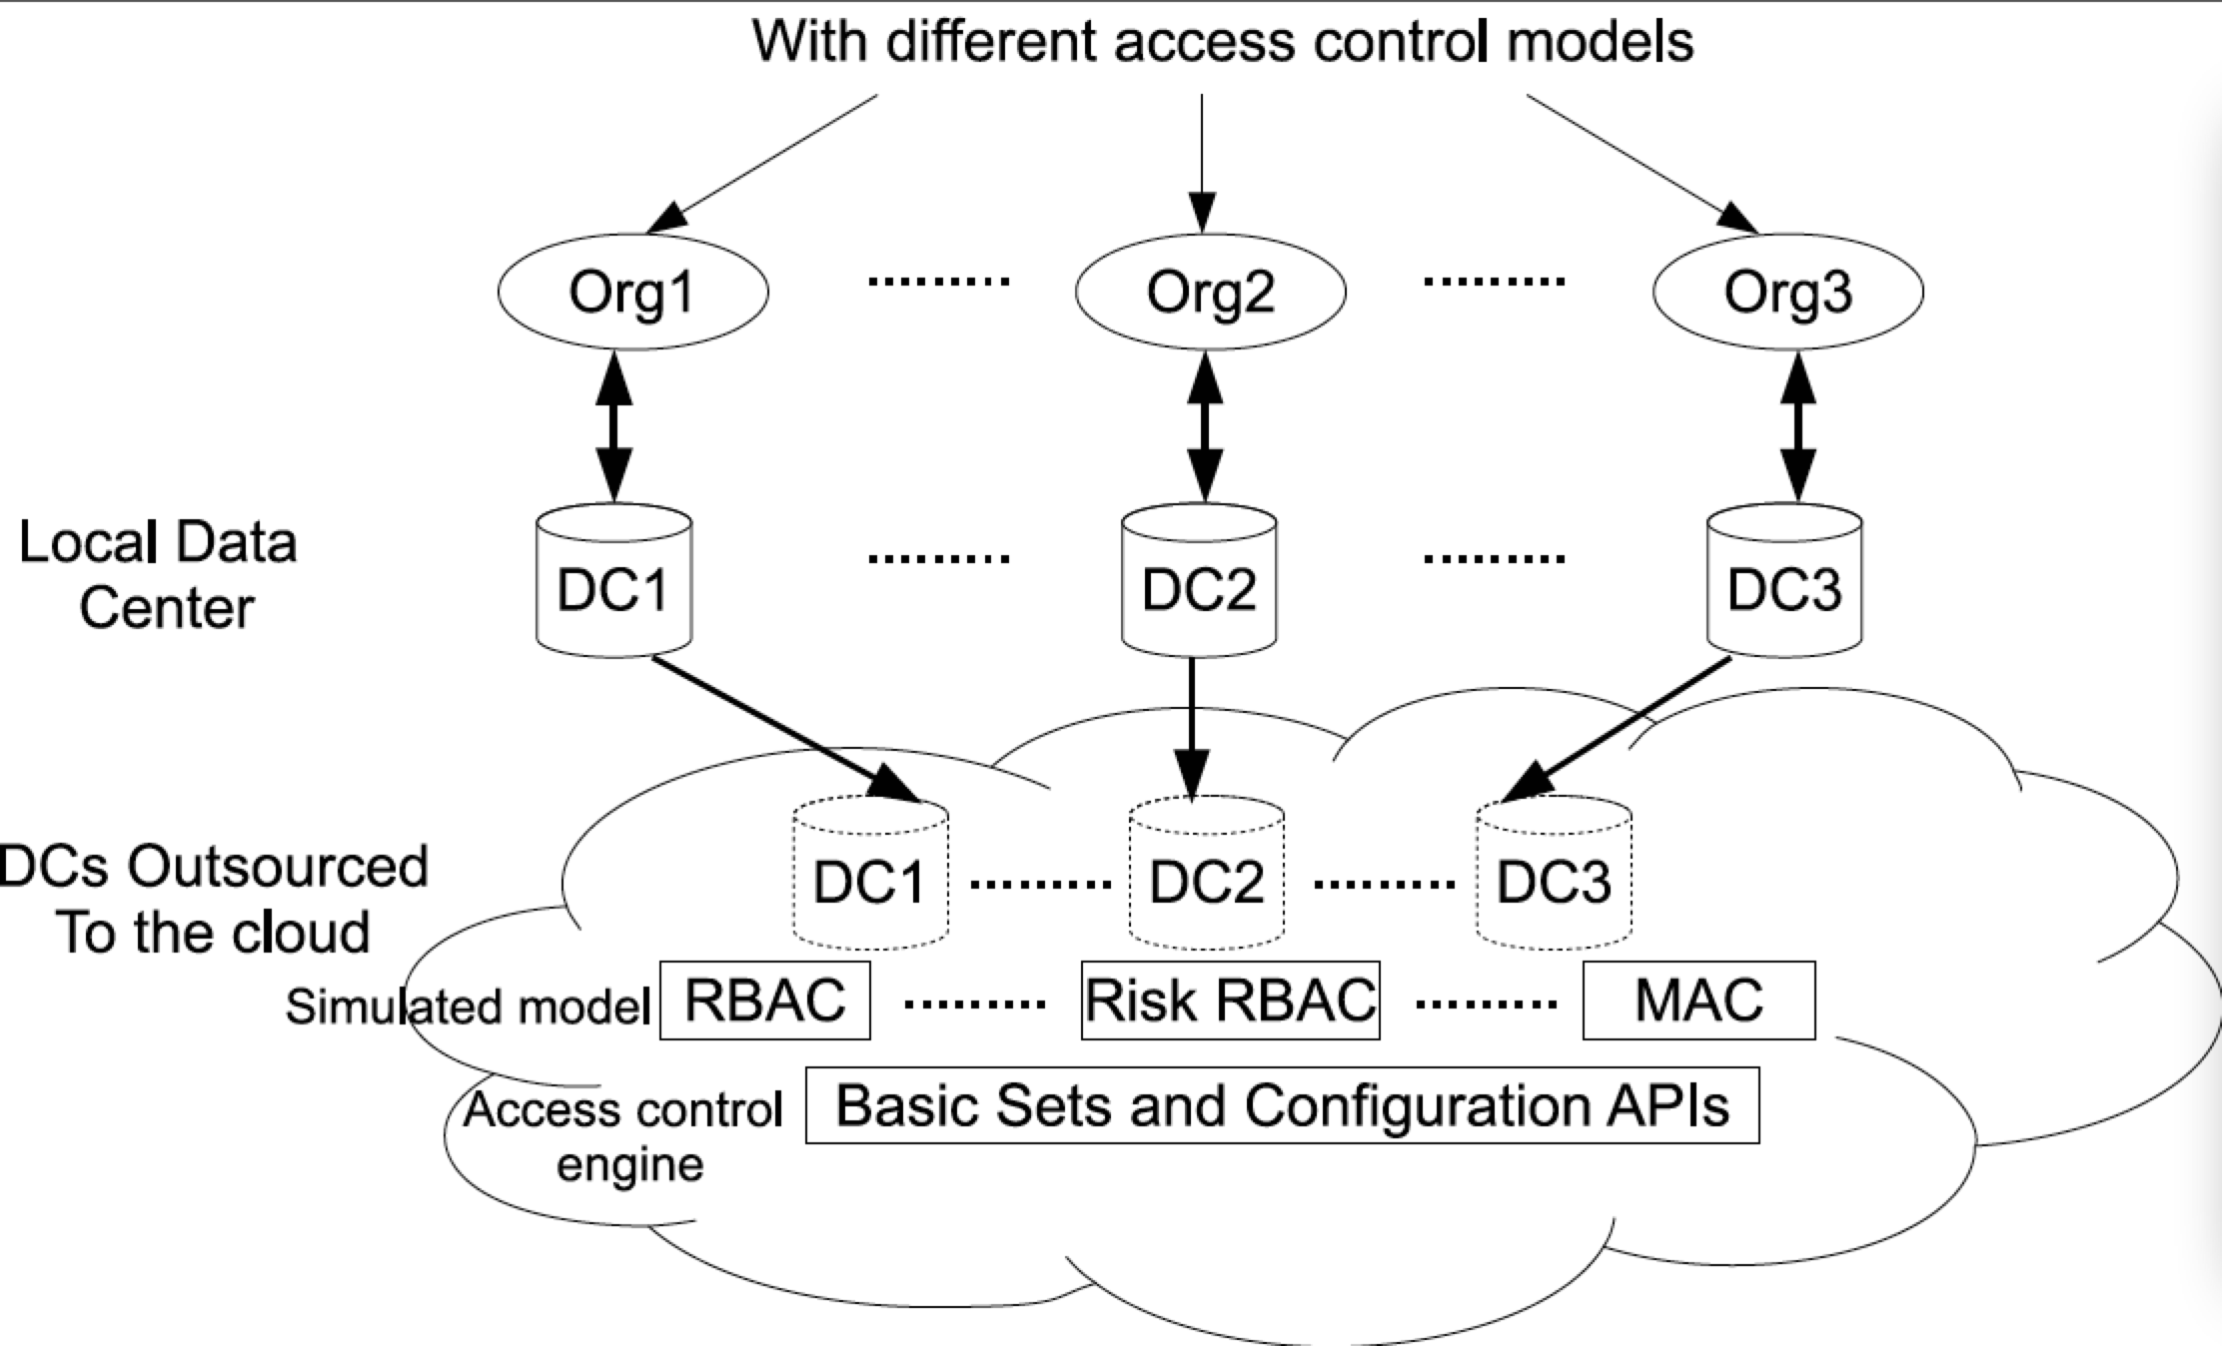
Problem
World-Leading Research with Real-World Impact!
35
Notes:
Mention domain and group

Slide 36
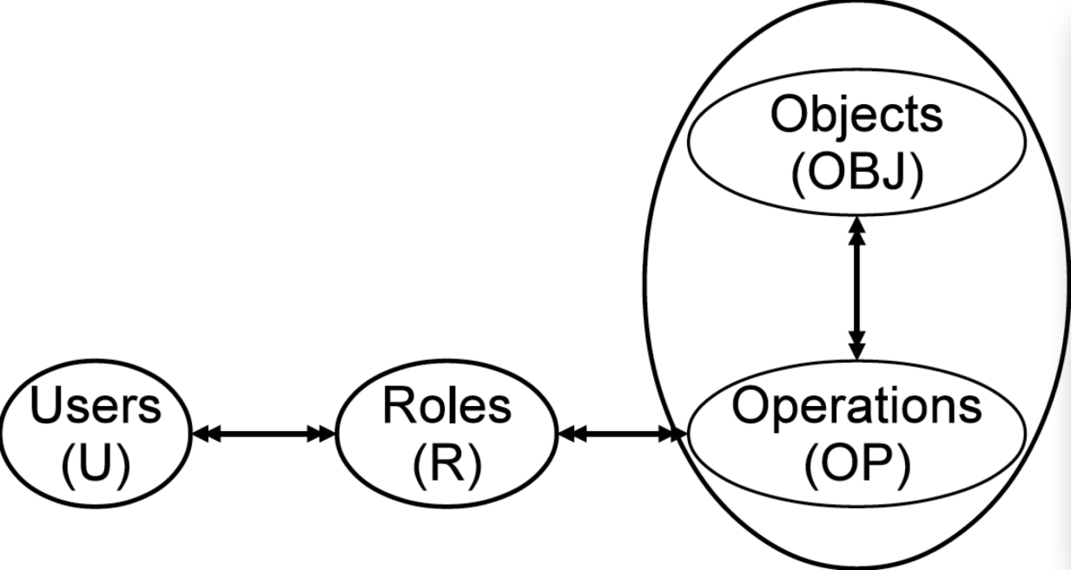
OpenStack (Grizzly Release)
Limitations
Tenant can not configure their own policy, uses cloud role instead
Not able to configure tenant administrator
Access control on operation level, no control on object level
Give identity:createUser permission to role r1, then r1 can create users in any tenant
Give nova:stop permission to role r1, r1 can stop any machine in the tenant
Access control only based on role
World-Leading Research with Real-World Impact!
36

Slide 37
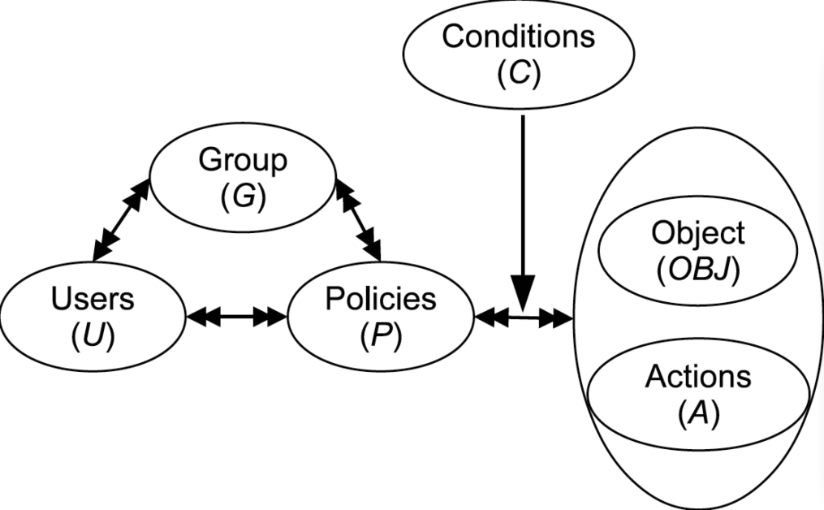
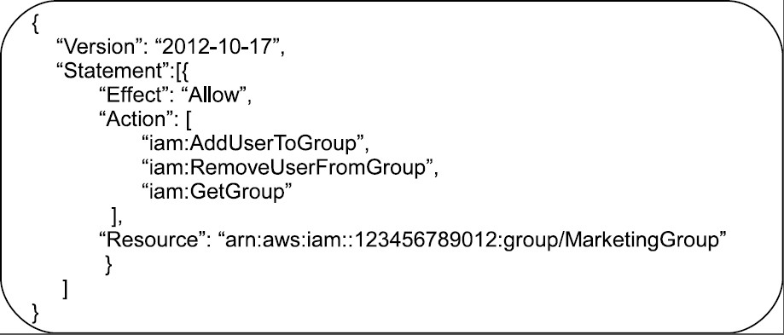
AWS Access Control
World-Leading Research with Real-World Impact!
37
Notes:
Emphasize concept of account

Slide 38
AWS Access Control
Advantages over OpenStack
Tenant has full control over their own policy, by account root user
Flexible policy : groups, user id, time, address.
Control over resources and operations
Limitations
No automation
Restricted set of attributes
Not flexible enough, group explosion (e.g., can not configure DAC, cumbersome to configure MAC)
No extension available (e.g., can not include customized attributes)
No subject and user distinction
World-Leading Research with Real-World Impact!
38

Slide 39
ABAC Solving Problems
Flexibility
Covers DAC, MAC and RBAC
Covers RBAC extensions
Resource-level fine-grained access control
Automation
User attributes inherited by subject and further object, access control automatically added for newly created objects
Ease in policy specification
Attributes defined to reflect semantic meaning and policy specified with certain level of relationship to natural language
World-Leading Research with Real-World Impact!
39

Slide 40
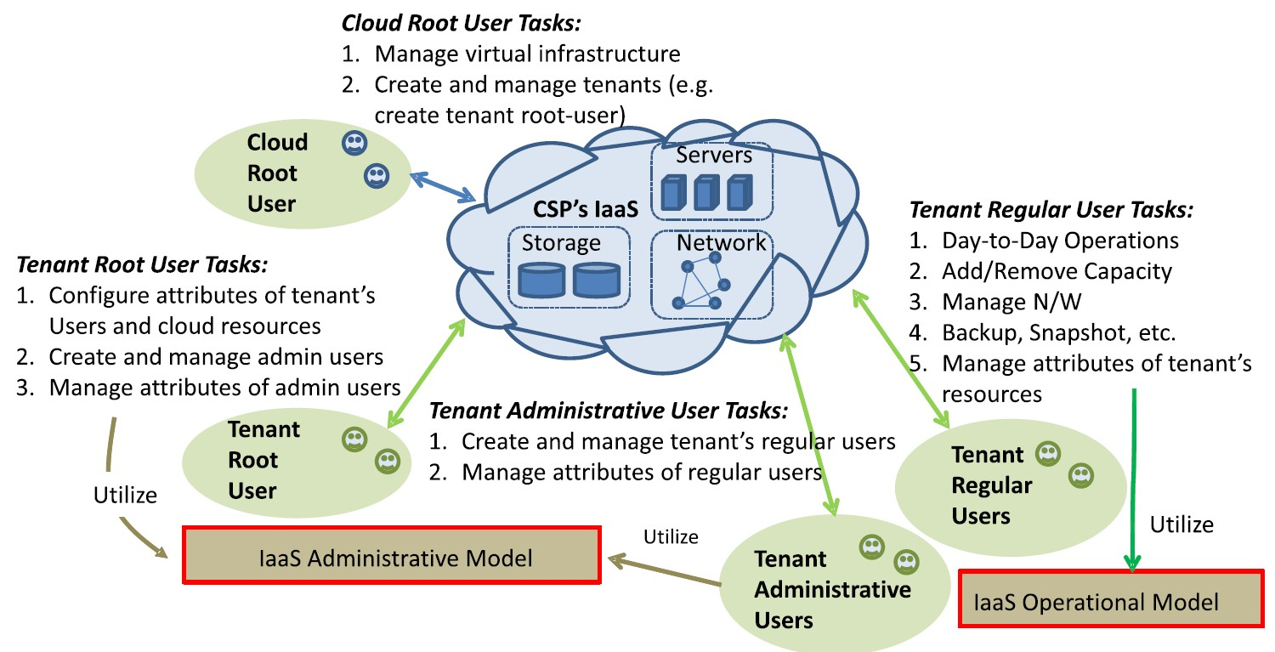
Access Control in IaaS
World-Leading Research with Real-World Impact!
40
Notes:
Take the CS department migration as example
All types of users first
What is used to control their actions
How does this policy be configured

Slide 41
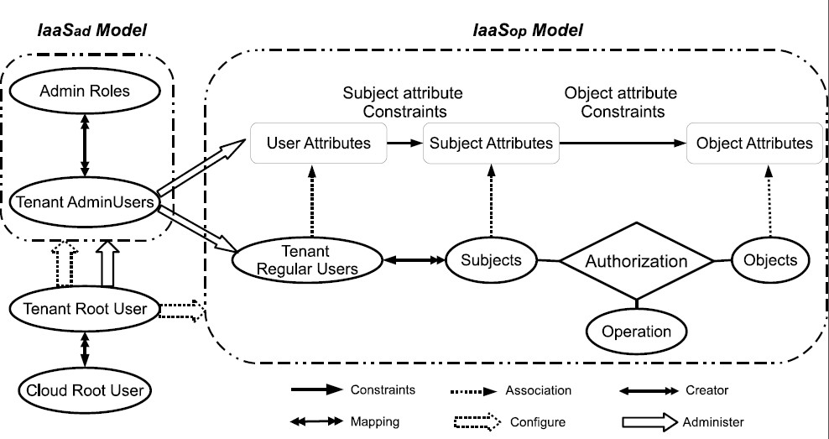
IaaSad and IaaSop Model
Different types of object may have different sets of attributes.
World-Leading Research with Real-World Impact!
41

Slide 42
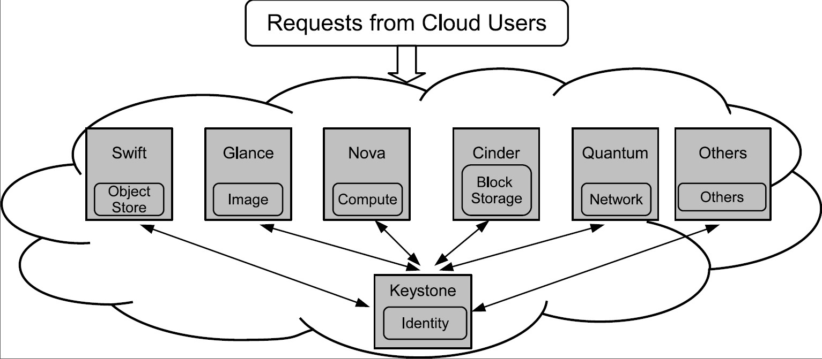
OpenStack
World-Leading Research with Real-World Impact!
42

Slide 43
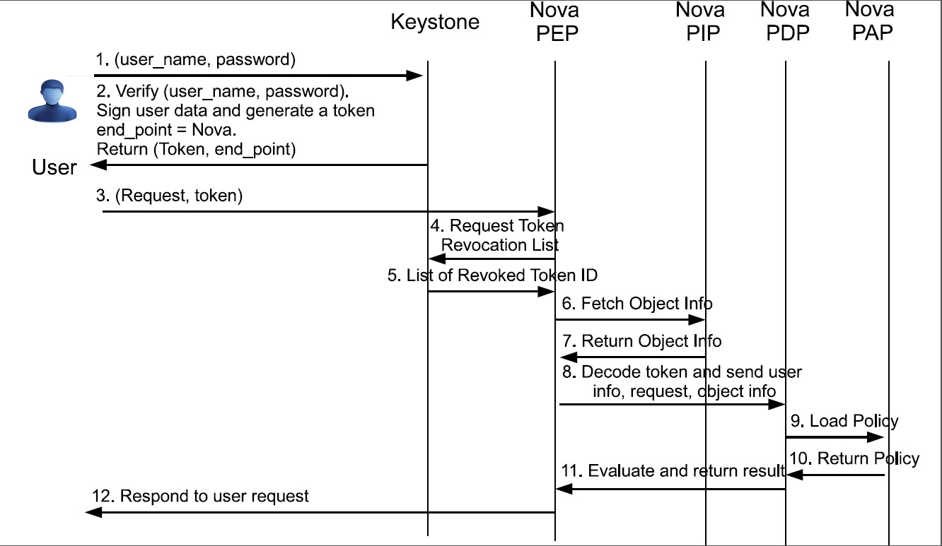
OpenStack Authorization for Nova
World-Leading Research with Real-World Impact!
43
Notes:
What is a token and how is it generated?

Slide 44
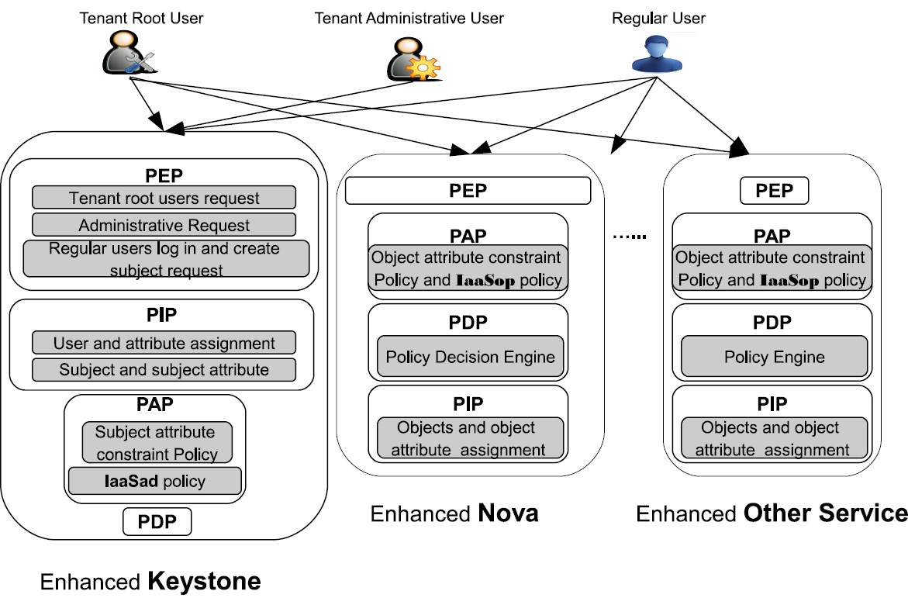
Enforcement Models
Enforcement Model I
World-Leading Research with Real-World Impact!
44

Slide 45
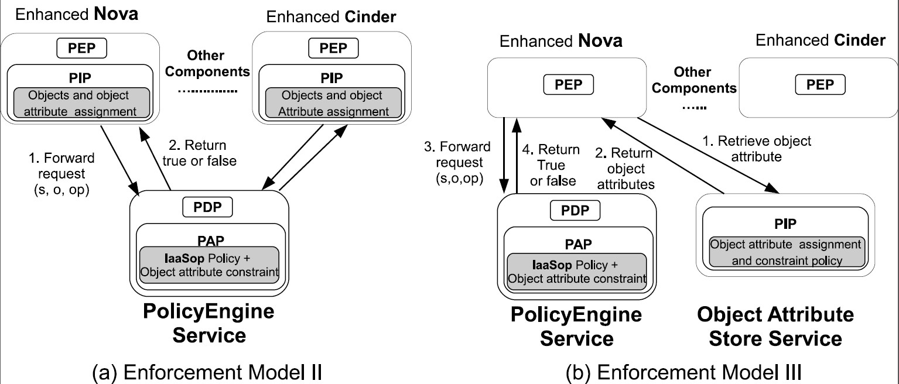
Enforcement Models
World-Leading Research with Real-World Impact!
45

Slide 46
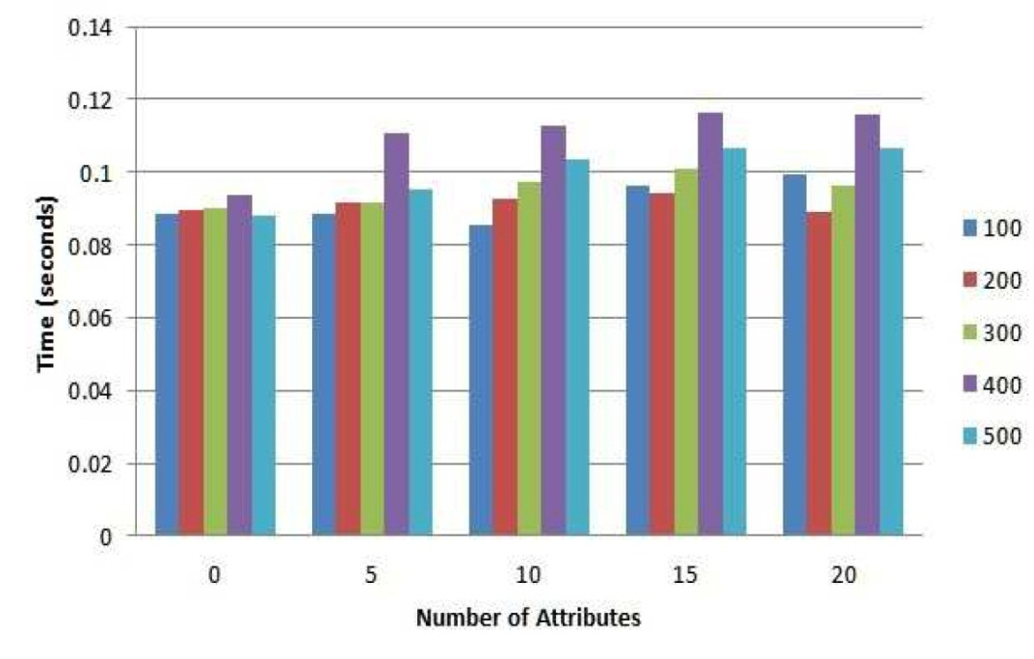
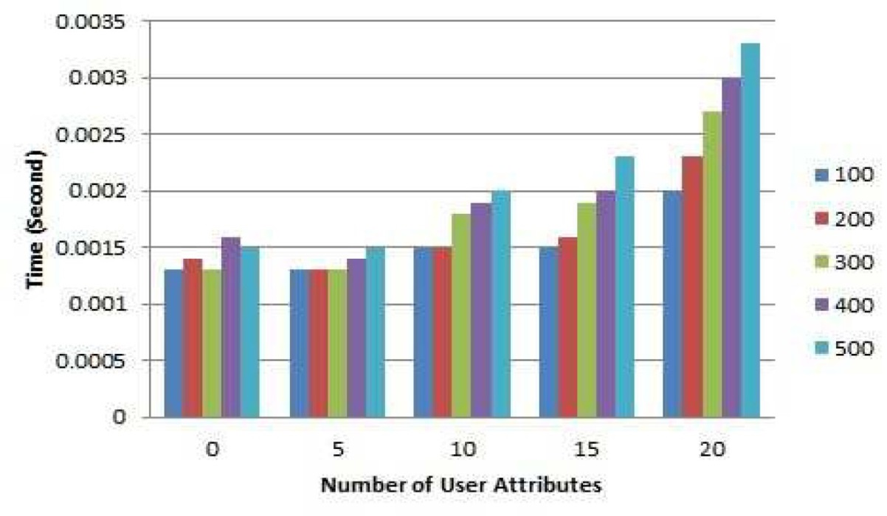
Experiment Result
Time for generating token from Keystone
(Enforcement Model 1)
Time for receiving request from PolicyEngine
(Enforcement Model 2)
World-Leading Research with Real-World Impact!
46

Slide 47
Conclusion
Policy
Formal Operational Model. ABAC-alpha to cover classical models DAC, MAC and RBAC; ABAC-beta extends ABAC-alpha to cover extensions to RBAC model which is dominant in recent decades
Formal administration Model GURA. Straight forward extension to Administrative RBAC model, easy extension to attribute based model
Formal reachability analysis on GURA model, future analysis on extended models subsumes our results
Enforcement
ABAC designed for single tenant access control in IaaS
Implementation
Implement ABAC on selected components in OpenStack and evaluate performance
World-Leading Research with Real-World Impact!
47

Slide 48
Publications
[1] Xin Jin, Ram Krishnan, and Ravi Sandhu. A unified attribute-based access control model covering DAC, MAC and RBAC. Data and Applications Security and Privacy XXVI, pages 41–55, 2012 (cited by 32)
[2] Xin Jin, Ram Krishnan, and Ravi Sandhu. A role-based administration model for attributes. In Proceedings of the First International Workshop on Secure and Resilient Architectures and Systems, pages 7–12. ACM, 2012.
[3] Xin Jin, Ram Krishnan, Ravi Sandhu, Reachability analysis for role-based administration of attributes. ACM DIM Workshop , held In Conjunction with ACM CCS , 2013.
[4] Xin Jin, Ram Krishnan, Ravi Sandhu, Unified attribute based access control model covering RBAC and its extensions. To be submitted to journal.
[5] Xin Jin, Ram Krishnan, Ravi Sandhu, Attribute-Based Access Control for Cloud Infrastructure as a Service. To be submitted to conference.
Others:
[6] Xin Jin, Ravi Sandhu, and Ram Krishnan. RABAC: Role-centric attribute-based access control. In 6th International Conference, on Mathematical Methods, Models, and Architectures for Computer Network Security, MMM-ACNS 2012.
[7] Ravi Sandhu, Khalid Zaman Bijon, Xin Jin, and Ram Krishnan. RT-based administrative models for community cyber security information sharing. In Collaborative Computing: Networking, Applications and Work sharing (CollaborateCom), 2011 7th International Conference on, pages 473–478. IEEE, 2011.
World-Leading Research with Real-World Impact!
48

Slide 49
Thanks
Questions?
World-Leading Research with Real-World Impact!
49

