Slide 1


Secure Cyber Incident Information Sharing
UTSA Team Leads
Dr. Ram Krishnan, Assistant Professor, ECE
Dr. Ravi Sandhu, Professor (CS) and Executive Director (ICS)
April 09, 2014

Slide 2









LMI Research Institute (LRI):
Academic Partnership Program
Through formal working relationships with universities across the country, LMI bridges the gap between academia and industry to create innovative solutions and explore new research topics
The partnership program exposes students to real-world challenges faced by the federal government through structured, funded research projects

Slide 3
Cyber Incident Response
Secure information sharing amongst a set of entities/organizations
  Often ad hoc
What are the effective ways to facilitate information sharing in such circumstances?
  Information sharing models
  Infrastructure, technologies, platforms

Slide 4
Agile Incident Response
Org A
Personnel Join/Leave
County Threat Emergency Response
Long-Term
Members
Org B
Team 1
Personnel+Resources
Personnel+Resources
Local Police
Org C
Resources Add/Remove
Within a team:
Controlled access
Flexible and fine-grained access control
Team should function unaffected by membership dynamics
Org D
Team 2

Slide 5
Cyber Incident
Information Sharing Scenarios
High-assurance scenarios
  Closed network
  Data exfiltration
Medium-assurance scenarios
  Community
  Electric grid

Slide 6
Closed Network Scenario
Unusual activity in Air Force, Navy & Army networks
A physically secure and air-gapped meeting room with members from AFCYBER, ARCYBER and FLTCYBER
Members bring data for analysis and collaboration
  Maps, a VM configured with software tools, a VM image with a virus/worm, log files, etc.
Strict control on data import/export

Slide 7
Data Exfiltration Scenario
Unusual file transfers from IP addresses within an org to an external IP address
Similar activities observed in partner orgs
Need to find if these events are connected
  Any correlation between those files?
Members bring data for analysis+collaboration

Slide 8
Community Scenario
Cyber incidents across critical infrastructure providers in a community
  Emergency response, healthcare, banks, utility
Need a community information sharing platform
  Controlled access

Slide 9
Electric Grid Scenario
Cyber incidents in electric power provider orgs
  Local utilities, ISOs, ERCOT, NERC
Need a standing platform to facilitate sharing
  Controlled access

Slide 10
Key Requirements
Cyber infrastructure sharing to support data and compute
Light-weight and agile
Rapid deployment and configuration
Secure environment

Slide 11
Cloud Infrastructure as a Service
Virtualized IT infrastructure (servers, storage, networks, OS, etc.)
  Delivered as a service over a network, on demand, dynamic scaling, etc.
Prominent examples
  Amazon AWS
  OpenStack

Slide 12
Information Sharing in a High-Assurance Scenario
Physically secure meeting room
Air-gapped network
Cloud-in-a-box

Slide 13

Enforcement in Cloud IaaS
Air-Gapped Meeting Room
Cloud-in-a-Box
Add/Remove Data
Add/Remove Data
Secure Isolated Domain (SID)
View #1: OrgC
View #2: SID
View #1: OrgA
View #2: SID
Participant C
Participant A
Join/Leave Users
Join/Leave Users
Add/Remove Data
Join/Leave Users
Participant B
View #1: OrgB
View #2: SID

Slide 14
Next Steps
UTSA to incorporate 24 AF input
Develop prototype in OpenStack
Share research results with 24 AF
  August/September

Slide 15
Thanks
Comments, Q&A

Slide 16
Backup

Slide 17
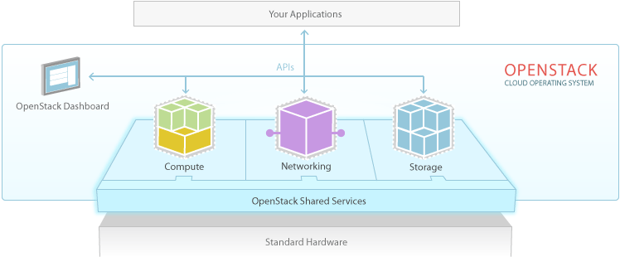
OpenStack
> 200 companies
~14000 developers
>130 countries
OpenStack
  Dominant open source cloud IaaS platform

Slide 18
Project Goal
Tenant #3
Tasks:
Manage Virtual Infrastructure
Create and Manage Tenants (e.g. create tenant super-user)
Inter-Tenant Sharing
CSP Personnel
Tenant #2
CSP’s OpenStack
Servers
Storage
Network
Tasks:
Architect Attributes of Org’s Users + Cloud Resources
Create and Manage Admin Users
Manage Attributes of Admin Users
Tasks:
Day-to-Day Operations
Add/Remove Capacity
Manage N/W
Backup, Snapshot, etc.
Tasks:
Create and Manage Org’s Regular Users
Manage Attributes of Regular Users
Manage Attributes of Org’s Resources
Tenant #1 Regular IT Users
Tenant #1
IT Super-Users (Architects)
Tenant #1 Administrative IT Users
Utilize
Utilize
Utilize
ABAC Administrative Models
ABAC Operational Models

