Slide 1
Institute for Cyber Security
Towards ABAC in Hadoop Ecosystem
Prof. Ravi Sandhu
Executive Director and Endowed Chair
Institute for Cyber Security, University of Texas at San Antonio
ravi.sandhu@utsa.edu, www.profsandhu.com
Ford EEIT & GDIA
Big Data Access Control Symposium
Dearborn, Michigan
May 2, 2017

Slide 2
PEI Models: 3 Layers
Security and system goals
(objective policy)
Necessarily Informal
Policy Models
Formal/
quasi-formal
System block diagrams, protocol flows
Enforcement Models
Pseudo-code
Implementation Models
Actual Code

Slide 3
PEI Models: 3 Layers
Security and system goals
(objective policy)
Necessarily Informal
Policy Models
Formal/
quasi-formal
System block diagrams, protocol flows
Enforcement Models
Pseudo-code
Implementation Models
Actual Code

Slide 4
Multi-Layer Authorization
Data and Objects
Services
Cluster Resources and Applications

Slide 5
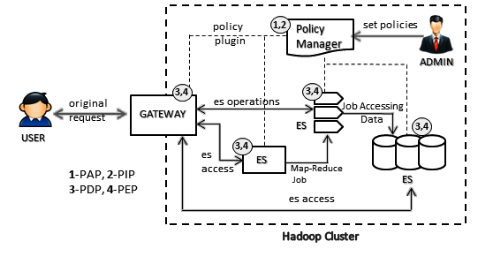
Hadoop Ecosystem
Enforcement Model
Policy Manager : Apache Ranger, Apache Sentry
Gateway : Apache Knox
Ecosystem Service (ES) : Apache Hive, HDFS, Apache Storm, Apache Kafka, YARN

Slide 6
PEI Models: 3 Layers
Security and system goals
(objective policy)
Necessarily Informal
Policy Models
Formal/
quasi-formal
System block diagrams, protocol flows
Enforcement Models
Pseudo-code
Implementation Models
Actual Code

Slide 7
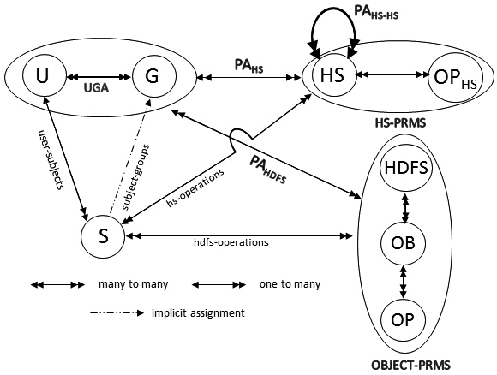
AC Model: Hadoop View
Users (U), Groups (G) , Subjects (S)
Hadoop Services (HS) : NameNode, YARN ResourceManager
Hadoop Service Operations (OP_{HS}) : access / communicate
Objects (OB) : Files and Directories in HDFS
Operations (OP) : read, write, execute

Slide 8
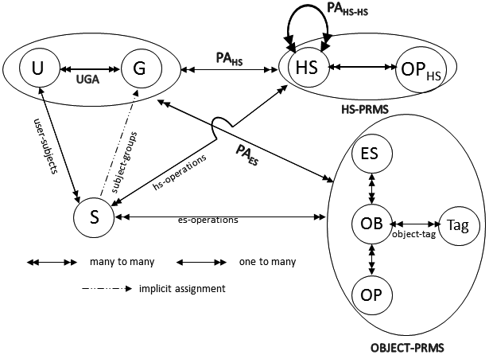
AC Model: Ranger View
Ecosystem Service (ES) : Hive, HDFS, Kafka, HBase
Objects (OB) : Files and Directories in HDFS; Tables, columns in Hive
Operations (OP) : read, write, execute, select, create
Tag : PII, top-secret

Slide 9
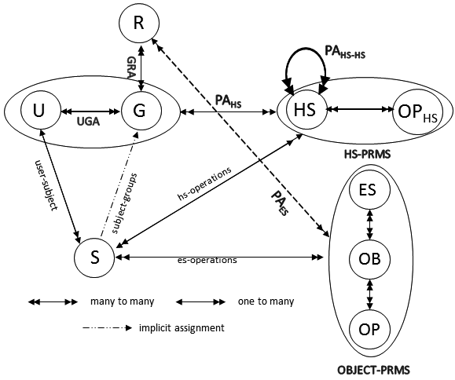
AC Model: Sentry View
Roles (R)

Slide 10
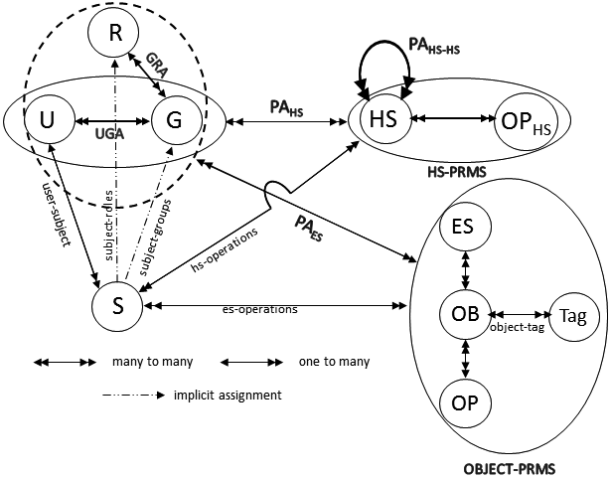
AC Model: Consolidated View

Slide 11
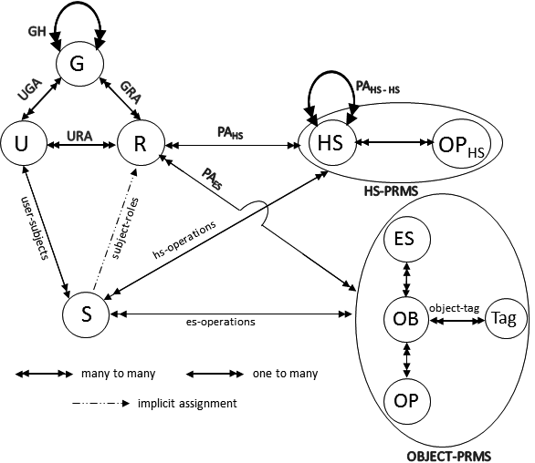
Proposed OT-RBAC Model
Object-Tagged RBAC

Slide 12
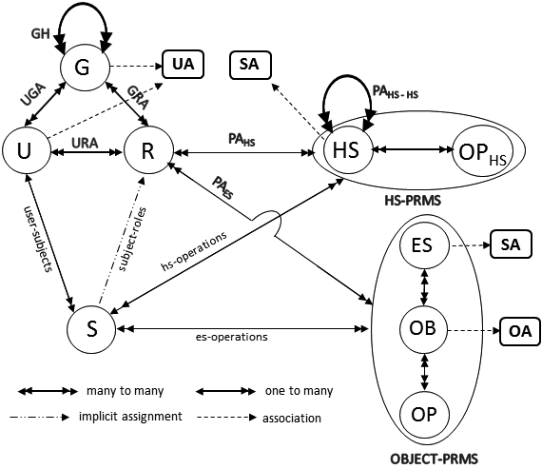
Adding Attributes to OT-RBAC

Slide 13
PEI Models: 3 Layers
Security and system goals
(objective policy)
Necessarily Informal
Policy Models
Formal/
quasi-formal
System block diagrams, protocol flows
Enforcement Models
Pseudo-code
Implementation Models
Actual Code

Slide 14
Publications
Gupta, M., Patwa, F., and Sandhu, R.: Object-Tagged RBAC Model for the Hadoop Ecosystem. In: Proc. of 31st Annual IFIP WG 11.3 Conference on Data and Applications Security and Privacy (DBSec), Philadelphia, PA, July 19-21, 2017. Available soon at http://www.profsandhu.com/conference_papers.htm
Gupta, M., Patwa, F., Benson, J., and Sandhu, R.: Multi-layer Authorization Framework for a Representative Hadoop Ecosystem Deployment. In: Proc. of 22nd ACM Symposium on Access Control Models and Technologies (SACMAT), Indianapolis, IN, June 21-23, 2017. http://profsandhu.com/confrnc/misconf/sacmat17-maanak.pdf
Sandhu, R.: The PEI Framework for Application-Centric Security. In: Proc. 5th IEEE International Conference on Collaborative Computing: Networking, Applications and Worksharing (CollaborateCom), Crystal City, Virginia, November 11-14, 2009. http://profsandhu.com/confrnc/misconf/collabcom09_pei.pdf

