Slide 1
Attribute-Based Access Control Models
and Beyond
Prof. Ravi Sandhu
Executive Director, Institute for Cyber Security
Lutcher Brown Endowed Chair in Cyber Security
University of Texas at San Antonio
AsiaCCS Keynote Talk
Singapore
April 16, 2015
ravi.sandhu@utsa.edu, www.profsandhu.com, www.ics.utsa.edu
© Ravi Sandhu
World-Leading Research with Real-World Impact!

Slide 2
Access Control
Discretionary Access Control (DAC), 1970
Mandatory Access Control (MAC), 1970
Role Based Access Control (RBAC), 1995
Attribute Based Access Control (ABAC), ????
© Ravi Sandhu
World-Leading Research with Real-World Impact!
2

Slide 3
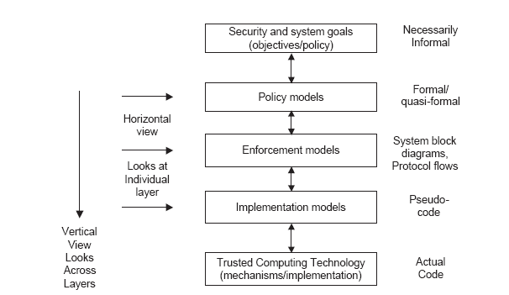
PEI Models
Idealized
Enforceable
(Approximate)
Codeable
© Ravi Sandhu
World-Leading Research with Real-World Impact!
3

Slide 4
Access Control
Discretionary Access Control (DAC), 1970
Mandatory Access Control (MAC), 1970
Role Based Access Control (RBAC), 1995
Attribute Based Access Control (ABAC), ????
© Ravi Sandhu
World-Leading Research with Real-World Impact!
4

Slide 5
Access Control
Fixed
policy
Discretionary Access Control (DAC), 1970
Mandatory Access Control (MAC), 1970
Role Based Access Control (RBAC), 1995
Attribute Based Access Control (ABAC), ????
Flexible
policy
© Ravi Sandhu
World-Leading Research with Real-World Impact!
5

Slide 6
Access Control
Enterprise
Oriented
Discretionary Access Control (DAC), 1970
Mandatory Access Control (MAC), 1970
Role Based Access Control (RBAC), 1995
Attribute Based Access Control (ABAC), ????
Beyond
Enterprise
© Ravi Sandhu
World-Leading Research with Real-World Impact!
6

Slide 7
Access Control
Administration
Driven
Discretionary Access Control (DAC), 1970
Mandatory Access Control (MAC), 1970
Role Based Access Control (RBAC), 1995
Attribute Based Access Control (ABAC), ????
Automated
Adaptive
© Ravi Sandhu
World-Leading Research with Real-World Impact!
7

Slide 8
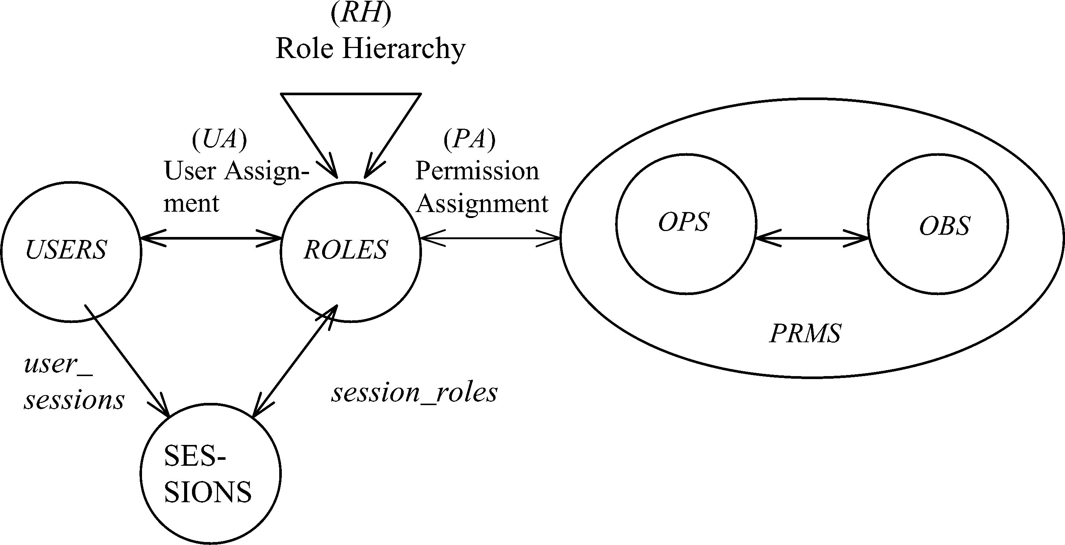
RBAC96 Model
Constraints
© Ravi Sandhu
World-Leading Research with Real-World Impact!
8

Slide 9
Fundamental Theorem of RBAC
  RBAC can be configured to do MAC
  RBAC can be configured to do DAC
  RBAC is policy neutral
RBAC is neither MAC nor DAC!
© Ravi Sandhu
World-Leading Research with Real-World Impact!
9

Slide 10
RBAC Shortcomings
Hard Enough
Impossible
Constraints
© Ravi Sandhu
World-Leading Research with Real-World Impact!
10

Slide 11
The RBAC Story
NIST-ANSI
Standard
Adopted
NIST-ANSI
Standard Proposed
RBAC96
model
Ludwig Fuchs, Gunther Pernul and Ravi Sandhu, Roles in Information Security-A Survey and Classification of the Research Area, Computers & Security, Volume 30, Number 8, Nov. 2011, pages 748-76
© Ravi Sandhu
World-Leading Research with Real-World Impact!
11

Slide 12
ABAC Status
Standard
Adopted
Proposed
Standard
RBAC96
paper
1990?
2015
ABAC still in pre/early phase
© Ravi Sandhu
World-Leading Research with Real-World Impact!
12

Slide 13
ABAC is not New
User (Identity)
Attributes
Public-keys +
Secured secrets
© Ravi Sandhu
World-Leading Research with Real-World Impact!

Slide 14
ABAC is not New
User (Identity)
X.500
Directory
X.509
Identity Certificates
Attributes
Public-keys +
Secured secrets
Pre Internet, early 1990s
© Ravi Sandhu
World-Leading Research with Real-World Impact!

Slide 15
ABAC is not New
User (Identity)
X.509
Attribute
Certificates
X.509
Identity Certificates
Attributes
Public-keys +
Secured secrets
Post Internet, late 1990s
© Ravi Sandhu
World-Leading Research with Real-World Impact!

Slide 16
ABAC is not New
User (Identity)
Attributes
SPKI Certificates
Public-keys +
Secured secrets
Post Internet, late 1990s
© Ravi Sandhu
World-Leading Research with Real-World Impact!

Slide 17
ABAC is not New
User (Identity)
Attributes
Anonymous
Credentials
Public-keys +
Secured secrets
Mature Internet, 2000s
© Ravi Sandhu
World-Leading Research with Real-World Impact!

Slide 18
ABAC is not New
Attributes
Action
Authorization Decision
User
Subject
Yes/No
Object
Context
XACML
Policy
Mature Internet, 2000s
© Ravi Sandhu
World-Leading Research with Real-World Impact!

Slide 19
ABAC is not New
unified model integrating
  authorization
  obligation
  conditions
and incorporating
  continuity of decisions
  mutability of attributes
Usage Control Models, early 2000s
© Ravi Sandhu
World-Leading Research with Real-World Impact!

Slide 20
ABAC Status
Standard
Adopted
Proposed
Standard
RBAC96
paper
1990?
2015
ABAC still in pre/early phase
© Ravi Sandhu
World-Leading Research with Real-World Impact!
20

Slide 21
Access Control
Discretionary Access Control (DAC), 1970
Mandatory Access Control (MAC), 1970
Role Based Access Control (RBAC), 1995
Attribute Based Access Control (ABAC), ????
© Ravi Sandhu
World-Leading Research with Real-World Impact!
21

Slide 22
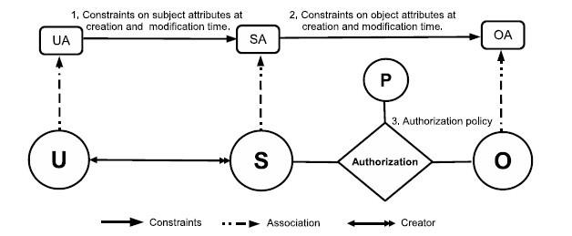
ABACα Model Structure
Policy Configuration Points
Can be configured to do simple forms of DAC, MAC, RBAC
© Ravi Sandhu
World-Leading Research with Real-World Impact!
22

Slide 23
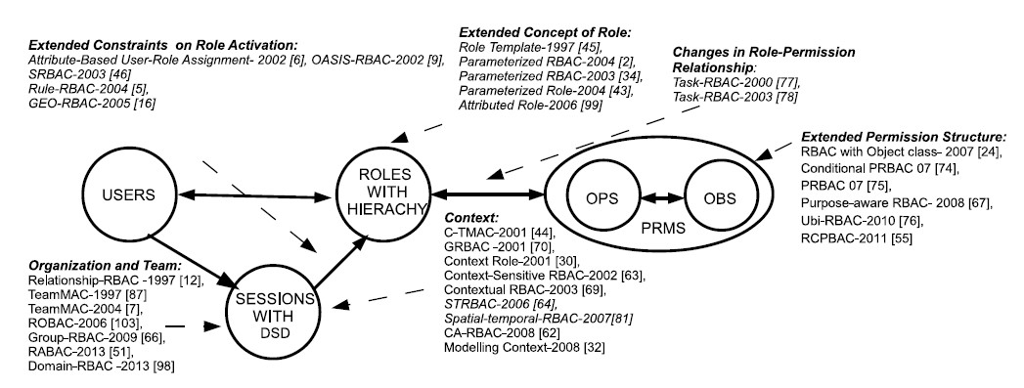
RBAC Extensions
1,4
1, 2, 4, 5
1, 4, 5
4, 5
1, 2, 3, 4, 5
4
1, 4, 5
1. Context Attributes
2. Subject attribute constraints policy are different at creation and modification time.
4. Policy Language
5. Meta-Attributes
3. Subject attributes constrained by attributes of subjects created by the same user.
World-Leading Research with Real-World Impact!
23
Notes:
Give examples about what is excluded

Slide 24
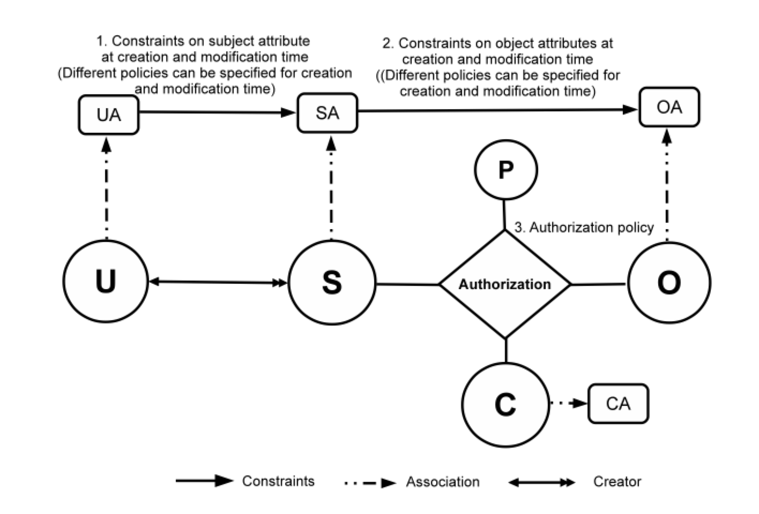
ABAC_{β} Model
Can be configured to do many
RBAC extensions
24
Notes:
Show abac-alpha
Then for each type of extension, highlight the extensions to ABAC
23 and 24 integrated

Slide 25
SOME RESEARCH CHALLENGES
© Ravi Sandhu
World-Leading Research with Real-World Impact!

Slide 26
Ultimate Unified Model
Attributes
Security
Access Control
Trust
Risk
Relationships
Provenance
© Ravi Sandhu
World-Leading Research with Real-World Impact!

Slide 27
Expressive Power
Idealized
Enforceable
(Approximate)
Codeable
© Ravi Sandhu
World-Leading Research with Real-World Impact!
27

Slide 28
Safety Analysis
Idealized
Enforceable
(Approximate)
Codeable
© Ravi Sandhu
World-Leading Research with Real-World Impact!
28

Slide 29
Attribute and Policy Engineering
29
Notes:
Show abac-alpha
Then for each type of extension, highlight the extensions to ABAC
23 and 24 integrated

Slide 30
Application Domains
  Cloud computing
  Internet of Things
  ……….
© Ravi Sandhu
World-Leading Research with Real-World Impact!
30

Slide 31
Access Control
Discretionary Access Control (DAC), 1970
Mandatory Access Control (MAC), 1970
Role Based Access Control (RBAC), 1995
Attribute Based Access Control (ABAC), ????
© Ravi Sandhu
World-Leading Research with Real-World Impact!
31

