Slide 1
Cyber Security R&D: A Personal Perspective
Ravi Sandhu Executive Director Professor of Computer Science Lutcher Brown Chair in Cyber Security
May 2019
ravi.sandhu@utsa.edu www.ics.utsa.edu www.profsandhu.com

Slide 2
ICS Facts and Figures
MISSION
Excellence in graduate-level sponsored research
PAST SYNOPSIS
Founded: 2007
PhDs graduated: 25
External funding raised: $22M
CURRENT STATUS
Faculty affiliates: 20
College of Sciences: 8, Engineering: 5, Business: 5, Education: 2
Includes 6 with research fully managed through ICS
Current PhD students: 32
College of Sciences: 22, Engineering: 7, Business: 2, Education: 1
Domestic: 17
Foreign: 15
Current non-PhD students: 8
Domestic: 7
Foreign: 1

Slide 3
Holistic Cyber Security Research
Objectives
POLICY
ATTACKS
Enable
What?
Why?
Respond
Enforce
Defend
PROTECT
How?
DETECT
Mechanisms
Complement

Slide 4
Holistic Cyber Security Research
Objectives
POLICY
ATTACKS
Enable
What?
Why?
Respond
Requires
Institute Level Effort
World Class Laboratories
Global Collaborative Connections
Enforce
Defend
PROTECT
How?
DETECT
Mechanisms
Complement

Slide 5
ICS Major Research Thrusts
APPLICATION DOMAINS
Cloud Computing, Internet of Things (IoT), Social Media, Big Data, Mobile Platforms, Enterprise, Insider Threat, Scientific Infrastructure, Smart Homes, Smart Cities, Smart Cars etcetera
WORLD CLASS LABS
FlexCloud
Flex Farm
FOUNDATIONAL TECHNOLOGIES
Access Control, Policy, Malware, Forensics, Blockchain, Artificial Intelligence, Machine Learning, Data Provenance, Formal Methods etcetera
Goal: Broaden and Deepen

Slide 6
Security Objectives
INTEGRITY
modification
AVAILABILITY
access
CONFIDENTIALITY
disclosure

Slide 7
Security Objectives
USAGE
purpose
Covers privacy and intellectual property protection
INTEGRITY
modification
AVAILABILITY
access
CONFIDENTIALITY
disclosure

Slide 8
Security Objectives
USAGE
purpose
USAGE
INTEGRITY
modification
AVAILABILITY
access
CONFIDENTIALITY
disclosure

Slide 9
Security Objectives
Cannot have it all
Need to reconcile
with non-Security Objectives
Cost
Convenience
Growth
CIAU
Safety

Slide 10
Cyber Security Goal
Enable system designers and operators to say:
This system is secure
Enable system designers and operators to say:
This system is as secure as it needs to be and no more
Not attainable
Many successful examples

Slide 11
Cyber Security is Dynamic
“My dear, here we must run as fast as we can, just to stay in place. And if you wish to go anywhere you must run twice as fast as that.”
― Lewis Carroll, Alice in Wonderland

Slide 12
Cyber Security Big Trends
Single enterprise
Cyber only
Configured
Static
Experts
Fractured
Multiple interacting parties
Cyber physical
Automated
Adaptive
Naïve users
Seamless

Slide 13
Cryptography
Symmetric Key Cryptography, 1977
Asymmetric Key Cryptography, 1996
BlockChain Applications, ????

Slide 14
Access Control
Discretionary Access Control (DAC), 1970
Mandatory Access Control (MAC), 1970
Role Based Access Control (RBAC), 1995
Attribute Based Access Control (ABAC), ????

Slide 15
Discretionary Access Control (DAC)
Core concept:
Custodian of information determines access
Core drawback:
Does not protect copies Therefore OK for integrity but not for confidentiality

Slide 16
Mandatory Access Control (MAC)
Top Secret
Secret
Confidential
Unclassified
can-flow

Slide 17
Mandatory Access Control (MAC)
Core concept:
Extend control to copies by means of security labels
Core drawback:
Covert channels can make copies that bypass this control

Slide 18
Access Control
Discretionary Access Control (DAC), 1970
Mandatory Access Control (MAC), 1970
Role Based Access Control (RBAC), 1995
Attribute Based Access Control (ABAC), ????

Slide 19
Role-Based Access Control (RBAC)
Primary-Care
Physician
Specialist
Physician
Physician
Health-Care Provider

Slide 20
Role-Based Access Control (RBAC)
Core concept:
Roles determine everything
Core drawback:
Roles are a natural concept for human users But not so natural for: Information objects IoT things Contextual attributes

Slide 21
Role-Based Access Control (RBAC)
Fundamental theorem of RBAC:
RBAC can be configured to do DAC
RBAC can be configured to do MAC

Slide 22
Access Control
Discretionary Access Control (DAC), 1970
Mandatory Access Control (MAC), 1970
Role Based Access Control (RBAC), 1995
Attribute Based Access Control (ABAC), ????

Slide 23
Attribute-Based Access Control (ABAC)
Operation
Access
Decision?
Yes/No
Actor
Target
Context

Slide 24
Attribute-Based Access Control (ABAC)
Core concept:
Attributes determine everything
Core drawback:
Flexibility at the cost of complexity
No fixed access decision rule

Slide 25
Access Control
Discretionary Access Control (DAC), 1970
Mandatory Access Control (MAC), 1970
Role Based Access Control (RBAC), 1995
Attribute Based Access Control (ABAC), ????

Slide 26
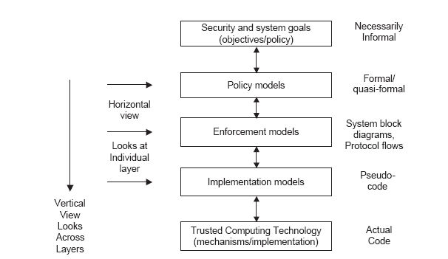
Access Control PEI Layers
Idealized
Enforceable
(Approximate)
Codeable

Slide 27
ICS Major Research Thrusts
APPLICATION DOMAINS
Cloud Computing, Internet of Things (IoT), Social Media, Big Data, Mobile Platforms, Enterprise, Insider Threat, Scientific Infrastructure, Smart Homes, Smart Cities, Smart Cars etcetera
WORLD CLASS LABS
FlexCloud
Flex Farm
FOUNDATIONAL TECHNOLOGIES
Access Control, Policy, Malware, Forensics, Blockchain, Artificial Intelligence, Machine Learning, Data Provenance, Formal Methods etcetera
Goal: Broaden and Deepen

Slide 28
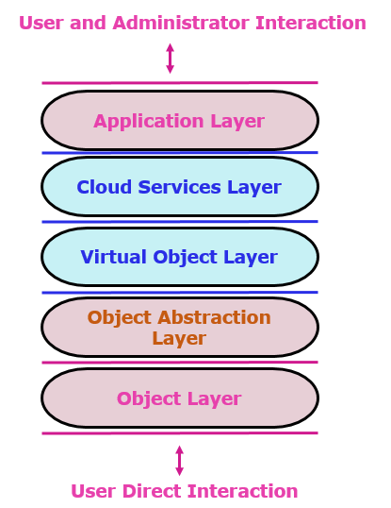
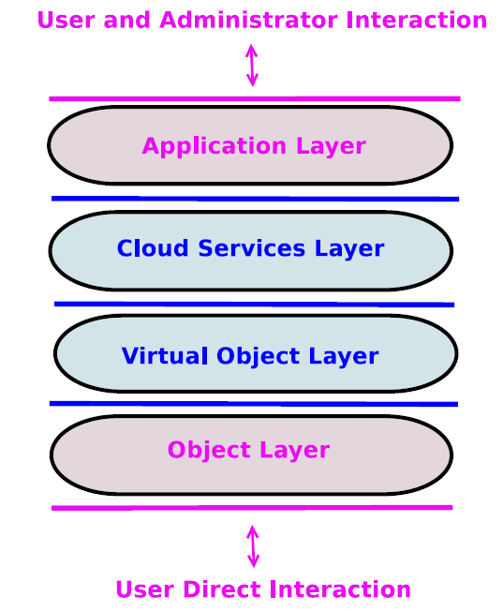
Cloud-Enabled IoT (CE-IoT)
a) Access Control Oriented (ACO) Architecture
b) Enhanced ACO (E-ACO) Architecture

Slide 29
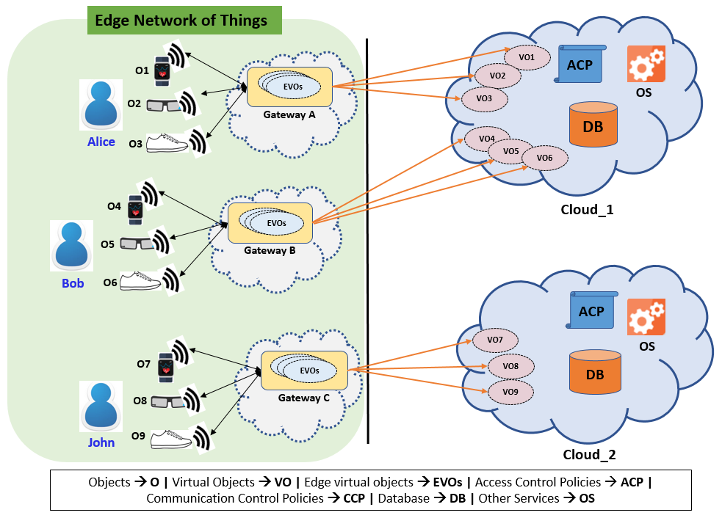
CE-IoT Enforcement Model
Certificate and Crypto Based Communication control
Attribute-Based Communication Control
CCP
Bandwidth and Latency
User-Centric Privacy
CCP
CCP

