Slide 1
Security and Privacy in the
Networked World
Prof. Ravi Sandhu
Executive Director and Endowed Chair
CODASPY Panel
March 3, 2014
ravi.sandhu@utsa.edu
www.profsandhu.com
www.ics.utsa.edu
© Ravi Sandhu
World-Leading Research with Real-World Impact!

Slide 2
Questions
What technologies and standards have proven to be not that useful from the perspective of safeguarding security?
What new technologies hold the most promise from the perspective of safeguarding security?
What other fields should we look to for inspiration?
What is the right mix of policy, technology, and legal recourses to minimize loss?
© Ravi Sandhu
World-Leading Research with Real-World Impact!
2

Slide 3
Questions
What technologies and standards have proven to be not that useful from the perspective of safeguarding security?
What new technologies hold the most promise from the perspective of safeguarding security?
What other fields should we look to for inspiration?
What is the right mix of policy, technology, and legal recourses to minimize loss?
© Ravi Sandhu
World-Leading Research with Real-World Impact!
3

Slide 4
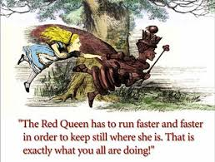
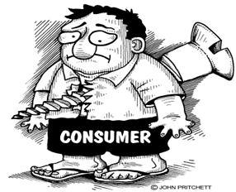
Perennial State of Cyber Security
Micro-security
Macro-security
© Ravi Sandhu
World-Leading Research with Real-World Impact!
4

Slide 5
Perennial Cyber Security Conundrum
What is the value of being “secure” while being “insecure”?
© Ravi Sandhu
World-Leading Research with Real-World Impact!
5

Slide 6
Grand Challenges
Cyber security as reconciliation of tradeoffs
Finding Goldilocks
Holistic versus myopic security
Don’t miss the forest for the trees
Technical versus social mechanisms
Neither one is sufficient
World-Leading Research with Real-World Impact!
6

