Slide 1
Institute for Cyber Security
Future of Access Control:
Attributes, Automation, Adaptation
Prof. Ravi Sandhu
Executive Director, Institute for Cyber Security
Lutcher Brown Endowed Chair in Cyber Security
University of Texas at San Antonio
PSG College of Technology, ICC3 Conference, Keynote
December 19, 2013
ravi.sandhu@utsa.edu, www.profsandhu.com, www.ics.utsa.edu
© Ravi Sandhu
World-Leading Research with Real-World Impact!

Slide 2
Institute for Cyber Security
The Science, Engineering, and
Business of Cyber Security
Prof. Ravi Sandhu
Executive Director, Institute for Cyber Security
Lutcher Brown Endowed Chair in Cyber Security
University of Texas at San Antonio
PSG College of Technology, ICC3 Conference, Keynote
December 19, 2013
ravi.sandhu@utsa.edu, www.profsandhu.com, www.ics.utsa.edu
© Ravi Sandhu
World-Leading Research with Real-World Impact!

Slide 3


Cyber Security Status
MicroSecurity
Not too bad
About as good as it is going to get
Criminals can only defraud so many
Big government/big business are real threats
MacroSecurity
New arena for researchers
Highly asymmetric, includes offense, clandestine
Dual goals: strong offense, strong defense
Cyber should be controllable
Nuclear, chemical, biological have been “controlled”
© Ravi Sandhu
World-Leading Research with Real-World Impact!
3

Slide 4
Cyber Security Status
MicroSecurity
Not too bad
About as good as it is going to get
Criminals can only defraud so many
Big government/big business are real threats
MacroSecurity
New arena for researchers
Highly asymmetric, includes offense, clandestine
Dual goals: strong offense, strong defense
Cyber should be controllable
Nuclear, chemical, biological have been “controlled”
Run as fast as you can to stay in place
© Ravi Sandhu
World-Leading Research with Real-World Impact!
4

Slide 5
21st Century Cyberspace
≈ 2010 US Department of Defense epiphanies
  A new domain akin to land, sea, air and space
  Have and use offensive cyber weapons
  Malware penetrations in highly classified networks
Consumerization of cyberspace
  Anytime, Anywhere, Anything
  BYOD: Bring your own device
  BYOC: Bring your own cyberspace?
Entanglement of cyber-physical-social space
  Just starting
© Ravi Sandhu
World-Leading Research with Real-World Impact!
5

Slide 6
Cyber Security Goal
Enable system designers and operators to say:
This system is secure
There is an infinite supply of low-hanging attacks
Not attainable
© Ravi Sandhu
World-Leading Research with Real-World Impact!
6

Slide 7
Cyber Security Goal
Enable system designers and operators to say:
This system is secure
There is an infinite supply of low-hanging attacks
Alternate goal:
This system is as secure as possible
More secure is always better
Not attainable
Not appropriate
© Ravi Sandhu
World-Leading Research with Real-World Impact!
7

Slide 8
Cyber Security Goal
Enable system designers and operators to say:
This system is secure “enough”
Mass scale, rather low assurance
  ATM network, On-line banking, E-commerce
One of a kind, extremely high assurance
  US President’s nuclear football
Many successful examples
© Ravi Sandhu
World-Leading Research with Real-World Impact!
8

Slide 9
Cyber Security Goal
Enable system designers and operators to say:
This system is secure “enough”
Mass scale, rather low assurance
  ATM network, On-line banking, E-commerce
One of a kind, extremely high assurance
  US President’s nuclear football
Many successful examples
Science
Engineering
Business
© Ravi Sandhu
World-Leading Research with Real-World Impact!
9

Slide 10
Cyber Security Ecosystem
Science
Science explains the cause of observed phenomenon
Engineering
Business
Distinguishing Characteristics of Cyber/Cyber Security
Cyberspace is an entirely man-made domain
Evolves rapidly and unpredictably
Validation primarily with respect to future systems
© Ravi Sandhu
World-Leading Research with Real-World Impact!
10

Slide 11
Cyber Security Ecosystem
Science
Science explains the cause of observed phenomenon and enables better construction of future systems
Engineering
Business
Distinguishing Characteristics of Cyber/Cyber Security
Cyberspace is an entirely man-made domain
Evolves rapidly and unpredictably
Validation primarily with respect to future systems
© Ravi Sandhu
World-Leading Research with Real-World Impact!
11

Slide 12
Scientific Method: Natural Sciences
Hypothesis
Prediction
Experimentation
Prediction
Confirmed
Prediction
Falsified
Hypothesis → Law
Reject Hypothesis
© Ravi Sandhu
World-Leading Research with Real-World Impact!
12

Slide 13
Scientific Method: Natural Sciences
Paradigms
Hypothesis
Prediction
Experimentation
Prediction
Confirmed
Prediction
Falsified
Hypothesis → Law
Reject Hypothesis
© Ravi Sandhu
World-Leading Research with Real-World Impact!
13

Slide 14
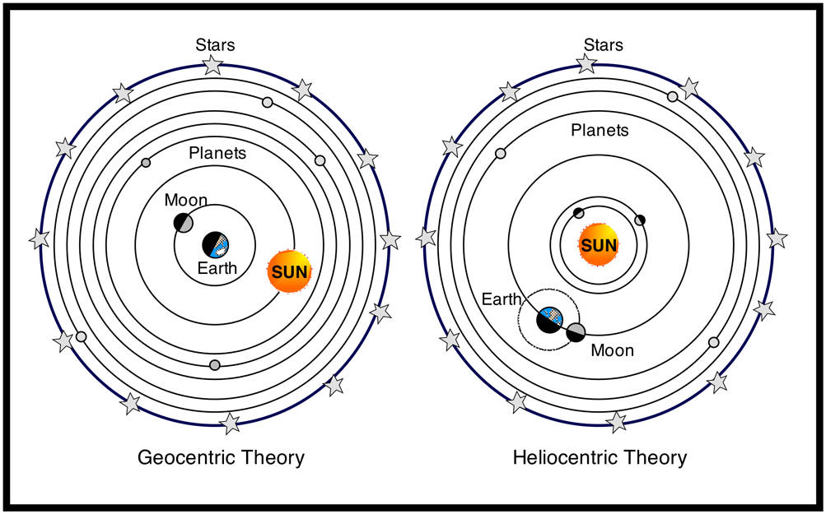
Heliocentric versus Geocentric
© Ravi Sandhu
World-Leading Research with Real-World Impact!
14

Slide 15
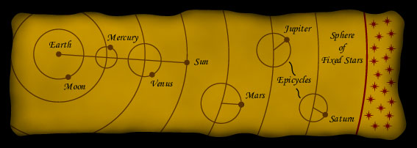
Epicycles
© Ravi Sandhu
World-Leading Research with Real-World Impact!
15

Slide 16
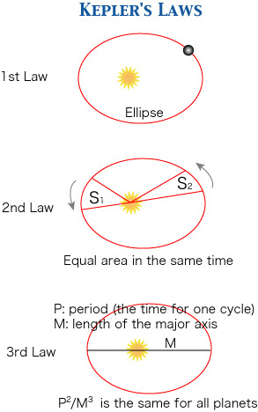
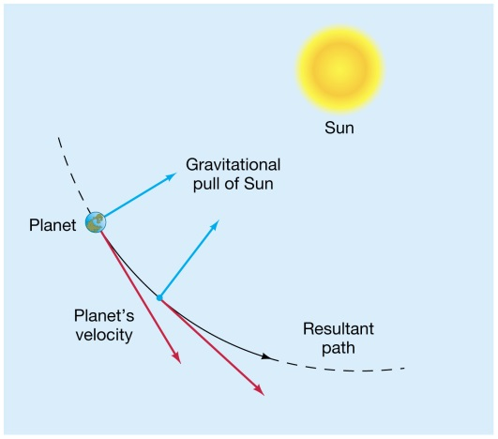
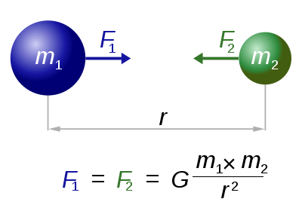
Circles versus Ellipses
© Ravi Sandhu
World-Leading Research with Real-World Impact!
16

Slide 17
Scientific Method: Cyber Sciences
Paradigms
Science explains the cause of observed phenomenon and enables better construction of future systems
Hypothesis
Prediction
Experimentation
Prediction
Confirmed
Prediction
Falsified
Hypothesis → Law
Reject Hypothesis
© Ravi Sandhu
World-Leading Research with Real-World Impact!
17

Slide 18
Science Quadrants
Utility
H
Edison
Pasteur
Fundamental
Understanding
L
H
junk
Bohr
Donald Stokes, 1997
Pasteur’s Quadrant: Basic
Science and Technological Innovation
L
© Ravi Sandhu
World-Leading Research with Real-World Impact!
18

Slide 19
Cyber Science Quadrants
Utility
H
Jobs
Cerf-Kahn
Fundamental
Understanding
L
H
junk
Turing
L
© Ravi Sandhu
World-Leading Research with Real-World Impact!
19

Slide 20
Cyber Security Quadrants
Utility
H
??
??
Fundamental
Understanding
L
H
junk
??
L
© Ravi Sandhu
World-Leading Research with Real-World Impact!
20

Slide 21
Access Control Decomposition
Policy
Specification
Policy
Enforcement
Policy
Administration
© Ravi Sandhu
World-Leading Research with Real-World Impact!
21

Slide 22
Access Control Decomposition
Policy
Specification
Policy
Enforcement
Policy
Reality
Policy
Administration
© Ravi Sandhu
World-Leading Research with Real-World Impact!
22

Slide 23
Access Control
Discretionary Access Control (DAC), 1970
Mandatory Access Control (MAC), 1970
Role Based Access Control (RBAC), 1995
Attribute Based Access Control (ABAC), ????
© Ravi Sandhu
World-Leading Research with Real-World Impact!
23

Slide 24
Access Control
Discretionary Access Control (DAC), 1970
Mandatory Access Control (MAC), 1970
Role Based Access Control (RBAC), 1995
RBAC can be configured to do MAC or DAC
Attribute Based Access Control (ABAC), ????
© Ravi Sandhu
World-Leading Research with Real-World Impact!
24

Slide 25
Access Control
Fixed
Policy
Discretionary Access Control (DAC), 1970
Mandatory Access Control (MAC), 1970
Role Based Access Control (RBAC), 1995
Attribute Based Access Control (ABAC), ????
Flexible
Policy
© Ravi Sandhu
World-Leading Research with Real-World Impact!
25

Slide 26
Access Control
Human
Driven
Discretionary Access Control (DAC), 1970
Mandatory Access Control (MAC), 1970
Role Based Access Control (RBAC), 1995
Attribute Based Access Control (ABAC), ????
Automated
Adaptive
© Ravi Sandhu
World-Leading Research with Real-World Impact!
26

Slide 27
Access Control
Discretionary Access Control (DAC), 1970
Mandatory Access Control (MAC), 1970
Role Based Access Control (RBAC), 1995
Messy or Chaotic?
Attribute Based Access Control (ABAC), ????
© Ravi Sandhu
World-Leading Research with Real-World Impact!
27

Slide 28
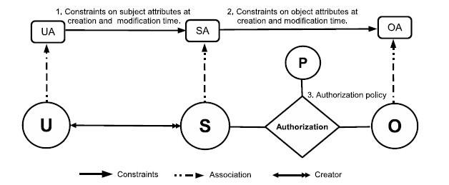
ABAC Model Structure
Policy Configuration Points
© Ravi Sandhu
World-Leading Research with Real-World Impact!
28

Slide 29
Usage Control Model (UCON)
unified model integrating
  authorization
  obligation
  conditions
and incorporating
  continuity of decisions
  mutability of attributes
© Ravi Sandhu
29

Slide 30
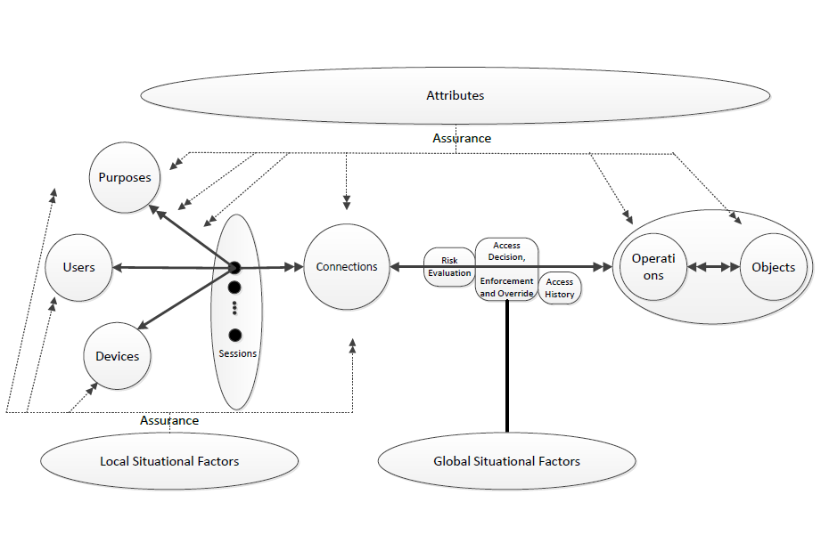
Risk Adaptive Access Control (RAdAC)
© Ravi Sandhu
World-Leading Research with Real-World Impact!
30

Slide 31
The RBAC Story
Standard
Adopted
Proposed
Standard
RBAC96
paper
© Ravi Sandhu
World-Leading Research with Real-World Impact!
31

Slide 32
ABAC Status
Standard
Adopted
Proposed
Standard
RBAC96
paper
199x?
2013
ABAC still in pre/early phase
© Ravi Sandhu
World-Leading Research with Real-World Impact!
32

Slide 33
Access Control Prognosis
Cyber technologies and systems trends will drive pervasive adoption of ABAC
ABAC deployment is going to be messy but need not be chaotic
Researchers can facilitate ABAC adoption and reduce chaos by developing
  Models
  Theories
  Systems
© Ravi Sandhu
World-Leading Research with Real-World Impact!
33

