Slide 1
UTSA's New Center Center for Security and Privacy Enhanced Cloud Computing (C-SPECC)
Ravi Sandhu Executive Director of ICS and C-SPECC Professor of Computer Science Lutcher Brown Chair in Cyber Security
College of Science, Research Conference, UTSA Campus October 6, 2017
ravi.sandhu@utsa.edu www.ics.utsa.edu www.cspecc.utsa.edu www.profsandhu.com

Slide 2
ICS Mission and History
MISSION
Sustained excellence in graduate-level sponsored research
2007-2012
Founded by start-up funding from State of Texas
2012-2017
Graduated to a self-sustaining operation
2017-2022
Major expansion by winning NSF C-SPECC grant
In collaboration with:
College of Science
College of Engineering
College of Business
College of Education and
Human Development
Open Cloud Institute
Cyber Center for Security & Analytics

Slide 3
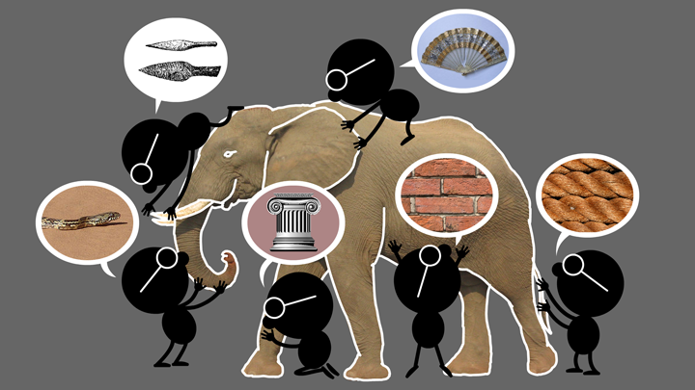
Natural Science
The Elephant Problem

Slide 4
Cyber Science
The Cyber-Elephant Problem

Slide 5
ICS Research Philosophy
Applied and Basic Research Combined (ABC)
Software: Waterfall -> Agile and DevOps
Security: Waterfall -> ???
Tech transfer: Technology Readiness Levels (TRLs) -> ???
* The New ABCs of Research
by Ben Schneiderman, 2016

Slide 6
ICS Major Research Areas
TECHNOLOGIES
Access Control
Policy
Malware
Detection and Forensics
Security Dynamics
APPLICATION DOMAINS
Cloud Computing
Internet of Things (IoT)
Social Networks
Enterprise

Slide 7
NIST Cloud Computing 3-4-5 Definition
5 Essential Characteristics
On-demand self service
Broad network access
Resource pooling (multi-tenant)
Rapid elasticity
Measured service
2009-2011
16 versions
3 Service Models
4 Deployment Models
Software as a Service (SaaS)
Platform as a Service (PaaS)
Infrastructure as a Service (IaaS)
Public
Private
Community
Hybrid/Multi

Slide 8
Cyber Security Landscape
Objectives
POLICY
ATTACKS
Enable
What?
Why?
Respond
Enforce
Defend
PROTECT
How?
DETECT
Mechanisms
Complement

Slide 9
Cyber Security Landscape

Slide 10
C-SPECC Overview

Slide 11
C-SPECC Goals
Achieve national recognition for research, innovation and education in secure cloud computing
Increase participation of underrepresented groups in high tech computing
Pursue innovative research-based educational strategies for high school through doctoral level

Slide 12
C-SPECC Scholarships

