Slide 1
Institute for Cyber Security
Attribute-Based Access Control Models
Prof. Ravi Sandhu
Executive Director, Institute for Cyber Security
Lutcher Brown Endowed Chair in Cyber Security
University of Texas at San Antonio
Colorado State University
Fort Collins
Sept. 16, 2014
ravi.sandhu@utsa.edu, www.profsandhu.com, www.ics.utsa.edu
© Ravi Sandhu
World-Leading Research with Real-World Impact!

Slide 2
Cyber Security Technologies
AUTHENTICATION
RISK
ANALYSIS
ASSURANCE
CRYPTOGRAPHY
ACCESS
CONTROL
INTRUSION/MALWARE
DETECTION
AND AUDIT
SECURITY ENGINEERING
& MANAGEMENT
© Ravi Sandhu
World-Leading Research with Real-World Impact!
2

Slide 3
Access Control Limitations
Analog Hole
Inference
Covert Channels
Side Channels
Phishing
Safety
Usability
Privacy
Attack Asymmetry
Compatibility
Federation
….
© Ravi Sandhu
World-Leading Research with Real-World Impact!
3

Slide 4
Access Control Limitations
Analog Hole
Inference
Covert Channels
Side Channels
Phishing
Safety
Usability
Privacy
Attack Asymmetry
Compatibility
Federation
….
Can manage Cannot eliminate
© Ravi Sandhu
World-Leading Research with Real-World Impact!
4

Slide 5
Access Control
Discretionary Access Control (DAC), 1970
Mandatory Access Control (MAC), 1970
Role Based Access Control (RBAC), 1995
Attribute Based Access Control (ABAC), ????
© Ravi Sandhu
World-Leading Research with Real-World Impact!
5

Slide 6
Access Control
Fixed
policy
Discretionary Access Control (DAC), 1970
Mandatory Access Control (MAC), 1970
Role Based Access Control (RBAC), 1995
Attribute Based Access Control (ABAC), ????
Flexible
policy
© Ravi Sandhu
World-Leading Research with Real-World Impact!
6

Slide 7
Access Control
Human
Driven
Discretionary Access Control (DAC), 1970
Mandatory Access Control (MAC), 1970
Role Based Access Control (RBAC), 1995
Attribute Based Access Control (ABAC), ????
Automated
Adaptive
© Ravi Sandhu
World-Leading Research with Real-World Impact!
7

Slide 8
Access Control
Discretionary Access Control (DAC), 1970
Mandatory Access Control (MAC), 1970
Role Based Access Control (RBAC), 1995
Messy or Chaotic?
Attribute Based Access Control (ABAC), ????
© Ravi Sandhu
World-Leading Research with Real-World Impact!
8

Slide 9
Access Control Models
Discretionary Access Control (DAC), 1970
  Owner controls access
  But only to the original, not to copies
  Grounded in pre-computer policies of researchers
Mandatory Access Control (MAC), 1970
  Synonymous to Lattice-Based Access Control (LBAC)
  Access based on security labels
  Labels propagate to copies
  Grounded in pre-computer military and national security policies
Role-Based Access Control (RBAC), 1995
  Access based on roles
  Can be configured to do DAC or MAC
  Grounded in pre-computer enterprise policies
Numerous other models but only 3 successes: SO FAR
© Ravi Sandhu
World-Leading Research with Real-World Impact!
9

Slide 10
The RBAC Story
NIST-ANSI
Standard
Adopted
NIST-ANSI
Standard Proposed
RBAC96
model
© Ravi Sandhu
World-Leading Research with Real-World Impact!
10

Slide 11
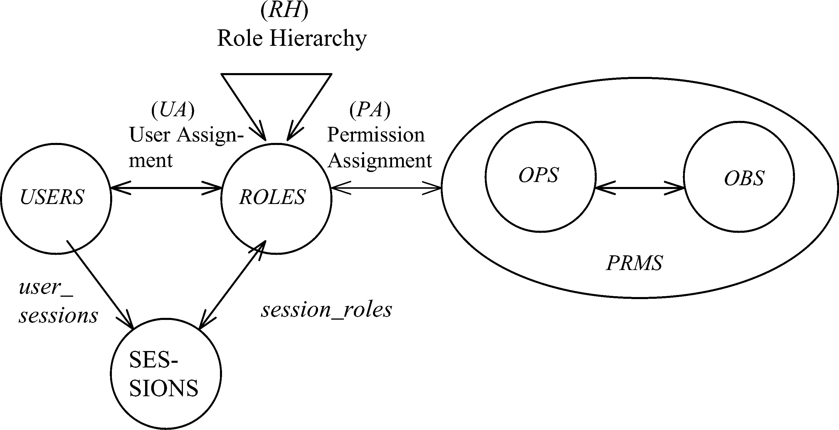
RBAC96 Model
Constraints
© Ravi Sandhu
World-Leading Research with Real-World Impact!
11

Slide 12
Fundamental Theorem of RBAC
  RBAC can be configured to do MAC
  RBAC can be configured to do DAC
  RBAC is policy neutral
RBAC is neither MAC nor DAC!
© Ravi Sandhu
World-Leading Research with Real-World Impact!
12

Slide 13
RBAC Shortcomings
Role granularity is not adequate leading to role explosion
  Researchers have suggested several extensions such as parameterized privileges, role templates, parameterized roles (1997-)
Role design and engineering is difficult and expensive
  Substantial research on role engineering top down or bottom up (1996-), and on role mining (2003-)
Assignment of users/permissions to roles is cumbersome
  Researchers have investigated decentralized administration (1997-), attribute-based implicit user-role assignment (2002-), role-delegation (2000-), role-based trust management (2003-), attribute-based implicit permission-role assignment (2012-)
Adjustment based on local/global situational factors is difficult
  Temporal (2001-) and spatial (2005-) extensions to RBAC proposed
RBAC does not offer an extension framework
  Every shortcoming seems to need a custom extension
  Can ABAC unify these extensions in a common open-ended framework?
© Ravi Sandhu
World-Leading Research with Real-World Impact!
13

Slide 14
RBAC Policy Configuration Points
Security Architect
Security
Administrator
Security
Administrator
Security
Architect
User
Security Architect
Constraints
Security Architect
© Ravi Sandhu
World-Leading Research with Real-World Impact!
14

Slide 15
Access Control Models
Policy
Specification
Policy
Enforcement
Policy
Reality
Policy
Administration
© Ravi Sandhu
World-Leading Research with Real-World Impact!
15

Slide 16
Access Control Models
Policy
Specification
Policy
Enforcement
RBAC, ABAC
Initial focus
Policy
Reality
MAC, DAC
focus
Policy
Administration
© Ravi Sandhu
World-Leading Research with Real-World Impact!
16

Slide 17
Attribute-Based Access Control (ABAC)
Attributes are name:value pairs
  possibly chained
  values can be complex data structures
Associated with
  users
  subjects
  objects
  contexts
    device, connection, location, environment, system …
Converted by policies into rights just in time
  policies specified by security architects
  attributes maintained by security administrators
  ordinary users morph into architects and administrators
Inherently extensible
© Ravi Sandhu
World-Leading Research with Real-World Impact!
17

Slide 18
ABAC Status
Standard
Adopted
Proposed
Standard
RBAC96
paper
1990?
2012
ABAC still in pre/early phase
© Ravi Sandhu
World-Leading Research with Real-World Impact!
18

Slide 19
ABAC Prior Work Includes
X.509, SPKI Attribute Certificates (1999 onwards)
  IETF RFCs and drafts
  Tightly coupled with PKI (Public-Key Infrastructure)
XACML (2003 onwards)
  OASIS standard
  Narrowly focused on particular policy combination issues
  Fails to accommodate the ANSI-NIST RBAC standard model
  Fails to address user subject mapping
Usage Control or UCON (Park-Sandhu 2004)
  Fails to address user subject mapping
  Focus is on extended features
    Mutable attributes
    Continuous enforcement
    Obligations
    Conditions
Several others ………..
© Ravi Sandhu
World-Leading Research with Real-World Impact!
19

Slide 20
ABACα Hypothesis (DBSEC 2012)
An ABAC model requires
  identification of policy configuration points (PCPs)
  languages and formalisms for each PCP
A core set of PCPs can be discovered by building the ABACα model to unify DAC, MAC and RBAC
Additional ABAC models can then be developed by
  increasing the sophistication of the ABACα PCPs
  discovering additional PCPs driven by requirements beyond DAC, MAC and RBAC
A small but crucial step
© Ravi Sandhu
World-Leading Research with Real-World Impact!
20

Slide 21
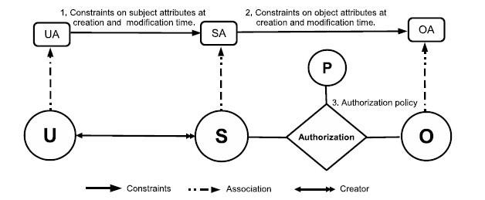
ABACα Model Structure
Policy Configuration Points
© Ravi Sandhu
World-Leading Research with Real-World Impact!
21

Slide 22
ABACα Model Structure
Policy Configuration Points
Can be configured to do DAC, MAC, RBAC
© Ravi Sandhu
World-Leading Research with Real-World Impact!
22

Slide 23
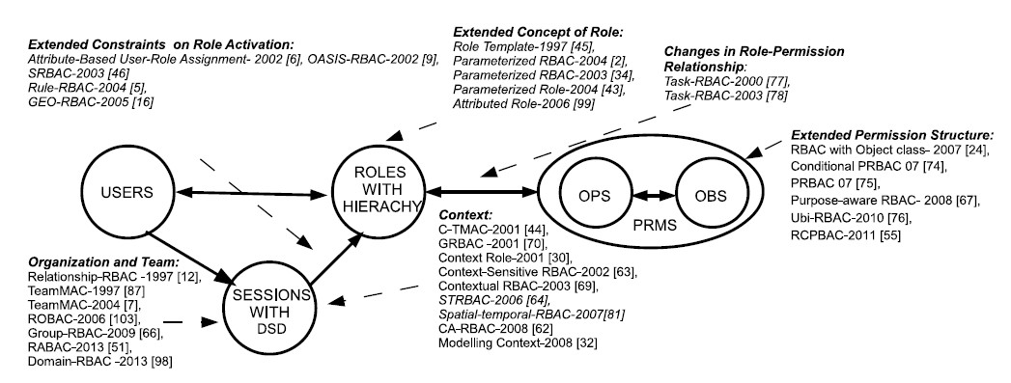
ABAC_{β} Scope
1,4
1, 2, 4, 5
1, 4, 5
4, 5
1, 2, 3, 4, 5
4
1, 4, 5
1. Context Attributes
2. Subject attribute constraints policy are different at creation and modification time.
4. Policy Language
5. Meta-Attributes
3. Subject attributes constrained by attributes of subjects created by the same user.
World-Leading Research with Real-World Impact!
23
Notes:
Give examples about what is excluded

Slide 24
Examples
2. Subject attribute constraints policy are different at creation and modification time.
1. Context Attributes
OASIS-RBAC
Prerequisite role
Initial role assignment constraints
Other role assignment constraints
3. Subject attributes constraints by attributes of subjects created by the same user.
Ubi-RBAC
CS Conference Room
Geography
Accounting
Science Building
Business Building
5. Meta-Attributes
UTSA Campus
Task-RBAC
Role
Task
OP
OBJ
task(r1) = {t1, t2}
readtask(o1) = {t1, t2, t3}
urole(u) = {r1, r2}
World-Leading Research with Real-World Impact!
24
Notes:
User can activate their roles in different spaces.
Users is allowed to activate r1 in UTSA space (modeled as subject) and r2 in CS conference room.
If a user does not specify his role in CS Department space, the default roles is depended on his activated roles in UTSA space.

Slide 25
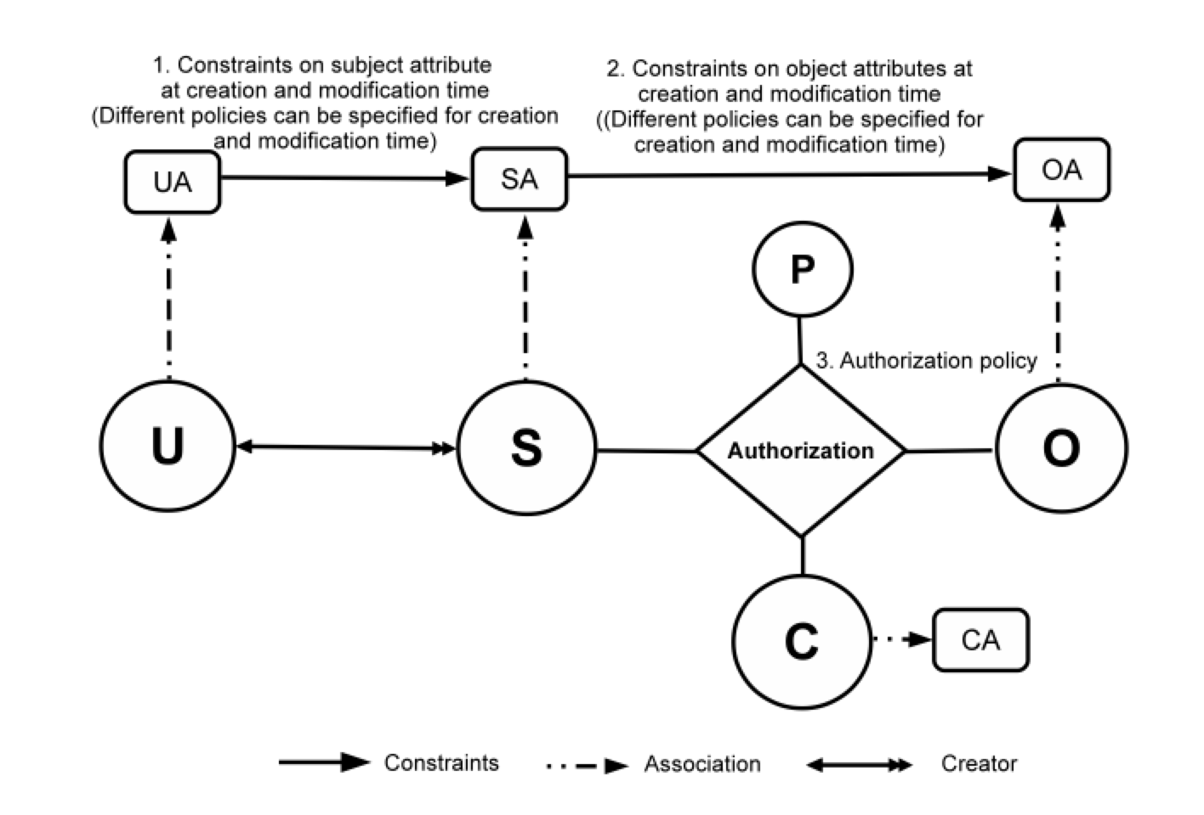
ABAC_{β} Model
25
Notes:
Show abac-alpha
Then for each type of extension, highlight the extensions to ABAC
23 and 24 integrated

Slide 26
ABAC Research at ICS
GURA model for user-attribute assignment
Safety analysis of ABAC_{α} and ABAC_{β}
Undecidable safety for ABAC models
Decidable safety for ABAC with finite fixed attributes
Constraints in ABAC
ABAC Cloud IaaS implementations (OpenStack)
Attribute Engineering
Attribute Mining
Unification of Attributes, Relationships and Provenance
© Ravi Sandhu
World-Leading Research with Real-World Impact!
26

