Slide 1
Institute for Cyber Security
Security and Trust Convergence:
Attributes, Relations and Provenance
Prof. Ravi Sandhu
Executive Director, Institute for Cyber Security
Lutcher Brown Endowed Chair in Cyber Security
University of Texas at San Antonio
Colorado State University
Fort Collins
Sept. 15, 2014
ravi.sandhu@utsa.edu, www.profsandhu.com, www.ics.utsa.edu
© Ravi Sandhu
World-Leading Research with Real-World Impact!

Slide 2
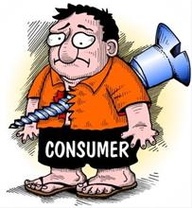
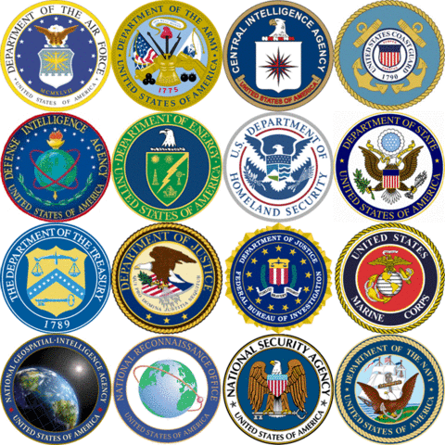

State of Cyber Security
© Ravi Sandhu
World-Leading Research with Real-World Impact!

Slide 3
State of Cyber Security
About as good or as bad as it is going to get
Not too bad
Big crime is a real threat but criminals can only defraud so many
Big government/big business are real threats
© Ravi Sandhu
World-Leading Research with Real-World Impact!

Slide 4
State of Cyber Security
Cyber should be “controllable”
Nuclear, chemical, biological have been “controlled”
New arena for researchers
Highly asymmetric, includes offense, clandestine
Dual conflicting goals: strong offense, strong defense
Need game-changing technologies
A New Threat Grows Amid Shades of 9/11
The nation remains largely unaware of the potential for disaster from cyberattacks.
By TOM KEAN and LEE HAMILTON
WALL STREET JOURNAL, 9/11/2014
© Ravi Sandhu
World-Leading Research with Real-World Impact!

Slide 5
State of Cyber Security
Escalating reputational and even existential threat against mass theft of consumer information
Even the most iconic high tech companies are breachable
Cost of clean-up after a mass theft far exceeds aggregate actual loss of money
There are many scarier scenarios than mass data breach of consumer data
Some of this scarier stuff has happened
© Ravi Sandhu
World-Leading Research with Real-World Impact!

Slide 6
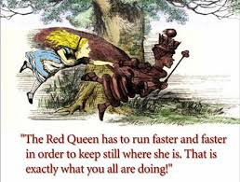
State of Cyber Security
© Ravi Sandhu
World-Leading Research with Real-World Impact!

Slide 7
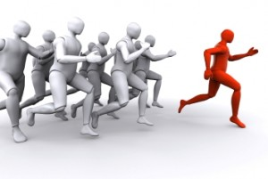
Who has the Initiative?
© Ravi Sandhu
World-Leading Research with Real-World Impact!

Slide 8
Who has the Initiative?
Federal R&D priorities 2011:
Tailored Trustworthy Spaces
Moving Target
Designed-In Security
Cyber Economic Incentives
Science of Security
© Ravi Sandhu
World-Leading Research with Real-World Impact!

Slide 9
Who has the Initiative?
DoD R&D priorities 2011:
Assuring Effective Missions
Agile Operations
Resilient Infrastructure
Trust
Federal R&D priorities 2011:
Tailored Trustworthy Spaces
Moving Target
Designed-In Security
Cyber Economic Incentives
Science of Security
© Ravi Sandhu
World-Leading Research with Real-World Impact!

Slide 10
Security and Trust
Attributes
Security
Access Control
Trust
Risk
Relationships
Provenance
© Ravi Sandhu
World-Leading Research with Real-World Impact!

Slide 11
Security and Trust
Attributes
Security
Access Control
Trust
Risk
Relationships
Provenance
Least Privilege
Privilege Abstraction
Separation of Duty
Constrained Administration
© Ravi Sandhu
World-Leading Research with Real-World Impact!

Slide 12
Security and Trust
Attributes
Security
Access Control
Trust
Risk
Relationships
Provenance
Least Privilege
Privilege Abstraction
Separation of Duty
Constrained Administration
Automation
Adaptation
© Ravi Sandhu
World-Leading Research with Real-World Impact!

Slide 13
Security and Trust
Attributes
Security
Access Control
Trust
Risk
Relationships
Provenance
Automation
Adaptation
© Ravi Sandhu
World-Leading Research with Real-World Impact!

Slide 14
Attributes
Discretionary Access Control (DAC), 1970
Mandatory Access Control (MAC), 1970
Role Based Access Control (RBAC), 1995
Attribute Based Access Control (ABAC), ????
© Ravi Sandhu
World-Leading Research with Real-World Impact!

Slide 15
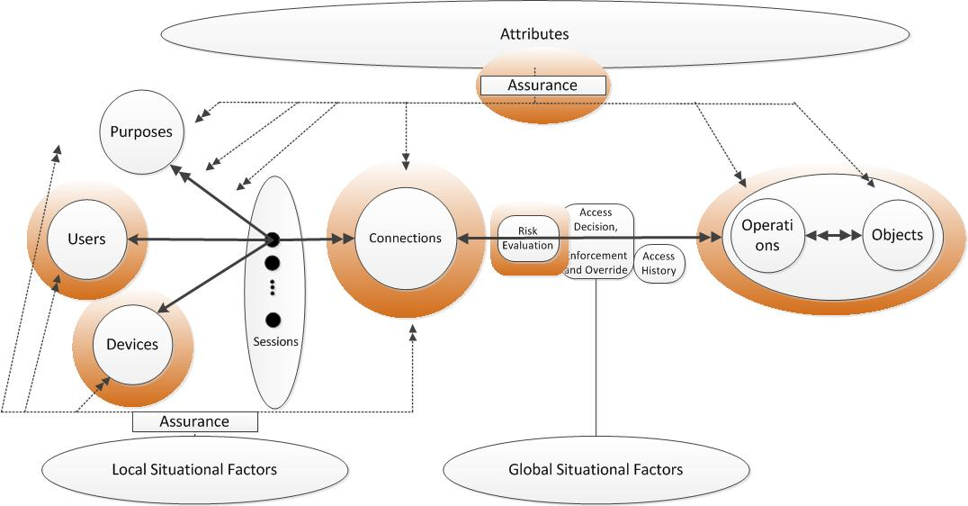
Attributes
© Ravi Sandhu
World-Leading Research with Real-World Impact!

Slide 16
Relationships
Bob
Dave
f
f
f
c
c
Alice
Ed
c
Harry
f
f
f
Carol
Fred
George
f
c
f
f
© Ravi Sandhu
World-Leading Research with Real-World Impact!

Slide 17
Provenance
Anyone can upload a homework.
A user can replace a homework if she uploaded it and the homework is not submitted yet.
A user can submit a homework if she uploaded it and the homework is not submitted already.
A user can review a homework if she is not the author of the homework, the user did not previously review the homework, and the homework is submitted already but not graded yet.
A user can grade a homework if the homework is reviewed but not graded yet.
© Ravi Sandhu
World-Leading Research with Real-World Impact!

Slide 18
Relationships, Attributes and Provenance
Bob
Dave
f
f
f
c
c
Alice
Ed
c
Harry
f
f
f
Carol
Fred
George
f
c
f
f
© Ravi Sandhu
World-Leading Research with Real-World Impact!

Slide 19
Final Thoughts
© Ravi Sandhu
World-Leading Research with Real-World Impact!

