Slide 1
Institute for Cyber Security
Attribute-Based Access Control:
Insights and Challenges
Prof. Ravi Sandhu
Executive Director and Endowed Chair
DBSec
Taipei, Taiwan
August 8, 2017
ravi.sandhu@utsa.edu
www.profsandhu.com
www.ics.utsa.edu
© Ravi Sandhu
World-Leading Research with Real-World Impact!

Slide 2
Policy-Mechanism
Policy
What?
Mechanism
How?
© Ravi Sandhu
World-Leading Research with Real-World Impact!
2

Slide 3
Access Control Evolution
Discretionary Access Control (DAC), 1970
Mandatory Access Control (MAC), 1970
Role Based Access Control (RBAC), 1995
Attribute Based Access Control (ABAC), ????
© Ravi Sandhu
World-Leading Research with Real-World Impact!
3

Slide 4
Access Control Evolution
Discretionary Access Control (DAC), 1970
Mandatory Access Control (MAC), 1970
Role Based Access Control (RBAC), 1995
Attribute Based Access Control (ABAC), ????
Born 1990s
© Ravi Sandhu
World-Leading Research with Real-World Impact!
4

Slide 5
Access Control Evolution
Discretionary Access Control (DAC), 1970
Mandatory Access Control (MAC), 1970
Relationship Based
Access Control (ReBAC) ????
Role Based Access Control (RBAC), 1995
Provenance Based
Access Control (PBAC)
????
Born mid
2000s
Born late
2000s
Attribute Based Access Control (ABAC), ????
Born 1990s
© Ravi Sandhu
World-Leading Research with Real-World Impact!
5

Slide 6
ABAC = Final Word?
NO!! Never!!
Is ABAC the right word for the moment?
  Certainly a strong candidate
  Already too late?
    ReBAC (relationship-based access control) not ABAC
    Big Data, Analytics and AI will take care of everything
What is lacking in ABAC?
  Usage Control (UCON) concepts of attribute mutability, enforcement and obligation continuity, and post-obligations
  Task-Based Access Control
  Risk-Based Access Control
  Policy-Based Access Control
  …………….
© Ravi Sandhu
World-Leading Research with Real-World Impact!
6

Slide 7
The ABAC Challenge
ABAC is orders of magnitude more complex than anything that has been an Access Control winner so far (DAC, MAC, RBAC)
  We need the complexity, but need to manage it
  If Google can index the web, we can do ABAC!!
Cloud-enabled IoT may be the killer app
© Ravi Sandhu
World-Leading Research with Real-World Impact!
7

Slide 8
ABAC Research Agenda
7. ABAC Design, Engineering and Applications
3. Administrative
ABAC Models
4. Extended
ABAC Models
5. ABAC Policy
Architectures and Languages
6. ABAC Enforcement Architectures
2. Core ABAC Models
1. Foundational Principles and Theory
Based on RBAC experience
© Ravi Sandhu
World-Leading Research with Real-World Impact!
8

Slide 9
ABAC Research Agenda
7. ABAC Design, Engineering and Applications
3. Administrative
ABAC Models
4. Extended
ABAC Models
5. ABAC Policy
Architectures and Languages
6. ABAC Enforcement Architectures
2. Core ABAC Models
1. Foundational Principles and Theory
© Ravi Sandhu
World-Leading Research with Real-World Impact!
9

Slide 10
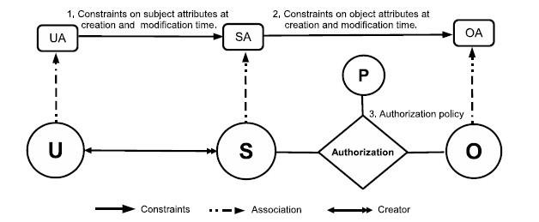
2. Core ABAC Models: ABAC_{α}
Policy Configuration Points
Can be configured to do simple forms of DAC, MAC, RBAC
Jin, Krishnan, Sandhu 2012
© Ravi Sandhu
World-Leading Research with Real-World Impact!
10

Slide 11
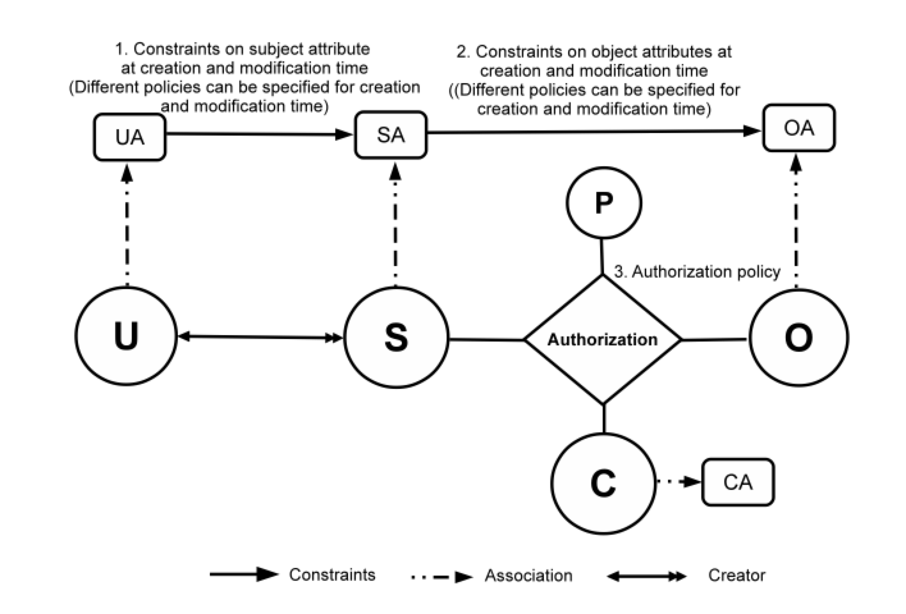
2. Core ABAC Models: ABAC_{β}
Can further be configured to do many
RBAC extensions
Jin, Krishnan, Sandhu 2014
© Ravi Sandhu
World-Leading Research with Real-World Impact!
11

Slide 12


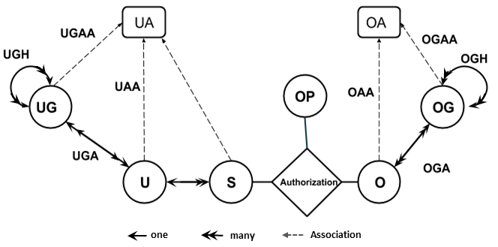
2. Core ABAC Models: HGABAC
U: User
UG: User-Group
S: Subject
UA: User Attributes
O: Object
OG: Object-Group
OA: Object Attributes
OP: Operations
Hierarchical Group and Attribute Based Access Control (HGABAC)
  Introduces the notion of User and Object Groups
  Core advantage is simplified administration of attributes
  User and Objects are assigned set of attributes in one go as compared to single assignment at a time.
Servos and Osborn, 2015

Slide 13
ABAC Research Agenda
7. ABAC Design, Engineering and Applications
3. Administrative
ABAC Models
4. Extended
ABAC Models
5. ABAC Policy
Architectures and Languages
6. ABAC Enforcement Architectures
2. Core ABAC Models
1. Foundational Principles and Theory
© Ravi Sandhu
World-Leading Research with Real-World Impact!
13

Slide 14
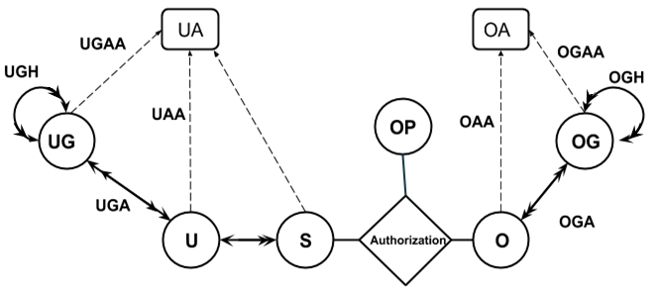
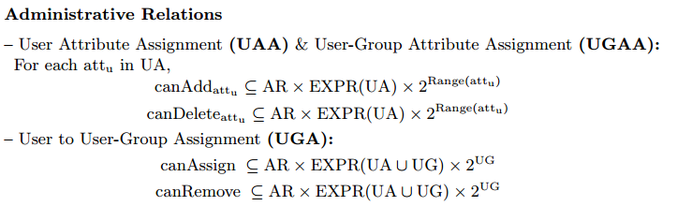
3. Administrative ABAC Models: GURA and GURA_{G}
Jin, Krishnan, Sandhu, 2012
Gupta, Sandhu, 2016
© Ravi Sandhu
World-Leading Research with Real-World Impact!
14

Slide 15
ABAC Research Agenda
7. ABAC Design, Engineering and Applications
3. Administrative
ABAC Models
4. Extended
ABAC Models
5. ABAC Policy
Architectures and Languages
6. ABAC Enforcement Architectures
2. Core ABAC Models
1. Foundational Principles and Theory
© Ravi Sandhu
World-Leading Research with Real-World Impact!
15

Slide 16
4. Extended ABAC Models: UCON
unified model integrating
  authorization
  obligation
  conditions
and incorporating
  continuity of decisions
  mutability of attributes
Usage Control Models, early 2000s
Park, Sandhu, Pretschner
© Ravi Sandhu
World-Leading Research with Real-World Impact!
16

Slide 17
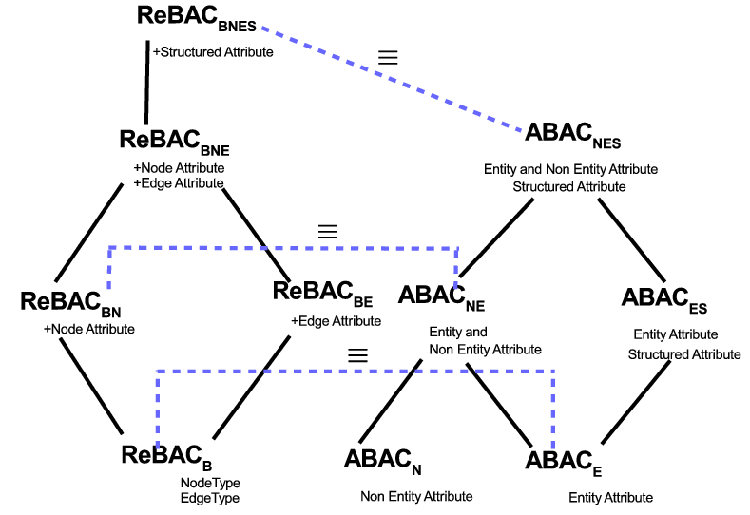
4. Extended ABAC Models: ReBAC versus ABAC
Equivalence of ReBAC and ABAC Structural Variants
© Ravi Sandhu
World-Leading Research with Real-World Impact!
17

Slide 18
4. Extended ABAC Models: ReBAC versus ABAC
Non-Equivalence of ReBAC and ABAC Variants
© Ravi Sandhu
World-Leading Research with Real-World Impact!
18

Slide 19
ABAC Research Agenda
7. ABAC Design, Engineering and Applications
3. Administrative
ABAC Models
4. Extended
ABAC Models
5. ABAC Policy
Architectures and Languages
6. ABAC Enforcement Architectures
2. Core ABAC Models
1. Foundational Principles and Theory
© Ravi Sandhu
World-Leading Research with Real-World Impact!
19

Slide 20
1. Foundations: Safety
A single infinite attribute with no creation leads to undecidable safety. Rajkumar 2012
Pre_UCON with finite attributes and unbounded creation has decidable safety. Rajkumar, Sandhu 2016
ABAC_{α} has decidable safety. Ahmed, Sandhu 2017
GURA has decidable safety/reachability. Jin, Krishnan, Sandhu 2017
© Ravi Sandhu
World-Leading Research with Real-World Impact!
20

Slide 21
ABAC Research Agenda
7. ABAC Design, Engineering and Applications
3. Administrative
ABAC Models
4. Extended
ABAC Models
5. ABAC Policy
Architectures and Languages
6. ABAC Enforcement Architectures
2. Core ABAC Models
1. Foundational Principles and Theory
© Ravi Sandhu
World-Leading Research with Real-World Impact!
21

Slide 22
5. Policy Architecture: Centralized ABAC_{α} style
Policy Configuration Points
© Ravi Sandhu
World-Leading Research with Real-World Impact!
22

Slide 23
5. Policy Architecture: Diffused AWS style
© Ravi Sandhu
World-Leading Research with Real-World Impact!
23

Slide 24
ABAC Research Agenda
7. ABAC Design, Engineering and Applications
3. Administrative
ABAC Models
4. Extended
ABAC Models
5. ABAC Policy
Architectures and Languages
6. ABAC Enforcement Architectures
2. Core ABAC Models
1. Foundational Principles and Theory
© Ravi Sandhu
World-Leading Research with Real-World Impact!
24

Slide 25
6. ABAC Enforcement Architecture: Federated ABAC
Fisher 2015
NCCOE, NIST, Building Block
© Ravi Sandhu
World-Leading Research with Real-World Impact!
25

Slide 26
ABAC Research Agenda
7. ABAC Design, Engineering and Applications
3. Administrative
ABAC Models
4. Extended
ABAC Models
5. ABAC Policy
Architectures and Languages
6. ABAC Enforcement Architectures
2. Core ABAC Models
1. Foundational Principles and Theory
© Ravi Sandhu
World-Leading Research with Real-World Impact!
26

Slide 27
7. ABAC Applications: Cloud IaaS
Cloud Computing IaaS
  Single tenant
  Multi tenant
  Multi cloud
Jin, Tang, Dang, Bijon, Pustchi, Zhang, Biswas, Ahmed, Cheng,
Patwa, Krishnan, Sandhu
2012 onwards
© Ravi Sandhu
World-Leading Research with Real-World Impact!
27

Slide 28
7. ABAC Applications: Cloud Enabled IoT
Alsheri, Bhatt,
Patwa, Benson,
Sandhu
2016 onwards
© Ravi Sandhu
World-Leading Research with Real-World Impact!
28

Slide 29
ABAC Research Agenda
7. ABAC Design, Engineering and Applications
3. Administrative
ABAC Models
4. Extended
ABAC Models
5. ABAC Policy
Architectures and Languages
6. ABAC Enforcement Architectures
2. Core ABAC Models
1. Foundational Principles and Theory
© Ravi Sandhu
World-Leading Research with Real-World Impact!
29

