Slide 1
A Perspective on IoT Security
Ravi Sandhu
Executive Director and Chief Scientist
Institute for Cyber Security (ICS)
University of Texas at San Antonio (UTSA)
Professor of Computer Science
Lutcher Brown Endowed Chair in Cyber Security
Lead PI , National Science Foundation C-SPECC Center
ESORICS Keynote
September 2022
ravi.sandhu@utsa.edu www.ics.utsa.edu www.profsandhu.com

Slide 2
Holistic Cyber Security
Objectives
POLICY
THREATS
ATTACKS
Enable
What?
Why?
Respond
Enforce
How?
Defend
PROTECT
DETECT
Mechanisms

Slide 3
Holistic Cyber Security
Objectives
POLICY
THREATS
ATTACKS
Enable
What?
Why?
Respond
Enforce
How?
Defend
PROTECT
DETECT
D
Mechanisms
Dynamic Balance

Slide 4
Holistic Cyber Security
Application Context
IoT
CPS
Enterprise
Cloud
Social
Metaverse
…….
Objectives
POLICY
THREATS
ATTACKS
Enable
What?
Why?
Respond
Enforce
How?
Defend
PROTECT
DETECT
D
Mechanisms
Dynamic Balance

Slide 5
Holistic Cyber Security
Application Context
IoT
CPS
Enterprise
Cloud
Social
Metaverse
…….
Objectives
POLICY
THREATS
ATTACKS
Enable
What?
Why?
Respond
Enforce
How?
Defend
PROTECT
DETECT
D
Mechanisms
Dynamic Balance

Slide 6
Holistic Cyber Security
IoT Use Cases
Smart Homes
Wearable IoT
Smart Health
Smart Cars
…….
Objectives
POLICY
THREATS
ATTACKS
Enable
What?
Why?
Respond
Enforce
How?
Defend
PROTECT
DETECT
D
Mechanisms
Dynamic Balance

Slide 7
Holistic Cyber Security
Objectives
Threat
Grade
Military
Professional
Amateur
THREATS
ATTACKS
POLICY
Enable
What?
Why?
Respond
Enforce
How?
Defend
PROTECT
DETECT
D
Mechanisms
Dynamic Balance

Slide 8
Holistic Cyber Security
Threat
Grade
Military
Professional
Amateur
THREATS
ATTACKS
Objectives
POLICY
Security
Posture
Military
Professional
Amateur
Enable
What?
Why?
Respond
Enforce
How?
Defend
PROTECT
DETECT
D
Mechanisms
Dynamic Balance

Slide 9
Holistic Cyber Security
Threat
Grade
Military
Professional
Amateur
Security
Posture
Military
Professional
Amateur
THREATS
ATTACKS
Objectives
POLICY
Example
Nuclear Strike
ATMs
Your Exercise
Enable
What?
Why?
Respond
Enforce
How?
Defend
PROTECT
DETECT
D
Mechanisms
Dynamic Balance

Slide 10
Holistic Cyber Security
Threat
Grade
Military
Professional
Amateur
THREATS
ATTACKS
Objectives
POLICY
Security
Posture
Military
Professional
Amateur
Enable
What?
Why?
Respond
Enforce
How?
Defend
PROTECT
DETECT
D
Mechanisms
Dynamic Balance

Slide 11
Joint Work with
Doctoral Graduates
Mehrnoosh Shakarami, Operation and Administration of Access Control in IoT Environments, Spring 2022.
Safwa Ameer, User-To-Device Access Control Models for Cloud-Enabled IoT With Smart Home Case Study, Summer 2021.
Maanak Gupta, Secure Cloud Assisted Smart Cars and Big Data: Access Control Models and Implementation, Fall 2018.
Smriti Bhatt, Attribute-Based Access and Communication Control Models for Cloud and Cloud-Enabled IoT, Summer 2018.
Asma Alshehri, Access Control Models for Cloud-Enabled Internet of Things, Spring 2018.

Slide 12
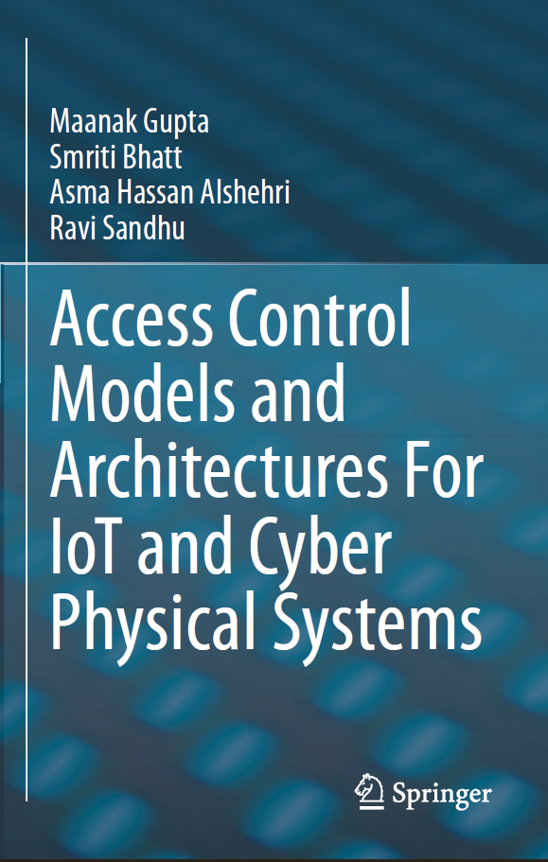
Joint Work with
Doctoral Graduates
Mehrnoosh Shakarami, Operation and Administration of Access Control in IoT Environments, Spring 2022.
Safwa Ameer, User-To-Device Access Control Models for Cloud-Enabled IoT With Smart Home Case Study, Summer 2021.
Maanak Gupta, Secure Cloud Assisted Smart Cars and Big Data: Access Control Models and Implementation, Fall 2018.
Smriti Bhatt, Attribute-Based Access and Communication Control Models for Cloud and Cloud-Enabled IoT, Summer 2018.
Asma Alshehri, Access Control Models for Cloud-Enabled Internet of Things, Spring 2018.

Slide 13
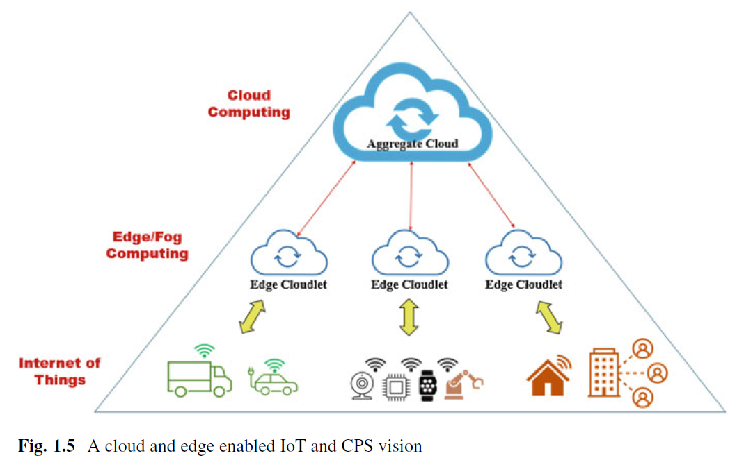
Cloud-enabled IoT
CE-IoT
Equivalently
Cloud-enabled
Cloud-assisted
Cloud-coupled

Slide 14
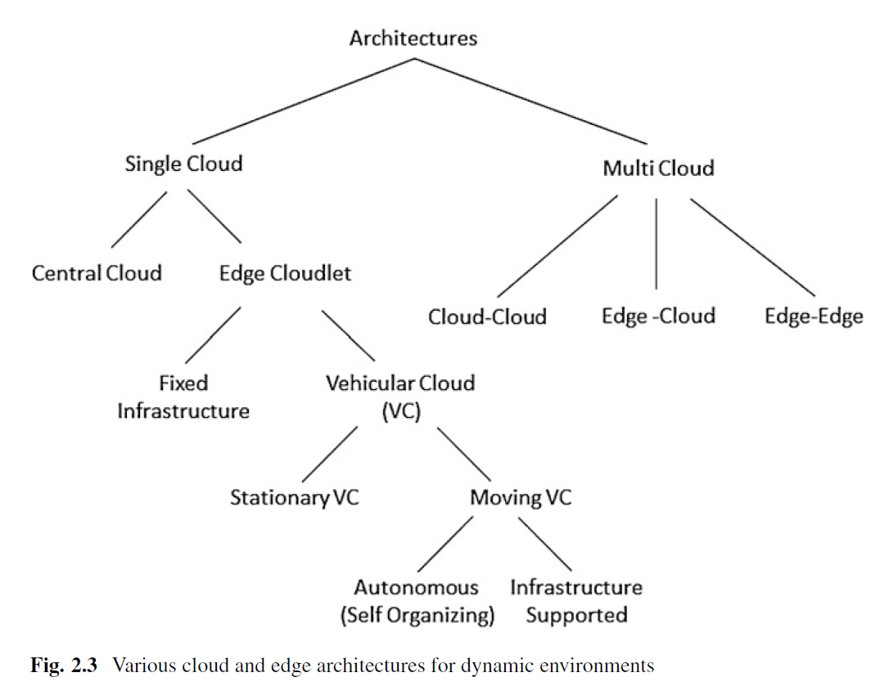
CE-IoT Architectures

Slide 15
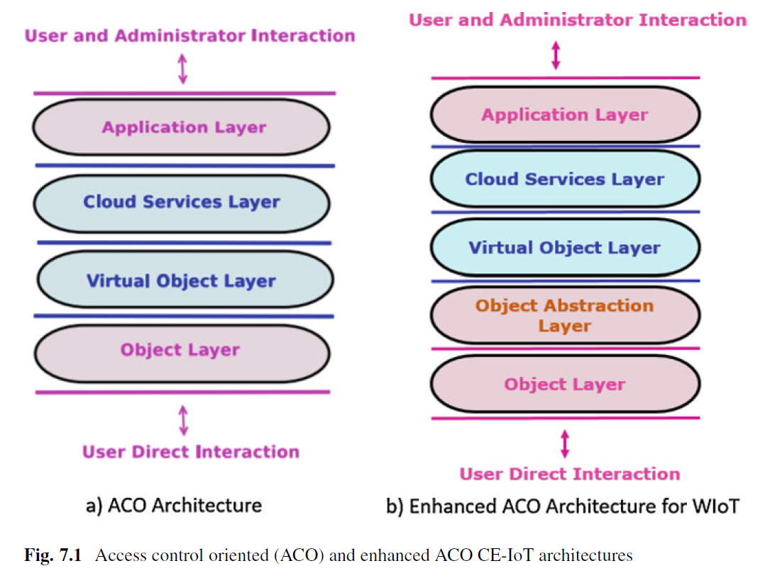
CE-IoT Basic Architectures

Slide 16
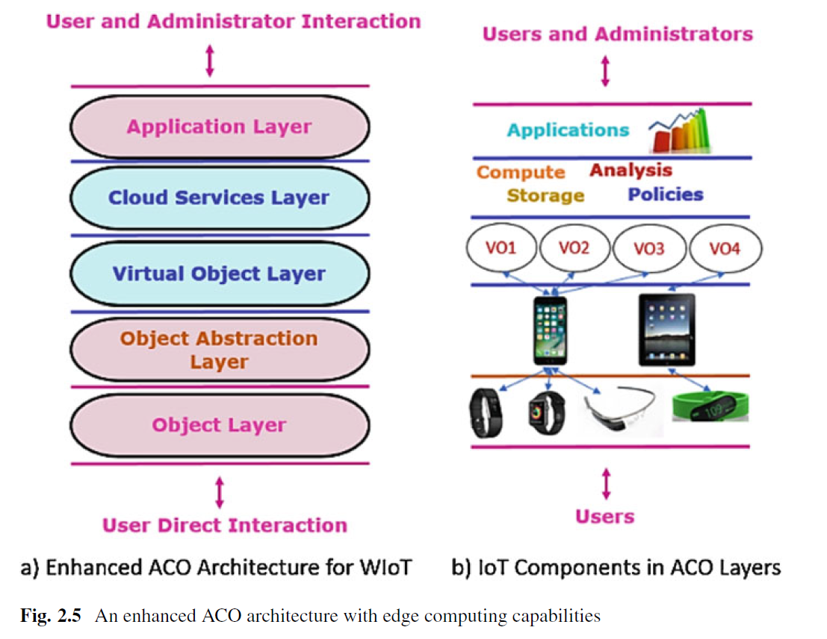
CE-IoT for
Wearable IoT (WIoT)

Slide 17
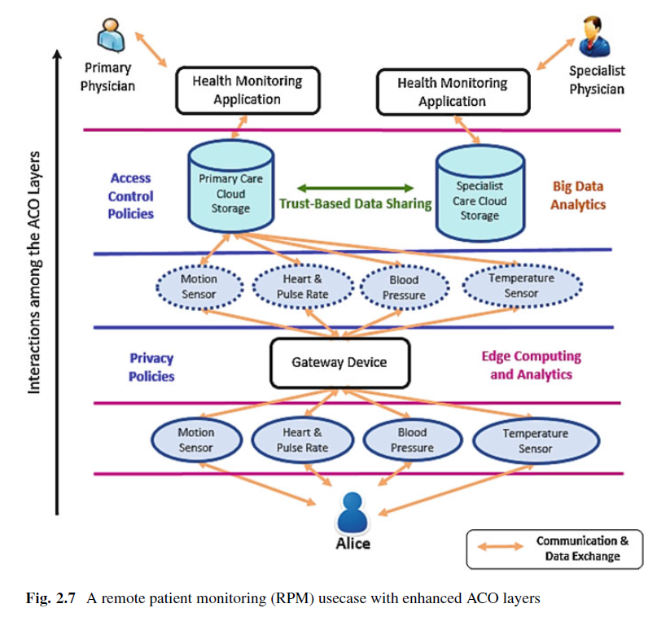
CE-IoT for Smart Health

Slide 18
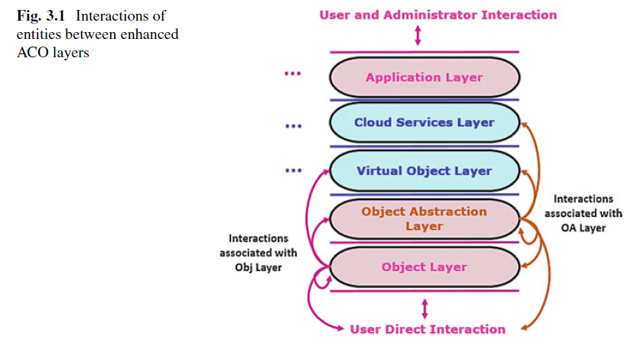
CE-IoT Interactions

Slide 19
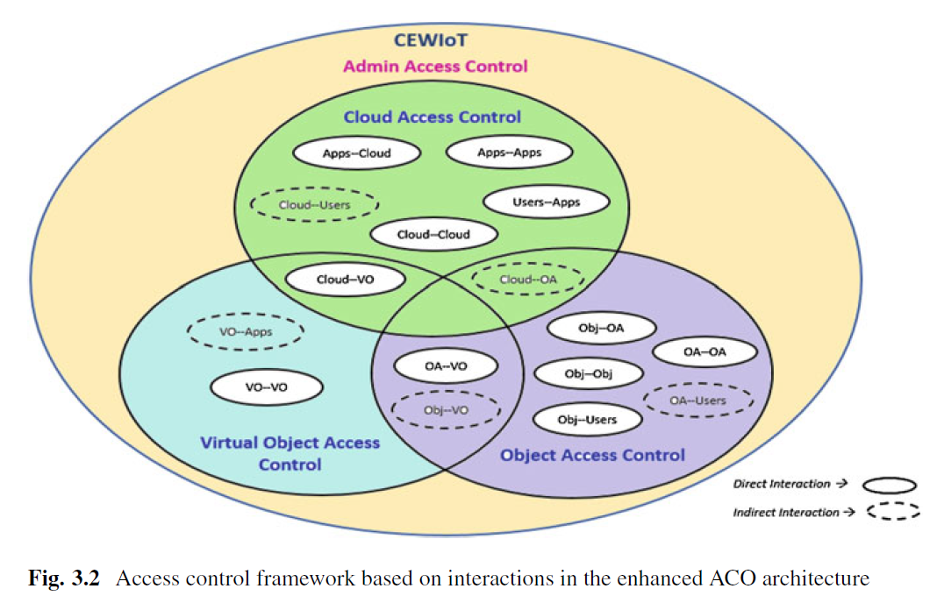
CE-IoT
Access Control Framework

Slide 20
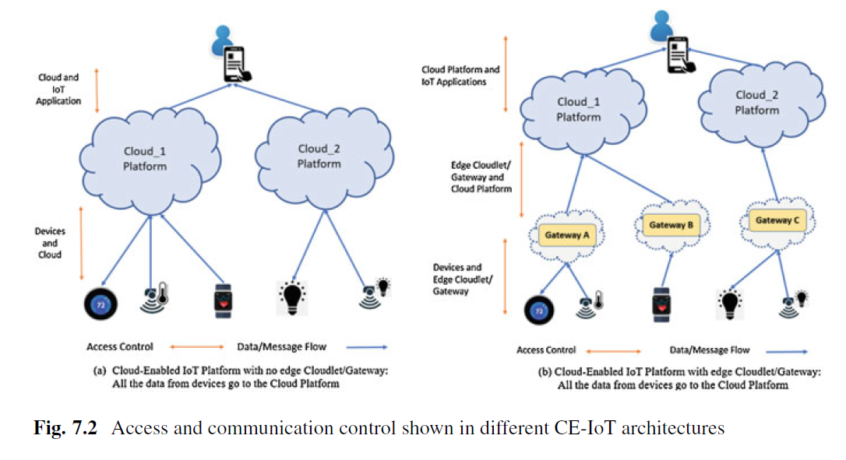
CE-IoT
Communication Control

Slide 21
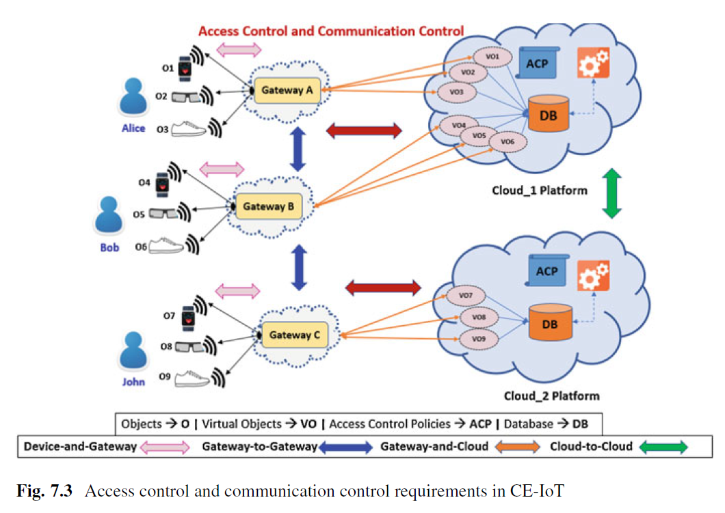
CE-IoT
Communication Control

Slide 22
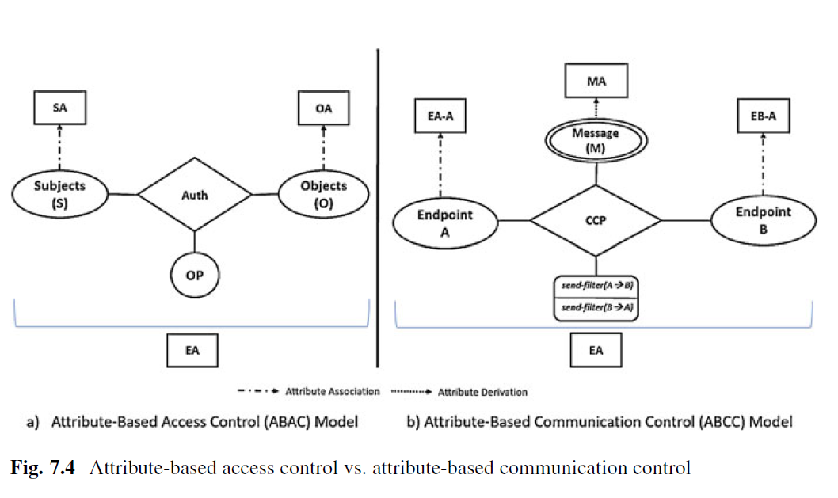
CE-IoT
Communication Control

Slide 23
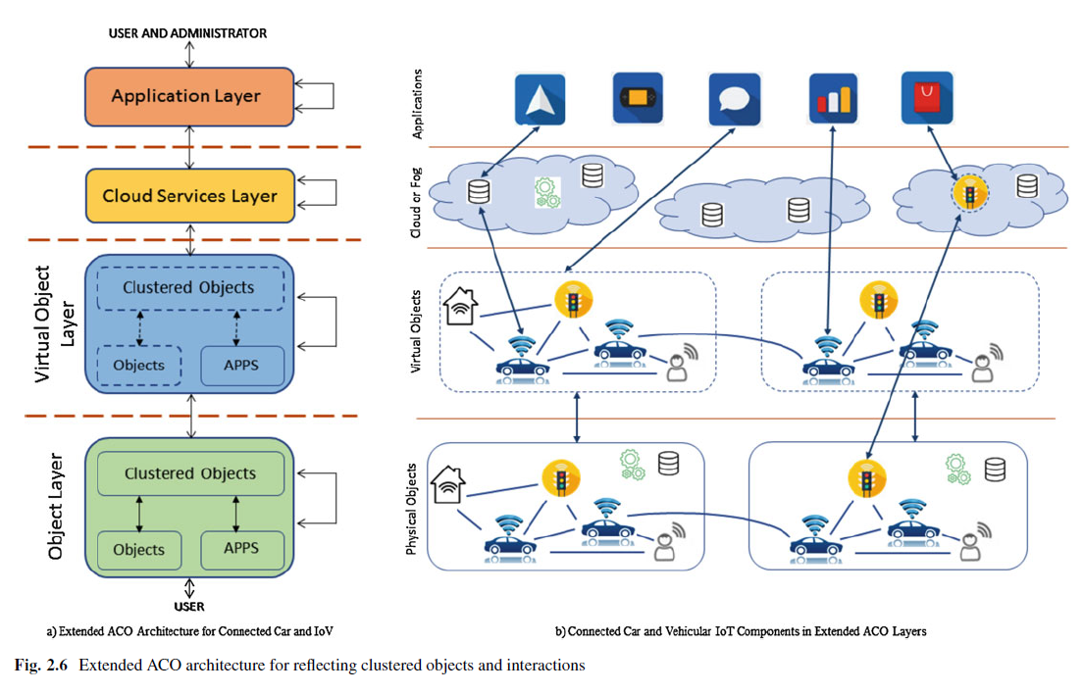
CE-IoT for Smart Cars

Slide 24
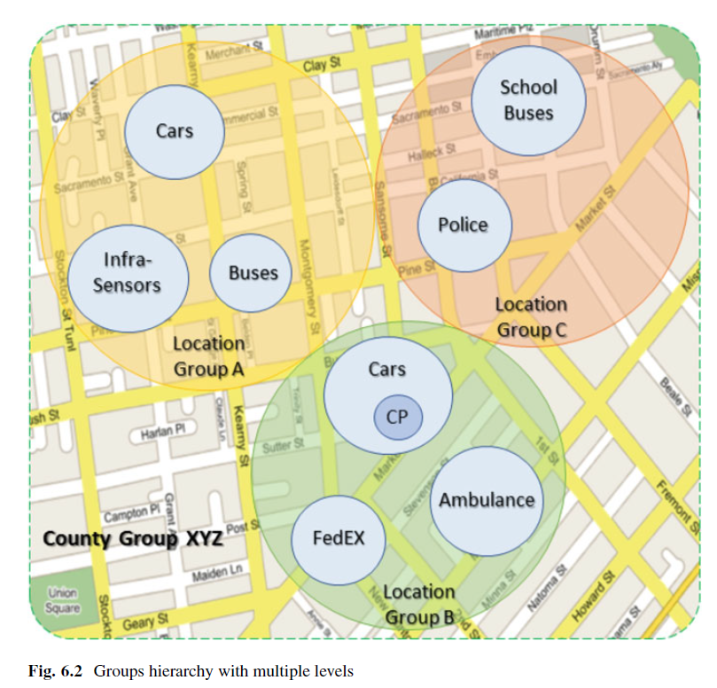
CE-IoT for Smart Cars
Dynamic Groups

Slide 25
Access Control
Discretionary Access Control (DAC)
1970
Mandatory Access Control (MAC) 1970
Role Based Access Control (RBAC) 1995
Attribute Based Access Control (ABAC)
Relationship-Based Access Control (ReBAC)
Usage Control (UCON)
2020s (Hopefully)

Slide 26
Access Control Research Convergence
ABAC
ReBAC
RBAC
…
DAC
MAC
Convergent Access Control (CAC)
Access Control Policy Models
Access Control Enforcement Models
Application
Context

Slide 27
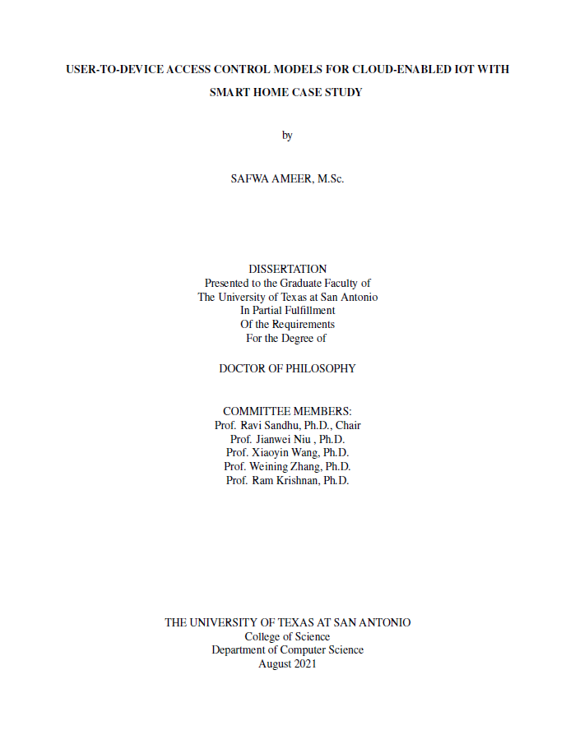
Joint Work with
Doctoral Graduates
Mehrnoosh Shakarami, Operation and Administration of Access Control in IoT Environments, Spring 2022.
Safwa Ameer, User-To-Device Access Control Models for Cloud-Enabled IoT With Smart Home Case Study, Summer 2021.
Maanak Gupta, Secure Cloud Assisted Smart Cars and Big Data: Access Control Models and Implementation, Fall 2018.
Smriti Bhatt, Attribute-Based Access and Communication Control Models for Cloud and Cloud-Enabled IoT, Summer 2018.
Asma Alshehri, Access Control Models for Cloud-Enabled Internet of Things, Spring 2018.

Slide 28
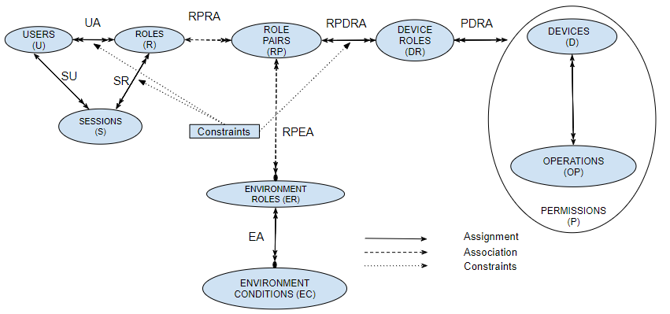
Smart Home IoT EGRBAC
(Extended Generalized RBAC)

Slide 29
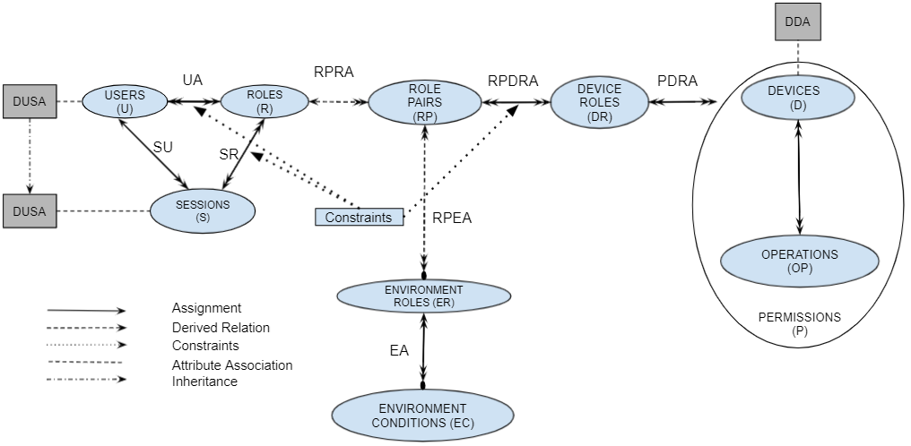

$$\text{Smart} \text{Home} \text{IoT} HyBAC_{RC}$$
(Hybrid AC Role-Centric)

Slide 30
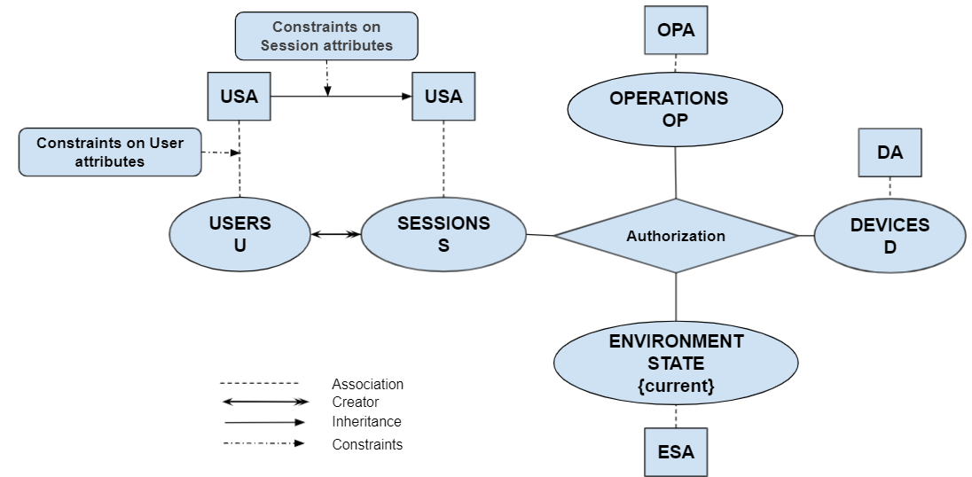
Smart Home IoT HABAC
(Home ABAC)

Slide 31
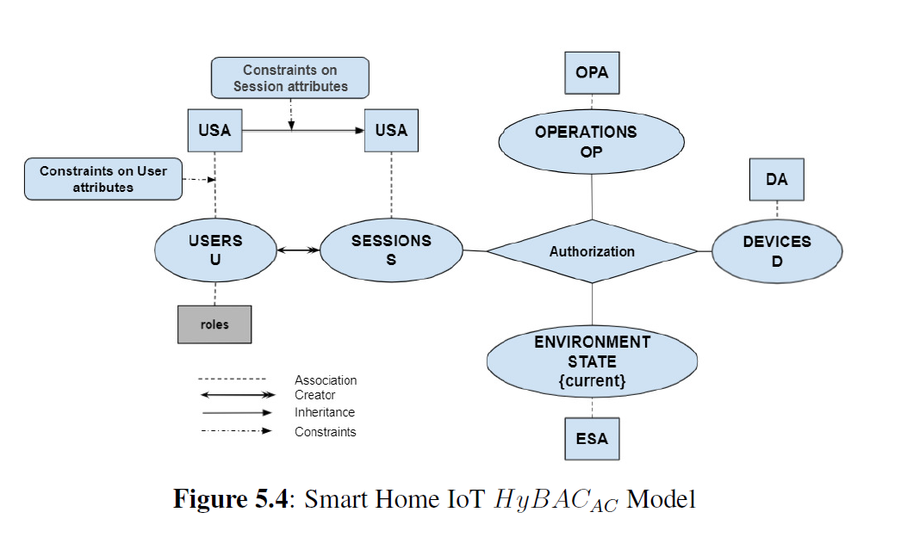
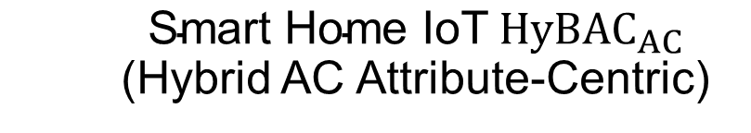
$$\text{Smart} \text{Home} \text{IoT} HyBAC_{AC}$$
(Hybrid AC Attribute-Centric)

Slide 32
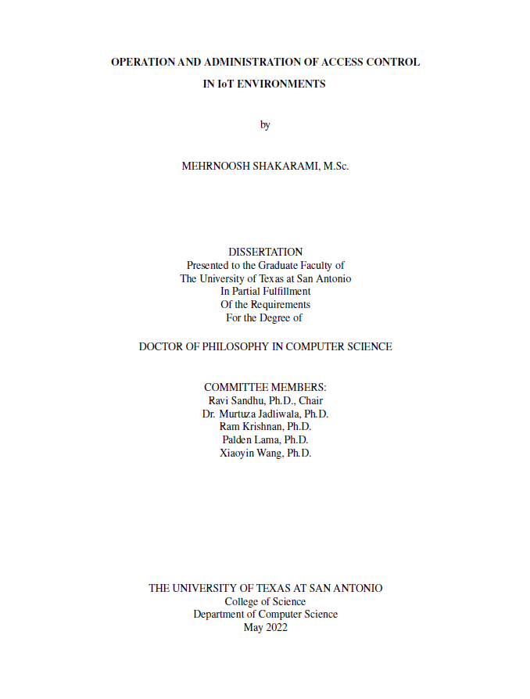
Joint Work with
Doctoral Graduates
Mehrnoosh Shakarami, Operation and Administration of Access Control in IoT Environments, Spring 2022.
Safwa Ameer, User-To-Device Access Control Models for Cloud-Enabled IoT With Smart Home Case Study, Summer 2021.
Maanak Gupta, Secure Cloud Assisted Smart Cars and Big Data: Access Control Models and Implementation, Fall 2018.
Smriti Bhatt, Attribute-Based Access and Communication Control Models for Cloud and Cloud-Enabled IoT, Summer 2018.
Asma Alshehri, Access Control Models for Cloud-Enabled Internet of Things, Spring 2018.

Slide 33
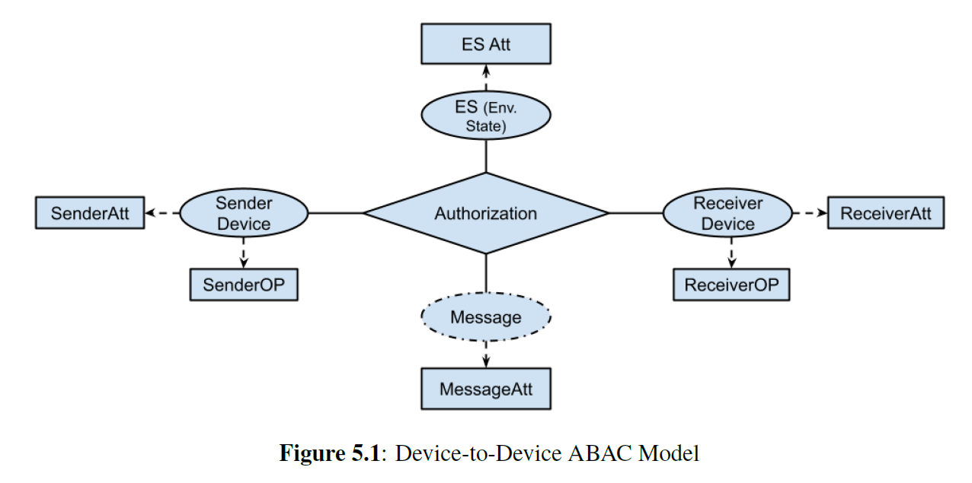
Device-to-Device ABAC
(Communication Control)

Slide 34
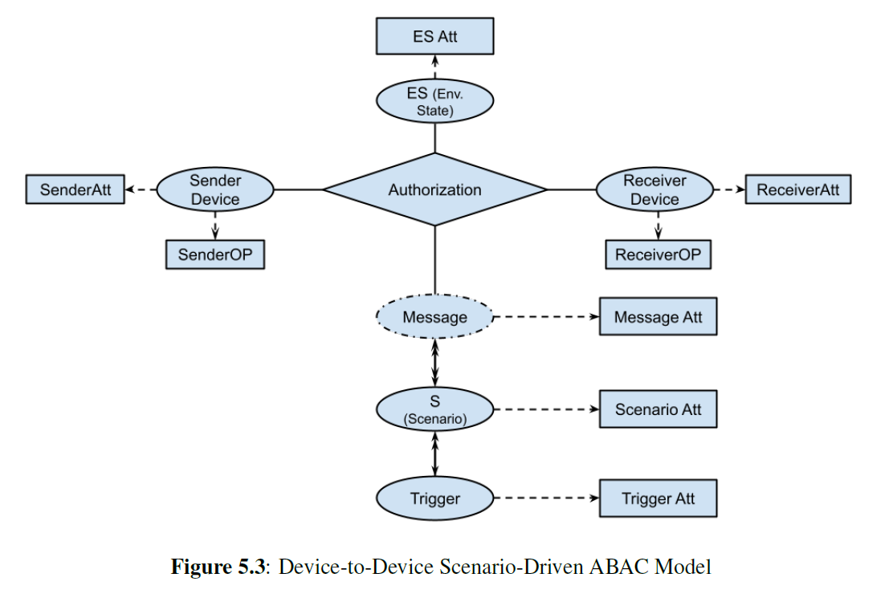
Scenario Driven
Device-to-Device ABAC

Slide 35
Take Aways
Meaningful IoT is necessarily Cloud-Enabled
Equivalently: Cloud-Assisted, Cloud-Coupled
Motivated by Professional Grade threats
Need convergence of access control models:
RBAC, ABAC, ReBAC, UCON ….
IoT requires traditional access control (actor to target) as well as communication control (sender to receiver)
Future/Ongoing work:
  Integration with Zero Trust concepts
  Application of Machine Learning
  Integration with Detection technologies
  Integration with Policy technologies
  Integration with Response technologies
  Administration models
  …..

