Slide 1
An Access Control Perspective on the Science of Security
Ravi Sandhu
Executive Director and Chief Scientist
Professor of Computer Science
Lutcher Brown Chair in Cyber Security
Keynote Lecture
Hot Topics in the Science of Security
Raleigh, North Carolina
April 11, 2018
ravi.sandhu@utsa.edu
www.ics.utsa.edu
www.cspecc.utsa.edu
www.profsandhu.com

Slide 2
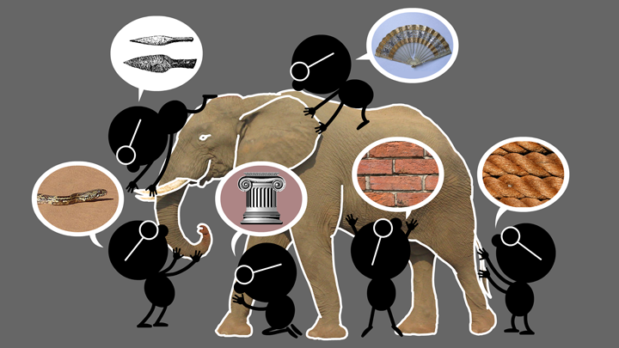

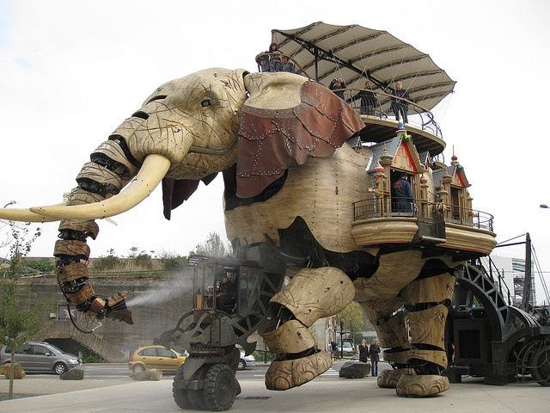


Natural vs Cyber Science
Elephant Problem
Cyber-Elephant Problem
The cyber-elephant problem requires Applied and Basic research Combined (ABC)
* The New ABCs of Research, Ben Schneiderman, 2016

Slide 3
Applied and Basic Combined
Utility
Engineering
H
Science
Edison
Pasteur
Fundamental
Understanding
L
H
junk
Bohr
Donald Stokes, 1997
Pasteur’s Quadrant: Basic
Science and Technological Innovation
L

Slide 4
Applied and Basic Combined
Utility
Engineering
H
Science
Edison
Pasteur
Fundamental
Understanding
L
H
junk
Bohr
Combine the
science quadrants
Donald Stokes, 1997
Pasteur’s Quadrant: Basic
Science and Technological Innovation
L

Slide 5
Holistic Cyber Security
Objectives
POLICY
ATTACKS
Enable
What?
Why?
Respond
Enforce
Defend
PROTECT
How?
DETECT
Mechanisms
Complement

Slide 6
Access Control Evolution
Fixed policy
Discretionary Access Control (DAC), 1970
Mandatory Access Control (MAC), 1970
Role Based Access Control (RBAC), 1995
Attribute Based Access Control (ABAC), ????
Born 1990s
Flexible policy

Slide 7
ABAC Research Space
7. ABAC Design, Engineering and Applications
3. Administrative
ABAC Models
4. Extended
ABAC Models
5. ABAC Policy
Architectures and Languages
6. ABAC Enforcement Architectures
2. Core ABAC Models
1. Foundational Principles and Theory

Slide 8
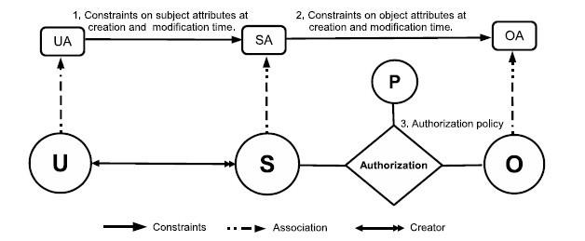
2. Core ABAC Models
Policy Configuration Points
ABAC_{α}
Can be configured to do simple forms of DAC, MAC, RBAC (Jin, Krishnan, Sandhu 2012)

Slide 9
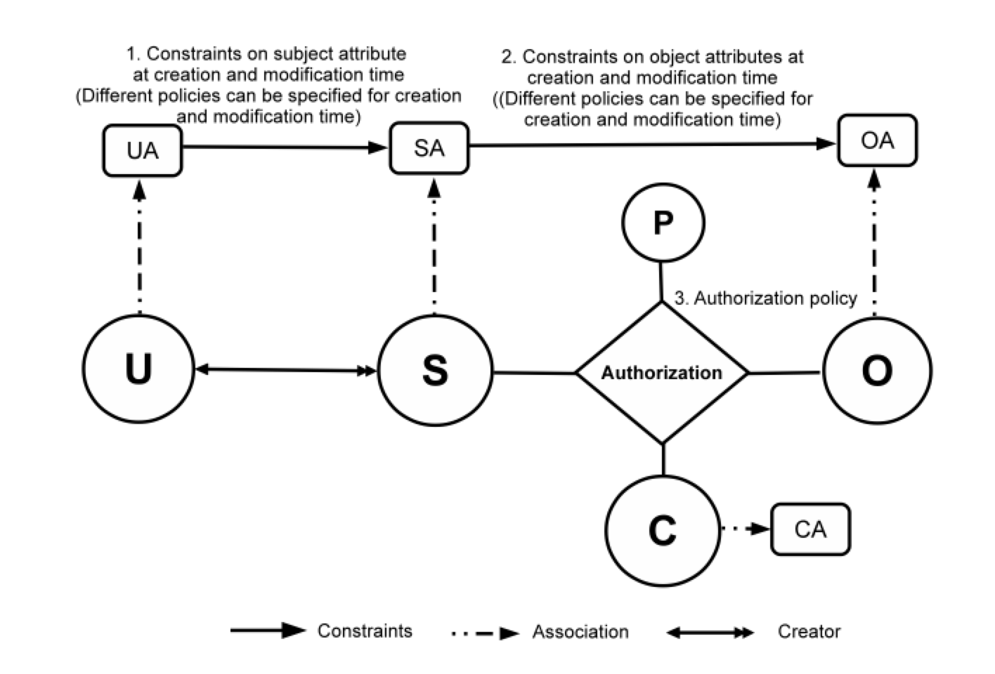
2. Core ABAC Models
ABAC_{β}
Can further be configured to do many
RBAC extensions (Jin, Krishnan, Sandhu 2014)

Slide 10
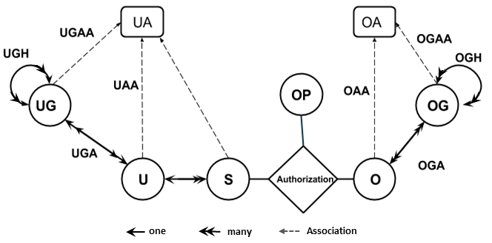
3. Administrative ABAC Models
HGABAC
Hierarchical Group and Attribute Based Access Control (HGABAC)
  Introduces User and Object Groups
  Simplifies administration of attributes
Servos and Osborn, 2015

Slide 11
7. ABAC Design, Engineering and Applications
Cloud Enabled IoT
Alsheri, Bhatt, Patwa, Benson, Sandhu
2016 onwards

Slide 12
5. ABAC Policy Architectures and Languages
Amazon AWS Style

Slide 13
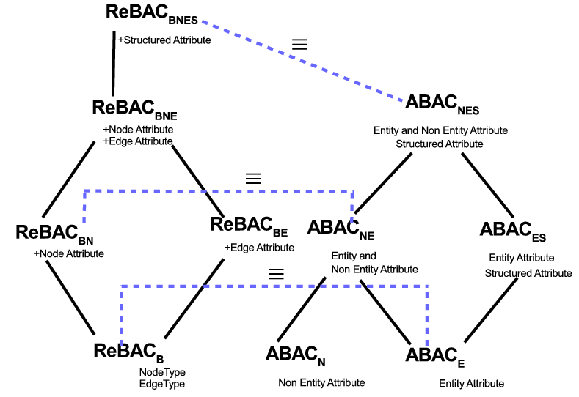
4. Extended ABAC Models
ReBAC vs ABAC
ReBAC and ABAC are not that different
(Tahmina, Sandhu 2017)

Slide 14
6. ABAC Enforcement Architectures
Federated
ABAC
Fisher 2015
NCCOE, NIST, Building Block

Slide 15
1. Foundational Principles and Theory
Safety Analysis
Discretionary Access Control (DAC), 1970
Mandatory Access Control (MAC), 1970
Can subject s obtain a right r on object o?
Current state?
Some future state?
Role Based Access Control (RBAC), 1995
Safety
Complexity
Attribute Based Access Control (ABAC), ????
Ahmed, Rajkumar, Sandhu
2016 onwards

Slide 16
ABAC Research Space
7. ABAC Design, Engineering and Applications
3. Administrative
ABAC Models
4. Extended
ABAC Models
5. ABAC Policy
Architectures and Languages
6. ABAC Enforcement Architectures
2. Core ABAC Models
1. Foundational Principles and Theory

Slide 17
Take-Aways for
Science of Security
Applied and Basic Combined
Holistic

